Slide 1




ALS Orbit Stability
Greg Portmann, Eric Norum, Mike Chin, Jonah Weber
BES Light Source Beam Stability Workshop
November 1, 2018

Slide 2
Causes of Undesirable Orbit Motions
Thermal
Vibration & bending modes
Injection
Transients
Insertion Device Perturbations
Master Oscillator & RF
Magnet Power Supplies
Hertz
.1
1
10
100
1k
10k
100k
1M
Beam Position monitors (BPMs) need to measure orbits over a
large range of frequencies
As well as, a range of beam currents, and fill patterns (single to multi-bunch fills)

Slide 3
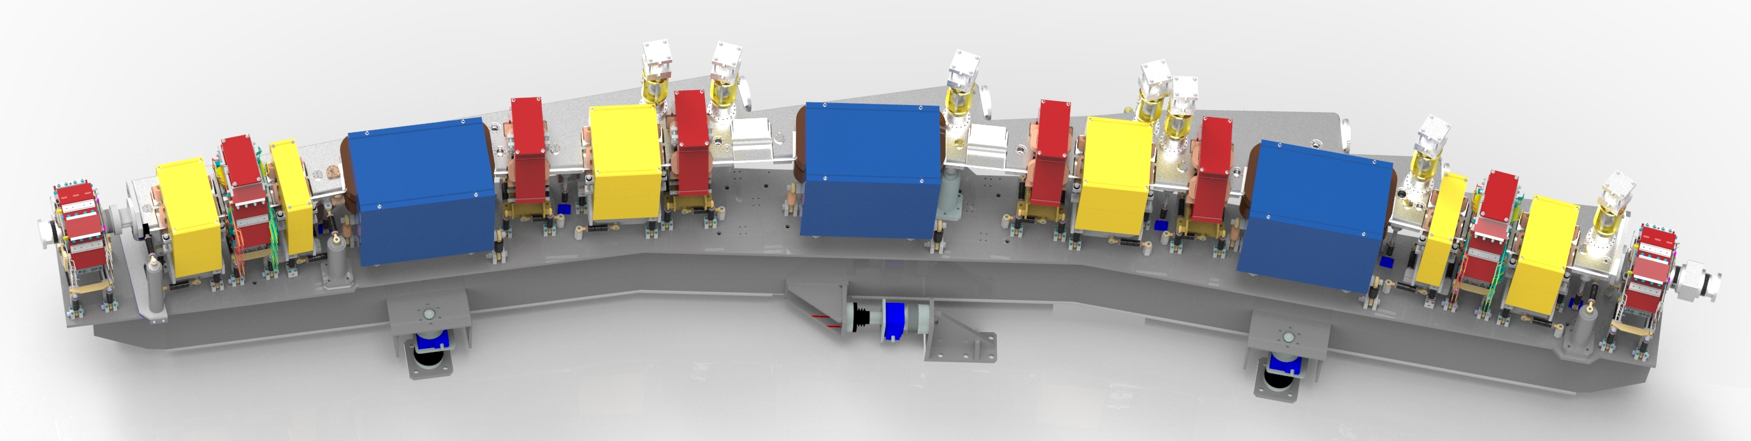
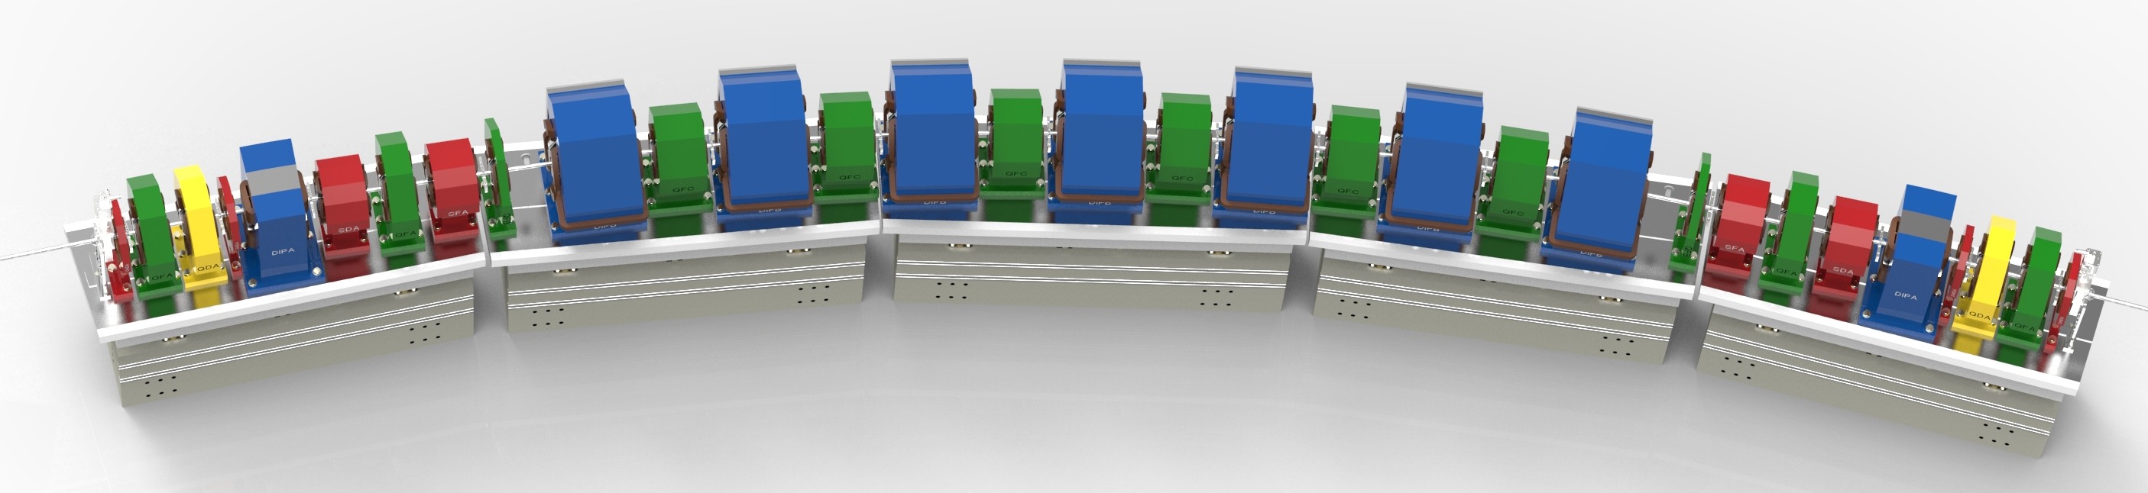
Orbit Stability Goal (ALS and ALS-U)
ALS
Storage Ring | ALS-U | ALS
Electron Energy | 2.0 GeV | 1.9 GeV
Horizontal Emittance (full coupling) | <75 pm (50 pm stretch goal) | 2 nm
Vertical Emittance | <75 pm (full coupling) | 30 pm
ID Beam Size (x/y) | <14 μm / <14 μm | 251 / 10.4 μm
Bend Beam Size (x/y) | <5 μm / <10 μm | 40.3 / 7.1 μm (Center bend)
ALS-U
ALS has 7 to 10 μm vertical beam sizes
ALS-U will have 5 to 14 μm beam sizes in both planes
The requirement is 1/10 the beam size
-> 0.5 μm @ the Bends, 1.4 μm @ the IDs
The goal is 1/20 the beam size
-> 0.25 μm @ the Bends, 0.7 μm @ the IDs
ALS and ALS-U have similar requirements
The BPM development goal is 200 nm RMS from a few days to 10 kHz

Slide 4
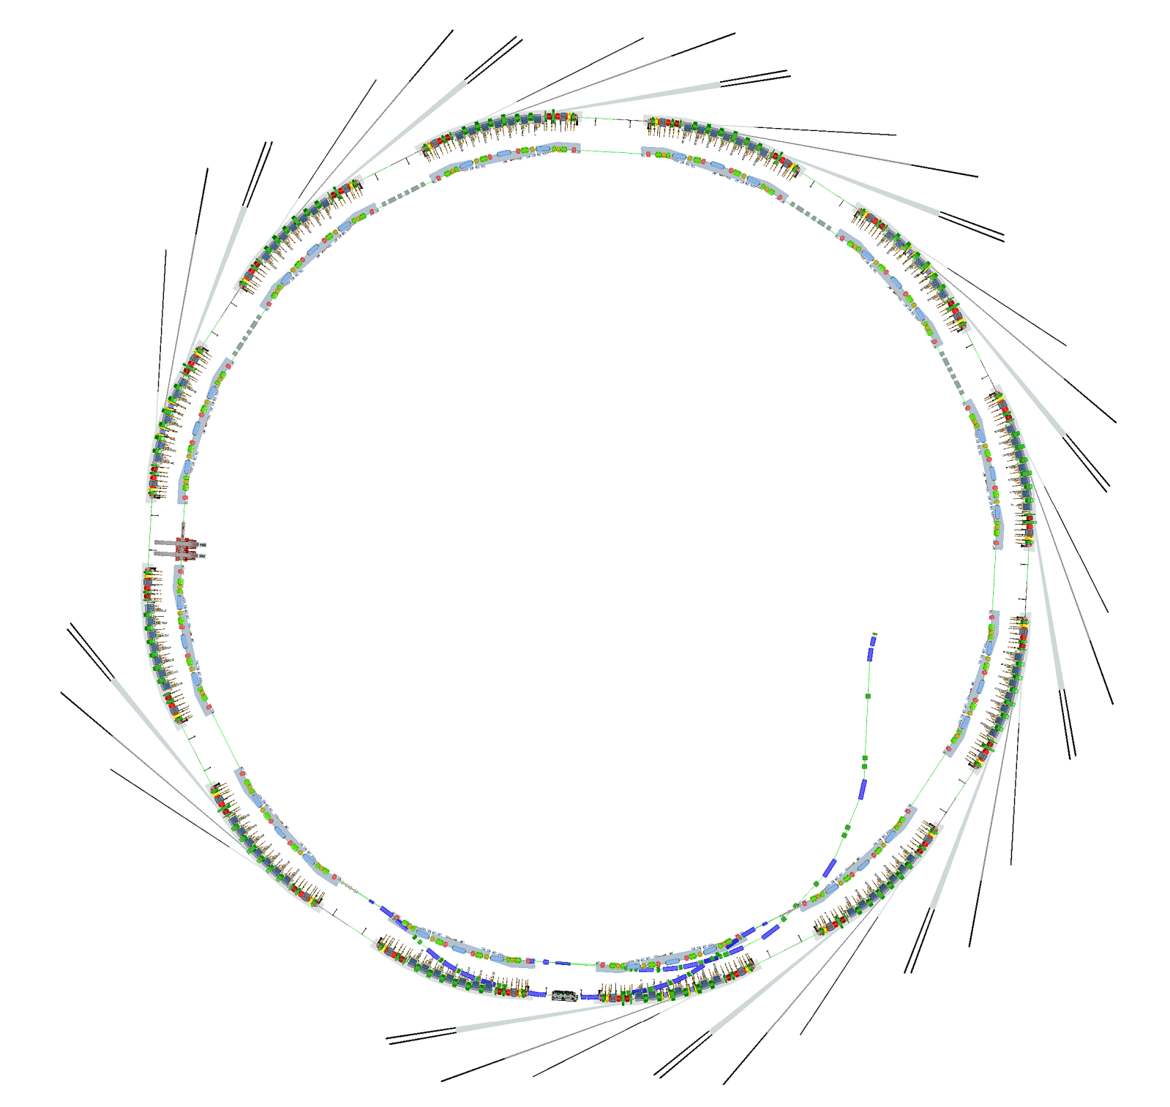
ALS and ALS-U BPM Needs
Recently built 158 BPMs for ALS
114 Storage Ring
37 Injector
And a few spares
ALS-U will need
192 in the storage ring
(16 /sector)
72 in the accumulator ring
(6 /sector)
~20 in the transfer lines
What’s New
Storage Ring (SR)
Accumulator Ring (AR)
3 Transfer Lines
  BR to AR (BTA)
  AR to SR Transfer Line (ATS)
  SR to AR Transfer Line (STA)
BTA
STA
ATS

Slide 5
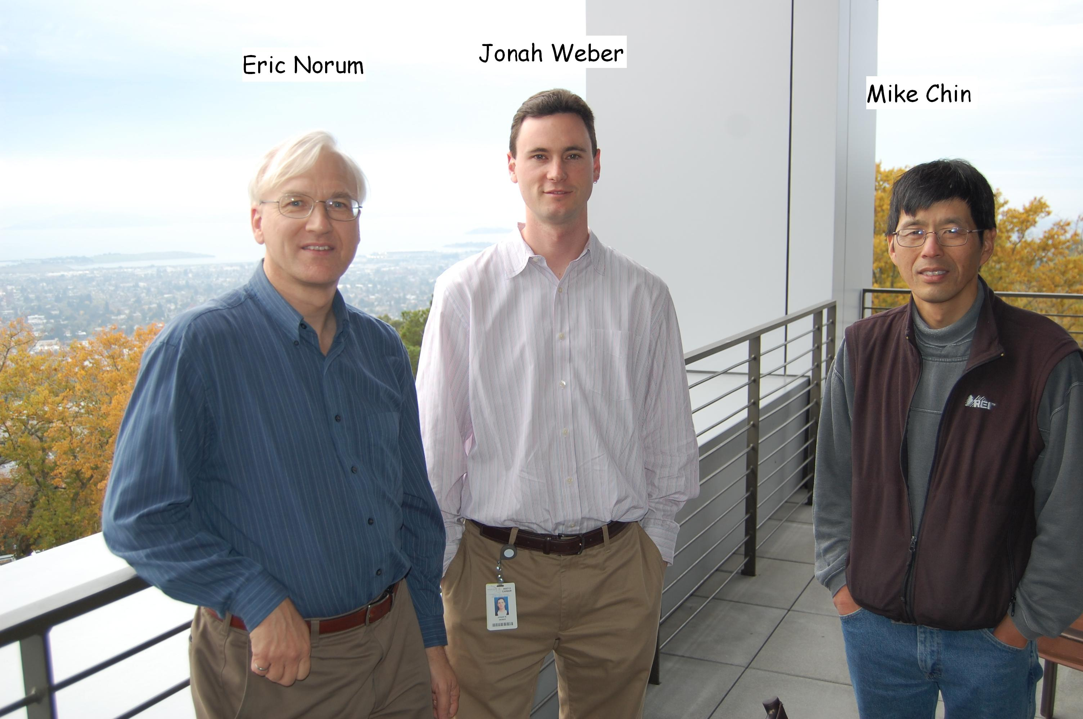
ALS Instrumentation Group
Missing: Rick Lellinger who coordinates purchases, fabrication, and installation

Slide 6
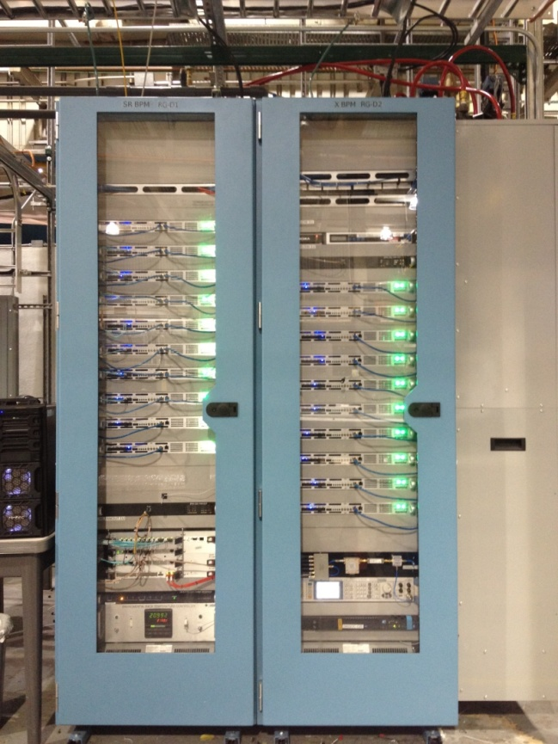
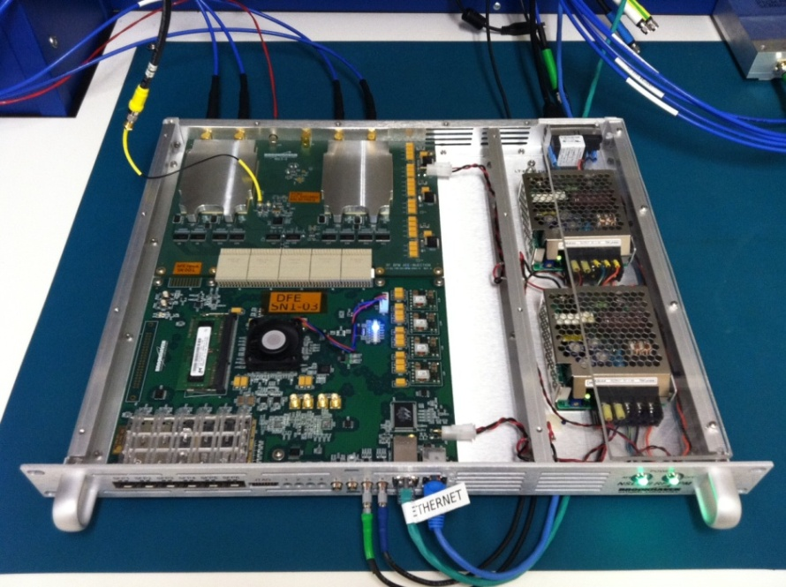
The NSLS-2 BPM
    Storage Ring Thermal Racks Regulated to +-0.1C
BNL started a new BPM development for the NSLS-II project.
We helped test this BPM at ALS before NSLS-II was built (similar RF frequencies)
We leveraged this development for the new ALS BPM
ALS doesn’t have temperature controlled racks, so we further developed the pilot tone compensation method that NSLS-II started.
We are very grateful to the NSLS-II team for their openness and expertise!
Kurt Vetter, Joe Mead, Kiman Ha, Yuke Tian, Marshall Maggipinto, Joe Delong,
Al Dellapenna, Danny Padrazo, … . And others including Jim Sebek at SSRL.

Slide 7
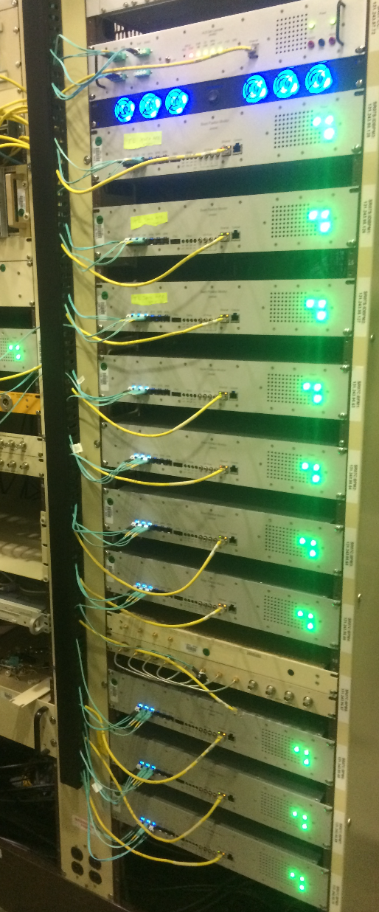
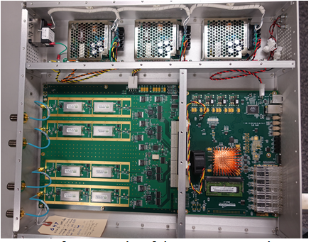
ALS BPM Development
Identical DFE as the NSLS-II BPM
The AFE was modified for ALS

Slide 8
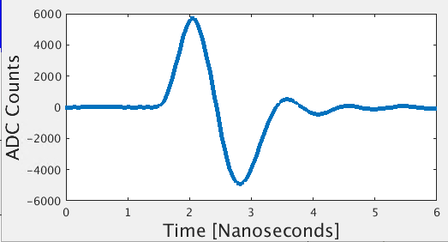
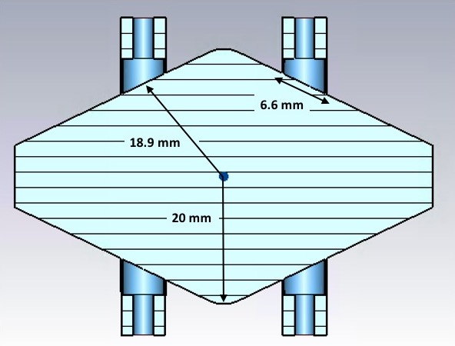
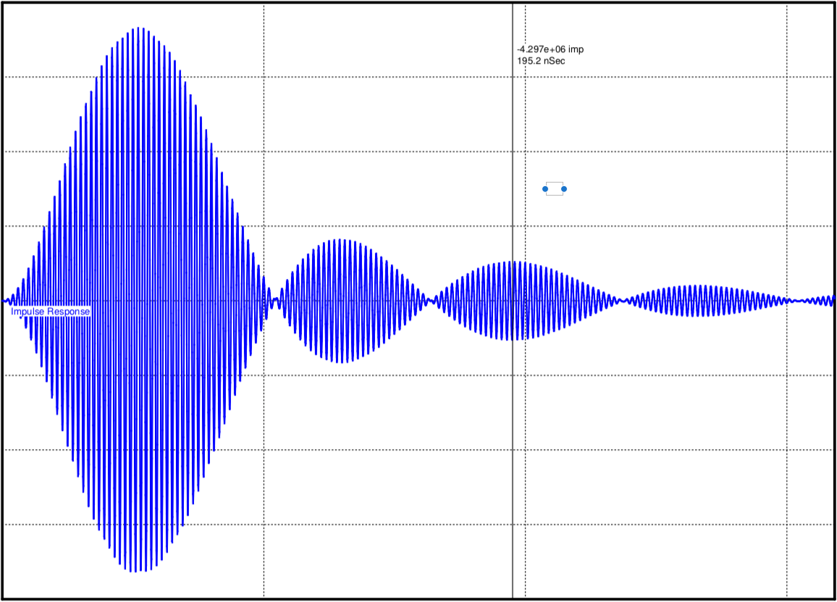
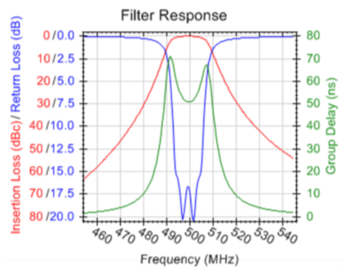
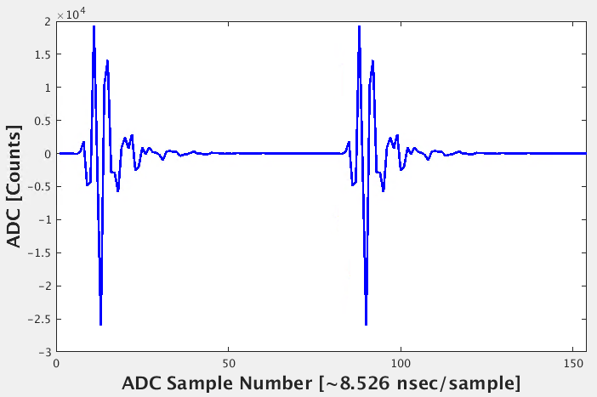
Signal Domains
ALS Arc Chamber
Button + Cable +
800MHz Lowpass
0 100 ns 200ns 300 ns
Single
Bunch
ADC
~117 MHz
ALS arc sector BPM sensitivity is 6.25 % / mm

Slide 9
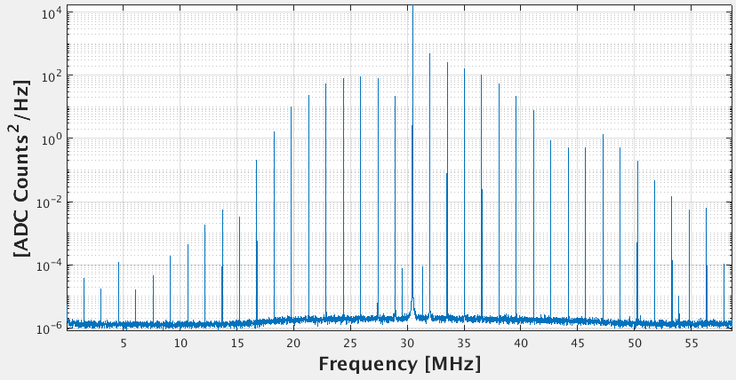
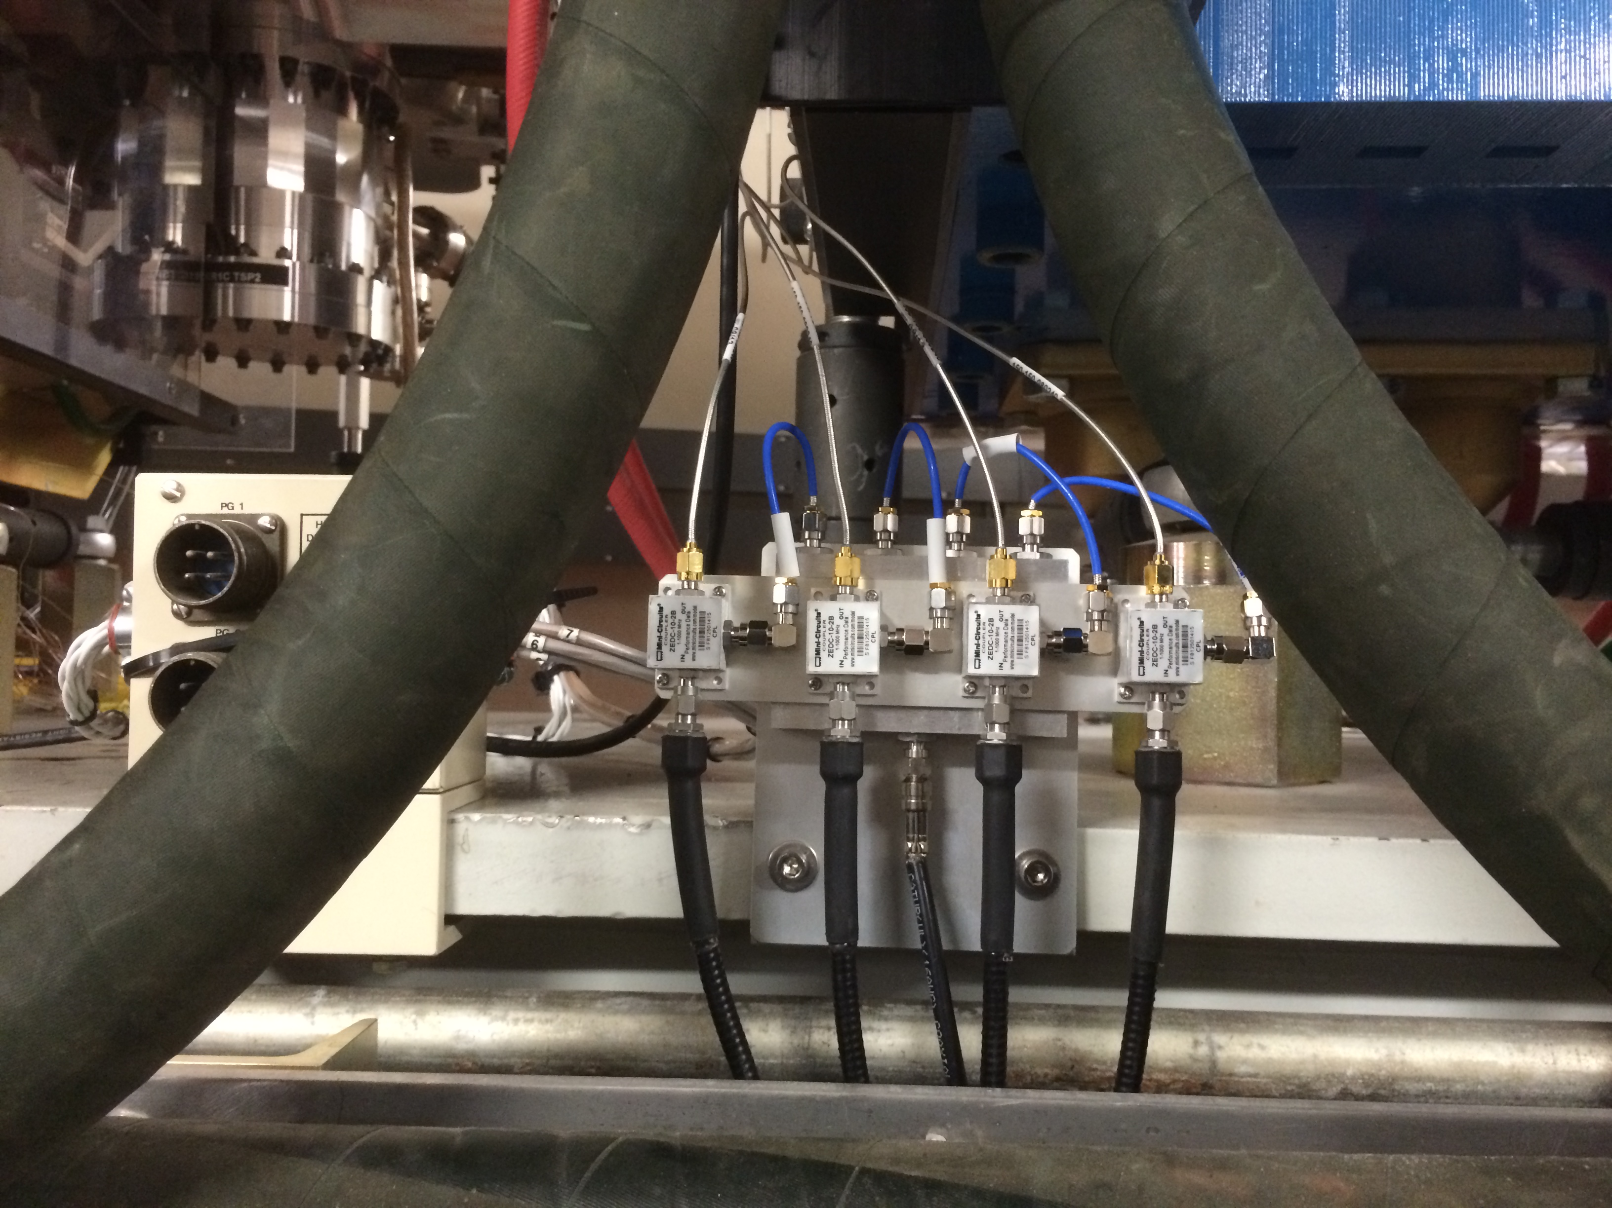
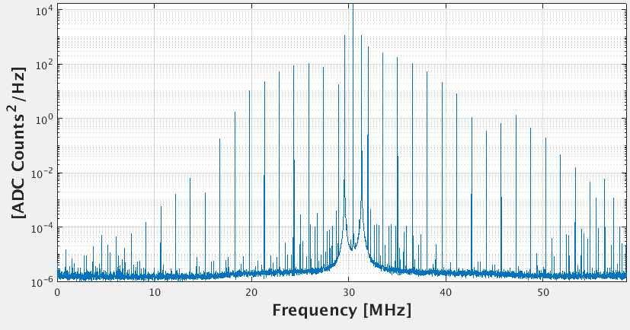
BPM ADC Spectrum w/ & w/o pilot tone
Pilot tone combiner
was installed in the
tunnel for temperature
stability.
Pilot Tones

Slide 10
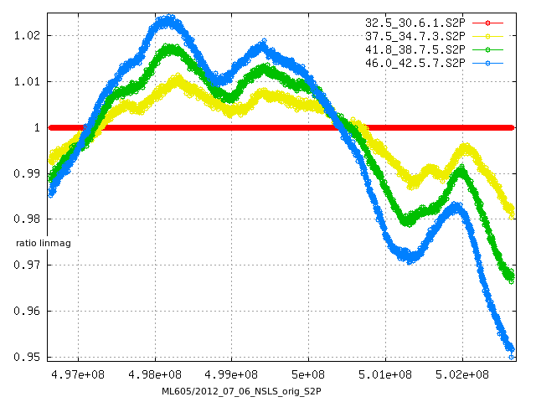
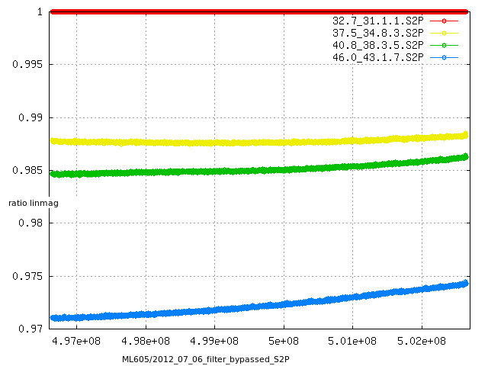
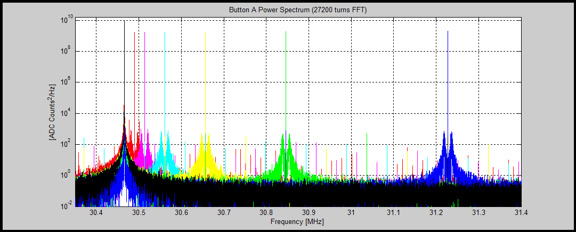
SAW Filter Thermal Analysis
  Normal BPM Channel with SAW Filters
SAW Filters Bypassed
+5.0 DegC
+9.3 DegC
+13.5 DegC
1 MHz
  Temperature introduces a relatively curvy response in the transfer function. This indicates that a pilot tone correction can
  only work if the tones are close to the RF frequency. In fact, a pilot tone at +2 MHz from at RF (~499.645 MHz) would indicate
  that the system gain goes down with temperature, whereas at RF the gain goes up.
M. Chin
RF (blk) + calibration tone at 1/64, 1/32, 1/16, 1/8, 1/4, 1/2 a revolution harmonic.

Slide 11
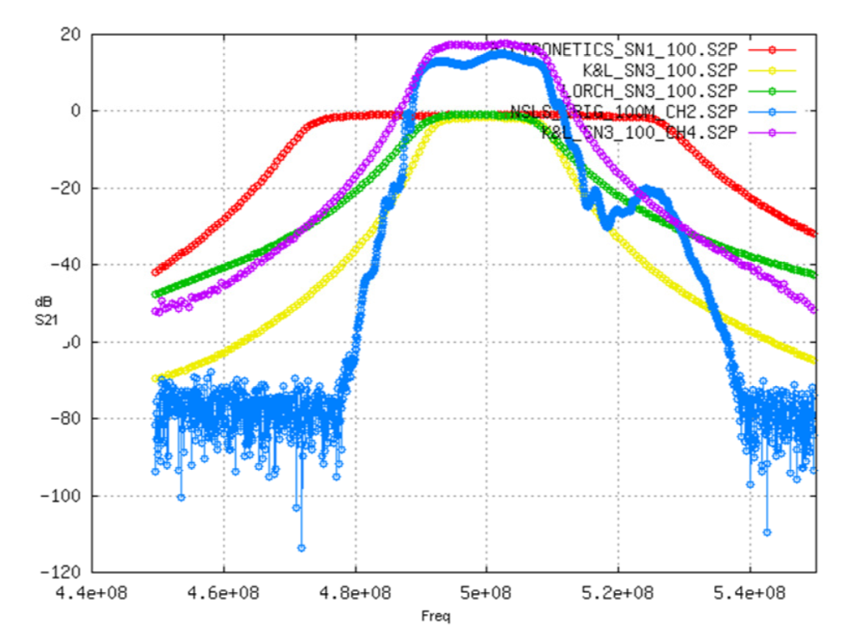
Bandpass Filter Study
Lorch Filter Temperature Test
Lorch Ceramic Filter
+11.0 DegC
Saw Filter
+16.0 DegC
The ceramic filter had an improved linear response with temperature change
We original chose the Lorch ceramic filter (assembled from 4 ceramic blocks)
Then we change to a mono-block ceramic filter from CTS
M. Chin

Slide 12
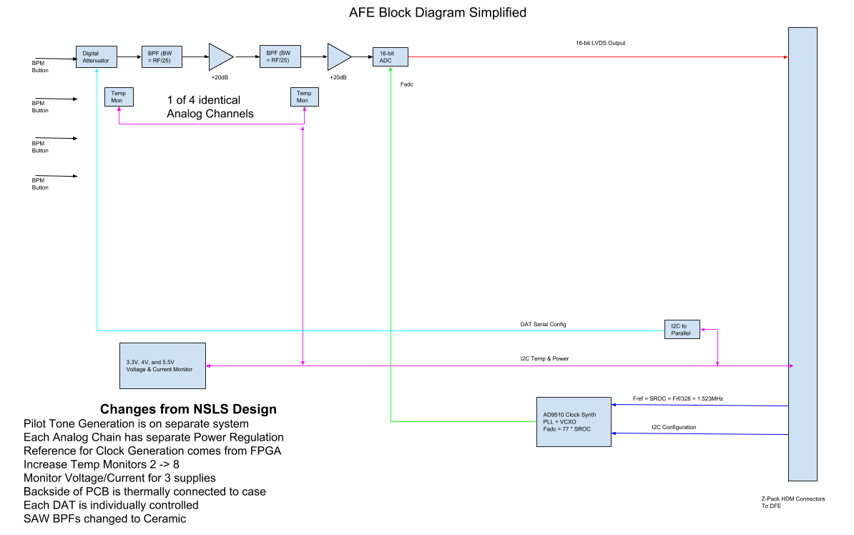
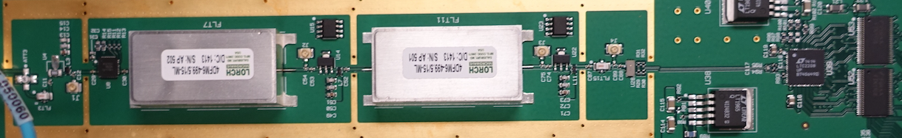
BPM AFE Design Changes from NSLS2
M. Chin

Slide 13
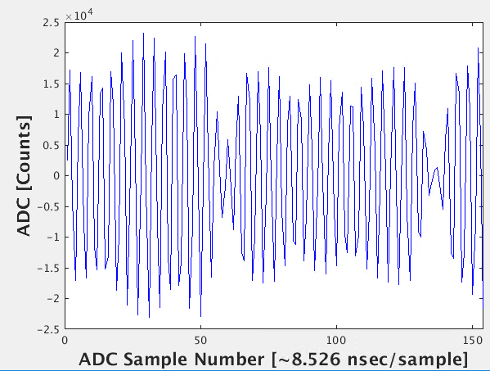
Parameters for the SR and Booster
Single Bunch Fill
Multi-Bunch Fill

Slide 14
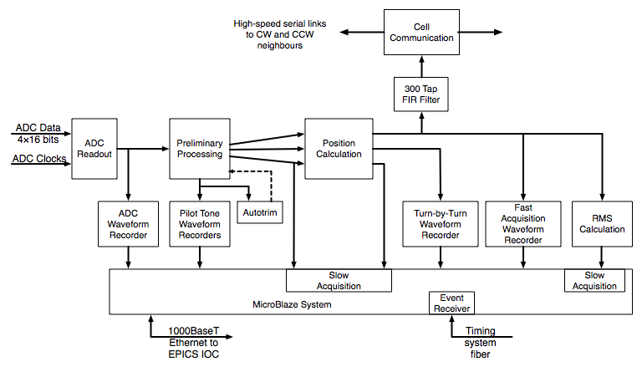
BPM Firmware
‘Fast Acquisition: ~10 kHz positions to fast orbit feedback FPGAs — Dual 3.125 Gb/s fiber links
Same digital board as NSLS2
Complete firmware change
Complete EPICS software change
ADC, turn-by-turn, and Fast Acquisition waveform recorders with capacity up to 2²⁴ samples
Slow Acquisition (~10 Hz): positions to EPICS-based orbit feedback
Acquisition clocks and triggers synchronized ALS timing system
E. Norum

Slide 15
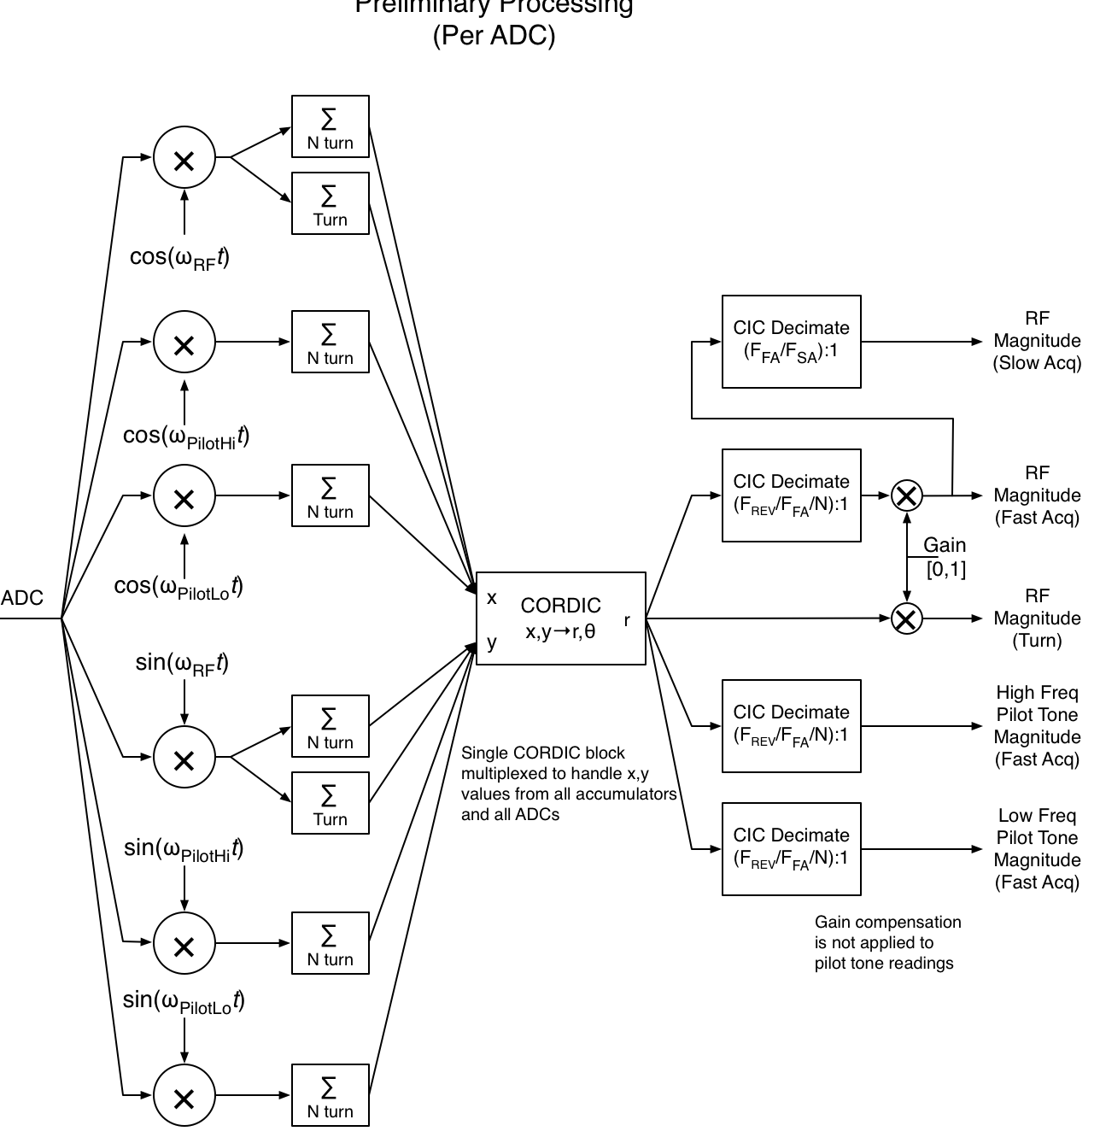
BPM Firmware: Preliminary Processing Block
Down sampling
Synchronous Demodulation
(presently N = 19)
E. Norum

Slide 16
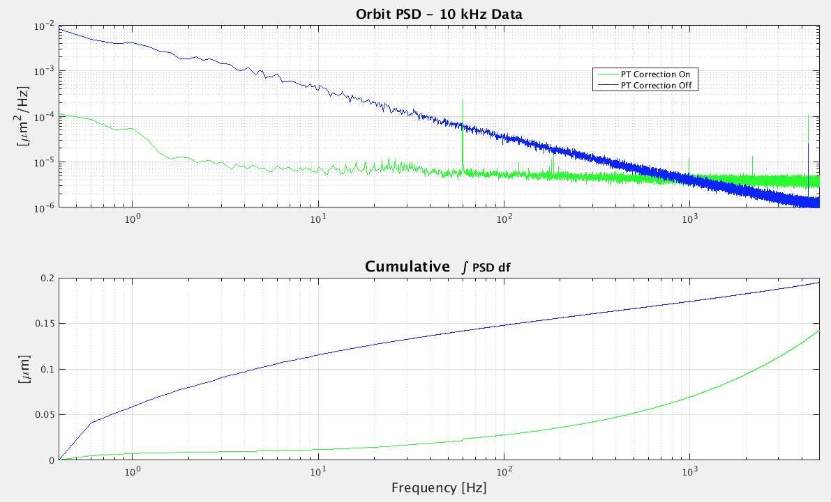
BPM Noise Floor Measurements
Measure setup: one button signal split 4 ways to the BPM inputs.
BPM meets our 200 nm RMS noise floor goal from .4 Hz to 5 kHz w/ or w/o pilot tone correction.
Pilot tone correction provides a benefit up to about 1 kHz. RMS noise from .4 Hz to 1 kHz is 75 nm.
There is room for improving the pilot tone noise floor.

Slide 17
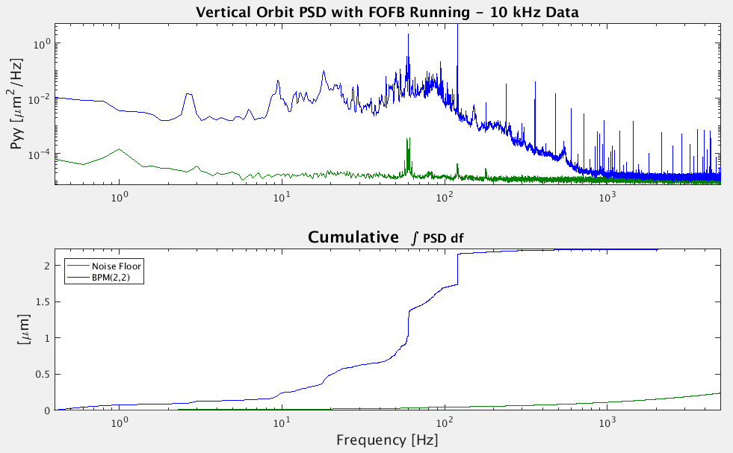
Beam & Noise Floor at 10 kHz
The area between the lines shows the possible improvement factor if we upgrade our fast orbit feedback system.
There isn’t much beam motion above 1 kHz. It might be a challenge to measure beam motion above 5kHz. The solution is likely a combination of better ADCs (faster and/or higher resolution) and cleaner pilot tone generators.

Slide 18
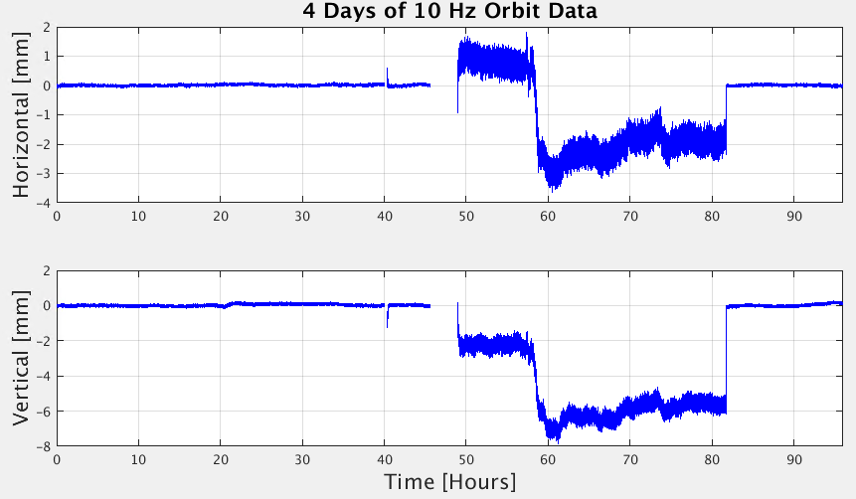
4 Day Orbit Drift Measurement
Pilot Tone Compensation On
Pilot Tone Comp. Off
Orbit Drift Measurement (using a 4-way split button signal)

Slide 19
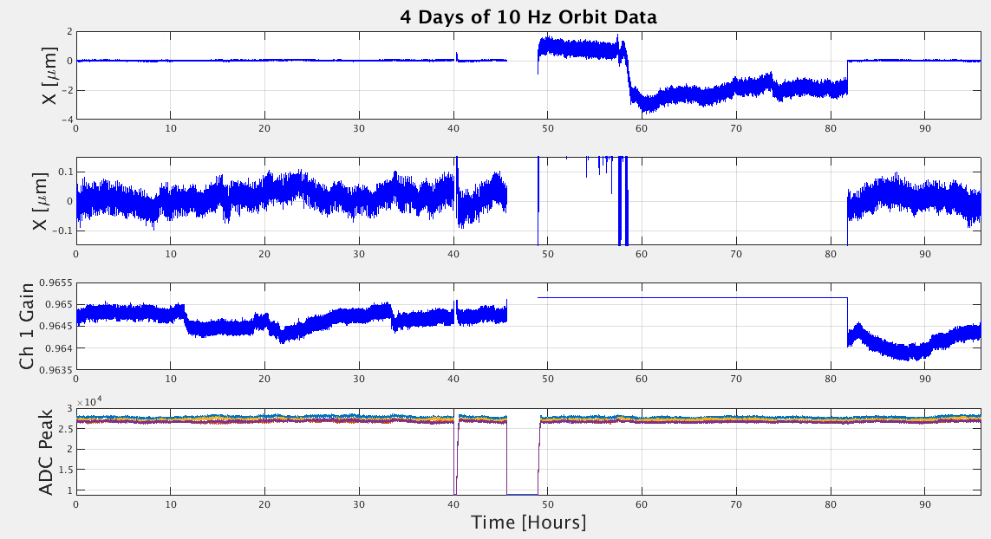
Drift measurement in more detail
Orbit Drift Measurement (using a 4-way split button signal)
Maintained ±.2 μm RMS over 4 days with pilot tone compensation.

Slide 20
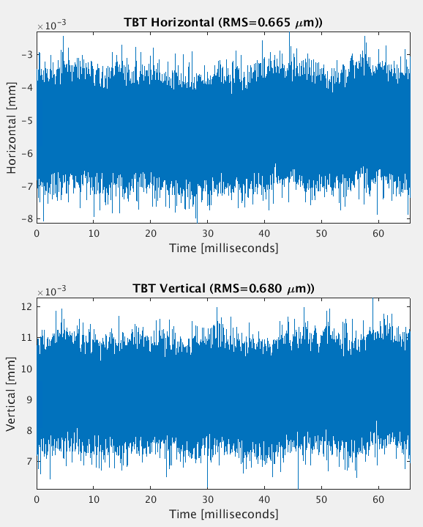
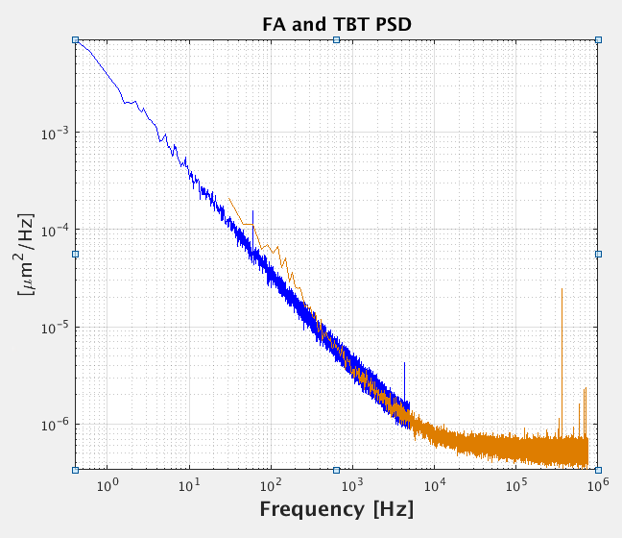
Multi-bunch Turn-By-Turn Orbit Measurement
Noise measurement done at 500 mA
using one button split 4-ways.

Slide 21
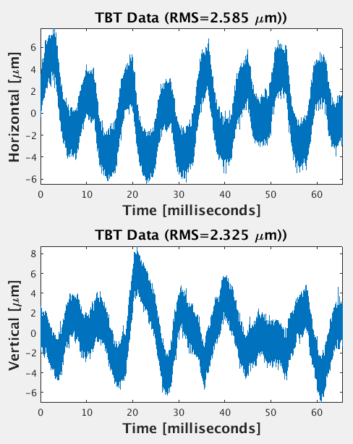
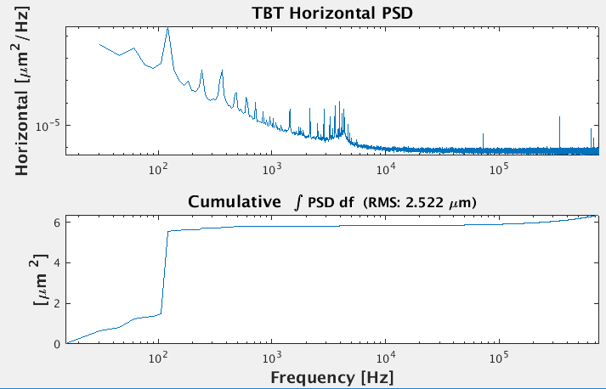
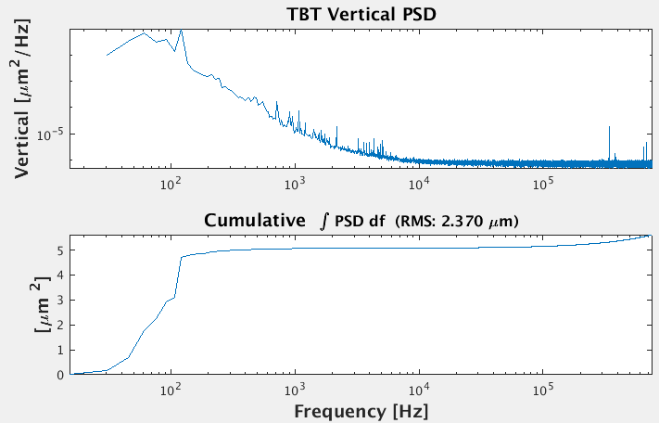
Multi-bunch Turn-By-Turn Orbit Measurement
Beam spectrum measurement

Slide 22
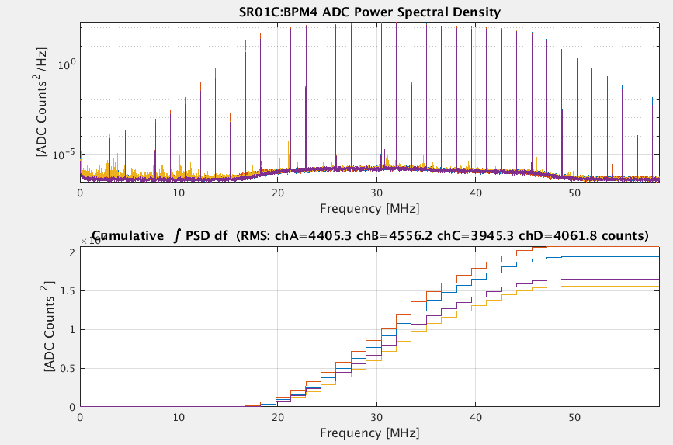
Single Bunch Turn-By-Turn Orbit Measurement
Two processing modes:
IQ uses just the RF Rev Harmonic (the normal mode)
RMS uses the whole spectrum

Slide 23
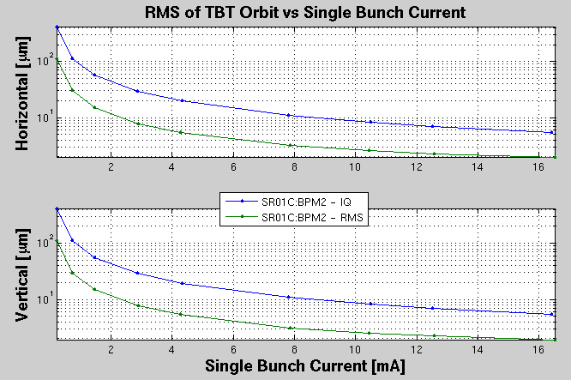
Turn-By-Turn, Single Bunch Orbit RMS
IQ uses just the RF Rev Harmonic, RMS uses the whole spectrum.

Slide 24
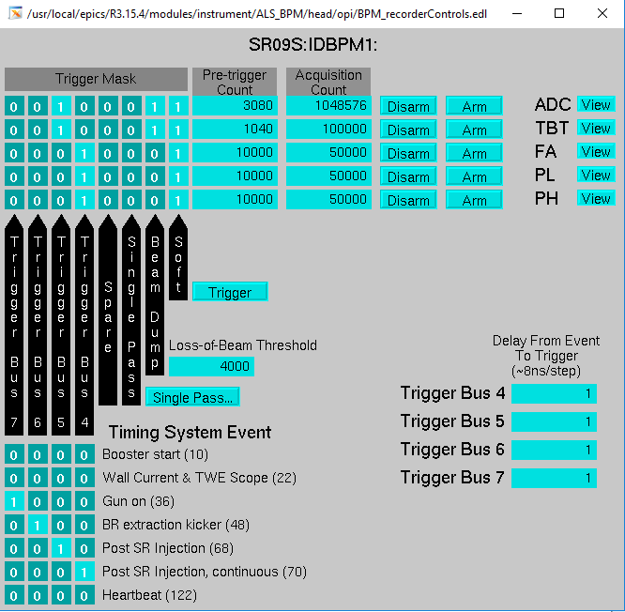
Data Recorder
Data buffers for ADC, TBT, FA data streams with capacity up to 2²⁴ samples (~16M)
Trigger selection: any timing system (MRF) trigger, beam dump, single pass threshold, or software PV.

Slide 25
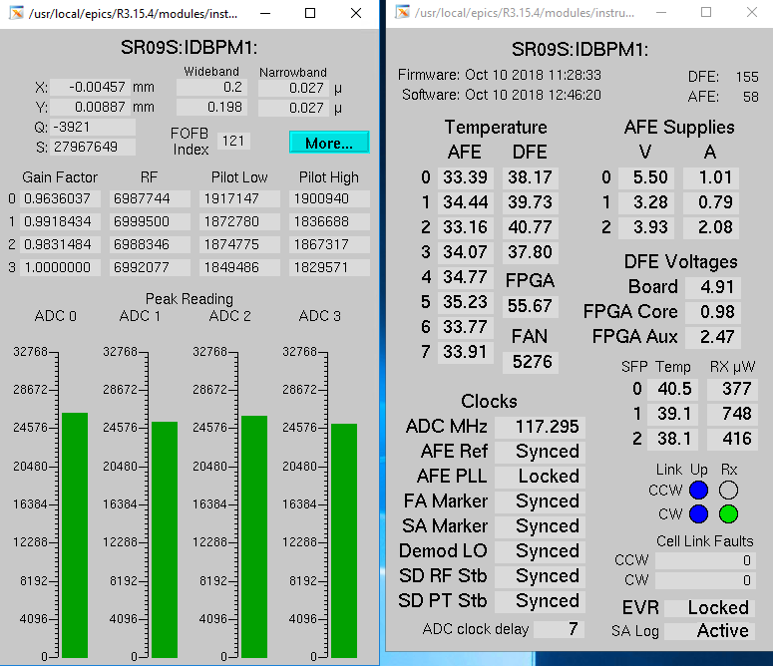
BPM Health Monitoring and Maintenance
Health monitoring of temperature, voltages, clocks, etc.
The pilot tone provides an opportunity to run diagnostics checks on the BPM electronics during shutdown days. Presently, two pilot tones can be set on 5 different frequencies (including RF), and it could be expanded to include more frequencies.
The pilot tone also allows for transparent swapping of BPM electronics.

Slide 26
BPM R&D
The wish list is the following.
Faster ADCs (presently ~125MHz)
  77 Samples / SR turn is a little low
Component R&D
  Bandpass filters
  DAT, amplifiers, …
Cleaner pilot tones
4 Channel ADCs
Develop a pilot tones on RF compensation method
Hopefully ALS-U will provide an opportunity to address these issues.

Slide 27
Orbit Stability
Fast orbit feedback

Slide 28
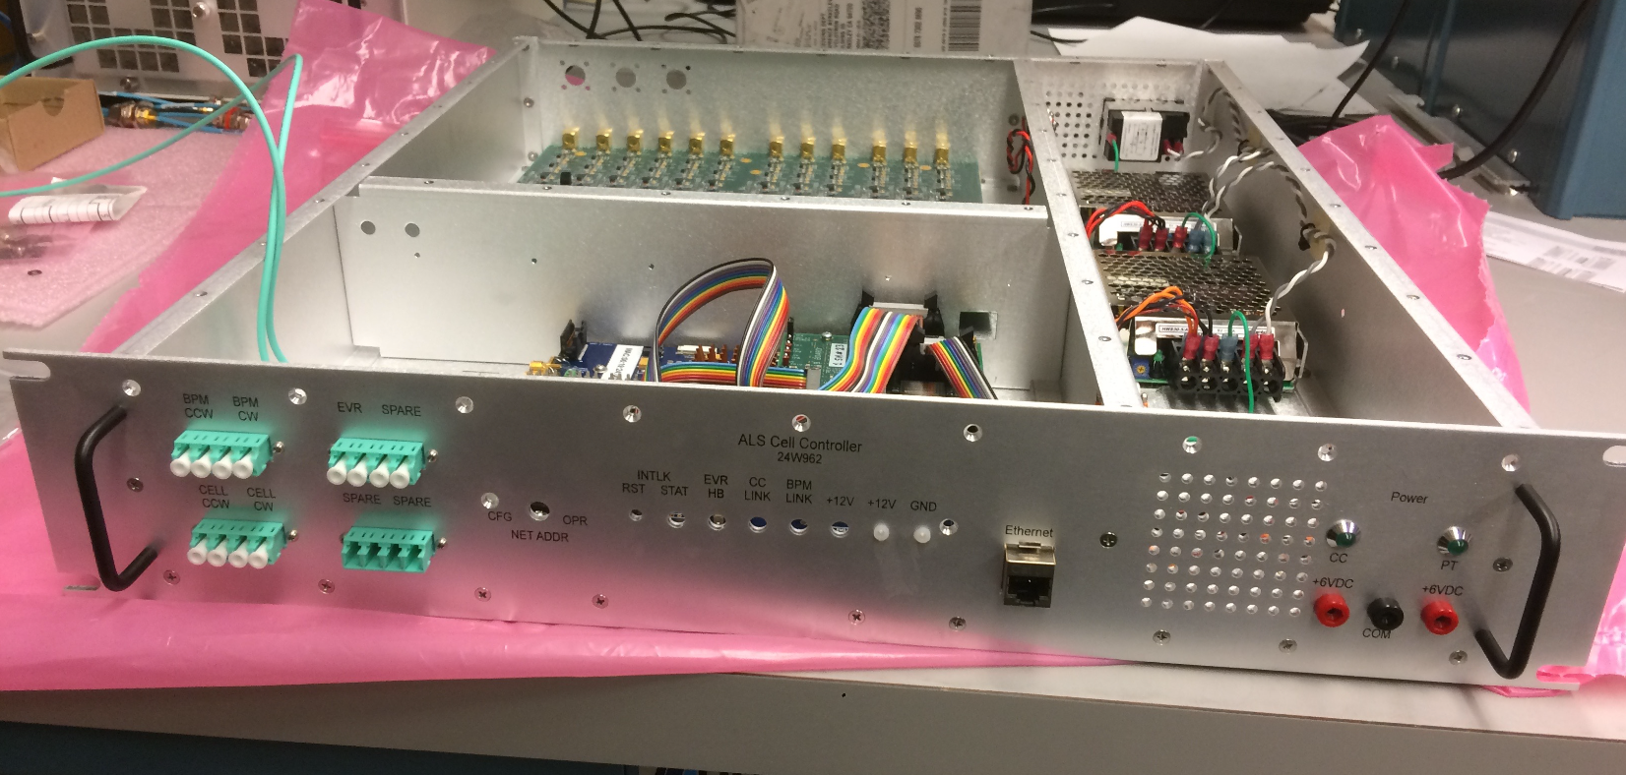
Cell Controllers and FOFB
The ALS Cell Controller
Conceptually similar to NSLS2 FOFB System
Different hardware, firmware, and software
Multiple Functions
FOFB – Collects BPM data at 10 kHz, computes the fast orbit feedback compensation, communicates to the fast power supplies
Generates the pilot tones for the BPMs
Fast orbit interlock (relay output)

Slide 29
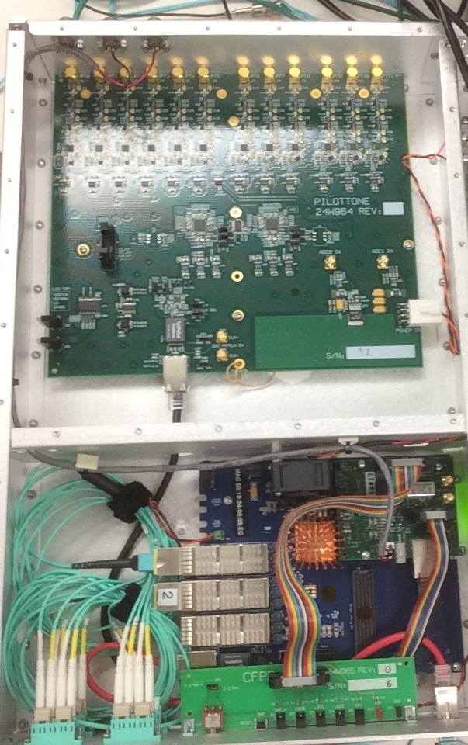
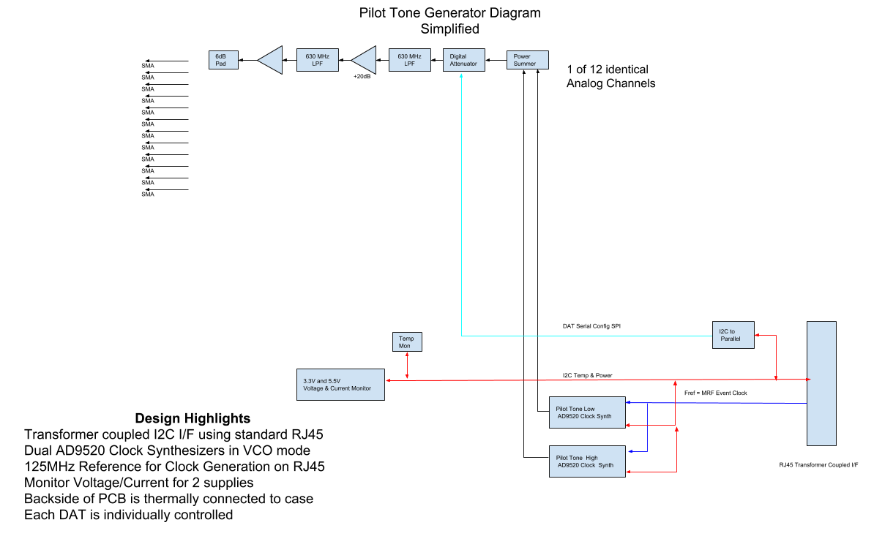
ALS Pilot Tone Generator
Two Tone Generators
Presently run at ±11/19 Rev Harmonic (~882 kHz)

Slide 30
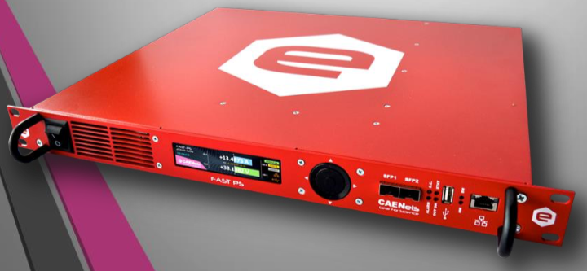
Fast orbit feedback architecture
MRF: Events / Timing Data (fiber fanouts)
Fast Orbit Feedback Network (Dual 3.125 Gb/s fiber links)
Ethernet – EPICS Channel Access
1 Gb/s Ethernet fiber links
Cell
Controller
...
Cell
Controller
PS1
BPM1
PS2
BPM2
PS3
BPM3
BPM Network
Dual 3.125 Gb/s fiber links
PS4
BPM4
Power Supply for FOFB
(Caen Fast-PS Series)
PS5
BPM5
PSn
BPMn
Fast Feedback
Power Supplies
Beam Position
Monitors
Per Sector

Slide 31
Fast Orbit Feedback System
FPGA based, one cell controller per SR sector
3.125 Gb/s fiber links to local BPMs and to neighboring units
1 Gb/s ethernet fiber link to local fast corrector power supplies
10 kHz update rate
< 20 µs latency from facility timing system ‘fast acquisition’ marker until new power supply setpoint transmission. Includes time to:
  acquire position values from all local BPMs
  acquire position values from all other fast feedback units
  compute new power supply setpoints
  transmit packet to local power supplies
Provides orbits interlocking (relay output) at the 10 kHz rate with approximately 20 µs latency from the start of a BPM acquisition.

Slide 32
Orbit Feedback SystemTransition Plan
Transitioning from Bergoz BPMs to our new BPM
  Present state is,
  70 Bergoz, 52 New BPMs
  In 2019 we hope to transition to,
  12 Bergoz, 112 New BPMs
The present FOFB system uses both Bergoz and new BPMs at a 1 kHz data rate. System commissioned by Christophe Steier, Simon Leemanns, Tom Scarvie, Eric Williams, … .
In 2019, we hope to transition to new Caen power supplies and increase the data rate to 10 kHz.
We also have funding to replace the aluminum vacuum chambers at the fast correctors with higher bandwidth stainless steel chambers.
Aiming for a closed loop bandwidth between 500 to 1000 Hz

Slide 33
BPM Position
Monitor
Fun Measurements

Slide 34
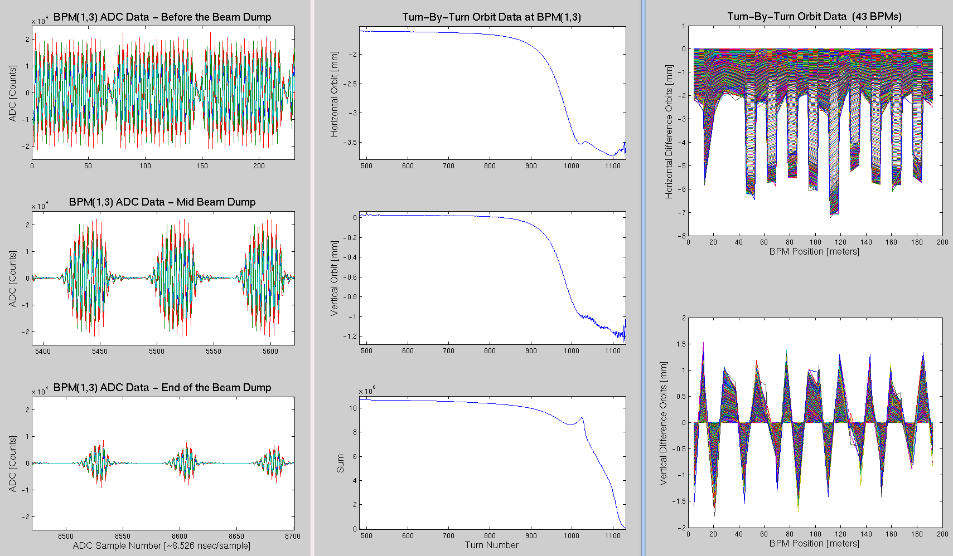
Beam Dump Monitoring at ALS
ADC buffers can also provide some limited fill pattern information.
500 mA multi-bunch TBT is about .5 μm rms

Slide 35
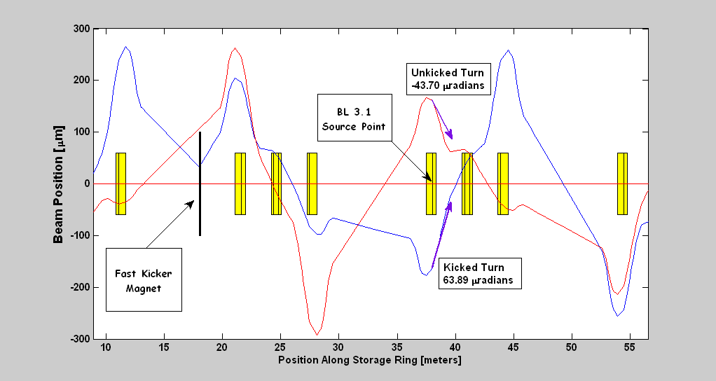
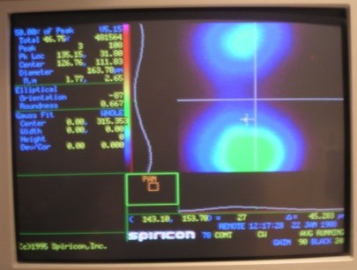
Pseudo Single Bunch Kicker – Kicking Every Other Turn
BL 3.1 Image for Single Bunch, 750 Volts on the kicker, 1.52/2 MHz

Slide 36
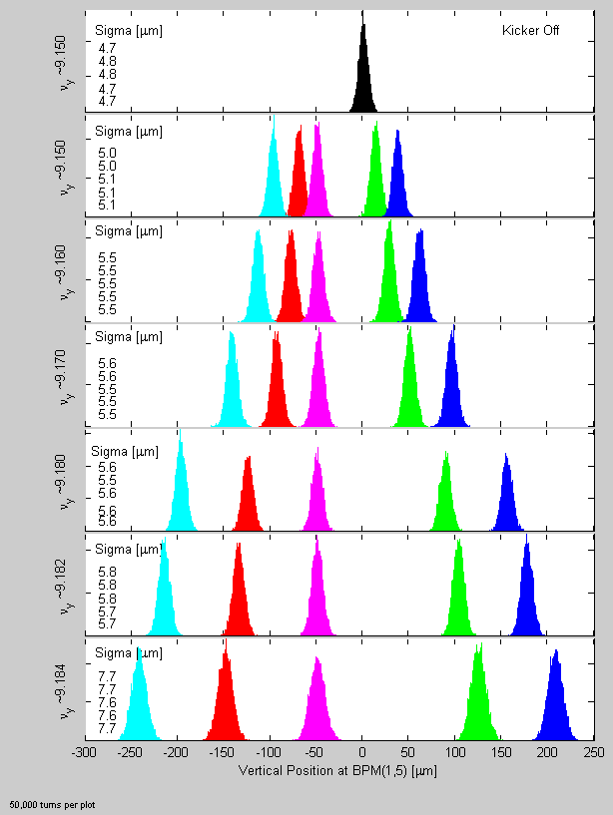
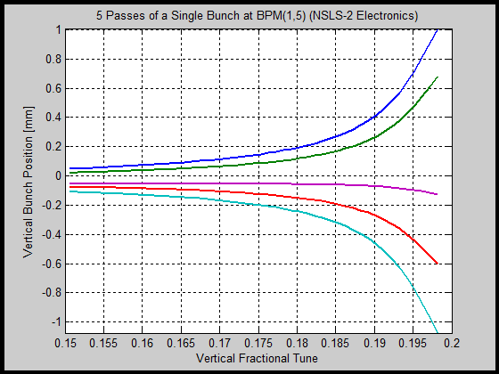
Pseudo Single Bunch Kicker – Kicking Every 5th Turn
BPM TBT Histogram at Different Vertical Tunes (NSLS2 BPM)
Model Orbits for Each of the 5 Turns Verses Vertical Tune

Slide 37
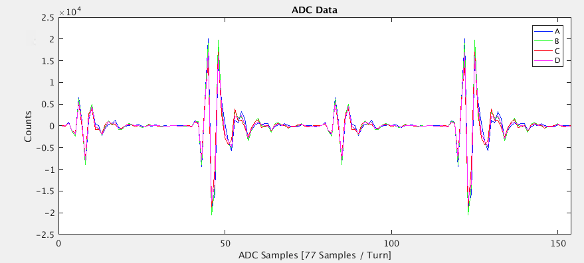
2-Bunch, Asymmetric Current
Fill pattern
About 1.2 mA each in bunches 144, 145, 146
About 4.0 mA each in bunches 308, 309, 310
The fast injection magnets were used to kick the beam.
The orbits were computed using RMS ADC counts over half a turn (77 samples / turn):
Orbit1 from ADC samples 1:38 (the 1.2mA bunches)
Orbit2 from ADC samples 40:77 (the 4.0mA bunches)

Slide 38
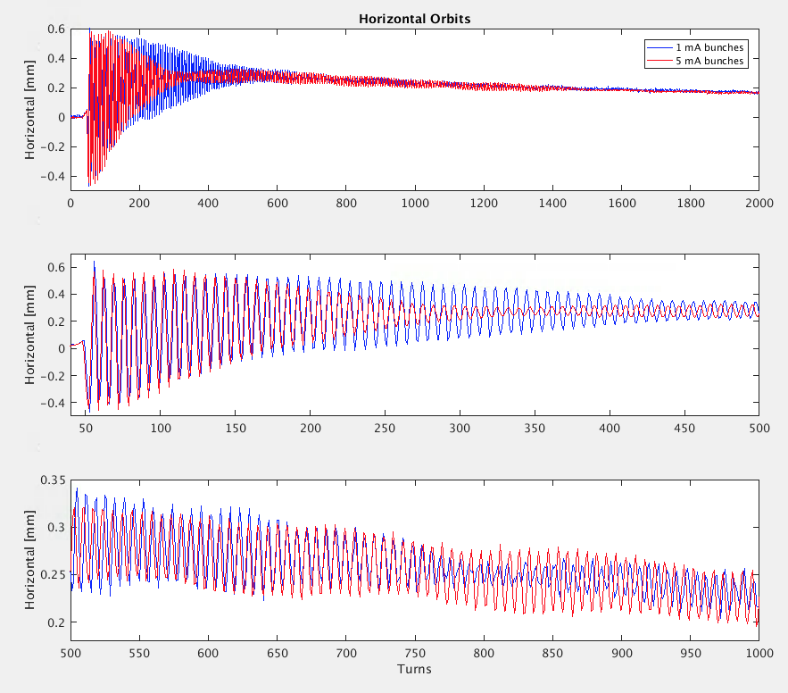
2-Bunch, Asymmetric Current
The high current bunches have a larger horizontal tune and faster decoherence time.
The larger bunches make an extra 360 degree phase advance in about 650 turns -> .0015 tune separation between the bunches

Slide 39
Conclusion
The pilot tone system is working well
  For real-time compensation of BPM electronic errors
  As a diagnostic tool for BPM health and performance
We’d like to thank ALS management for supporting this effort!
We’d like to thank the NSLS-II team for being bold and taking a new direction with BPM development. And providing us open access to their work.

Slide 40
Extra
Slides
Bunch Current Monitor (BCM)

Slide 41
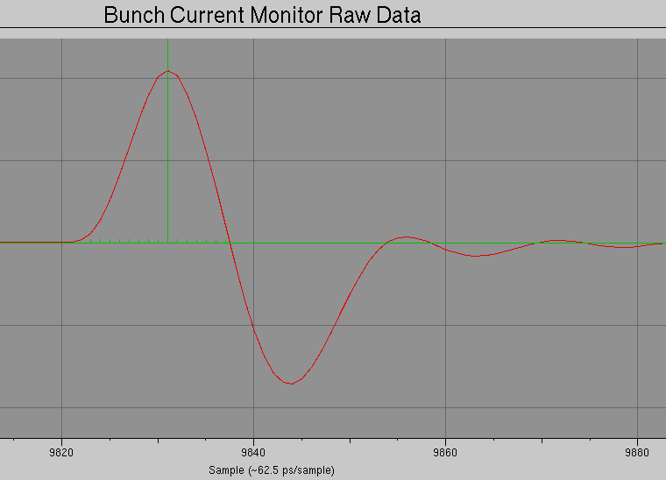

Bunch Current Monitor (BCM)
The bunch current and phase can be estimated from a BPM button signal by sampling a button signal at just off the RF frequency.
32 samples / 2 nsec

Slide 42

Bunch Current Monitor (BCM)
[Nanoseconds]

