Slide 1




Single Bunch Instabilities with Transverse Feedback at Diamond Light Source
Eirini Koukovini-Platia
(currently at CERN)
Acknowledgements
M. Abbott, R. Bartolini, R. Fielder, S. Gayadeen, A. Morgan, G. Rehm
Next Generation Beam Position Acquisition and Feedback Systems
12-14 November 2018, Barcelona

Slide 2
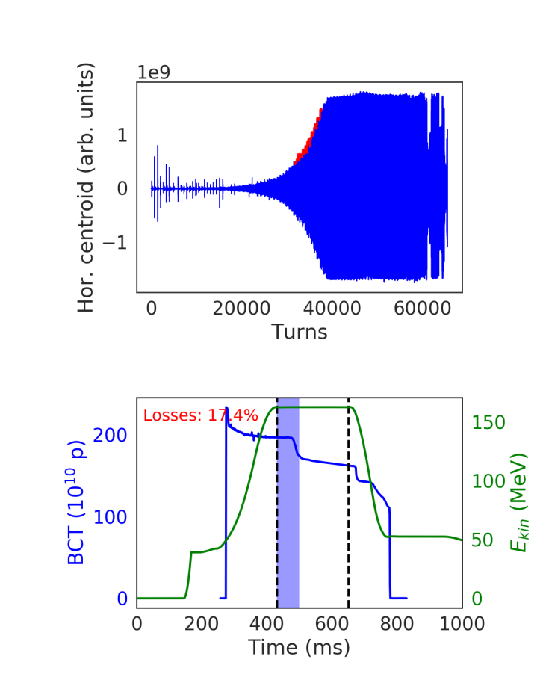
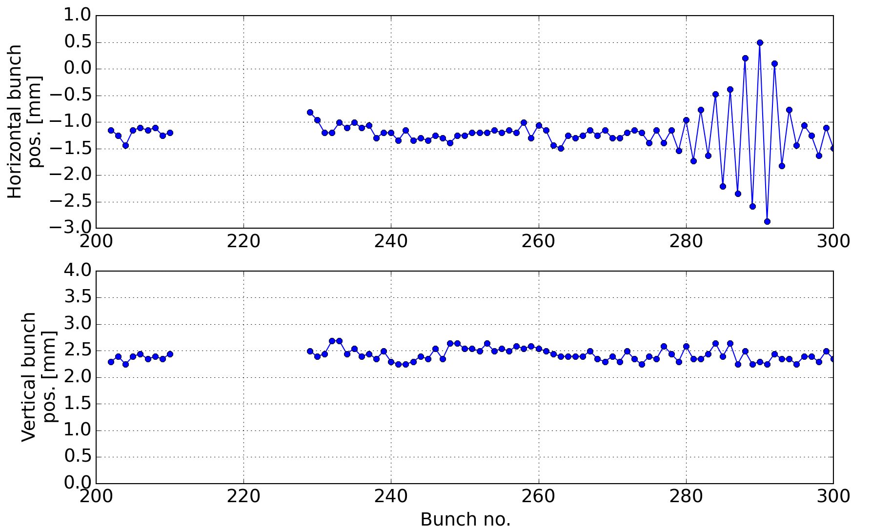
Introduction
Multi- or single-bunch collective phenomena are an important limitation to high current operation in storage rings (both hadron and electron machines)
Proton Synchrotron Booster (CERN)
Horizontal single-bunch instability
Super Proton Synchrotron (CERN)
Horizontal multi-bunch instability
Courtesy M. Schenk et al.
Next Generation Beam Position Acquisition and Feedback Systems
12-14 November 2018, Barcelona

Slide 3
Introduction
Multi- or single-bunch collective phenomena are an important limitation to high current operation in storage rings (both hadron and electron machines)
Can lead to
  longitudinal or transverse instabilities
  beam quality deterioration
  beam loss
A well-established method to actively damp instabilities is the use of transverse bunch-by-bunch feedback systems [1-7]
Next Generation Beam Position Acquisition and Feedback Systems
12-14 November 2018, Barcelona

Slide 4
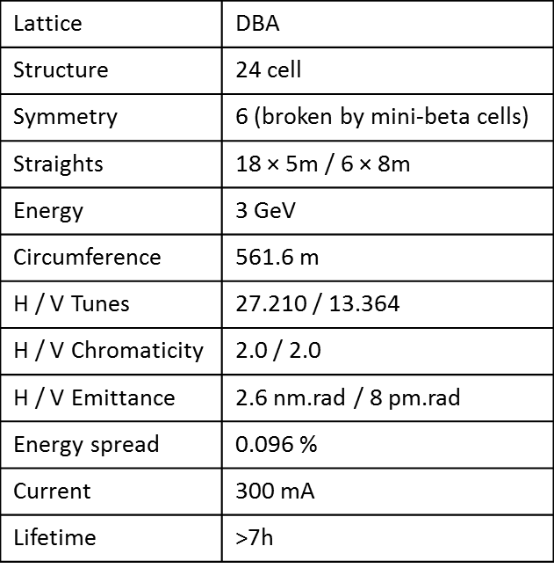
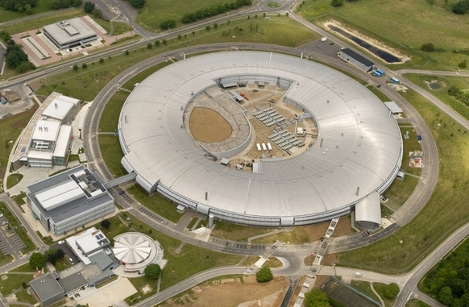
Diamond Light Source
Diamond is the UK’s national synchrotron radiation facility
Located at Rutherford Appleton Laboratory, Oxfordshire
Construction began March 2003
Start of user operations Jan 2007
* Parameters before the insertion of the DDBA
Next Generation Beam Position Acquisition and Feedback Systems
12-14 November 2018, Barcelona

Slide 5
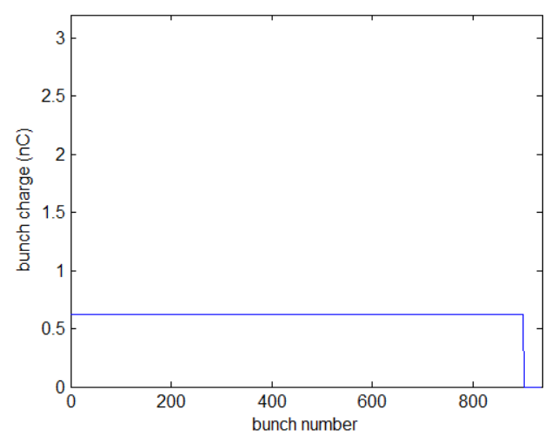
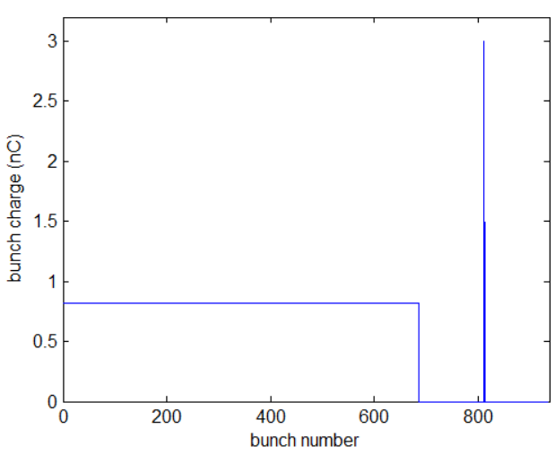
Transverse Feedback at Diamond
Up to 936 electron bunches separated by 2 ns
Design of the transverse multi-bunch feedback (TMBF) allows:
  bunch-by-bunch selectable control over filters, gain and excitation
  possibility to control independently a single bunch in a hybrid filling
  pattern [8]
Standard Mode
900 bunches, 2 ns apart,
I_{tot} = 300 mA, ~0.33 mA/bunch
Hybrid Mode
Train of 686 bunches plus a
single bunch of ~1.8 mA,
I_{tot} = 300 mA
Next Generation Beam Position Acquisition and Feedback Systems
12-14 November 2018, Barcelona

Slide 6
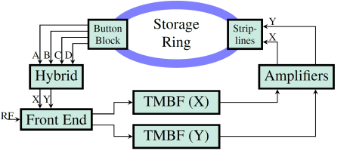
TMBF Schematics
The nominal feedback settings at Diamond is 0 dB gain. The controller then applies a correction signal with 180° phase in the stripline kickers
A 4-button electrode assembly with an RF hybrid circuit picks up
the x and y position of each bunch
Converts raw 3rd harmonic signal into a 250 MHz bandwidth
bunch position signal suitable for processing by TMBF
Signal is digitised at 500 MHz, processed
by the field-programmable gate array (FPGA),
and then reconverted to drive the striplines [9]
Next Generation Beam Position Acquisition and Feedback Systems
12-14 November 2018, Barcelona

Slide 7
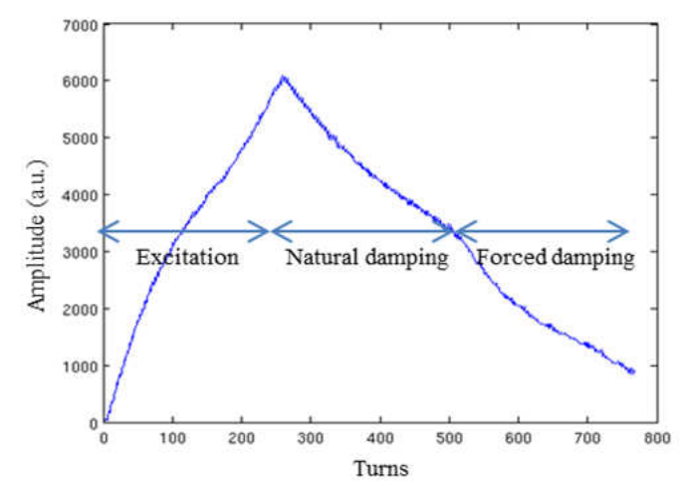
Functionalities of TMBF at Diamond
Apart from suppressing coupled-bunch instabilities, the TMBF at Diamond is also used for the
continuous tune measurement on a single bunch without any visible disturbance of the user beam
grow-damp experiments [10]
(offline post-processing provides
the damping or growth rate
of each mode)
Next Generation Beam Position Acquisition and Feedback Systems
12-14 November 2018, Barcelona

Slide 8
Motivation for Single-Bunch Studies
Many studies on the effectiveness of a feedback system suppressing single bunch instabilities, such as the transverse mode coupling instability (TMCI) for zero chromaticity [11-16]
Published paper on simulations of head-tail instabilities [17]
Results showed there is no general rule for the optimum TMBF settings for single bunch effects as they depend on the impedance of each machine
Measurements were performed at Diamond with a single bunch without and with the transverse feedback to investigate its effect on
  the TMCI threshold
  the weak head-tail instability
With different chromaticity, gain and phase of TMBF
Focus on the vertical plane, being the most critical
Next Generation Beam Position Acquisition and Feedback Systems
12-14 November 2018, Barcelona

Slide 9
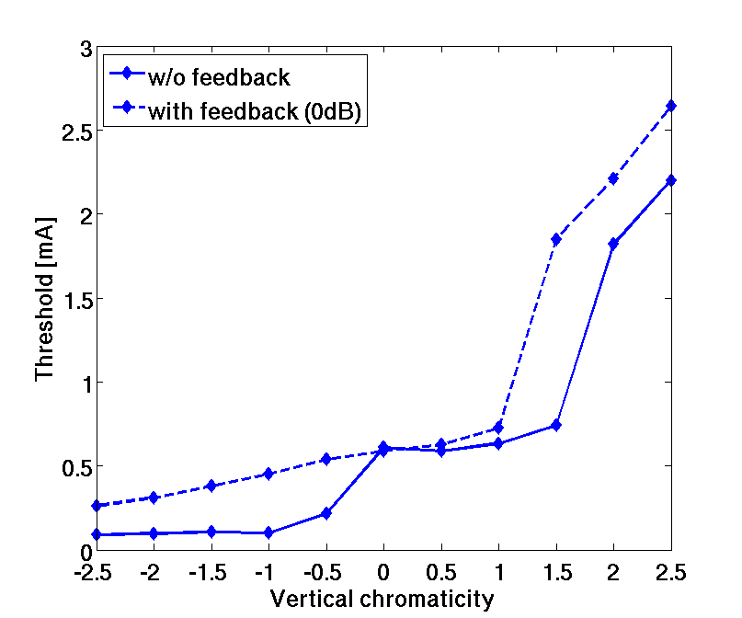
Vertical Single Bunch Instability Thresholds
Measurements
Starting from low intensity, the instability thresholds are measured by injecting more current into a single bunch till beam losses occur or cannot inject anymore
The vertical chromaticity Q’_{y} was varied between -2.5 and 2.5 in steps of 0.5
TMBF was used in resistive mode, i.e. damping coherent betatron oscillations
Hybrid mode: ~1.8 mA max. in a single bunch
TMCI ~0.6 mA was not much affected with TMBF with nominal settings
Next Generation Beam Position Acquisition and Feedback Systems
12-14 November 2018, Barcelona

Slide 10
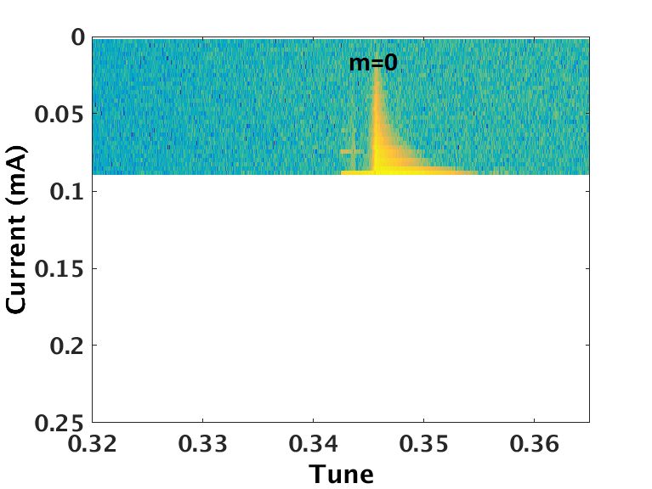
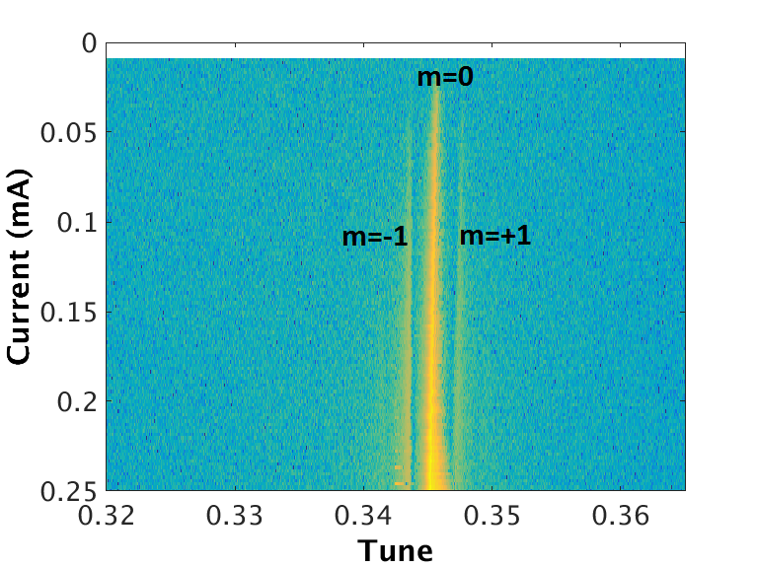
Negative Chromaticity
Without feedback
With resistive feedback
Threshold: ~0.07 mA
Dipole mode m=0 unstable
Threshold: ~0.25 mA
Nearly a factor 7 higher intensity with TMFB for certain negative chromaticity values (resistive feedback most effective acting on the bunch centroid)
Even so, similar intensity of 1.8 mA achieved with Q’_{y}=2 is out of reach
Next Generation Beam Position Acquisition and Feedback Systems
12-14 November 2018, Barcelona

Slide 11
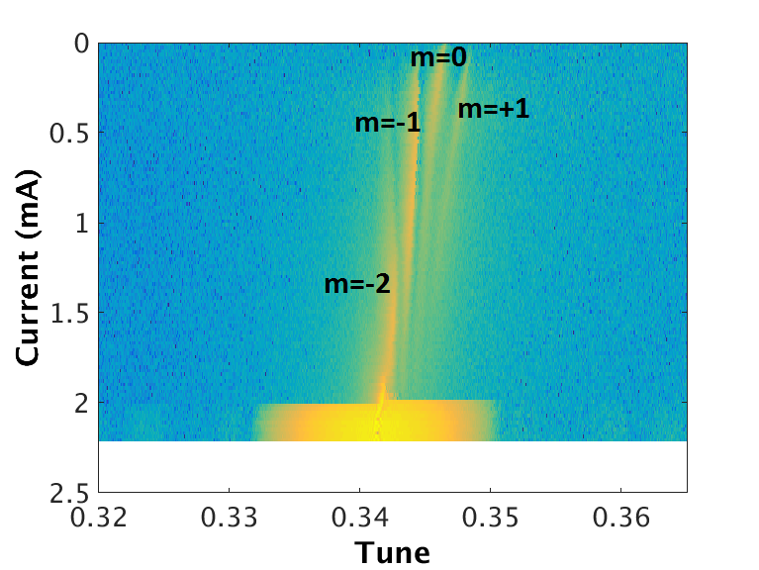
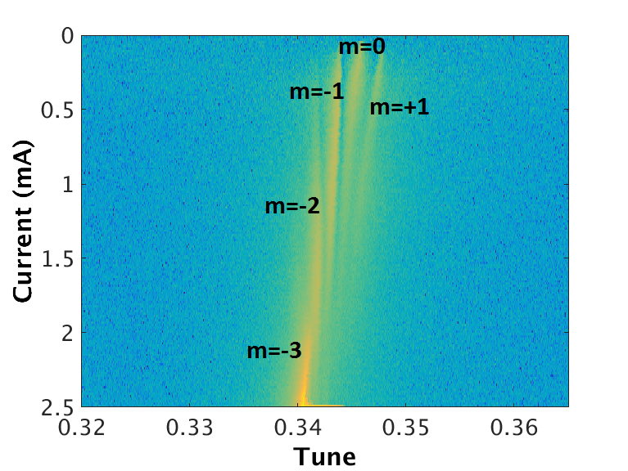
Positive Chromaticity
Without feedback
Resistive feedback
Threshold: ~2.1 mA
Threshold: ~2.5 mA
Some intensity increase observed also for positive chromaticity
With TMBF on, instability is no longer of mode m = -2, but instead of m = -3
Next Generation Beam Position Acquisition and Feedback Systems
12-14 November 2018, Barcelona

Slide 12
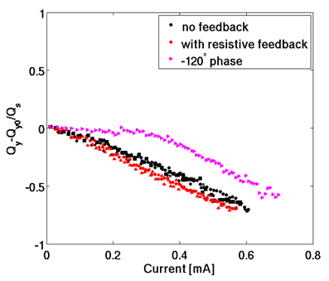
Effect of Feedback Phase
The feedback phase can be changed from resistive to reactive as well as
any intermediate value by changing the phase of the feedback inside the
finite impulse response (FIR) filter [18]
A reactive feedback shifts the coherent betatron frequency either up or down. A purely reactive feedback corresponds to a phase of ±90°
For an intermediate phase, the mode 0
is prevented from shifting down up to
a certain current
Eventually, however, it starts to shift
down until it merges with mode -1,
causing TMCI instability at 0.74 mA
The purely reactive phase has a similar
result and raises the instability onset
to 0.71 mA
Next Generation Beam Position Acquisition and Feedback Systems
12-14 November 2018, Barcelona

Slide 13
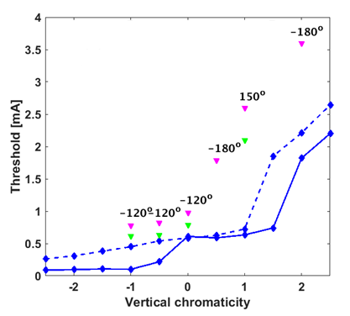
Additional Gain in the Feedback
Additional gain in the feedback was provided by increasing the back-end amplifier gain to its maximum value
The phase of the TMBF was varied and the highest achieved intensities are recorded below
In the TMCI regime both resistive and intermediate phase increase the threshold when additional gain is provided
For other chromaticity values, the phase that allows the maximum intensity varies
In most cases, an intermediate phase was found to be best without a unique answer for all chromaticities
- w/o TMBF
-- with resistive TMBF
- Resistive with extra gain
- Best phases with extra gain
Next Generation Beam Position Acquisition and Feedback Systems
12-14 November 2018, Barcelona

Slide 14
Possible Operational Use for Diamond
With single-bunch selected feedback settings, one can raise the intensity of a single bunch from 1.8 mA to 3.6 mA
After years of operation limited to 1.8 mA in the single bunch of the hybrid mode, it is now possible to double the intensity if desired by the users thanks to this study
- w/o TMBF
-- with resistive TMBF
- Resistive with extra gain
- Best phases with extra gain
Other machines report bigger effect of the TMBF on the TMCI threshold
The maximum increase found in these measurements was a factor of two, likely related to the specific feedback system
A factor of 3.4 increase in the TMCI was only possible by changing an attenuator to a smaller value (-12 dB), allowing more gain
Next Generation Beam Position Acquisition and Feedback Systems
12-14 November 2018, Barcelona

Slide 15
Modeling the TMBF in sbtrack
Effort to model the feedback system in the macro-particle code sbtrack used at Diamond
Ideal feedback
  It assumes a perfect signal from pick-up (bunch centroid position) and applies a perfect kick on all particles, i.e. without any noise contributions nor signal processing
  It is purely resistive (no possibility to vary the phase), giving an angular kick x’ and/or y’
More realistic feedback
  User can define the closed-loop feedback gain and phase, and the phase can vary from resistive to reactive and any intermediate value
  Centroid position from previous turns is stored and used for the correction signal (as in the machine)
Next Generation Beam Position Acquisition and Feedback Systems
12-14 November 2018, Barcelona
15

Slide 16
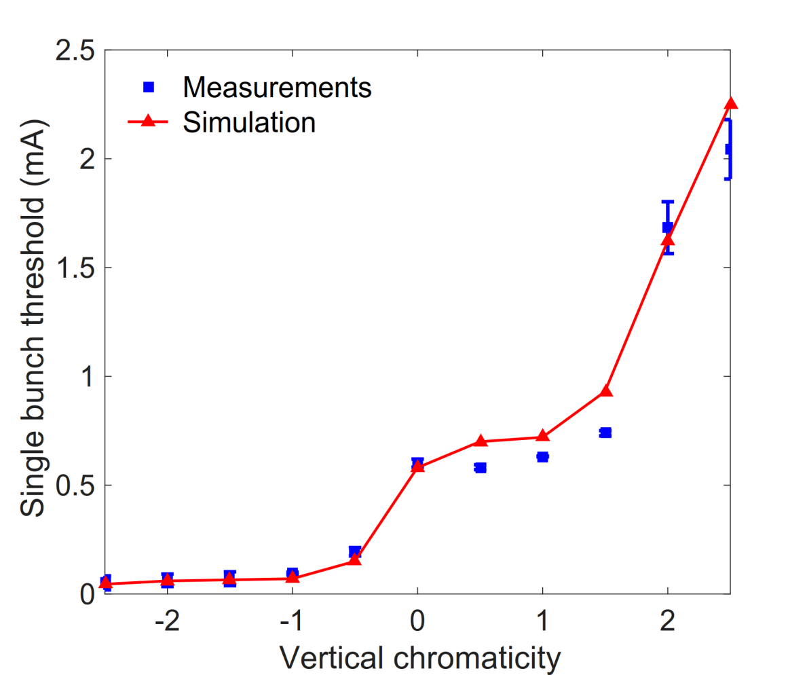
Reproducing Measured Thresholds with Simulations without Feedback
Impedance model in sbtrack used [19]
Very good agreement between measurements and simulations for various chromaticities
Next Generation Beam Position Acquisition and Feedback Systems
12-14 November 2018, Barcelona
16

Slide 17
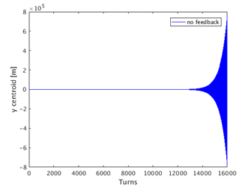
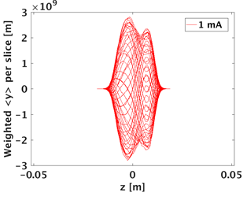
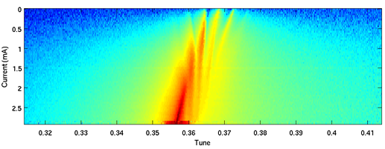
Example 1a: unstable case without feedback
From measurements we saw that for Q’_{y} = 1, the bunch is unstable with 1 mA
Vertical centroid
(simulation)
Head-tail mode -1
(simulation)
sbtrack predicts unstable
bunch for this intensity
m=0
m=+1
m=-1
m=+2
Measurements also reveal head-tail mode m=-1 unstable at 1 mA
m=-2
Next Generation Beam Position Acquisition and Feedback Systems
12-14 November 2018, Barcelona
17

Slide 18
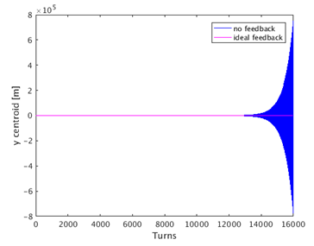
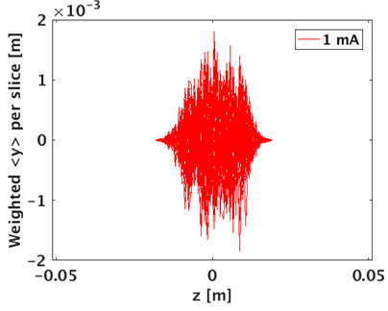
Example 1b: with ideal feedback
No feedback
Ideal feedback
Next Generation Beam Position Acquisition and Feedback Systems
12-14 November 2018, Barcelona
18

Slide 19
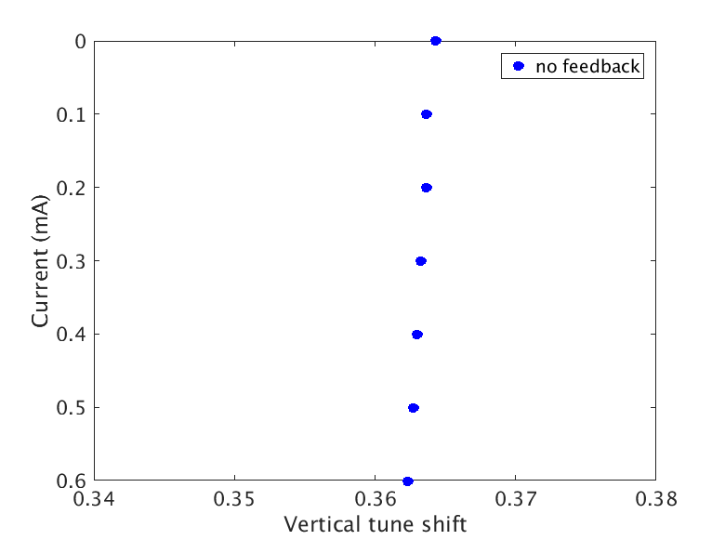
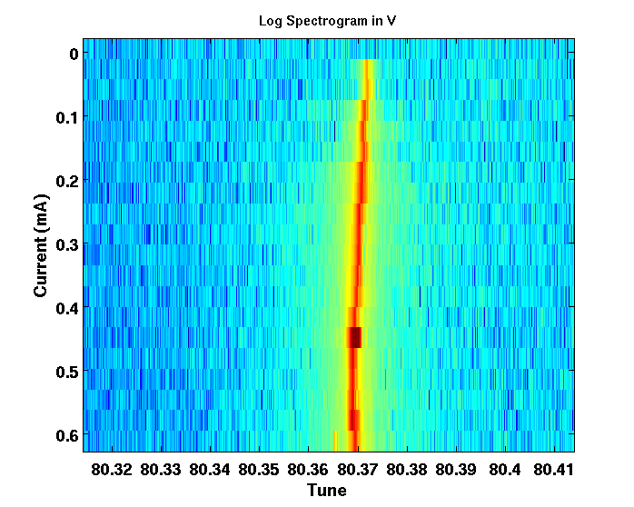
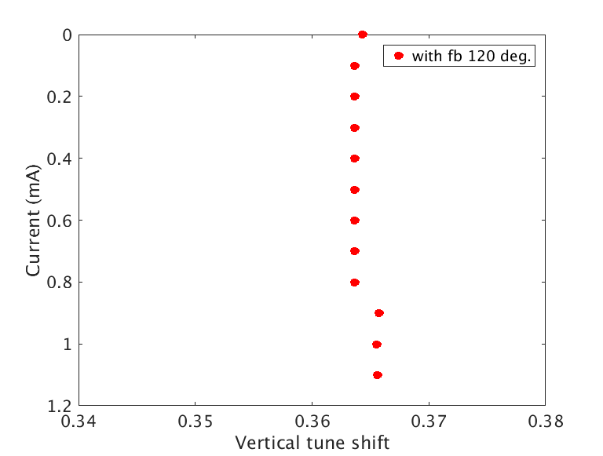
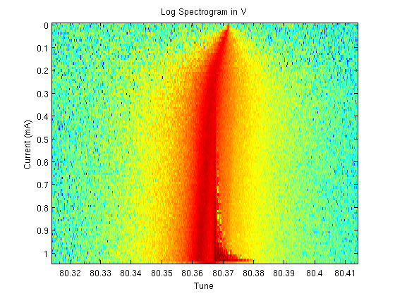
Example 2: different phase of TMFB
Simulations
Measured
No feedback
TMCI
~0.6 mA
TMCI 0.61 mA
Feedback with
120° phase
TMCI
~1.1 mA
TMCI 1.04 mA
Next Generation Beam Position Acquisition and Feedback Systems
12-14 November 2018, Barcelona
19

Slide 20
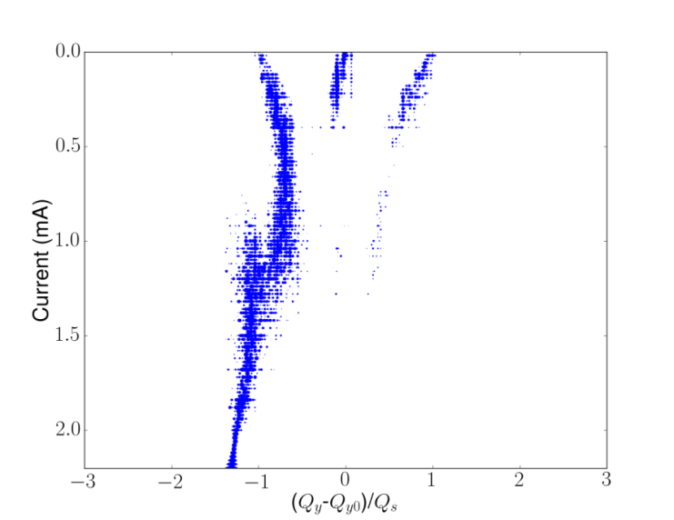
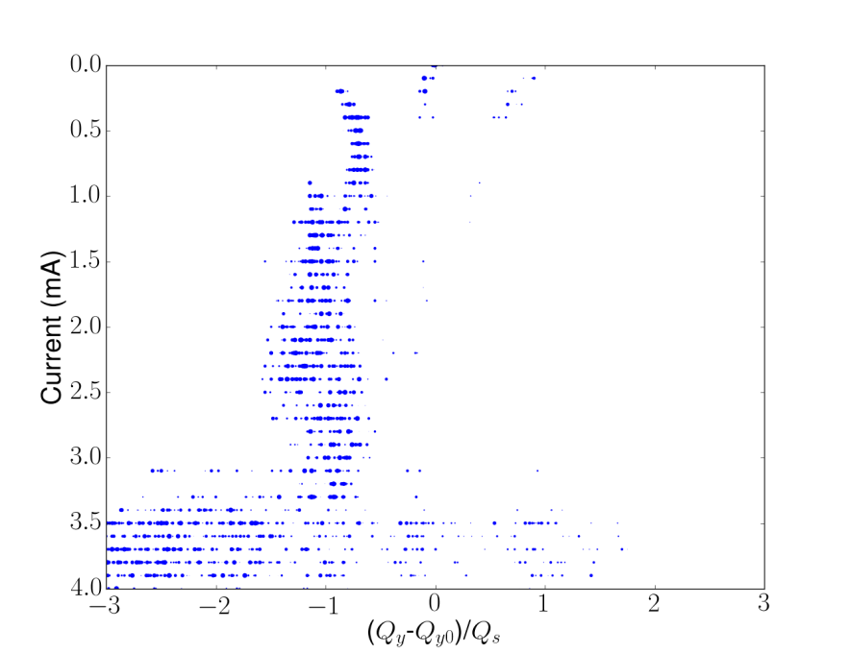
Example 3: positive chromaticity
Simulations
Measured
m=0
No feedback
m=-1
m=+1
m=-2
Thresh. ~2.1 mA
Thresh. ~2 mA
m=0
Feedback with
180° phase
m=-1
m=+1
m=-2
Does not predict so clearly the m=-3 and threshold is bit higher ~3 mA
Thresh.
~2.5 mA
Next Generation Beam Position Acquisition and Feedback Systems
12-14 November 2018, Barcelona
20

Slide 21
Summary
Measurements
The nominal resistive feedback has a beneficial effect on the instability thresholds for both negative and positive chromaticities
By adjusting some of the feedback settings one can maximize its performance and increase the TMCI threshold
Changing the feedback phase increases the instability thresholds, but no unique phase works best for all chromaticities (similar conclusion with studies at ALS by J. Byrd [16])
A factor of two higher single bunch current can be stored while keeping the same operational chromaticity (Q’_{y}=2), useful for the hybrid mode
Modeling of TMBF
Ideal feedback model and one with variable phase and gain, considering previous turns has been implemented
First tests show promising results with improvements to be made
Next Generation Beam Position Acquisition and Feedback Systems
12-14 November 2018, Barcelona

Slide 22
References
[1] J.H.Wang et al., in Proc. PAC’07, Albuquerque, USA, June 2007, paper MOPAN053.
[2] H.S. Kang et al., in Proc. PAC’01, Chicago, USA, Aug. 2001, paper TPAH302.
[3] R. Nagaoka et al., in Proc. PAC’07, Albuquerque, USA, June 2007, paper MOPAN009.
[4] M. Dehler et al., in Proc. EPAC’04, Lucerne, Switzerland, July 2004, paper THPLT019.
[5] W. Barry et al., in Proc. PAC’95, Dallas, Texas, USA, May 1995, paper RAE13.
[6] G. Rehm, M.G. Abbott, and A.F.D. Morgan, in Proc. IBIC’14, Monterey, CA, USA, Sept. 2014, paper WEPD24.
[7] W. Cheng et al., in Proc. IBIC’14, Monterey, CA, USA, Sept. 2014, paper WEPD27.
[8] I. Uzun, M. Abbott, M.T. Heron, A. Morgan, and G. Rehm, in Proc. ICALEPCS’11, Grenoble, France, Oct. 2011, paper MOPKS027.
[9] I. Uzun, M. Heron, A. Morgan, and G. Rehm, in Proc. International Conference on Field
Programmable Logic and Applications 2010, Milano, Italy, Aug. 2010.
[10] R. Bartolini, R. Fielder, G. Rehm, and V. Smaluk, in Proc. IPAC’16, Busan, Korea, May 2016, paper TUPOR013.
Next Generation Beam Position Acquisition and Feedback Systems
12-14 November 2018, Barcelona
22

Slide 23
References
[11] S. Myers, in Proc. PAC’87, Washington DC, USA, Mar. 1987.
[12] E. Karantzoulis, and M. Lonza, in Proc. EPAC’06, Edinburgh, Scotland, June 2006, paper THPCH045.
[13] M.M. Karliner et al., in Proc. EPAC’96, Barcelona, Spain, June 1996, paper WEP010G.
[14] R.D. Ruth, in Proc. HEACC’83, Batavia, USA, Aug. 1983, pp.389.
[15] V.V. Danilov, and E.A. Perevedentsev, CERN, Geneva, Switzerland, Rep. CERN-SL 93-38 AP, Sept. 1993.
[16] J. Byrd, and W. Barry, in Proc. Advanced ICFA Beam Dynamics Workshop, Arcidosso,
Italy, Sept. 1996.
[17] A. Burov, Phys. Rev. Accel. Beams, vol. 19, 084402, Aug. 2016.
[18] M.G. Abbott, G. Rehm, and I.S. Uzun, in Proc. ICALEPCS’15, Melbourne, Australia, Oct. 2015, paper MOPGF097.
[19] I. P. S. Martin, E. Koukovini-Platia et al., Phys. Rev. Accel. Beams, vol. 21, 060701, June 2018
Next Generation Beam Position Acquisition and Feedback Systems
12-14 November 2018, Barcelona
23

Slide 24

Thank you for your attention!
Next Generation Beam Position Acquisition and Feedback Systems
12-14 November 2018, Barcelona

Slide 25
Back-up slides
Ideal feedback (assumes 180º phase)
x’ = x’ – g_{x} * x̅’
y’ = y’ – g_{y} * y̅’, where g_{y} is the gain
Realistic feedback (phase can vary, takes into account previous turns)
feedback_filter_taps = 10 % number of taps for the feedback filter
phi_y_deg = 180
The code calculates the fractional part of the tune and then calculates the ratio k/m used in the FIR filter (k and m can take any value between 1 and the max. taps of the filter. The ratio should be as close as possible to the fractional tune). A circular buffer stores the average centroid beam position in the current turn and the last m turns, where m is defined in the ratio k/m.
n = 1:8; filter = cos( 2*pi*n*k/m + phi)
y’ = y’ + g_{y} * ( sum (circBuff(2:buffSize). * filter) )
where n is the number of turns stored (automatically calculated), k/m (= 3/8) is the ratio, circBuff stores the current and last 8 turns
Next Generation Beam Position Acquisition and Feedback Systems
12-14 November 2018, Barcelona

Slide 26
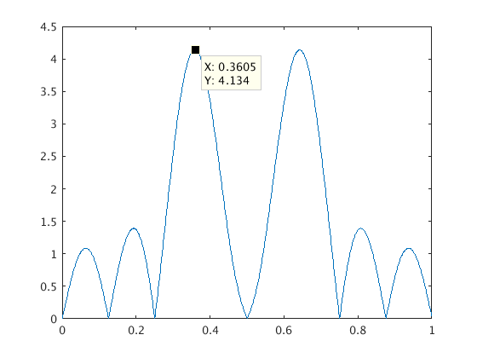
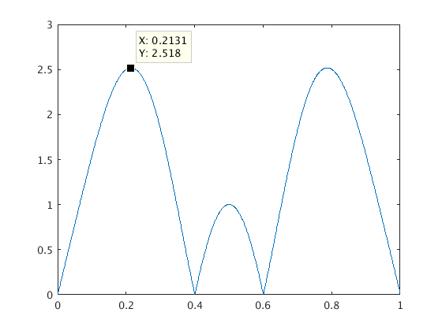
Amplitude Response of the Filter
Vertical
Horizontal
|fft(cos(2π*n*3/8 +φ)|
|fft(cos(2π*n*1/5 +φ)|
Tune
Tune
Check the amplitude response of the filter
Maximum amplitude around the tune point (as it should)
Next Generation Beam Position Acquisition and Feedback Systems
12-14 November 2018, Barcelona
26

Slide 27
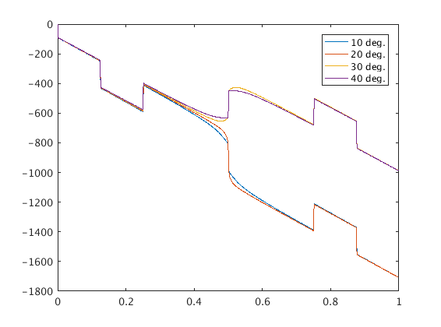
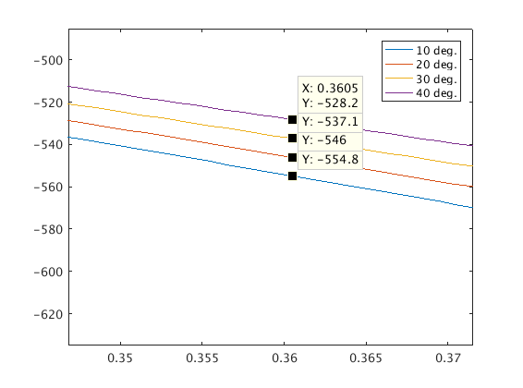
Phase Response of the Filter
Phase angle (degrees)
Phase angle (degrees)
Tune
Tune
The group delay of the amplifier must be as constant as possible, i.e. the phase response must be linear, otherwise the feedback efficiency is reduced for some modes and the feedback can even destabilize
Next Generation Beam Position Acquisition and Feedback Systems
12-14 November 2018, Barcelona
27

