Slide 1
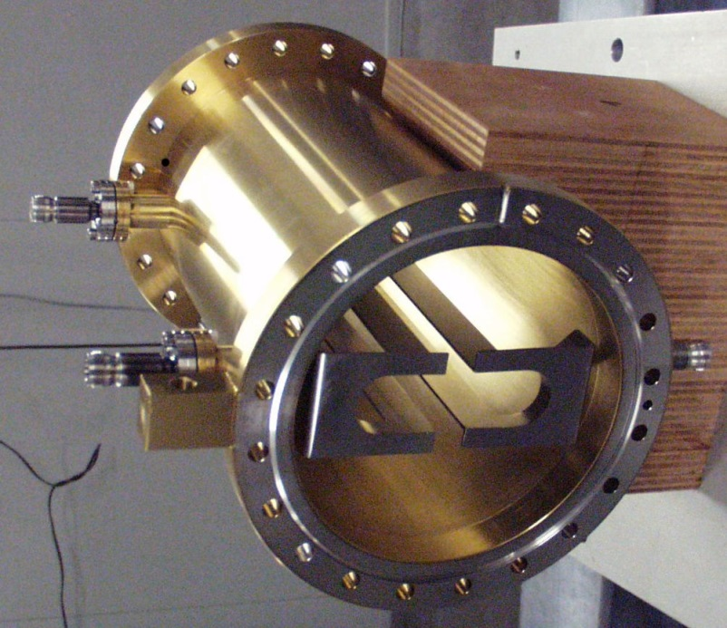
Fast Kickers for Multi Bunch Feedbacks
M. Dehler
Paul Scherrer Institut, Switzerland

Slide 2
Task list
High efficiency, strong kick with reasonable amplifier power
For some applications, transverse homogeneity of kick
Low broad band impedance/short range wake fields
Negligible contributions from higher order modes
No thermal problems with heat up due to wake fields or synchrotron radiation

Slide 3
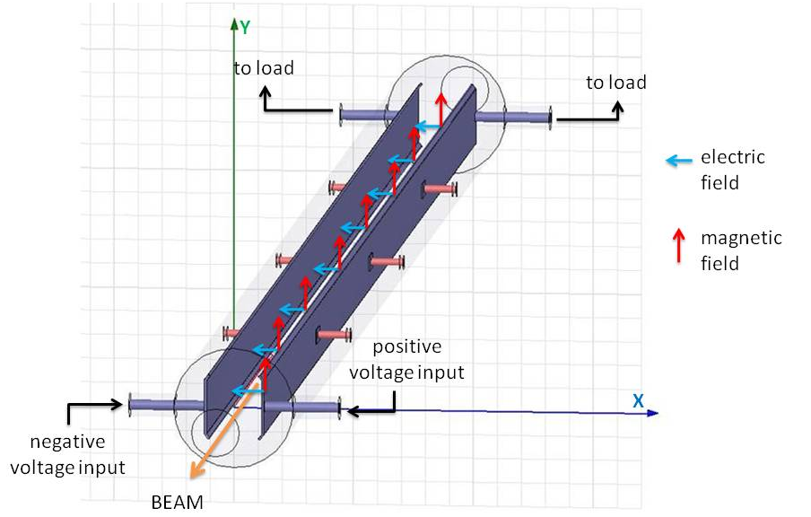
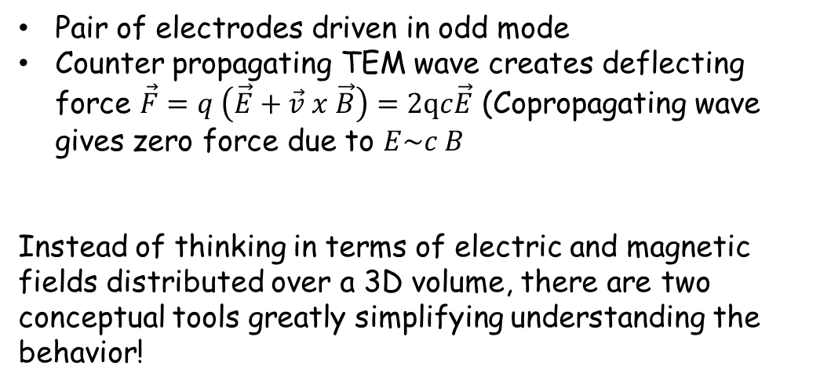
Some Basics
The classical way of thinking about kickers
Pair of electrodes driven in odd mode
Counter propagating TEM wave creates deflecting force $\vec{F}=q \left(\vec{E}+\vec{v} x \vec{B}\right)=2qc\vec{E}$ (Copropagating wave gives zero force due to $E\sim c B$
Instead of thinking in terms of electric and magnetic fields distributed over a 3D volume, there are two conceptual tools greatly simplifying understanding the behavior!
(court. C Belver-Aguilar)

Slide 4
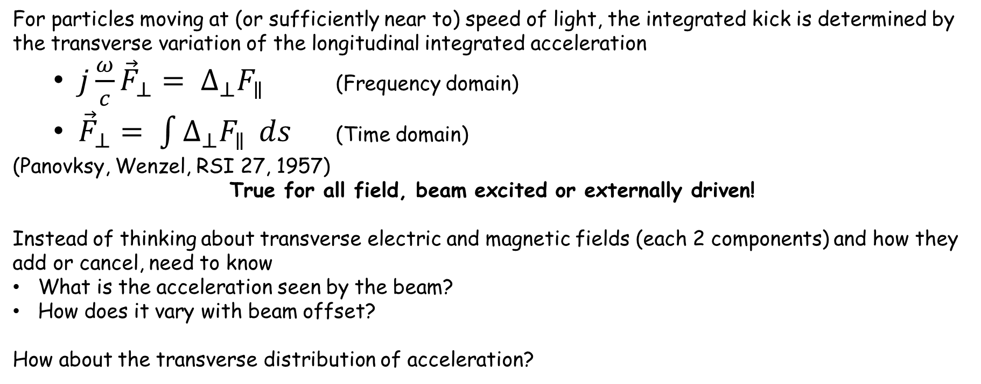
Tool #1: Panovsky Wenzel Theorem
For particles moving at (or sufficiently near to) speed of light, the integrated kick is determined by the transverse variation of the longitudinal integrated acceleration
  $j\frac{ω}{c}{\vec{F}}_{⊥}= ∆_{⊥}F_{∥}$ (Frequency domain)
  ${\vec{F}}_{⊥}= \int{∆_{⊥}F_{∥}} ds$ (Time domain)
(Panovksy, Wenzel, RSI 27, 1957)
True for all field, beam excited or externally driven!
Instead of thinking about transverse electric and magnetic fields (each 2 components) and how they add or cancel, need to know
What is the acceleration seen by the beam?
How does it vary with beam offset?
How about the transverse distribution of acceleration?

Slide 5
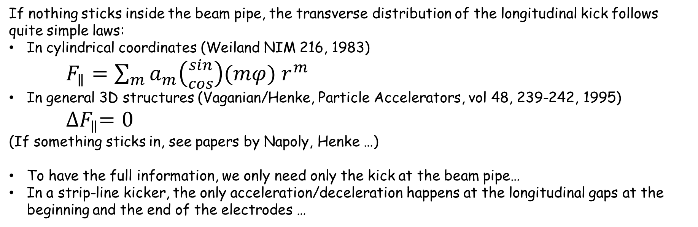
Tool #2: Indirect wake field integration schemes
If nothing sticks inside the beam pipe, the transverse distribution of the longitudinal kick follows quite simple laws:
In cylindrical coordinates (Weiland NIM 216, 1983)
$F_{∥}=\sum_{m}{a_{m}\left({sin \atop cos}\right)(mφ) r^{m}}$
In general 3D structures (Vaganian/Henke, Particle Accelerators, vol 48, 239-242, 1995)
${∆F}_{∥}=0$
(If something sticks in, see papers by Napoly, Henke …)
To have the full information, we only need only the kick at the beam pipe…
In a strip-line kicker, the only acceleration/deceleration happens at the longitudinal gaps at the beginning and the end of the electrodes …

Slide 6
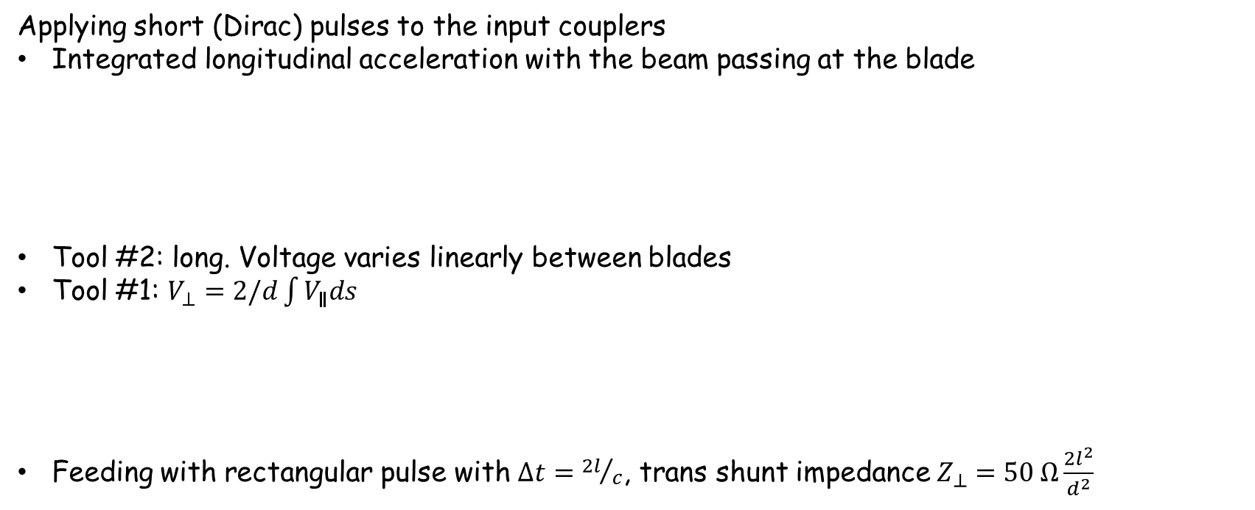
Applying this to the basic kicker
Applying short (Dirac) pulses to the input couplers
Integrated longitudinal acceleration with the beam passing at the blade
Tool #2: long. Voltage varies linearly between blades
Tool #1: $V_{⊥}=2/d\int{V_{∥}ds}$
Feeding with rectangular pulse with $∆t={2l}/c$, trans shunt impedance $Z_{⊥}=50 Ω\frac{{2l}^{2}}{d^{2}}$
V
s
2 l
V
s
2 l
V
s
2 l

Slide 7
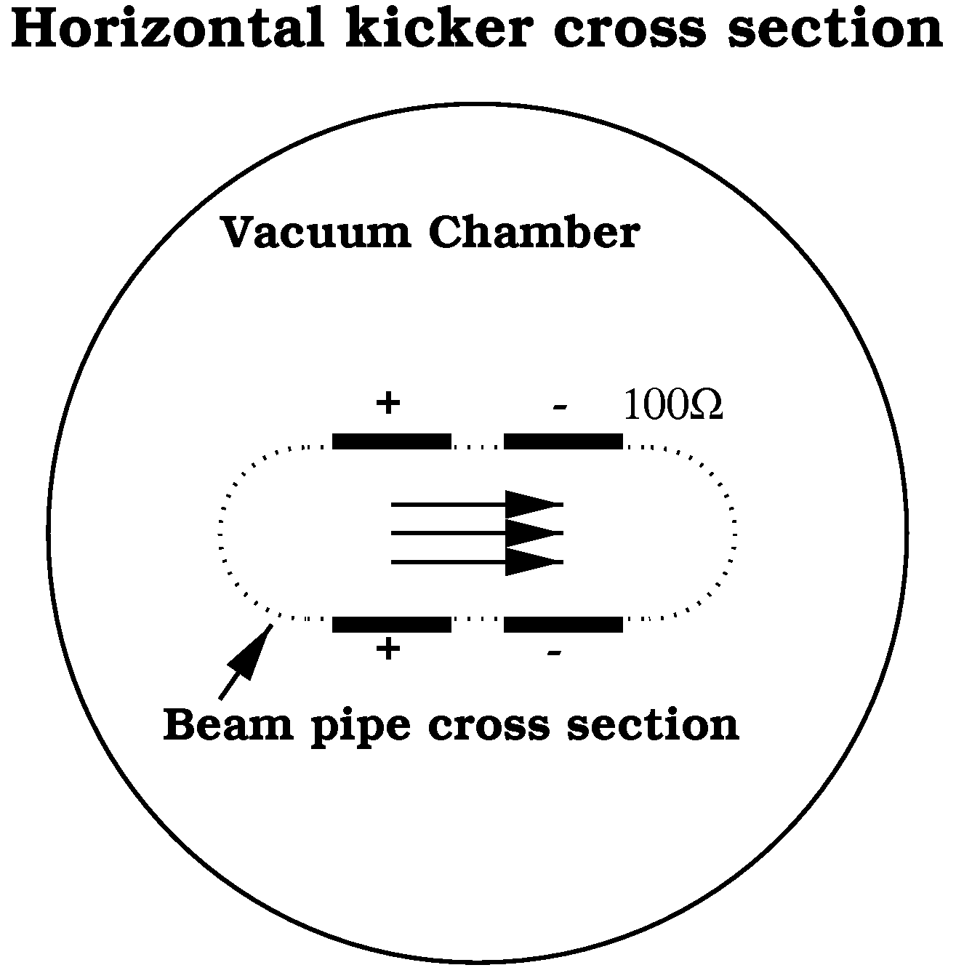

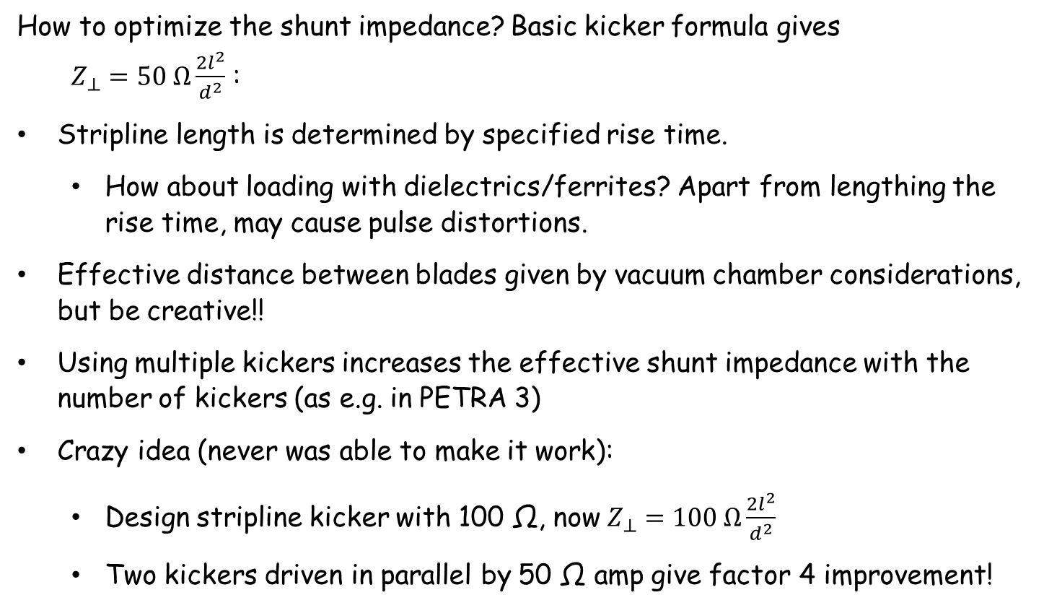
Efficiency
How to optimize the shunt impedance? Basic kicker formula gives $Z_{⊥}=50 Ω\frac{{2l}^{2}}{d^{2}}$ :
Stripline length is determined by specified rise time.
  How about loading with dielectrics/ferrites? Apart from lengthing the rise time, may cause pulse distortions.
Effective distance between blades given by vacuum chamber considerations, but be creative!!
Using multiple kickers increases the effective shunt impedance with the number of kickers (as e.g. in PETRA 3)
Crazy idea (never was able to make it work):
  Design stripline kicker with 100 Ω, now$Z_{⊥}=100 Ω\frac{{2l}^{2}}{d^{2}}$
  Two kickers driven in parallel by 50 Ω amp give factor 4 improvement!

Slide 8
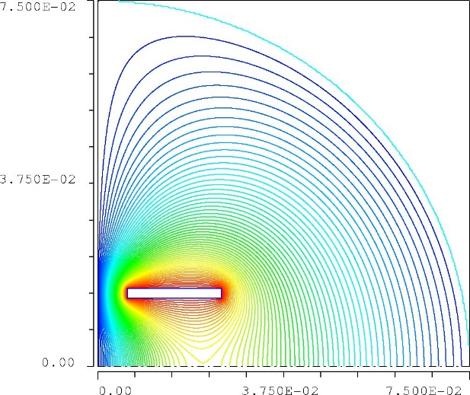
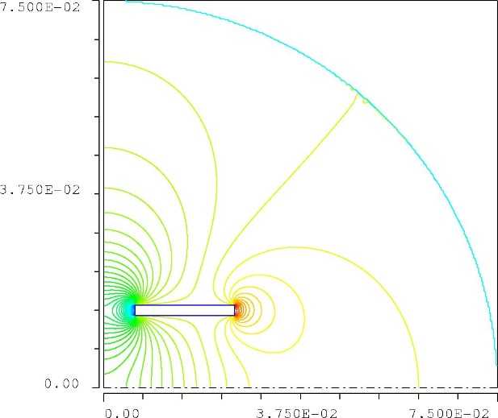
Homogeneity
Standard strategy: maximize shunt impedance
= locate and shape electrode to maximize variation of potential
Isolines of potential (electrodes and wakes..)
Isolines of deflection strength
Should we care about homogeneity of deflection?

Slide 9
Kickers for feedbacks
  With amplifier power of several hundred Watts, we will generate deflections of few µrad, inhomogeneities will account for tens of nrad max.
  Transverse single bunch emittance (even of pm rad) will not be affected, the beam size and so the kick variation over the cross section of the beam is too small.
  A shift in the kick strength due to e.g. orbit variations leads to a change in the open loop gain of the feedback of a few % (= 0.x dB). Variations due to frequency dependencies in the analog signal chain are probably much higher
  No problem at all
Fast injection/extraction system e.g. for swap-out injection
  Deflections much higher (0.8 mrad/kicker for APS-U)
  Needs to do a well defined deflection to work
  Yes, needs to be examined

Slide 10
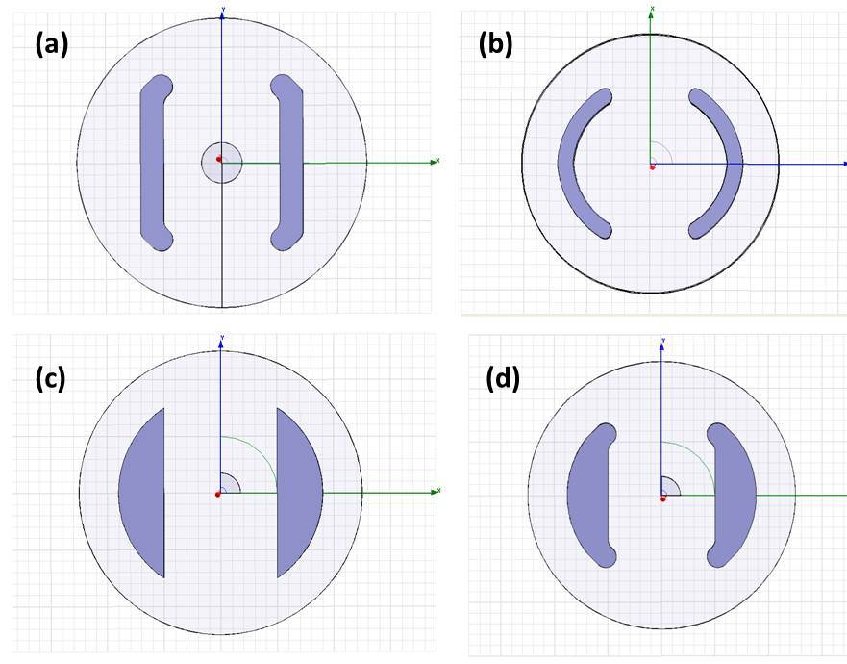
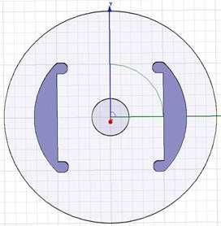
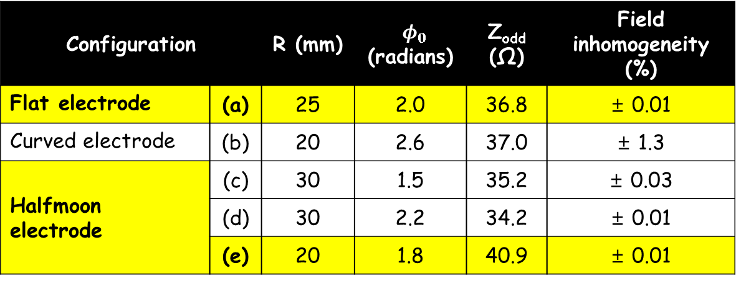
Study of cross sections of kicker electrodes (C. Belver-Aguilar/IFIC, LCWS 2012)
Configuration |  | R (mm) | $φ_{0}$ (radians) | Z_{odd} (Ω) | Field inhomogeneity (%)
Flat electrode | (a) | 25 | 2.0 | 36.8 | ± 0.01
Curved electrode | (b) | 20 | 2.6 | 37.0 | ± 1.3
Halfmoon electrode | (c) | 30 | 1.5 | 35.2 | ± 0.03
 | (d) | 30 | 2.2 | 34.2 | ± 0.01
 | (e) | 20 | 1.8 | 40.9 | ± 0.01
Field inhomogeneity in vicinity of 1 mm around the beam axis
(e)

Slide 11
Short term wakes
What are the sources?
Possibly tapers from the beam pipe cross section to that of the kicker (So - do you really need these specially shaped electrodes?)
Longitudinal gaps at beginning and end of the electrodes (You remember tools #1 and #2 a few slides before, do you?).By the way, we also need to connect to the feedthroughs …

Slide 12


Some basic things about wakes in small gaps
(a)
(b)
$$h\overset{→}{}∞$$
$$h=l$$
Beam pipe wall
Q
Q
Dirac (=ultra short bunch) wake fields
V
V
s
s
2 l
In case (a), the bunch will (mainly) irradiate into the gap, the resulting impedance will be resistive with an increase in the loss factor and a none to negligible increase in |Z/n|
Case (b) will be also resistive for very short bunches (length << 2 l), since the bunch has already passed, when the reflection comes back.
In Case (b), with a bunch length similar to the gap height, energy radiated by the head is fed into the tail, the impedance is reactive affecting |Z/n| (microwave instability threshold …)
Sometimes a deeper gap is better …

Slide 13
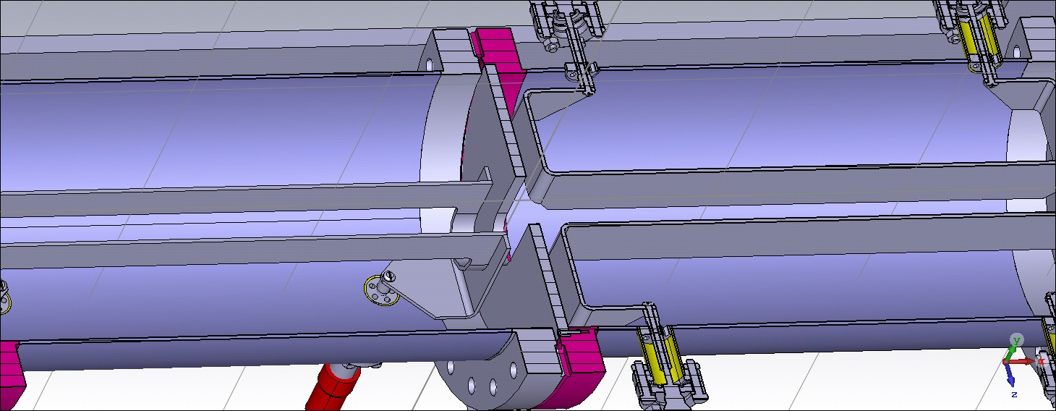

Slide 14
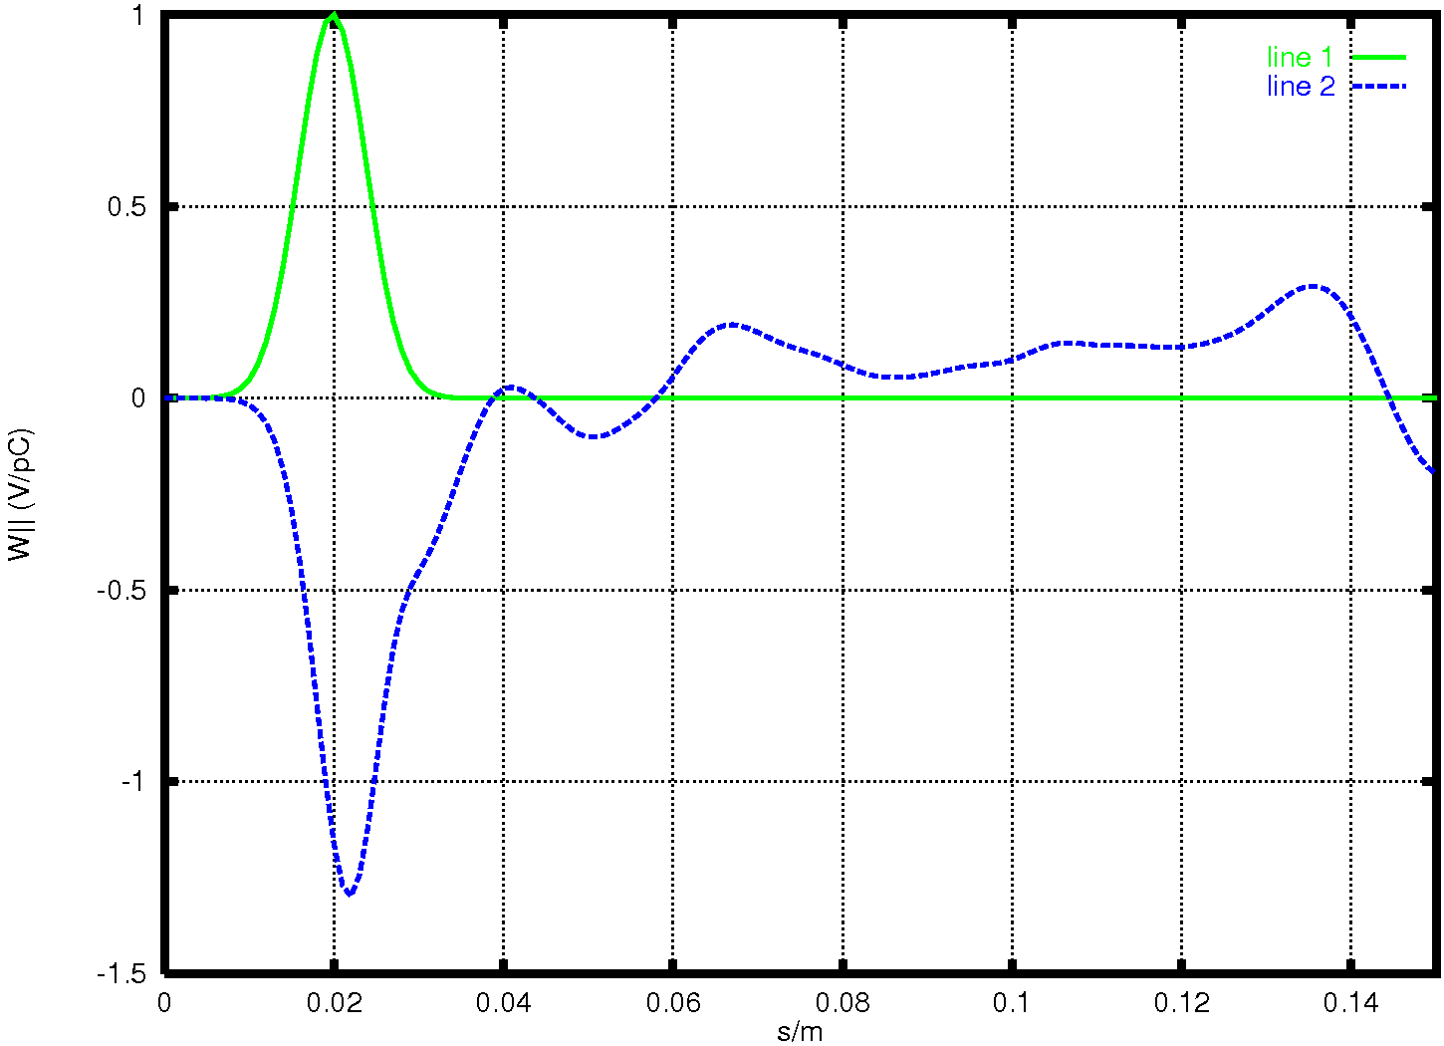
Single bunch wake for horizontal kicker of SLS

Slide 15
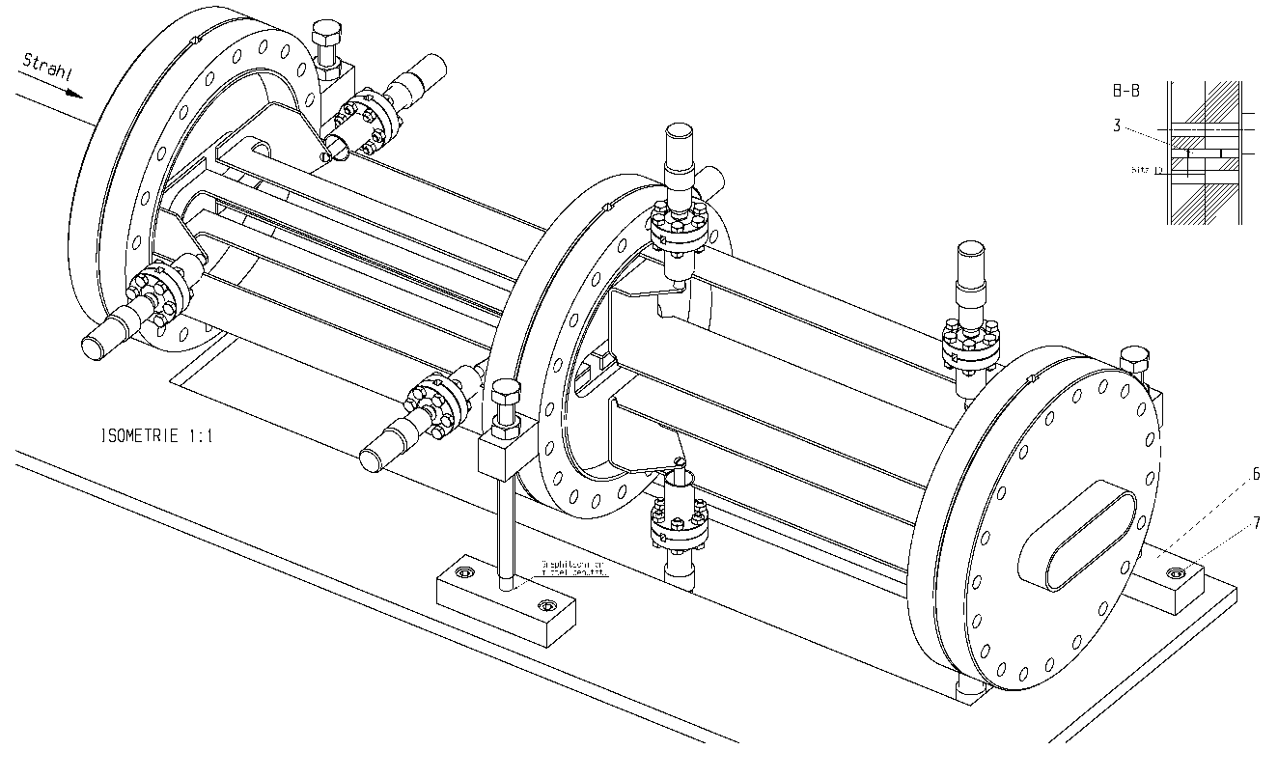
(Generally) Useful:
Subadditive combination of wakes by close positioning
Passing a gap (of a kicker, BPM, …), the self field of the bunch is getting diffracted and needs some time (=distance along trajectory) to recover.
A second perturbation/gap encountered within this recovery time will have a reduced wake field/loss factor/Z over n

Slide 16
Higher order modes
How about longitudinal modes?
The kicker is a three conductor system – 2 blades and the surrounding tank: we have two TEM modes:
Odd mode
Even mode
+Vk
+Vk
-Vk
+Vk
Gnd
Gnd
The odd mode, used for deflection, is well matched by definition.
But the even mode (responsible for the longitudinal coupling at lower frequencies) typically has an elevated impedance (typically 60-70 Ω) and will not be matched.

Slide 17
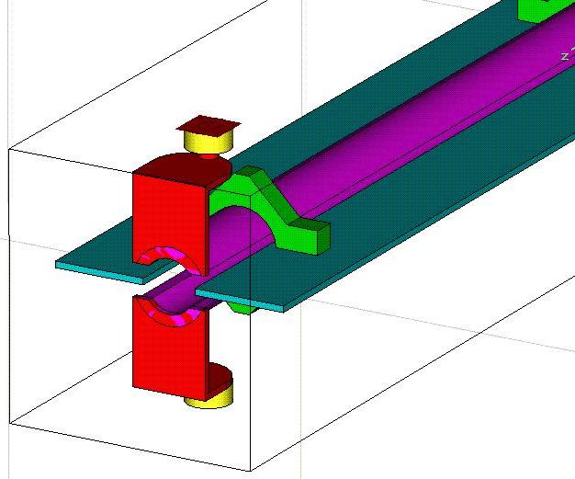
If you worry about even mode impedance, best strategy to decouple blades by introducing shielded side vanes
Stripline kicker for intra bunch train feedback at FLASH/EXFEL
(Dehler et al, BIW ‘08)
Kicker for swap-out injection at APS-U
(Yao et al, IPAC’15)

Slide 18
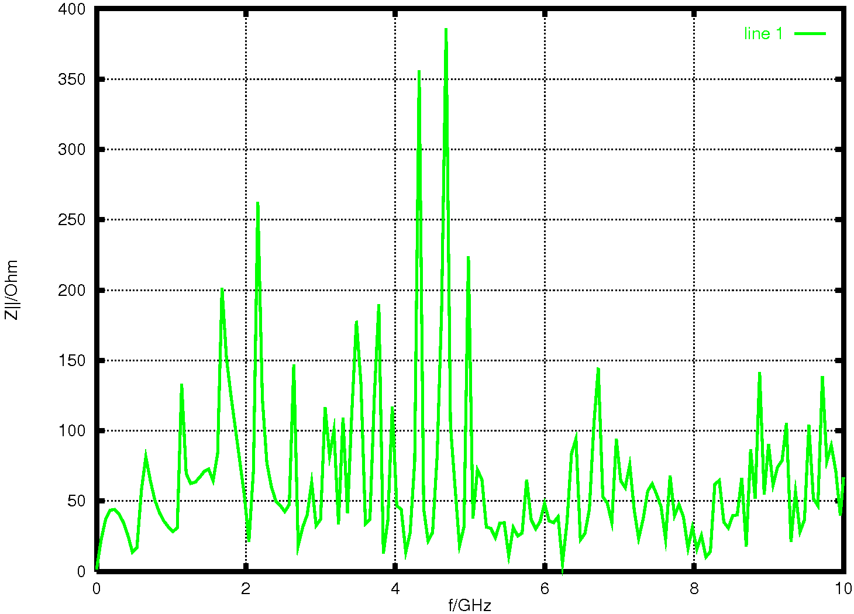
With lots of power couplers, all HOMs should by damped quite strongly, right?
Impedance (FFT from a long range wake calculation) for the horizontal kicker/SLS
(Loaded Q’s actually underestimated …)

Slide 19
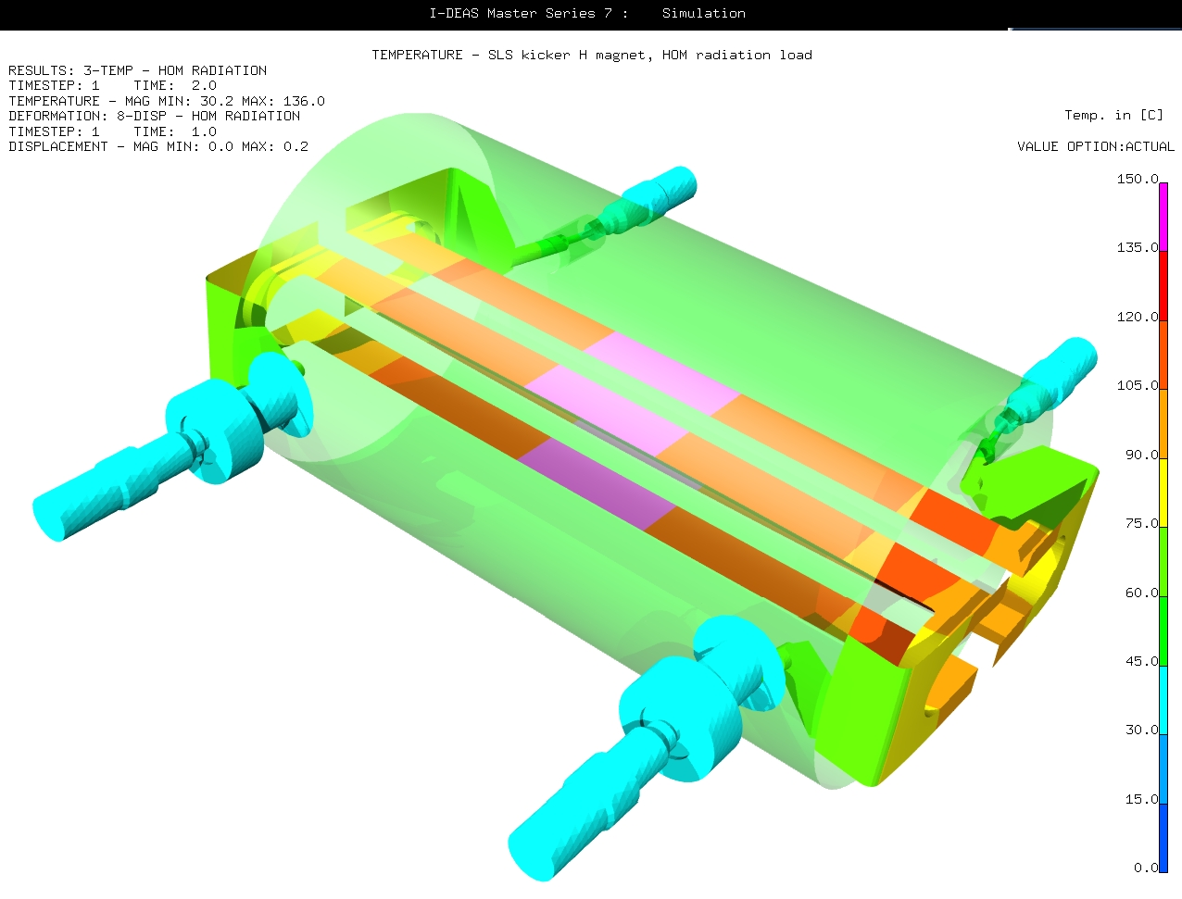
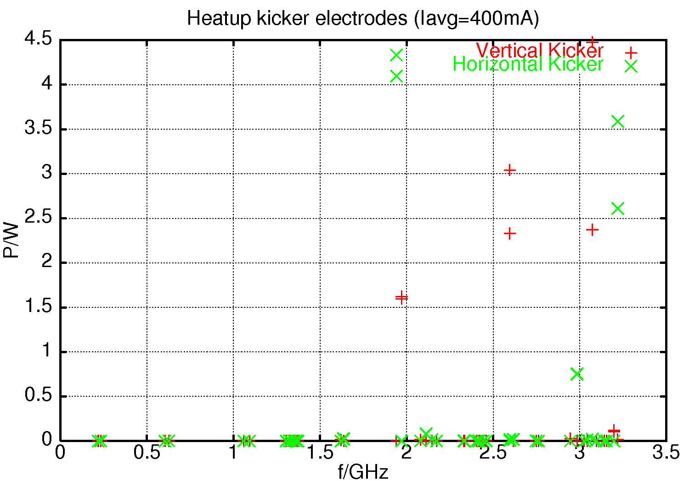
The electrodes (and possibly the ground vanes) shield the beam quite well, so CBI excitation via HOMs is not a big topic, but the electrodes are relatively well thermally isolated and need to absorb part of the HOM power
Temperature distribution assuming 16 W HOM power absorption by the blades

Slide 20
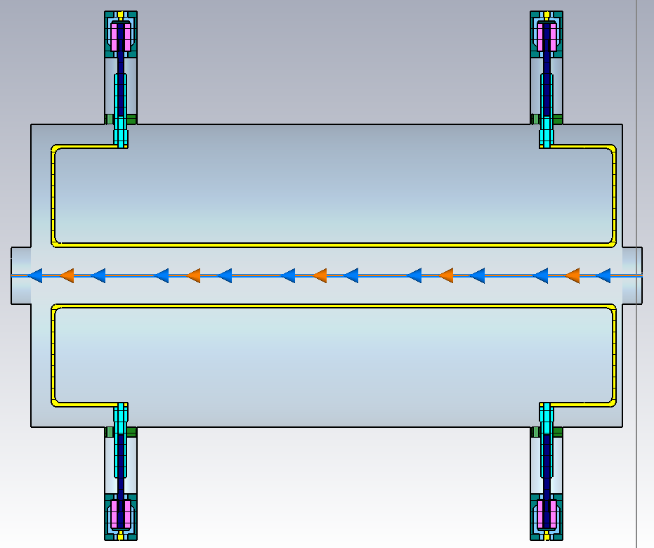
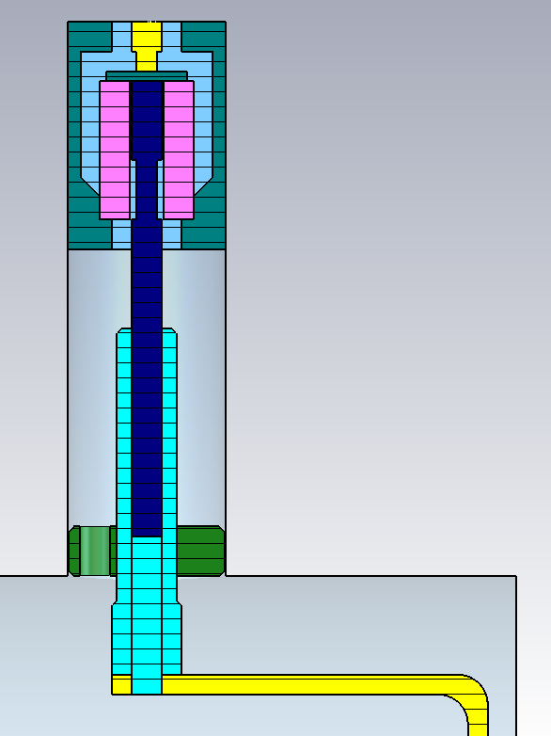
Stripline power distribution
Thermal troubles with virtually the same kicker at Diamond
(slide court. G Rehm, A. Morgan)
0.36W / 0.87W
3W / 7.25W
6.24W / 15.1W
0.5W / 1.2W
Power lost into structure
24W @ 300mA 686 bunches
58W @ 500mA 686 bunches
Plus 2.9W / 7W delocalised loss

Slide 21
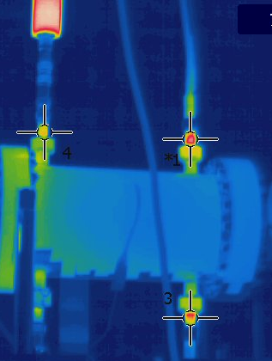
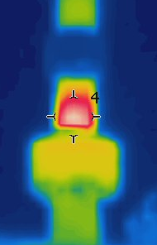
Measurements with 300mA stored beam
52ºC
Differences to SLS:
Different bunch spectrum (shorter bunches)
Vacuum feedthroughs with COVAR conductors (bad conduction)
?
Situation currently stable, since no 600 mA operation planned
66ºC
~27ºC
~27ºC
55ºC
69ºC
45ºC

Slide 22
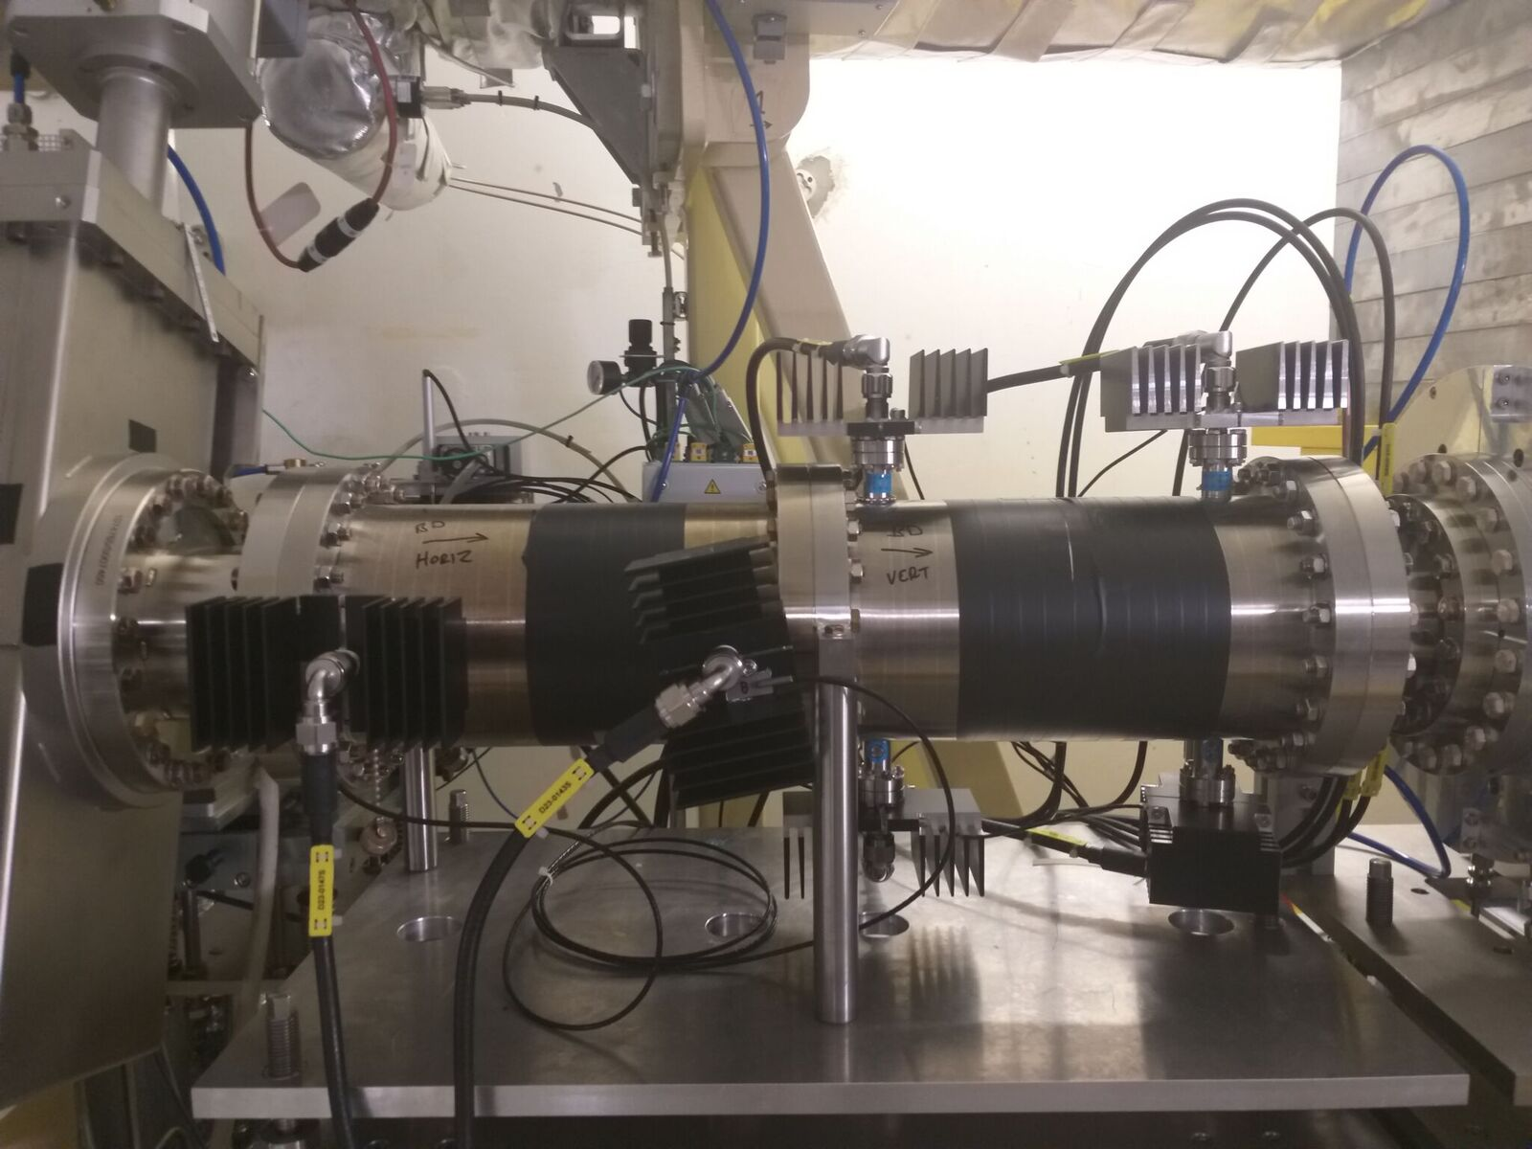
DIAMOND: Just to be on the safe side

Slide 23
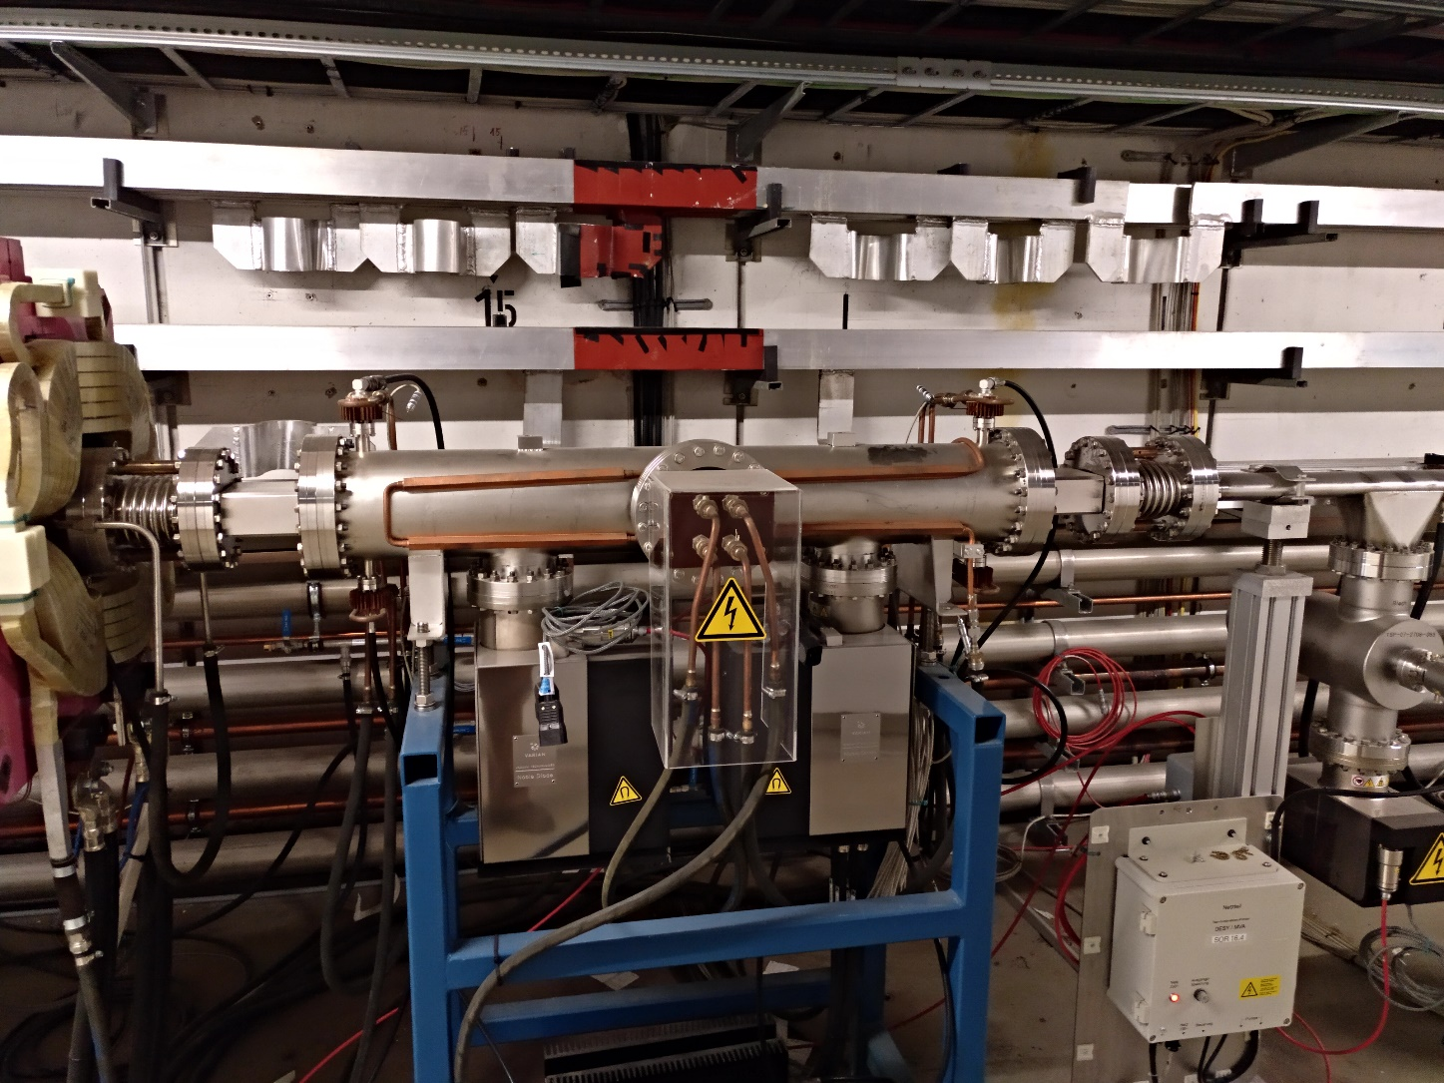
Petra III: Fully water cooled
(pictures court. R. Wanzenberg/F. Obier)
Length | 1 m
Bandwidth | 130 MHz
# of kicker | 2/plane
Rshunt | 30 kΩ
Deflection (P=250W) | 1 µraq

Slide 24
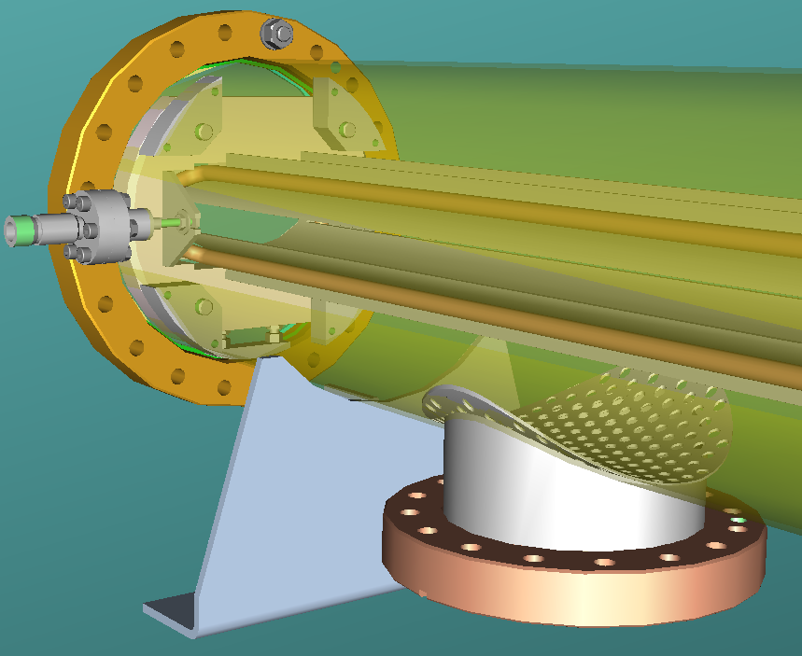
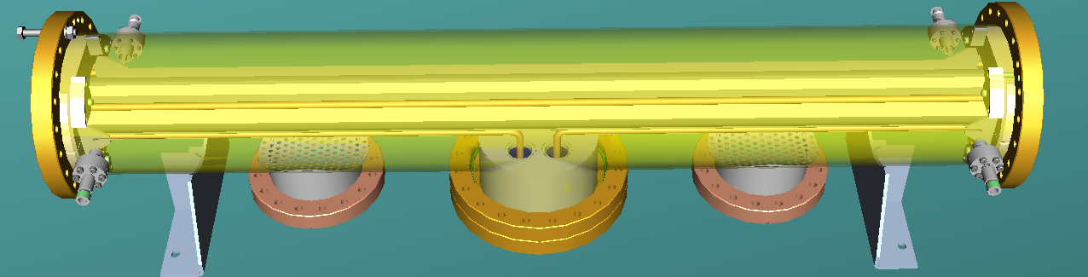
Active cooling of the blades via in-vacuum cooling system
Probably even OK with thermal heating by synchrotron radiation!

Slide 25

To finish
There is no ‘one size fits it all’ design, always machine specific solutions
Efficiency optimization, typically easiest task
Be careful about impedance ffects, specially long range
Even more concerning thermal effects
Thanks for your attention!!

