Slide 1
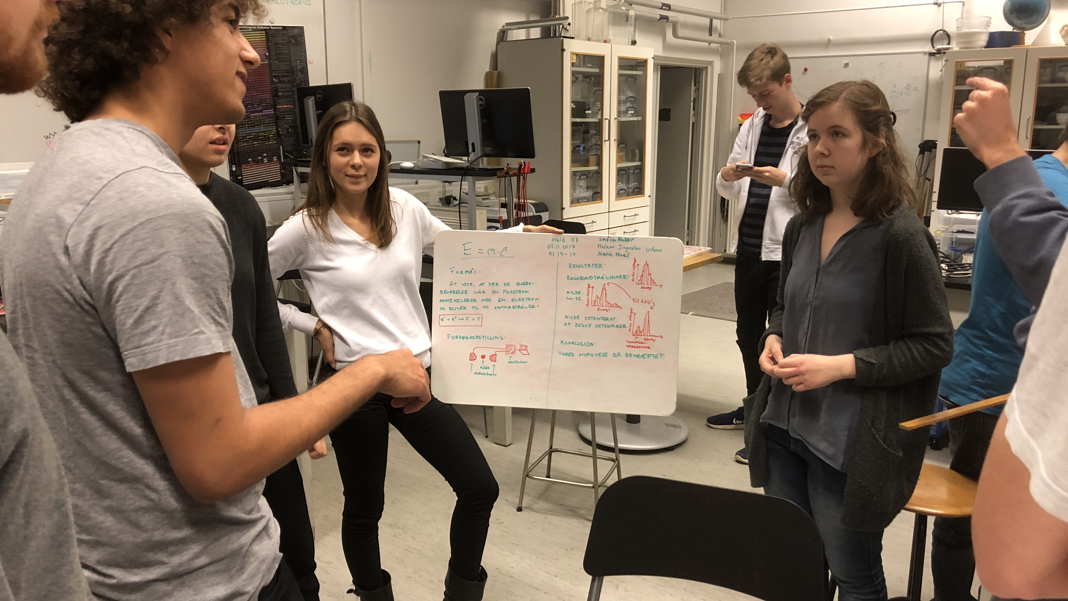
Low Cost Gamma Ray Detectors for Outreach and Education
I.G. Bearden
Experimental Subatomic Physics
EPIC
Niels Bohr Institute

Slide 2
PLAN
INTRODUCTION:
  What I will talk about
  Why I am talking about this
  Context in which this has been done
WHAT IS ”AVAILABLE”?
  A quick non-objective, non-exhaustive market ”survey”
THE NICE-NBI SOLUTION
  DAQ
  HOW TO BUILD A 100€ Gamma Spectrometer
  Mini PET Scanner
NEXT STEPS

Slide 3
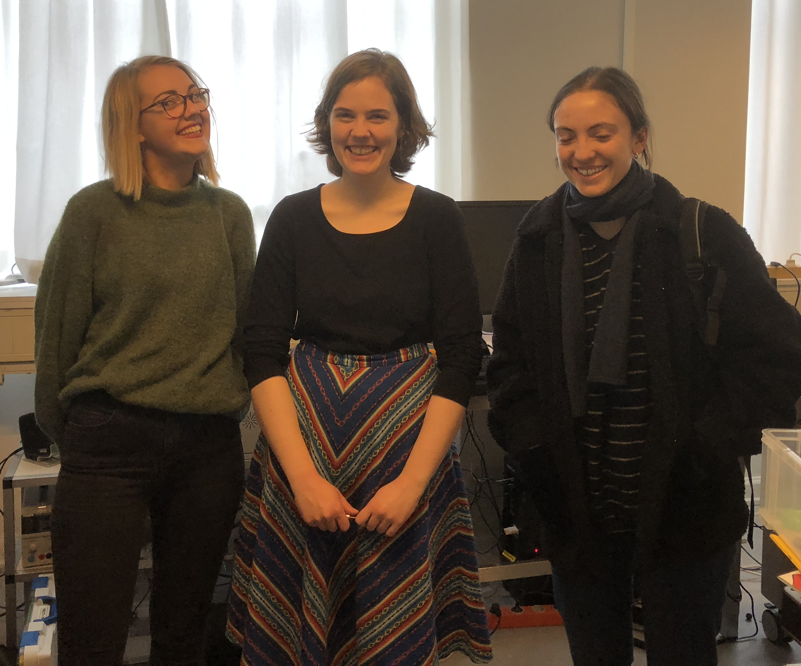
THE TEAM
Jo Verwohlt Damm
Axel Boisen
IGB
Marta Mrozowska

Slide 4
PLAN
INTRODUCTION:
  What I will talk about
  Why I am talking about this
  Context in which this has been done
WHAT IS ”AVAILABLE”?
  A quick non-objective, non-exhaustive market ”survey”
THE NICE-NBI SOLUTION
  DAQ
  HOW TO BUILD A 100€ Gamma Spectrometer
  Mini PET Scanner
NEXT STEPS

Slide 5
What I will talk about:
Simple detectors for Nuclear and Particle physics
Designed and built in-house (collaboration* between IGB and Axel Boisen from NBI’s fantastic electronics shop)
Design goals:
  AS INEXPENSIVE AS POSSIBLE
  ROBUST (to be used in both our teaching and outreach labs)
  AS FEW ”black boxes” AS POSSIBLE
BASED on rather new tech (Silicon Photomultipliers) as well as old (GM tubes, PMTs) depending on the purpose.
*Typically: IGB : ”I wonder if we could find a way to…” Axel, next day: ”Yes, like this. I made it for you”
Not all heroes wear capes, you know,

Slide 6
Why this?
I am an experimental physicist.
PhD & first post-doc: high-spin gamma spectroscopy
Since then: Ultrarelativistic Heavy Ion Physics (presently: ALICE@LHC)
Teaching: I want to give students ”real” experimental experience as early as possible
Outreach: I want to finds ways to make the words ”nuclear” and ”radiation” less mysterious and frightening.

Slide 7
Context

Slide 8
Denmark
5.6 Mpeople
1/2 the size of Austria
  (unless we count Greenland)
No tuition (also for EU residents)
State stipend of 5500DKK

Slide 9

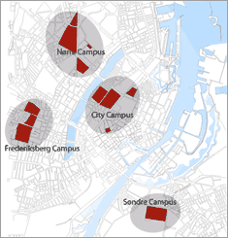
University of Copenhagen
Roughly 40 kStudents
7000 faculty & staff

Slide 10
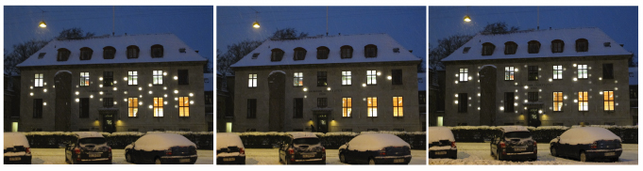
Niels Bohr Institutet
Physics department of KU
~85(?) tenured faculty
~115 PhD students
~120 Post Docs
~600 students BSc&MSc students
155±10 new students/year. All physics majors (various ”specializations” bio, astro,geo…)

Slide 11
Aside
Colliderscope: available from iTunes
Data from ATLAS inner tracker

Slide 12
Curriculum
Bologna 3+2 (+3)
In DK secondary shools
3 levels (A,B,C)
Our students have had
Math: A
Phys: A or B**
Chem: A or B
At least 2 of these A
**quite a bit of laboratory work. In principle, well prepared for uni lab work.

Slide 13
PLAN
INTRODUCTION:
  What I will talk about
  Why I am talking about this
  Context in which this has been done
WHAT IS ”AVAILABLE”?
  A quick non-objective, non-exhaustive market ”survey”
THE NICE-NBI SOLUTION
  DAQ
  HOW TO BUILD A 100€ Gamma Spectrometer
  Mini PET Scanner
NEXT STEPS

Slide 14
MARKET ”SURVEY”:commercial
Many commercially available nuclear/particle physics detector systems.
Both ”research” and ”educational” solutions.
Many of these are very good…BUT
Typically,* ”educational” solutions are expensive and not terribly flexible systems, often dependent on proprietary software.
*there may be some that are reasonably priced and open source that I have not found.

Slide 15
MARKET ”SURVEY”:commercial
CAEN offers several nice packages, but 5-8k€/setup.
Canberra offers good NaI+Integrated base, 4k€+closed software.
”legacy” research equipment often requires expensive HV, DAQ, etc.
Difficult to have large scale lab teaching based on these

Slide 16
MARKET ”SURVEY”:Open Source
$100* Cosmic ray detector ”Cosmic Watch” MIT (SiPM coupled to plastic scintillator) NEW: SensL offers $60 SiPM for students
MUON HUNTER based on inexpensive commercial electronics and 2 GM tubes in coincidence. Working system for ≈150€, depending on availability GM tubes, etc.
A number of web resources explaining how to build various detectors…(probably more applicable to hobbyists than to large scale lab teaching)
*$100 if you don’t have to buy scintillator

Slide 17
PLAN
INTRODUCTION:
  What I will talk about
  Why I am talking about this
  Context in which this has been done
WHAT IS ”AVAILABLE”?
  A quick non-objective, non-exhaustive market ”survey”
THE NICE-NBI SOLUTION
  HOW TO BUILD A 500€ PET SCANNER
NEXT STEPS

Slide 18
PLAN
INTRODUCTION:
  What I will talk about
  Why I am talking about this
  Context in which this has been done
WHAT IS ”AVAILABLE”?
  A quick non-objective, non-exhaustive market ”survey”
THE NICE-NBI SOLUTION
  DAQ
  HOW TO BUILD A 100€ Gamma Spectrometer
  Mini PET Scanner
NEXT STEPS

Slide 19
IN-HOUSE Detectors for N&P Phys.
Generous support from NICE* and the Experimental SubAtomic Physics group at NBI
Support from NBI (technical infrastructure)
Fantastic students
ALLOW:
  NBI BiGS (BILLIGE GAMMA SPECTROMETER)
  Muon telescopes based on both SiPM+Scint & GM-tubes
  Alpha and beta spectroscopy (in development)
*Denmark’s National Instrument Center for CERN Experiments

Slide 20
DAQ
100MS/s USB Oscilloscope, Logic Analyzer and Variable Power Supply
Connects via USB
Works on Mac, Windows, Linux
Scripting language, allows for some real time signal processing
$279 ($179 academic) +$15 BNC breakout

Slide 21
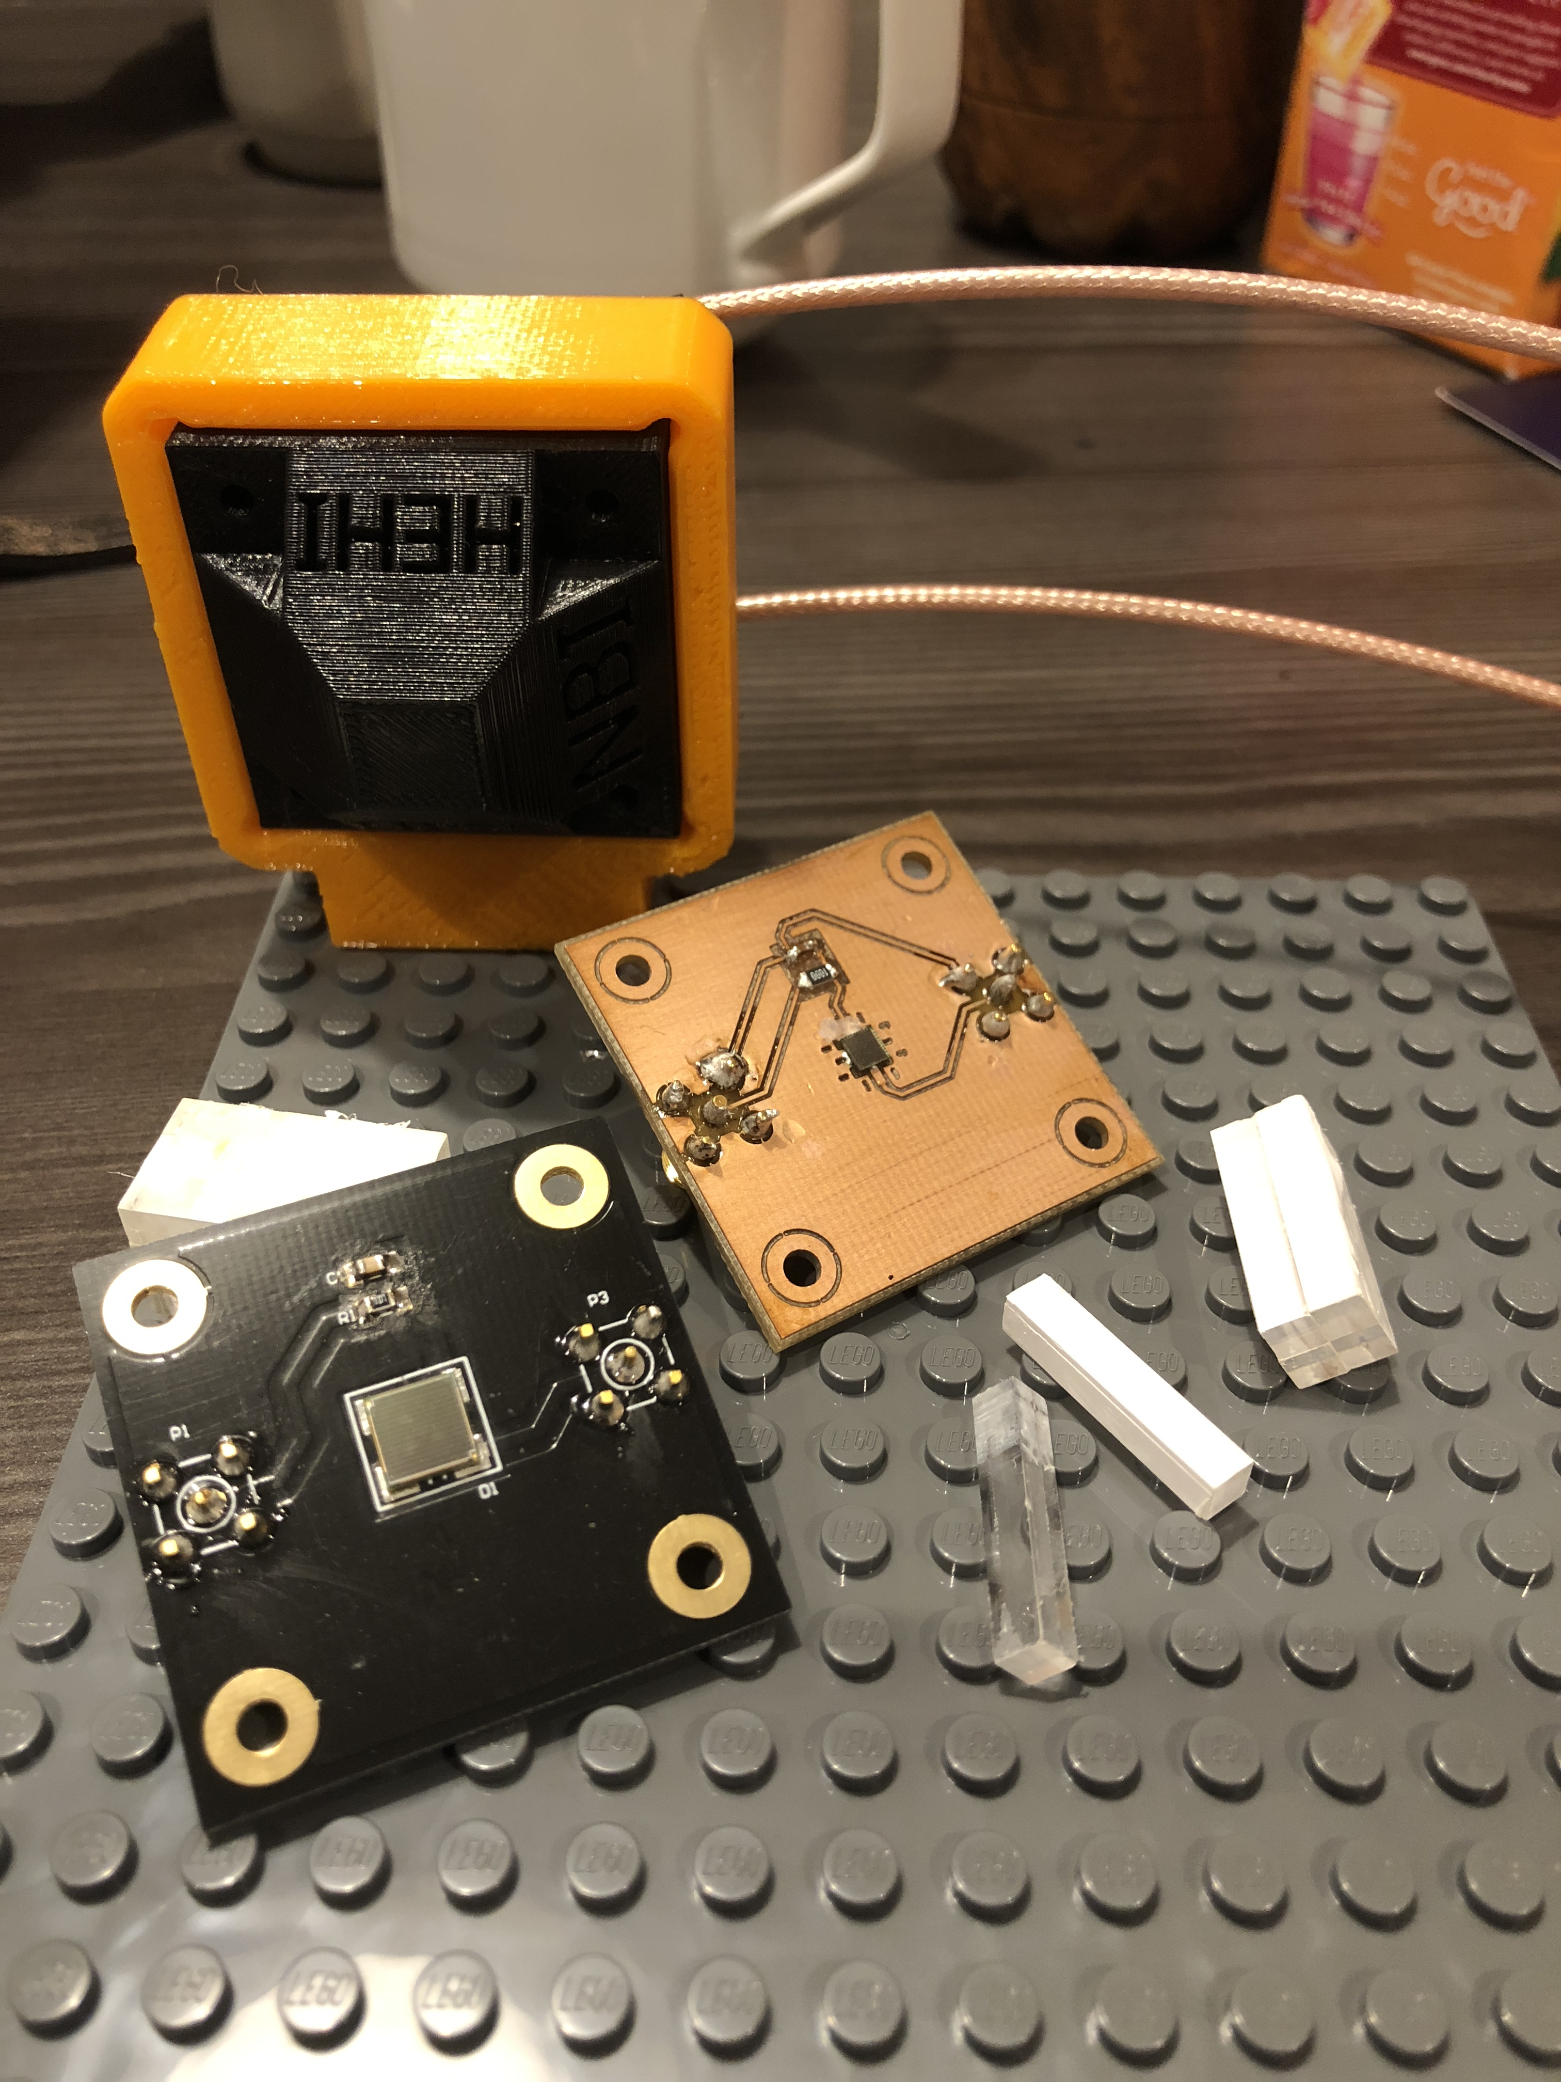
The 100€ γ spectrometer (BiGS)
Optical
Grease
SiPM
PCB
LYSO
3D printed cover

Slide 22
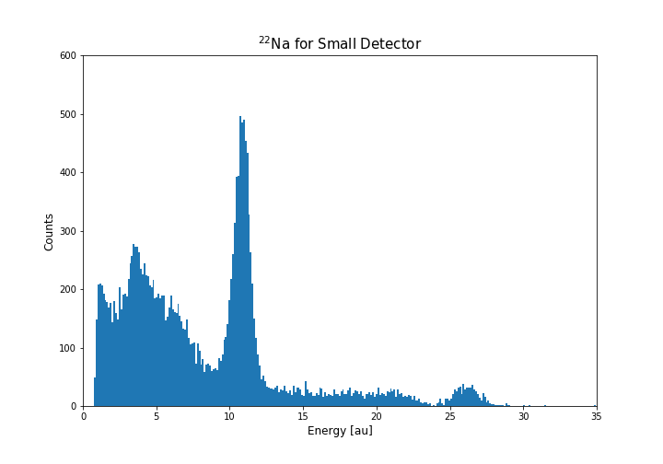
The 100€ γ spectrometer (BiGS)
Singles spectrum ²²Na:
Optical
Grease
SiPM
PCB
LYSO
²²Na source
3D printed cover

Slide 23
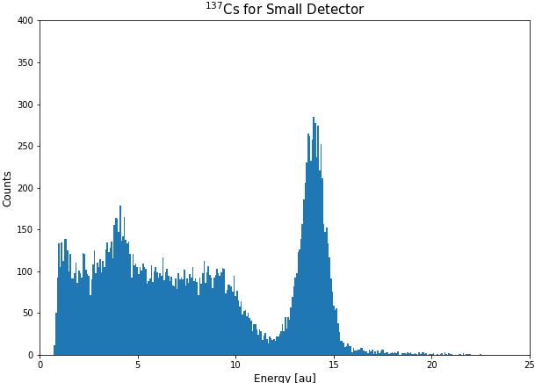
The 100€ γ spectrometer (BiGS)
Singles spectrum ¹³⁷Cs:
Optical
Grease
SiPM
PCB
LYSO
¹³⁷Cs source
3D printed cover

Slide 24
The 100€ γ spectrometer (BiGS)
Good resolution:
Optical
Grease
ΔE/E≈10%
SiPM
PCB
LYSO
¹³⁷Cs source
3D printed cover

Slide 25
The 100€ γ spectrometer (BiGS)
Singles spectrum:
Optical
Grease
ΔE/E≈10%
SiPM
PCB
LYSO
¹³⁷Cs source
3D printed cover

Slide 26
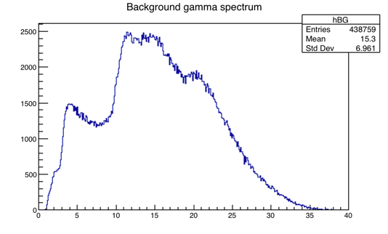
LYSO scintillator
Lutetium-yttrium oxyorthosilicate
4x4x22mm (fra PET Scanner)
Optical
Grease
SiPM
PCB
LYSO
Charge (au)
3D printed cover

Slide 27
LYSO scintillator
Lutetium-yttrium oxyorthosilicate
4x4x22mm (fra PET Scanner)
Optical
Grease
γ
SiPM
γ
PCB
LYSO
γ
γ
Charge (au)
γ
γ
3D printed cover

Slide 28
Why is this interesting for Teaching/Outreach?
Inexpensive detectors (<10% cost of commercial alternatives)
Don’t require high voltage (SiPMs 25-30V, compared to ≈1kV for PMTs)
  Less expensive, more safe
Simple system that can be put together by students
Highly transportable:
  Detectors small and light, DAQ powered by USB
  Detector can be powered by batteries

Slide 29
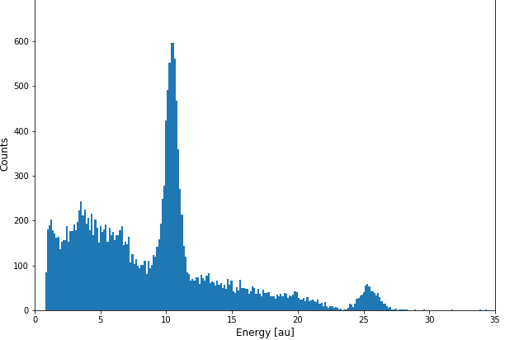
Not perfect, though, because
511keV
4x4x22mm
Small scintillators, poor efficiency for higher gamma energy
LYSO is radioactive, can make it difficult to measure low activity souces below ≈600keV
Steeply falling background makes peaks non-gaussian (so more difficult for novices to fit
Poor efficiency->low count rates, challenging for impatient researchers
1274 keV
6x6x40mm

Slide 30
Intro course @NBI: Mechanics & Special Relativity
How to do good SR experiments in under 3 hours?
Need 10+ setups (30 students/section, 6 sections)
Needs to be simple enough that students don’t drown in technical details

Slide 31
Intro course @NBI: Mechanics & Special Relativity
How to do good SR experiments in under 3 hours?
Need 10+ setups (30 students/section, 6 sections)
Needs to be simple enough that students don’t drown in technical details
Answer: measure gammas from e+ e- annihilation!

Slide 32
Beta+ decay:

Slide 33
PET Scanner
Fluorodeoxyglucose (¹⁸F)

Slide 34
PET Scanner
Fluorodeoxyglucose (¹⁸F)
¹⁸O(p,n)¹⁸F

Slide 35
Many per second

Slide 36
Don’t ”see” gamma
NB: de kilder i bruger har
Ca. 37000 henfald/s

Slide 37
”see” gamma
NB: de kilder i bruger har
Ca. 37000 henfald/s

Slide 38
With 2 BiGS:miniPET Scanner
V (27-28V)
V (27-28V)
DetA
²²Na
Det B
Oskop
PC
Notes:
HUSK: forbind projekter med slogan!!

Slide 39
no coincendence
Trigger detector

Slide 40
Coincendence!

Slide 41
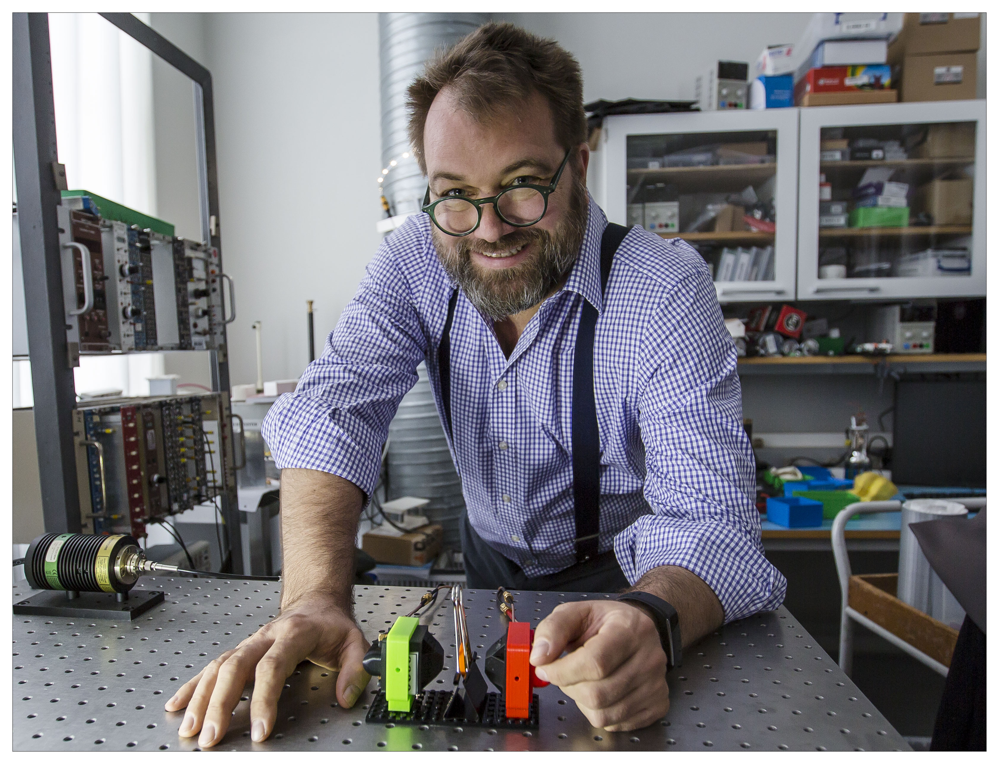
In real life, it looks like this:

Slide 42
Coincidence* spectrum
*Need to explicitly tell students the technical meaning of ”coincidence” as it is quite different from ordinary usage

Slide 43
Two ways to do this:
Maximize trigger rate in Det A
Use DetB to measure at various angles
Find coincidence peak at 180°
Place DetA and Det B in same plane at 180°
Move source through scanner
When source exactly between A & B: Coincidence!

Slide 44
Students ”see” that
The two coincident gammas are each 511keV
Aha! Rest mass of e is 511keV/c²
And gammas are always back to back!
So annihilation occurs at rest wrt lab and
E_{γ1}+E_{γ2}=m_{e-}c²+m_{e+}c²
That Einstein guy might have been onto something!

Slide 45
Can be used with younger students
Demonstrate how PET scanners work
NB: this is one of S’cool labs cool labs!
Requires different scaffolding, fewer technical details

Slide 46
PLAN
INTRODUCTION:
  What I will talk about
  Why I am talking about this
  Context in which this has been done
WHAT IS ”AVAILABLE”?
  A quick non-objective, non-exhaustive market ”survey”
THE NICE-NBI SOLUTION
  DAQ
  HOW TO BUILD A 100€ Gamma Spectrometer
  Mini PET Scanner
NEXT STEPS

Slide 47
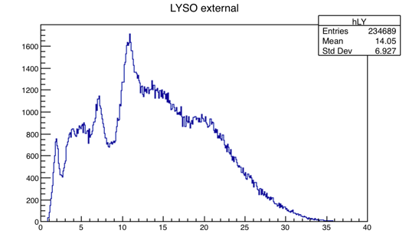
NEXT STEPS
Upper level labs: background subtraction:
Look at ¹⁷⁶Hf gamma spectrum
γ
γ
γ
γ
γ
γ

Slide 48
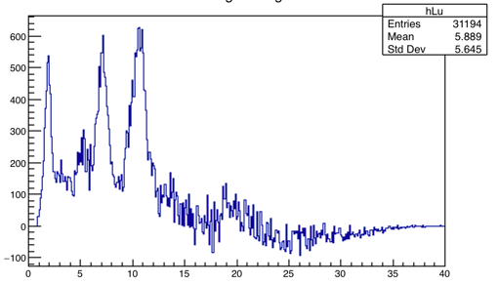
Normalize, subtract et voila!
¹⁷⁶Hf γ spectrum

Slide 49
Environmental measurements
System extremely portable
Collect gamma spectra anywhere (you’re allowed to be with a computer)
November 2018: local school group to NBI to build and characterize BiGS (resolution, efficiency, P/T)
September 2019: Class to Fukushima.
  Can we measure residual ¹³⁷Cs?

Slide 50
TO DO!
EVALUATE
How can we prove that including such activities in outreach and education improve:
Interest in physics generally
Interest in Nuclear & particle physics

Slide 51
TO DO!
For Physics students
How can we prove that including such activities in improve educational outcomes?
Increase interest in Nuclear & particle physics?
Increase technical skills?

Slide 52
BASIC QUESTION:
HOW SHOULD WE MEASURE IMPACT OF INDIVIDUAL ACTIVITIES?

Slide 53
SUMMARY
Possible to produce performant low cost detectors.
Consumer grade digital scopes work extremely well in teaching and outreach applications.
You can put together a (very small!) PET scanner demonstrator for roughly 500CHF.
Highly portable systems might give interesting possibilities for new activities.

