Slide 1
ERMC, RMM and Study Towards a CERN-DEMO for a 16 T FCC Dipole
12/07/2018
Susana Izquierdo Bermudez, Davide Tomasini,

Slide 2
Outline
The CERN roadmap towards a 16 T FCC dipole
ERMC&RMM Non Graded
ERMC&RMM Graded
DEMO
SMC – Parallel program to develop key technologies in smaller coils
DEMO design

Slide 3
Outline
The CERN roadmap towards a 16 T FCC dipole
ERMC&RMM Non Graded
ERMC&RMM Graded
DEMO
SMC – Parallel program to develop key technologies in smaller coils
DEMO design

Slide 4
Design strategy – ERMC/RMM Non Graded
Demonstrate the field
Design based on the “available” critical current density (~20% lower than FCC target at 18 T, 4.2 K).
As field quality is not an objective, profit from the use of an iron pole to decrease the ratio between the field in the aperture and in the coil to ~ 1.
18 % margin on the load line.
Study the mechanics
Produce the magnet in the shortest possible delay.
Use FRESCA2 cable (biggest available cable)
Plan: 1 eRMC magnet and 1 RMM magnet (RMM contains eRMC coils)
1 eRMC & 1 RMM spare coils planned

Slide 5
Features & Outcome
Mica in-between the pole turn and the pole to avoid bonding → Faster training?
Required the development of new concepts for coil handling.
Enhanced mica insulation (larger mica coverage to avoid stress concentration on the cable edges) → Issue of impregnation?
Required several iterations of insulation tests
Outcome:
Summer 2018 (coil visual inspection)
End 2018 (first fold powering test results)
End 2019 (destructive inspection)
Study of assembly parameters. Understand what are the limits in terms of stress/Jc degradation in the 16-18 T range.
Plans for eRMC (Test: end 2018 – mid 2019):
Assembly 1: Azimuthal load to 16 T, axial load to be defined
Assembly 2: Azimuthal load to 18 T, axial load to be defined
And then, in RMM configuration (Test: mid 2019 – end 2019):
Assembly 3: Azimuthal load to 16 T, axial load to be defined
Assembly 3: Azimuthal load to 18 T, axial load to be defined
Assembly 4: Azimuthal load to 18 T, axial load to be defined
Risk: we have only one magnet of each type, so the statistics will be very low.

Slide 6
Design strategy – ERMC/RMM Graded
Coil size → Grading
High Field Nb₃Sn splice development needed
Field quality (b_{n}<10 units, including iron saturation)
Other definitions/requirements:
Design based on the “available” critical current density T_{c0} = 16 K, B_{c20} =28.8T, α = 0.96, C₀ = 255230 A/mm²T. Cable degradation = 5%.
Stay within “CERN-knowledge-boundaries” in terms of cable geometry (<40 strands,<1 mm, cu/sc>=1)
Needs to be accommodated within the same structure, changing only the coil pack assembly
Baseline design in terms of LF margin and inner support structure more conservative than EuroCirCol.
Plan: 5 eRMC magnets and 3 RMM magnet (RMM contains eRMC coils)
3 eRMC & 2 RMM spare coils planned
https://indico.cern.ch/event/464602/contributions/1139555/attachments/1205091/1755702/151212_Grading.pdf

Slide 7
Features
If successful in the non-graded, we will keep:
Un-bonded pole turn to pole
Mica insulation
Internal splice in higher field than SMC
First test beginning of 2020
Internal support requirements
First magnet has 4 mm inner support, 2 mm can be explored. Feedback end of 2021.
Study of assembly parameters
New resins qualification, after pre-qualification in SMC

Slide 8
Design strategy – Demonstrator
Could we accommodate in RMM structure a magnet with flared ends?
For the demonstrator, I would step towards EuroCirCol criteria for designing the magnet:
FCC Jc: T_{c0} = 16 K, B_{c20} =29.38 T, α = 0.96, C₀ = 1.03*267845 A/mm² T. Cable degradation = 3%.
14 % margin on the LF (and HF)
Inner support = 2 mm (maybe a bit more)
Explore cable options outside “CERN-knowledge-boundaries” in terms of cable geometry (<60 strands,<1.1 mm, cu/sc>=0.8)

Slide 9
Features
If successful in the non-graded & graded programs, we will keep:
Un-bonded pole turn to pole
Mica insulation
2 mm inner support
Internal splice
New resin
Well defined loading strategy

Slide 10
SMC
Internal splice
New resins & insulation systems qualification
Conductor qualification

Slide 11
Overview on magnet parameters
RMM non graded
RMM graded
DEMO
 |  | RMM non graded | RMM |  | DEMO
 |  |  | graded
 |  |  | HF | LF | HF | LF
strand diameter | mm | 1 | 1 | 0.7 | 1.1 | 0.85
Cu/SC | -- | 1 | 1 | 1.2 | 0.8 | 1.2
# of strands/cable | -- | 40 | 28 | 40 | 44 | 56
# turns/quadrant | -- | 132 | 30 | 132 | 13 | 42
coil width | mm | 86 | 69 |  | 53
I_{nom} | A | 8850 | 8625 |  | 21000
J_{overall} | A/mm² | 248 | 259 | 350 | 339 | 422
J_{cu} | A/mm² | 735 | 805 | 1236 | 904 | 1454
J_{sc} | A/mm² | 735 | 805 | 1075 | 1130 | 1212
Ratio LF/JF | -- | n.a. | 1.35 |  | 1.25
B₀ at I_{nom} | T | 16 | 16 |  | 15.43
B_{p} at I_{nom} | T | 16 | 16.6 | 13.67 | 16.08 | 13.22
1-B_{p}(I_{nom})/B_{ss}(1.9 K)¹ | % | 17 | 14 | 20 | 14 | 18
1-I_{nom}/I_{ss}¹ | % | 19 | 16 | 23 | 15 | 21
F_{x}/h at I_{nom} | MPa | 122 | 145 |  | 141
F_{y}/w at I_{nom} | MPa | -46 | -65 |  | -72

Slide 12
Outline
The CERN roadmap towards a 16 T FCC dipole
ERMC&RMM Non Graded
ERMC&RMM Graded
DEMO
SMC – Parallel program to develop key technologies in smaller coils
DEMO design

Slide 13
Cable Parameters
 |  | Strands | Dstrand | CU/SC | Width | Thickness | Keystone angle
 |  | (-) | (mm) | - | (mm) | (mm) | (degrees)
Option 1: Same width LF and HF | DEMO HF | 44 | 1.10 | 0.8 | 25.700 | 2.002 | 0.00
 | DEMO LF | 56 | 0.85 | 1.2 | 25.700 | 1.547 | 0.00
Option 2: Best width LF and HF | DEMO HF | 44 | 1.10 | 0.8 | 25.958 | 2.002 | 0.00
 | DEMOLF | 56 | 0.85 | 1.2 | 25.475 | 1.547 | 0.00
In the design we assume:
3 % thickness expansion during HT
1 % with expansion during HT
The baseline for FCC is to use cored cables
Assumed degradation during cabling: 3 %

Slide 14
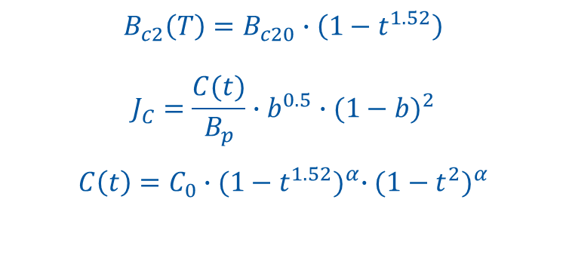
Critical Current Density
$$B_{c2}\left(T\right)=B_{c20}∙\left(1−t^{1.52}\right)$$
$$J_{C}=\frac{C(t)}{B_{p}}∙b^{0.5}∙{(1−b)}^{2}$$
$$C\left(t\right)=C_{0}∙{(1−t^{1.52})}^{α}∙{(1−t^{2})}^{α}$$
 | Hi-Lumi | FCC models | FCC target
T_{c0} (K) | 16 | 16 | 16
B_{c20} (T) | 29.38 | 28.8 | 29.38
α | 0.96 | 0.96 | 0.96
C₀(A/mm²T) | 188870 | 255230 | 275880
J_{c} at 4.2 K | Hi-Lumi | FCC models | FCC target
12 T | 3200 | 3850 | 4700
16 T | 1580 | 1900 | 1960
18 T | 1040 | 1250 | 1520

Slide 15
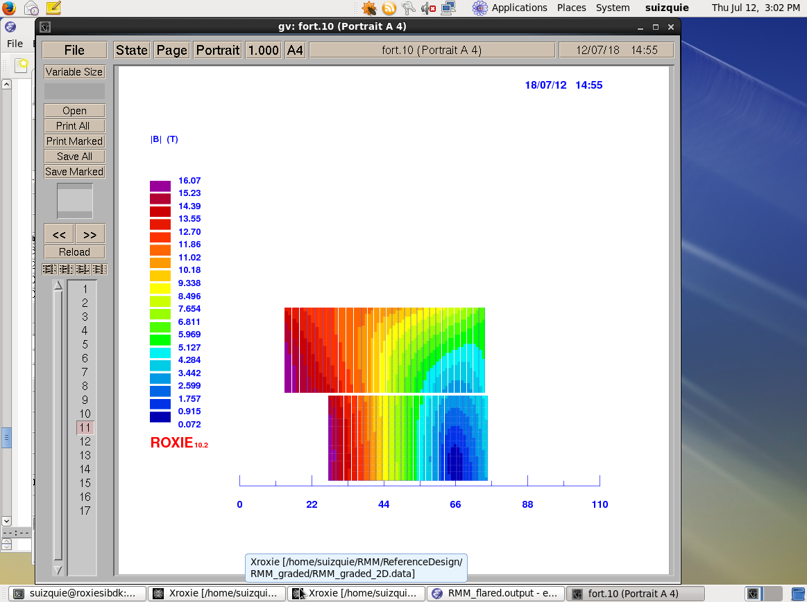
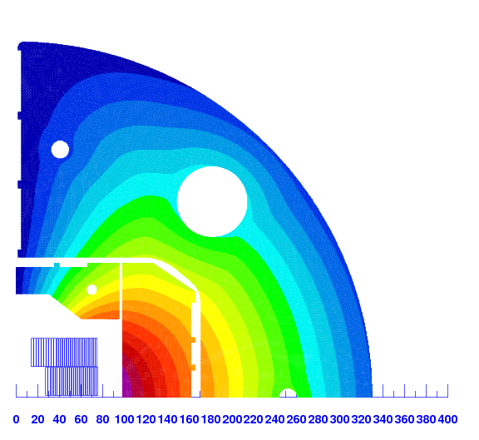
Magnetic design
I_{nom} = 21 kA
RMM yoke
Pads under
optimization
R= 13.5 mm
R= 34 mm

Slide 16
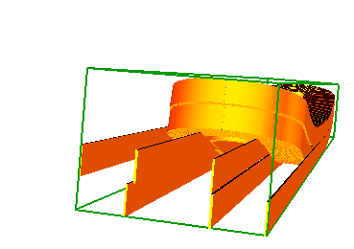
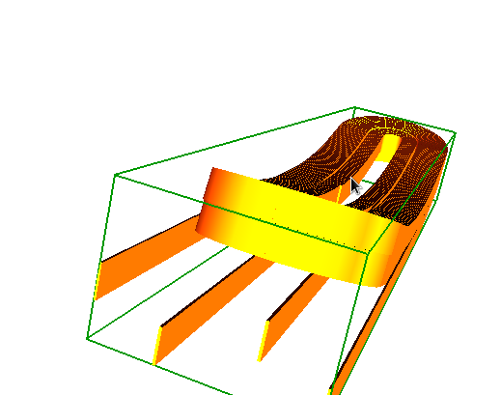
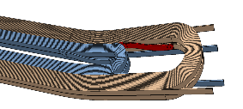
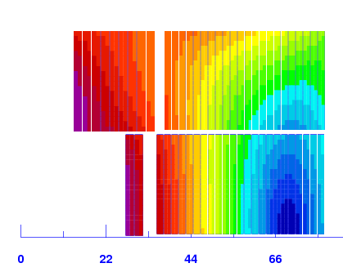
Grading, several ideas…
Internal splice in the coil ends, “transparent” for the 2D cross section.
External splices, “transparent” for the 2D cross section but with 4 leads to extract (difficult find the space).
External splices, with layer jump in the coil ends (only 2 leads, CEA approach).
External splices, with wedge in the straight section to have space for the layer jump (only 2 leads).
Courtesy CEA

Slide 17
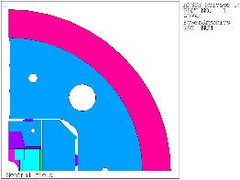
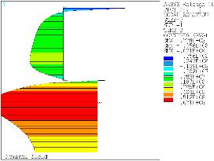
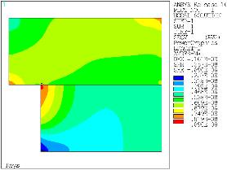
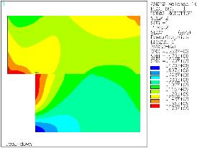
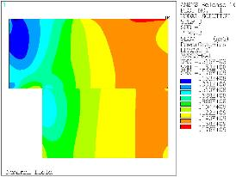
Mechanical design
First 2D analysis fulfills EuroCircolCriteria
Key aspects under study
Impact of the vertical force of the magnetic pad on the coil stress
Pads/pushers geometries and contact surfaces

