Slide 1
scintillation in admixtures based on noble gases (and why?)
D. Gonzalez-Diaz
(1st DISCO meeting)

Slide 2
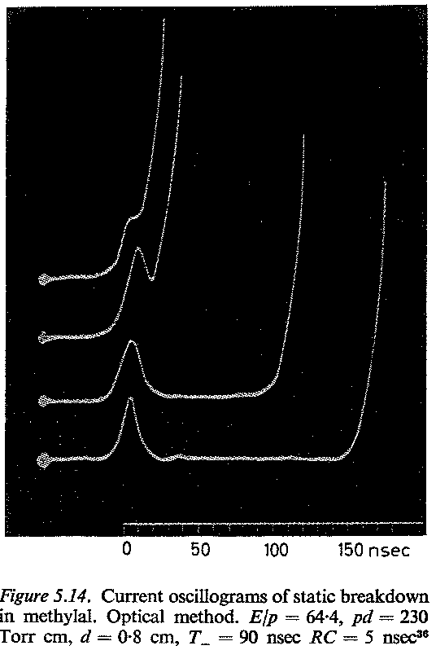
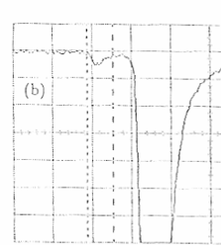
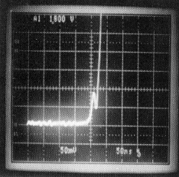
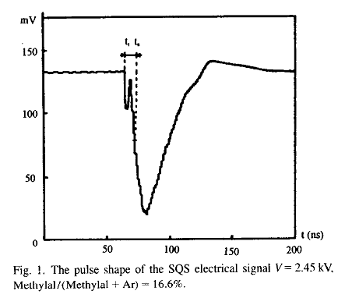
‘Fast’ breakdown - experimental evidence in detectors
Fast: opposed to ‘slow’ (driven by feedback at the cathode). The name tells NOTHING about the physical interpretation, except that it does not require of secondary processes at the cathode.
Usually features a ‘precursor’ pulse.
[RAE64]
PPAC
RPC
[FON91]
[DUE94]
Gain
A signature of low-gain
cathode streamer-only
breakdown
single-wire (SQS mode)
Precursor pulse
at low gains
It certainly exists, but it may
not be the only mechanism, or it may be the result of different physical processes.
[HON96]
P. Fonte

Slide 3
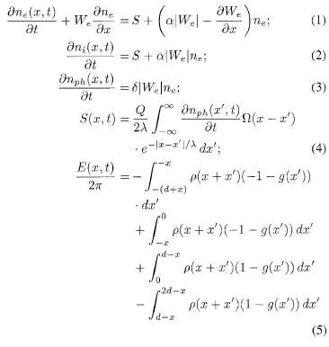
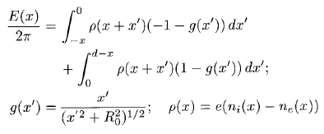

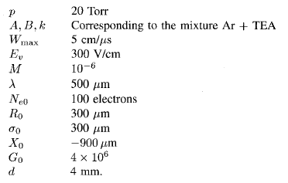
‘Fast’ breakdown (‘photon-assisted/classical interpretation’)
photon-feedback term
1D hydro equations for electrons and ions with photon-feedback term
Space-Charge cylinder
?
?
parameters
P. Fonte

Slide 4
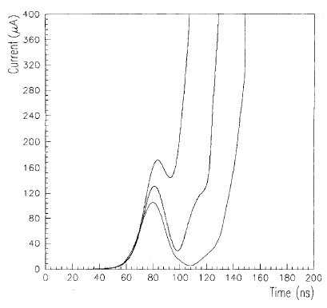
‘Fast’ breakdown (‘photon-assisted/classical interpretation’)
Main (technical) objections:
Many free parameters, some difficult to experimentally access (spectrum of emission, photo-ionization x-section)
->getting better these days.
Hydro solutions neglect avalanche or ionization fluctuations, but those will likely trigger breakdown earlier than the average solution to the equations.
Approximate: transverse dynamics becomes a parameter.
->Probably solvable with present computing power.
simulation
Other objections:
No quantitative comparison with data.
Does not seem to reconcile well with the fact that improvements on maximum gain with quencher concentrations above some ~1% are very modest.
Contrary to common wisdom, it does not need of Space-Charge to progress, except if invoking enhanced charge-recombination at low fields, making the process even more difficult to describe.
It does not seem to be general enough to explain most known systematics on MPGD detectors.
avalanche
transition
streamer
P. Fonte

Slide 5
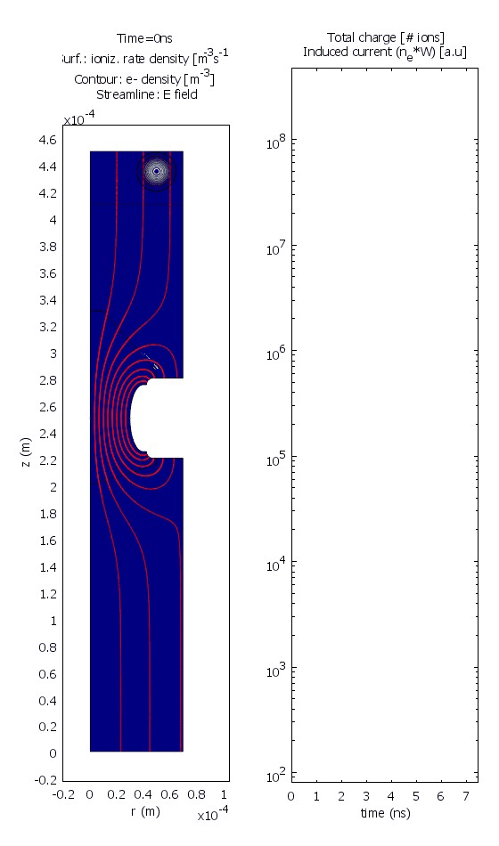
‘Fast’ breakdown (‘diffusion-assisted/modern interpretation’)
GEM
hole: 60 µm
gap: 100 µm
N₀=100 e⁻
V=1250V
precursor is present as well:
Can we learn something from its shape, relative probability, delay with respect to the streamer signal… that will help at pinning down the underlying mechanisms?
P. Fonte

Slide 6
let us proudly introduce…

Slide 7
a microscopic software for electron and photon transport in gas
Degrad
(W_{I}, F,
cloud size)
scintillation MC, and photo-absorption
x-section database
C. D. R. Azevedo, D. Gonzalez-Diaz, S. F. Biagi et al.,
’Microscopic simulation of xenon-based optical TPCs in the presence of molecular additives’
Nucl. Instr. Meth., 877, 1(2018)157
(S₁, S₂)
Magboltz electron
x-section database
Magboltz
Garfield++
(v_{d},D_{L},D_{T} )

Slide 8
supported by ‘new scintillating gases and structures for next-generation scintillation-based gaseous detectors’
(RD51 common project)
1. UT Arlington
Contact person: D. R. Nygren, drnygren@lbl.gov
2. IFIC-Valencia
Contact person: J. J. Gomez-Cadenas, gomez@cern.ch
3. INFN - Sezione di Roma and Laboratorio Nazionale di Frascati
Contact persons: D. Pinci, davide.pinci@roma1.infn.it
E. Baracchini, baracch@gmail.com
4. AIST/University of Tokyo
Contact person: T. Fujiwara, fujiwara-t@aist.go.jp
5. Santiago de Compostela University*
Contact person: D. Gonzalez-Diaz, diegoglezdiaz@gmail.com
6. Royal-Holloway London
Contact person: J. Monroe, Jocelyn.Monroe@rhul.ac.uk

Slide 9
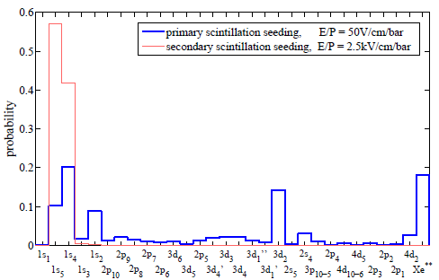
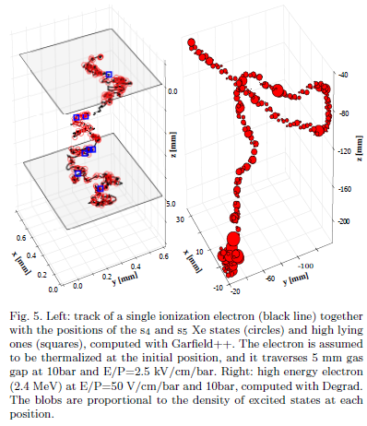
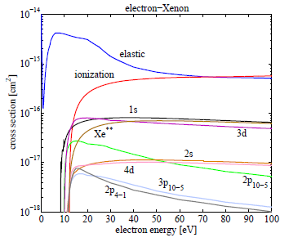
computation of probability distribution of excited states
Garfield++
Degrad
xenon 2016

Slide 10
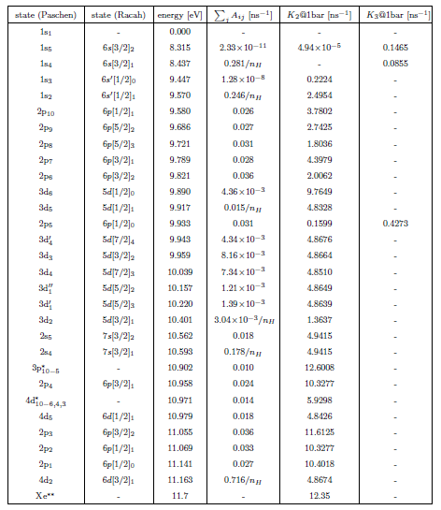
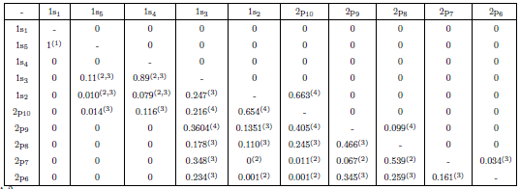
computation of atomic cascade
decay constant
2-body collision rates
3-body collision rates
each value represents a vector!

Slide 11
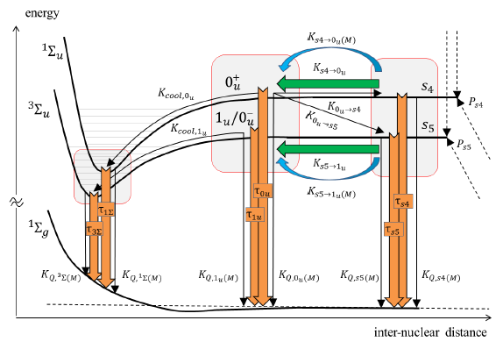
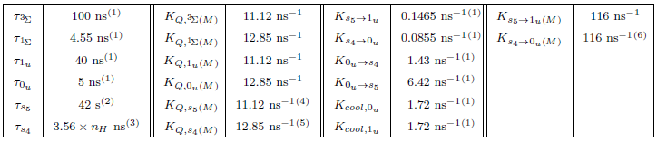
computation of excimer pathways
(analogous for 2p₅ and Xe**)

Slide 12
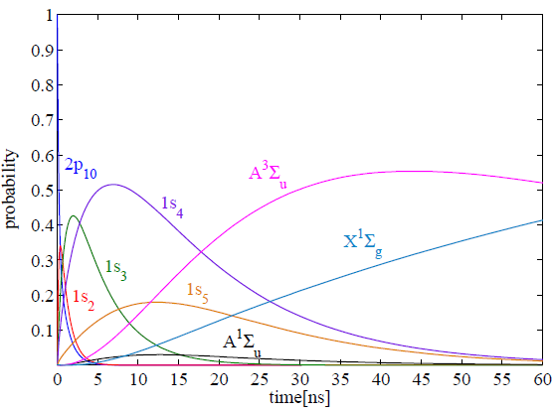
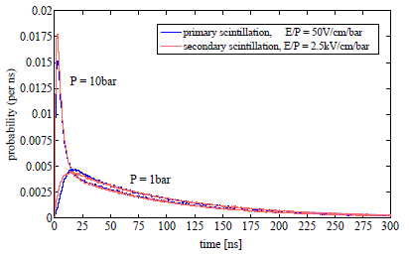
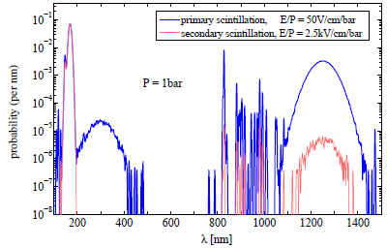
example of electron transport + light production code
time distribution
energy spectra

Slide 13
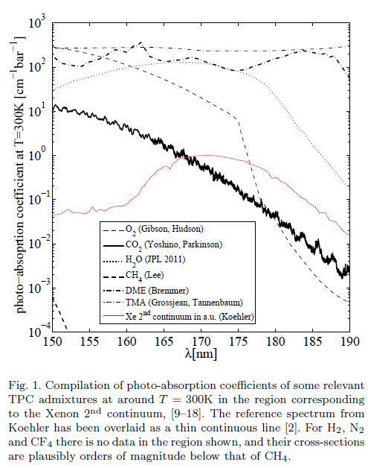
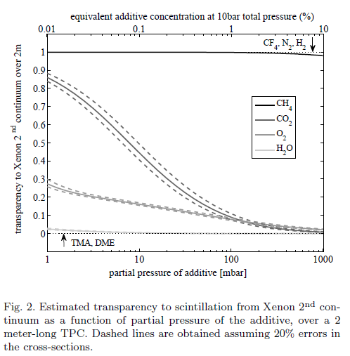


light transparency
i-C₄H₁₀
C₂H₆

Slide 14
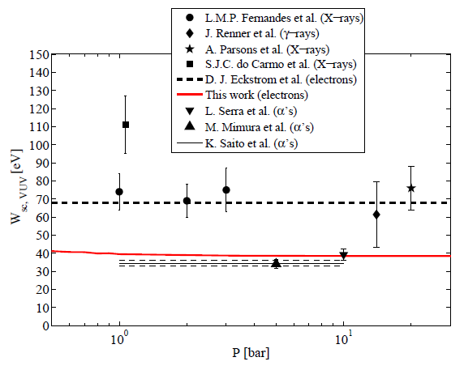
comparison with data: primary scintillation yields
VUV region
IR region
simulated
measured (α’s)

Slide 15

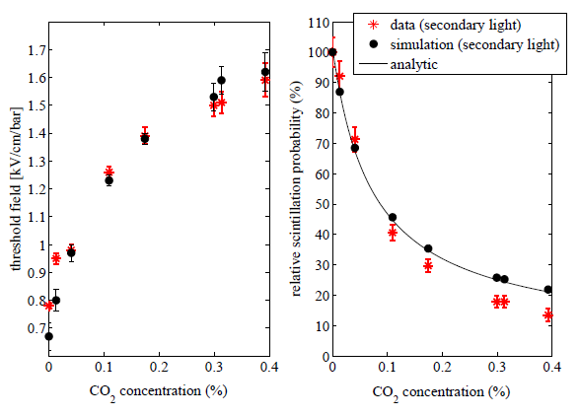

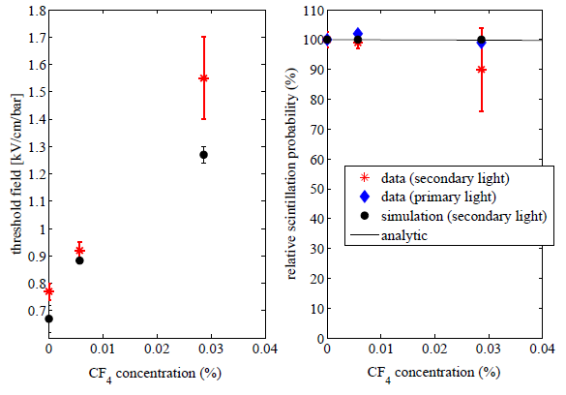
comparison with data: secondary scintillation (EL) yields
to first order:

Slide 16
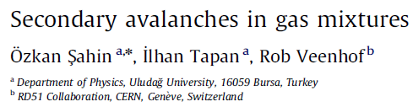
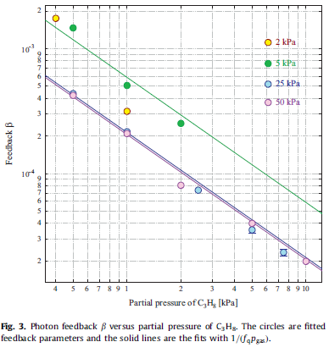
comparison with data: feedback parameter β (related to maximum gain; arguably, to streamer formation too)
!

Slide 17
current and future activities
The lab is focused on the study of scintillating mixtures and structures for next generation neutrino, dark matter and nuclear physics experiments.
There are 3 UHVacuum-grade systems, pressure-compatible (up to 10bar), with recirculation, purification and gas monitoring.
Scintillation studies are focused on the xenon-band (170nm) but we would like to extend these studies to visible (CMOS camera already purchased) and harder VUV (down to Ar-band, at least).
funding situation
The procured lab’s equipment for this project is worth 150kE, and additional resources are available for the next 3years (60kE, at least).
No major concerns with hardware stability/availability.
Main problem is the availability of manpower. Students in Santiago are good, but the present funding scheme does not allow hiring. The situation will likely improve next year, but it is unlikely that manpower can be allocated to this project (but hardware can).

