Slide 2
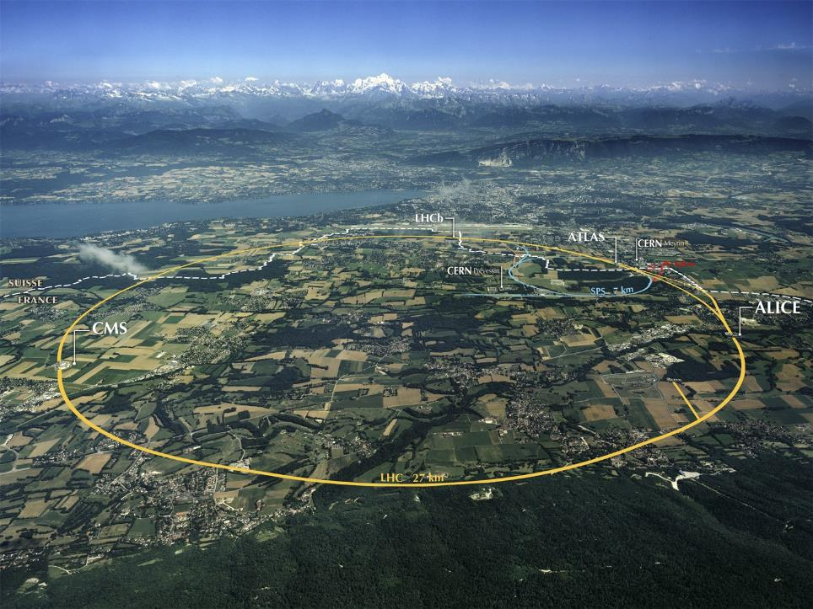
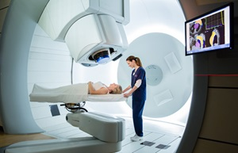
Future Ion Therapy – Challenges and Opportunities
Maurizio Vretenar, CERN
OMA Workshop, GSI, 11 December 2018
Notes:
Thanks to organisers and apologies – hardware accelerator physicist who has only recently approached the use of our machined in the medical world – physicist point of view but curious on the effect of physical quantities on organism

Slide 3
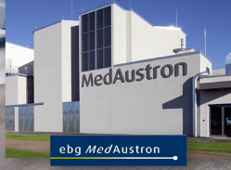
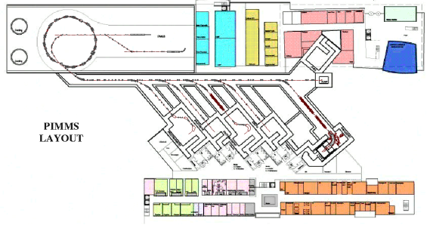
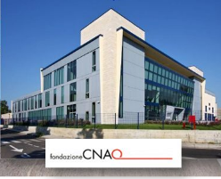
Medical accelerators at CERN - PIMMS
Assets: a wide competence in particle accelerators and an old tradition of being a meeting place where people from different countries and laboratories collaborate.
Long-standing CERN contribution to medical accelerator developments:
  Medicyc 1982-1990, Eulima 1985-1989 → Cyclotrons at Centre Lacassagne, Nice.
  LIBO (Linac Booster) 1998-2001 → LIGHT linac being built by ADAM/AVO.
  PIMMS (Proton Ion Medical Machine Study) 1996-2000 → CNAO and MedAustron proton&ion synchrotrons.
Interruption due to concentration of resources on LHC construction from 2002.
16 years later, interest from CERN and some support from the management to restart a medical accelerator activity.
But where should we go? Particle therapy has made an enormous progress in the last 20 years and the situation is very different from the initial pioneering years.

Slide 4
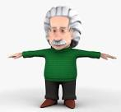



Accelerators for medicine
Number of operating accelerators worldwide
protons
proton therapy
Hadron therapy
Primary beam
≈ 75
>300
0
≈ 14’000
7
≈ 1’500
0
ions
ion therapy
(low en.)
IORT Inter Operation Radiation Therapy
electrons
(high en.)
VHEE Very High Energy Electron Therapy
Accelerator
Secondary beam
X-rays
Radiation Therapy
Target
neutrons
neutron therapy
imaging
PET Positron Emission Tomography
Radioisotopes
therapy
theragnostics
Targetd Alpha Therapy, others
Total: ≈ 16’000 particle accelerators operating for medicine

Slide 5
The potential of particle accelerators
All these systems share the vision of a bloodless surgery and imaging: penetrate into the human body to treat diseases and to observe internal organs without using surgical tools.
Particle beams (primary and secondary) precisely deliver large amounts of energy to small volumes, penetrate in depth (different from lasers) and interact with cells, molecules, and atoms (electrons and nuclei).
Particles beams can activate the nuclei generating radiation that can destroy cancerous cells or can be detected from outside.
Nuclear medicine:
application of radioactive substances in the diagnosis and treatment of disease
Radiation therapy:
therapy using ionizing radiation, generally as part of cancer treatment to control or kill malignant cells

Slide 6
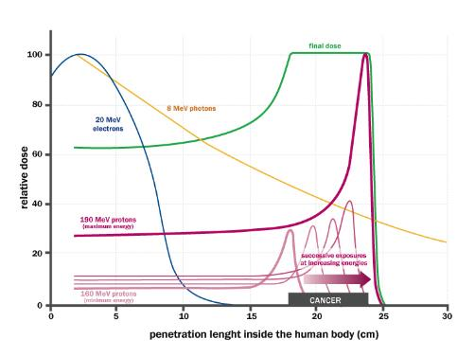
The fascination of the Bragg peak
Bethe-Bloch equation of ionisation energy loss by charged particles
Different from X-rays or electrons, protons (and ions) deposit their energy at a given depth inside the tissues, minimising the dose to the organs close to the tumour.
Required energy (protons) about 230 MeV, corresponding to 33 cm in water.
Small currents: 10 nA for a typical dose of 1 Gy to 1 liter in 1 minute.
Spread-Out Bragg Peak (SOBP)
accelerators-for-society.org

Slide 7
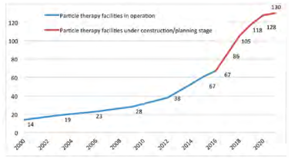
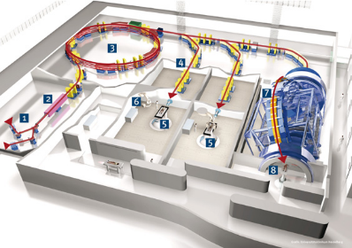
The rise of particle therapy
First experimental treatment in 1954 at Berkeley.
First hospital-based proton treatment facility in 1993 (Loma Linda, US).
First treatment facility with carbon ions in 1994 (HIMAC, Japan).
Treatments in Europe at physics facilities from end of ‘90s.
First dedicated European facility for protons and carbon ions in 2009 (Heidelberg).
From 2006, commercial proton therapy cyclotrons appear on the market (but Siemens gets out of proton/carbon synchrotrons market in 2011).
Nowadays 3 competing vendors for cyclotrons, one for synchrotrons (all protons).
More centres are planned in the near future.
A success story, but …
many discussion on effectivness, cost and benefits.
Some negative feedback from the running centers: lack of patients, high running costs,…

Slide 8
The difficulties of particle therapy
Cost: a commercial single-room proton therapy system has a price starting from 30 M€, to be compared with 2-3 M€ of a X-ray radiotherapy system. A proton and ion therapy centre has a cost of 150-200 M€. Running costs are also high, mainly because of the needs in personnel to run the facilities.
Range uncertainties: X-ray therapy has reached a high level of precision and can be coupled to on-line diagnostics. Particle therapy is difficult to calibrate (energy loss depends on tissues), dosimetry is less precise, and on-line scanning is not possible.
Assessing performance: advantage of particle therapy in reducing dose to tissues surrounding the tumour, with less risk of secondary cancer and less damage to critical organs. There is no or little impact on survival rate, the main result is in improving quality of life after treatment. While survival rates are easy to measure and compare, quality of life is not an easily measureable parameter; only recently studies are starting to take this parameter into account.
Centralisation of medicine: the high cost of particle treatment calls for large centralised units that have difficulties in attracting patients from hospitals located in a large region.

Slide 9
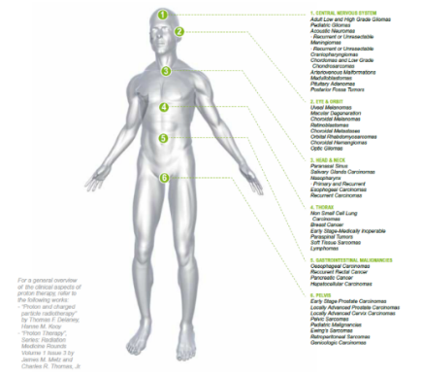
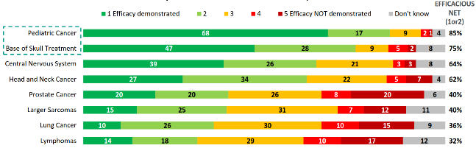
Advantages of proton therapy
The main recognised advantage of proton therapy are for:
Pediatric tumours, where surrounding tissues are more delicate and the risk of secondary tumours is higher.
Tumours close to vital organs: base of skull, central nervous system, head and neck.
Source: IBA, state of proton therapy market entering 2017
Source: IBA proton therapy fact-sheet,

Slide 10
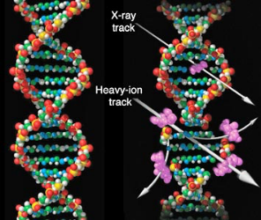
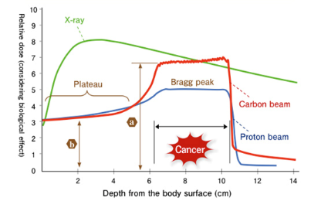
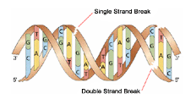
Ion therapy is different
Light ions (e.g. Carbon) are more effective than protons or X-rays in attacking cancer.
The particle (or X-ray) breaks the DNA; multiple breaks kill the tumour cell. However, the key mechanism is DNA self-repair by the body cells.
Protons and X-rays cause single-strand breaks, easy to repair.
C ions produce a 22 times more ionisations per length generating many double-strand breaks that are much more difficult to repair.
Ions are effective with hypoxic radio-resistant tumours (1 to 3% of cancers), allow for a lower dose thanks to their higher RBE, and have increased dose conformity thanks to less lateral scattering.
So far, 2/3 of cases treated at the mixed facilities (CNAO, etc.) are with carbon.
Radio Biological Effectiveness (RBE) is higher for Carbon than for protons.
1.1 for protons
3 for C ions
(reference is 1 for Co X-rays)

Slide 11
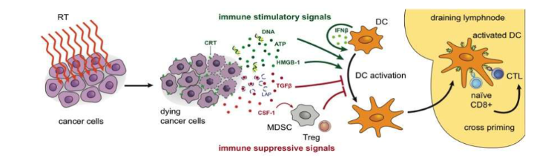
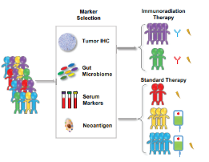
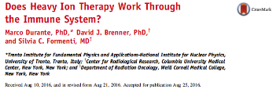


Ion therapy and immunotherapy
The «holy grail» of particle therapy
Combination of local therapies with immunotherapy, to convert the individual tumor into an in situ vaccine. The application of local radiation therapy as an adjuvant to immunotherapy is under active investigation both preclinically and clinically and is currently considered one of the most promising strategies to defeat cancer.
Potential to extend the reach of radiation therapy to diffused tumours and methastasys, responsible for the largest amount of cancer deaths.
Opens the way to personalised treatments, the future of cancer treatment.
Formenti & Demaria, Lancet Oncol. 2009
Selection of immunoradiation therapy or standard therapy for patients based on predictive biomarkers.

Slide 12
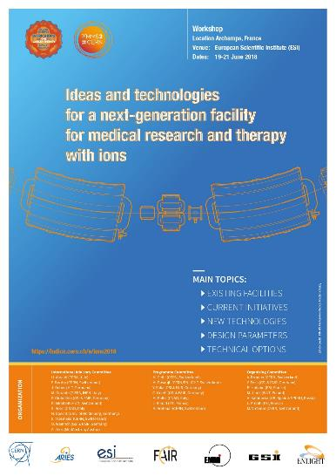
Requirements for the future of ion therapy
Prepariing the future of ion therapy: requirements
Delivery:
Fast dose delivery (possibly with 3D feedback for moving organs);
Some range calibration online (e.g. proton or helium radiography);
The rotating gantry is mandatory (possibly coupled to on-line MRI);
Using multiple ions might be an asset.
Accelerator:
Lower cost, compared to present (120 M€ for HIT and CNAO);
Higher beam intensities than present (e.g. 10 times HIT);
Reduced footprint from present (to about 1’000 m2);
Lower running costs;
Smaller facilities with less treatment rooms, distributed on the territory.
Key messages from the International Workshop organized at Archamps in June 2018

Slide 13
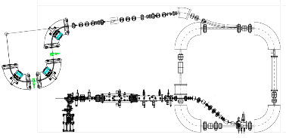
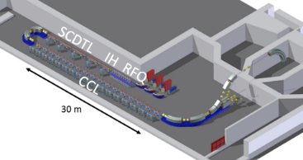
A second PIMMS initiative
CERN is ready to launch a new Proton Ion Medical Machine Study to propel a new generation of ion therapy facilities, based on:
Novel accelerator design (compactness, cost, simple operation)
Fast delivery scheme;
Multiple ion capability;
Equipped with a rotating gantry.
Two technical options:
10 m
23 m
1. Superconducting synchrotron with 4 90⁰ magnets
2. Bent high-frequency linear accelerator

Slide 14
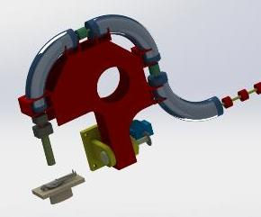
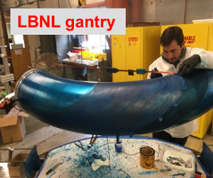
The Superconducting synchrotron
Initial design by the TERA Foundation based on Canted Cosine Theta Magnets.
The TERA-CCT design:
3.5 T magnets with nested quadrupoles, 10e10 ions/cycle;
27 m circumference (+6 m linac injector), footprint <1000 m2;
Magnet rise time may limit beam delivery.
SC gantry with similar CCT magnets

Slide 15
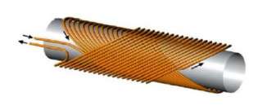
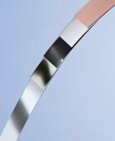
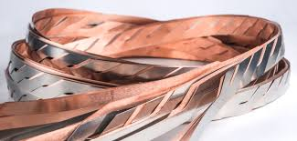
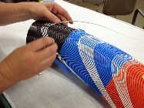
Magnets: CCT or HTS?
2 options being considered for the superconducting magnets:
Canted Cosine Theta (CCT)
LBNL is building a prototype 90deg CCT for use in a gantry
High Temperature Superconductor (HTS)
Large development effort in Europe based on YBCO conductors (yttrium barium copper oxyde)
Tape developed with industry, to reach 20T in high-field dipoles for high-energy colliders.
S. Caspi, L. Brouwer, LBNL
Advantages:
Simple construction;
Nested quadrupole (additional quadrupole layer)
Disadvantages:
Limited field
Possible field errors
Advantages:
Higher field;
Technology being developed at CERN
Disadvantages:
Cost of magnetic material
Need external quadrupoles

Slide 16
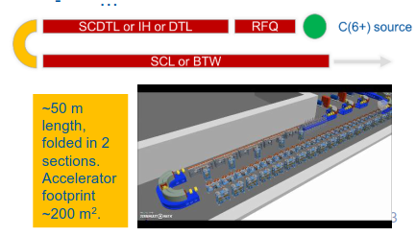


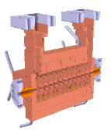
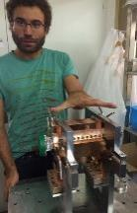
The high-frequency linac
Concept under development by CERN and TERA. 400 MeV/u linac for fully stripped Carbon (6+)
3 GHz linear accelerator similar to the proton linac of ADAM/AVO for the high-energy part.
3 innovations: ion source and LEBT for C6+, bending section at 100 MeV, low-beta accelerating structures
C6+ ion source and beam transport
High-frequency RFQ
High energy section
Advantages:
Much faster beam delivery (200 Hz, 10e8 ions/pulse);
Easy pulse-to-pulse energy variation (fast 3D scanning).
Disadvantages:
More innovative solution, several new components and R&D time;
Present delivery schemes and protocols optimised for synchrotrons, important modifications on the medical side.

Slide 17
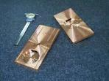
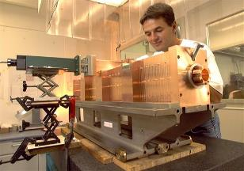
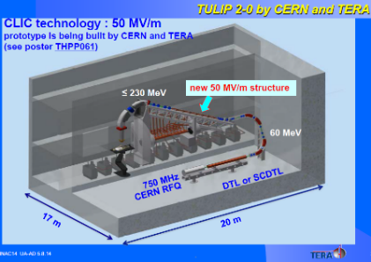
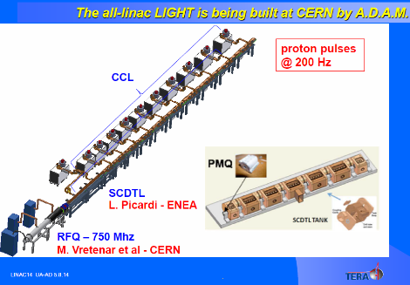
Alternative solutions: the linear accelerator
The TERA Foundation (U. Amaldi) has launched in 1995 a collaboration with CERN for the development of a proton therapy linac operating at high frequency (3 GHz) and high gradient (30-50 MV/m) reaching 230 MeV in 25 meters.
The LIBO prototype structure and accelerating cells (CERN)
Advantages of a LINAC:
High repetition frequency with pulse-to-pulse energy variability
Small emittance, no beam loss.
The TULIP concept using CLIC high-gradient cavities – 15 meters
The LIGHT linac by ADAM (being assembled and built in a CERN test area) – 25 meters

Slide 18
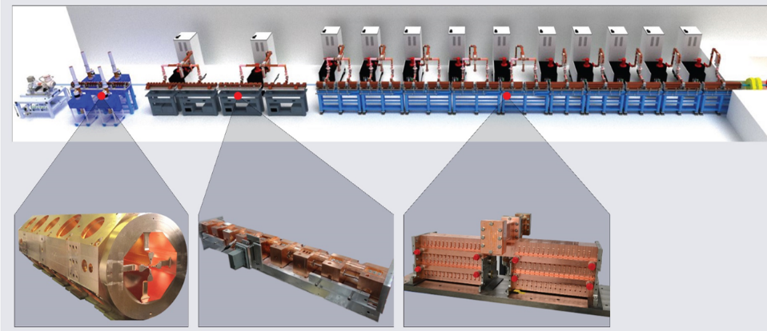

LIGHT (Linac for Image Guided Hadron Therapy)
25 m
A. Degiovanni, HG2018 Workshop, Shankai, China
750 MHz Radio Frequency Quadrupole (RFQ)
3 GHz Side Coupled Drift Tube Linac (SCDTL)
3 GHz Coupled Cavity Linac (CCL)
ADAM is an old CERN spin-off now part of the UK company AVO (Advanced Oncotherapy). They reported acceleration to 52 MeV in September 2018. From end 2019, the development will continue at Daresbury Laboratory (UK). The first LIGHT unit will be installed at the Harley Street Hospital in London.

Slide 19
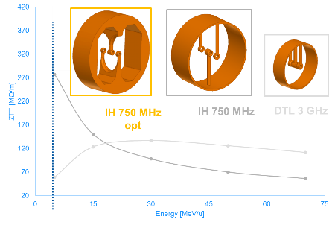
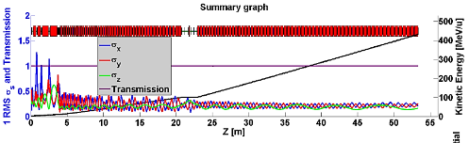
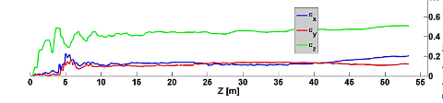
Accelerating structures and gradients
Present Design (430 MeV/u)
Tot. length 53 m
Tot. RF power 260 MW
Optimised for power consumption
Gradient 30 MV/m: higher values are possible but at the price of a drastic increase in RF power.
IH
DTL
CCL
S. Benedetti, A. Grudiev and A. Latina, Design of a 750 MHz
IH structure for medical applications, Linac16
High frequencies and low particle velocity (case of ions) don’t go well together (cell length in a linac is βλ/2).
Need of new designs adapted to the high-frequency and to introduce an intermediate frequency (70 MHz).
S. Benedetti, High-gradient and high-efficiency linear accelerators for hadron therapy, EPFL PhD Thesis

Slide 20
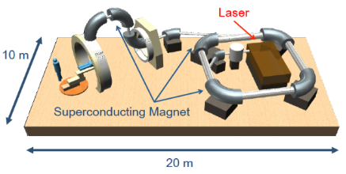
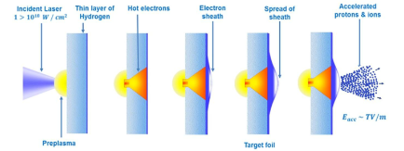
New technologies at the horizon
The goal of the study that we are starting at CERN is to have a Technical Design Report ready in 2022, to be used for the construction of a next-generation facility.
On a longer-term perspective, fascinating options are appearing.
Laser-plasma acceleration
1st Generation Quantum Scalpel
Positive: minimum footprint and limited energy to produce the relatively small quantities of ions required for therapy.
Negative: the requirements of reliability, stability and reproducibility of medical standards are very far from what achievable with present laser-based accelerators.
An interesting idea from K. Noda (HIMAC, Japan):
The future generation facility should be a «quantum scalpel» where a supercondcting synchrotron is fed by a laser-based injector.
The linac (10 MeV/u) is one of the most difficult parts of a conventional facility. Replacing it with a laser system would allow gaining in size and complexity, but the laser produced beam has to respect the requirements for injection into a synchrotron.

Slide 21
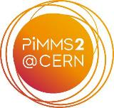

An open collaboration based on CERN and SEEIIST
2019 will see the start of the PIMMS2 study, in collaboration with the SEEIIST. Other partners are welcome to join the collaboration.
4 Workpackages:
Injector linac
SC synchrotron
Linac
Beam delivery and gantry.
South-East European International Institute for Sustainable Technologies.
Establishment of a particle accelerator laboratory in SEE, to foster peace and collaboration.
In 2018 the SEEIIST has opted for a combined cancer therapy and biomedical research facility.
Funding primarily from structural and pre-accession EU funds.
01/2019-06/2020 Parallel study and comparison of two designs, superconducting synchrotron and linac
07/2020-06/2022 Technical design of the preferred option

Slide 22
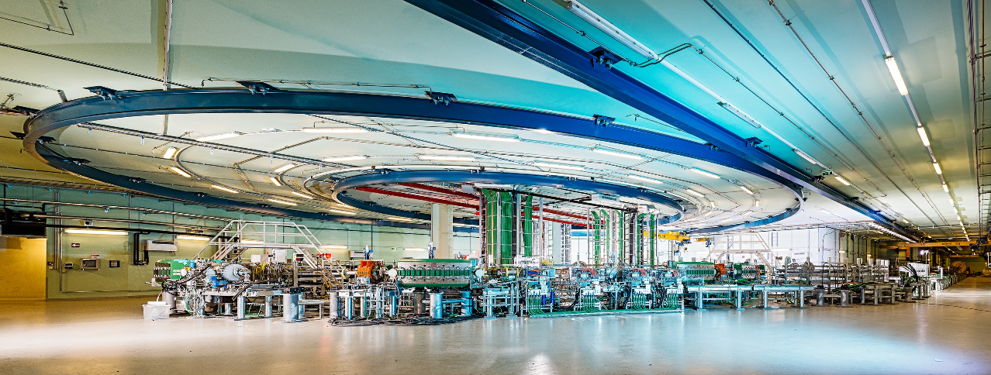
Conclusions
Ion therapy has already now a well-defined niche in the arsenal of tools to fight cancer. New emerging ions and coupling with immunotherapy could greatly extend its reach and increase future demand for ion therapy treatment.
There is wide space for improvement and for exciting new developments.
However, the accelerator is only a small part of large facilities devoted to delivering medicine to patients. To succeed, we have to break the barriers and optimise the entire sequence from the ion source to the patient.
the MedAUSTRON hall

Slide 23
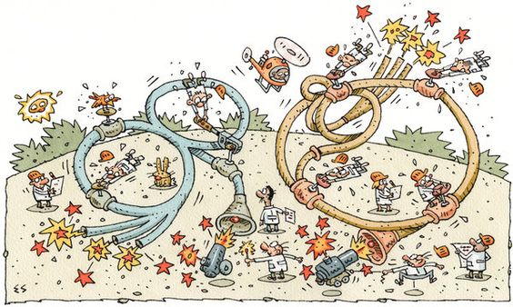
Thank you for your attention
maurizio.vretenar@cern.ch

