Slide 1
Challenges in medical accelerator design
Jarno Van de Walle
Accelerator physicist
Jarno.vandewalle@iba-group.com

Slide 2
Outline
Cyclotrons in proton therapy
Major future challenges
  Energy degrader and beam losses
  Variable energy accelerators
Beam diagnostics in the compact IBA ProteusONE®

Slide 3
Cyclotrons in proton therapy

Slide 4
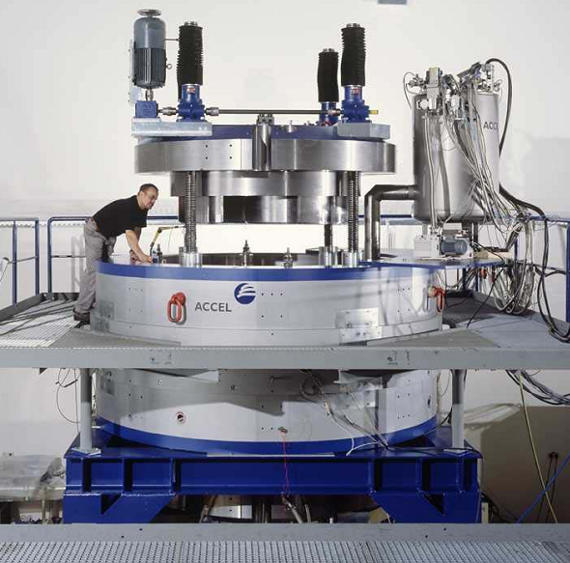
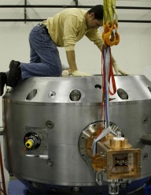
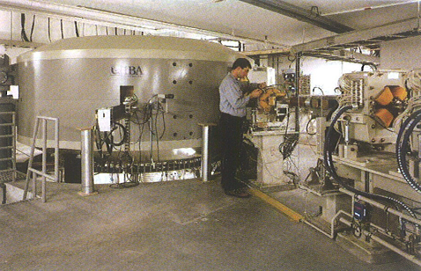
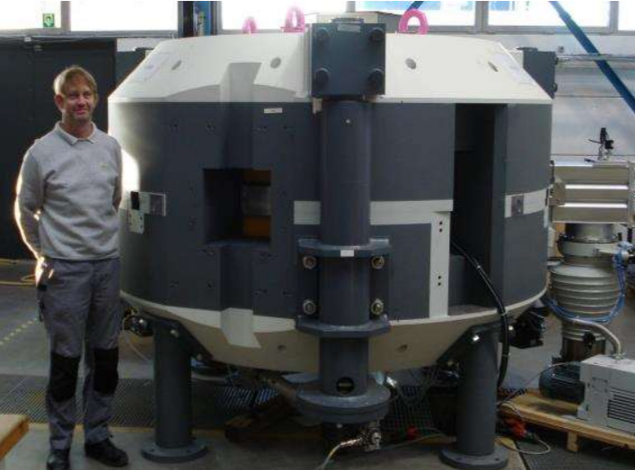
Current cyclotrons for proton therapy
IBA C230
230 MeV protons
4.3 m Diameter
CW beam
Normal conducting
Magnet: 200 kW
RF: 60 kW
Varian-Accel Probeam
250 MeV protons
3.1 m Diameter
CW beam
Superconducting (NbTi)
Magnet: 40 kW
RF: 115 kW
Mevion SC250
250 MeV protons
~1.5 m Diameter (shield)
Superconducting (Nb₃Sn)
IBA S2C2
MeV protons
2.2 m Diameter
Rep. rate: 1 kHz
Superconducting (NbTi)
RF: 11 kW

Slide 5
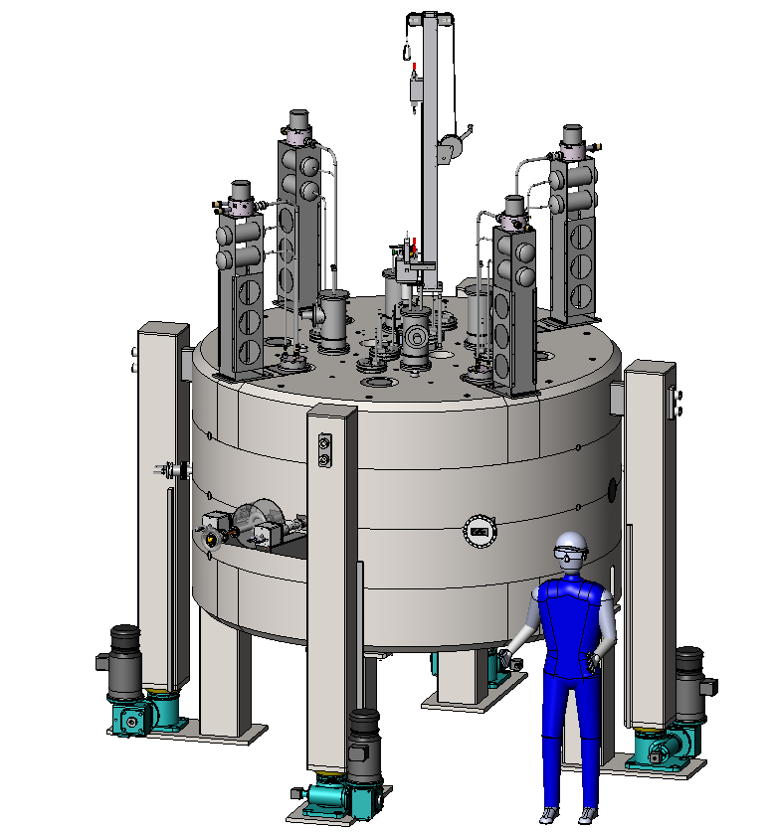
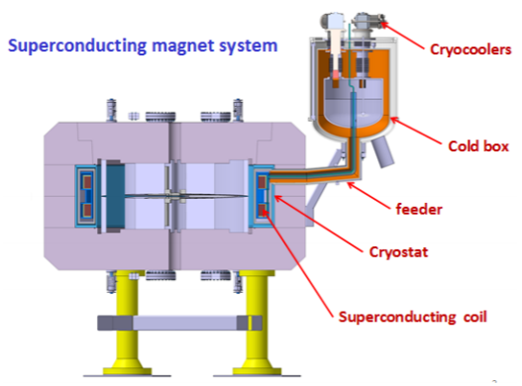
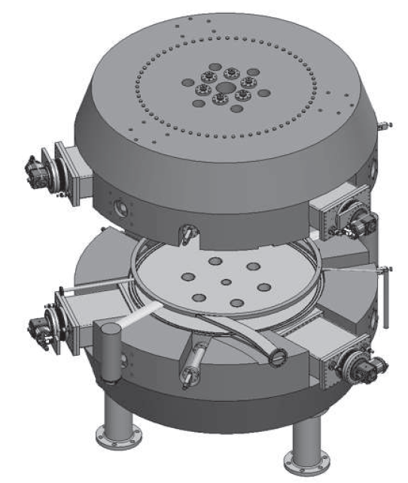
Ongoing cyclotron developments : fixed energy
SHI
230 MeV protons
2.8 m Diameter
CW beam
Superconducting (NbTi)
55 tons
4 T (extr.)
Pronova/Ionetix
250 MeV protons
2.8 m Diameter
CW beam
Superconducting (Nb₃Sn)
60 tons
3.7 T (extr)
Hefei/JINR
200 MeV protons
2.2 m Diameter
CW beam
Superconducting
30 tons
3.6 T (extr.)
Varian/Antaya
230 MeV protons
2.2 m Diameter
CW beam
Superconducting (Nb₃Sn)
30 tons+
5.5 T (extr.)
“Flutter” coils

Slide 6
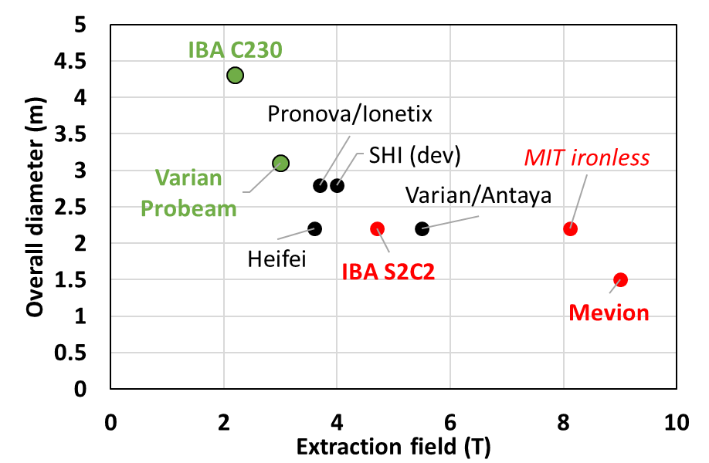
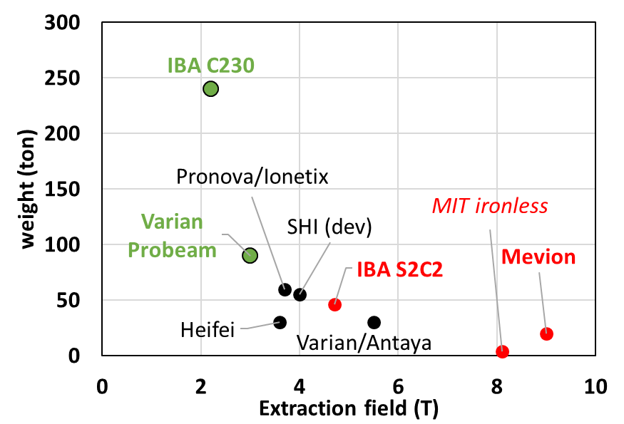
Size and weigth versus field

Slide 7
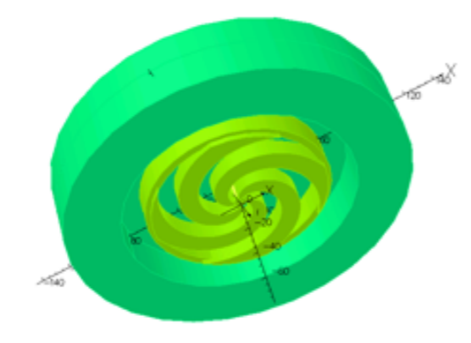


Limits for isochronous cyclotrons
Minervini, MIT, DTRA-TR-12-40
$\frac{d<B\left(r\right)>}{dr}$ > 0 : f=cte = isochronous cyclotron
⇒ Continuous beam
$\frac{d<B\left(r\right)>}{dr}$ < 0 : dfdt < 0 = synchro cyclotron
⇒ Pulsed beam

Slide 8
Superconducting (SC) challenges
Fabrication of SC coils on industrial scale
Cryogenics installation : cryocoolers (“dry”) or He bath (“wet”, ex. fast ramping)
In synchro cyclotrons the SC coil position is crucial in extracting the correct energy and direction of the beam
  S2C2 (5.7 T central field) :
    Horizontal positioning precision down to 0.1 mm needed
    Vertical beam angles sensitive to sub 0.1 mm vertical tilt/shift of the coil
  MEVION (9 T central field) :
  Cyclotron rotates with gantry : active tie rod system needed

Slide 9
Major future challenges

Slide 10
Major future challenges
Minimize beam losses
  Reduce decommissioning costs
  Reduce shielding requirements = reduce size
  Synchro-cyclotron : largely asymmetric emittances
  No more degrader …
Variable energy accelerators
  Linacs
  Synchrotrons
  FFAG’s
  Superconducting (ironless) synchro-cyclotrons
  + achromatic gantries

Slide 11
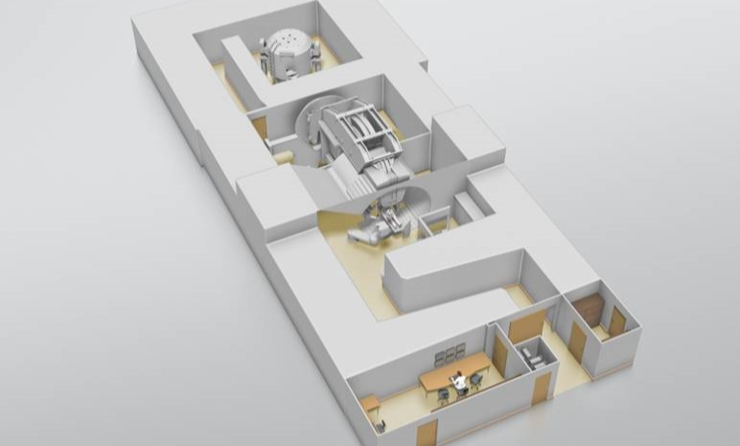
The degrader in the IBA ProteusONE®
Treatment room
Cyclotron vault
degrader

Slide 12
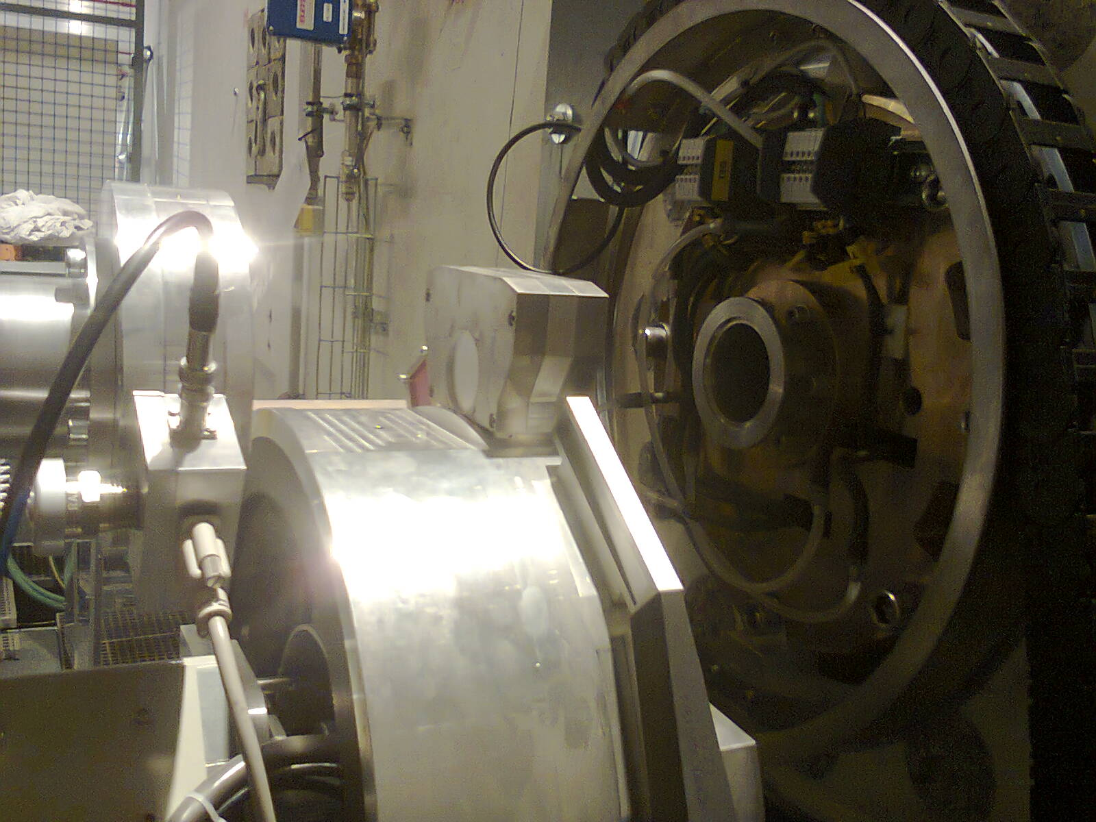
The degrader in the IBA ProteusONE®
Symmetric emittance in front of rotating gantry needed
BPM + beamstop on degrader position
Air filled IC in front of degrader

Slide 13
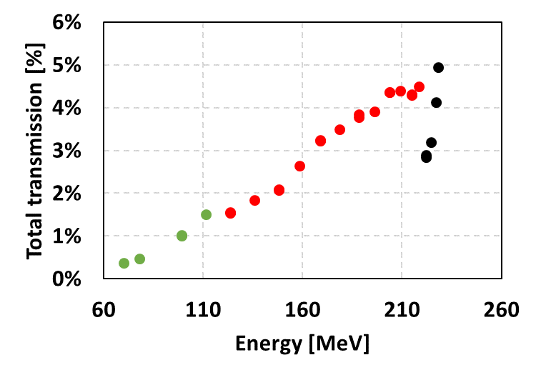
The degrader in the IBA ProteusONE®
Transmission from cyclotron exit to isocenter
Graphite
Al
Be

Slide 14
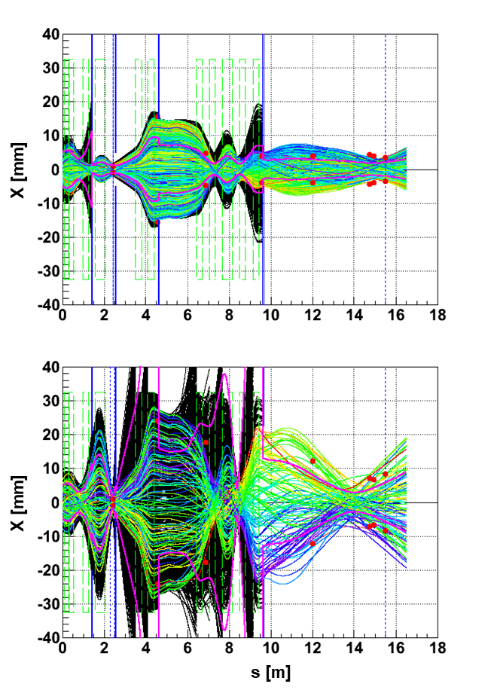
The degrader in the IBA ProteusONE®
Horizontal beam tracks
Transmission from cyclotron exit to isocenter
Graphite
Al
230 MeV
Be
70 MeV

Slide 15
Major future challenges
Minimize beam losses
  Reduce decommissioning costs
  Reduce shielding requirements = reduce size
  Synchro-cyclotron : largely asymmetric emittances
  No more degrader …
Variable energy accelerators
  Linacs
  Synchrotrons
  FFAG’s
  Superconducting (ironless) synchro-cyclotrons
  + achromatic gantries

Slide 16
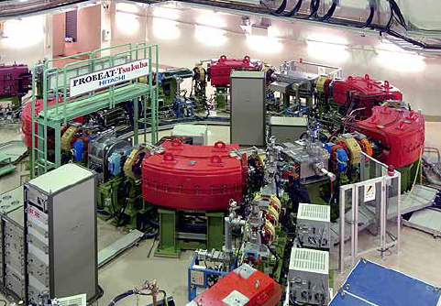
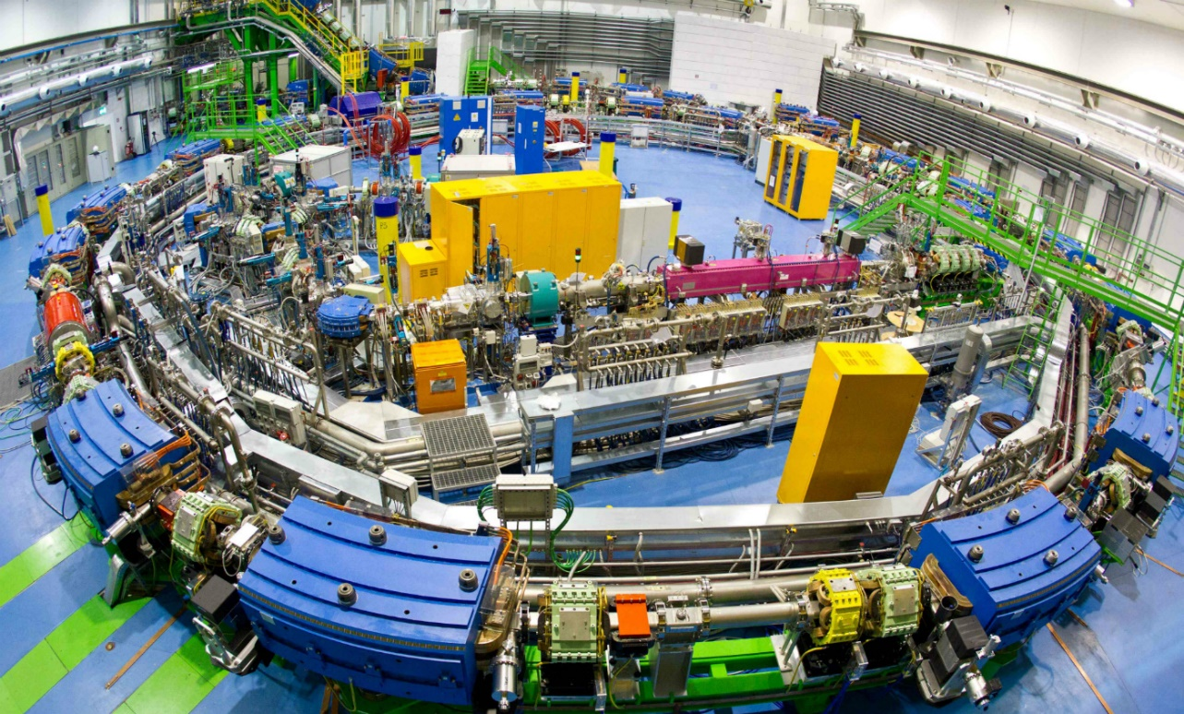
Variable energy options
Hitachi
70-250 MeV protons
Slow (>1s) or fast cycling (50 ms)
7 m Diameter
“PIMMS” (CERN) design
Up to Carbon
25 m Diameter
Rep. rate: 5 Hz
Installed @CNAO, MedAustron

Slide 17
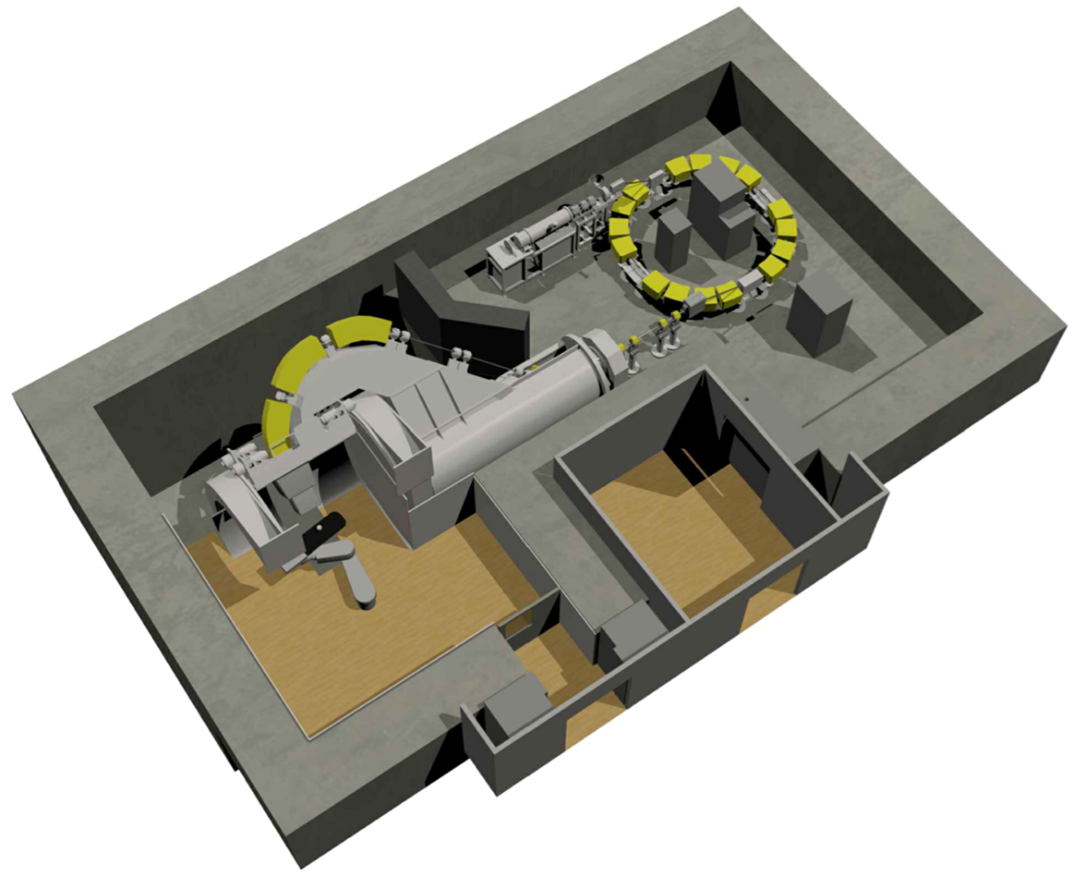
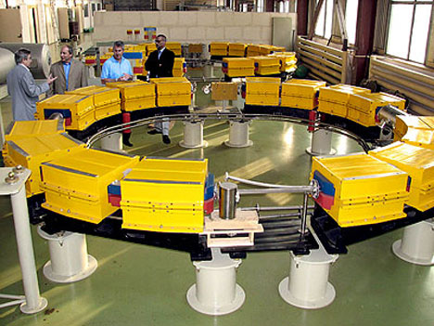
Variable energy options
Protom
Up to 330 MeV protons
5 m Diameter, ~16 tons
Being installed @MGH

Slide 18
Variable energy cyclotron (development)
∅ 2.8 m
MIT/ProNova
250 MeV protons
(2.4-)2.8 m Diameter
Pulsed beam
Superconducting (Nb₃Sn)
4 tons
Cost …. ?
Variable-energy possible

Slide 19
Beam diagnostics in the IBA ProteusONE®

Slide 20
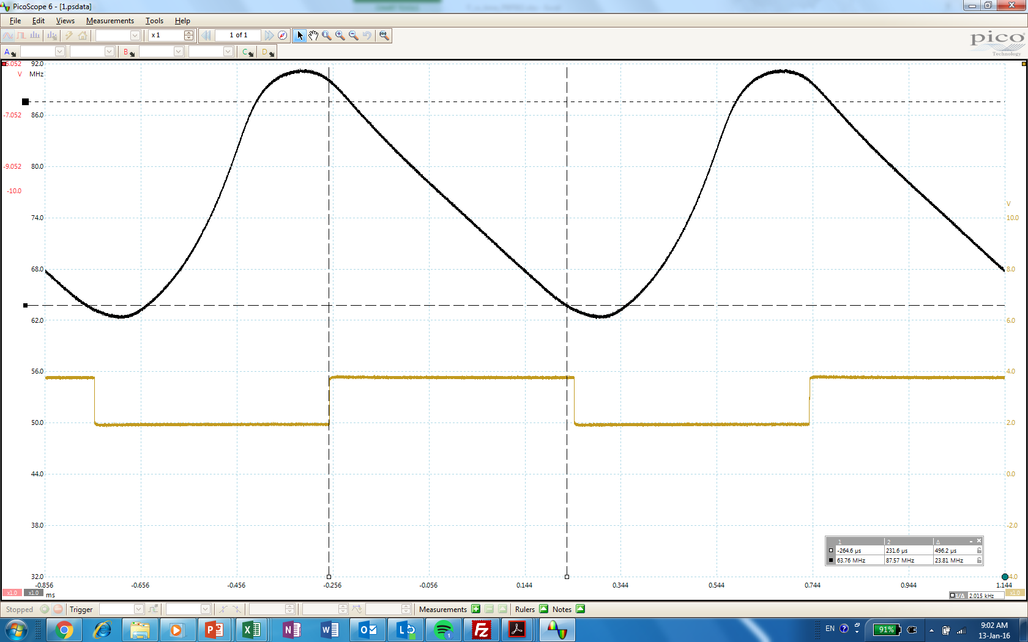
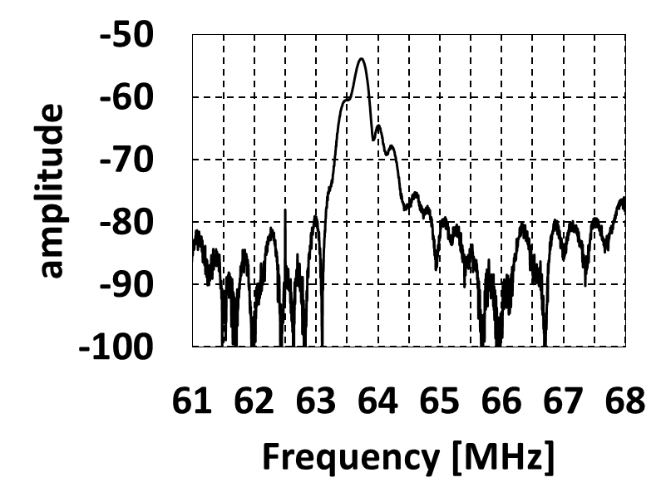
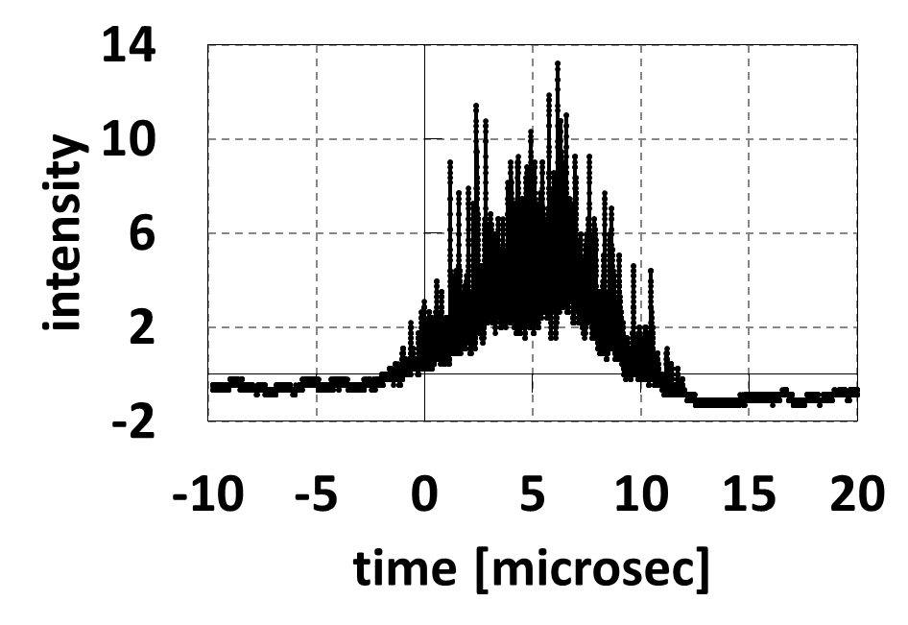

S2C2 and ProteusONE® : time structure
92
86
80
RF Frequency [MHz]
74
68
62
10
5
RF voltage [kV]
0
0
200
400
600
800
1000
$$2πf=\frac{qB(r)}{γm_{0}}$$
Time [μs]
Fourier transform of diamond signal
Diamond detectors (in collaboration with Cividec)

Slide 21

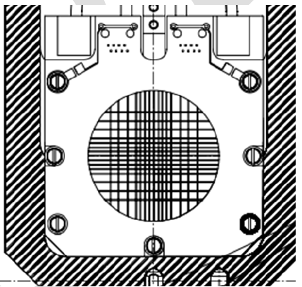
Beam monitor devices in the CGTR ^{(*)} : BPM’s
(*) Compact Gantry, part of the ProteusONE® system
1. Beam Position Monitor (BPM)
Air filled ionization chamber with H & V wires
∅ 60 mm
degrader

Slide 22
Beam monitor devices in the CGTR ^{(*)} : BPM’s
(*) Compact Gantry, part of the ProteusONE® system
1. Beam Position Monitor (BPM)
Air filled ionization chamber with H & V wires
∅ 60 mm
@ end of “energy selection system” (ESS)
Disperion function maximized
degrader

Slide 23
Beam monitor devices in the CGTR ^{(*)} : BPM’s
(*) Compact Gantry, part of the ProteusONE® system
1. Beam Position Monitor (BPM)
Air filled ionization chamber with H & V wires
∅ 60 mm
@ entrance of scanning magnets
degrader

Slide 24
Beam monitor devices in the CGTR : BPM’s
Horizontal beam tracks
1. Beam Position Monitor (BPM)
Air filled ionization chamber with H & V wires
∅ 60 mm
230 MeV
degrader
70 MeV

Slide 25
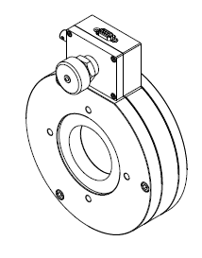
Beam monitor devices in the CGTR : IC CYCLO
1. Beam Position Monitor (BPM)
2. IC CYCLO (Ionization chamber) + BEAMSTOP
Measures beam pulses coming out the S2C2 : 0.100 to 150 pC/pulse (1e6-1e9 protons)
IC CYCLO : 2 IC’s with 1 mm and 2.5 mm gap (asymmetric ionization chamber)
degrader

Slide 26
Beam monitor devices in the CGTR : IC CYCLO
1. Beam Position Monitor (BPM)
2. IC CYCLO (Ionization chamber) + BEAMSTOP
3. Nozzle IC’s
Measures beam pulses in the nozzle : 0.100 to 4 pC/pulse
Asymmetric IC’s (2 gap sizes : 3 and 5 mm)
degrader

Slide 27
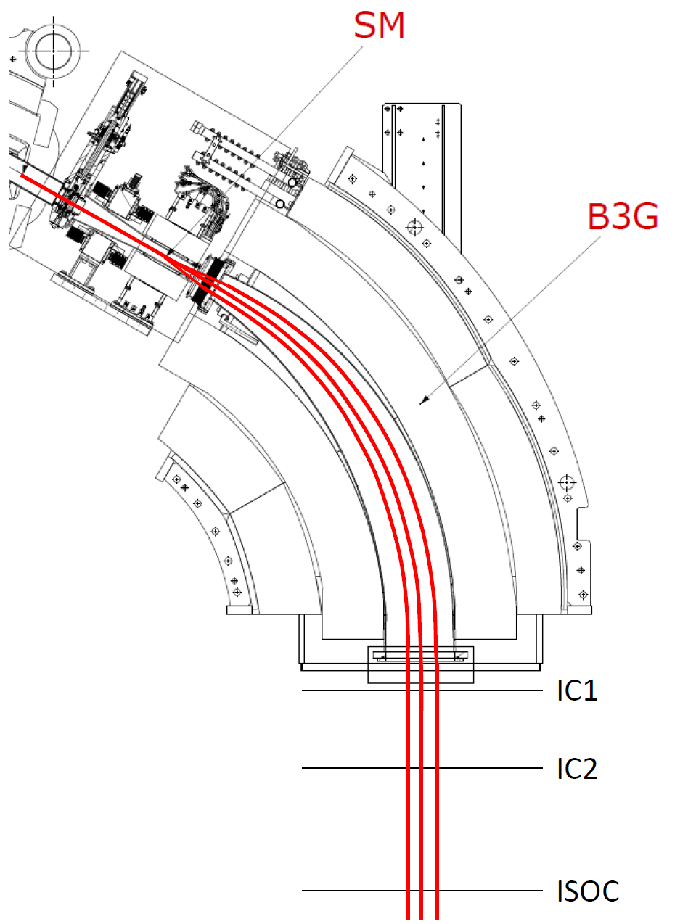
Nozzle beam diagnostics
Upstream scanning
Large area air-filled IC (30x30 cm²)
HV : 1.3 kV
Position and charge (dose) measurement
Recombination is major issue

Slide 28
The asymmetric IC
92
86
80
RF Frequency [MHz]
74
68
62
0
200
400
600
800
1000
Time [μs]
Ionization current (200 μs)
Proton pulse (10 μs)

Slide 29
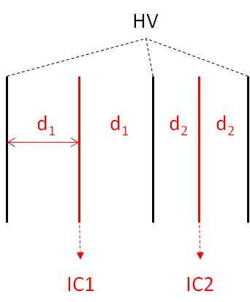


The asymmetric IC
92
86
80
RF Frequency [MHz]
74
68
62
0
200
400
600
800
1000
Time [μs]
Ionization current (200 μs) : integrated charge = $Q_{1,2}$
Proton pulse (10 μs)
d₁ = 3 mm
d₂ = 5 mm
beam
$$Q_{1}$$
$$Q_{2}$$

Slide 30
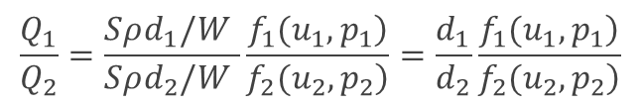
The asymmetric IC
92
86
80
RF Frequency [MHz]
74
68
62
0
200
400
600
800
1000
Time [μs]
Ionization current (200 μs) : integrated charge = $Q_{1,2}$
Proton pulse (10 μs)
d₁ = 3 mm
d₂ = 5 mm
$$\frac{Q_{1}}{Q_{2}}=\frac{Sρd_{1}/W }{Sρd_{2}/W }\frac{\left.f_{1}(u_{1},p_{1}\right)}{\left.f_{2}(u_{2},p_{2}\right)}=\frac{d_{1}}{d_{2}}\frac{\left.f_{1}(u_{1},p_{1}\right)}{\left.f_{2}(u_{2},p_{2}\right)}$$
beam
$$Q_{1}$$
$$Q_{2}$$

Slide 31
The asymmetric IC
92
86
80
RF Frequency [MHz]
74
68
62
0
200
400
600
800
1000
Time [μs]
Ionization current (200 μs) : integrated charge = $Q_{1,2}$
Proton pulse (10 μs)
Charge collection efficiency
d₁ = 3 mm
d₂ = 5 mm
Charge amplification
$$\frac{Q_{1}}{Q_{2}}=\frac{Sρd_{1}/W }{Sρd_{2}/W }\frac{\left.f_{1}(u_{1},p_{1}\right)}{\left.f_{2}(u_{2},p_{2}\right)}=\frac{d_{1}}{d_{2}}\frac{\left.f_{1}(u_{1},p_{1}\right)}{\left.f_{2}(u_{2},p_{2}\right)}$$
beam
$$Q_{1}$$
$$Q_{2}$$

Slide 32
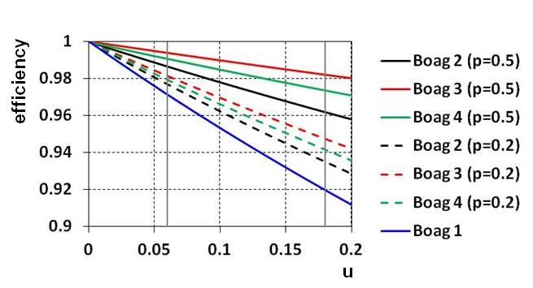
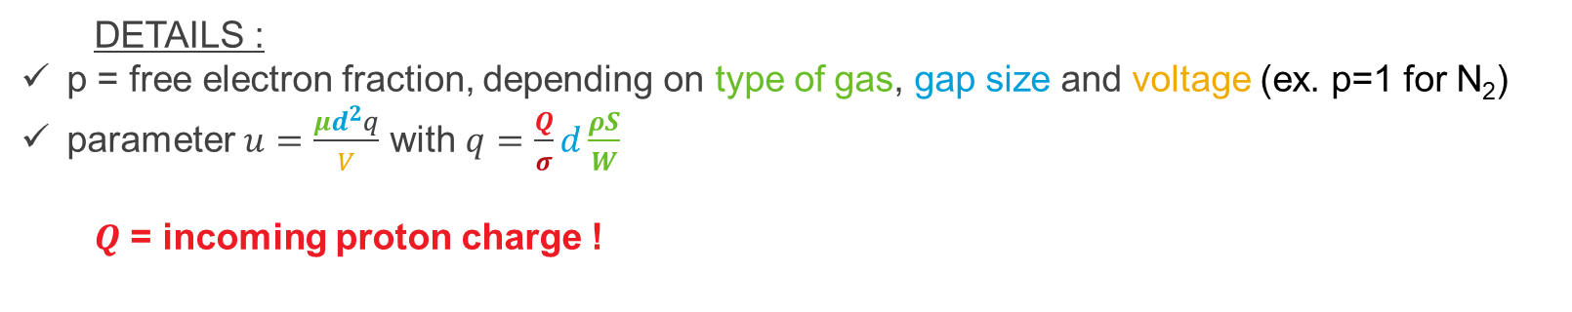

Boag theory for pulsed beams
Boag et al., Phys. Med. Biol. 41, 885 (1996)
$$collection efficiency f=p+\frac{1}{u}\ln\left(1+\left(1−p\right)u\right)$$
PARAMETERS :
- type of gas (air, N₂, …)
- type of particle (protons)
- gap size
- voltage
- spot size
DETAILS :
p = free electron fraction, depending on type of gas, gap size and voltage (ex. p=1 for N₂)
parameter $u=\frac{μd^{2}q}{V}$ with $q=\frac{Q}{σ}d\frac{ρS}{W}$
$Q$ = incoming proton charge !

Slide 33
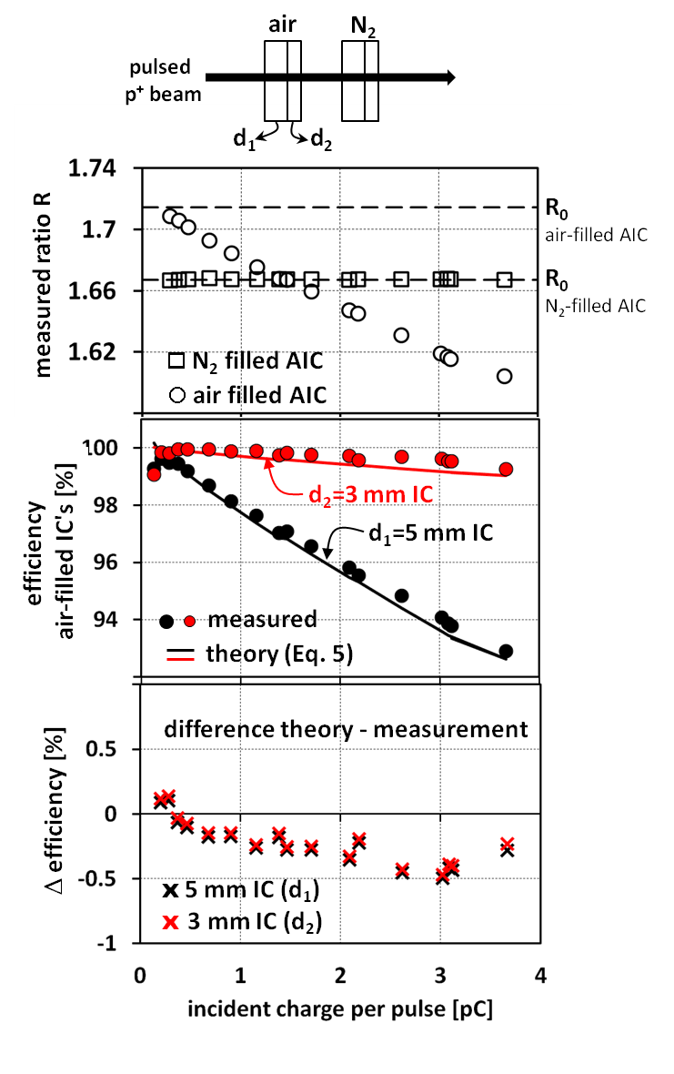
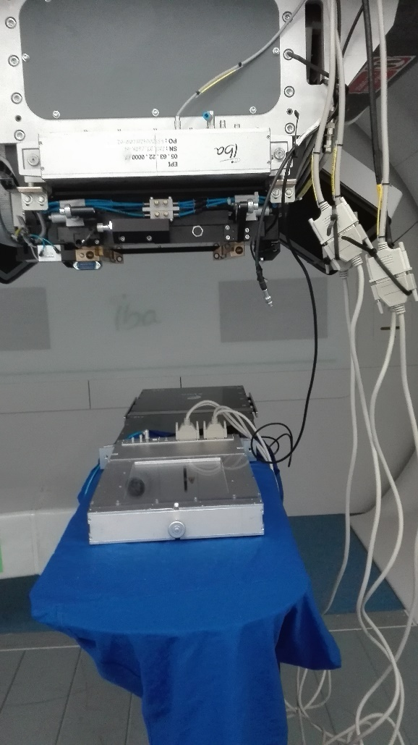
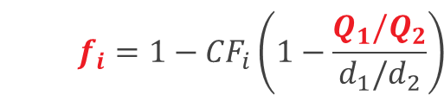

The asymmetric IC
$$\frac{Q_{1}}{Q_{2}}=\frac{Sρd_{1}/W }{Sρd_{2}/W }\frac{\left.f_{1}(u_{1},p_{1}\right)}{\left.f_{2}(u_{2},p_{2}\right)}=\frac{d_{1}}{d_{2}}\frac{\left.f_{1}(u_{1},p_{1}\right)}{\left.f_{2}(u_{2},p_{2}\right)}$$
$$f_{i}=1−{CF}_{i}\left(1−\frac{Q_{1}/Q_{2}}{d_{1}/d_{2}}\right)$$

Slide 34
Conclusions
Reduce footprint of proton therapy facility :
  Reduce cyclotron size → trend towards synchro-cyclotrons
  Reduce beam losses → reduce shielding
  Variable energy option : superconducting ironless synchro-cycloton
Beam diagnostics :
  Non-interceptive …
  Consider difference pulsed vs continuous beam

Slide 35
Thank you
Jarno Van de Walle
Jarno.vandewalle@iba-group.com

Slide 36
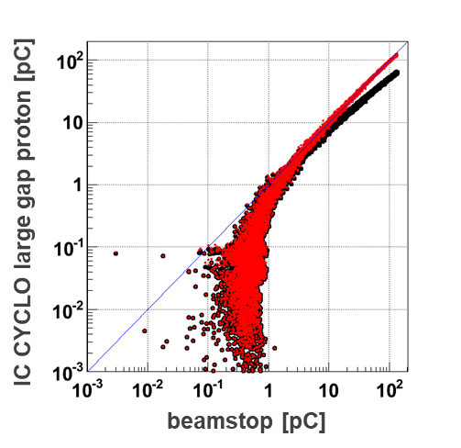
The asymmetric IC : example (IC CYCLO)

Slide 37
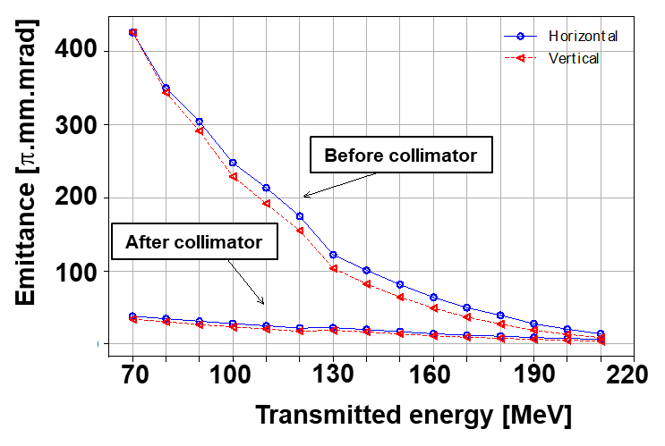
Beam losses : degrader
Emittance increases a lot for lower energies.
A circular collimator in front of the gantry reduces losses inside the gantry considerably

