Slide 1





Design and Optimisation of Ultra-Compact, High-Resolution
X-Ray Imaging Systems
Thomas Primidis
3rd OMA Topical Workshop – Medical Accelerator Design and Diagnostics

Slide 2
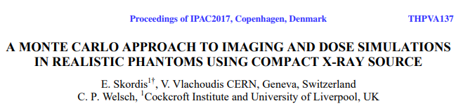
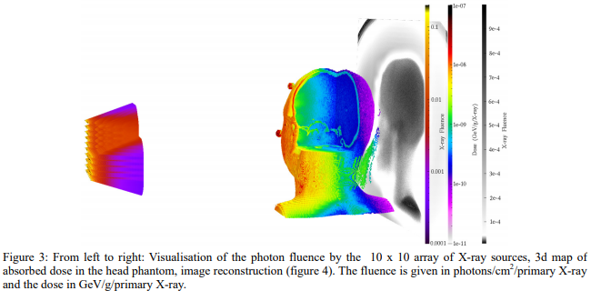
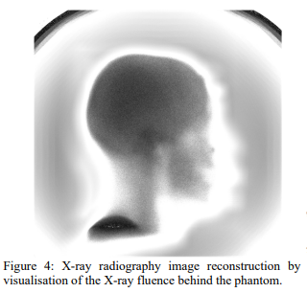

Slide 3
Digital Tomosynthesis vs Computerised Tomography
Around double dose than X-ray but offers depth information.
Much higher dose than X-ray but offers great 3D detail.

Slide 4
The benefit of the emitter array

Slide 5

Contents
Electron generation and acceleration
X-ray production from deceleration of electrons in a high Z target.
Filtration of the X-ray beam.
Transport of X-rays in the phantom-patient.
Radiation collection in a pixelated detector and generation of an image.
3D image reconstruction using generated images.
Discussion on the methods, approximations and next steps.

Slide 6
X-ray generation
6σ=100μm
Ta
a few μm
Al filter
1.5mm
X-rays
Gaussian beam spot
60 keV e- pencil beam
0 emittance
90 degrees incident angle
No magnetic field
No electric field

Slide 7
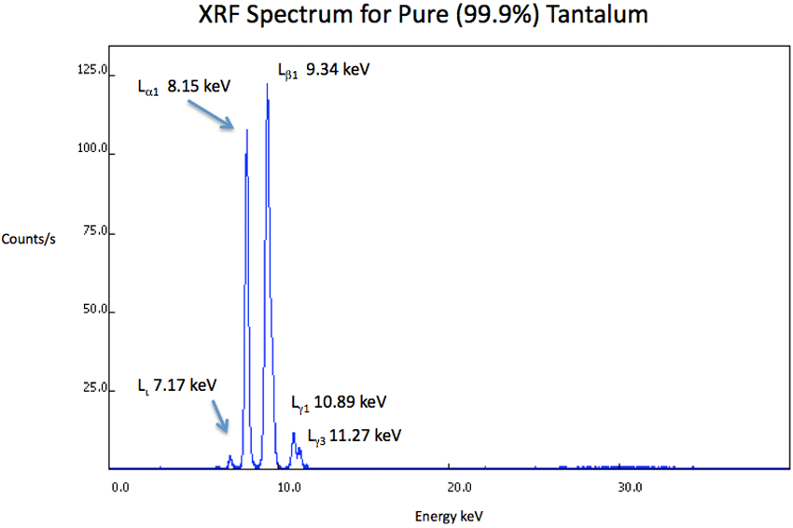
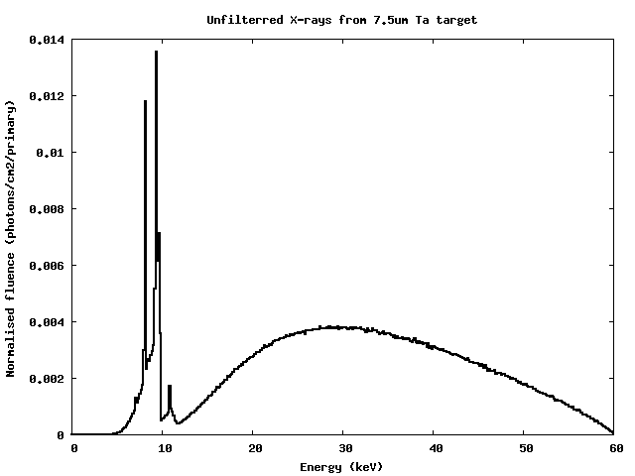
Compare the unfiltered spectrum with literature
Taken from
www.xrfresearch.com
on 7/12/18

Slide 8
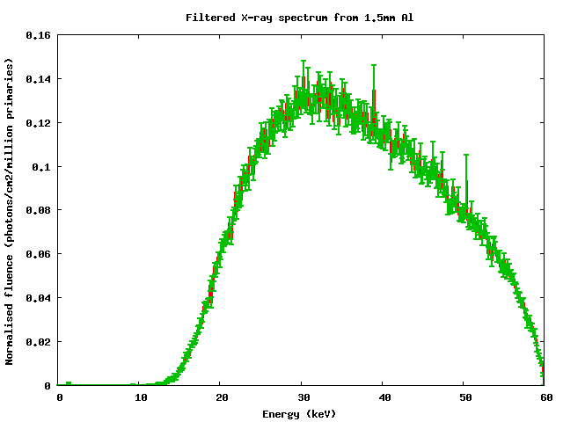
The spectrum after the Al filter.
Approximate this with a Gaussian:
μ=30keV
3σ=20keV

Slide 9
The emitter array
45 point X-ray sources
7x7 configuration
1cm pitch
Uniform cone beam each of
40 degrees full cone angle
Spectrum is Gaussian approximation of the previous simulation.

Slide 10
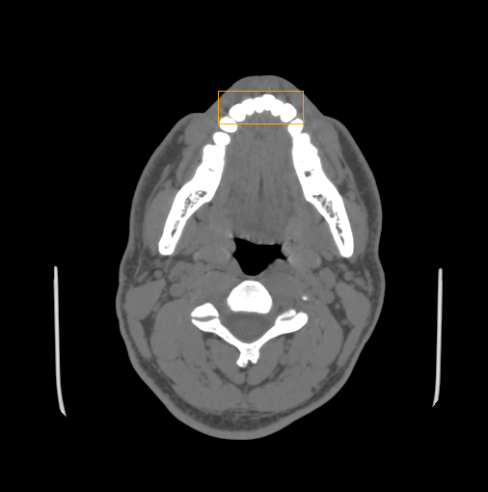
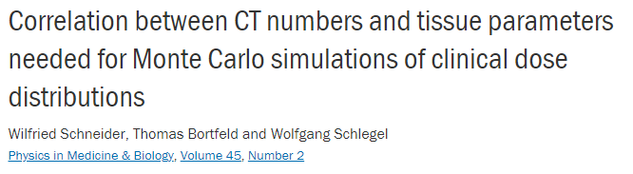
The phantom human head
Voxel size: 0.488mmx0.488mmx1.25mm
89 voxels x0.488=43.5mm
Anonymous phantom in DICOM format taken from:
Patient Contributed Image Repository www.pcir.org
35 voxels x0.488=17.1mm
184 slices x1.25=230 mm

Slide 11
The ideal X-ray detector
100% X-ray detection efficiency
100μm x 100μm pixel size
360 pixels, 36 mm total width
260 pixels, 26mm total height

Slide 12
The simulation geometry
Phantom selected volume
Emitter array plane
Detector 1mm away from phantom at teeth height.
Source Detector Distance = 12cm

Slide 13

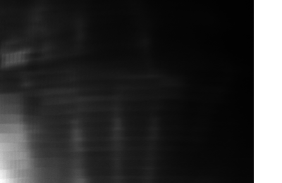
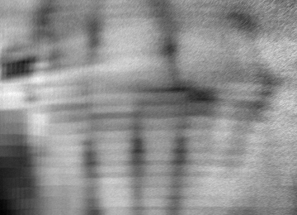



X-Ray images
$$μ=ln\left(\frac{I_{0}}{I}\right)$$
$$I_{0}$$
$$I=I_{0}e^{−μ}$$
Beer-Lambert Law

Slide 14
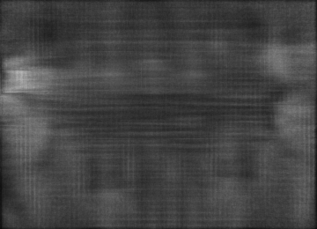
Image reconstruction

Slide 15
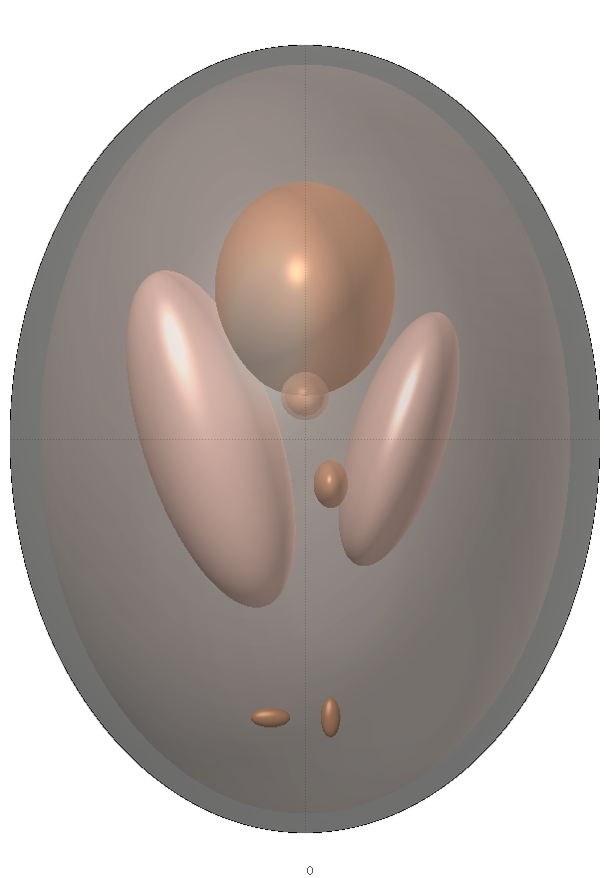
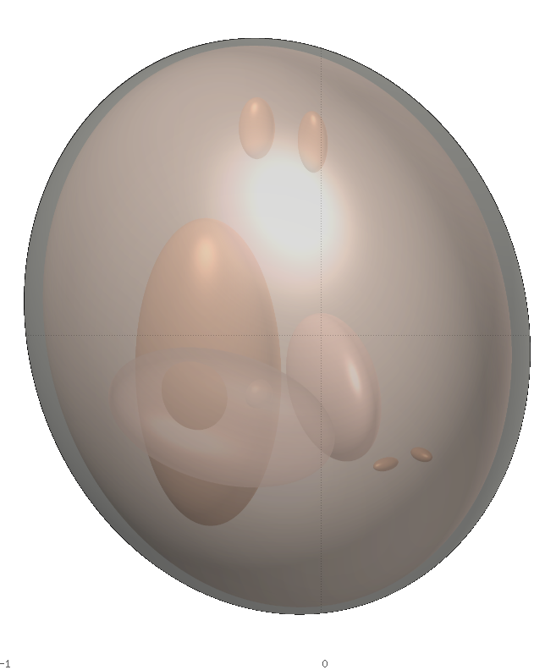

3D Shepp-Logan phantom
Ellipsoid parameters taken from:
HU to material conversion by

Slide 16
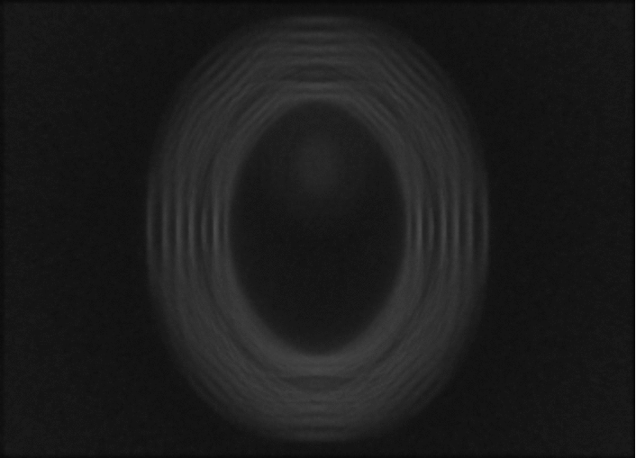
Shepp-Logan phantom digital tomosynthesis

Slide 17
Next steps: Use realistic description of the following
Assumed monoenergetic e- pencil beam with zero emittance.
Neglected electric and magnetic fields in the source geometry.
Fitted a Gaussian instead of sampling energies from the actual spectrum.
Assumed point sources.
Assumed uniform cone beam of X-rays.
Used an ideal detector.
Did not include all the components of the system like collimators etc.
This is only a proof of principle that the image quality of DT can be assessed with Monte Carlo techniques and offer system optimisation potential.

Slide 18
Most important challenge: Phase space sampling
5 orders of magnitude difference
Source simulations only generate a few 100.000 X-rays per day on cluster.
Imaging with high resolution detector requires trillions of X-rays to reduce stat. uncert.

Slide 19
Most important challenge: Phase space sampling
Source simulations only generate a few 100.000 X-rays per day on cluster.
Imaging with high resolution detector requires trillions of X-rays in MC.
A fast way to generate million times more particles must be found.
  Discrete multivariate distributions E(x,y,x`,y`)
  Multivariate Kernel Density Estimation
  Generative Adversarial Neural Networks
  Biasing techniques like particle splitting or even rare event.
  Apply some reasonable approximations.

Slide 20

Thank you
Thomas.Primidis@liverpool.ac.uk
linkedin.com/in/thomasprimidis

