Slide 1
Beam diagnostics for commissioning and operation at MedAustron
OMA 3rd topical workshop
GSI, 12-12-18
Andrea De Franco
Andrea.de.franco@medaustron.at

Slide 2
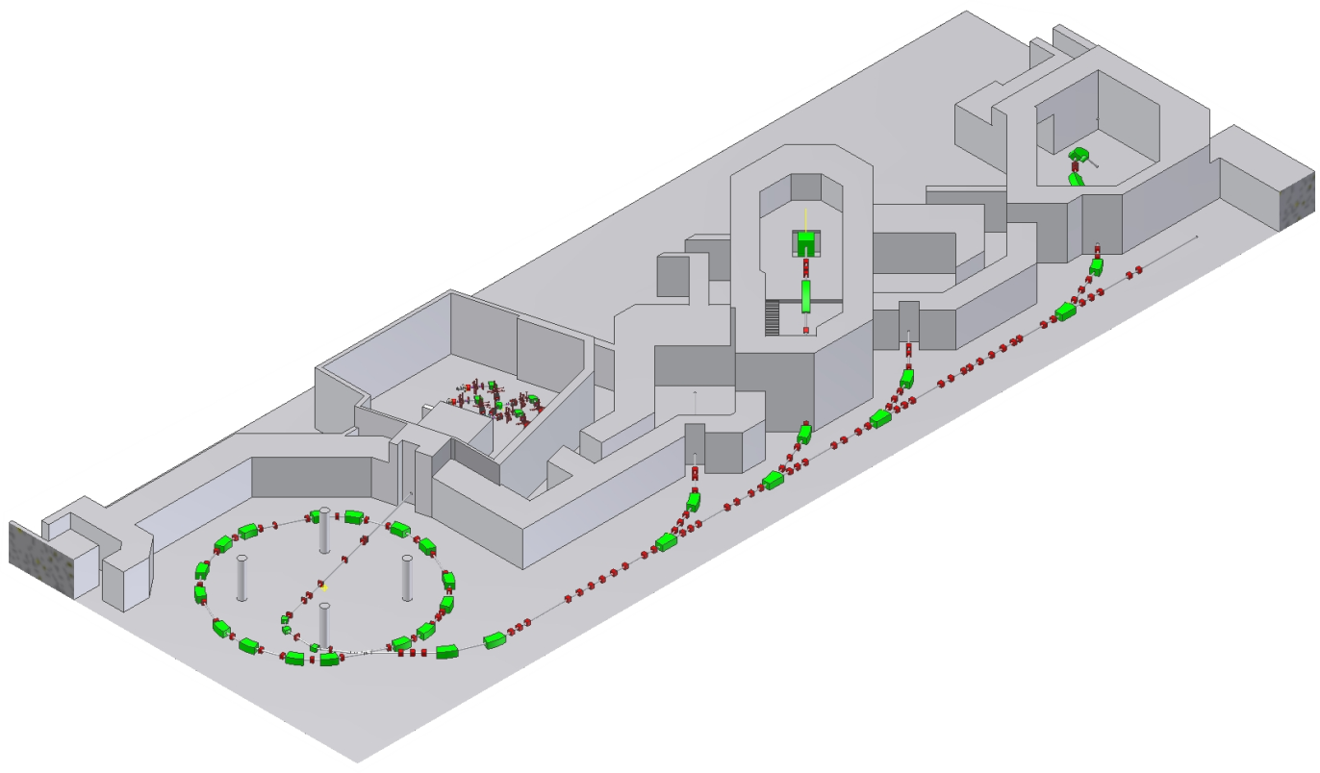
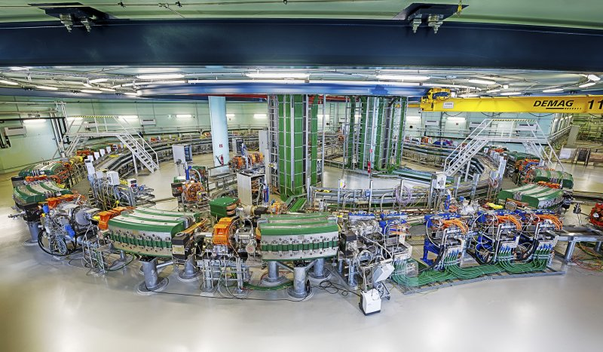
Why Beam Diagnostic?
Commissioning (BC)
Set up the machine
Optimize its settings
Operation – Uptime (OP – TB)
Troubleshooting
Drift prediction and correction
Quality Assurance (QA)
Law
Standards
Risk mitigations

Slide 3
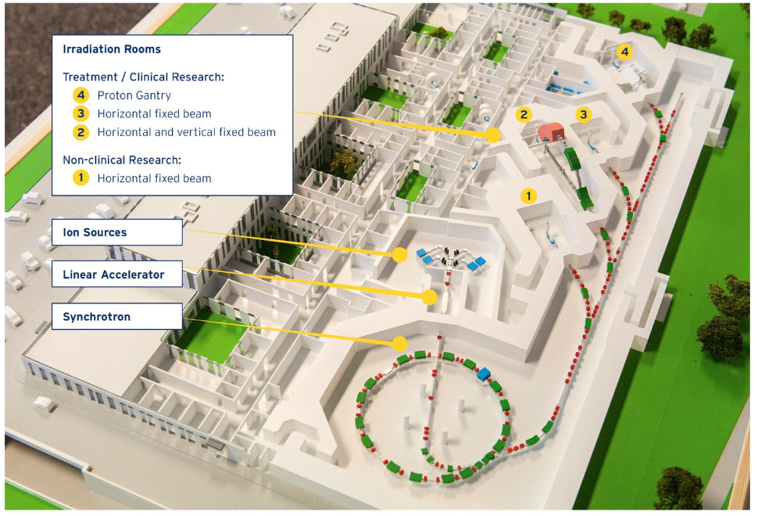
The Beast
Proton: 60 – 250 MeV (NCR: 800)
Carbon: 120 – 400MeV/u

Slide 4
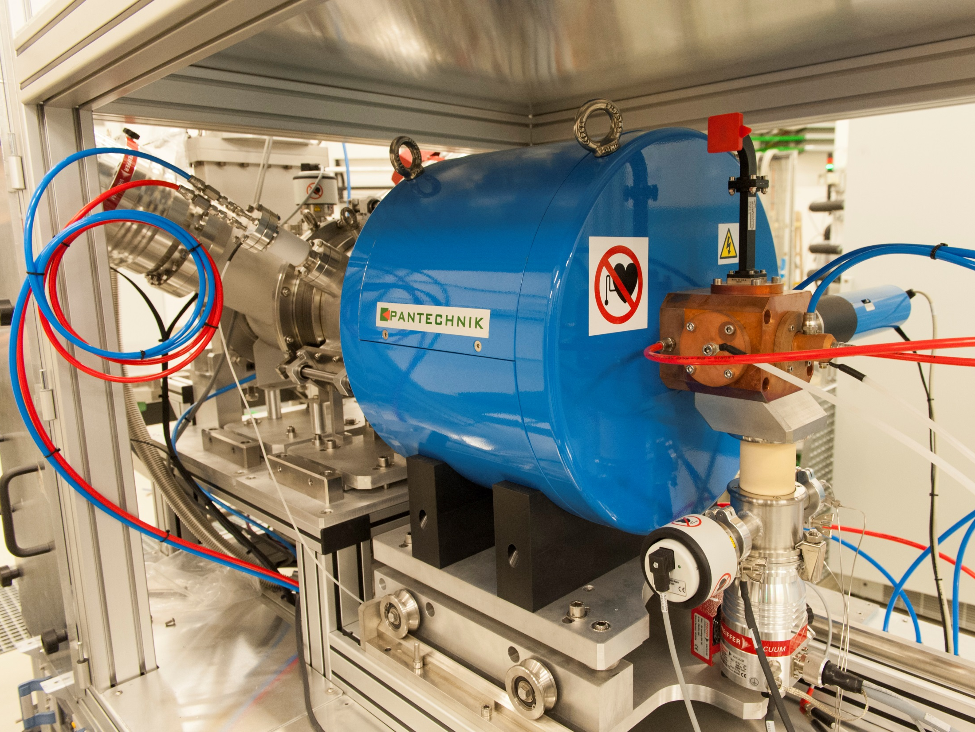
Ion Sources
Where it begins

Slide 5
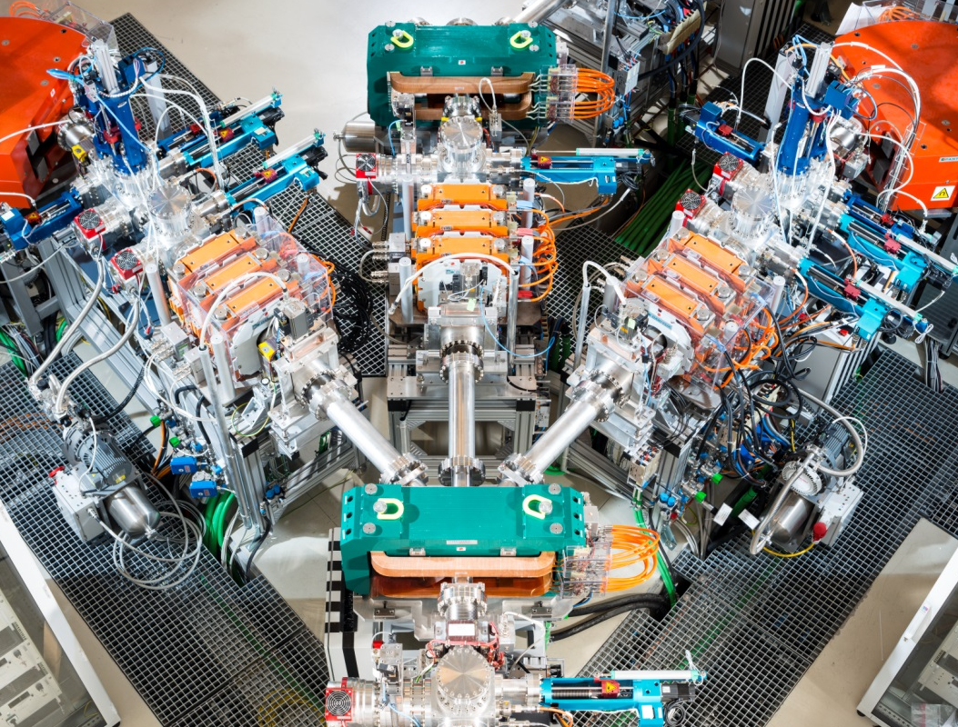
Low Energy Beam Transfer
Source / Particle type selection

Slide 6


The LEBT - BD
En: ~8keV/n
Current: ~100/500 µA (C⁴⁺ / H⁺₃)
Device | Parameters | Non-destructive | Used (how long/often) | Important for
Faraday cup | Intensity |  | BC(all the way) OP(weekly) TB(first!) | Source tuning Source stability
Wire scanners | Profile |  | BC(a week) OP(monthly) TB(rarely) | Optics optimization

Slide 7
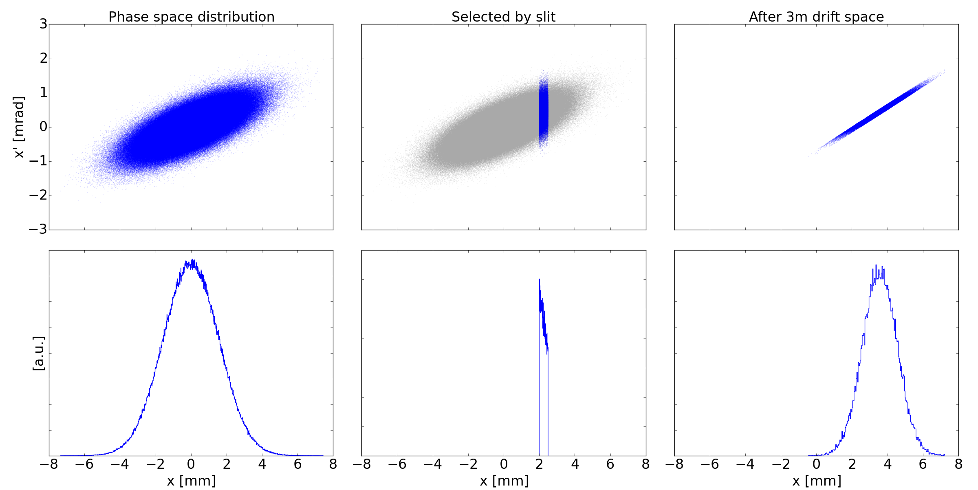
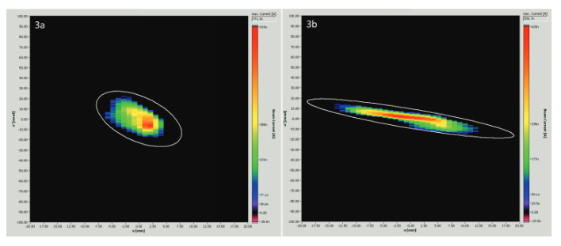
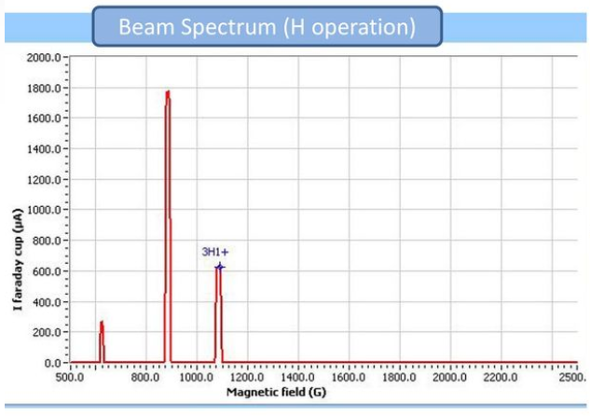
The LEBT - Techniques
Slit-grid emittance
Courtesy of N. Gambino
Courtesy of L. Adler
Source
Beam
Dipole
Different charge/mass
Slits
Monitor
Courtesy of L. Penescu

Slide 8
The LEBT - Techniques
Tecnhique | Parameter s | Devices | Non-destructive | Used for (how long/often) | Important for
Mass spectrometer | Ion Spectrum | Dipole Slits Faraday cup |  | BC(a week) OP(yearly) TB(never) | Source tuning
Slit-grid emittance | Emittance | Slits Wire scanners |  | BC(a week) OP(yearly) TB(rarely) | Source tuning – RFQ matching

Slide 9
The LEBT – Wish List
Parameter | Problems | Alternatives
Emittance | Limited resolution Takes time Emittance stability tricky | Pepper pot

Slide 10
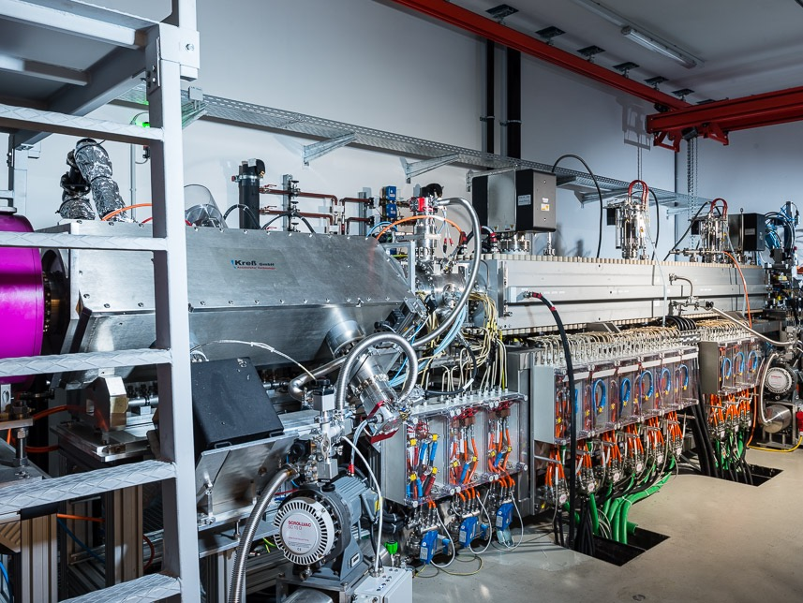
LINEAR ACCELERATOR
A kick to 7MeV/nucleon

Slide 11
The Linac & MEBT - BD
En: ~7MeV/n
Current: ~140/190 µA (C⁶⁺ / H⁺)
Device | Parameters | Non-destructive | Used for (how long/often) | Important for
Grid monitor | Profile |  | BC(3 weeks) OP(twice a year) TB(seldom) | Optics optimization – ring matching
Phase probe | Energy (ToF) |  | BC(2 weeks) OP(monthly) TB(rarely) | RFQ- Linac tuning Ring injection matching
Current transformers | Intensity |  | BC(All the way!) OP(daily) TB(first!) | RFQ-Linac tuning Losses minimization

Slide 12
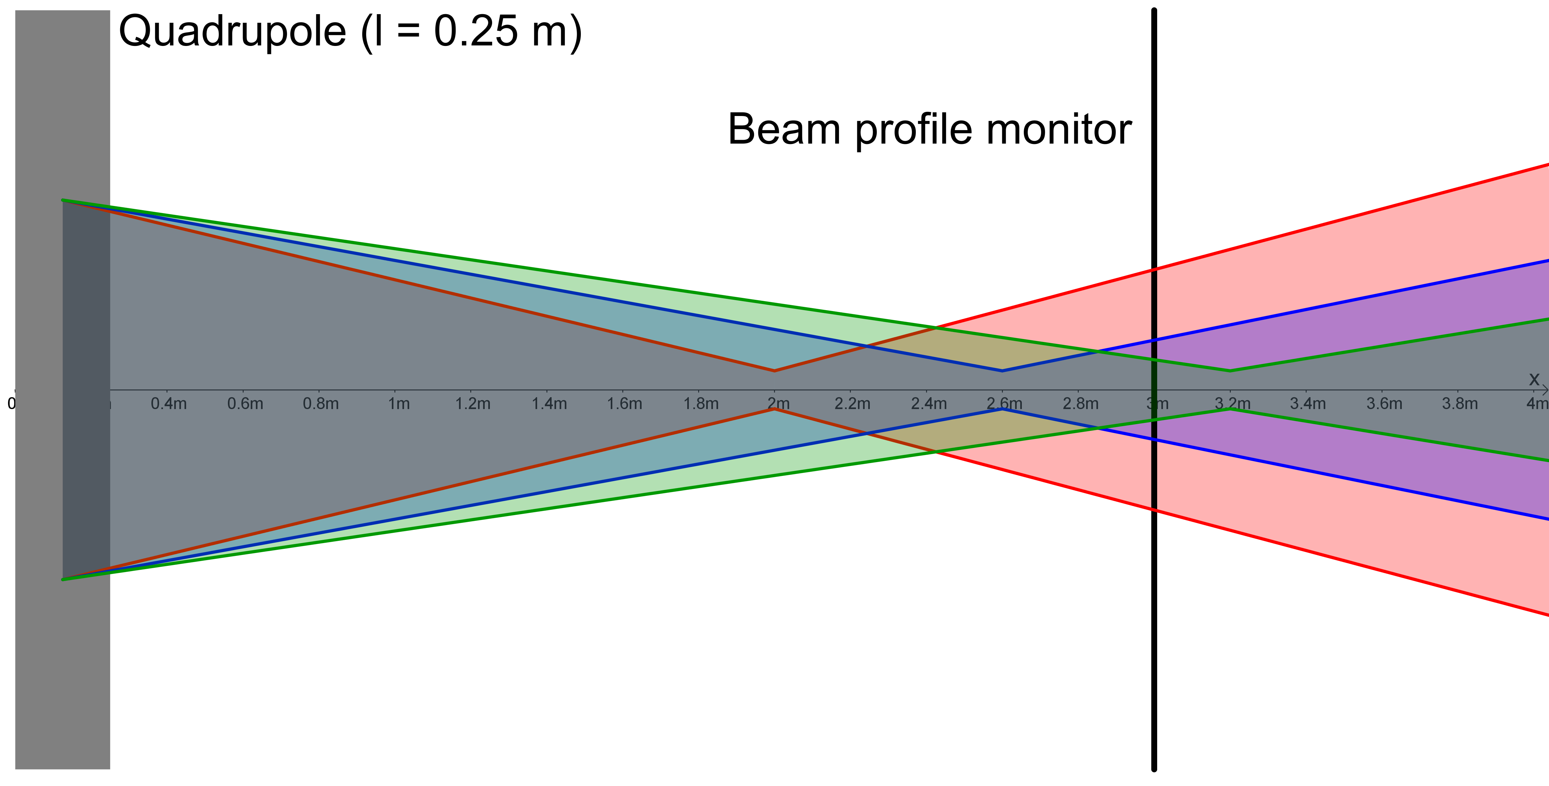

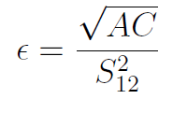
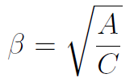
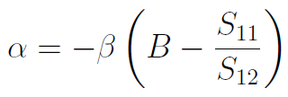
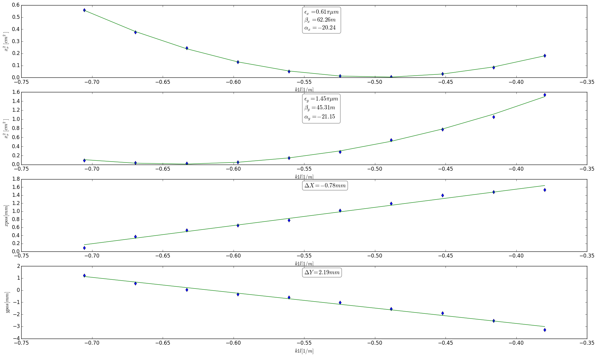
The Linac & MEBT - Techniques
Quadrupole tuning
Courtesy of L. Adler

Slide 13
The Linac & MEBT - Techniques
Tecnhique | Parameters | Devices | Non-destructive | Used for (how long/often) | Important for
Quadrupole tuning | Twiss Beam position offset at quadrupole | Quadrupole Grid monitor |  | BC(2 weeks) OP(never) TB(extremely rarely) | Optics set-up Definition of optical axis

Slide 14
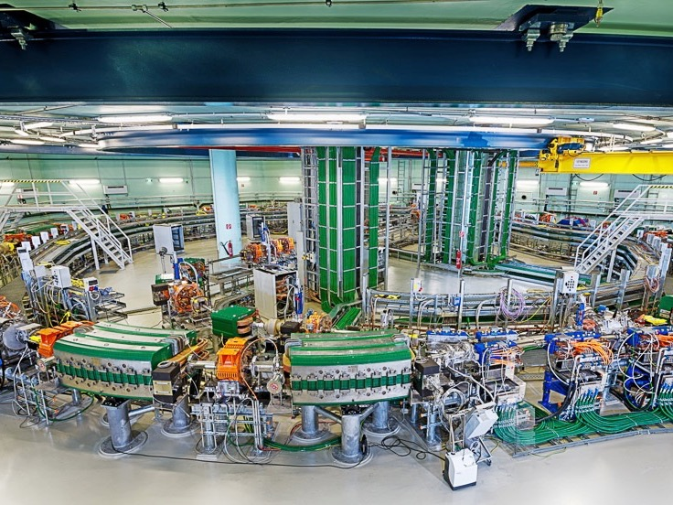
SYNCHROTRON
Where the magic happens

Slide 15
The Synchrotron - BD
Device | Parameters | Non-destructive | Used for (how long/often) | Important for
Pickups | Position |  | BC(all the way) OP(daily) TB(often) | Optics set-up Feedback loops Orbit corrections
Schottky | dp_p, emittance, Tune, Chromaticity |  | BC(a month) OP(monthly) TB(often) | Injection, extraction tuning Avoid resonance crossing
BBQ | Tune |  | BC(2 weeks) OP(yearly) TB(seldom) | Injection, extraction tuning Avoid resonance crossing
Current transformer | Intensity |  | BC(all the way) OP(all the time) TB(first) | Minimize losses Optimise injection

Slide 16
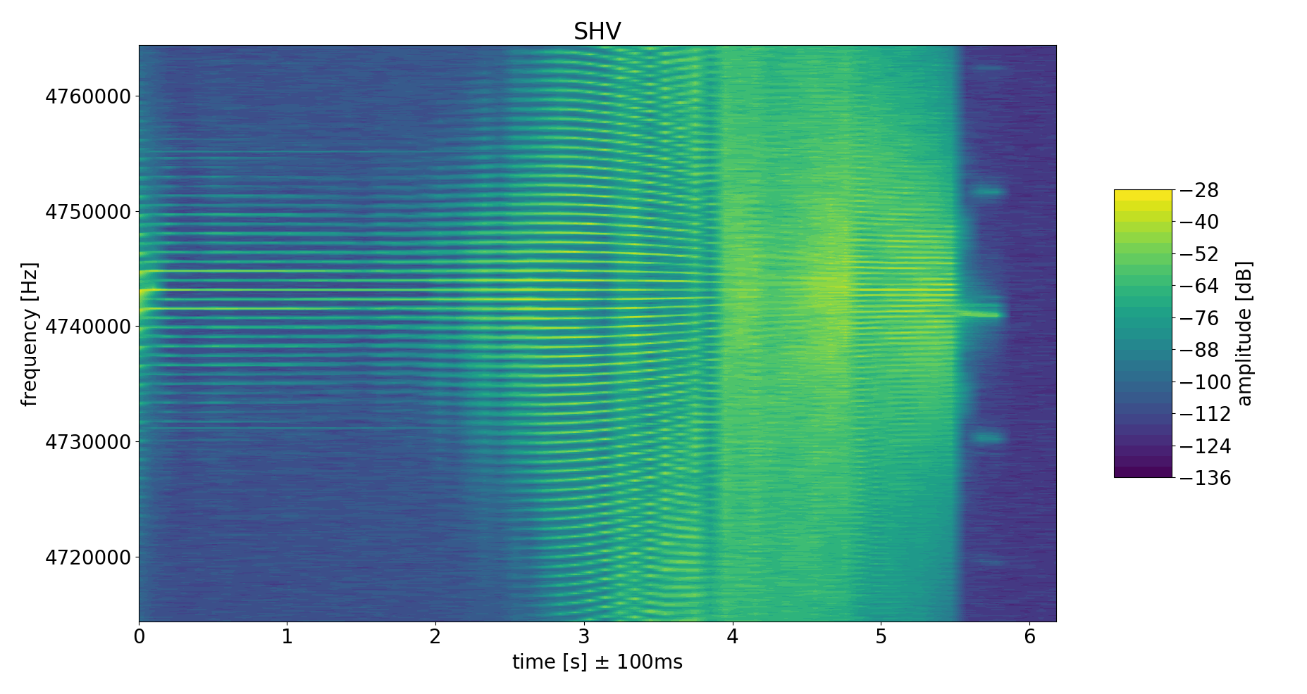
Schottky – Longitudinal
Amplitude
P, Q
Amplitude
P, Q

Slide 17
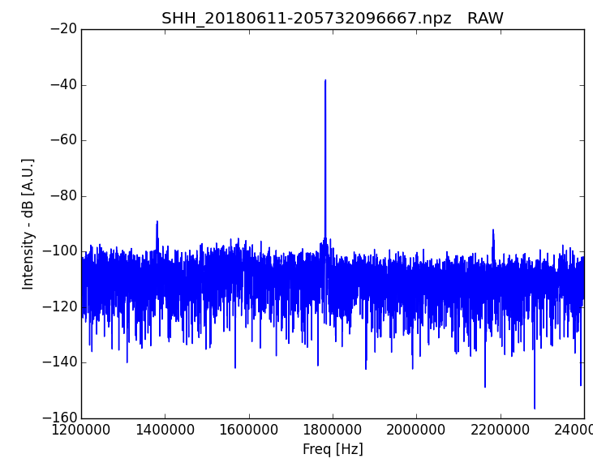
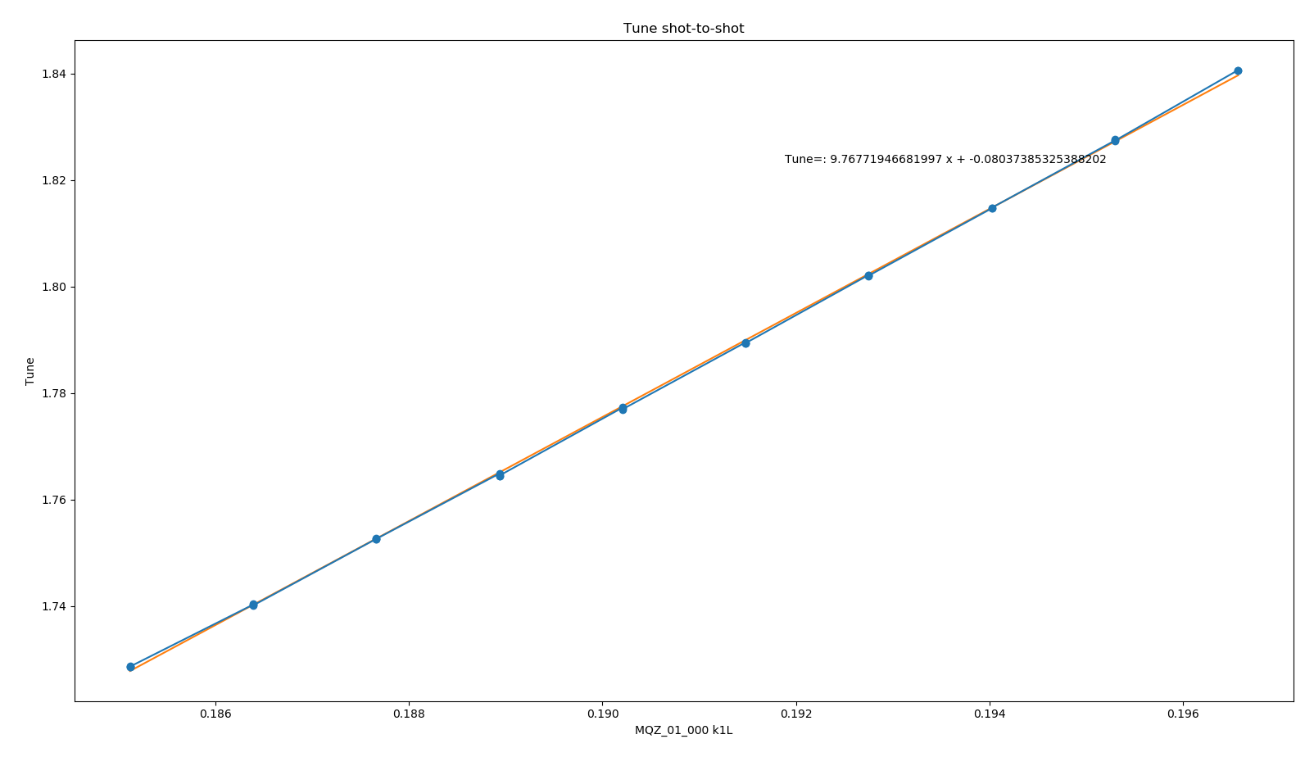
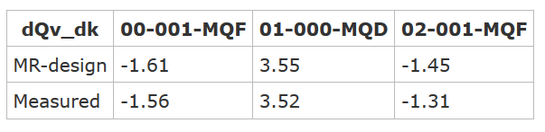
Schottky - Transverse

Slide 18
The Synchrotron - BD
Device | Parameters | Non-destructive | Used for (how long/often) | Important for
Scintillating screens | Profile |  | BC(a day) OP(never) TB(very rarely) | Injection optics First turn only
RF | Frequency / Voltage |  | BC(a month) OP(all the time) TB(often) | Feedback loops Energy verification
Pin diode | Extraction losses |  | BC(2 weeks) OP(yearly) TB(never) | Extraction optimization

Slide 19
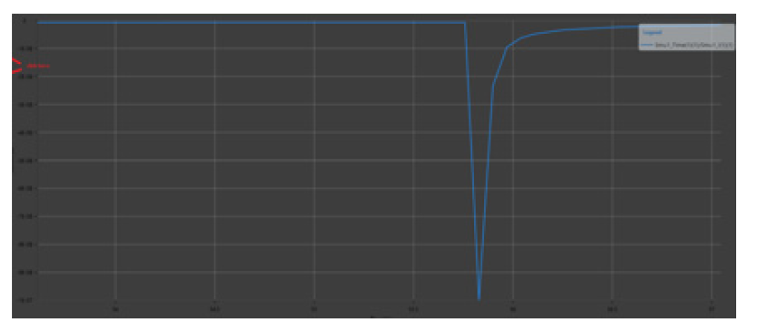
Pin diode
Courtesy of A. Pozenel
Circulating beam
Extracted beam

Slide 20
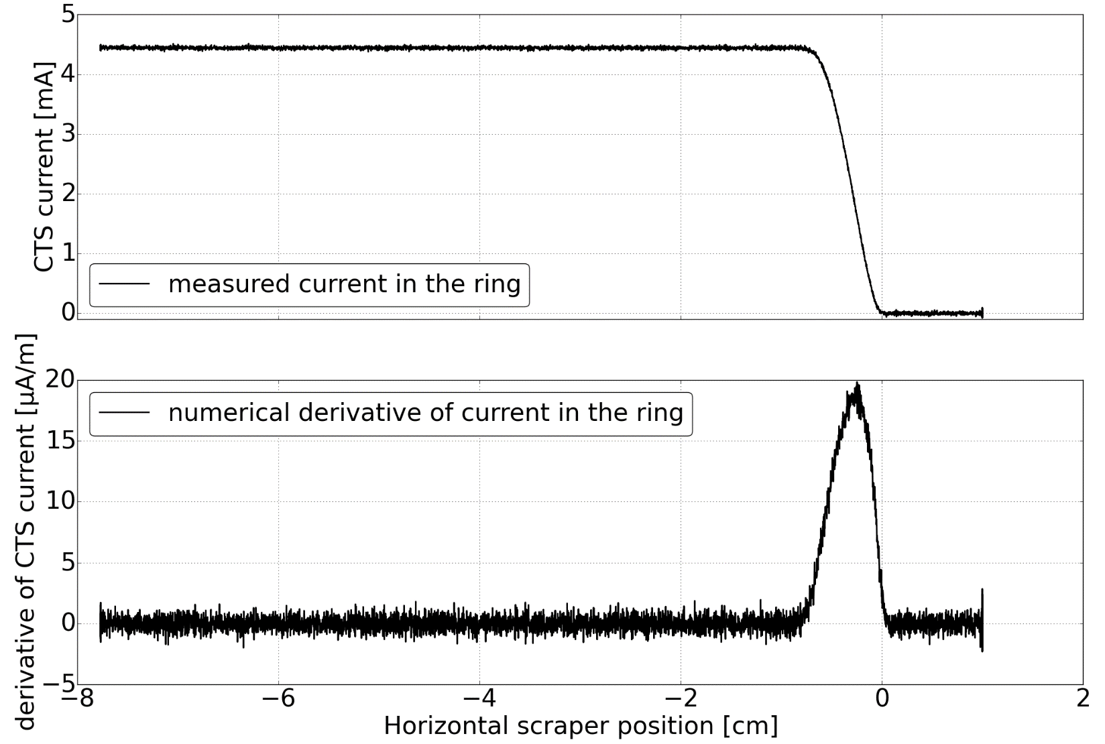
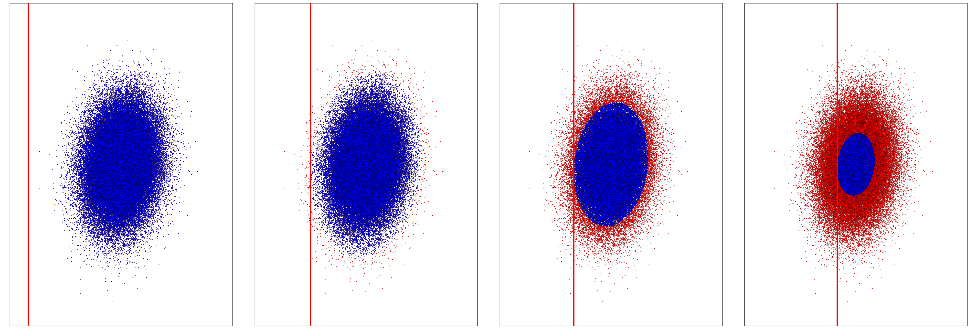
The Synchrotron - Techniques
Scraping
Slits intercept the beam.
Beam current drops
Courtesy of L. Adler

Slide 21
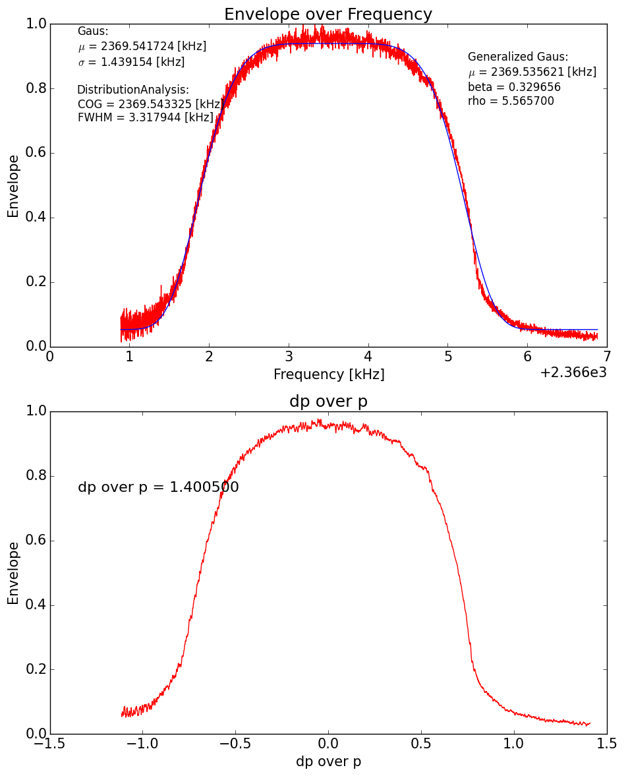
The Synchrotron - Techniques
Empty bucket scan
En
t
RF frequency slowly decreased
Portion of beam bunched → pickup signal intensity

Slide 22
The Synchrotron - Techniques
Tecnhique | Parameters | Devices | Non-destructive | Used for (how long/often) | Important for
Scraping | Emittance, Profile | Dipole Slits Faraday cup |  | BC(3 weeks) OP(yearly) TB(seldom) | MEBT matching Injection/Extraction set-up
RF momentum offset | Dispersion | Pickups RF |  | BC(2 weeks) OP(never) TB(never) | Losses min. Extraction set-up
Empty bucket scan | dp_p | RF Current trasformer |  | BC(2 weeks) OP(never) TB(never) | Extraction set-up

Slide 23
The Synchrotron – Wish List
Parameter | Problems | Alternatives
Profile | Destructive Can’t monitor transverse emittance dynamic effects Extraction mechanism highly sensitive on horizontal emittance | IPM / BIF

Slide 24
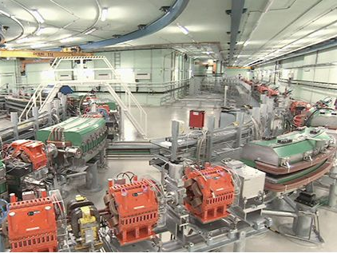
High Energy Beam Transfer line
To the room!

Slide 25
The HEBT - BD
Device | Parameters | Non-destructive | Used for (how long/often) | Important for
Scintillating fiber | Position, (intensity) |  | BC(2 months) OP(daily) TB(very often) | Optics set-up Drift monitoring
Nozzle MPWC | Profile, intensity |  | BC(2 months) OP(daily) TB(seldom) QA(daily) | Optics set-up Drift monitoring

Slide 26
The HEBT - Techniques
Tecnhique | Parameters | Devices | Non-destructive | Used for (how long/often) | Important for
Quadrupole k-modulation | Twiss Beam position offset at quadrupole | Quadrupole Scintillating fiber |  | BC(2 weeks) OP(never) TB(extremely rarely) | Optics set-up Definition of optical axis

Slide 27
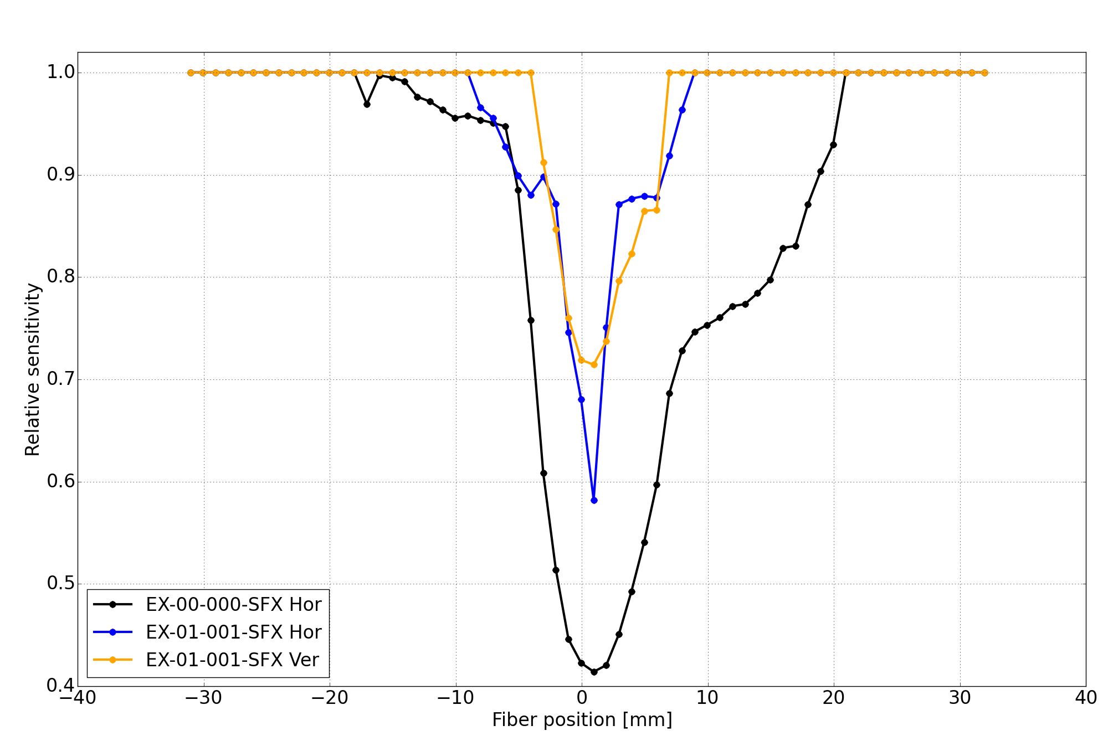
The HEBT – Wish List
Courtesy of L. Adler
Parameter | Problems | Alternatives
Profile, intensity | Destructive Radiation damage Identify scraping challenging | IPM / BIF MWPC

Slide 28
Thank you for your attention
This project has received funding from the European Union’s Horizon 2020 research and innovation programme under the Marie Skłodowska-Curie grant agreement No 675265.

