Slide 1
Possible Layout for a Proton-Driven Plasma Acceleration Experiment at CERN
R. Assmann, CERN
PPA09
17-18.12.2009
Many thanks to I. Efthymioupolos and F. Zimmermann

Slide 2
Introduction
Proposal by Allen Caldwell et al to use CERN’s proton beams to drive plasma waves for acceleration of electron beams (see Allen’s talk).
So far not much work on this at CERN but various parties are interested (accelerator physics, experi-mental area group, beam transfer line group, …).
Support from CERN accelerator director Steve Myers.
So far: Several discussions with Allen and one larger scale brain-storming meeting at CERN.
This workshop from my perspective: Collect present knowledge and define work plan towards proposal. Can we define baseline parameters?

Slide 3
Towards a Conceptual Layout
I only look at SPS candidate location (see talk by Ilias). This is mainly presently available real estate.
What I present has not yet been discussed widely. So take everything as a very preliminary sketch, meant to stimulate discussion and to be refined during this workshop.
This is my understanding of a possible conceptual layout, based on a few informal discussions at CERN and my experience in the SLAC plasma acceleration experiments.
Though I have been deeply involved at SLAC from 1996 to 2001, I did not participate to the recent developments. Please do not hesitate to give your input.

Slide 4
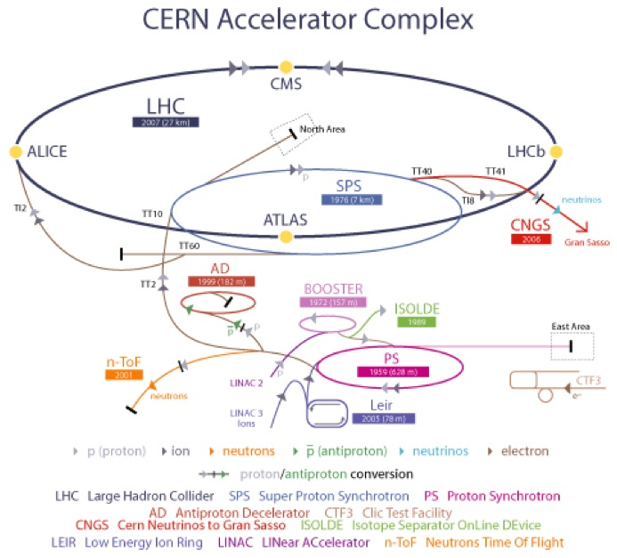

Slide 6
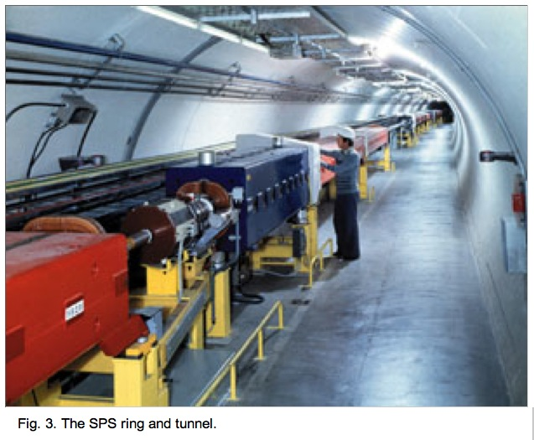

Slide 7
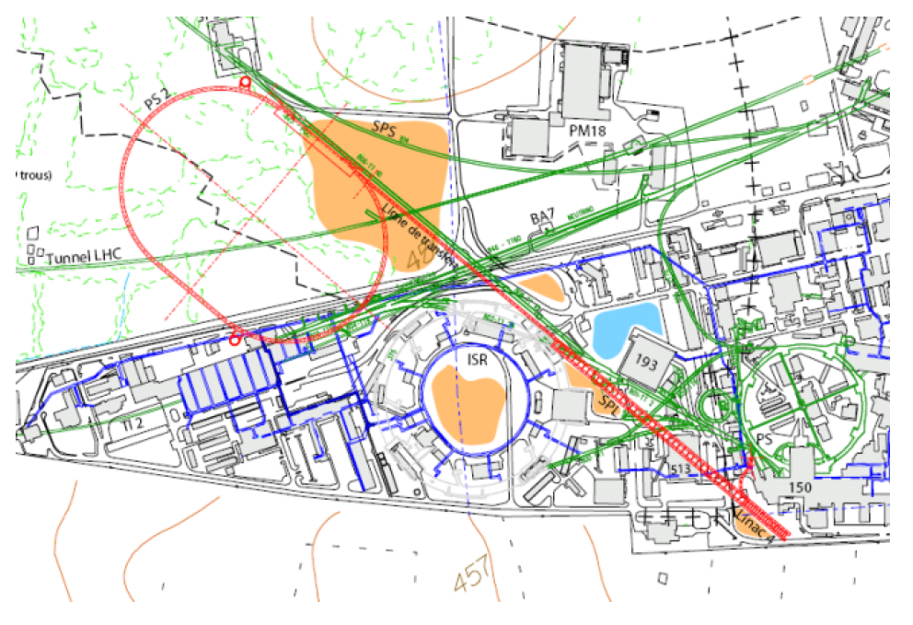
Meyrin Locations
➔ See talk Ilias E.

Slide 8
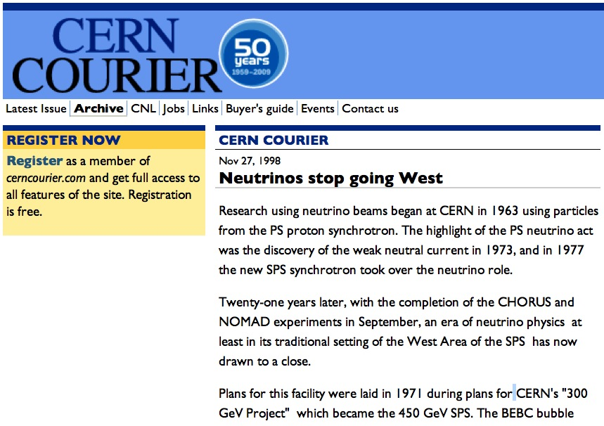
Beamlines to West Area

Slide 9
Basic Components of PPA
Beam production: Done in the SPS. Exists.
Beam transport to plasma: Tunnel exists. Beam line elements to be installed (existing old magnets or new).
Bunch compressor: Not evident. Must be integrated in SPS and/or beam transport line. Not for first phase of experiment.
Plasma cell: To be contributed from collaborators.
Imaging beam line: Generates image point π downstream of the proton-plasma interaction point. To be installed in existing tunnel.
Spectrometer: Crucial for energy diagnostics. Must be integrated with imaging beam line.
Diagnostics section: Measure energy gain and loss, etc.
Beam dump: Safely dump the beam.

Slide 10
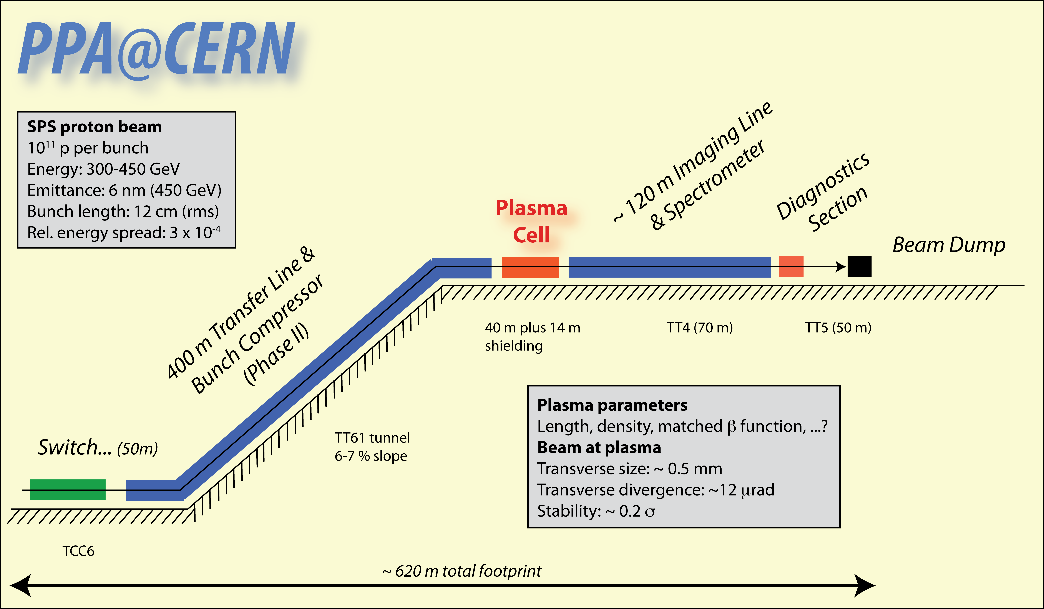
First Sketch

Slide 11
General Remarks
We are looking at an overall footprint of around 600 m.
Tunnels and experimental halls exist. Beamline tunnels are essentially empty.
We might still find old magnets that can be reused.
Power supplies, instrumentation and cables usually will not exist and must be procured.
This is a significant installation: We need a good scientific case and should try to optimize!
Are all components required or can we go towards a more compact experiment?
Positive about this location: Space allows to develop the experiment further (e.g. bunch compression). Start simple and then expand (like SLAC E-157 which started as 1 M$ experiment).

Slide 12
Issues Identified by Ilias E.
Coming out from the TT61 tunnel, the beam must be brought horizontal AND also bent left to make it to TT4/TT5:
  In the past tilted bends were used, that of course introduce dispersion in both planes - is that an issue for the plasma experiment?
  One can imagine separate function bends but then is the issue of space.... To be studied.
If the 70m of TT4 must be used for the experiment, would be nice afterwards to bend the beam downwards:
  This will send the beam at an angle in the dump so to direct the muons towards the earth and not towards the b.183/b.180 where all the magnet repair lines will be.
  I believe it can be done but is a serious safety issue that must be urgently addressed to validate the option.

Slide 13
The LHC Beam from the SPS
The LHC is filled with beam from the SPS.
The studied PPA location will branch off an LHC injection line.
We therefore can get easily the LHC beam:
  2e9 to 1.6e11 protons per bunch.
  Up to 288 bunches per beam extraction.
  Bunch distance is 25 ns if all 288 bunches are generated.
  A total of up to 2 MJ is stored in the extracted beam.
So far, usage of only one single bunch is assumed for proton-driven plasma acceleration.
Is there any interest in a multi-bunch structure?
Number of bunches might be limited from radiation protection aspects.
A single bunch will make access to experiment much easier!

Slide 14
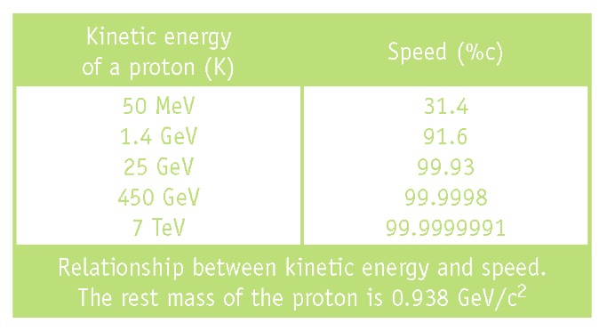
Relativistic Protons

Slide 15

Protons are not Electrons
SLAC electron beam before plasma and people 1999
➔ Much better transverse stability (better than electron beam tuned up).

Slide 16
The CERN Proton Bunch
The SPS/LHC proton bunch has excellent properties:
  Very stiff beam: can drive plasma without too much beam deterioration.
  Well controlled and maintained (for LHC, CNGS, HiRadMat, …).
  Variable in intensity (2e9-1.6e11) and emittance.
  Carries significant stored energy for driving plasma waves:
  ➔ up to 11 kJ (SLAC e-beam: ~0.1 kJ)
  This is 100 times more energy available than in the SLAC experiment.
  If we can couple this energy into the plasma, a new plasma wakefield acceleration frontier can be opened.
The issue is how to couple the proton energy to the plasma:
  CERN proton bunches are very long (120 mm), compared to the electron bunches used at SLAC (< 0.1 mm).
  Plasma wavelength is at the 1 mm scale.
  How do we couple the p bunch into the plasma?

Slide 17
Basic principle and scaling rules 5
Wavelength:
Accelerating field
(roughly)
Plasma density n₀ 10¹⁴ to 10¹⁵...
λ_{p} ~ mm
~ GV/m

Slide 18
CHALLENGE
How to best make use of CERN proton
beam within available real estate?
Creativity and good ideas

Slide 19
Use of Long Proton Bunches
Several solutions have been proposed (brainstorming ideas):
  Conventional bunch compression: How long and where? ➔ Frank’s talk.
  Self-modulation of the proton bunch by the plasma wakefield. Can we rely on this effect, can it be enhanced, …?
  Electro-magnetic modulation of bunch intensity versus longitudinal position in the SPS. Is this feasible?
  Mechanical nano/micro-chopper device. See next slide.
There must be an iterative loop between plasma simulation and beam study:
  What plasma density?
  What plasma wavelength?
  What transverse beam sizes?
We hope that this workshop can freeze some study scenario.

Slide 20
Nano-Chopping?
I thought about mechanical ways to modulate the long bunch (fast collimators).
Principle:
  A rotating wheel with gaps for beam passage and interleaved material for beam scattering.
  As the wheel rotates through the beam, a longitudinal modulation is created.
  Must rotate pretty fast…
Assume a disk with 32 cm radius, rotating with 120,000 rotations per minute (feasible):
  Speed at the edge: 4 km/s
  Nano-channels of 1.2 nm size and separated by 1.2 nm will create a modulation with 0.3 fs period.
Is there a chance for such an approach (can be outside vacuum)?

Slide 21
What Beam is Accelerated?
Two scenarios can be considered:
  Accelerating fields are witnessed on the proton bunch that drives the plasma wakefield (a la SLAC principle).
  A second electron bunch is injected after the proton bunch and is accelerated.
Initially we would like to go to scenario 1): take the proton bunch to both drive the plasma and witness acceleration.
Only in a second phase (once wakefields are characterized), we would like to inject a separate electron bunch to be accelerated.
Facility should reserve the space for an electron injector (use of old CTF injectors possible?).
Here, focus on scenario 1). Is this feasible for proton bunch?

Slide 22
Proton Bunch as Driver and Witness
The highly energetic proton bunch from the SPS is very nice as a driver, once the bunch length problem is solved.
However, it is not ideal as a witness bunch:
  Energy loss and gain will be only a small fraction of its incoming energy.
  The incoming energy spread might not be much smaller then the plasma action and must be folded in.
  The stiff beam requires significant distance from the spectrometer magnet to see the energy tails sticking out of the transverse beam size.
This is very different to the SLAC experiment with electrons. There the relative change in energy was always above 0.1% even initially and finally reached 50%.
Special care must be taken for diagnostics and analysis. Means also that significant space is required.

Slide 23
Energy Resolution with Proton Witness
The protons have an energy spread of about 100 MeV.
The energy gain should be larger to separate it from the natural energy spread in the beam.
Let’s assume:
  Energy gain: 400 MeV
  This is a ΔE/E of: 8.8e-4
Two 1.5 T magnets: generate a 20 mrad deflection.
At obervation point, ΔL = 120 m downstream:
  Assume vertical deflection.
  Maximum energy gain seen as: Δy = ΔE/E × ΔL = 1.1 mm.
  Not much bigger than spot size (0.5 mm rms plus dispersive size from 3e-4 energy spread).
We need significant energy gain to see it reliably!

Slide 24
Data Rate
The SPS is a cycled circular machine. This is very different from a linear accelerator like the SLAC linac!
Different users for the SPS can share a cycle. Beam is delivered to several users in the same run.
A SPS cycle is around 30 s in length.
We should imagine a data rate of 1 shot per 30 seconds.
In particular, it is not possible with the present configuration to have several shots per second.

Slide 25
From Accelerator Side
This is for discussion and further input from other machine experts.
Possible proton beam parameters are well known.
Identified a possible location with a footprint of about 620 m.
What can we do with it?
Need breakthrough idea to efficiently couple proton bunch to plasma. Feasibility issue.
Need to define plasma parameters (density, length) and beam parameters at plasma entry and exit.
Then we can do a rough design and costing of beamlines and experimental area.

Slide 26
For Discussion

