Slide 1

Muon Colliders compared to other options of the HEP programmme
J.P Delahaye / CERN

Slide 2
Disclaimer
(Fair) comparison of future options of High Energy Colliders (Leptons & Protons)
    Muon Colliders (Proton driven (MAP), Positron driven (LEMMA), in LHC (& FCC?)
    E⁺/E⁻ Circular Colliders (FCC ee, CEPC)
    E⁺/E⁻ Linear Colliders (ILC, CLIC, PWFA, LPA, DLA)
    Protons Colliders (LHC, FCC hh)
Over a wide energy range
  From 125 GeV to Multi-TeV at the level of the elementary constituents
Of major performances, especially:
  Physics potential: Luminosity
    Including whole particle energy spectrum
    limited to particles within 1% momentum spread
    Total = ∑ from all detectors
  Limitations by practical technicalities:
    Cost & Power
Through objective Figures of Merit (FoM) for fair comparison
  Based on official data when available, collected in 2015, thus possibly out of date
  Some power estimations slightly corrected for common assumptions
  When no available data (Cost), estimation using a common model even if not accurate
Welcome to point out necessary corrections or updates

Slide 3
Data (updated August 2015)

Slide 4
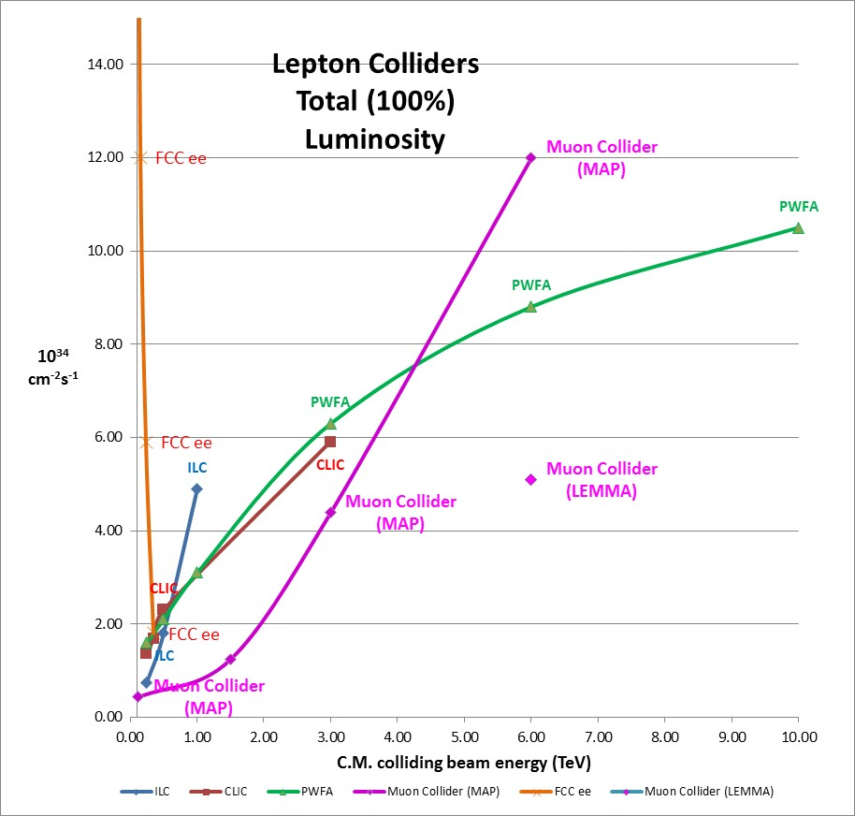
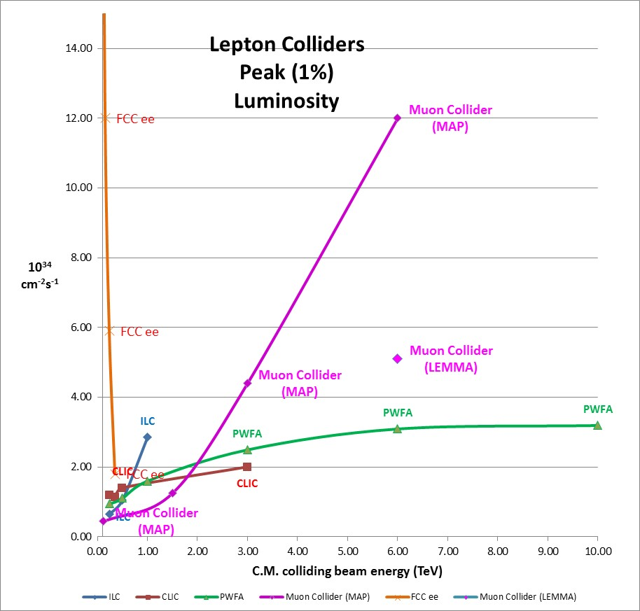
Lepton Colliders Luminosity
(1 Interaction Point)
Circular
Circular
Linear
Muons
Muons
Linear

Slide 5
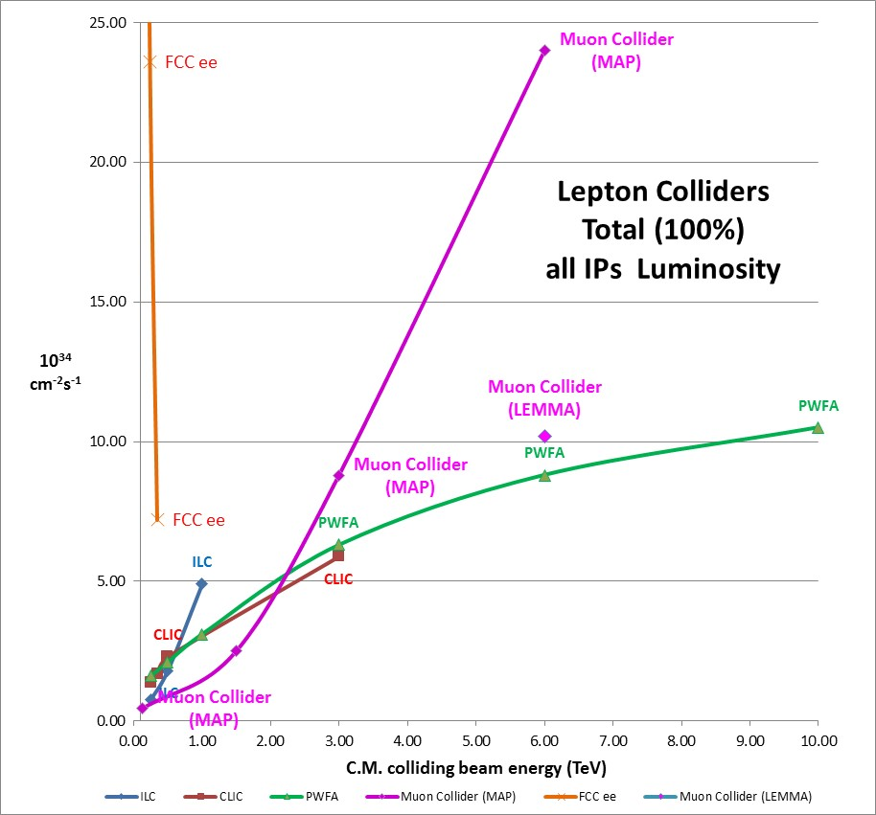
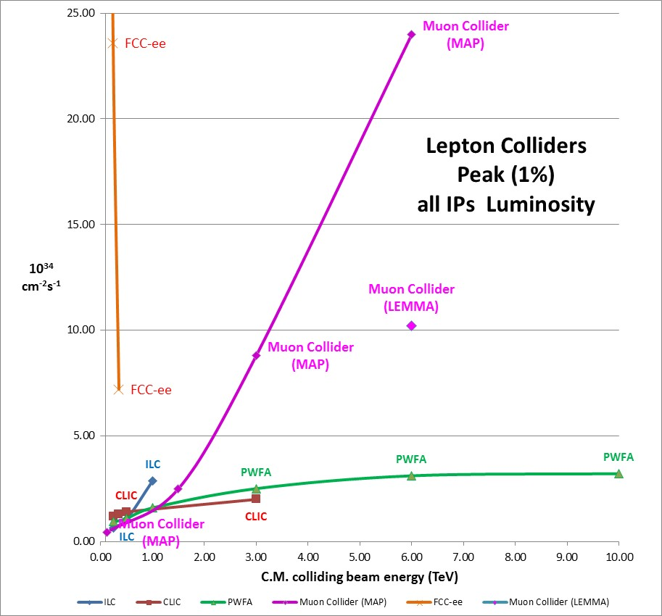
Lepton Colliders Luminosity
(all Interaction Points)

Slide 6
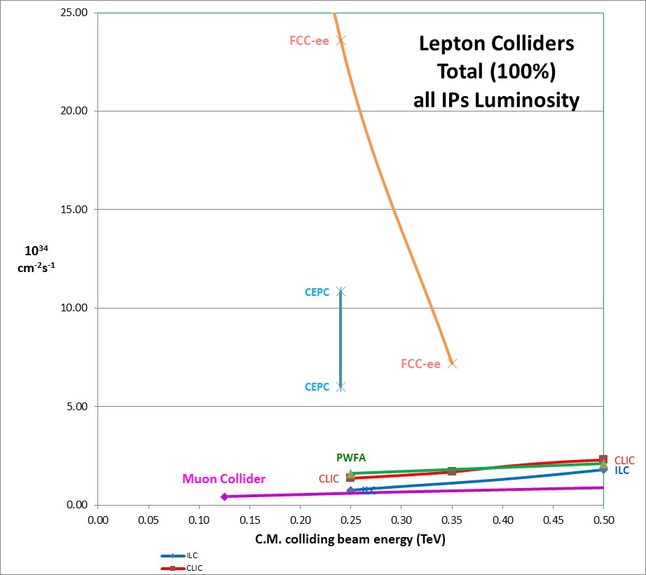
Lepton Colliders
All IP Luminosity in HIGGS energy range
HIGGS Factory

Slide 7
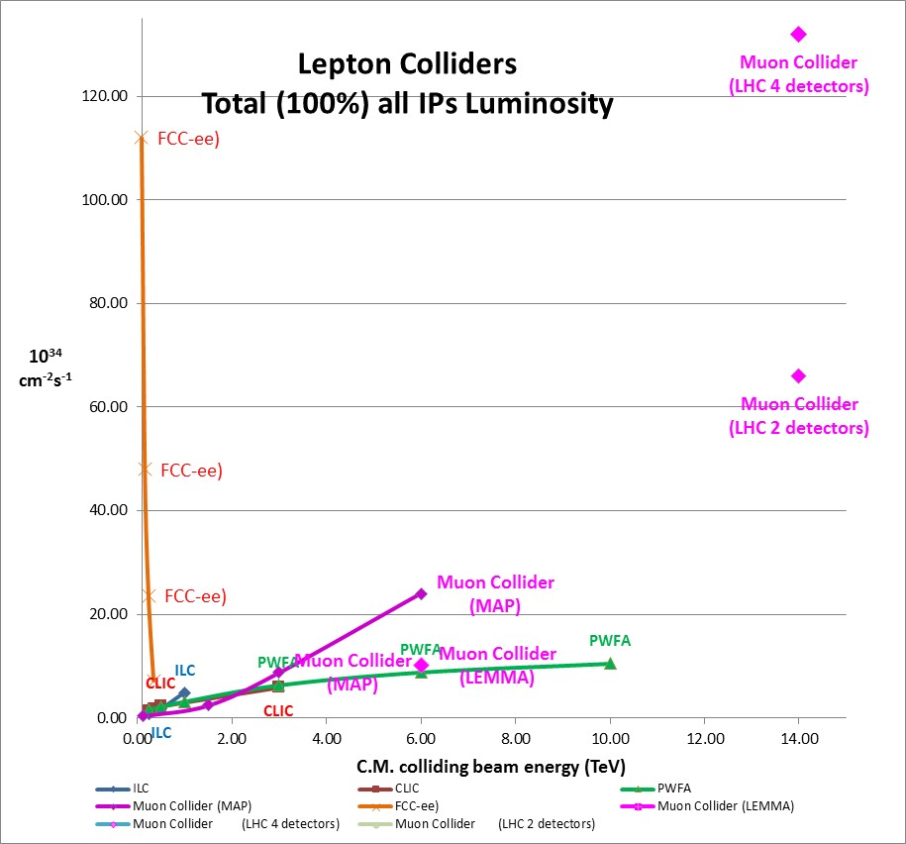
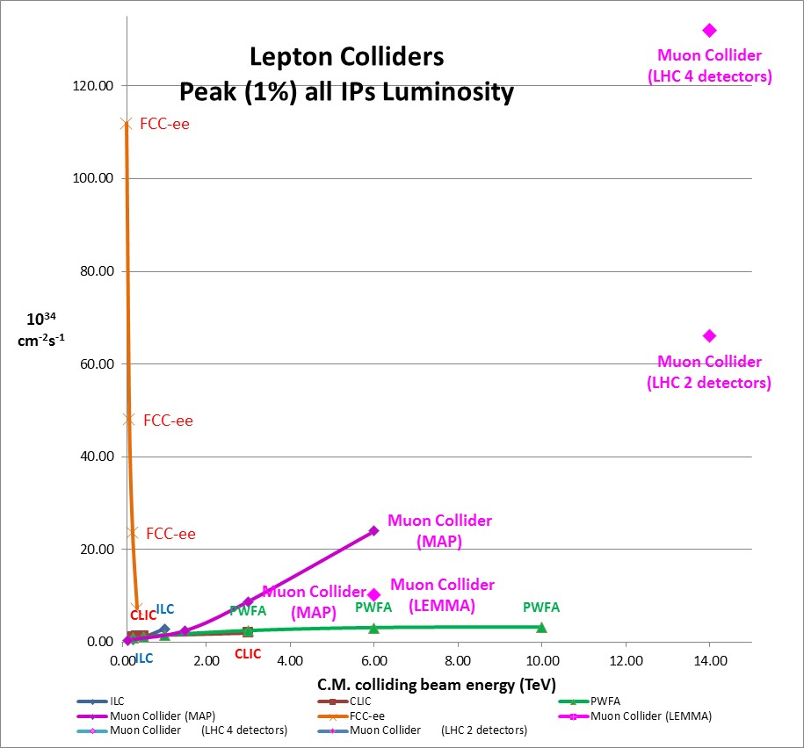
Lepton Colliders All IP Luminosity
(D.Neuffer and V. Shiltsev, A 14 TeV muon collider in the LHC tunnel @ IPAC18)
Lepton Collider Technoloy for largest Luminosity:
Low energy range (0-350GeV): Circular colliders
Medium energy range (350-2000GeV): Linear Colliders
High energy range (Multi-TeV): Muon Colliders
  > 2.5 TeV for 100% momentum spread
  > 1.5 TeV for 1% momentum spread
Muon colliders attractive potential:
Performance larger than e+/e- Linear Colliders
Energy reach larger than e+/e- Circular Colliders (no synch radiation)
Acceleration efficiency larger than Proton Colliders (no gluons)

Slide 8
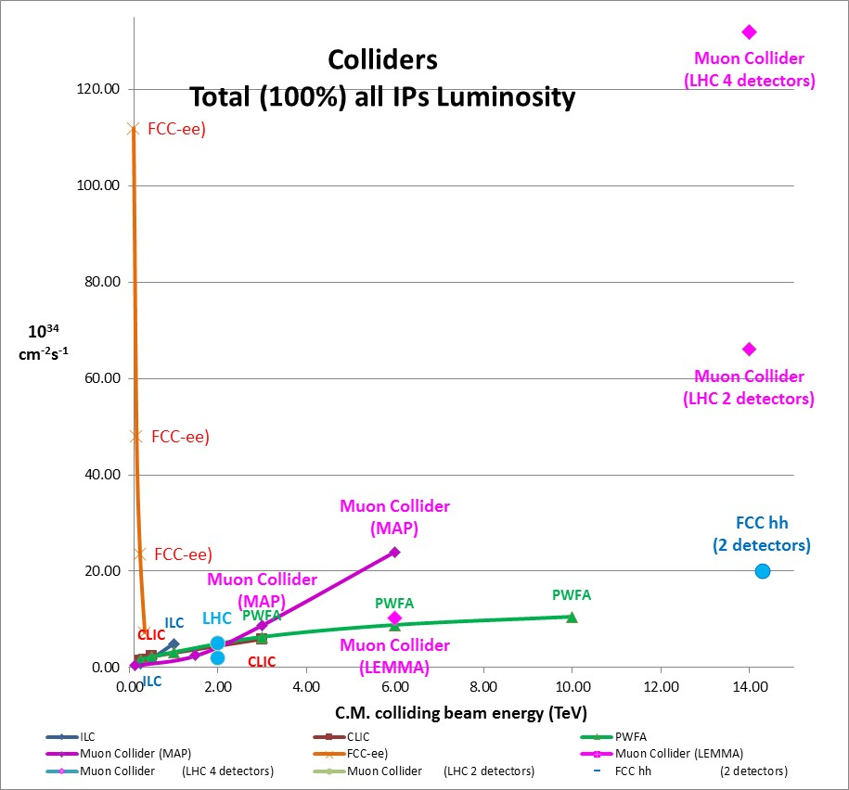
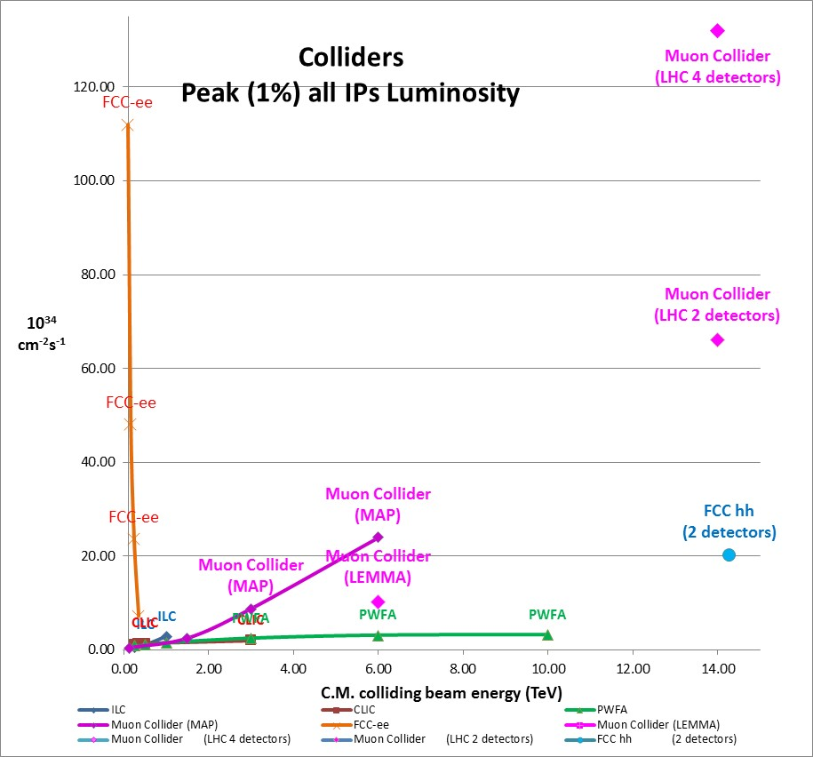
Lepton & Hadron Colliders Luminosity (elementary constituent c.m.energy)
Muon Collider in LHC tunnel (27km)
Similar energy reach (14 TeV) than FCC hh (100km)
With larger luminosity (3.10³⁵ / Detector) ????
Muon Collider in FCC tunnel (100km)
Energy reach in the 50-100 TeV range
(4 to 7 times larger than FCC hh)
Attractive luminosity (1.10³⁵ / Detector)

Slide 9
Future Facilities limited by Practicalities
Power Cost
Material
7 B$
200MW

Slide 10
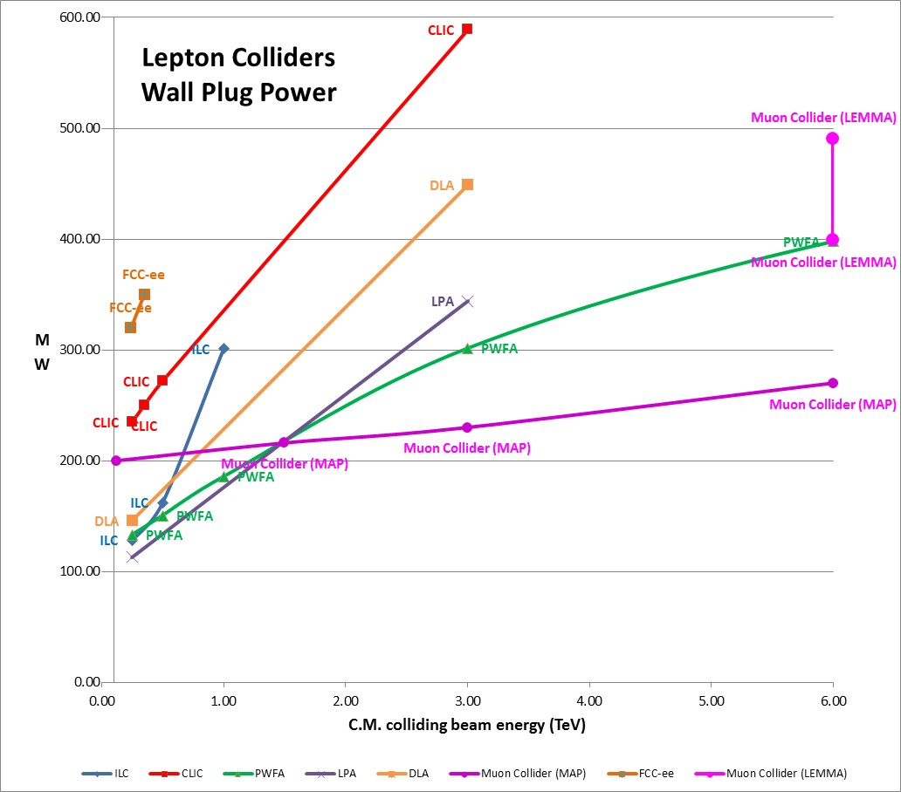
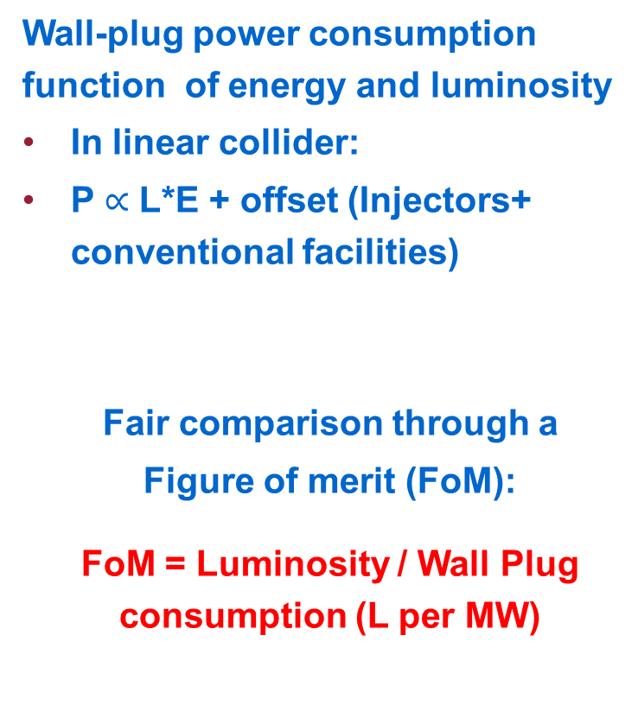
Wall-plug power consumption
Wall-plug power consumption function of energy and luminosity
In linear collider:
P $∝$ L*E + offset (Injectors+ conventional facilities)
Fair comparison through a
Figure of merit (FoM):
FoM = Luminosity / Wall Plug consumption (L per MW)
Muons

Slide 11
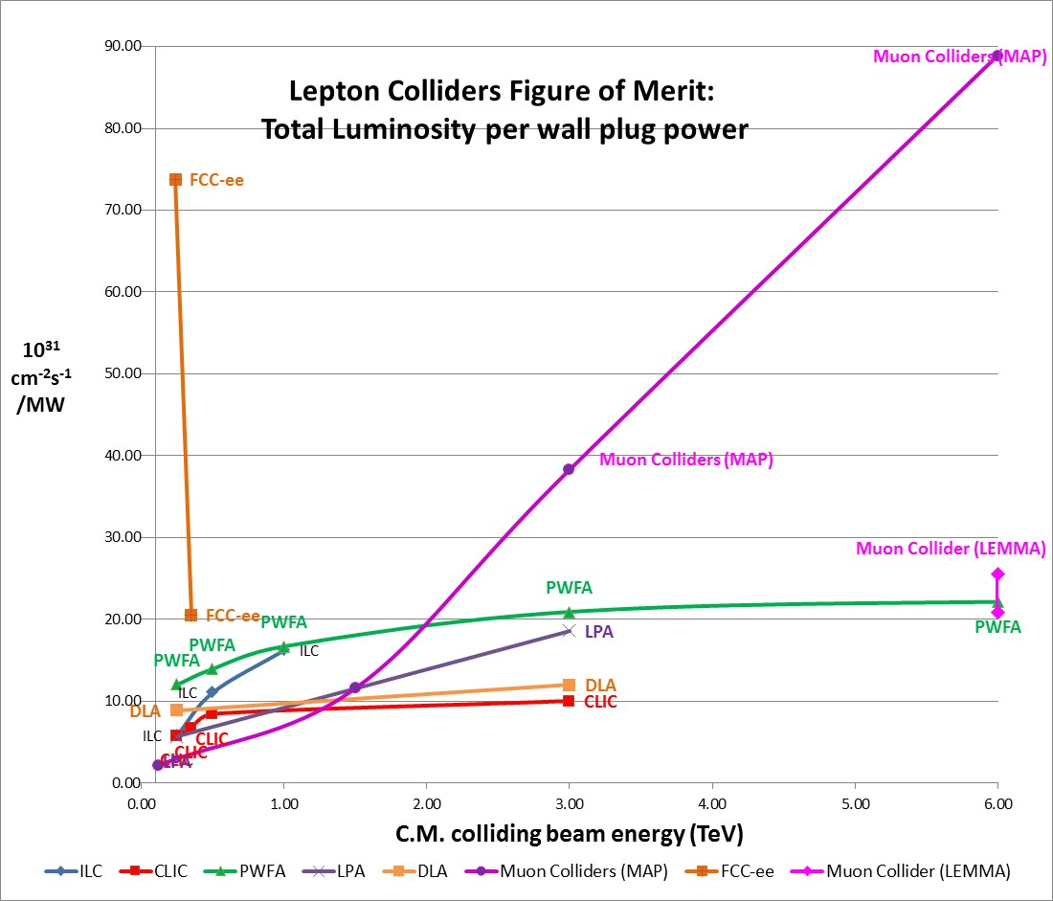
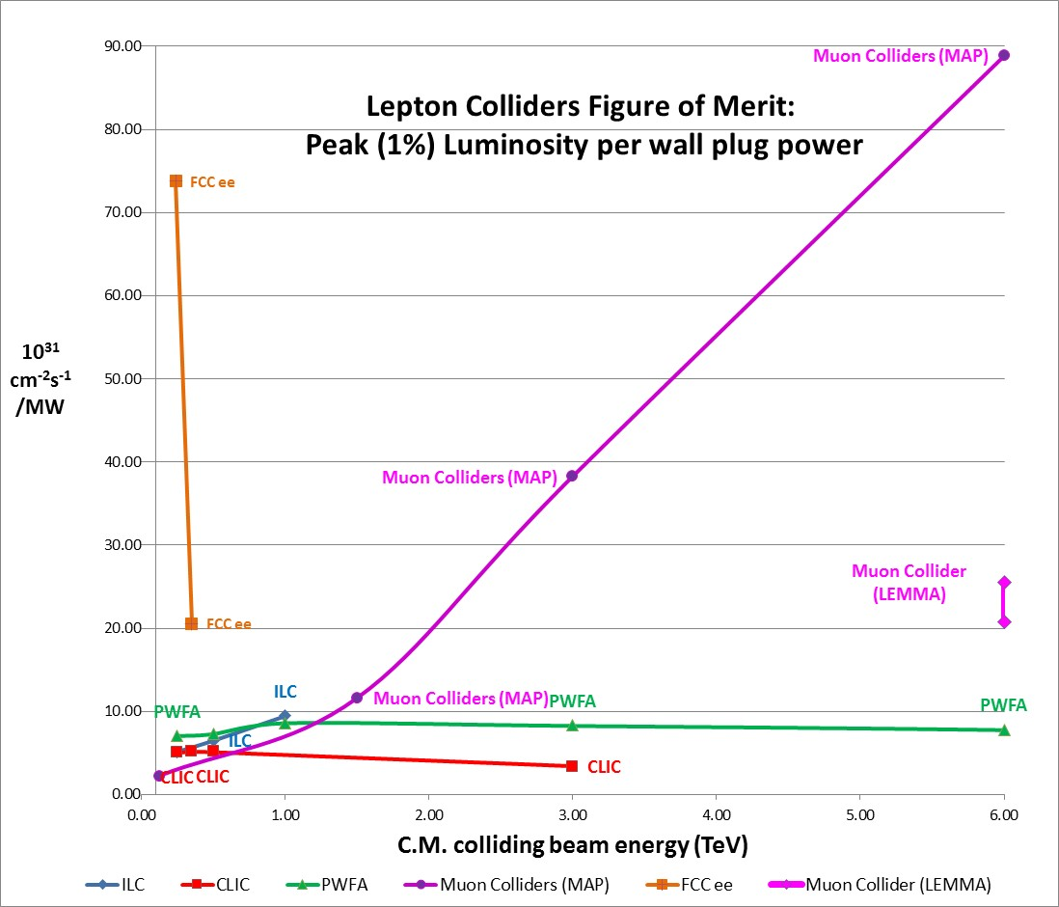
Figure of merit:
Luminosity per wall plug power
Circular
Muons
Muons
Linear

Slide 12
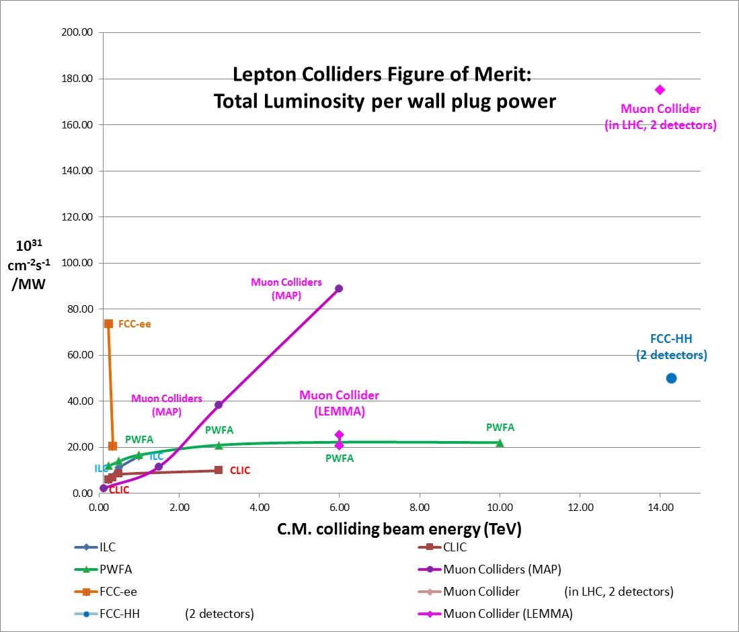
Figure of merit:
Luminosity per wall plug power

Slide 13
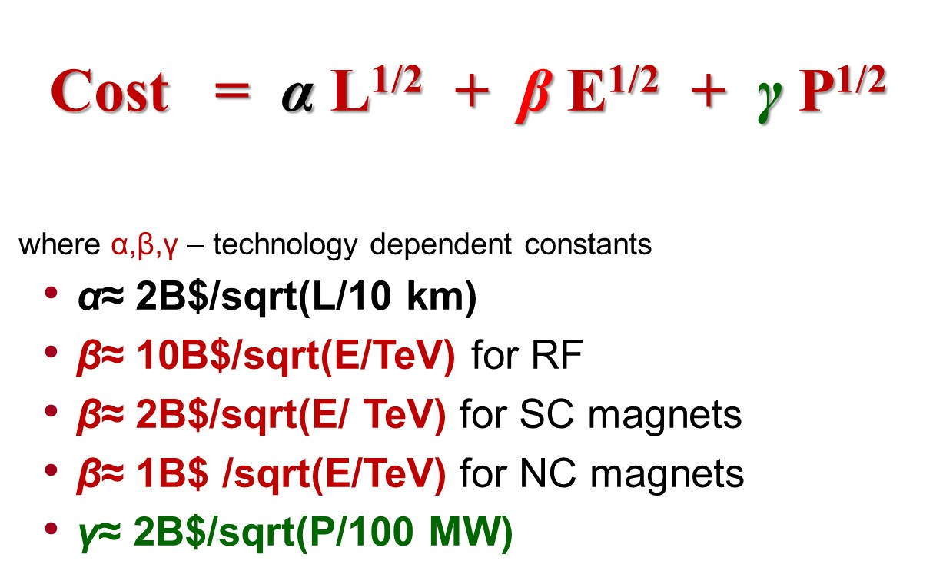
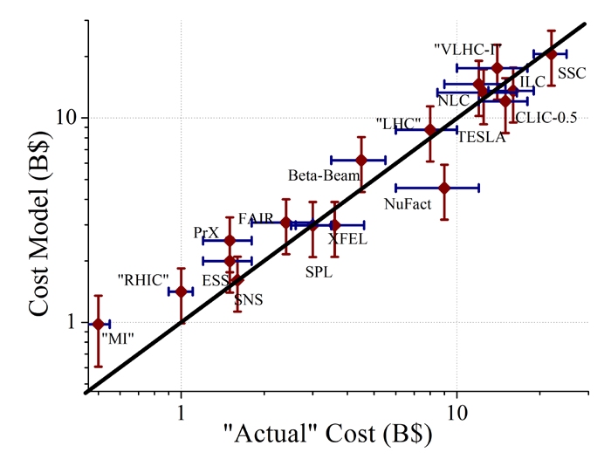
Phenomenological Cost model (V.Shiltsev)
Conventional Technology
Total Cost (US/DOE rules)
vs Model (Log-Log)
“Total Project Cost “
“Tunnel Length”
Civil Construction
“Energy” – Cost of
Accelerator
Components
“Site Power”
Infrastructure
The model is good to +-30%

Slide 14
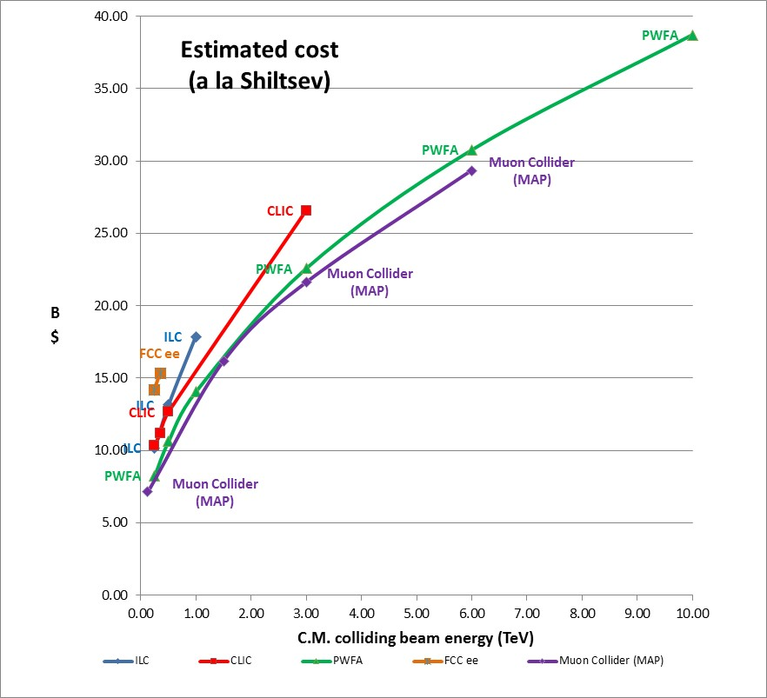
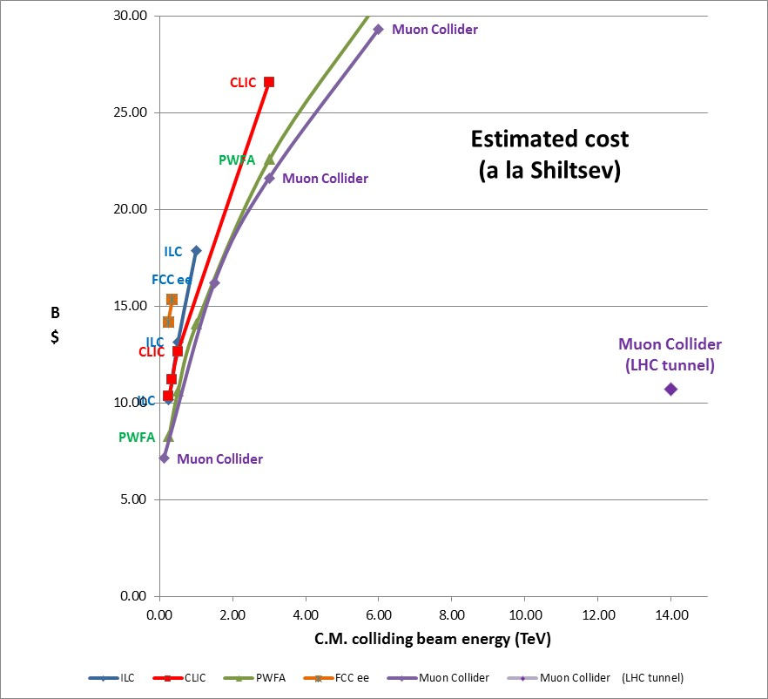
Estimated cost (a la Shiltsev)

Slide 15
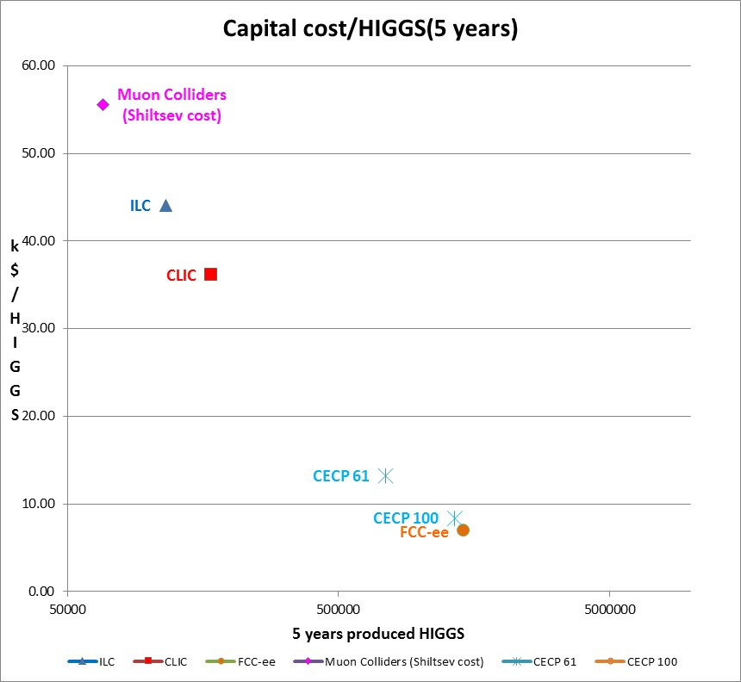
HIGGS cost

Slide 16
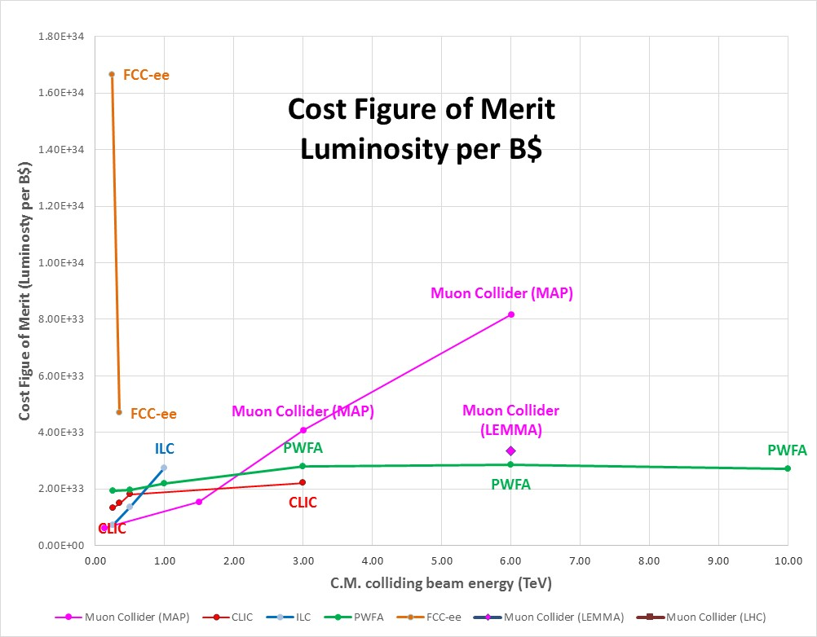
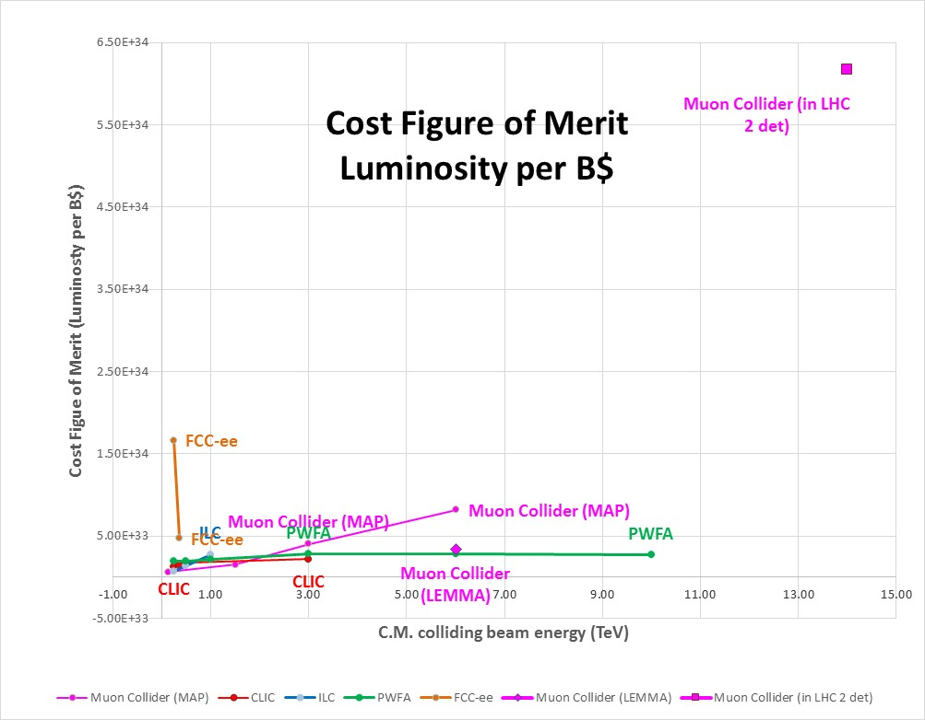
Cost Figure of merit
Luminosity per Billion$

Slide 17
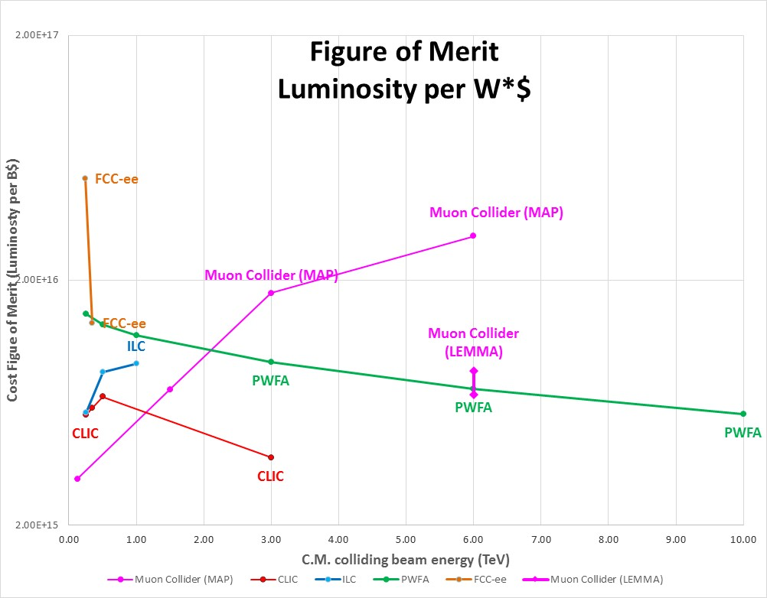
Combined Figure of Merit
FoM =L / (Power x Cost)
Combined
FoM
(L/($W))

Slide 18
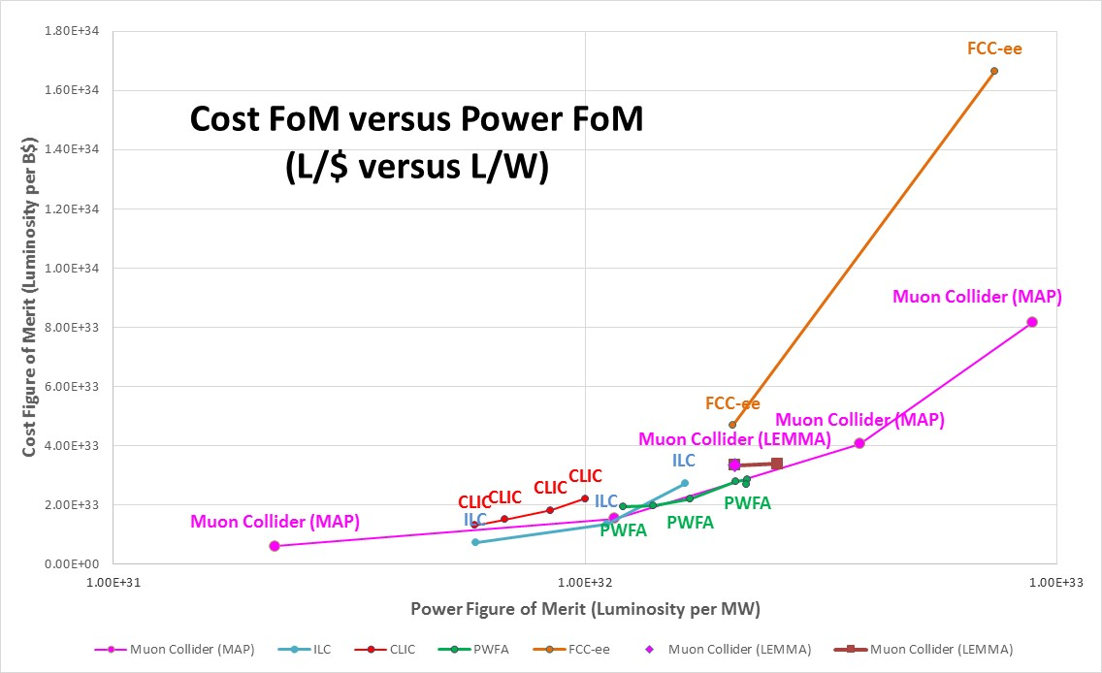
Cost Figure of Merit versus Power FoM

Slide 19
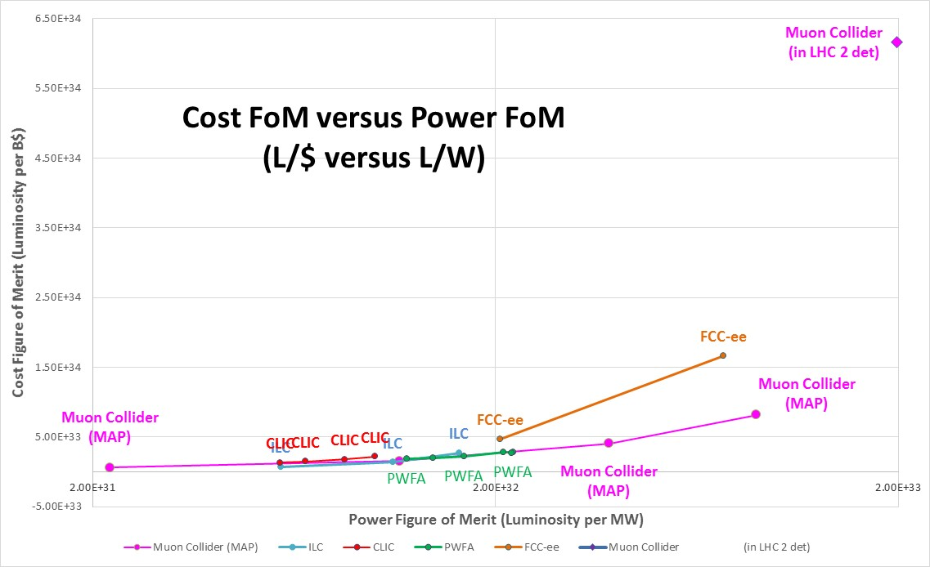
Cost Figure of Merit versus Power FoM

Slide 20
Conclusion
e+/e- Circular Colliders best suited technology in the HIGGS-TOP energy range, but large circumference rings and limited in energy upgrade
Linear Colliders best suited technology in the TeV energy range with similar performance and various energy reach
Muon Collider (MC) ideal (only envisageable?) technology to extend lepton colliders in the Multi- TeV range with attractive Cost & Power FoMs
Although challenging and performance limited, MC as HIGGS Factory attractive as a step towards higher colliding beam energies
MAP scheme pretty mature, relies on critical 10⁶ 6D cooling
LEMMA scheme appealing (no cooling, energy reach) if feasible (e+ rate?)
Impressive potential of Muon Collider in LHC tunnel (preliminary)
Taking advantage of existing CERN facilities (LHC tunnel and injectors) to reduce cost
Excellent Luminosity, Power FoM and Cost FoM but at limit of neutrino radiation on site
Energy reach similar to 100TeV FCC-hh at level of elementary constituents
«Too nice to be true»??? Preliminary study to be confirmed by detailed feasibility study
Muon Collider most promising technology for future HEP facility
Enabling both precision and exploratory physics
Extending the energy frontier

