Slide 1


The (Recent) History of Boosted Physics Workshops
Steve Ellis
Big Picture:
The LHC is intended to find new “stuff” (BSM physics)
At the LHC new and old heavy particles will often be boosted → 1 jet
It will be a challenge to find the new stuff!
☞ Experimenters and Theorists will need to work together!!!
E.g., this week!
Borrowed results from many sources – thanks!
Oxford University 22.06.10

Slide 2
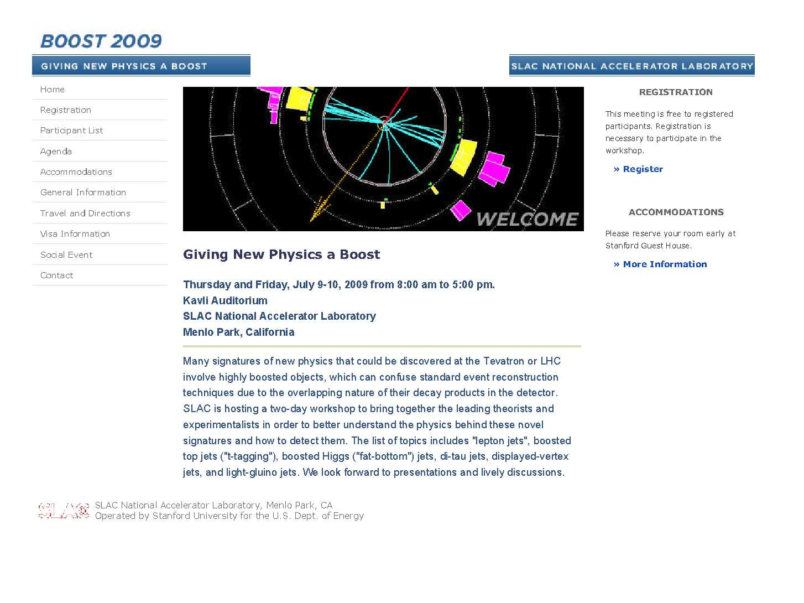
Precursor - Boost 2009:
http://www-conf.slac.stanford.edu/Boost2009/default.asp

Slide 3
As in 2010, there were 2 Primary Topics & Working Groups in 2009 -
Boosted Hadronic Final States
Jet Algorithms
Subjet observables
Discrimination from ordinary jets
Comparison between Theory & Data
Boosted Leptonic Final States
Classification of Models & Signals
State of MC Generators

Slide 4
Working Groups: Physics topics
Hadronic Final States
Boosted tops (test case and new physics tag)
Boosted Higgs (search target)
RPV Susy (search target)
Leptonic Final States
Lepton jets
Light vectors/PGBs

Slide 5
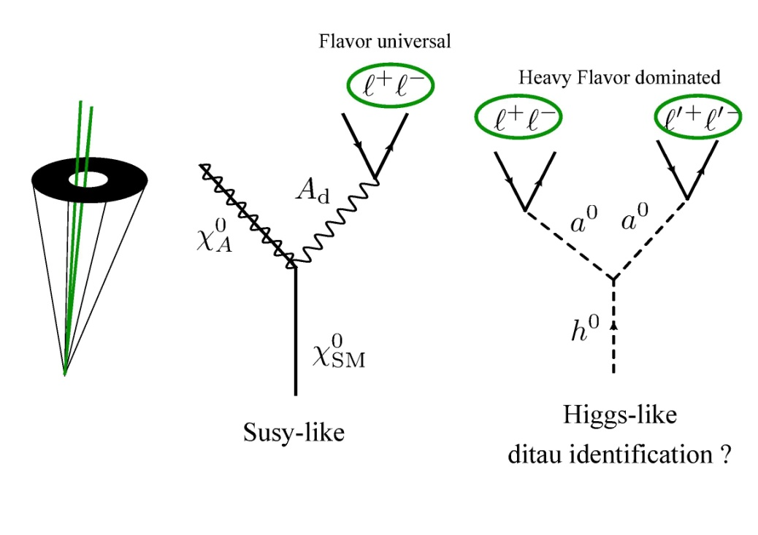
Report from Lepton Jets -
Summary:
Still making operative definitions of lepton Jets
New signals + tools appearing
Important searches to be done at Tevatron
Early searches possible at LHC
B-Physics & Fixed Targets
Experiments

Slide 6
Report from Hadron Jets -
Short term plan Forward:
Compare various jet tagging/grooming strategies on a set of interesting processes (assigned HW):
  Z + Higgs (120 GeV), Z pairs, Z + jet
  Jet pairs, top pairs
  Common set of generator choices (or even better, event samples).
Try to understand what each strategy does at each step, comparing as
  possible between different strategies.
  Results binned (somewhat widely) in pT
  Study jet mass reconstruction and other interesting variables.
  (Still needs to be done systematically – but there is progress,
  see talks this week)

Slide 7
Hadronic Jets II - Questions
Can we get early and clean samples (from LHC) to use to calibrate our simulations? (boosted top σ ~ fraction of a pb at 7 TeV, tuff now, but will happen)
Can we calibrate using tops without fitting away the new physics?
Can we develop a more general toolkit for dealing with jet substructure that is less tuned to look for W/Z/Higgs-like topologies (two body decays) or top-like topologies (two two body decays)?
Does a “jet mass” trigger make sense (perhaps for an upgrade) and would we gain anything by including one?

Slide 8


Seattle Workshop on Jet Substructure –
Boost 2009.5
http://silicon.phys.washington.edu/JetsWorkshop/
WiKi at (may be useful this week)
http://librarian.phys.washington.edu/lhc-jets/index.php/Main_Page

Slide 9
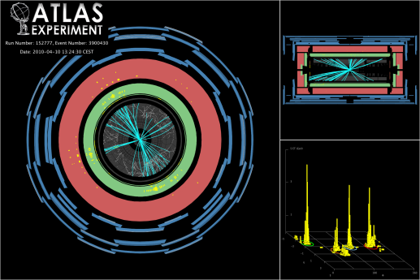
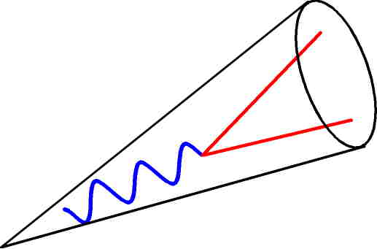
Background for Workshop:
Hadronic “stuff” is be organized into jets
At 14 (7) TeV many interesting particles
(t, W, Z, Higgs, Susy, ..) will be boosted enough to be in a single jet
Want to reconstruct objects from multiple jets (as at Tevatron), but also
Want to use single jets in SEARCH for BSM physics
Want to distinguish jets with decays from QCD jets
Want to use jet substructure for this purpose
See the following Review talks by Gustaaf, Jay and Gavin

Slide 10
Goals for Discussion in Seattle –
  Experimental challenges for jet substructure
  Comparison of jet substructure techniques
  Development of software tools
  Development of theoretical tools (QCD & SCET)

Slide 11
  Working Groups in Seattle –
  1) Develop, compare and (learn how to) certify jet substructure tools
  (Brock provided some sample data sets http://tev4.phys.washington.edu/TeraScale/)
    Tagging specific states, e.g., top quarks, Higgs
    Generic grooming of jets for searches, e.g., pruning, trimming
  2) Utilize and compare SCET and standard QCD theory tools and results
Here review a few highlights -

Slide 12
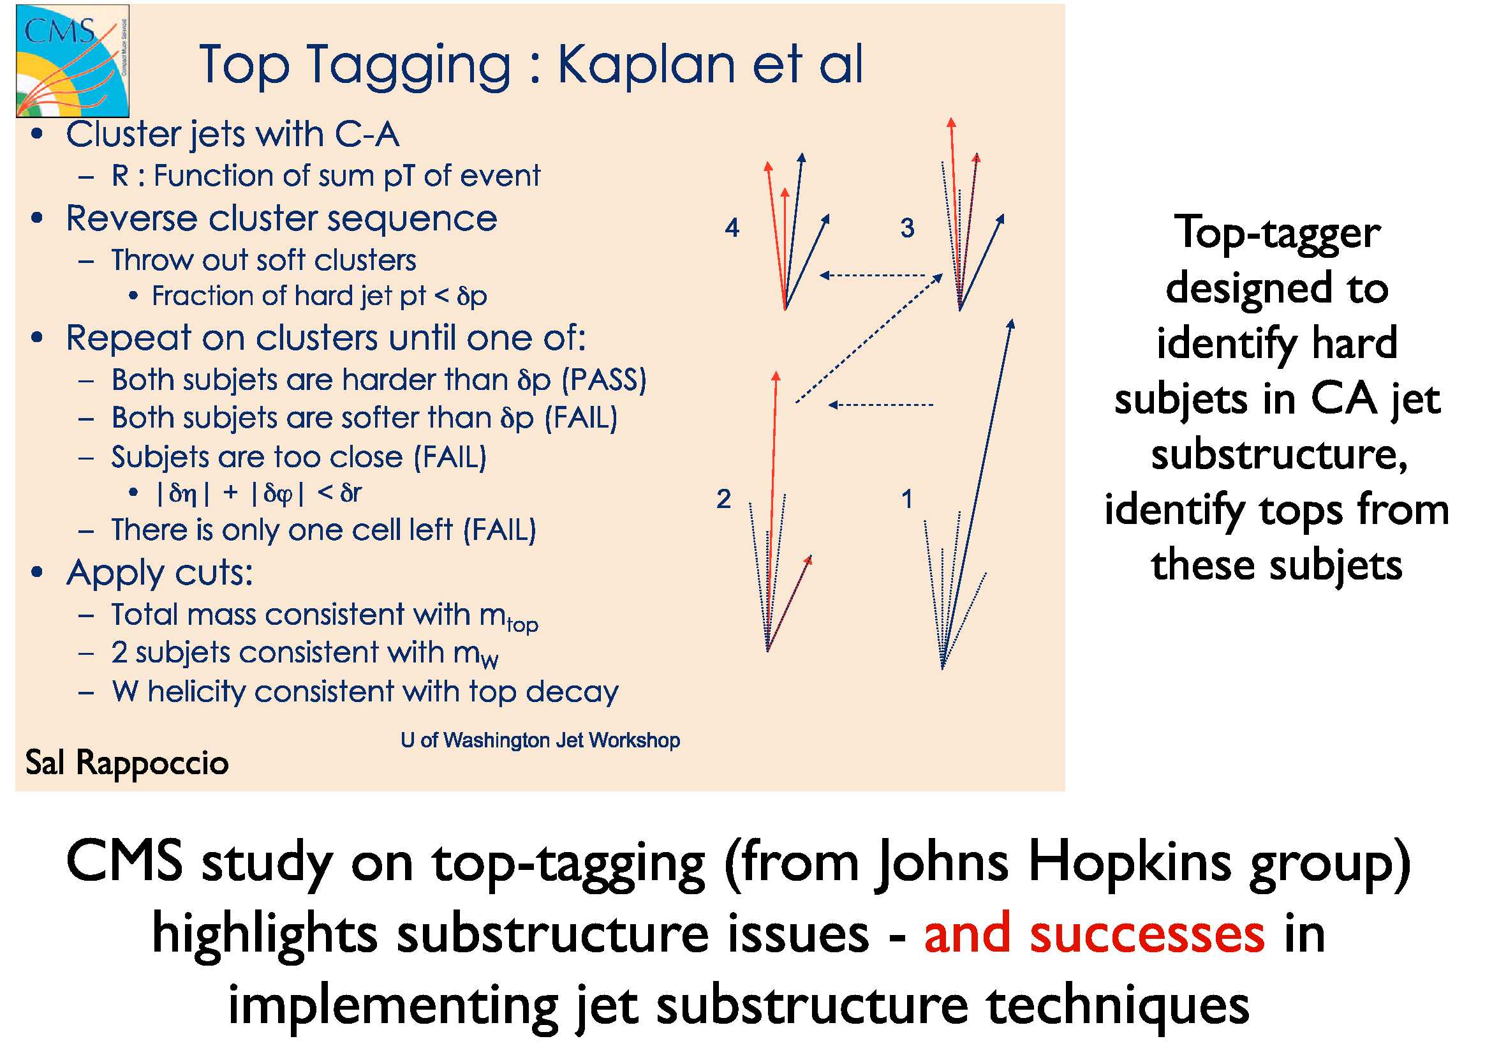

Slide 13
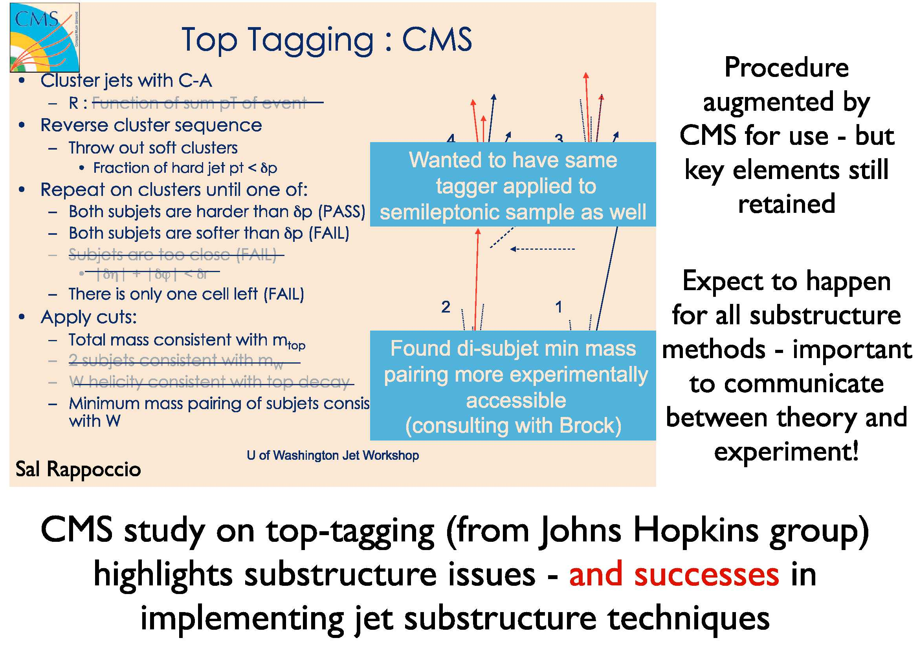

Slide 14
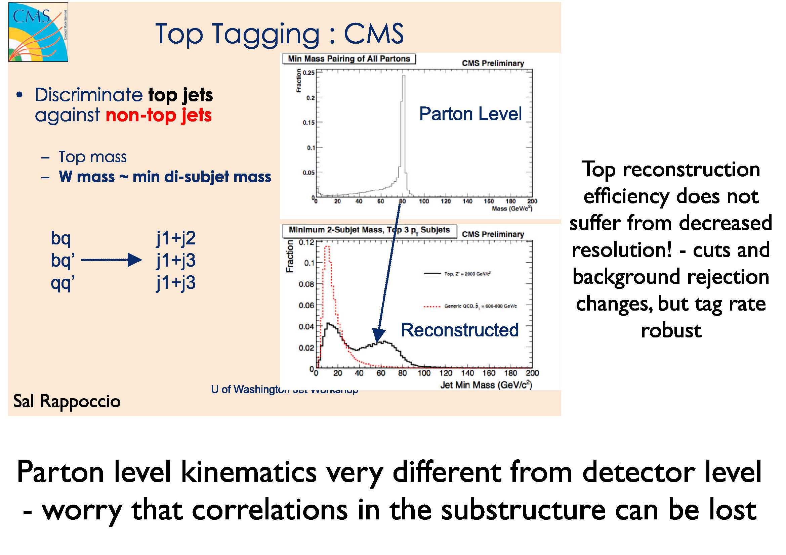

Slide 15
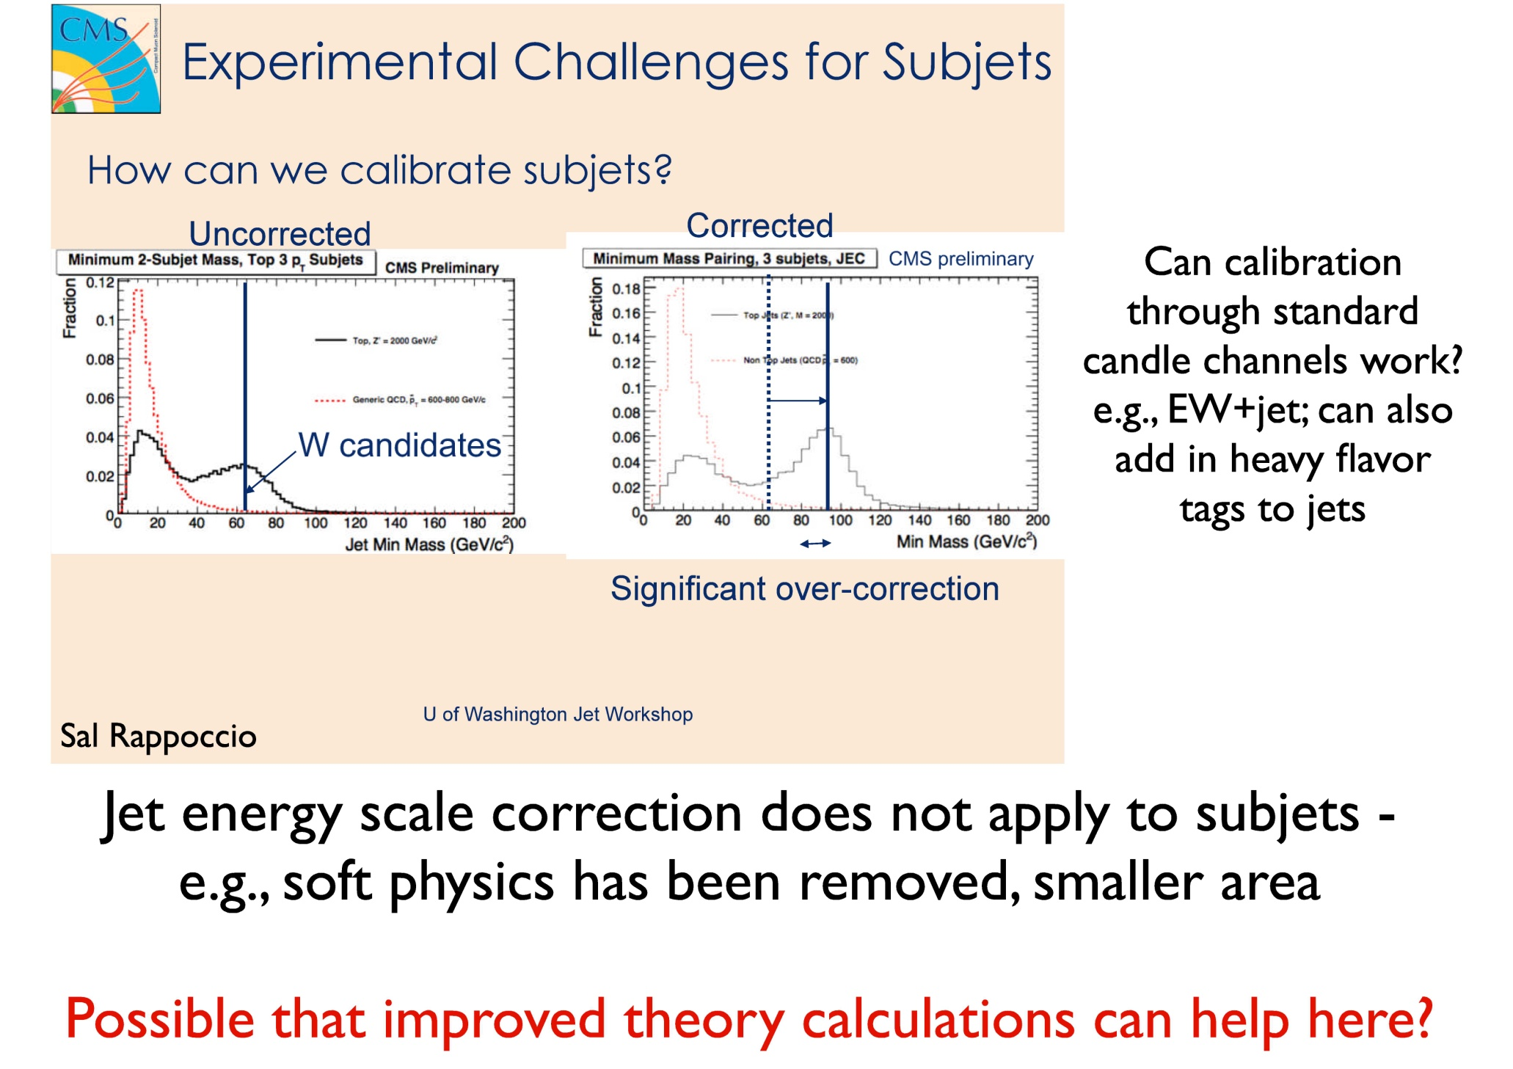
Hear more this week!

Slide 16
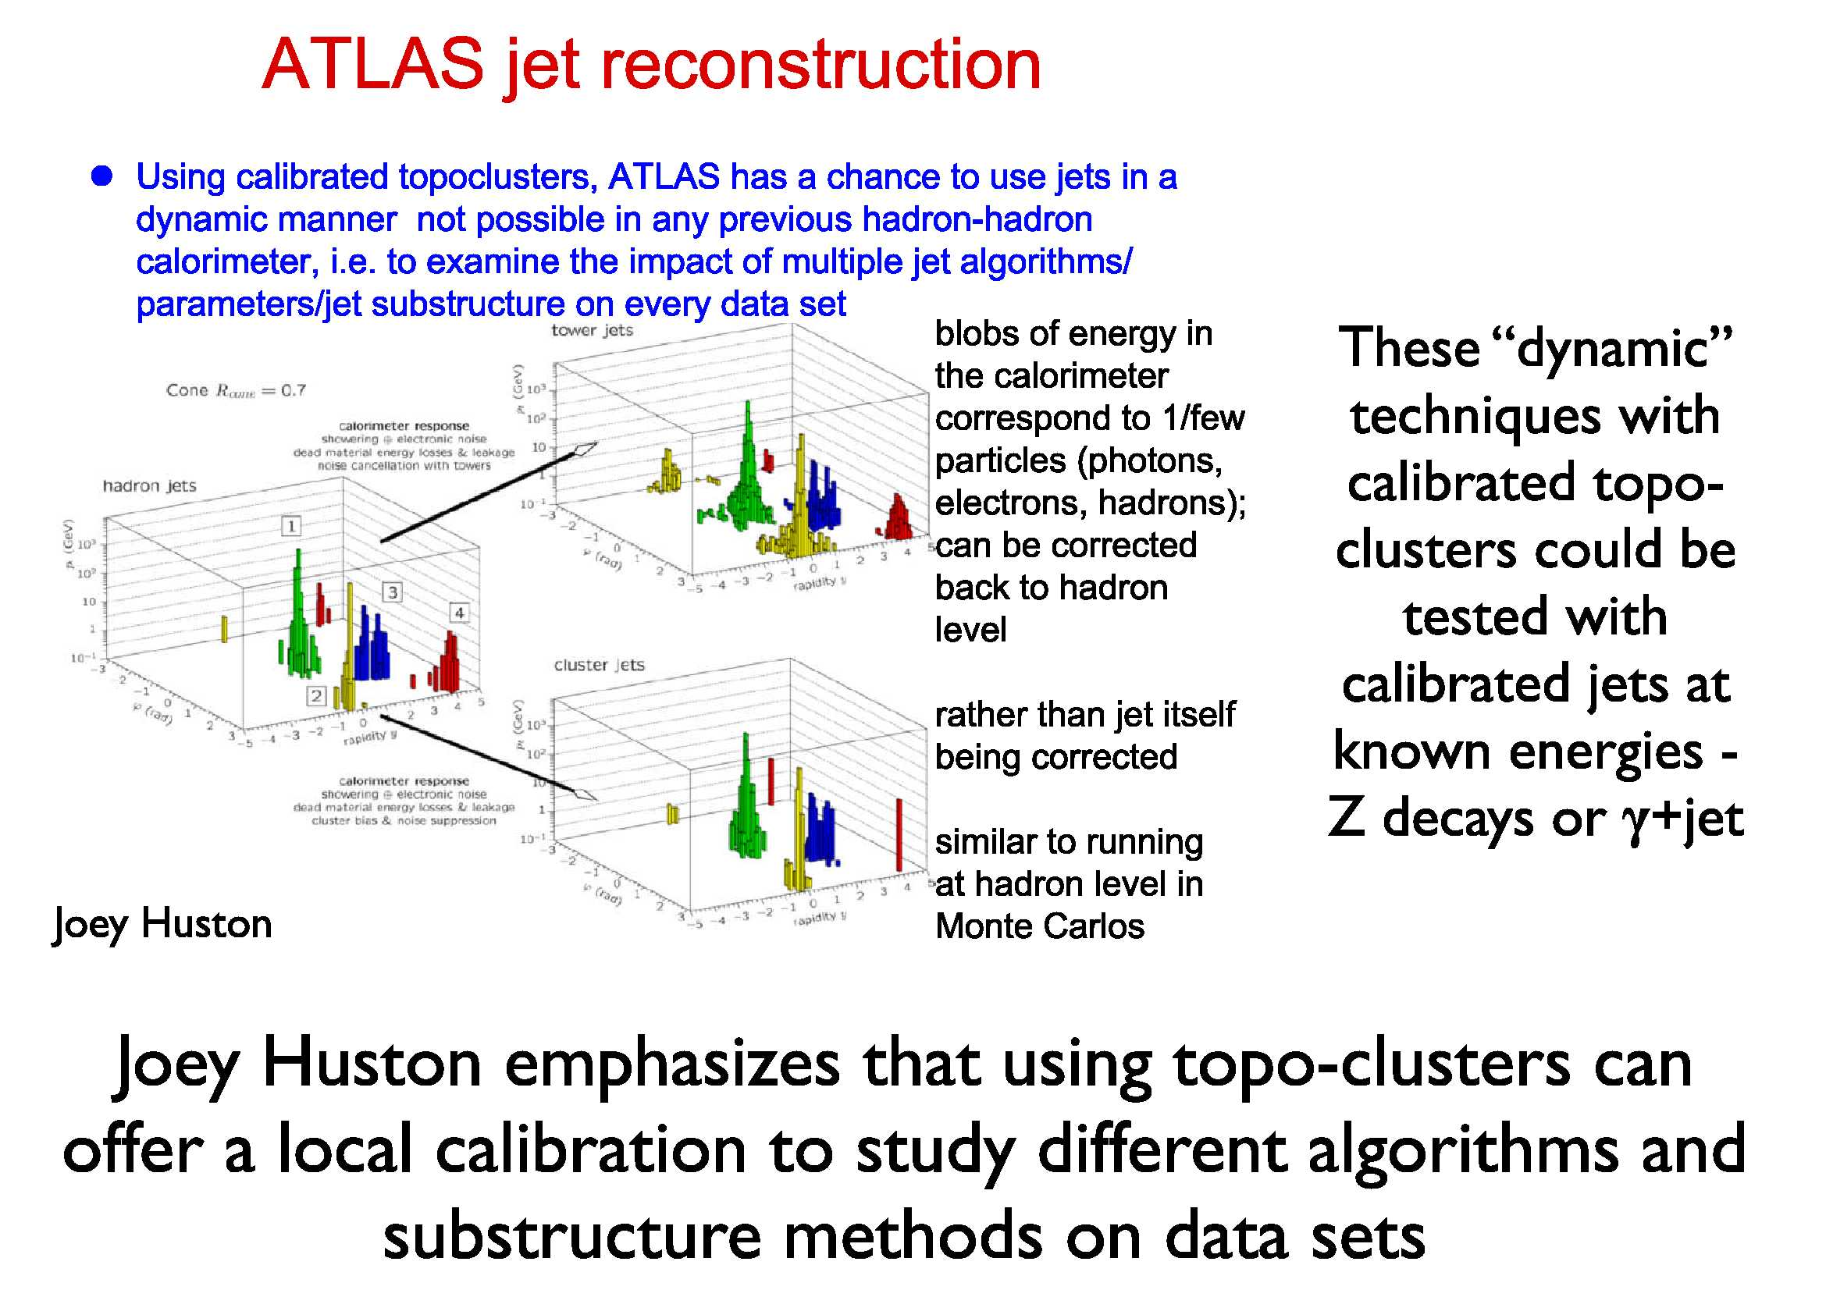
(These are not your Daddy’s jets)
Hear more this week!

Slide 17
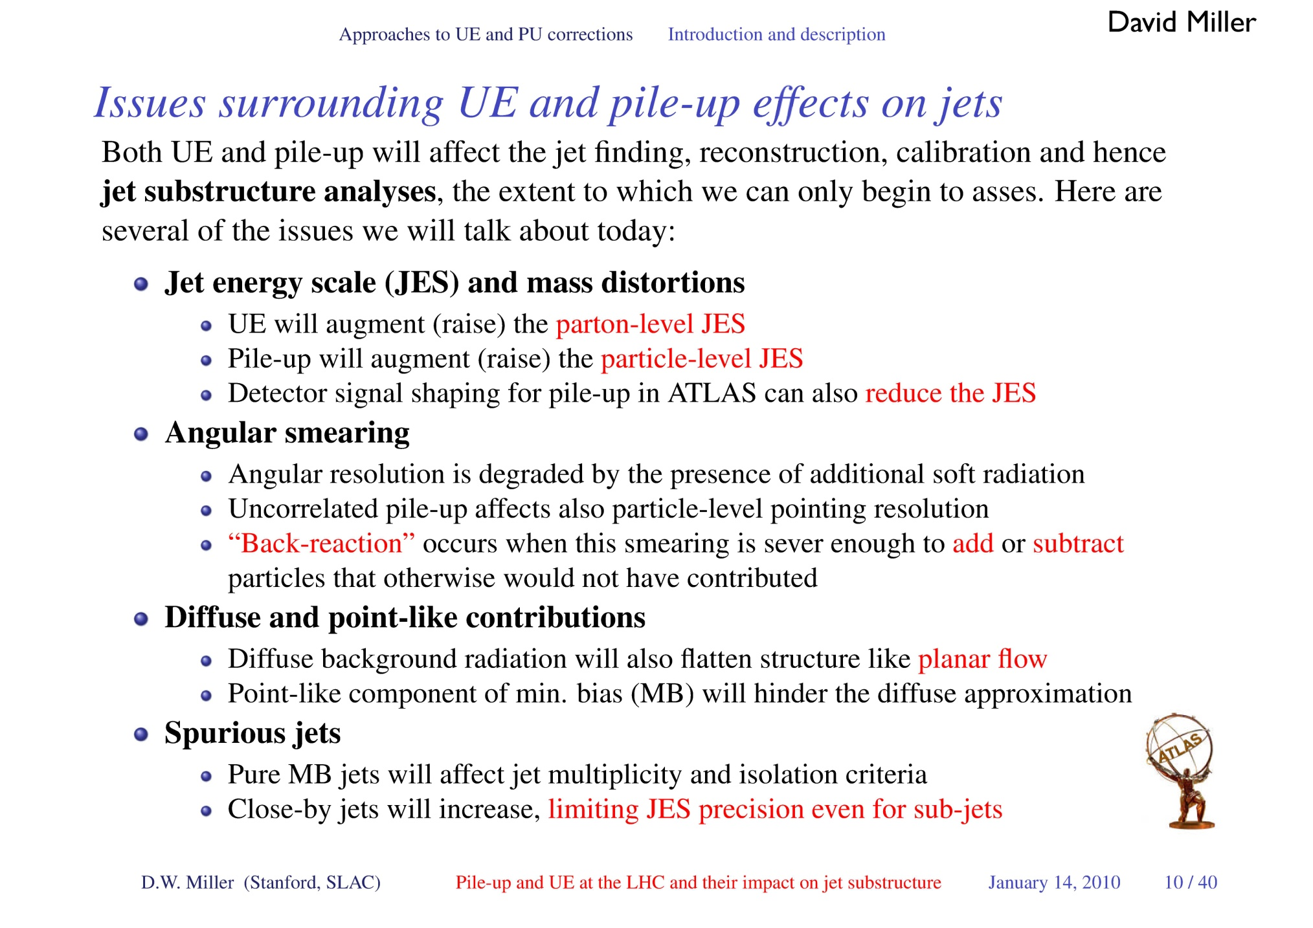

Slide 18
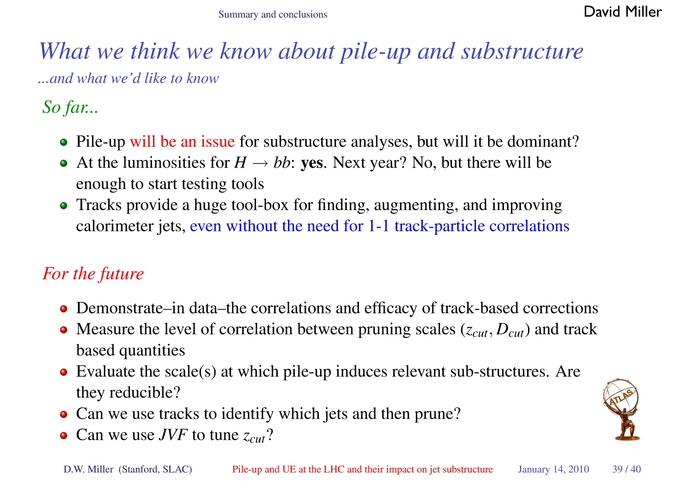
Can pruning help? More this week?

Slide 19
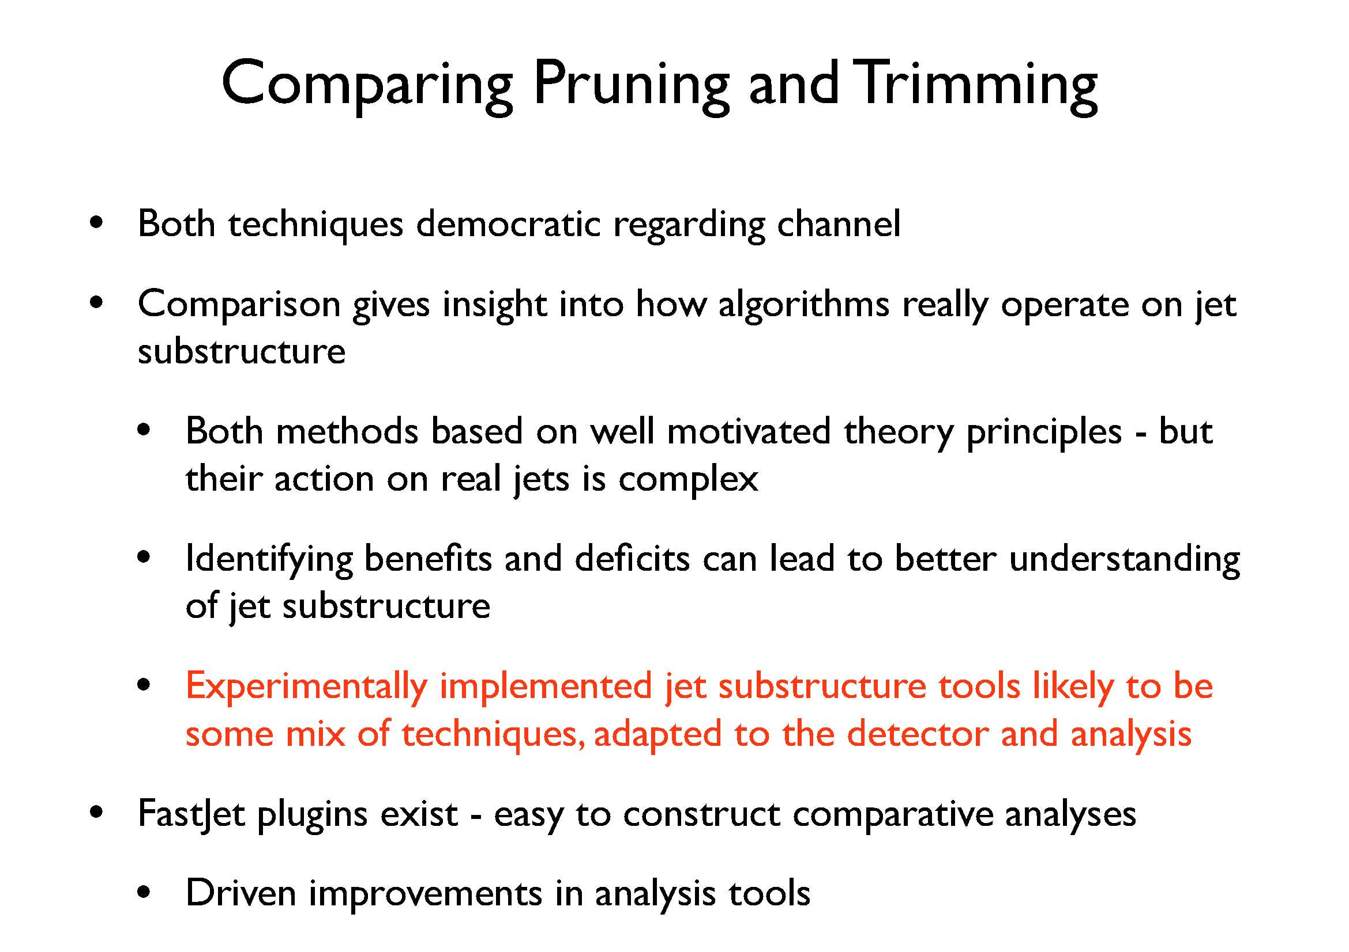

Slide 20
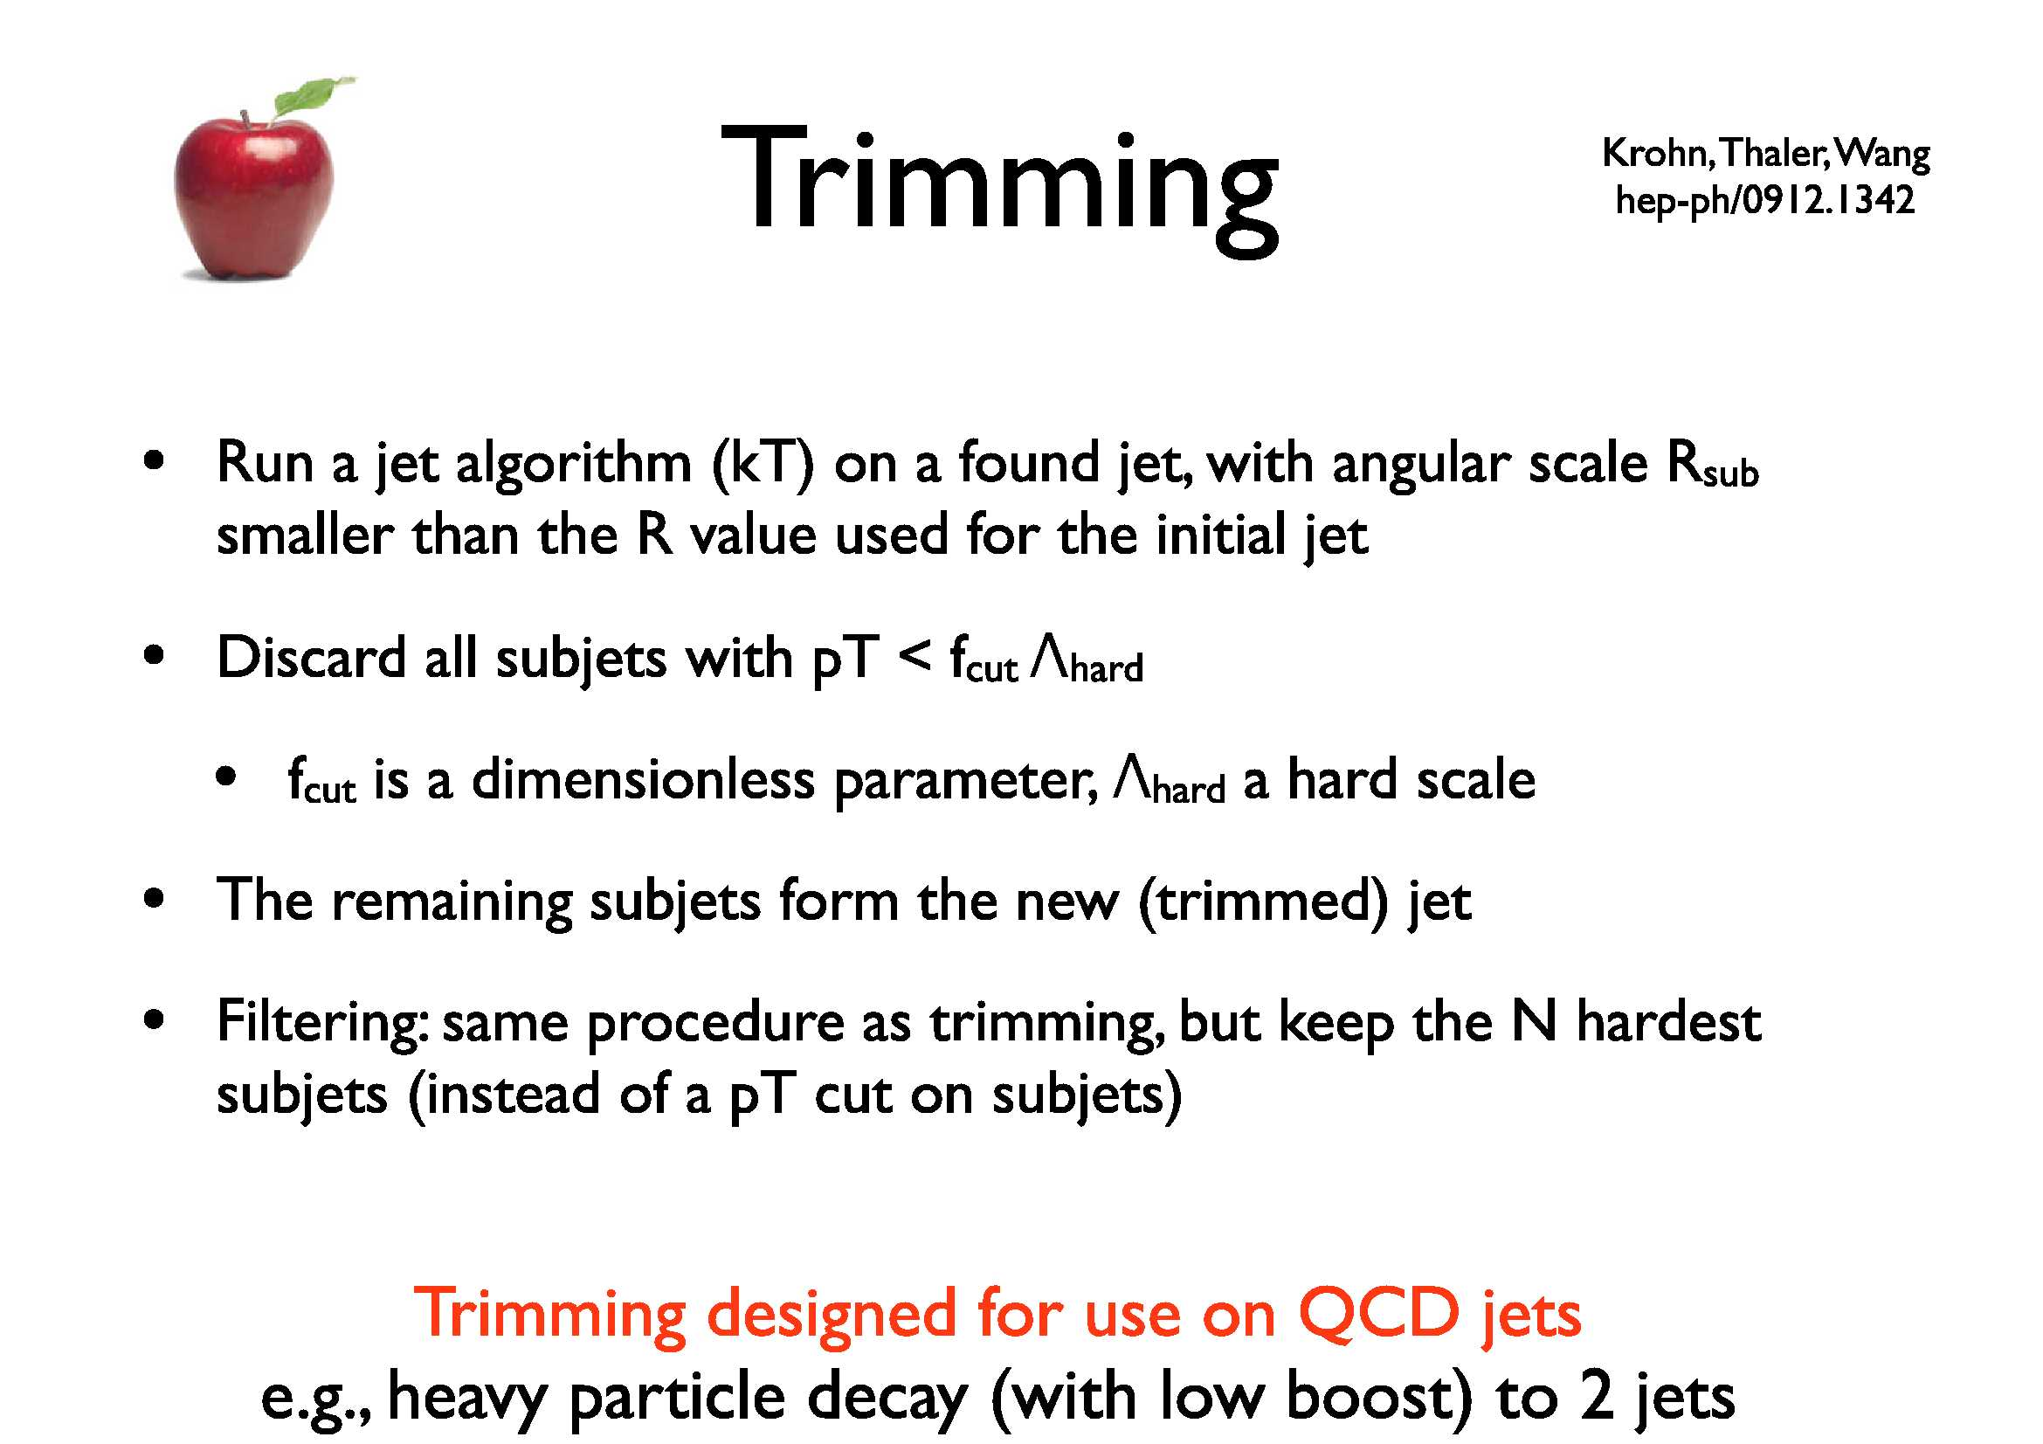

Slide 21
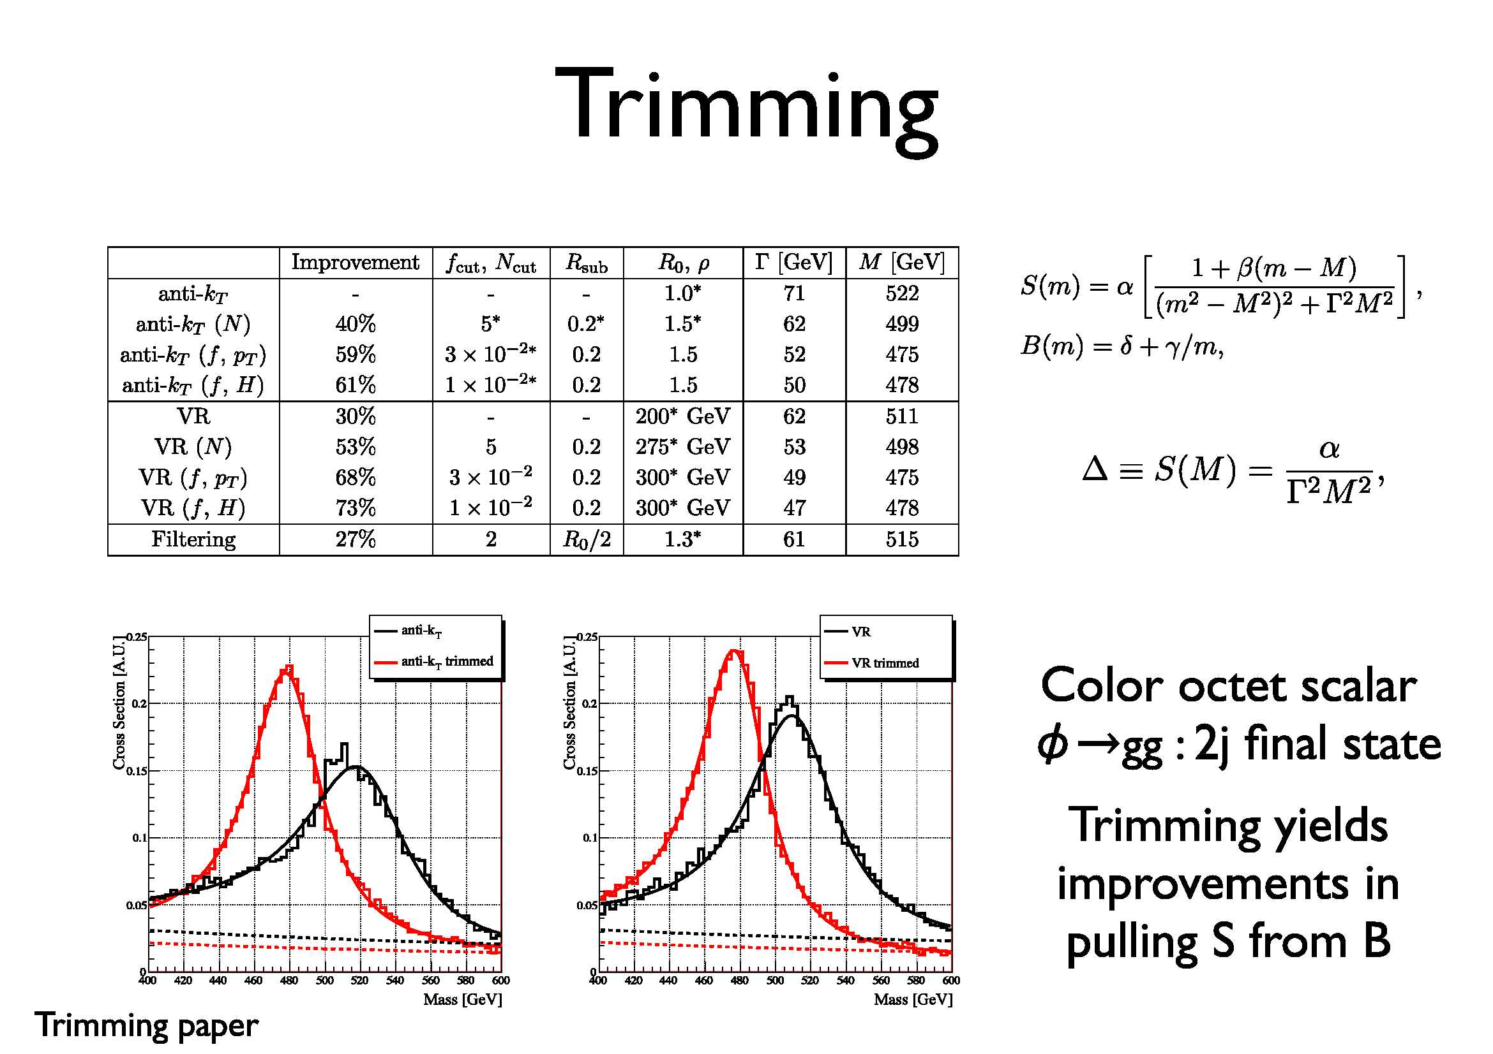

Slide 22
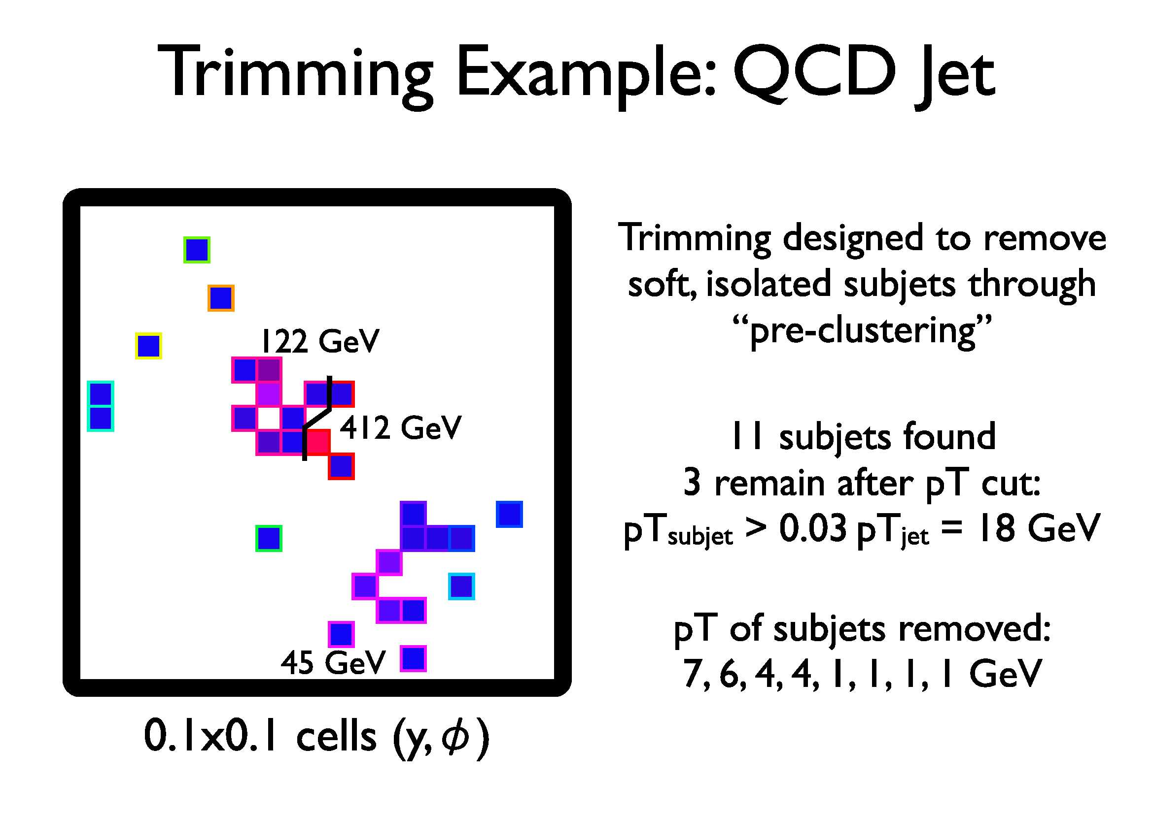

Slide 23
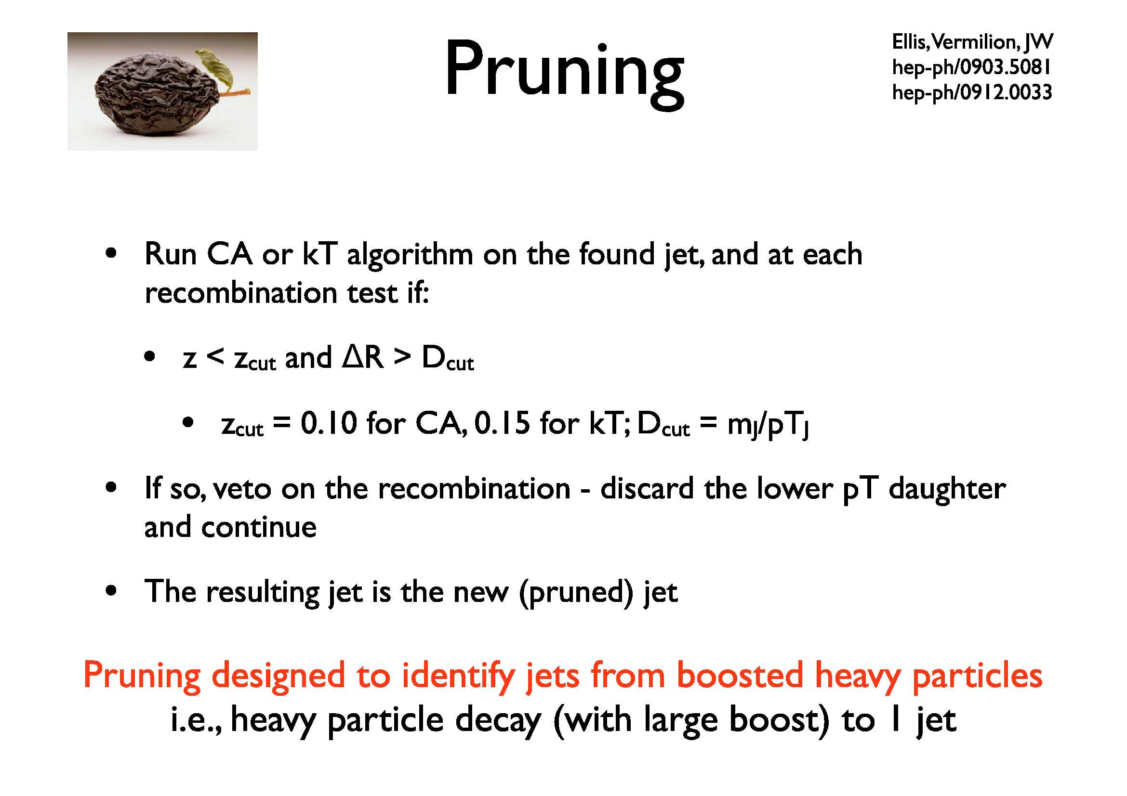

Slide 24
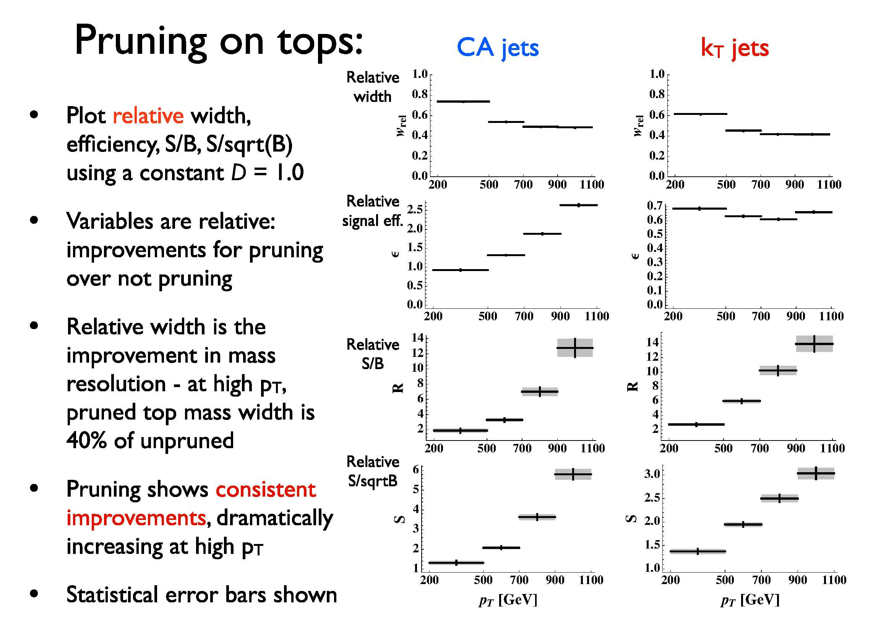

Slide 25
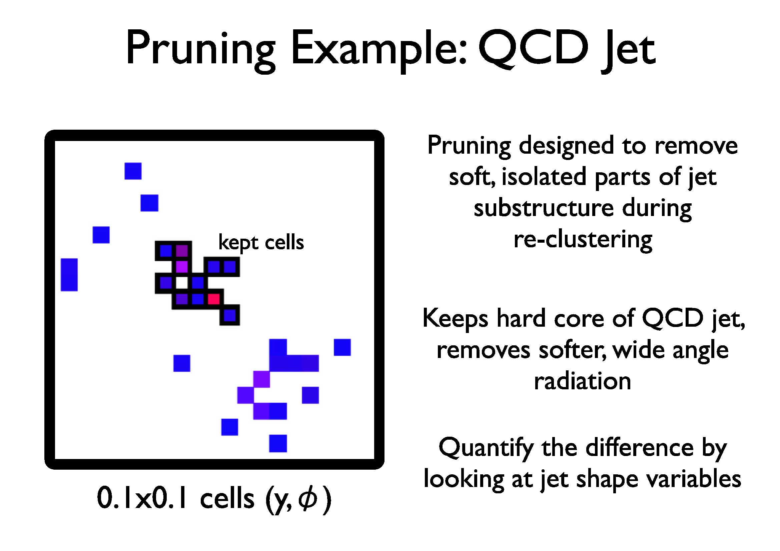
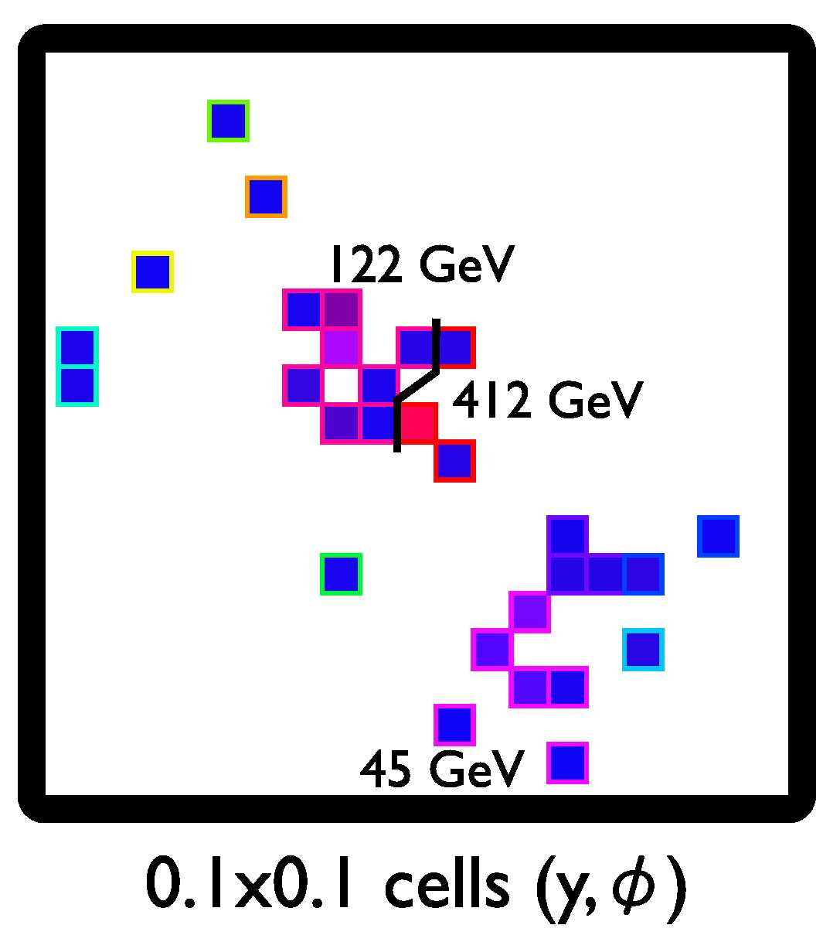
Trimmed

Slide 26
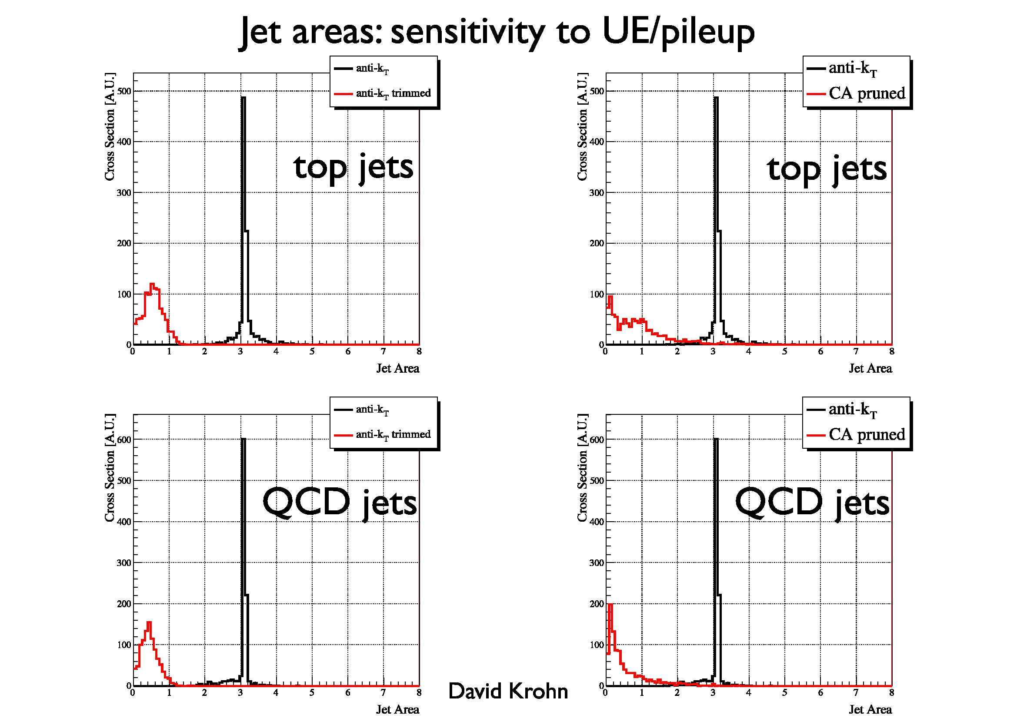

Slide 27
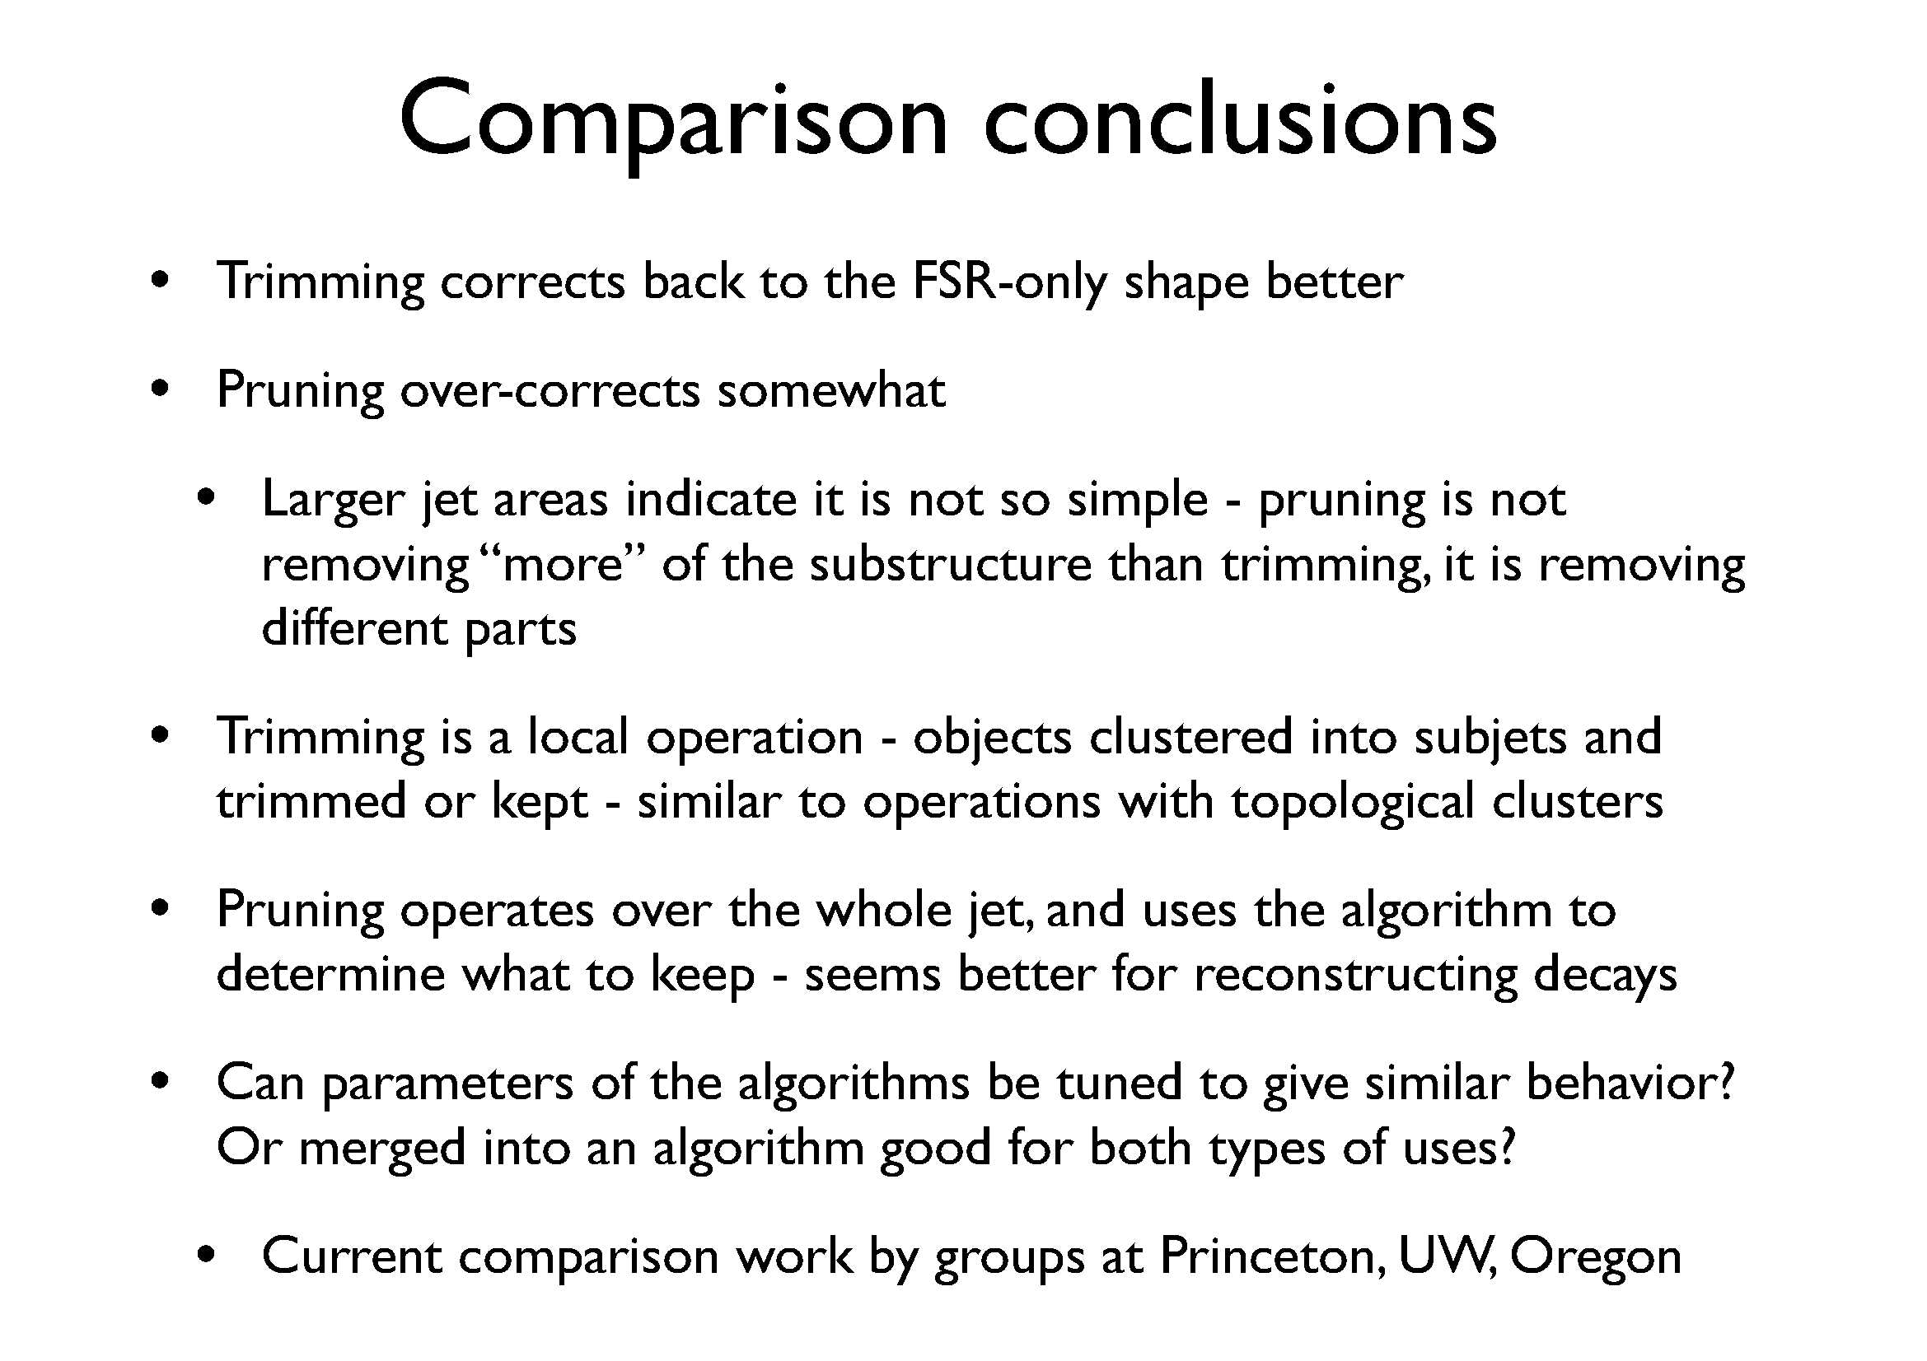
See talk by M. Spannowsky

Slide 28
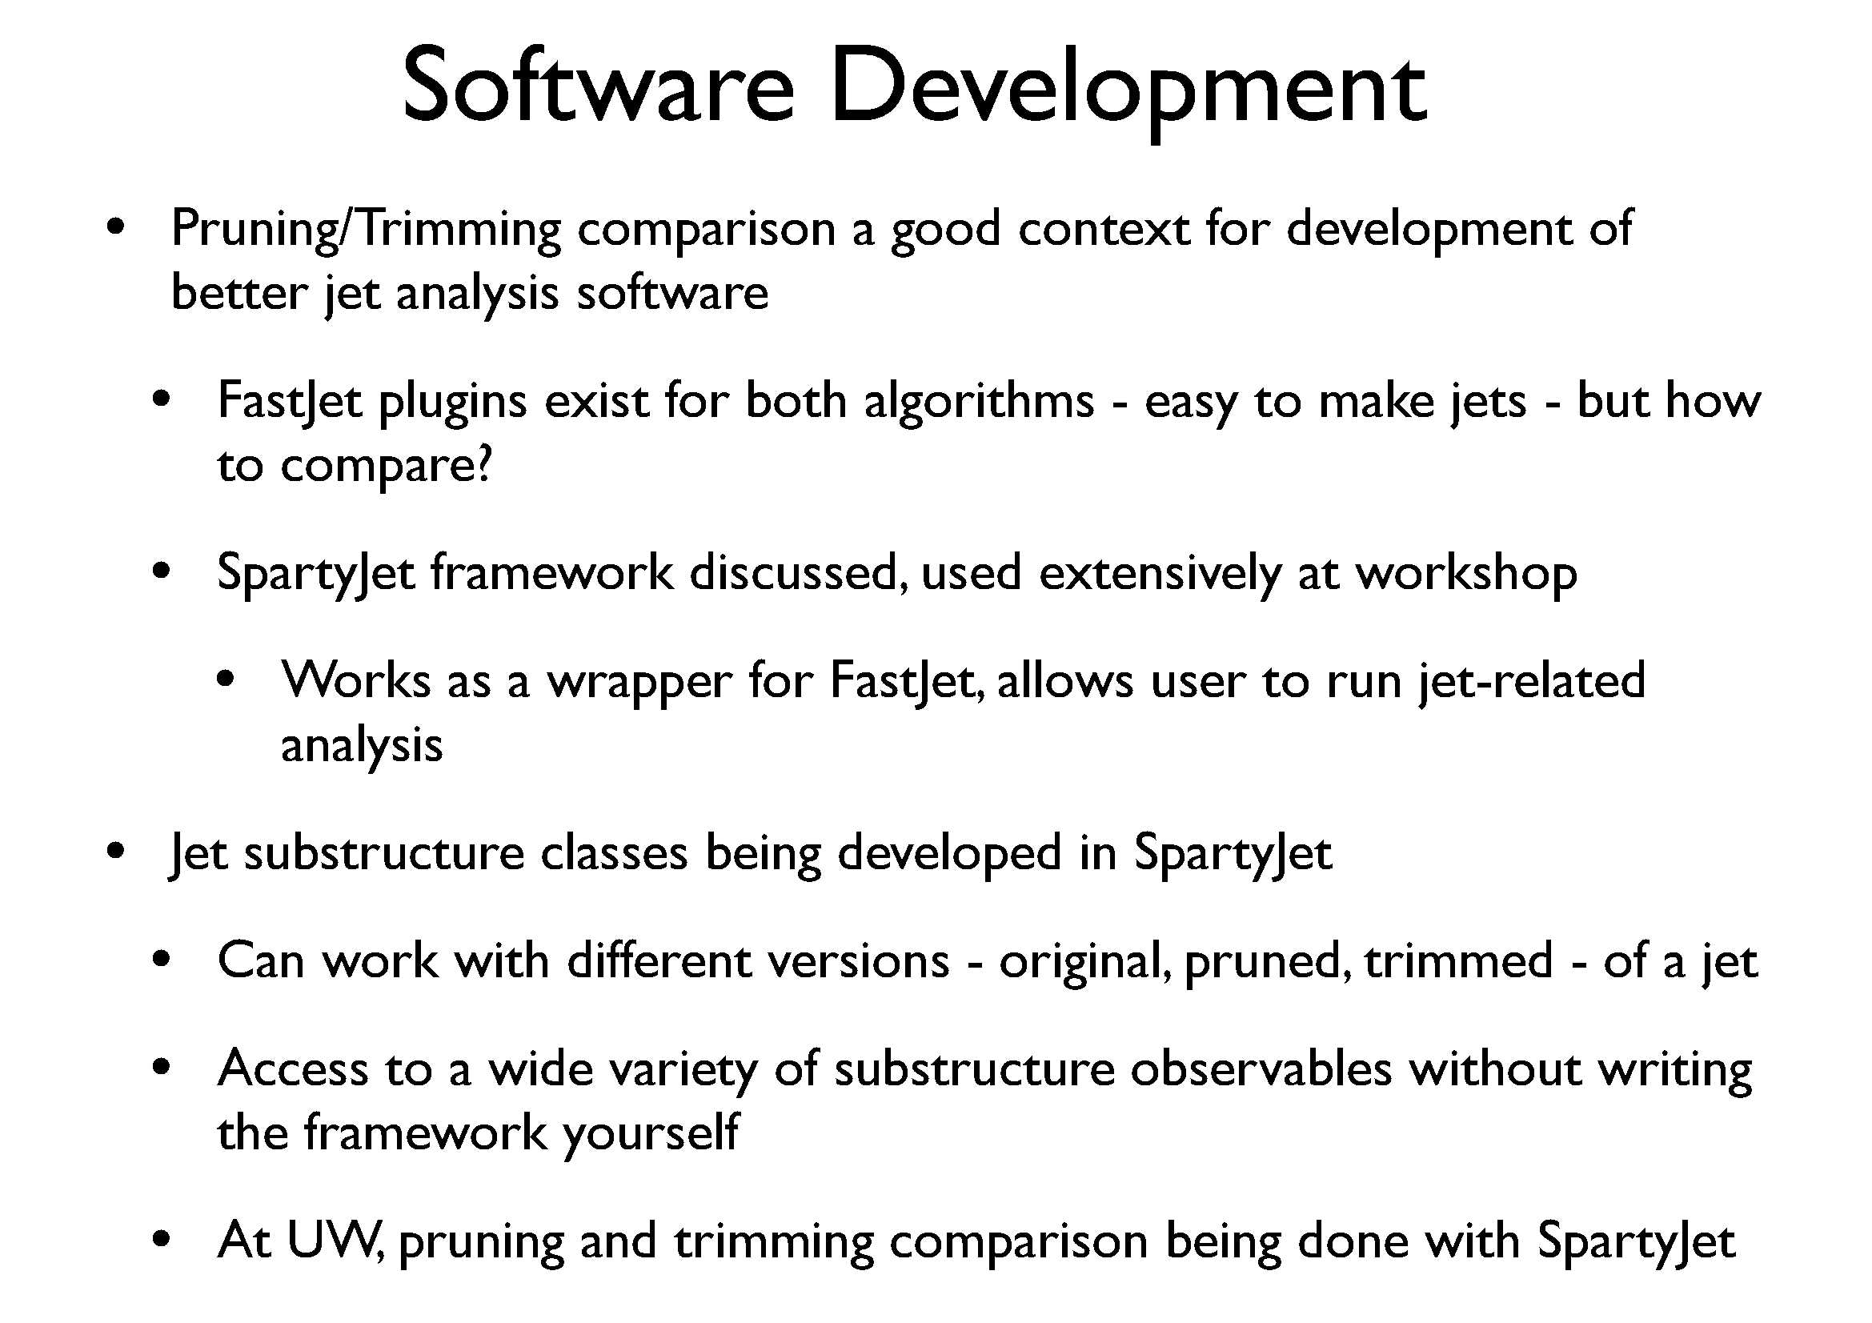
See presentation by C. Vermilion

Slide 29
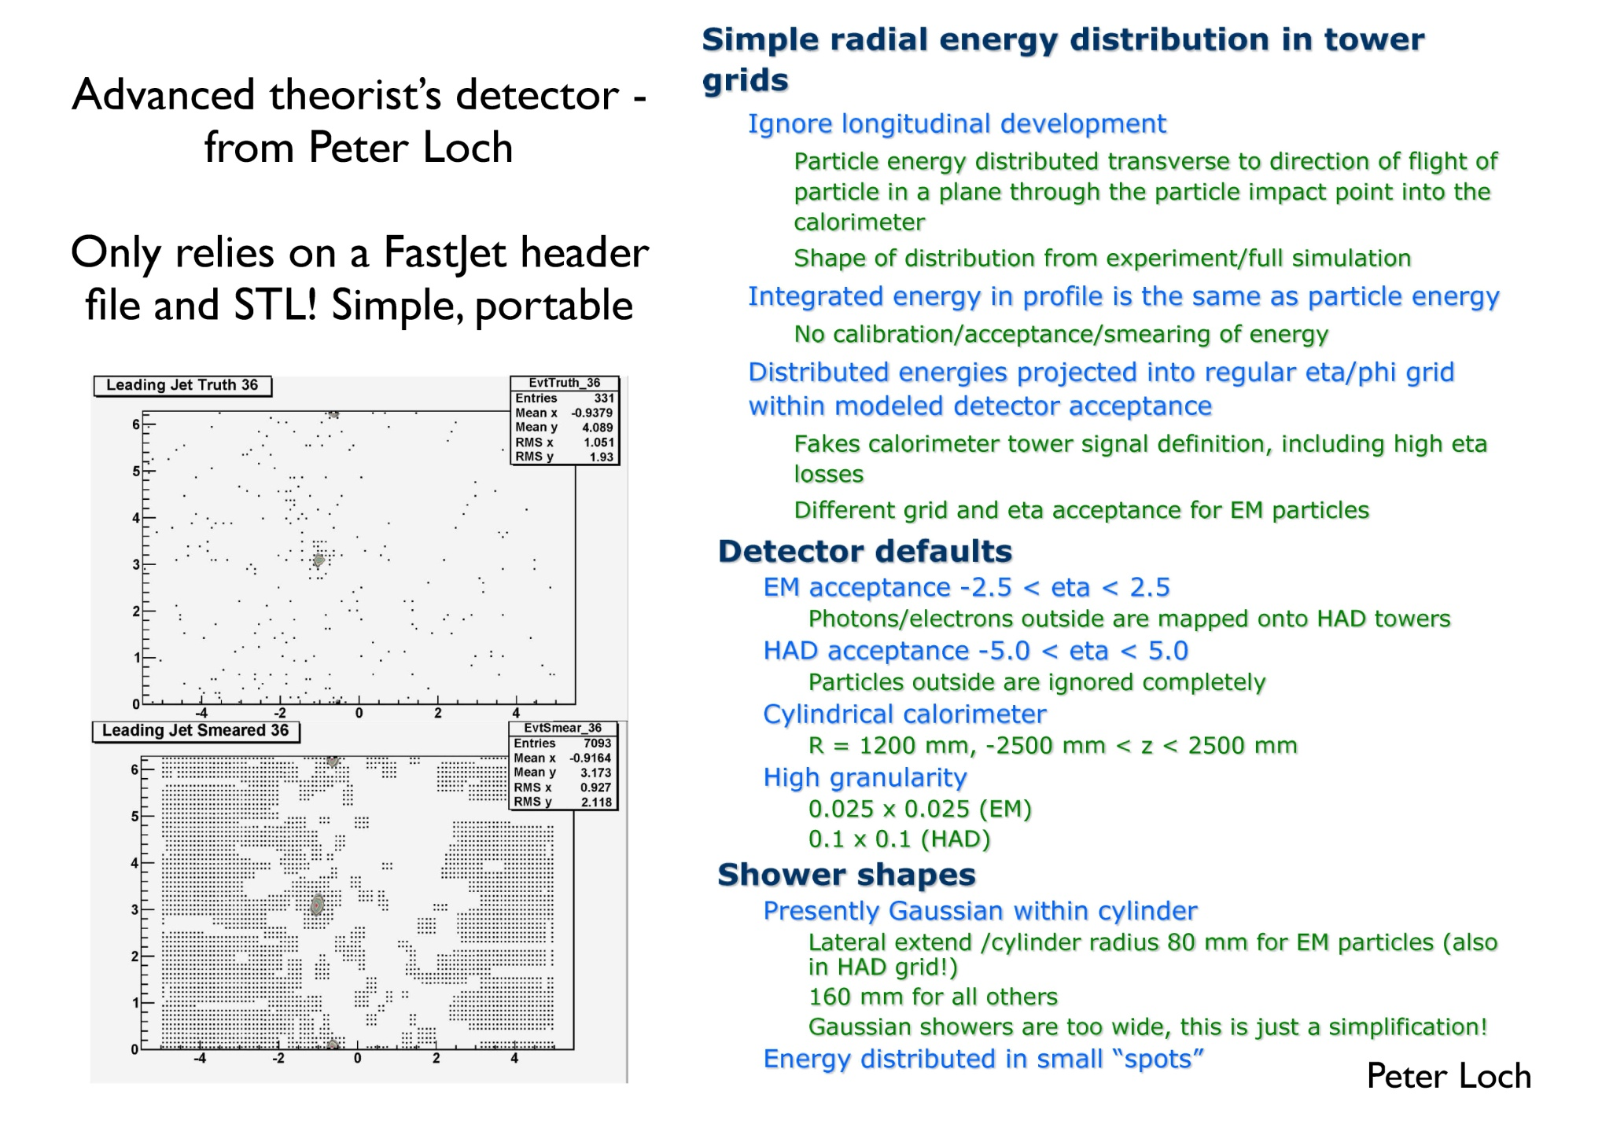

Slide 30
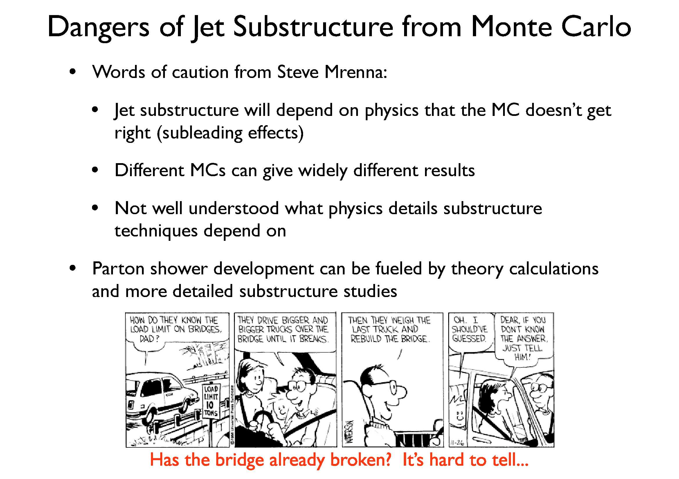
Check current MC status this week!

Slide 31
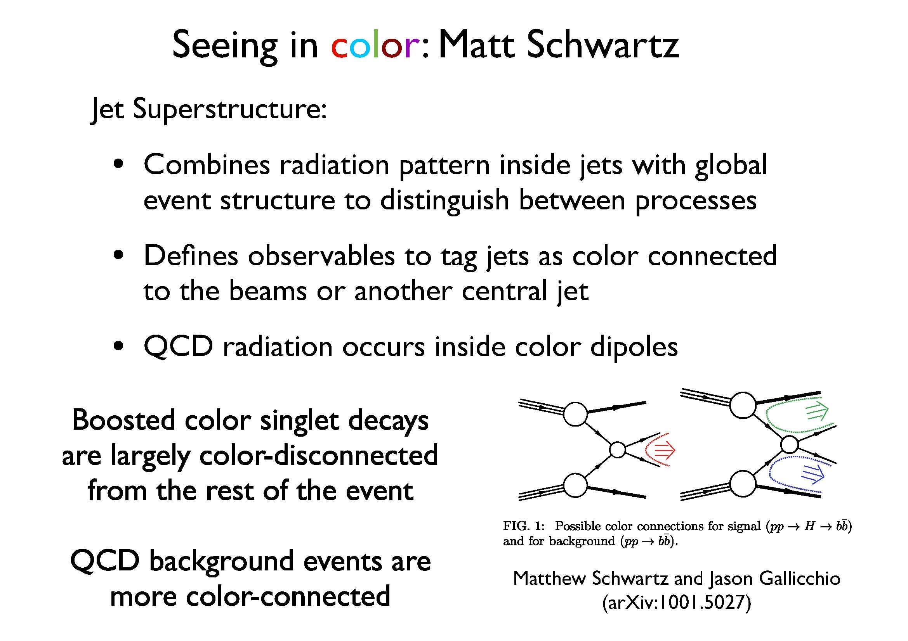

Slide 32
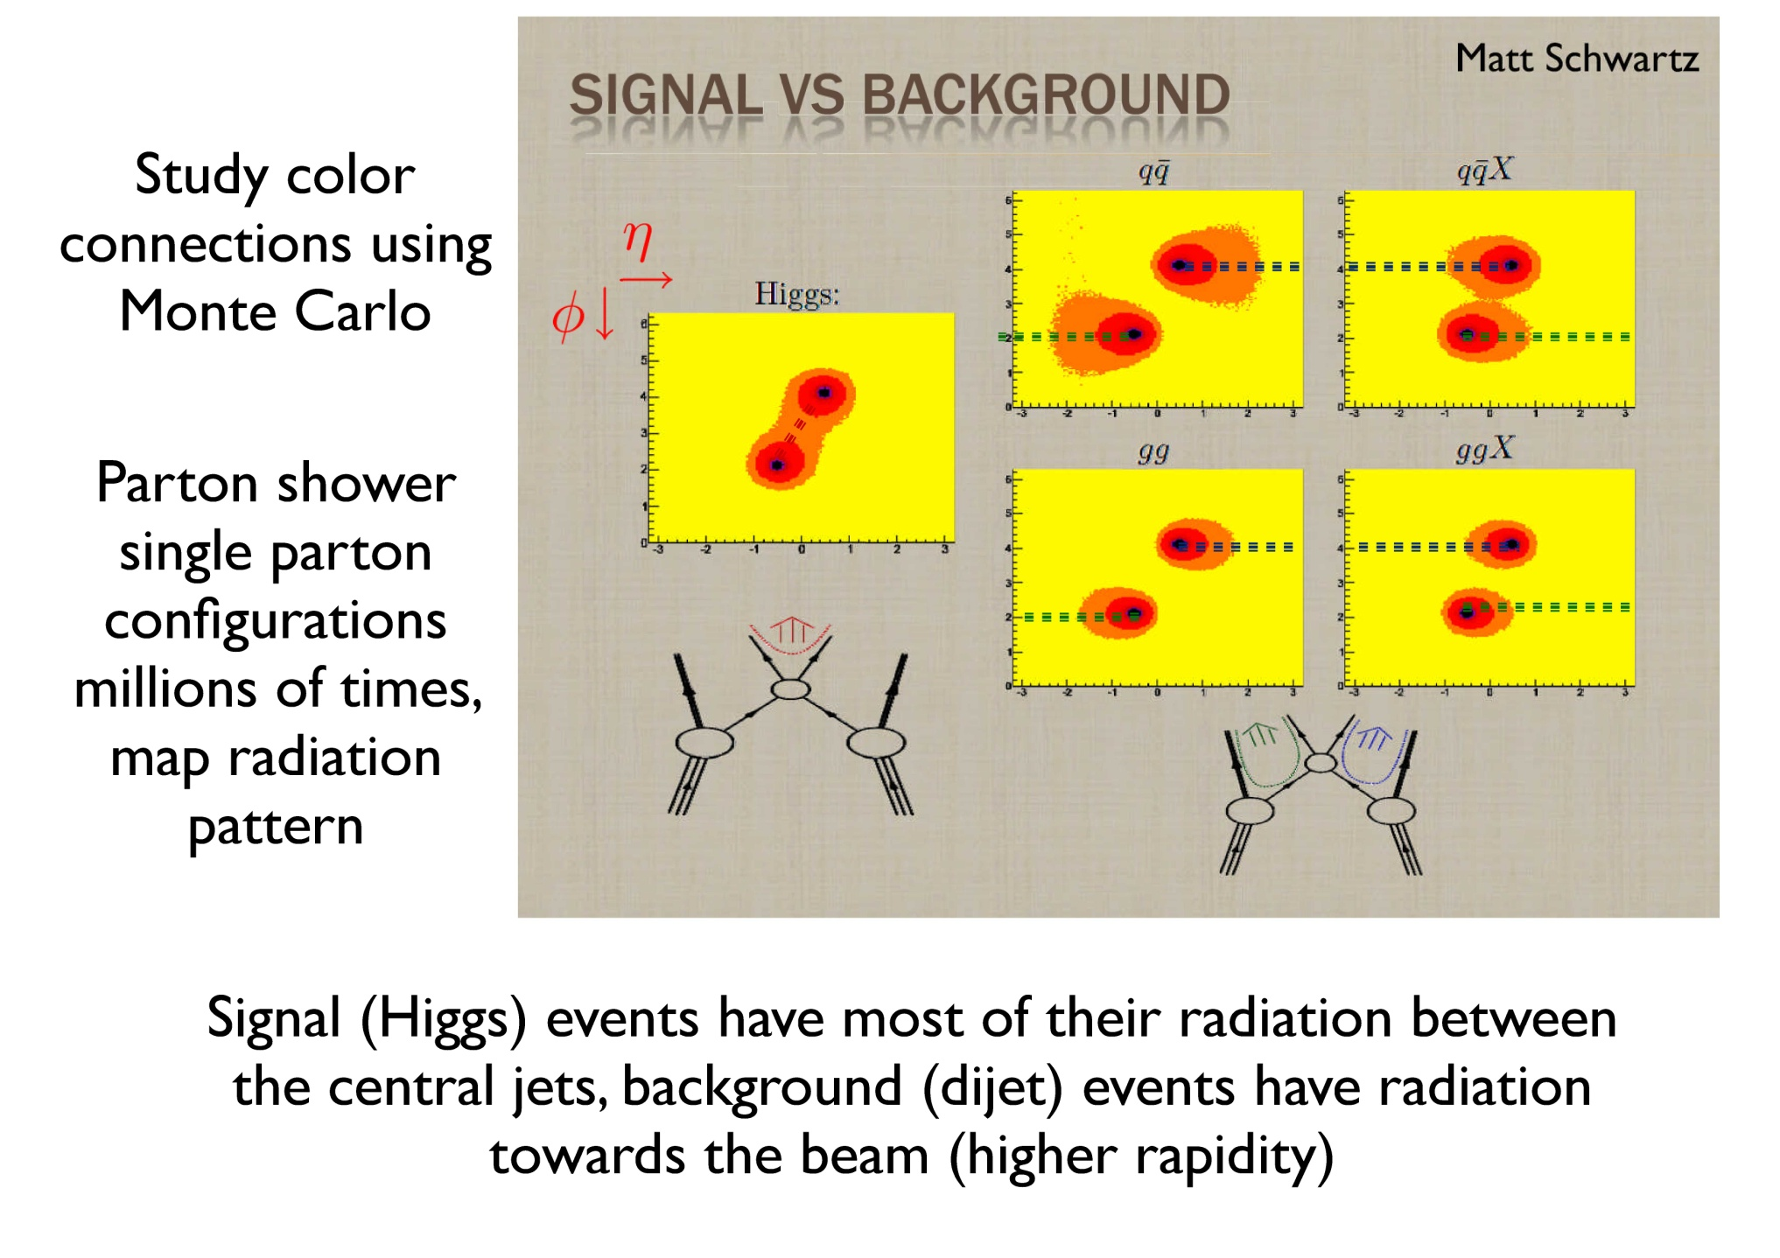

Slide 33
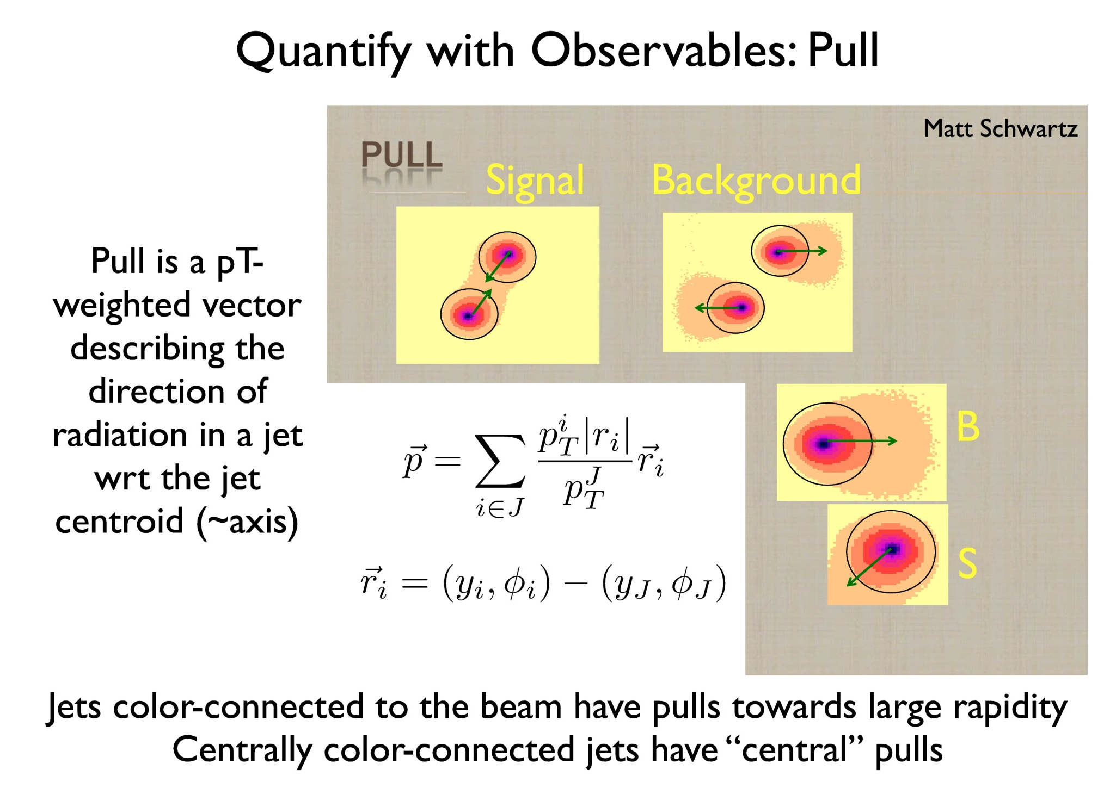

Slide 34
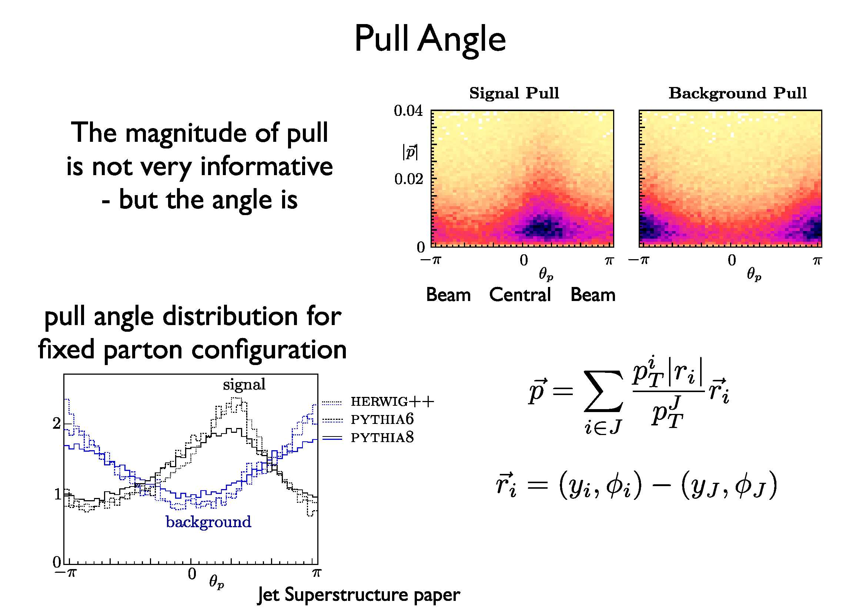

Slide 35
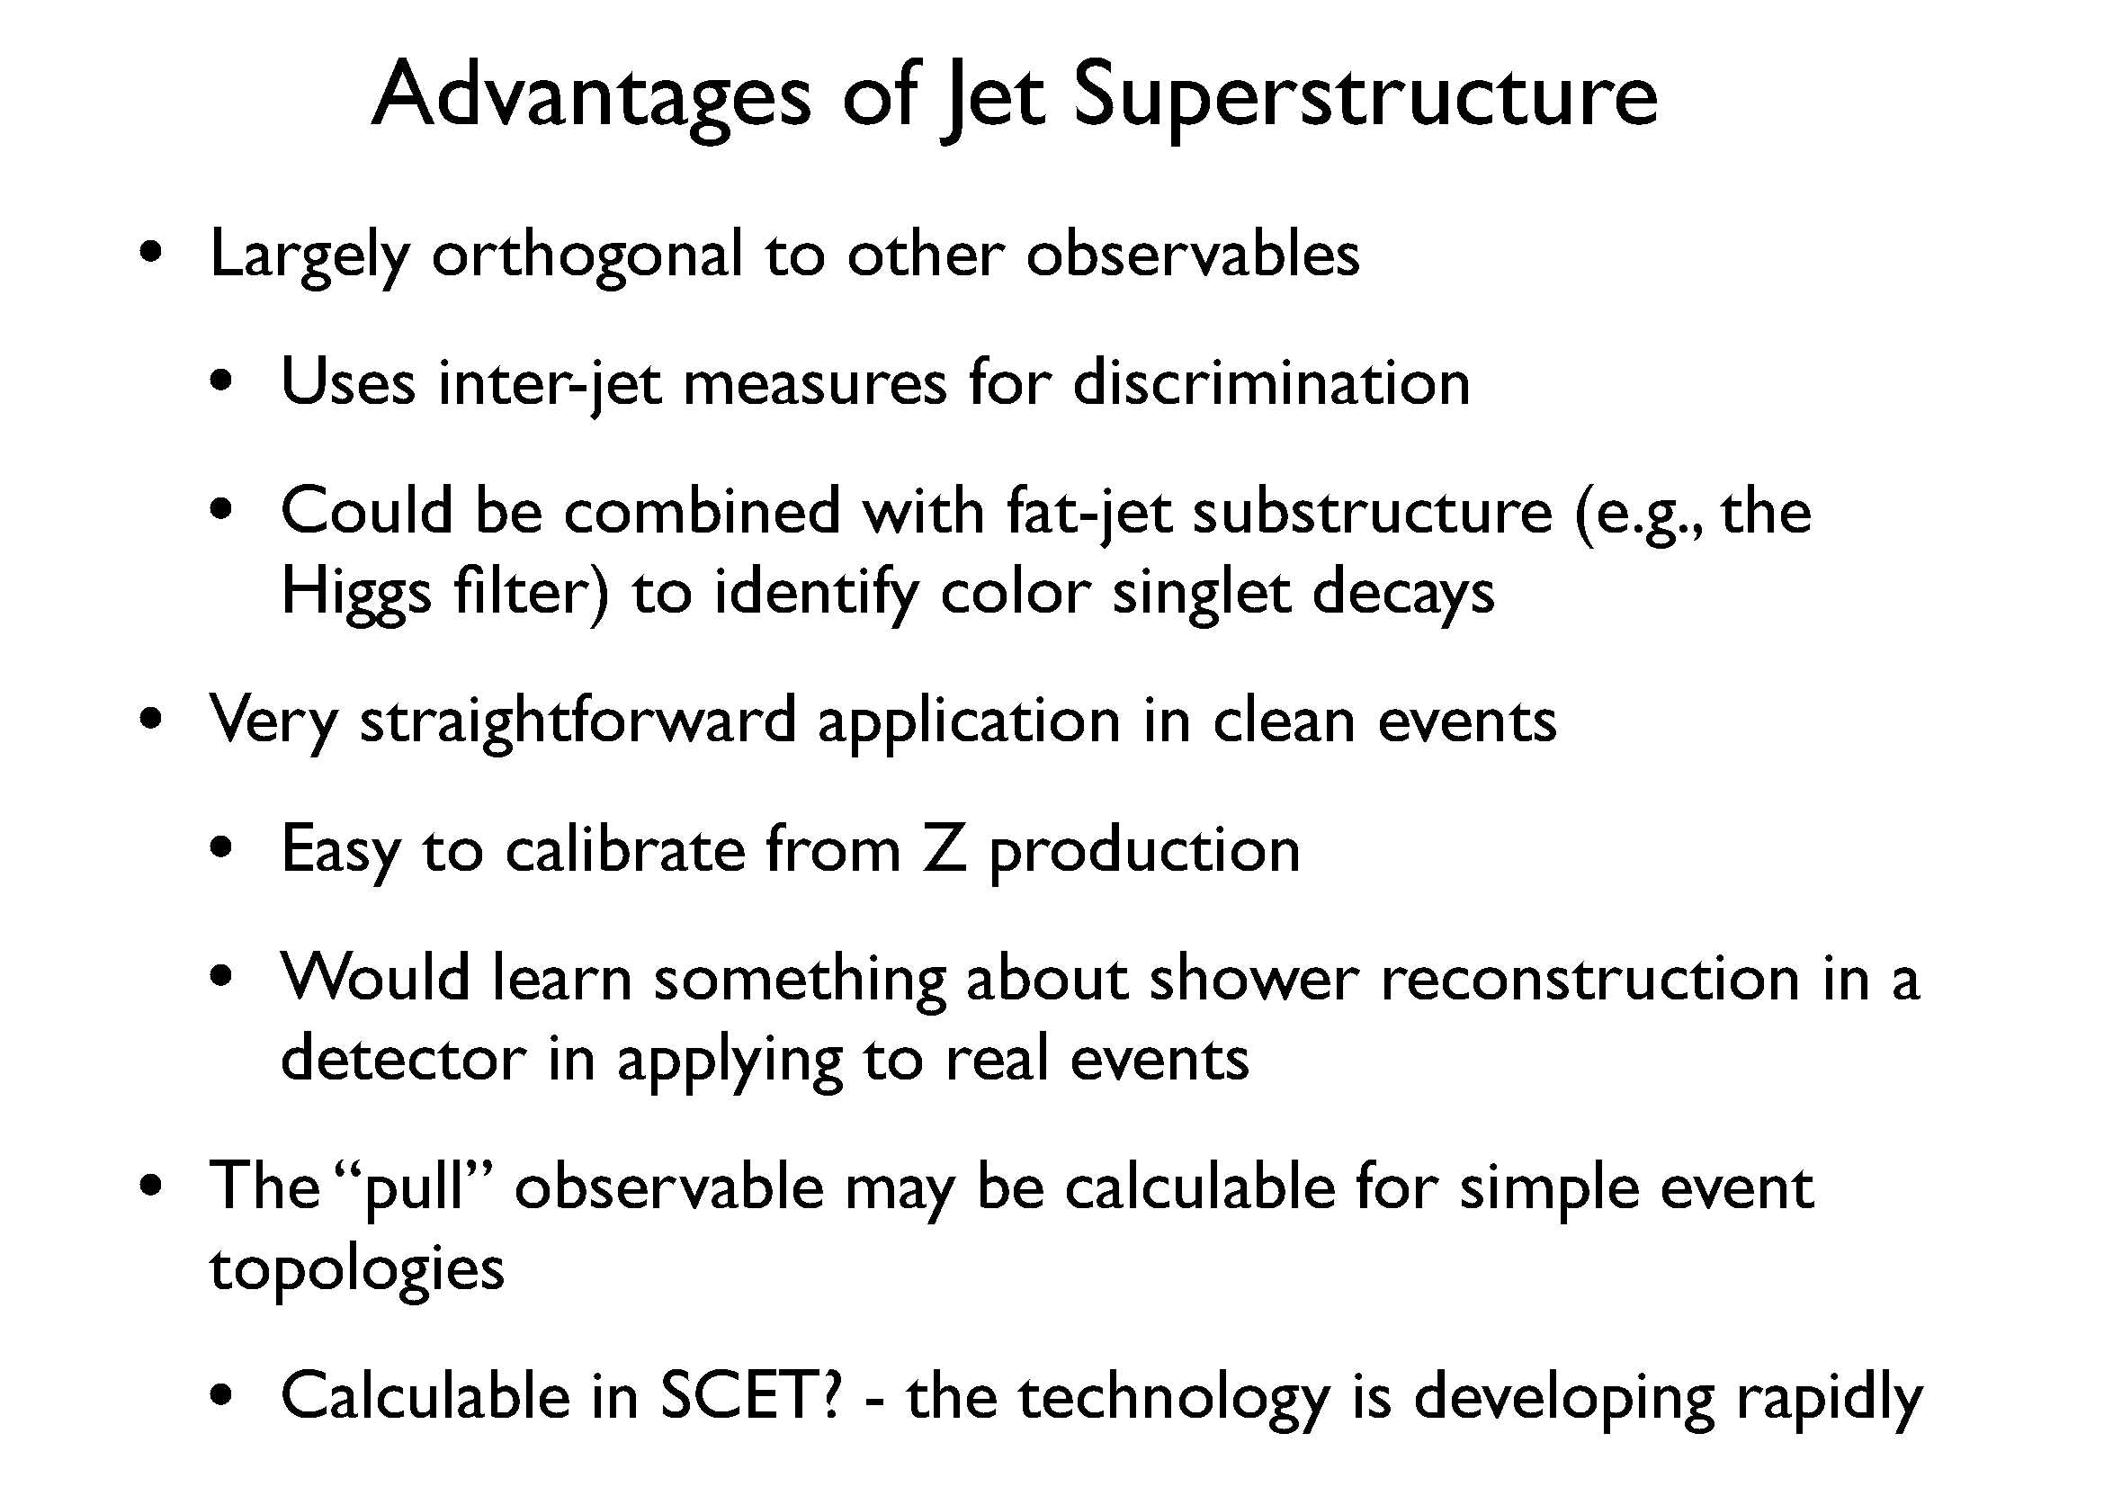

Slide 36
HW (expectations) for Boost 2010 :
Better understanding of tools to tag and/or groom jets using jet substructure – both absolutely and comparatively –
to find old/new physics
to reduce specific algorithm dependence
to reduce impact of UE and Pile Up
Better understanding of how well experiments can utilize and calibrate these tools given specific detector strengths and weaknesses

Slide 37
HW (expectations) for Boost 2010 :
Better understanding of what measurements need to be made this year and how to communicate the results to the larger community ⇒ practice discussing physics with theorists!
Better software tools – e.g.,
FastJet plugins
Useful analysis interfaces like SpartyJet, e.g., to simplify the comparison of various analysis techniques
Fast but realistic detector simulations for studies inside AND outside of the experimental collaborations

Slide 38
Extra Detail Slides

Slide 39
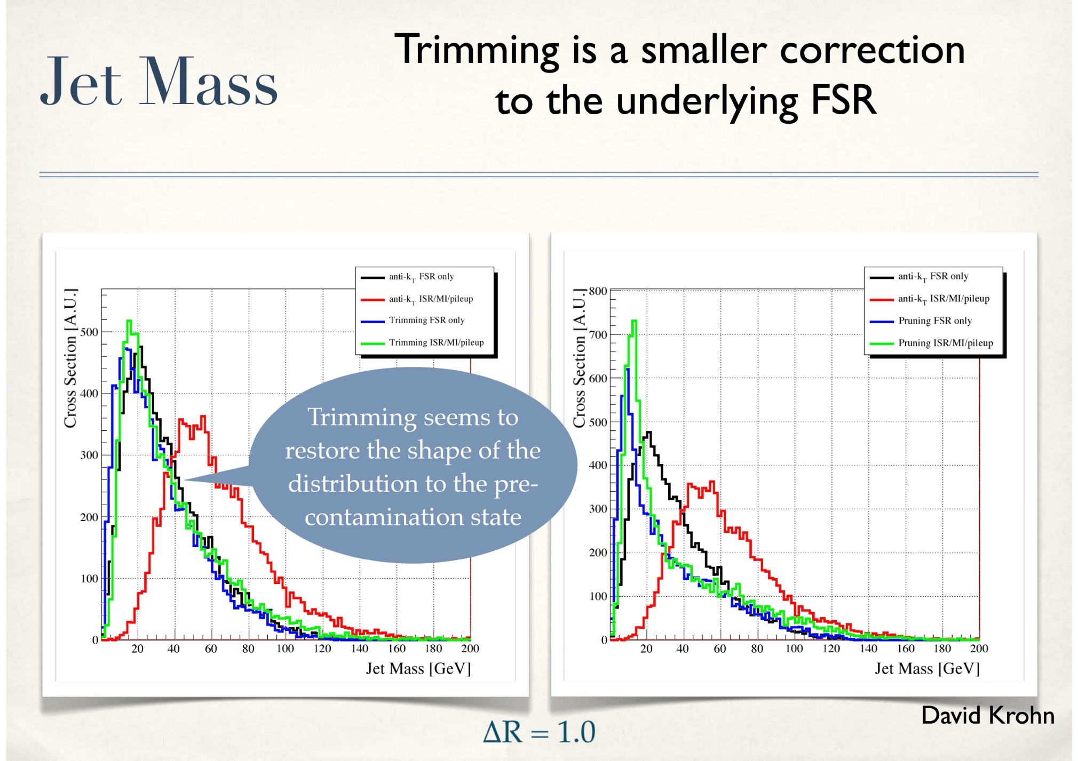

Slide 40
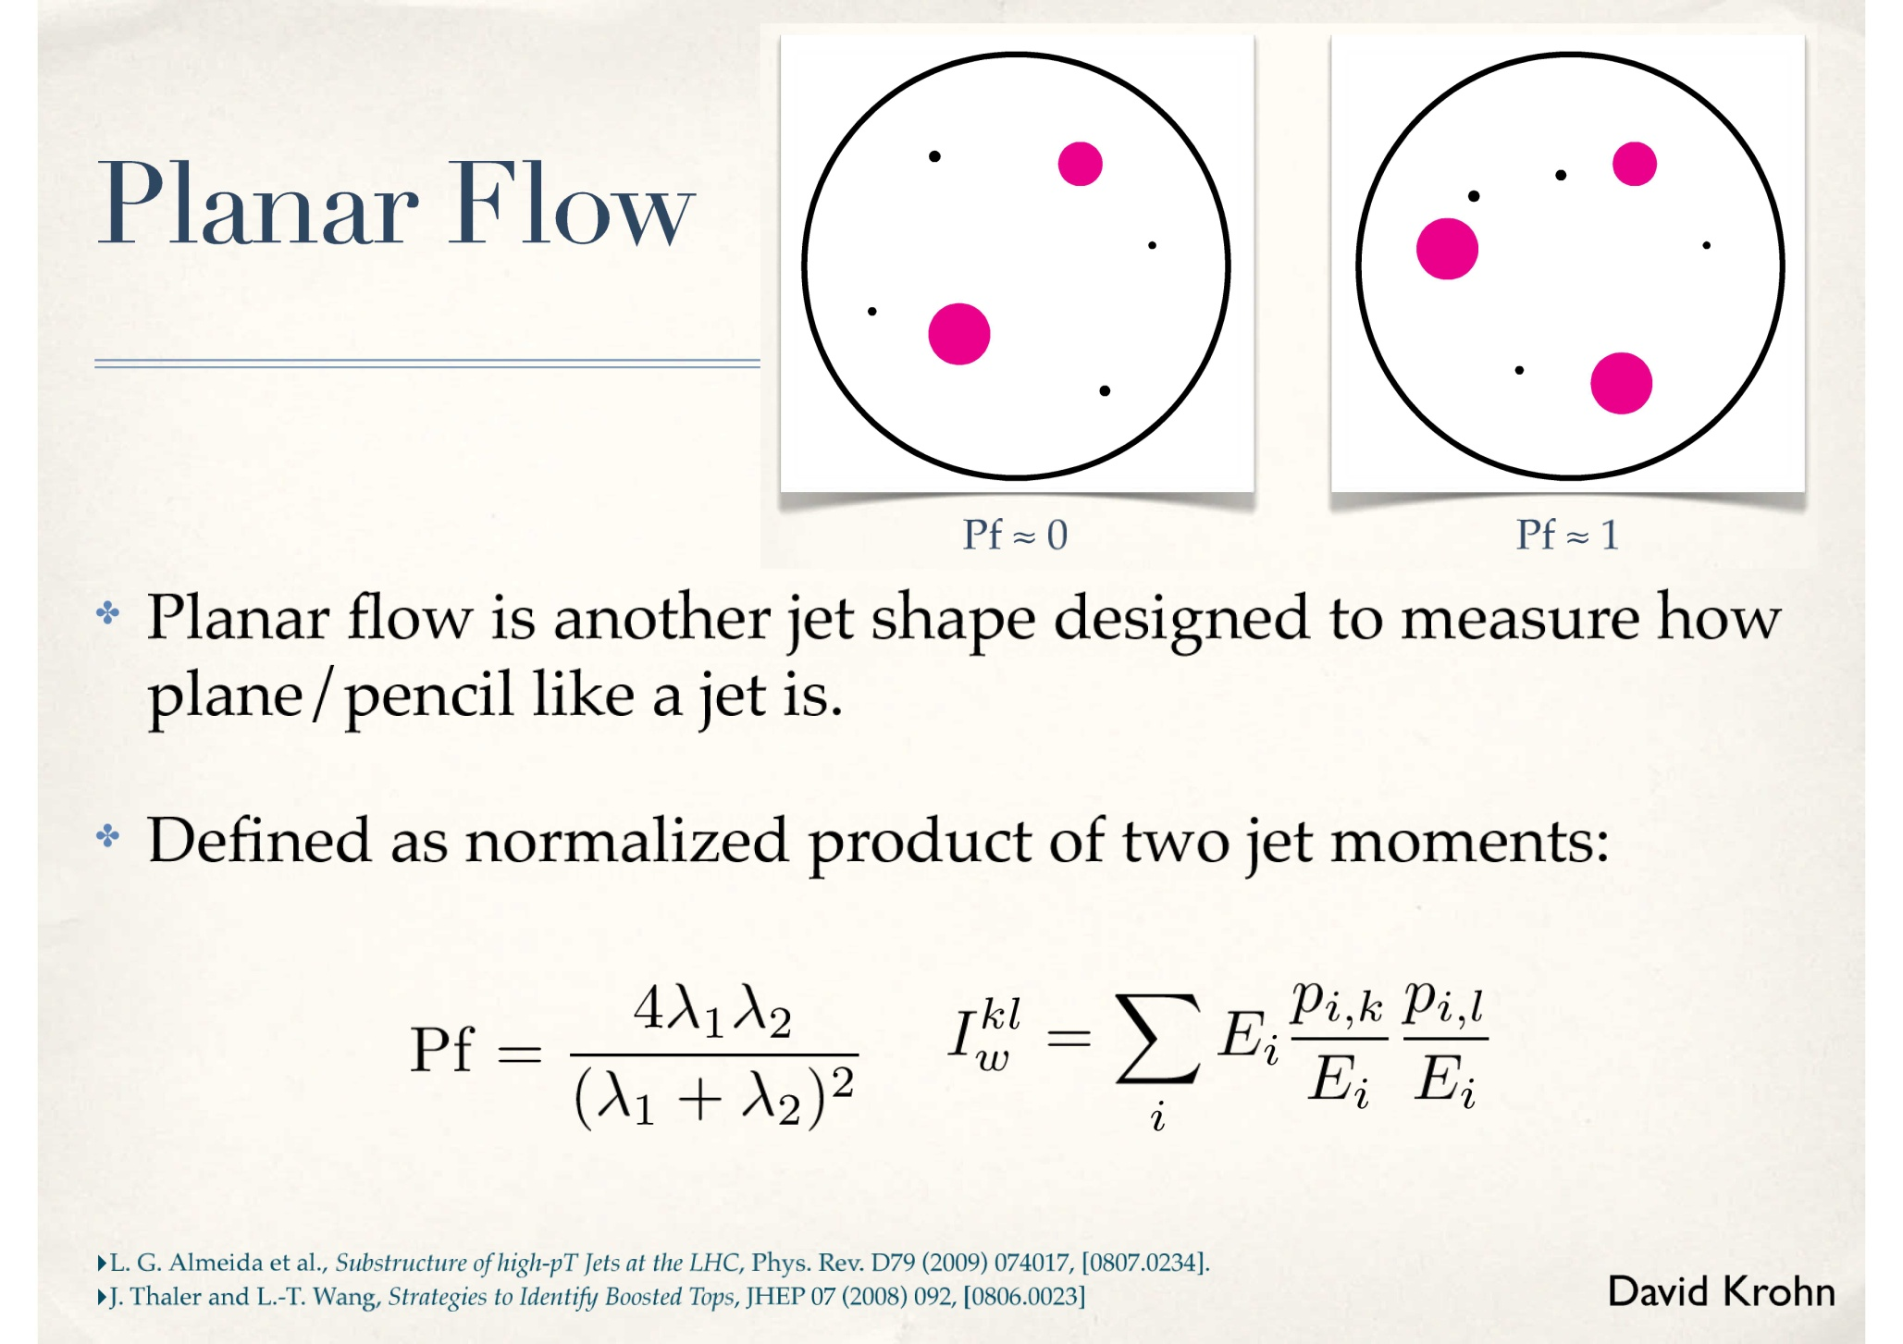

Slide 41
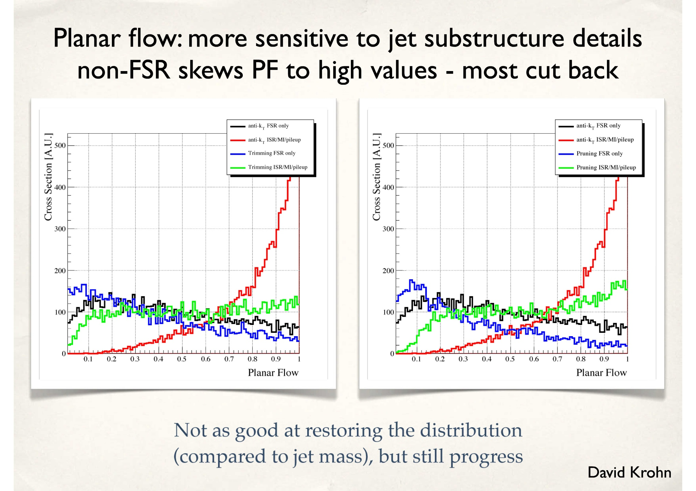

Slide 42
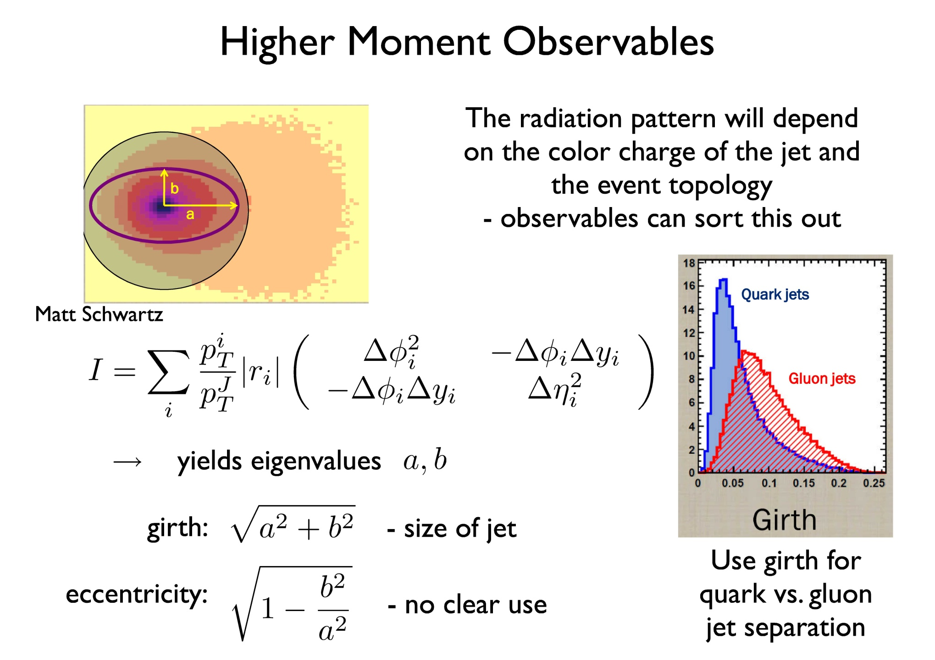

Slide 43
Soft Collinear Effective Theory (SCET)
(Recent but Incomplete List)
Jets and Jet Substructure in e+e-
SDE, Hornig, Lee, Vermilion and Walsh (UC/UW) 0912.0262, 1001.0014
Cheung, Luke and Zuberi (Toronto) 0910.2479
Jouttenus (MIT) 0912.5509
Jets and Jet Substructure in pp
Stewart, Tackmann and Waalewijn (MIT) 1004.2489
(and previous)
Also Banfi, Dasgupta, Khelifa-Kerfa, Marzani (Zurich/Oxford)
1004.3483

Slide 44
More Information:
software at tinyurl.com/jetpruning
See comparisons from Jet Substructure Workshop in Seattle in January 2010 (HW for Boost 2010)
WiKi at
http://librarian.phys.washington.edu/lhc-jets/index.php/Main_Page
Jet tools available e.g.,
http://librarian.phys.washington.edu/lhc-jets/index.php/SpartyJet

Slide 45
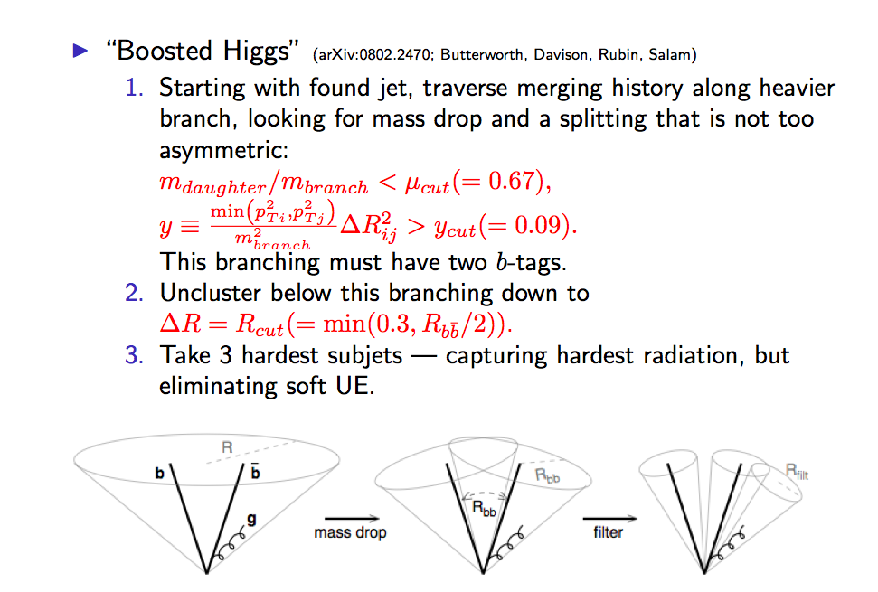

Slide 46
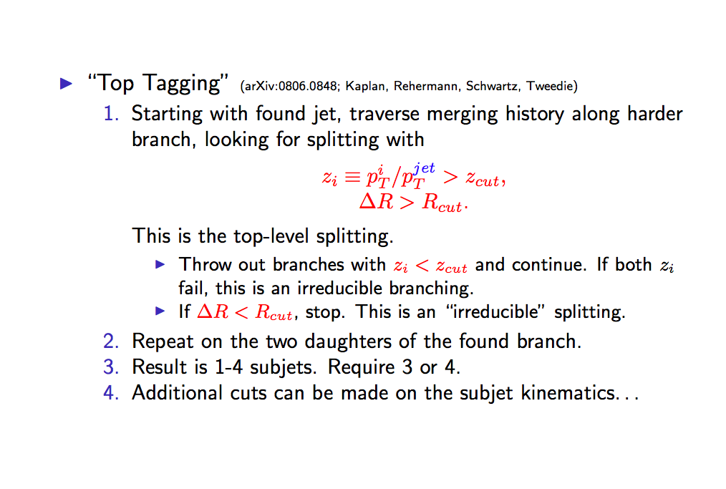

Slide 47
Compare to other “Jet Grooming” – CA jets
PSJ (Kaplan, et al., for tops) – find primary subjets and build “groomed” jet from these (3 or 4 of them)
  Define ,
  ,
  Start of top of branch (the jet) and follow hardest daughter at each branching (discarding softer daughters) until reach first branching where . If does not exist, discard jet.
  If such a branching exists, start again with each daughter of this branching as top branch as in 2. Again follow along the hardest daughter (discarding softer daughters) until a branching where . If present, the daughters of this (2nd) hard branching are primary subjets. If not present, the original daughter is primary subjet. This can yield 2, 3 or 4 primary subjets.
  Keep only 3 and 4 subjet cases and recombine the subjets with CA algorithm.

Slide 48
Compare to other “Jet Grooming” – CA jets
MDF (Butterworth, et al., for Higgs) – find primary subjets and build “groomed” jet from these (2 or 3 of them)
  For each p → 1,2 branching define ,
  ,
  Start of top of branch (the jet) and follow hardest daughter at each branching (discarding softer daughters) until reach first branching where . If does not exist, discard jet.
  If such a branching exists, define and start again with each daughter of this branching as top branch as in 2. Again follow along the hardest daughter (discarding softer daughters) until a branching where , (but for early branchings). If present, the daughters of this (2nd) hard branching are primary subjets. If not present, the original daughter is primary subjet. This can yield 2, 3 or 4 primary subjets.
  Keep the 3 hardest subjets (discard 1 subjet case but keep if only 2). Recombine the (2 or) 3 subjets with CA algorithm.

