Slide 1
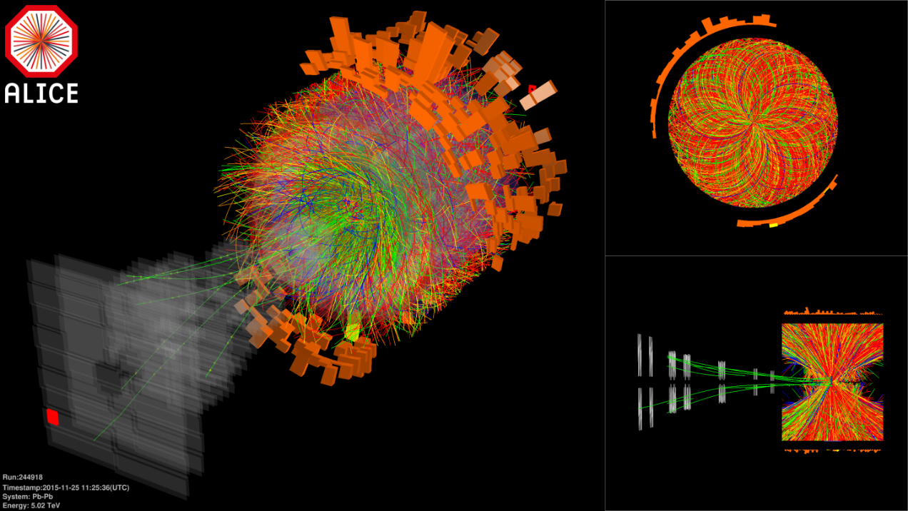
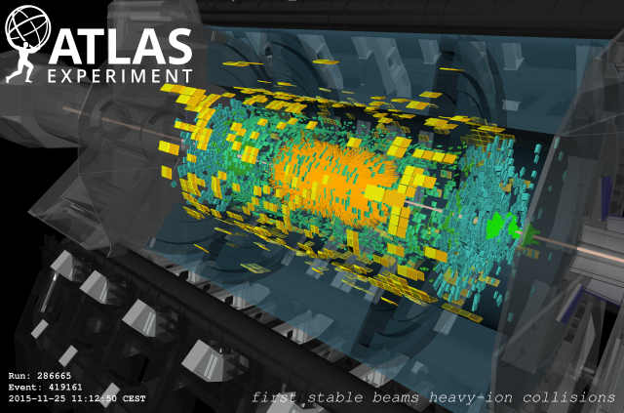
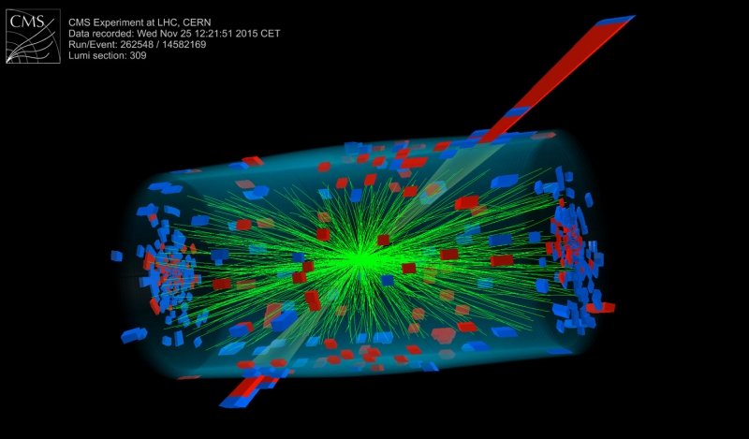
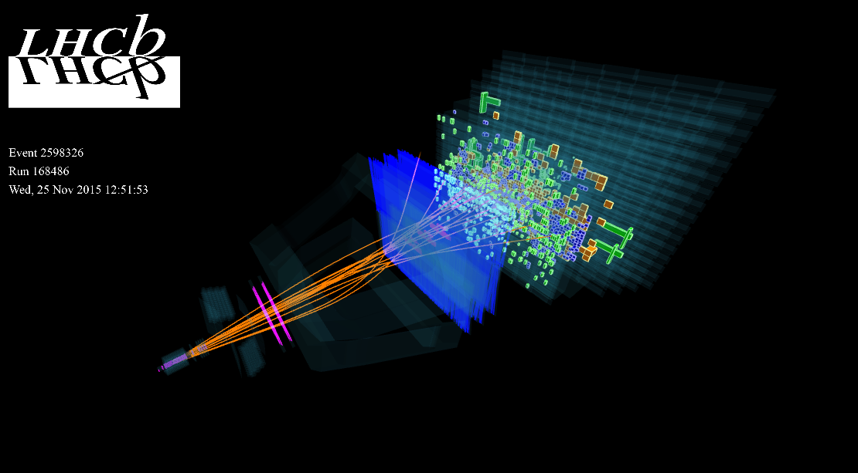

LHC machine -
Perspectives for nuclear beams
John Jowett (CERN)
On behalf of many colleagues past and present in CERN Accelerator and Technology Sector

Slide 2
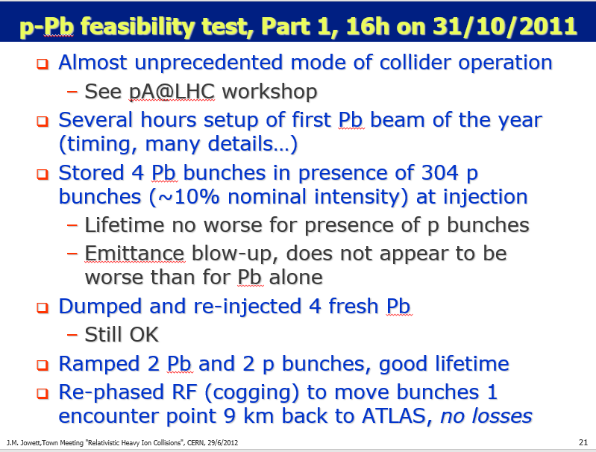
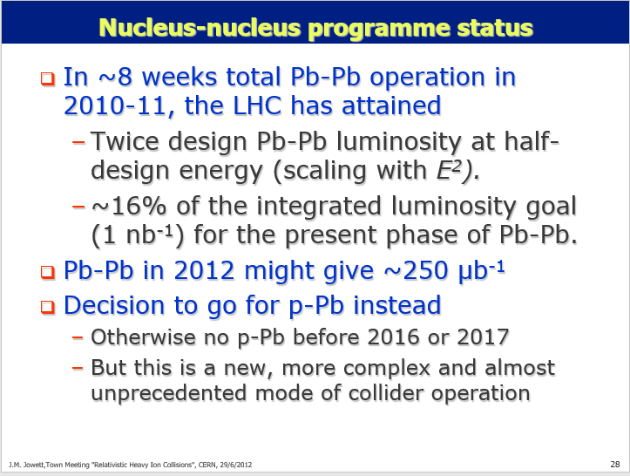
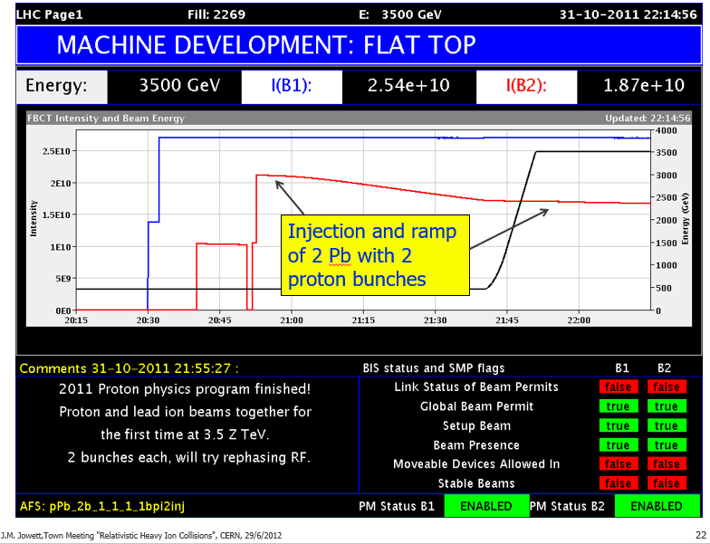
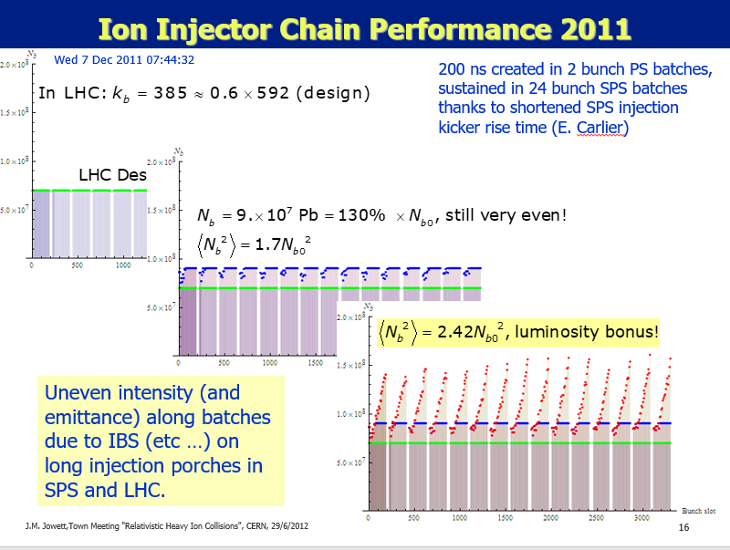
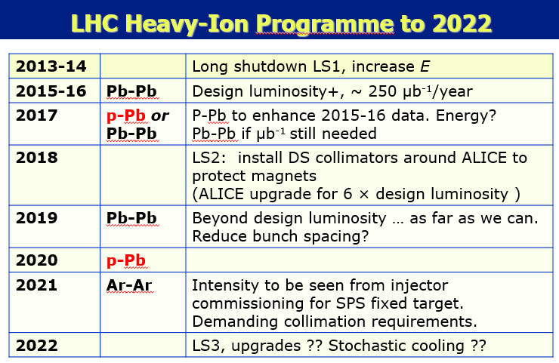
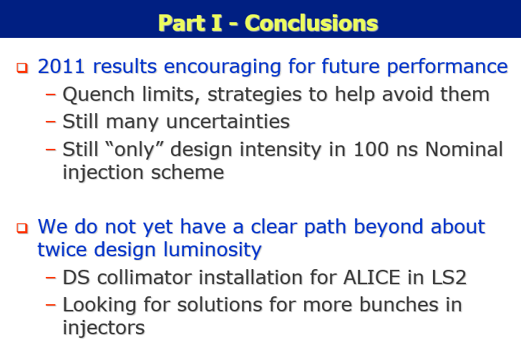
Last “Town Meeting” on 29/6/2012
Feasibility of p-Pb collisions?
ALICE LoI emerged around time of this meeting

Slide 3
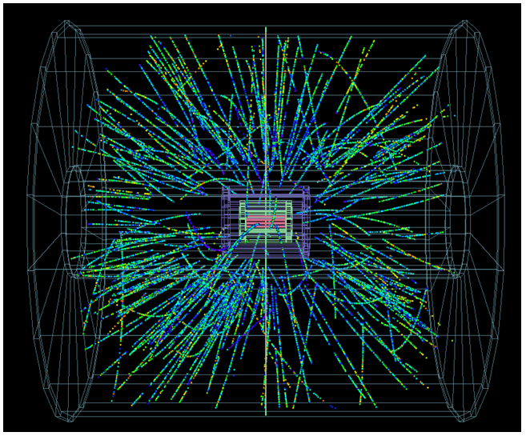
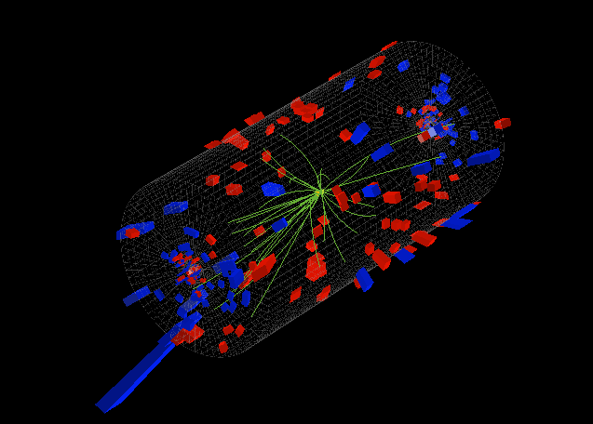
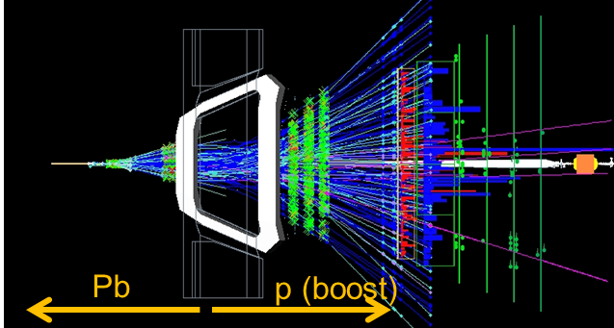
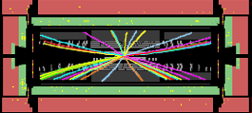
11 weeks later: Pilot p-Pb run, night of 13-14 September 2012
16:00 Starting injection, problems with ions, timing events not sent out correctly.
18:30 Filling Pb ions, first time in 2012
19:00 Start of ramp. Lost the beam on TCT position interlocks, revert collimator settings and try again ….
QPS problems. RF problems.
22:52 15 p and 15 Pb bunches at 4 Z TeV, 8 colliding per experiment, 3 sacrificial for collimation setup
23:35 Beams in collision, unsqueezed, optimising …
00:50 Start of loss maps to set up collimation
01:26 Stable beams for p-Pb Physics
06:04 Adjust mode to move IP for ALICE
06:25 Stable beams again, IP moved by -0.5 m
07:55 Stable beams again, IP moved by +0.5 m
09:35 Beams dumped by operators
ALICE
ATLAS
LHCb
CMS

Slide 4
Historical energy jumps
This was the largest factor of increase in the energy of a given type of collision ever achieved in the history of particle accelerators - and brought new, surprising physics results.
LHC Run 1 closed with a full p-Pb run, a further factor 1000 in luminosity, … the first major upgrade of the LHC beyond its design (pp and PbPb only).

Slide 5
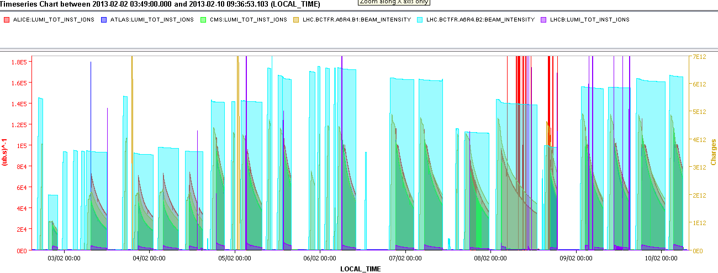
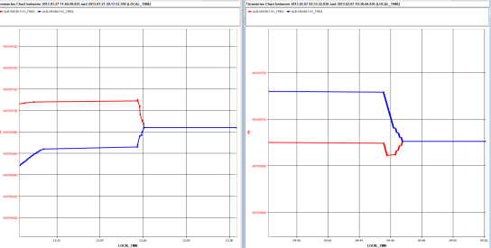
Second half of 2013 run - Luminosity production in Pb-p mode
Max. peak luminosity 1.15x10²⁹cm⁻².s⁻¹!
Intermediate filling scheme to limit the losses
IP1,5 separated
VdM scans
~“Design” luminosity achieved at 4/7 design energy.
1x10²⁹cm⁻².s⁻¹
Increase of BLM monitor factor (losses at the start of the ramp), rematch injection energy to the SPS
Set the style of future Pb-Pb and p-Pb runs.
Increase of BLM monitor factor (losses end of ramp + squeeze)
Increase bandwidth of orbit feedback
Increase of BLM monitor factor (losses during the squeeze),
reduction of longitudinal blow-up at injection
Common frequency trimmed by -10Hz
27/01
07/02
RF frequencies
R. Versteegen

Slide 6
LHC Heavy Ion Injector Chain
ECR ion source (2005)
  Provide highest possible intensity of Pb²⁹⁺
RFQ + Linac 3
  Adapt to LEIR injection energy
  strip to Pb⁵⁴⁺
LEIR (2005)
  Accumulate and cool Linac3 beam
  Prepare bunch structure for PS
PS (2006)
  Define LHC bunch structure
  Strip to Pb⁸²⁺
SPS (2007)
  Define filling scheme of LHC
Notes:
Performance of LHC depends on quality of beam that can be injected

Slide 7
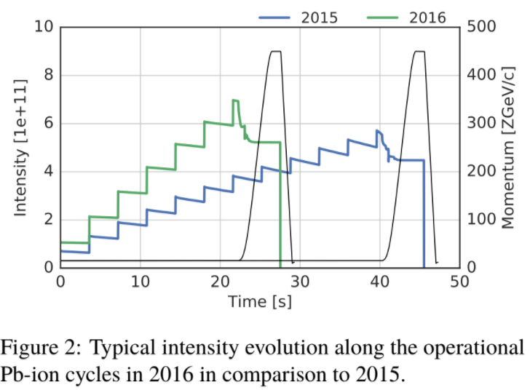
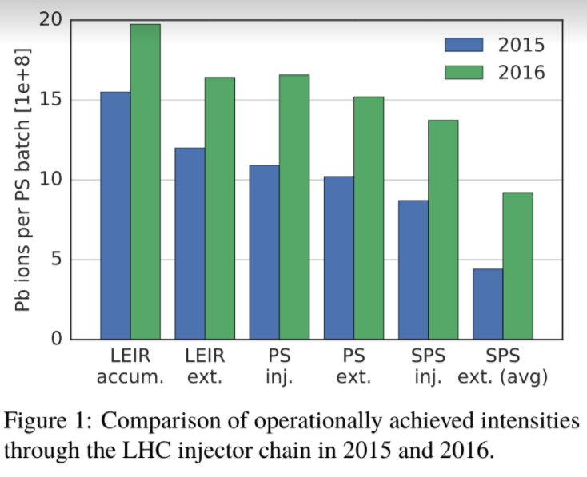
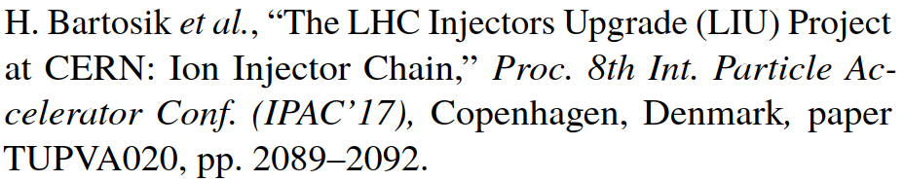
Major injector improvements since 2015
Improvements in upstream injectors allowed re-introduction of bunch-splitting in PS to stay below single-bunch limit in SPS (which remains the main intensity bottleneck).
NB we will take advantage of these gains in Pb-Pb for the first time in 2018.

Slide 8
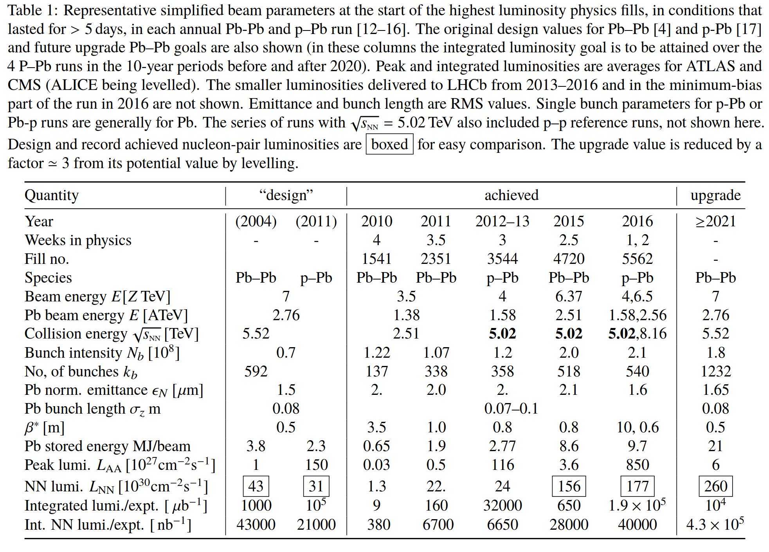
Pb-Pb parameters from Design Report to HL-LHC upgrade
Paper at IPAC2018
https://doi.org/10.18429/JACoW-IPAC2018-TUXGBD2
TUXGBD2
+ its bibliography
The 2018 Pb-Pb run (end of next week!) should implement and exploit most of the features of the configuration for “HL-LHC” luminosity.
Levelled,
could be ~15.

Slide 9
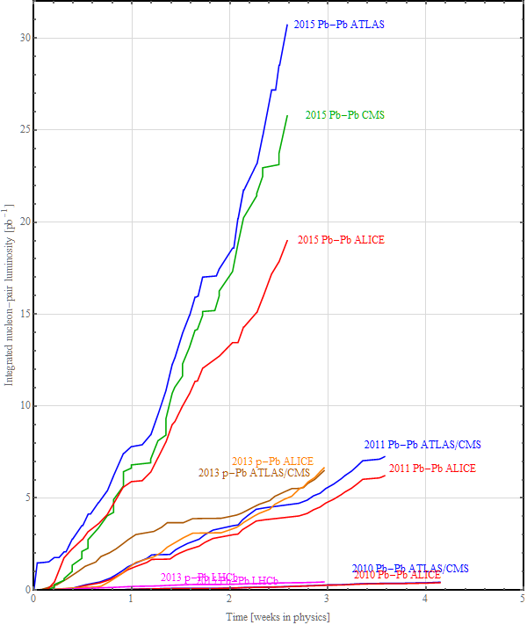
Nucleus-nucleus programme status
Expect to achieve LHC “first 10-year” baseline Pb-Pb luminosity goal of
1 AA nb⁻¹ = 43 NN pb⁻¹
in Run 2 (=2015+2018)
Goal of the first p-Pb run was to match the integrated nucleon-nucleon luminosity for the preceding Pb-Pb runs but it already provided reference data at 2015 energy.
Equivalent energy runs
2012 pilot p-Pb run not shown

Slide 10
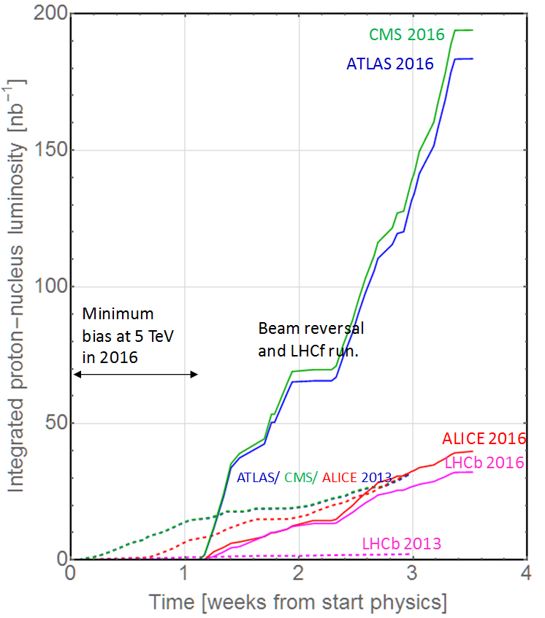
Proton-nucleus programme status
Feasibility and first p-Pb run at 4 Z TeV in 2012/13.
Complex 2016 run plan determined after Chamonix 2016:
Minimum bias run at 4 Z TeV mainly for ALICE
High luminosity run for all experiments (+LHCf) at 6.5 Z TeV, with beam reversal p-Pb and Pb-p.
Ie, 2 new optics and 3 setups with full qualifications in 1 month.
Asymmetric beams, unequal frequency ramp, cogging for collisions off-momentum, etc.
Many filling schemes used for luminosity sharing.
Original design goal

Slide 11
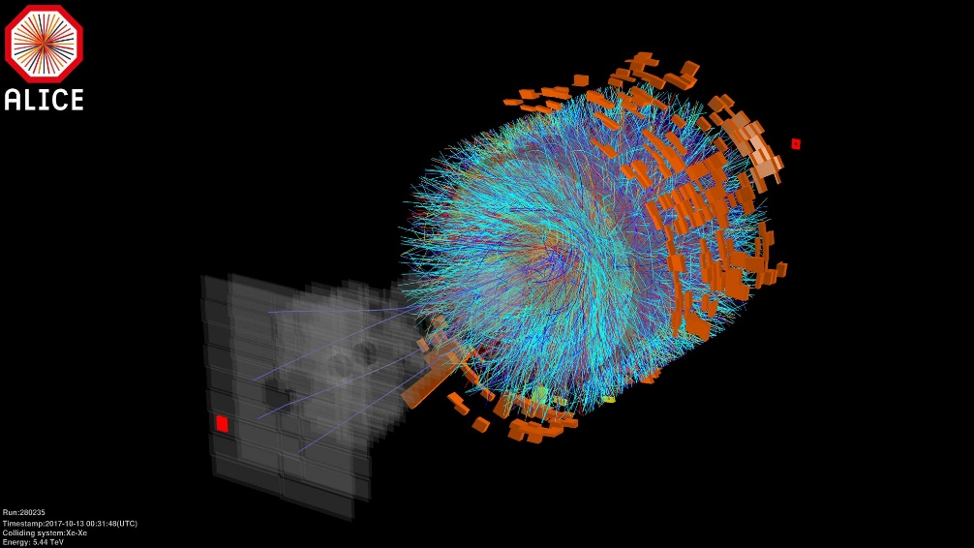
Xe-Xe collisions in LHC, 13 October 2017 (16 h beam time total)
Papers at IPAC2018
http://accelconf.web.cern.ch/AccelConf/ipac2018/
MOPMF039 M. Schaumann et al, First Xenon-Xenon Collisions in the LHC
MOPMF038 N. Fuster-Martinez et al, Cleaning Performance of the Collimation System with Xe Beams at the Large Hadron Collider
TUPAF020 R. Alemany-Fermandez et al, Performance of the CERN Low Energy Ion Ring (LEIR) with Xenon
Future interest in lighter species

Slide 12
Crystal Collimation Xenon Cleaning
Dump
β-coll
δp/p-coll
Standard
First observation of channelling with nuclei – no fragmentation.
Very promising approach to what now appears to be the most severe intensity limit on future Pb beams.
Plan to test again with Pb beams during the 2018 run.
Dump
β-coll
Crystal
δp/p-coll
Looking at loss maps along the ring: no dangerous peaks with crystal
R. Rossi et al
Notes:
The loss maps shows with Xe beams an improvement when crystal collimation is used
general reduction of background along all the ring
no dangerous peaks observed

Slide 13
Future performance (Run 3+HL-LHC)
Fulfilling the ALICE 2012 LoI
For more details on the HL-LHC projections see HL-HE-LHC workshop 30/10/2017
https://indico.cern.ch/event/647676/contributions/2721132/
and other recent talks.

Slide 14
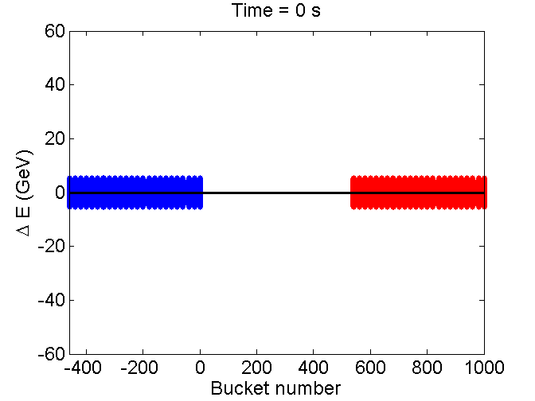
SPS momentum slip stacking for 50 ns bunch spacing
Feasibility relies on
  Large bandwidth of SPS 200 MHz travelling
  wave cavities
  Low ion intensity (no need for feed-back,
  feed-forward, …)
  Independent cavity control
  (SPS LLRF upgrade in LS2)
Macroparticle simulations show
  Proof of principle (without intensity effects)
  Longitudinal emittance blow-up (factor 2.5) at re-capture
  due to filamentation in large bucket
  Bunch rotation at extraction becomes necessary for injection into LHC
  Optimization of re-capture is crucial to keep losses <5%
H. Bartosik, Chamonix 2017

Slide 15
LIU baseline (Jan 2017) parameters at start of collisions
Simplified scenario - see talk by H Bartosik, Chamonix 2017
  All bunches are equal (consider single bunch pair simulation)
  Initial bunch intensity (start of stable beams)
  Initial emittance (start of stable beams)
  Crossing angles 170, 100, 170 μrad, operation at 7Z TeV
  Other bunch parameters as Design Report nominal
  Three luminosity-sharing scenarios, just for illustration of the possibilities (equal β* scenario is nominal!):
  Some collisions in LHCb (not shown in detail)

Slide 16
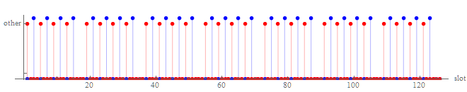
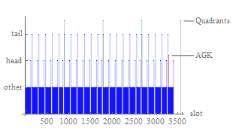


Filling scheme example for HL-LHC
56 bunch SPS train
after slip-stacking
Displace two trains in Beam 2 to make collisions in LHCb
Seen by Beam1``
Seen by Beam2``
23 injections of 56-bunch trains give total of 1232 in each beam.
1136 bunch pairs collide in ATLAS CMS, 1120 in ALICE, 81 in LHCb (longer lifetime).

Slide 17
Optics compatibility with p-p operation
ATS optics will be used for p-p operation
The β*=0.5 m values assumed for heavy-ion operation do not require ATS
  Rather little gain from low β* in high burn-off regime
However to minimise set-up we can use essentially the same squeeze as ATS (telescopic part of squeeze has not started yet)
  Interaction region squeeze sequences
  Must add a squeeze of ALICE as usual
Necessary functionality is included in ATS optics design
  (Might consider further squeezing later.)
We will use this optics in 2018!
Completely new optics cycle compared with p-p optics has (almost) been commissioned.

Slide 18
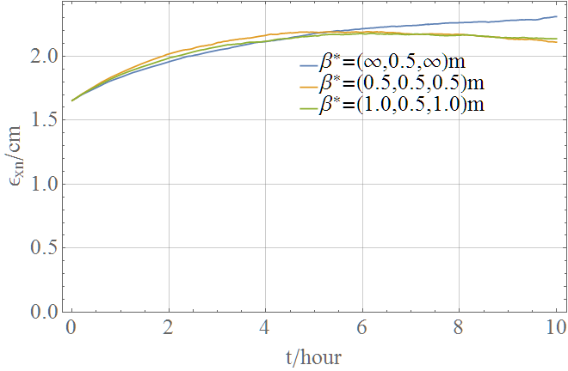
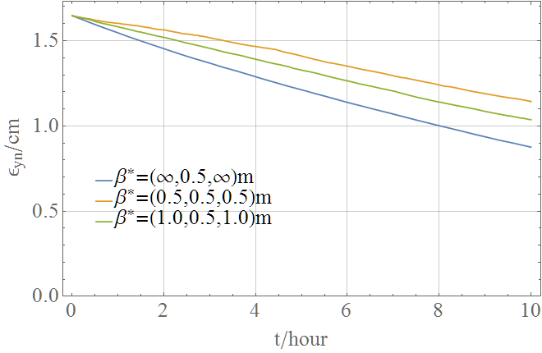
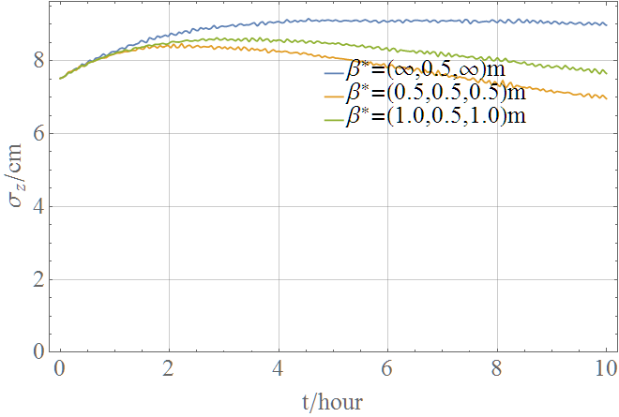
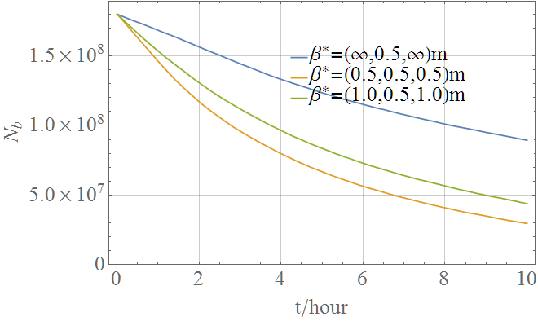
CTE Simulation of (most typical) colliding bunch pair
IBS dominates initially, radiation damping takes over as intensity decays and emittance grows.
Smaller injected emittance does not help much.
Radiation damping dominates (low betatron coupling)
IBS dominates initially, radiation damping takes over
Intensity decay dominated by luminosity burn-off (huge electromagnetic cross sections)
T. Mertens
Interplay of radiation damping, IBS, luminosity burn-off couples all 4 quantities.
Different evolution according to luminosity-sharing scenario.
(Does not include additional emittance growth usually seen in operation.)

Slide 19
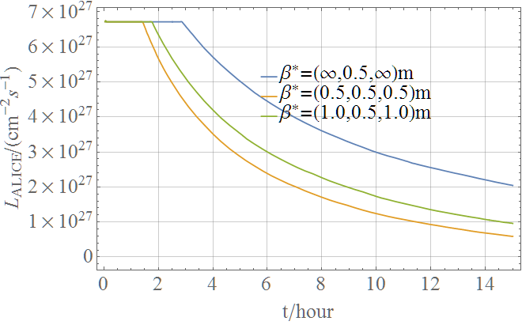
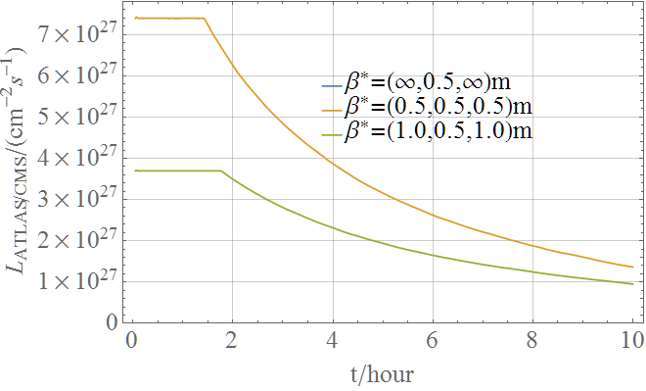
Luminosities in an ideal (prolonged) fill
ALICE, levelling at maximum acceptable (rates around 50 kHz), assuming 1100 bunches colliding
Baseline is the orange scenario with similar luminosities in 3 experiments.
ATLAS or CMS, assumed levelling at similar levels to ALICE (not strictly necessary, just an assumption to simplify presentation).

Slide 20
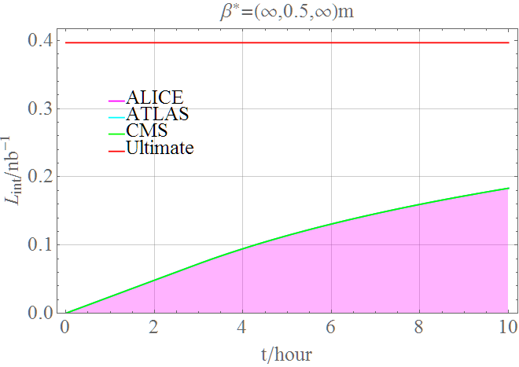
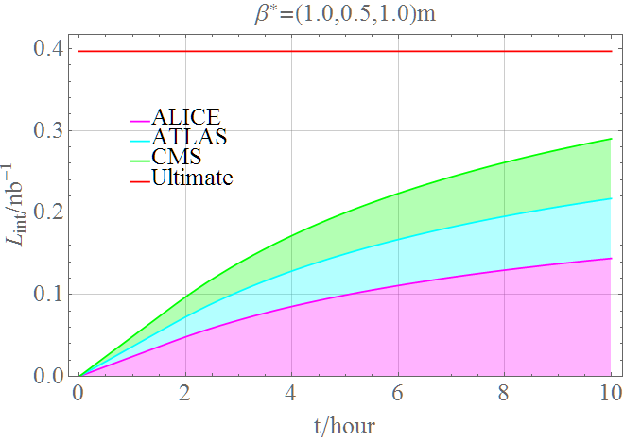
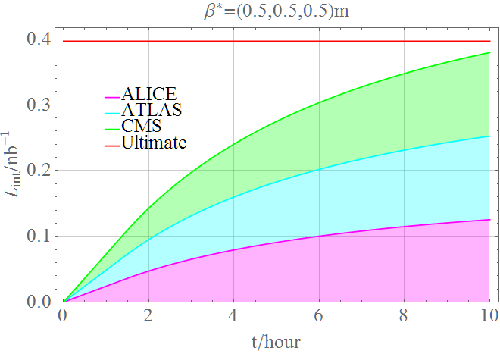
Integrated luminosity in prolonged fills
Fraction obtained is the luminous efficiency.

Slide 21
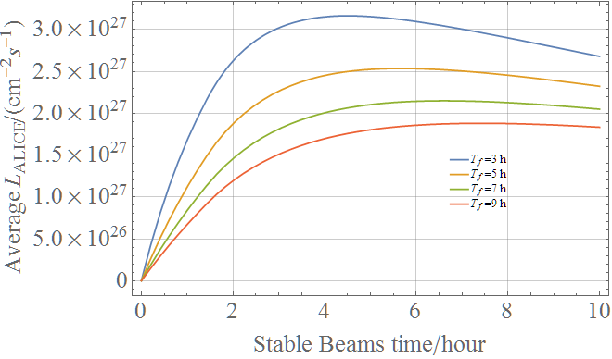
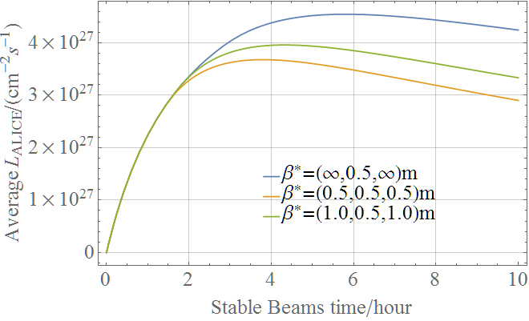
Effect of turn-around time on average luminosity

Slide 22
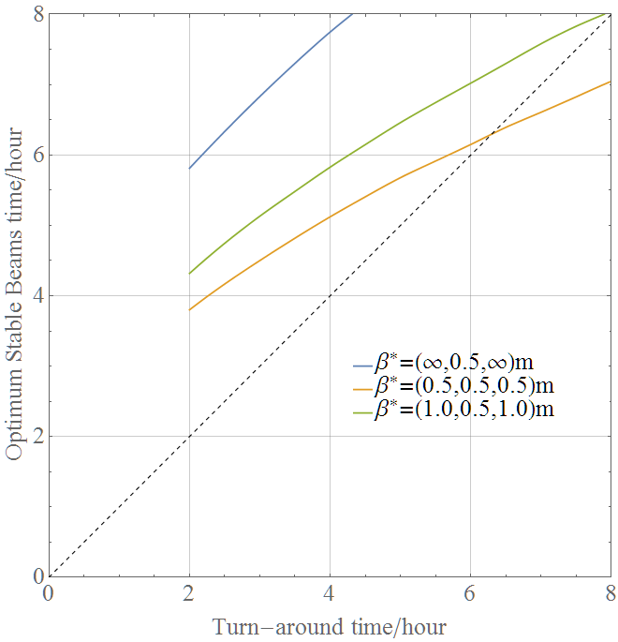
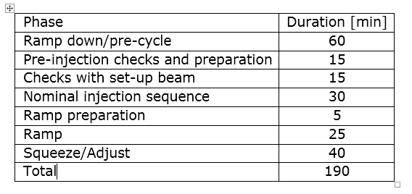
Optimum time spent in Stable Beams
Assumes the operators know that the next turn-around time will be the same value.
Break-down of the minimum turn-around time as for p-p
45
200

Slide 23
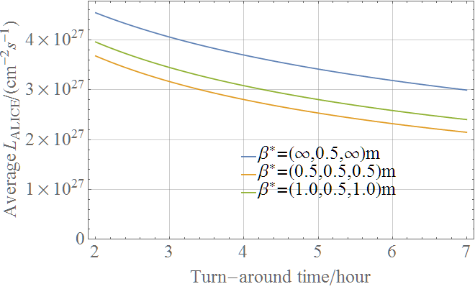
Integrated luminosity in annual Pb-Pb run
Operation efficiency in last Pb-Pb run in 2015 was 62%. Even higher in 2016 p-Pb.
Similar analysis for p-Pb suggests ~ 1 pb⁻¹ is possible in a full one-month run.

Slide 24
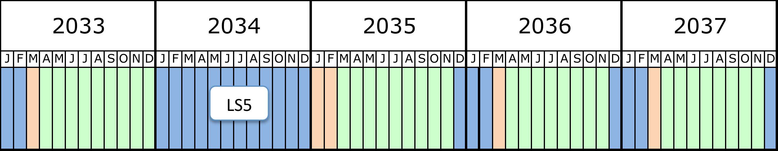
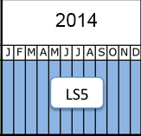
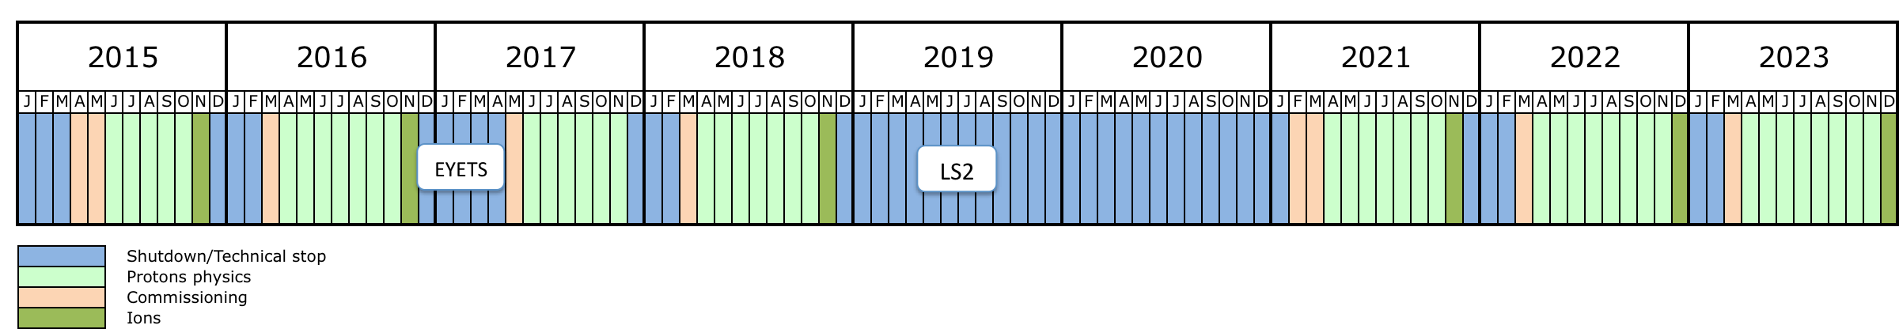
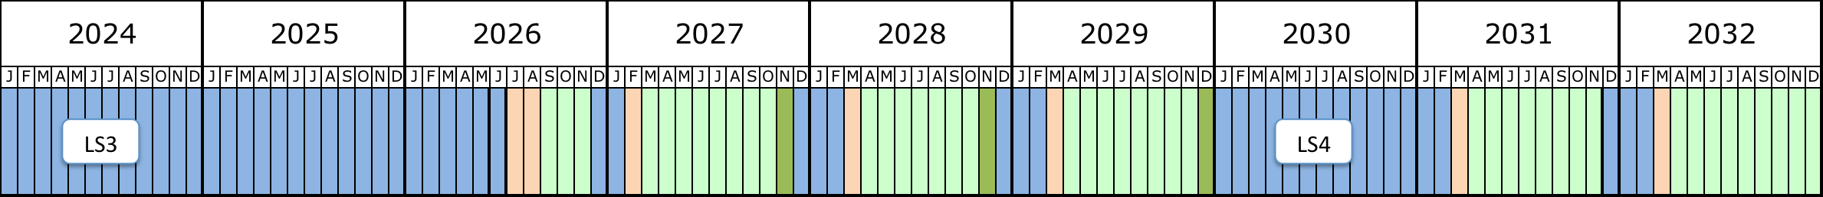
LHC heavy-ion runs, past & baseline future
+ species choices according to ALICE 2012 LoI (under review in HL-LHC workshop) `
LHC will have done 12 ~one month heavy ion runs between 2010 and 2030 (LS4). 6/12 done very soon.
Pb-Pb
Pb-Pb
p-Pb
p-Pb!
2010
2011
2012
2013
Run 1
LS1
p-p & Pb-Pb
NOW!
?
p-Pb
Pb-Pb
Pb-Pb
p-p
Pb-Pb
Pb-Pb
p-Pb
Pb-Pb
(adapted without permission)

Slide 25
UPC processes at the collision point
Strong luminosity burn-off of beam intensity.
Discussed for LHC since Chamonix 2003 … see several references.
Each of these makes a secondary beam emerging from the IP with rigidity change that may quench bending magnets.
Hadronic cross section is 7.7 b (so luminosity debris contains much less power).

Slide 26
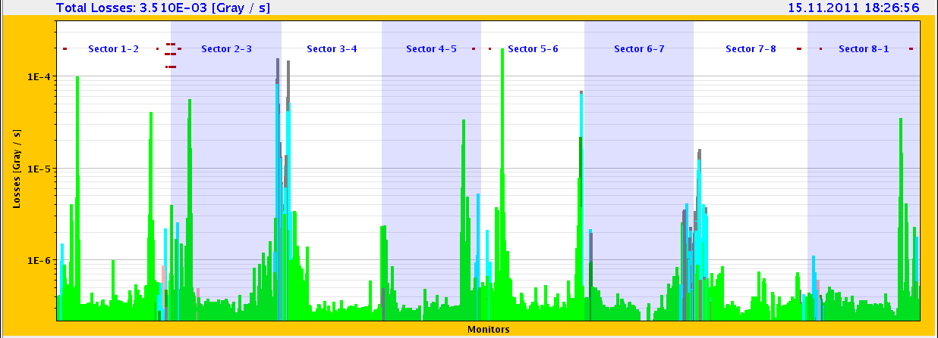
Steady-state losses during Pb-Pb Collisions in 2011
Bound-free pair production secondary beams from IPs
IBS & Electromagnetic dissociation at IPs, taken up by momentum collimators
Losses from collimation inefficiency, nuclear processes in primary collimators
??
Beam loss monitors in the full LHC Ring
No time to fully discuss major topic of heavy-ion collimation in this talk.

Slide 27
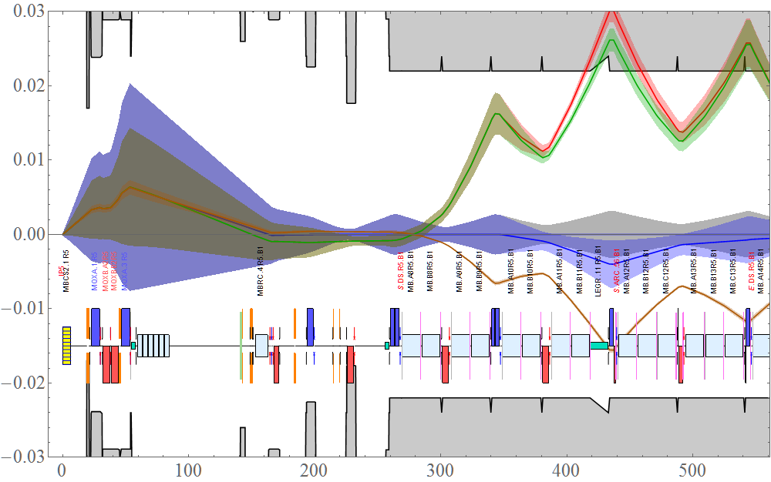
Orbit bumps mitigate BFPP for CMS (or ATLAS)
BFPP beam, without and with bump
Plan to test this strategy further to fully validate the nominal HL-LHC levelled luminosity at ATLAS/CMS during the 2018 run (no further mitigation upgrades are planned for these experiments).
Primary loss location close to the connection cryostat - details slightly optics-dependent (If necessary, bumps should avoid quenches at the start of physics
Extra BLMs were specifically added for heavy-ion operation in loss region
Variations of bump possible, uses moderate fraction of available corrector strengths
We applied bumps like these with ~ 3 mm amplitude around CMS and ATLAS from the beginning of the 2015 run

Slide 28
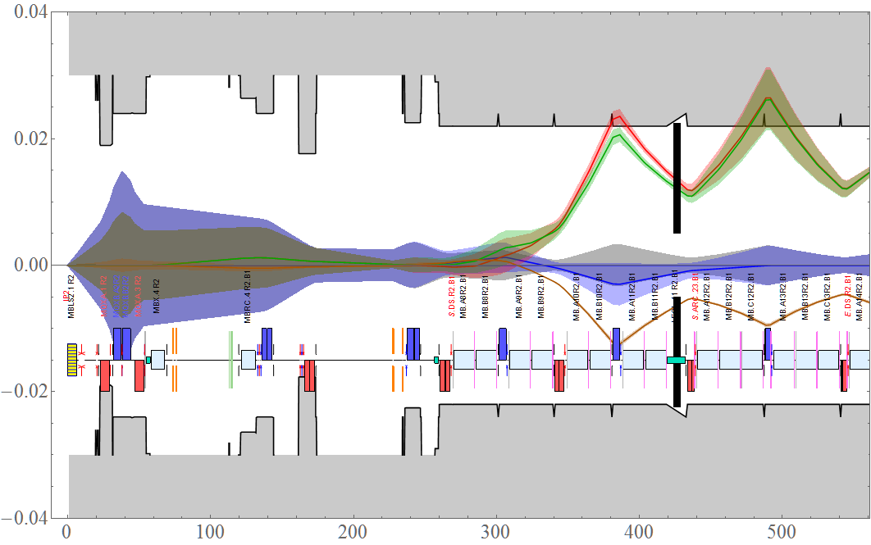
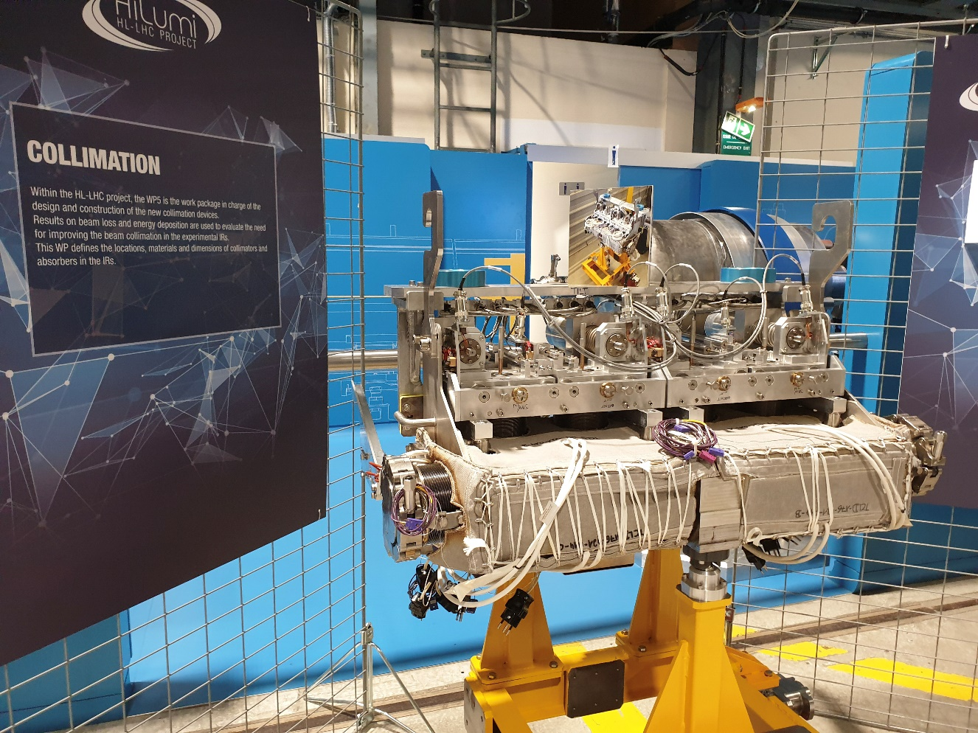
Orbit bumps alone are not effective for ALICE
BFPP beam, without and with bump
TCLD collimator
(post LS2)
IR2 has different quadrupole polarity and dispersion from IR1/IR5
Primary BFPP loss location is further upstream from connection cryostat
Solution is to modify connection cryostat to include a collimator to absorb the BFPP beam – to be ready for LS2 installation
With levelled luminosity in ALICE, quenches were not seen in 2015
TCLDs should allow luminosity increase for upgraded ALICE to run at at 50 kHz
Also during LS2, further TCLD collimators will be installed between 11 T magnets in IR7 to improve Pb collimation (first application of Nb₃Sn superconductors in an operating accelerator).

Slide 29
Beyond HL-LHC baseline: lighter nuclei

Slide 30
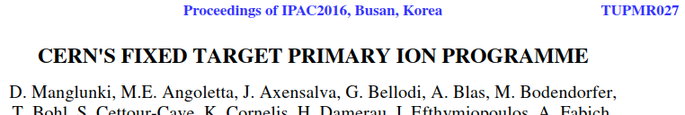
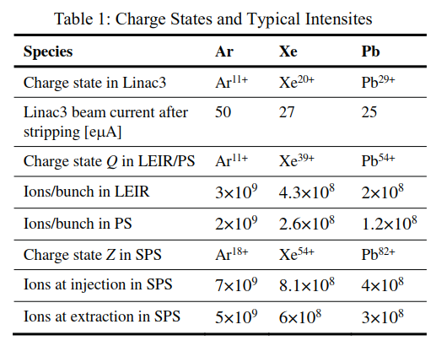
Bunch intensity at SPS extraction for various species
Experience with other species in LHC injectors for fixed target
  Less stringent requirements on
  beam quality (emittance)
Use this highly simplified scaling to project future luminosity performance as a function of p.
Assume that other quantities (like geometric beam size), filling scheme, other loss rates, etc, are equal.
Treat results only as tentative and indicative only!
For Pb-Pb they are a bit more optimistic than HL-LHC baseline.
Don’t go too low in Z with this!
Not everything in the periodic table will work well in the ion source.

Slide 31

UPC cross sections determining intensity burn-off
List of species are examples that are of interest.
Some species (e.g., Cu) are difficult to produce in the ECR heavy ion source.
Noble gases are particularly favourable.
Cross section scalings from papers by G. Baur et al, S. Klein, I. Pshenichnov, ….
Pb is worse in this respect because of high BFPP and EMD cross-sections.
Makes short fills, more time spend refilling, ramping, etc.

Slide 32
Higher nucleon-nucleon luminosity with lighter ions
Extrapolations of present experience to possible future fully-prepared “one-month run” conditions with lighter species.
Preliminary estimates for a range of the scaling factor p. p = 1.5 seems reasonable.
Detailed operational cycles to be worked out.
Longer fills from smaller UPC cross-sections. Plus: more luminosity events are hadronic.
Possible limits from collimation losses, radio-protection in Linac3/LEIR (lightest species), etc, are still to be properly analysed on species-by-species basis.

Slide 33
Higher nucleon-nucleon luminosity with lighter ions
Extrapolations of present experience to possible future fully-prepared “one-month run” conditions with lighter species.
  No discussion of calendar here.
Simplified comparatives estimates for a range of the scaling factor p. p = 1.5 seems reasonable.
Detailed operational cycles to be worked out.
Longer fills from smaller UPC cross-sections. Plus: more luminosity events are hadronic.
Possible limits from collimation losses, radio-protection in Linac3/LEIR (lightest species), etc, are still to be properly analysed on species-by-species basis.

Slide 34

Time-averaged nucleon-nucleon luminosity wrt Pb-Pb
Simplified scenario:
Fill lengths optimized for 2.5 h turn-around (dump to next Stable Beams).
Analytical estimates assuming beam losses dominated by luminosity burn-off (no simulations of other physics as for canonical Pb-Pb projections).
Assume 3 experiments taking full luminosity - no levelling of any experiment!
Overall operational efficiency factor 50% (standard HL-LHC assumption).
Gives reasonable indication of potential increase in integrated NN-luminosity from lighter species.

Slide 35

Pessimistic “no-gain” scaling (p=1)
Stored energy in beam W_{b} is identical in this case ⇒ Collimation risks ~ comparable.
f_{IBS} indicates strength of IBS emittance growth – all cases better than Pb.
Overestimates integrated luminosity for Pb-Pb wrt official values (since no levelling, etc). Initial event rates are high! Much longer fills.

Slide 36

Plausible scaling (p=1.5)
Stored energy in beam W_{b} increased in this case ⇒ Collimation risks higher
f_{IBS} indicates strength of IBS emittance growth – still better than Pb.
NB still no luminosity levelling, etc. High event rates! Some pileup µ ~1. Fills still longer.

Slide 37

Optimistic scaling (p=1.9)
Stored energy in beam W_{b} several times Pb ⇒ Collimation risks higher, may need new solutions
f_{IBS} indicates strength of IBS emittance growth – comparable to Pb.
NB still no luminosity levelling, etc. High event rates! Some pileup µ ~1. Fills still longer.

Slide 38
Caveats about lighter species
Collimation is more complicated, needs careful study
  See first measurements with Xe vs. Pb in MOPMF038 paper in IPAC2018
  Simulations done for Ar, Xe (by Pascal Hermes) have not yet included effects of DS collimators in IR7.
    Planned for study (N. Fuster-Martinez)
  Crystal collimation (tested with Xe) may be a solution for the future (Pb also)
  It takes time to change species in the injector chain, therefore it is hard to gain experience.
  The dramatic improvements in transmitted Pb intensity in 2015-16 were the result of many detailed studies and improvements.

Slide 39
Special runs with other species
The 2012 p-Pb run and the 2017 Xe-Xe run used a special rapid-commissioning strategy to go from scratch to physics delivery in a 16 h shift.
  Limits on total stored energy in beam to avoid lengthy validation.
  May have to use the operational p-p optics (not so good for ALICE)
Other short runs can be envisaged within these constraints
Example of current interest
  O-O run: needs to be separated in time from Pb-Pb to allow lengthy switchover of ion source and injector chain. Springtime of a typical year?
  Could be followed by short p-O run of interest for cosmic ray physics

Slide 40
Conclusions
It has been possible to rapidly recommission the LHC in multiple new heavy-ion conﬁgurations very eﬃciently and substantially exceed design performance.
The baseline performance goals for Pb-Pb integrated luminosity from the ALICE LoI of 2012 appear to be within reach by end of Run 4
  Most features already available for 2018 Pb-Pb run
  Greatest remaining uncertainties: collimation in LHC, slip-stacking in SPS.
We can go further with p-Pb luminosity than we did in 2016.
The feasibility of runs with lighter species has been demonstrated with Xe-Xe in 2017.
  There is very good hope for substantially higher integrated nucleon-nucleon luminosity than with Pb-Pb but further studies (and resources) are certainly required.
Scope for special short runs (O-O,p-O, …) at small cost in LHC time and within certain limits of intensity and scheduling.

Slide 41
BACKUP SLIDes

Slide 42
References in these slides
References to International Particle Accelerator Conferences (IPAC) up to 2017 can be found at
  http://jacow.org/index.php?n=Main.Proceedings
References to IPAC2018 (two weeks ago) can be found in the pre-press proceedings
  http://accelconf.web.cern.ch/AccelConf/ipac2018/
Fairly comprehensive list of references on LHC heavy ion programme to date in IPAC2018 survey talk TUXGBD2

Slide 43
Summary (from QM2018)
Since its startup in 2009, the Large Hadron Collider at CERN has spent about 3 months of its operating time providing nucleus-nucleus (Pb-Pb) collisions.
Peak Pb-Pb luminosity is now over 3 times design and integrated luminosity is expected to attain the initial design goal of 1 nb-1 in the 4th Pb-Pb run in late 2018.
Following the demonstration of their feasibility in 2012, two one-month runs have been devoted to proton-nucleus (p-Pb) collisions in multiple conditions, with luminosity far beyond expectations.
Recently, Xe-Xe collisions have also been demonstrated in a short run.
All the LHC experiments now participate fully in the heavy-ion programme.
With this experience in hand, strategies to overcome physical performance limits established, and upgrades to the LHC and its injector chain in the pipeline, it is timely to take stock of the prospects and challenges for future performance of the LHC with nuclear beams.

Slide 44

Pb-Pb peak luminosity at 3×design in 2015
k_{b}=474
Start of HL-LHC HI
Van der Meer scans
k_{b}=518
k_{b}=426
Source refill
ALICE polarity reversal
k_{b}=250
Design luminosity
`Crystal
coll. MD
k_{b}=10-50
Collimation quench test
25/11
BFPP quench test&recovery
LHCb should have about 2% of ATLAS
18 days of Pb-Pb since 2011
Heavy-ion runs of LHC are very short but very complex.
Experiments have many requests for changes of conditions.
This run was preceded by a week of equivalent energy p-p collisions to provide reference data.
Completely different from classical operation of Tevatron or LHC p-p.
25/11

Slide 45

Pb bunch intensity in LHC during 2016 p-Pb run
R. Alemany, M. Schaumann

Slide 46

Record Pb-p luminosity in ATLAS/CMS at 8.16 TeV
Common BPMs and moving encounters had constrained charge of p and Pb bunches to be similar.
Increase in p intensity to
~3×10¹⁰/bunch
enabled by new synchronous orbit mode of beam position monitors (R. Alemany, J. Wenninger, beam instrumentation group …)
Pb intensity to ~2.1×10⁸/bunch
25% increase in ATLAS/CMS from filling scheme
(Expt. on crystal collimation of Pb)
Peak luminosity a factor ~6 beyond original “design” value (J. Phys. G 39 (2012) 015010)
Could have gone higher still by further increase of p intensity but limited at present by Pb beam luminosity debris in magnets of Sector 12.
IPAC2017 TUPVA014

Slide 47
Goals of 2016 p-Pb run surpassed
 | Experiments | Primary goal | Achieved | Additional achieved
5 TeV p-Pb (Beam energy 4 Z TeV) | ALICE (priority) | 700 M min bias events | 780 M
 | ATLAS, CMS |  |  | >0.4 /nb min bias
 | LHCb |  |  | SMOG p-He etc
8 TeV p-Pb or Pb-p (Beam energy 6.5 Z TeV) | ATLAS, CMS | 100 /nb | 194,183 /nb
8 TeV p-Pb | ALICE, LHCb | 10 /nb | 14,13 /nb
 | LHCf | 9-12 h @ 10²⁸ cm⁻²s⁻¹ | 9.5 h @ 10²⁸ cm⁻²s⁻¹ | Min bias ATLAS, CMS, ALICE
8 TeV Pb-p | ALICE, LHCb | 10 /nb | 25,19 /nb
Note: ALICE and LHCb are asymmetric experiments, with different coverage according to beam direction.
Reminder: first 1 month p-Pb/Pb-p run at 5 TeV in 2013 gave 31/nb to ALICE, ATLAS, CMS and 2/nb to LHCb.

Slide 48


Duration of Xe run
Beam intensity roughly as expected.
See discussion of cross-sections later.

Slide 49


Xe lifetime analysis
Shows that beam intensity decay was dominated by luminosity burn-off (other effects on 100 h time scale).
Luminosity lifetime ~agrees with p=0.75 value (later in this talk).
Analysis by Marc Jebramcik, Michaela Schaumann. See IPAC2018 paper.

Slide 50
Conclusions
It has been possible to rapidly recommission the LHC in multiple new conﬁgurations very eﬃciently.
The baseline performance goals for Pb-Pb integrated luminosity from the ALICE LoI of 2012 appear to be within reach
  Most of them already available for 2018 Pb-Pb run
  Greatest remaining uncertainties: collimation in LHC, slip-stacking in SPS.
We can go further with p-Pb luminosity than we did in 2016.
The feasibility of runs with lighter species has been demonstrated with Xe-Xe in 2017.
  There is very good hope for substantially higher integrated nucleon-nucleon luminosity than with Pb-Pb but further studies (and resources) are certainly required.
Not discussed: it is easy to switch from Pb to O so short p-O runs (for cosmic ray physics, etc) should be feasible (using the model of p-Pb in 2012, Xe-Xe in 2017).

Slide 51

LEIR (Low-Energy Ion Ring)
Prepares beams for LHC using electron cooling
circumference 25p m (1/8 PS)
70 turn injection into horizontal+vertical+longitudinal phase planes
Fast Electron Cooling : Electron current from 0.5 to 0.6 A with variable density
RF capture
Dynamic vacuum (NEG, Au-coated collimators, scrubbing)
Ejection
Quadrupole
triplet
RF
D=0
RF
vacuum sector 4
Injection
Ejection
kicker
D0
D0
Quadrupole doublet
dipole
E-Cooling
D=0

Slide 52

Intensity transmission: injection to collision, Pb in 2016
Data from 2016 p-Pb run, for Pb beam only.
Expect Pb-Pb to be generally better.
Previous estimates of future Pb-Pb performance assumed 90% transmission from injection to collision.
Data justify using 95% now (previously 90%).
R. Alemany, M. Schaumann
>100% due to FBCT re-calibration

Slide 53


BFPP Quench MD – first luminosity quench in LHC
BLM thresholds in BFPP loss region raised by factor 10 for one fill 8/12/2015 evening.
Prepared as for physics fill, separated beams to achieve moderate luminosity in IP5 only.
Changed amplitude of BFPP mitigation bump from -3 mm to +0.5 mm to bring loss point well within body of dipole magnet (it started just outside).
Put IP5 back into collision in 5 μm steps.
Unexpectedly quenched at luminosity value (CMS):
Using nonlinear QED to quench superconductor!

Slide 54
Luminosity and BLM signals during measurement
Resolved decades of uncertainty about steady-state quench level of LHC dipole magnets.
Later a second collimation quench test with Pb was also successful.

Slide 55





DS collimators
LMBHA
LEN
LMBHB
IP7, for both proton and heavy-ion collimation losses
  Design, fabricate, test, and install during LS2, around IP7, two 11 T Dipole Full Assemblies (replace the MBs MBA-B8L7 and MBB-B8R7)
  Fabricate and test one spare 11 T Dipole Full Assembly
  Plan includes 14 magnet models, and 21 full-length prototype
  )
IP2, for heavy-ion secondary beams
  Design, fabricate, and install during LS2, around IP2, two Connection Cryostat Full Assemblies, i.e. no 11 T Dipole magnet needed for this
  Fabricate one spare Connection Cryostat Full Assembly
  A Connection Cryostat Full Assembly contains two new connection cryostats, LEP, and one
  by-pass cryostat, LEN
F. Savary

Slide 56


Spectrometer ON_ALICE=-7/6.37 (start of 2015 Pb-Pb run)
Include downward shift of IP by -2 mm (detector sank).
Constraints on crossing angle to allow spectator neutron cone to reach Zero Degree Calorimeters.
Spectrometer bump angle -77 µrad,
external bump +137 µrad for Beam 1.
Beam-beam separation

