Slide 1


14th Open LHCtopWG Meeting
Nov 20-21, 2018
Introduction
Mark Owen (Glasgow)
Michelangelo Mangano (CERN)
Martijn Mulders (CERN)

Slide 2
LHCtopWG : Introduction
14th open session of the LHC Top Working Group
  Forum for public discussions (ATLAS+CMS+LHCb+TH) on combination and interpretation of top physics measurements at the LHC
  Open sessions (twice per year) – aim always to allow time for discussion
Documentation and coordinates
  Integrated in the LPCC structure at CERN:
  http://lpcc.web.cern.ch/lhc-working-groups
  Agendas available at https://indico.cern.ch/categoryDisplay.py?categId=4463
  Public summary plots at
  https://twiki.cern.ch/twiki/bin/view/LHCPhysics/LHCTopWGSummaryPlots
  Subscribe to main open mailing list lhc-toplhcwg@cern.ch
Welcome to the second open session of 2018!

Slide 3
LHCtopWG Contacts
  Theory: Michelangelo Mangano
  ATLAS: Mark Owen
  CMS: Martijn Mulders
  LHCb: Steve Farry
Contacts for combinations / working groups:
  Top pair cross section: Veronique Boisvert (ATLAS), Jan Kieseler (CMS)
  Single top cross sections: Carlos Escobar (ATLAS), Jeremy Andrea (CMS)
  Top mass: Mark Owen (ATLAS), Steve Wimpenny (CMS)
  Charge asymmetry: Frederic Deliot (ATLAS), Thorsten Chwalek (CMS)
  Top pair differential cross sec. 8 TeV: Francesco Spanò (ATLAS), Maria Aldaya (CMS)
  Top pair differential cross sec. 13 TeV: James Howarth (ATLAS), Otto Hindrichs (CMS)
  W helicity: Mohammad Kareem (ATLAS), Mara Senghi (CMS)
  EFT: Nuno Castro and Johannes Erdmann (ATLAS), Nadjieh Jafari and Alexander Groshjean (CMS)
Also contacts for dedicated topics as needed (JES, b-tagging, generators, pseudo-top definitions, etc)

Slide 4
Ongoing Combinations
Ongoing combinations under review within the collaborations:
  Single top cross-section 7 & 8 TeV + Vtb extraction
  Top quark pair cross-section 7 & 8 TeV + extraction top pole mass & alpha_s
Planned combinations that are a bit further away:
  W helicity measurement
  Top mass: preparatory discussions and studies ongoing → more this afternoon
  Differential ttbar distributions (started with comparisons)

Slide 5
EFT Follow Up
The EFT document released earlier this year is a useful guide https://arxiv.org/abs/1802.07237 (CERN-LPCC-2018-01)
Various experimental analyses are following the spirit of the document; each analysis has their own challenges, however
This is a long-term project ; communication between analysts and theorists clearly essential !
Further discussions today

Slide 6
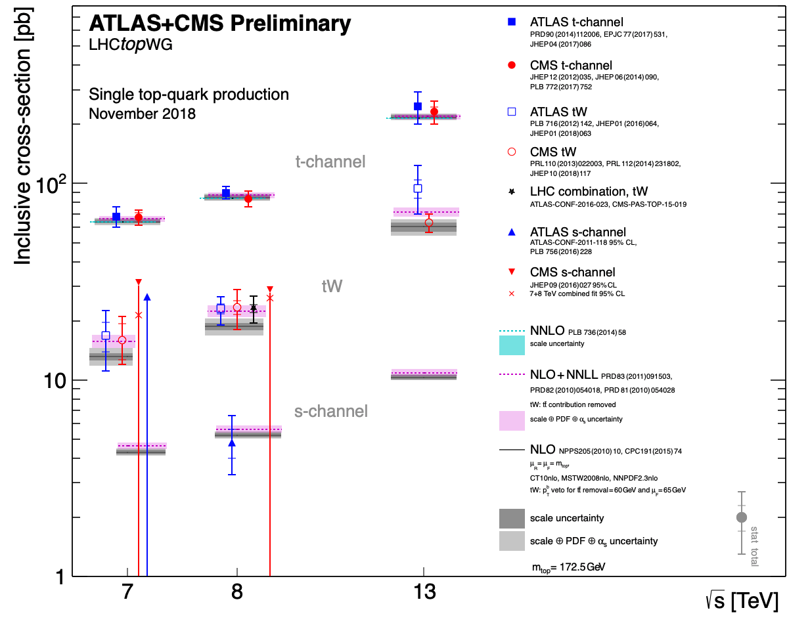
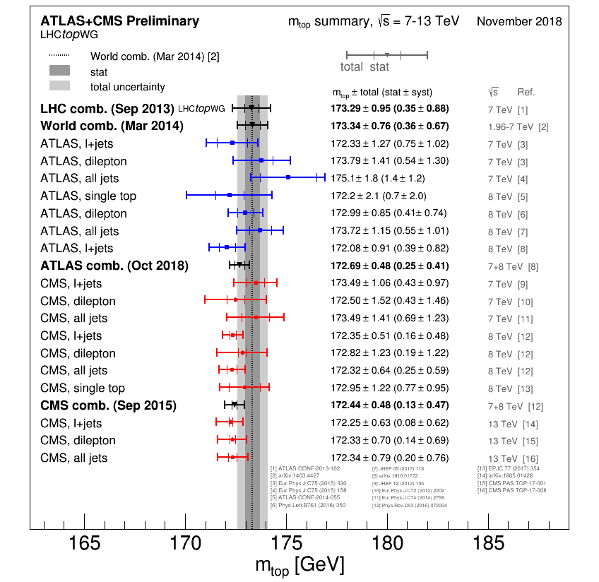
Summary Plots https://twiki.cern.ch/twiki/bin/view/LHCPhysics/LHCTopWGSummaryPlots
Updated two plots this time (updated references + new results):

Slide 7
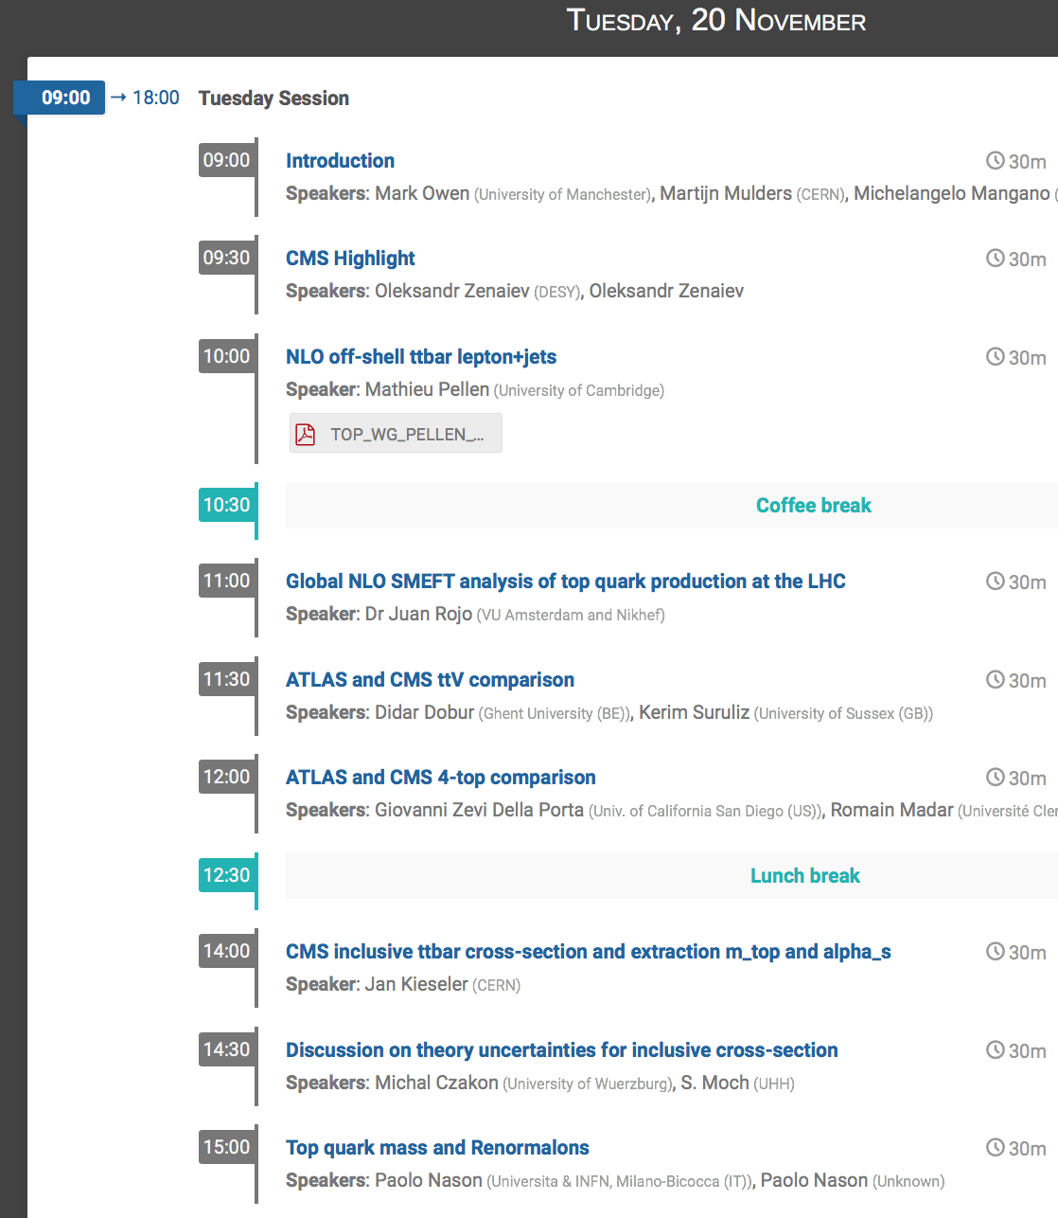
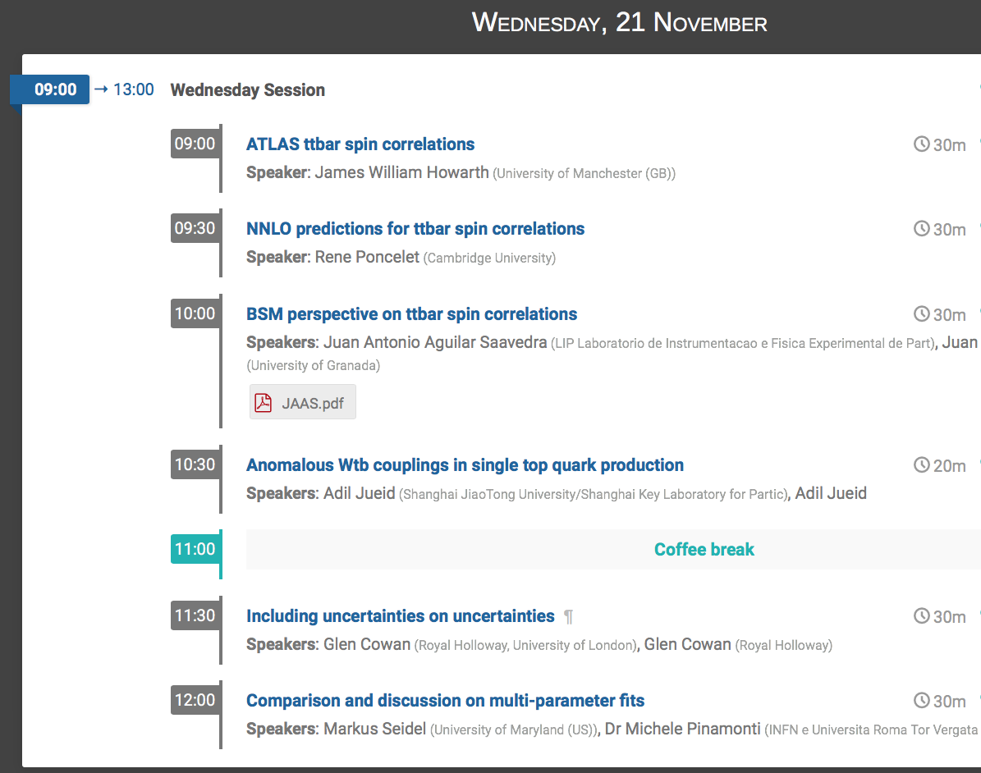
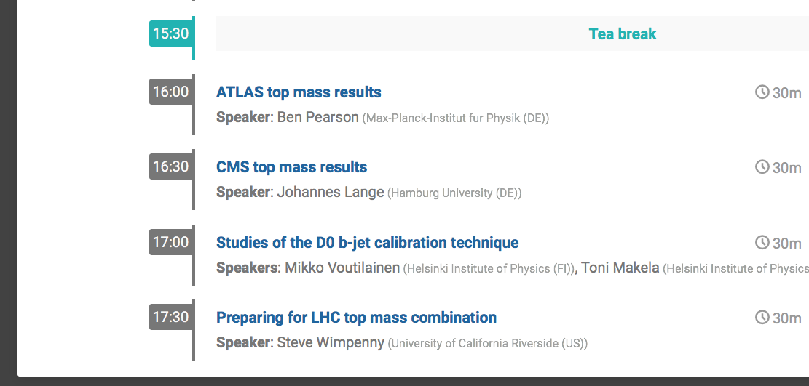
Council Chamber
Highlight
Salle Curie (40-S2-C01)
ttbar spin
correlations
EFT, comparisons
Single top Wtb
σ ttbar
Top mass
Next-to-leading-order Statistics

