Slide 1
VELO tracking

Slide 2
VELO open tracking in 2009 open data
Efficiency is about 94.2% for long tracks using 2mm window in PatVeloGeneralTracking if ±15mm open
  Could improve by 0.2% in MC minimum bias by optimising the window: chosen to work from ± 0 to ± 29mm open
  Probably not optimal for beam gas tracks though
    Now use generic in “beam gas” mode anyway

Slide 3
Tracking in overlap region
CondDBTag: sim-20091106-vc-md100-velotestxyrxy
From alignment fit to TED data
96 micron offset in y causes problems for RZ PR, both x and y cause problems for Space and General in overlap region
No effect within a detector half as code works in half box frame
<condition classID="6" name="VeloSystem">
<paramVector name="dRotXYZ" type="double">-0.0001 0 -0.0001 </paramVector>
<condition classID="1008106" name="VeloLeft">
<paramVector name="dPosXYZ" type="double"> 0.144 -0.048 0 </paramVector>
<condition classID="1008106" name="VeloRight">
<paramVector name="dPosXYZ" type="double"> -0.144 0.048 0 </paramVector>
[Deleted zero vectors]

Slide 4
Fix to PatVeloRTracking
Add code to ask the conditions DB for the ΔR between pairs of R detectors
  Needs to register with update service as it caches offsets
300 min bias events generated with
CondDBtag = ‘sim-20091106-vc-md100-velotestxyrxy’
Have 195 tracks with at least 6 clusters on one side and 3 on the other
Before fix RZ efficiency was zero to find as overlap tracks; after fix 45% with a 98% purity
Normal (TrackEffChecker) efficiency is unchanged
Ghost rate goes down ~0.5% and clone rate by 1.2%

Slide 5
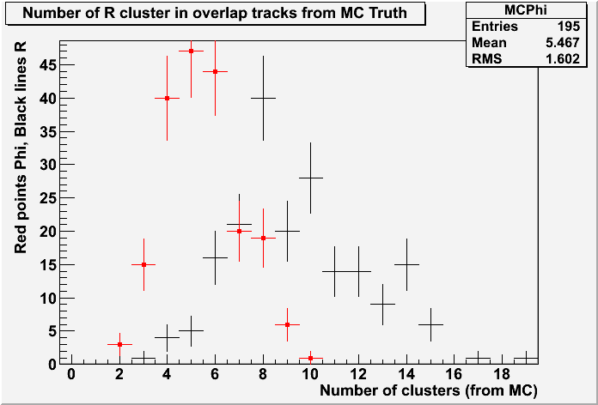
PatVeloGeneralTracking
Same procedure but correct for both x and y offsets
  Using just General (not Space then General)
  Clone rate down 0.1%, “physics” efficiency unchanged
  Overlap efficiency drops from 5.6 to 3.5%! (Purity goes to 100% though)
Why so bad?
Doglegs in phi sensors
Missing about 50% of phi
sensors
Means tracks all fail
extrapolation cuts due
to “missing” phi sensors

Slide 6
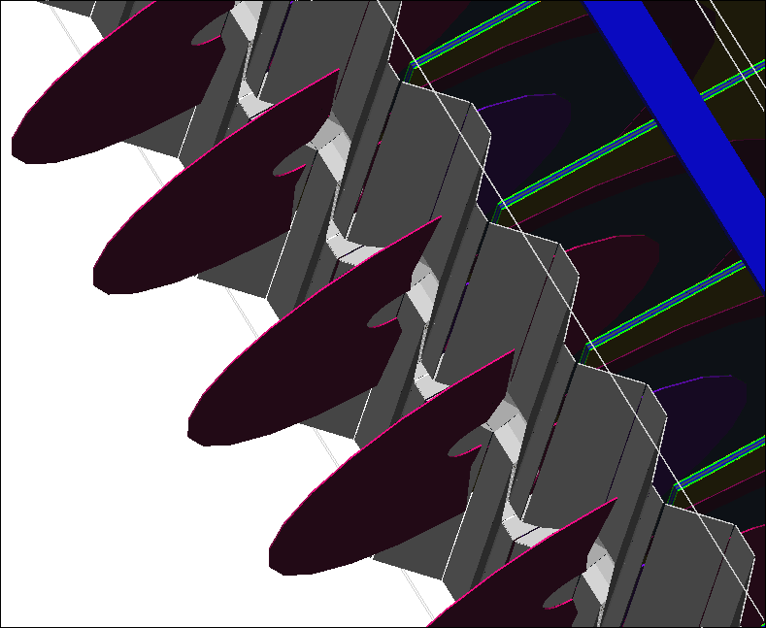
Note 3mm of dead material and guard rings before first strip on sensors

Slide 7
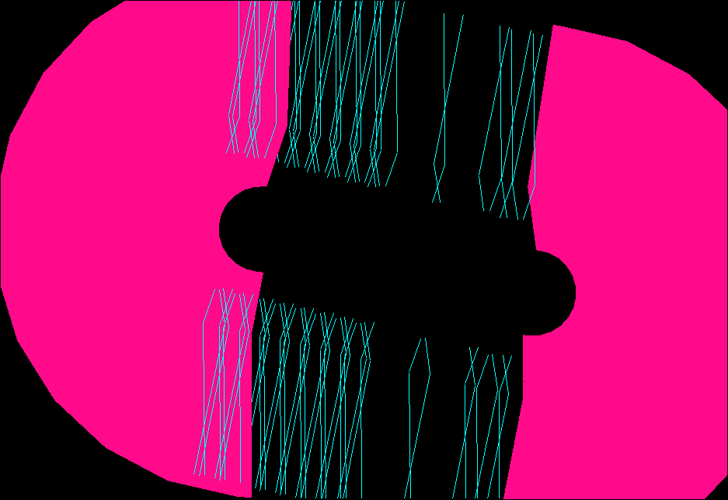
velotestxyrxy
Alignment set
Phi strips on the
edges of the sensors

Slide 8
No effect on Physics: need new alg for alignment
Need a specifically modified version of some combinations of PR algorithms to only look for overlap tracks
Needed for the most precise VELO half box alignment
Probably not needed in normal tracking stream, although if fast enough could include it
Merging tracks from both halves is not enough as too few phi hits to be found on either side

