Slide 1


BFKL Limit of N=4 SYM
Nikolay Gromov
Based on
N. G., V. Kazakov, S. Leurent, D. Volin 1305.1939 (PRL), 1405.4857 (JHEP)
M. Alfimov, N. G., V. Kazakov 1408.1042 (JHEP)
N. G., F. Levkovich-Maslyuk 1601.05679
N.G., F. Levkovich-Maslyuk, G. Sizov 1507.04010 (PRL)
N.G., F. Levkovich-Maslyuk, G. Sizov 1504.06640 (JHEP)
M. Alfimov, N.G., G. Sizov 1802.06908 (JHEP)
Gatchina, 2018

Slide 2

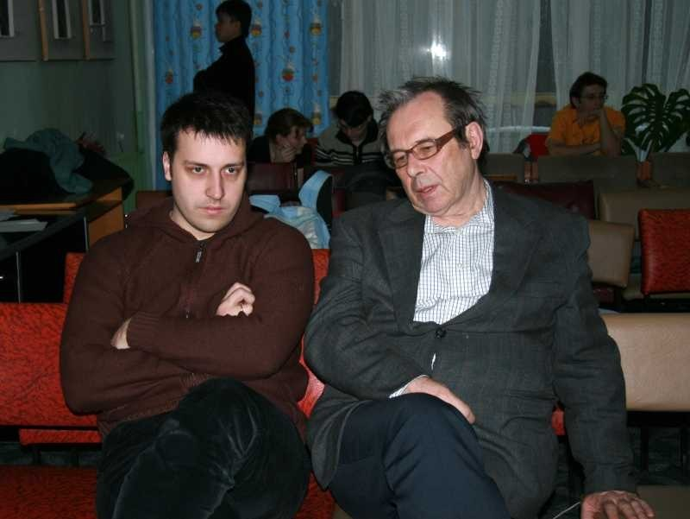

Slide 3
N=4 SYM
The “simplest” generalization of QCD:
Plus extra scalar fields
and fermions
Parameters: and
Symmetries:
Lorentz:
Conformal:
- rotation of the scalars
Super (graded) Lie algebra:

Slide 4
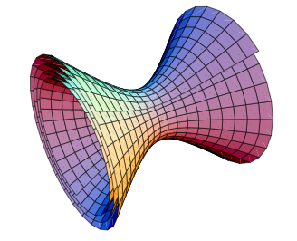
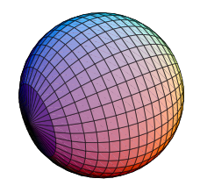
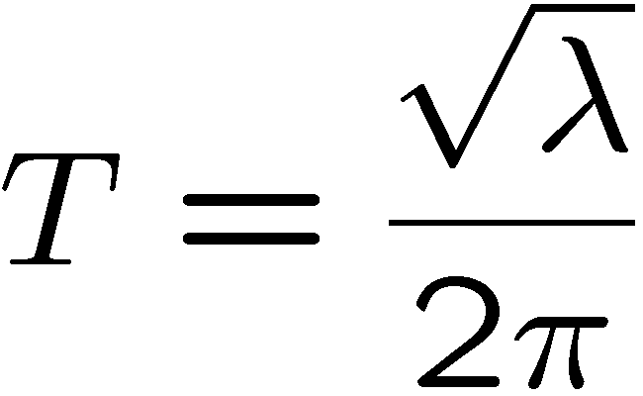
Dual description
String in AdS₅xS⁵
x
Symmetries:
Paramiter:
String tension:

Slide 5
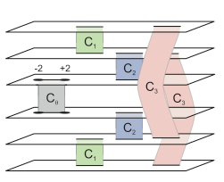
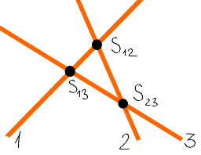
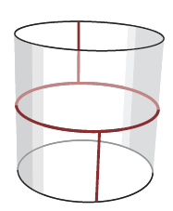
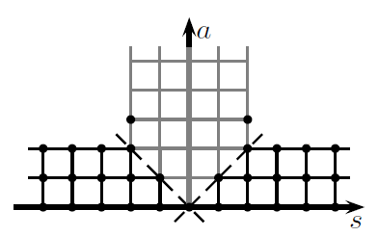
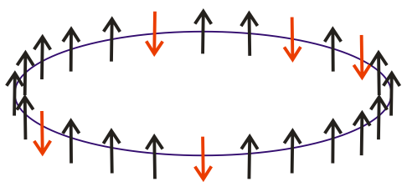
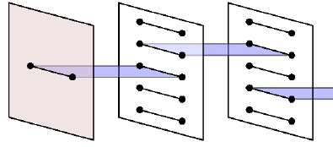
Integrability in gauge theory
Origins of YM integrability: Lipatov’s BFKL Hamiltonian
Perturbative integrability in N=4 SYM
Classical integrability of string ϭ-model on AdS5×S5, quasiclassics
S-matrix, asymptotic Bethe Ansatz.
Cusp dimension
Finite size corrections and mirror model
Analytic Y-system for exact spectrum,
TBA
Quantum spectral curve for all operators
Origins of YM integrability: Lipatov’s BFKL Hamiltonian
1993
2002
2003-2008
2004-2006
2005-2008
2009-2010
2011-2014
1993
Bena,Polchinski,Roiban
Kazakov,Marshakov, Minahan,
Zarembo, Frolov, Tseytlin
Schafer-Nameki
Beisert,Kazakov,Sakai,Zarembo
NG,Vieira
Arutyunov,Frolov,Staudacher
Staudacher, Beisert
Janik
Hernandez,Lopez
Roiban, Tseytlin
Beisert,Eden,Staudacher
Lipatov
Faddeev,Korchemsky
Minahan,Zarembo,
Beisert,Kristijanssen,Staudacher
Ambjorn,Janik,Kristijanssen
Arutyunov,Frolov
Bajnok,Janik, Lukowski
NG , Kazakov, Vieira
Bombardelli,Fioravanti, Tateo
NG , Kazakov,Vieira
Arutyunov, Frolov
Covagia,Fioravanti,N.G.,Tateo
Lipatov
Faddeev,Korchemsky
Alfimov,N.G.,Kazakov to appear
NG, Kazakov, Leurent, Volin

Slide 6
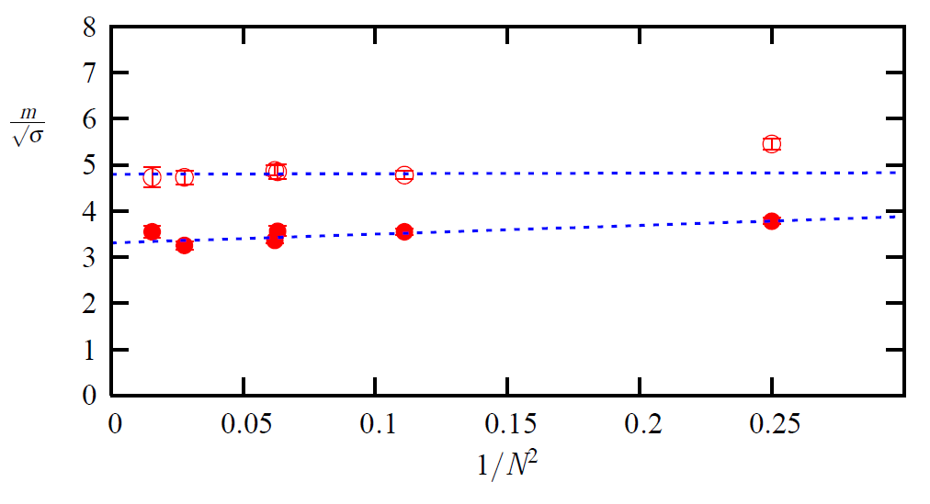
Planar limit?
Expansion in large N organized in 1/N² series. For real QCD 1/N² =1/9.
Teper 2008
N=8
N=3

Slide 7
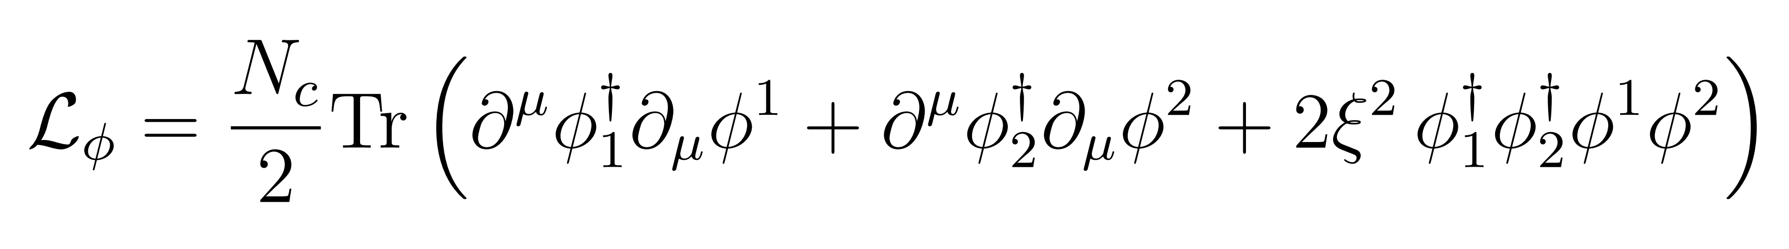
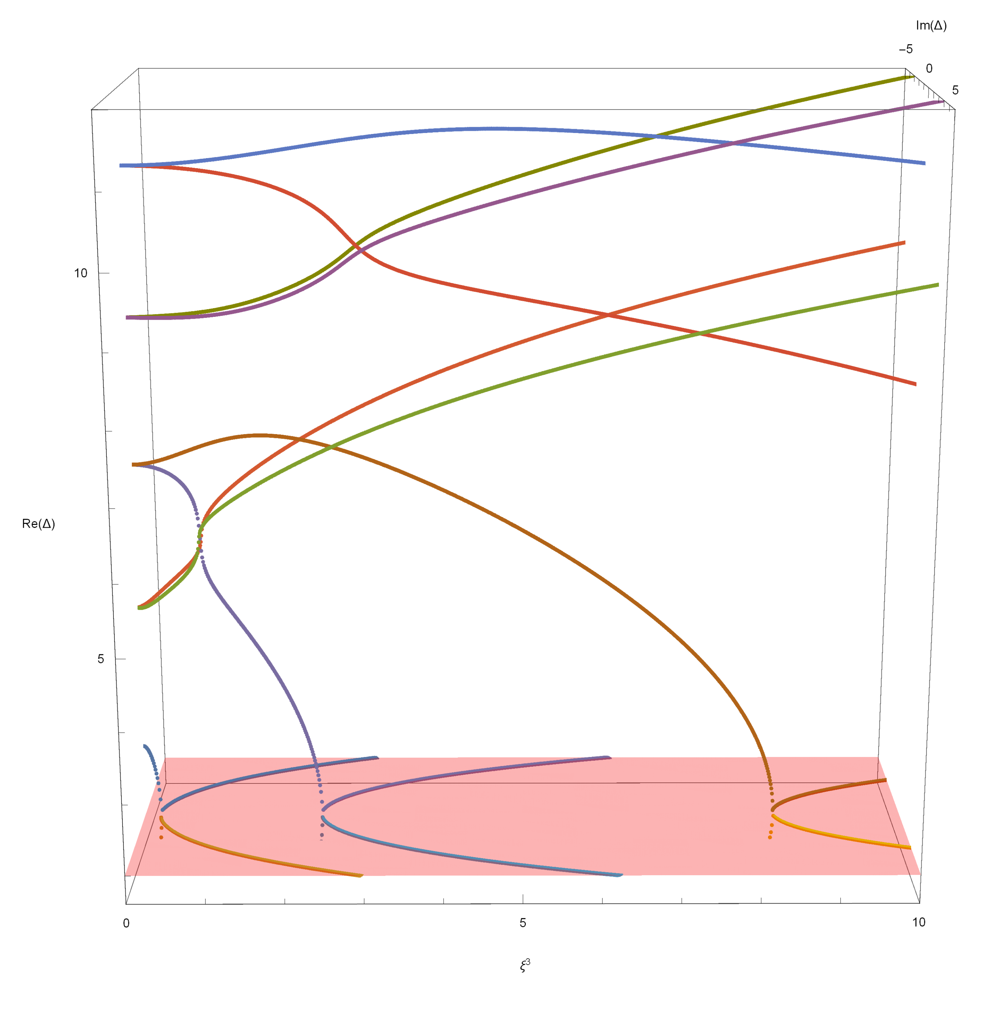
Do we need super-symmetry?
N=4 has a number of deformations, which brake super-symmetry, but preserve integrability
An extreme example is so-called "Fishnet” theory, which has only 2 scalar fields (no susy at all)
[Kazakov, Gurdagan]
[Grabner, Gromov,
Korchemsky, Kazakov,
Sizov, Negro] 2017
Can compute exact spectrum and 3,4 point correlation functions
[Grabner, Gromov,
Kazakov, Korchemsky 2017]
[Gromov,
Kazakov, Korchemsky 2018]

Slide 8
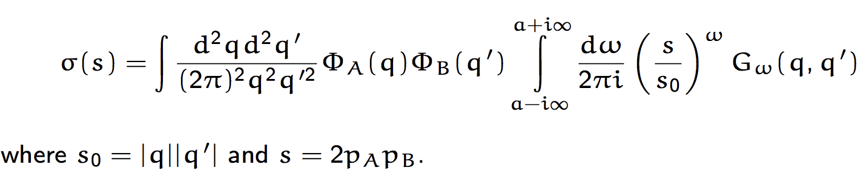
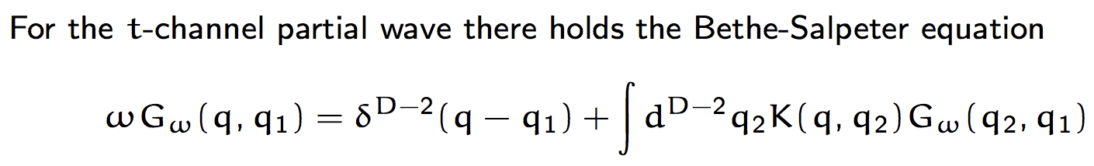
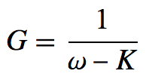
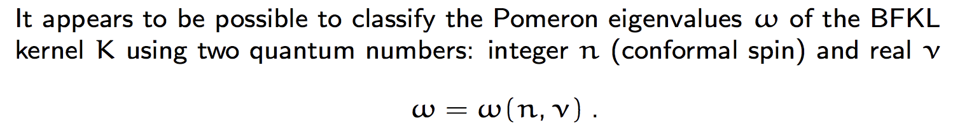
BFKL pomeron
The total crossection of the hight-energy scattering

Slide 9
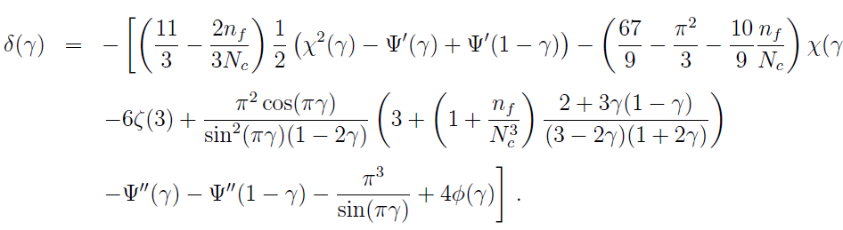
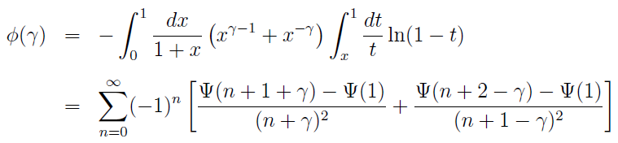
BFKL in QCD
Jaroszewicz, 1982
Lipatov 1986
Kotikov,Lipatov 2002
At the LO:
At NLO:
Fadin, Lipatov 1998
Kotikov,Lipatov 2002
Kotikov,Lipatov 2000

Slide 10
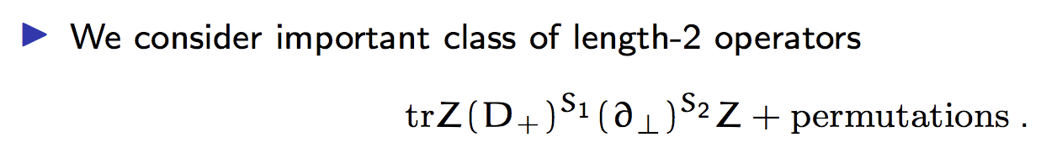

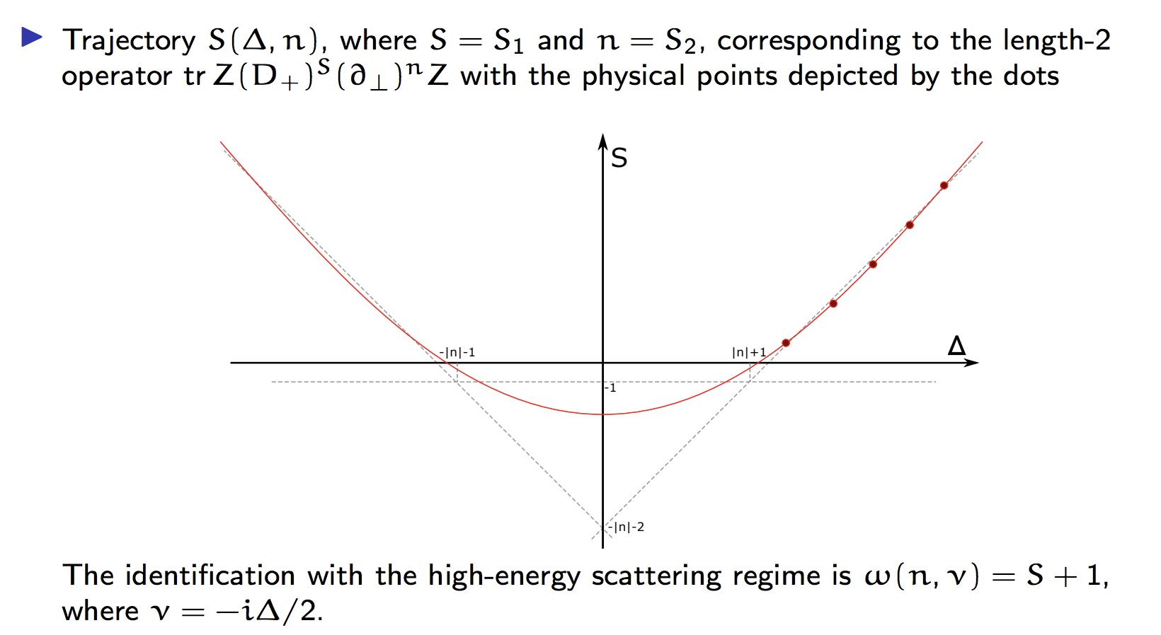
BFKL pomeron in N=4 SYM

Slide 11
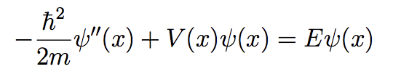

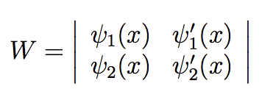
Spectrum in QM
Second solutions:
Wronskian = constant

Slide 12
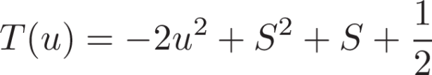





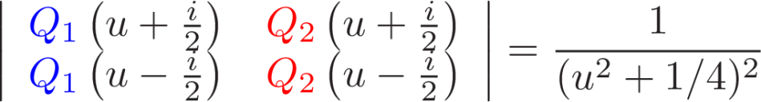
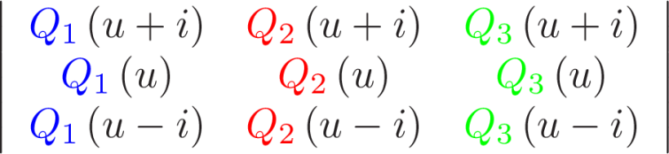



Spectrum of spin chains
In the simplest case
Two solutions: polynomial
singular solution
Equivalent description:
Easy to generalize SU(3):
- polynomial
- polynomial
- polynomial
- meromorphic
- meromorphic

Slide 13




From weak coupling
Two main ingredients:
QQ-relations
Analyticity
For N=4 we only have to change the analytic properties a bit!
- polynomial
- meromorphic
[Gromov, Kazakov, Leurent, Volin’13;
Gromov, Kazakov, Leurent, Volin’14]

Slide 14
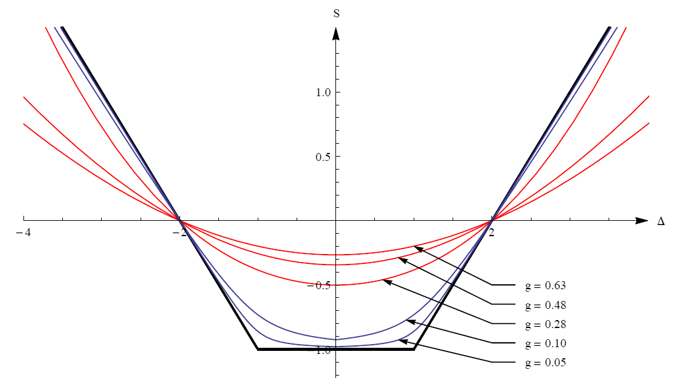




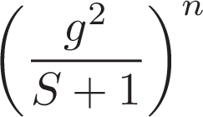

BFKL regime
Important class of single trace operators:
Spectrum for different spins:
[Brower, Polchinski, Strassler, -Itan `06]
BFKL regime:
[Kotikov, Lipatov, Rej, Staudacher, Velizhanin]
So that:
Resumming to all loops terms
In this regime SYM is undistinguishable from the real QCD

Slide 15
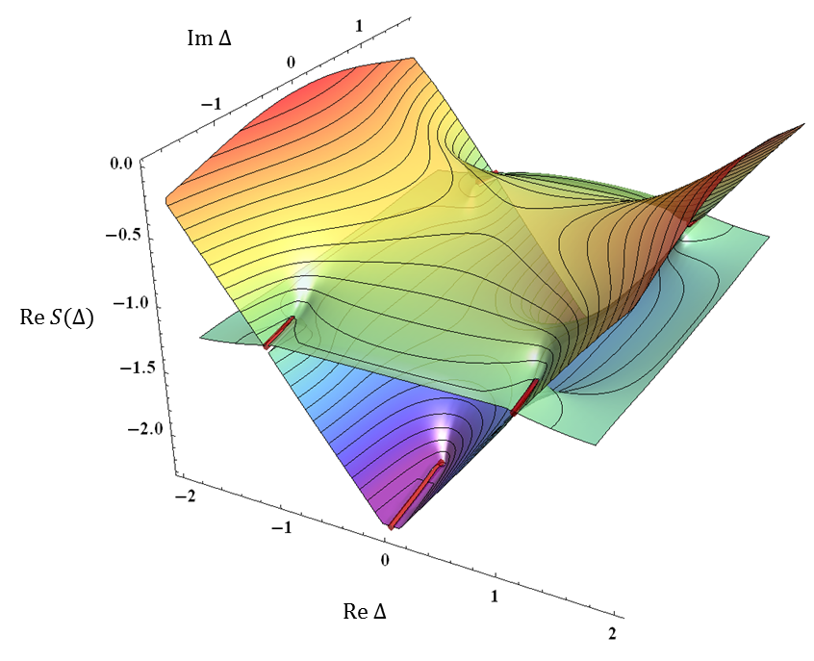


Analytic structure at finite coupling
Gromov,FLM,Sizov 2015

Slide 16

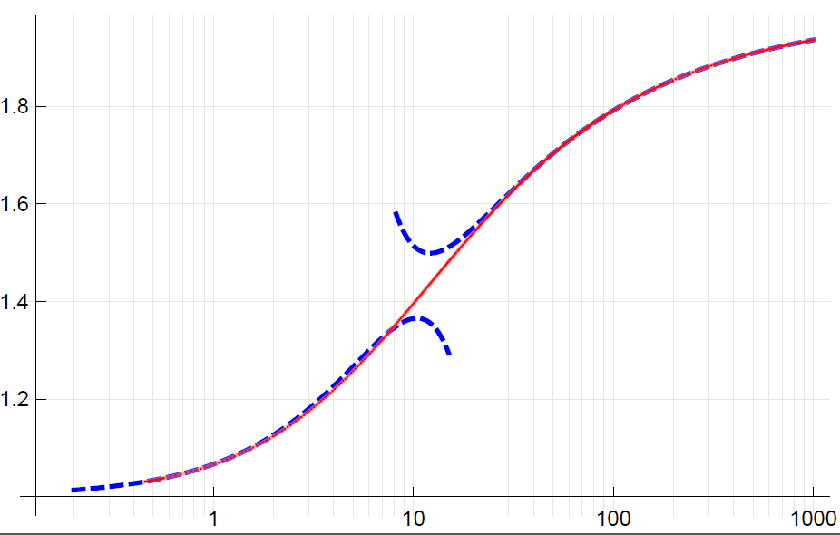



BFKL pomeron intercept
Gromov,FLM,Sizov 2015
become singular, need to do rotation/rescaling
strong coupling
Costa,Goncalves,Penedones 2012
Kotikov,Lipatov 2013
Brower,Costa,Djuric,Raben,Tan 2013
Gromov,FLM,Sizov 2014
numerics
weak coupling
Kotikov,Lipatov 2002
Brower,Polchinski,Strassler,Tan 2007

Slide 17
Known analytical results

Slide 18
BFKL in QCD
Jaroszewicz, 1982
Lipatov 1986
Kotikov,Lipatov 2002
At the LO:
At NLO:
Kotikov,Lipatov 2002
Kotikov,Lipatov 2000

Slide 19
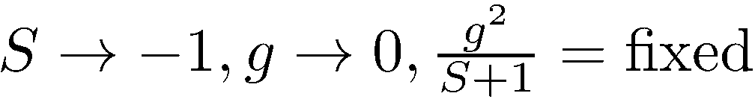
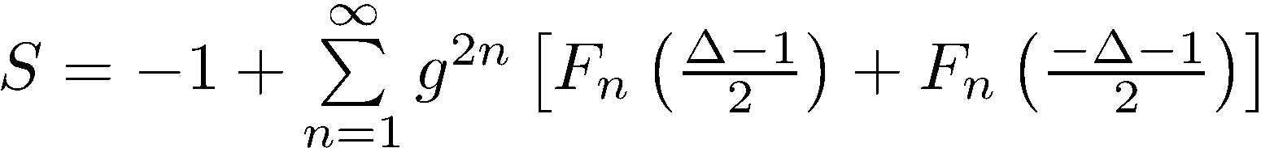
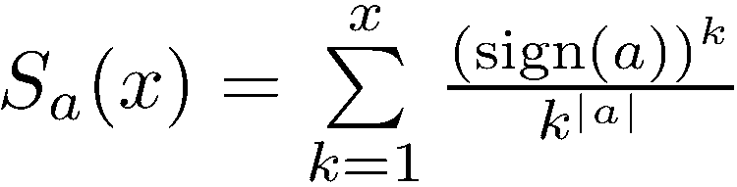
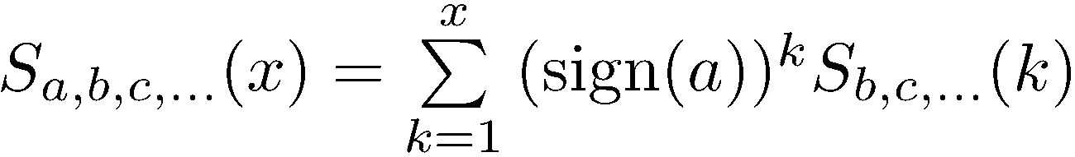

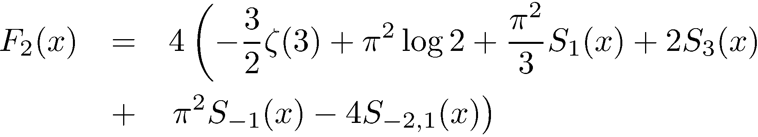

BFKL regime
Resums contributions from all loop orders
N=4 SYM should give the highest transcendentality part of the QCD result
Costa,Goncalves,Penedones 2012
Leading
order
Reproduced from QSC in
[Alfimov,Gromov,Kazakov 2014]
NLO
NNLO

Slide 20

Basis for NNLO
Each term has transcendentality 5
harmonic sums with transcendentality up to 5, and constants:
In total 288 elements
We derive analytic constraints from QSC
for expansion around poles at

Slide 21

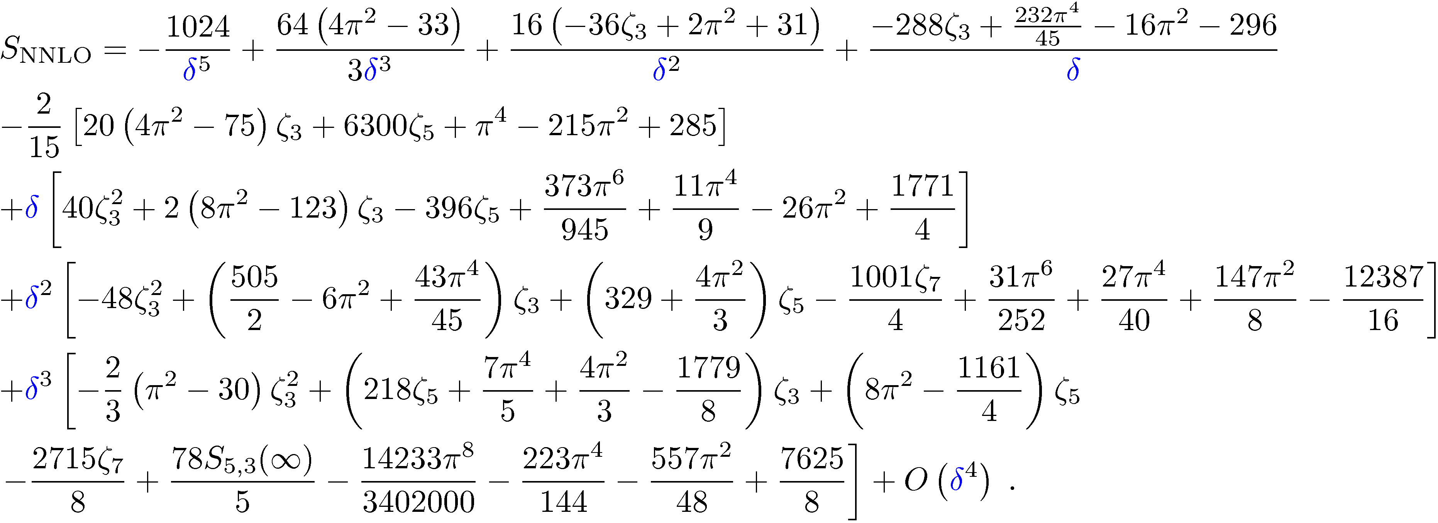
E.g. around we get the expansion
Get an overdetermined set of equations
on coefficients of basis elements
the result
Only 37 out of 288 coefficients are nonzero!

Slide 22
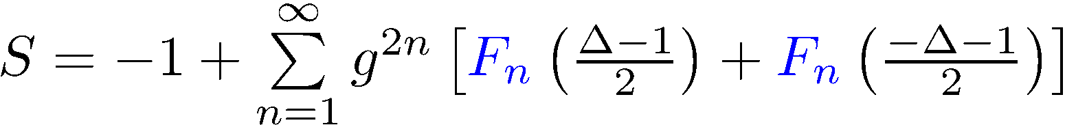
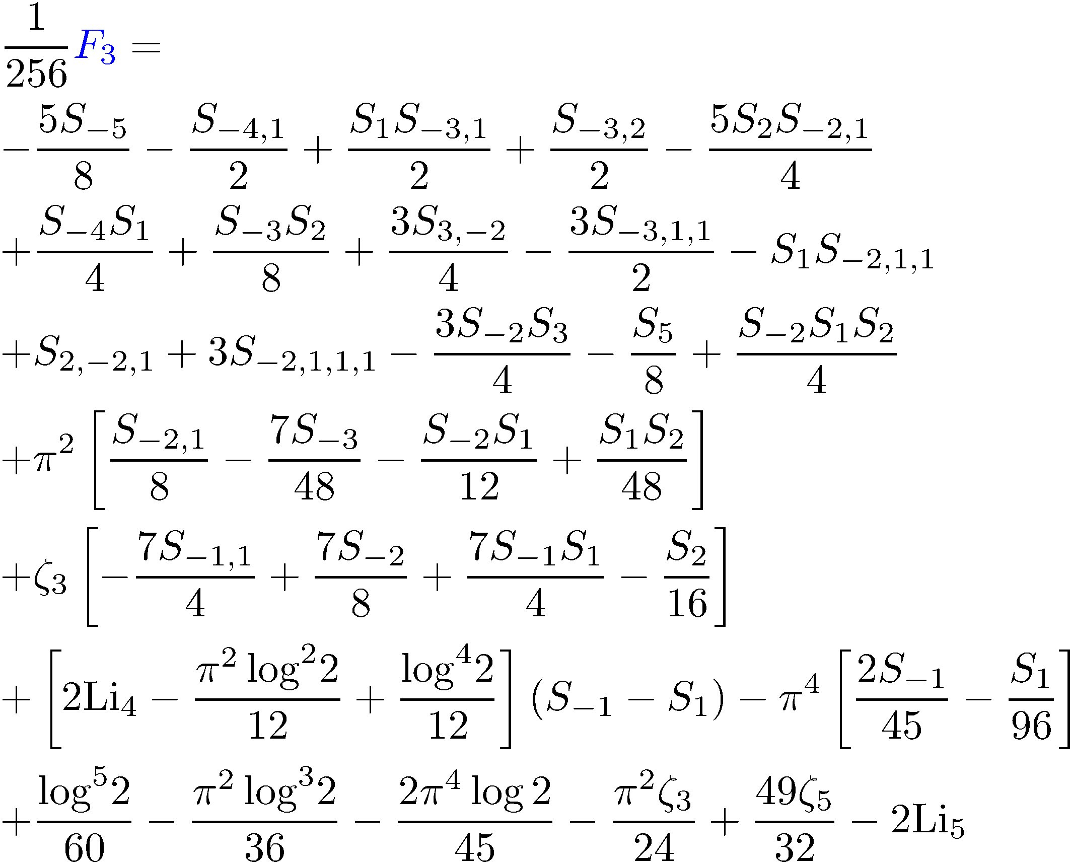
Our result: BFKL at NNLO
NG,Levkovich-Maslyk,Sizov
Phys.Rev.Lett. 115 (2015)
Found from
iterative solution of QSC
Confirmed recently by an independent calculation by Caron-Huot, Herran

Slide 23


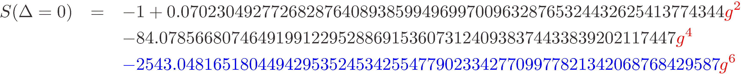
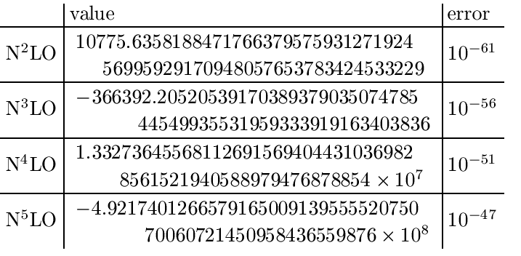
Numerical test
At and
computed NNLO by fitting
our numerical data
Reached 60 digits precision – perfect match with our analytic result!

Slide 24
Non-zero conformal spin

Slide 25
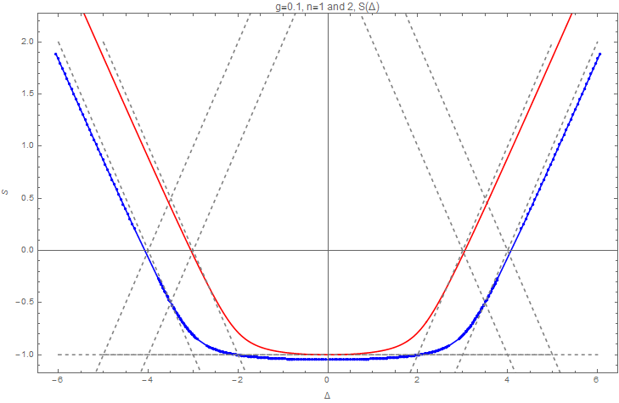
M. Alfimov, N.G., G. Sizov
Non-zero conformal spin means that one of the Conformal charges S2=n is nonzero
We analytically continue in S1=S finding S(Δ,n)
The Regge trajectory for g=1/10

Slide 26
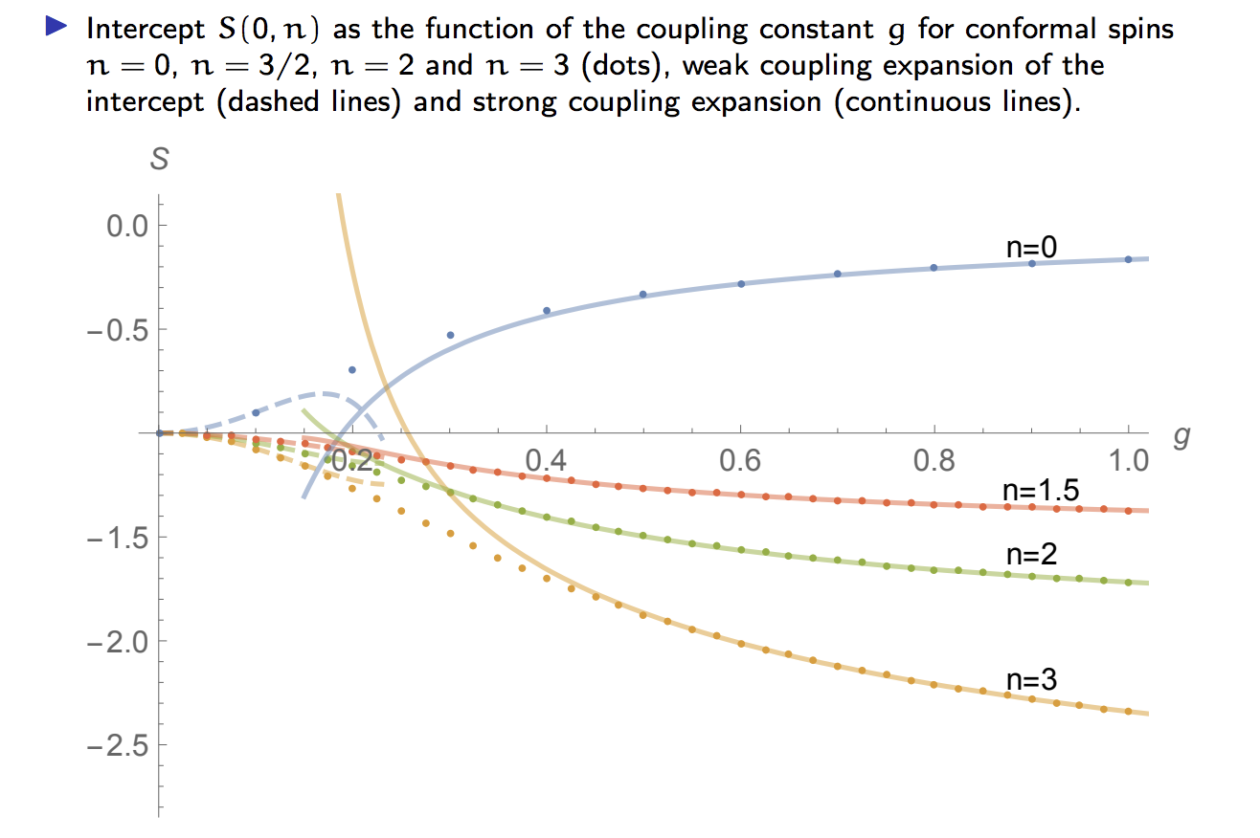
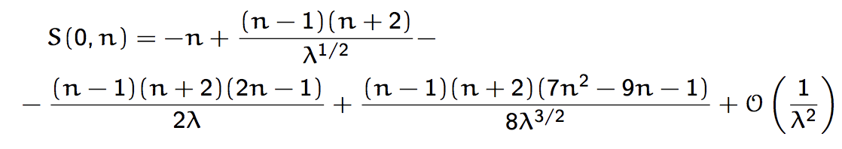

Slide 27
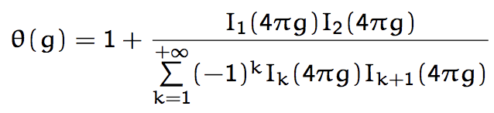
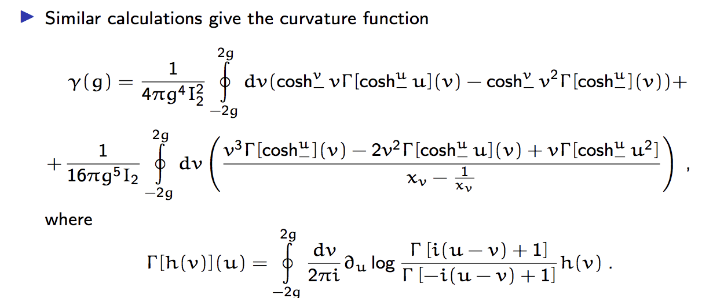
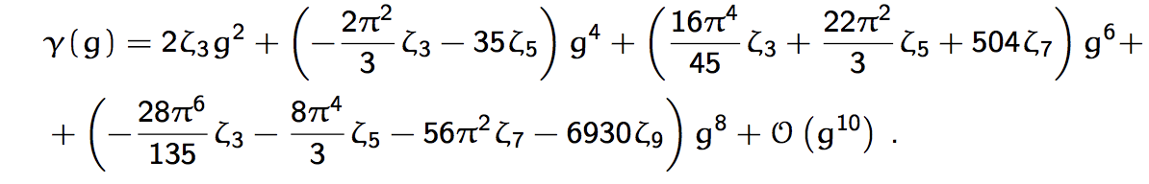
Exact all loop result in the vicinity of n=1

Slide 28
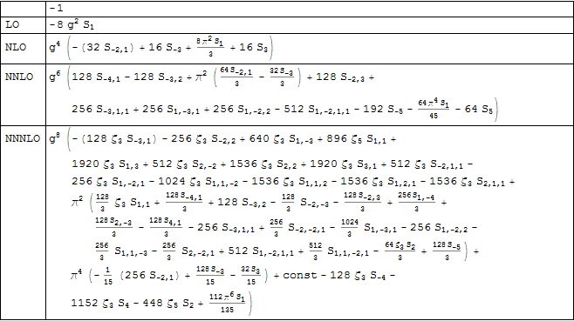
Intercept for any n
M. Alfimov, N.G., G. Sizov
Argument of all the harmonic sums is (|n|-1)/2

Slide 29
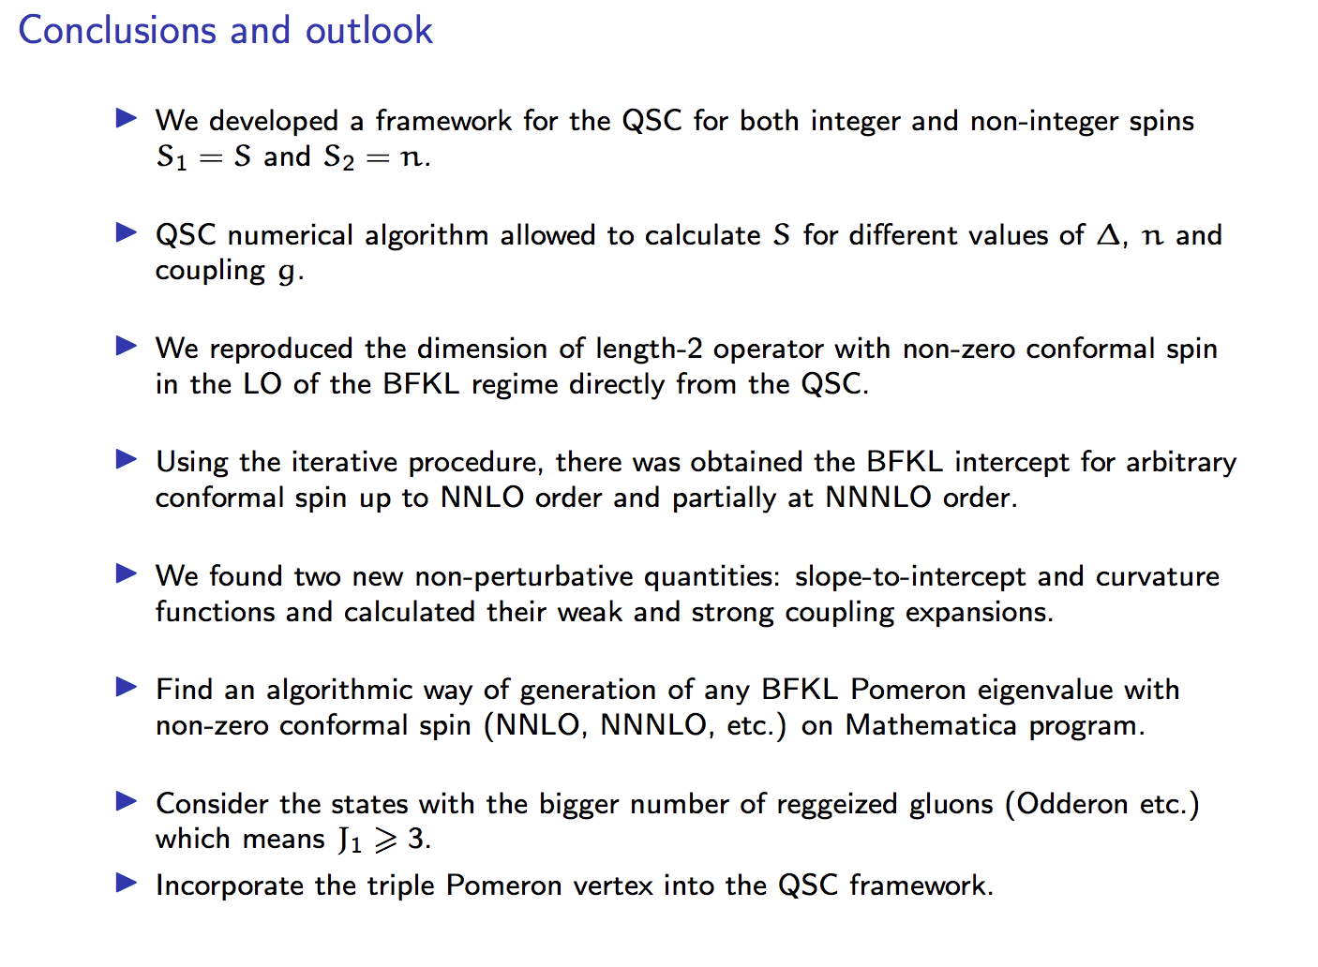

Slide 30
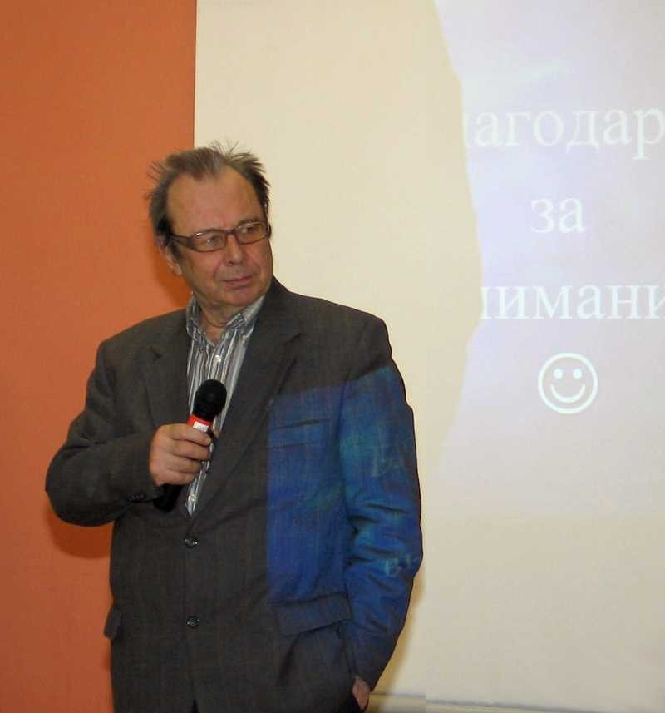
Thank you!

