Slide 1
IDCN Lake Geneva
CERN Spouse Welcome session 18th Sept
JULIANA BRAGINA- Events team volunteer
HANNALI MELENDEZ- Measurement team leader

Slide 2

What is IDCN
Events:
Corporate Events
Career Mornings
A non-profit association formed through the collaboration of companies, NGOs and academic institutions with the purpose of facilitating the job search for mobile employees’ partners, and providing member companies access to a turnkey pool of talent.
HOW?
Visibility:
Talent Management Platform (TMP): Online member registration and recruitment tool
LinkedIn group

Slide 3
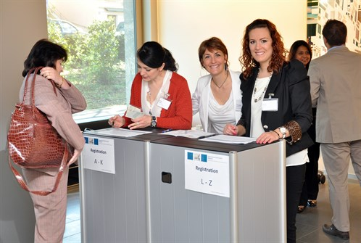
Employees’ Partners Benefits
Support in professional integration in a new country
The opportunity to network with human resources professionals, corporate representatives and likeminded partners
Increased awareness of professional opportunities

Slide 4
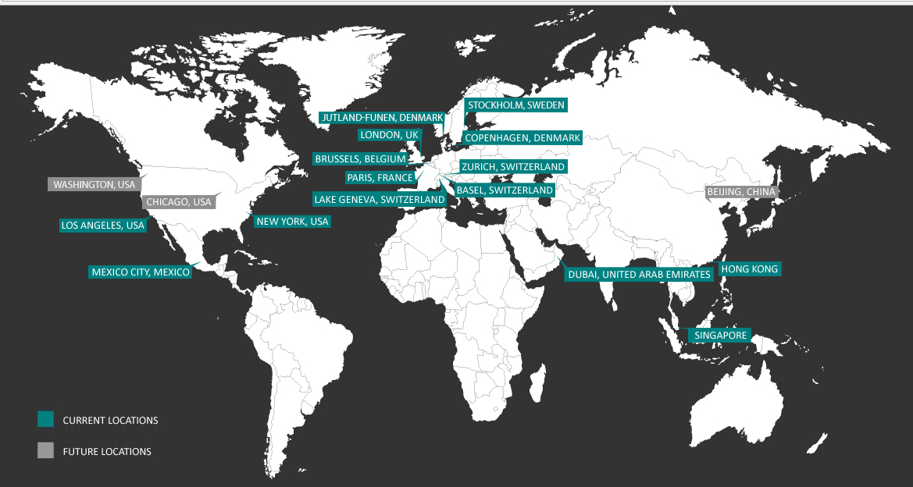
Where we are?
IDCN is a global Non-Profit Association of corporates, NGOs and academic institutions in 15 locations with 29 global organizations and almost 78 local entities.

Slide 5
The driving force behind IDCN
Think Global, act local.
The driving force behind IDCN
Think Global, act local.
The Executive Board
Global
Centre of Expertise
Corporate Members
Local
Service Providers
Partner Volunteers
Notes:
370 HR representatives of the Corporate Members / 101 organizations
8 Executive Board Members
2 Employees working for IDCN in the CENTRE OF EXPERTISE
X Service Providers
116 Volunteers
Facilitating the job search for more than 1,100 Partners in 13 locations around the world

Slide 6











Our Corporate members in the region - 2018
Notes:
370 HR representatives of the Corporate Members / 101 organizations
8 Executive Board Members
2 Employees working for IDCN in the CENTRE OF EXPERTISE
X Service Providers
116 Volunteers
Facilitating the job search for more than 1,100 Partners in 13 locations around the world

Slide 7




Upcoming events
Corporate Events
September
25
October
12
November
May
27
Career Mornings
 | Jan | Feb | Mar | Apr | May | Jun | Sep | Oct | Nov | Dec
Lausanne |  | 2nd Nestlé | 13th IMD
Geneva |  |  |  |  |  |  | 6th Nestlé |  |  | TBC UNIGE
April 26
April
15
May
13
October
TBD

Slide 8
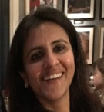
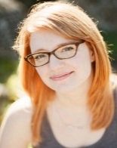
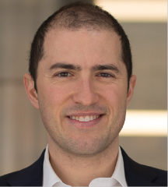
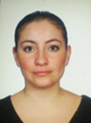


IDCN Volunteer Leadership Team
PRESIDENT
EVENTS LEAD
Bindiya Dua
COMMUNICATION LEAD
Jessica Watson
MEMBERSHIP LEAD
Ryan Mocan
MEASUREMENTS LEAD
Hannali Melendez
Corporate Mentors
PARTER PRESIDENT
Orsi Mokus
EVENTS
Natacha Rault
COMMUNICATION
Marcella Rispo
MEMBERSHIP
Elsa Gardel
MEASUREMENT
David Pope

Slide 9
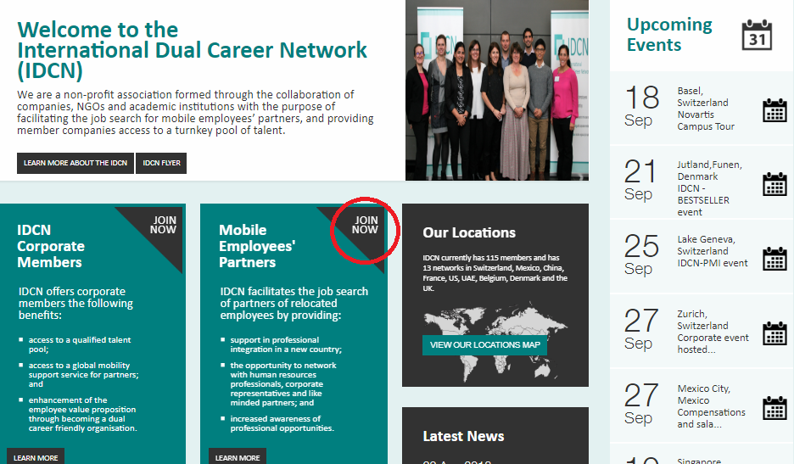
WEBSITE

Slide 10
CONTACT INFORMATION
Email:
  General Information: geneva@idcn.info
  Volunteer Opportunities: volunteer.geneva@idcn.info
  Membership Questions: membership.geneva@idcn.info
Other:
  Website: www.idcn.info
  LinkedIn: International Dual Career Network - IDCN Lake Geneva Region (Official Group)

Slide 11
Thanks for your attention!

