Slide 1
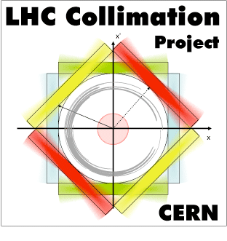

HL-TCC Technical Coordination Committee
54th meeting, August 2nd, 2018
CERN, Geneva, CH
Recap. of collimation losses in the IR7 dispersion suppressors
C. Bahamonde, R. Bruce, F. Cerutti, A. Lechner, S. Redaelli
On behalf of WP5
Acknowledgements: G. Arduini, R. Van Weelderen, G. Iadarola, G. Rumolo, et al.

Slide 2
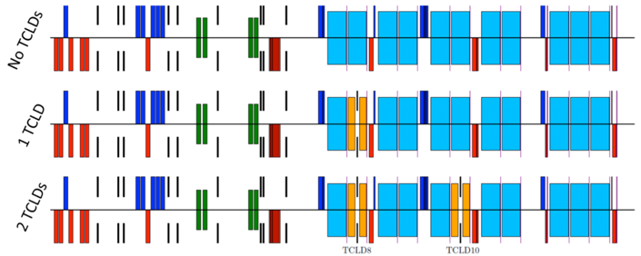
IR7 baseline layouts
Q7
Q8
Q9
Q10
Baseline
2016
Re-baselining in 2016 removed the second unit near Q10.
Studied also other locations between Q8 and Q9. Not discussed here.
Layouts studied in detail through simulations (tracking+energy deposition). Main focus was on quench limits from peak power deposited in SC coil. More recently, simulation results re-interpreted to assess other limitations.
Key reference: Collimation Review 2013
Annual meeting Daresbury, 2013
Annual meeting Madrid, 2017 + Chamonix 2018

Slide 3
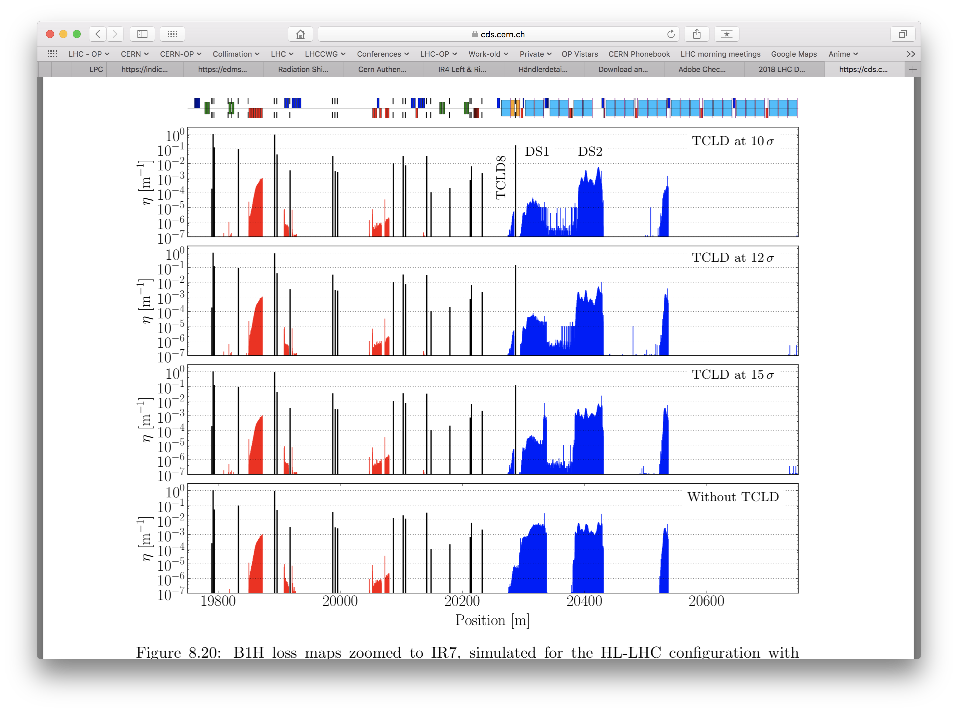
Beam losses
P. Hermes, PhD thesis
Tracking simulations for protons and ions are used as input for energy deposition simulations.
Benchmark to experimental data indicate that a factor x3 need to be added to the simulation result to reproduce loss pattern. Included in all numbers shown here.

Slide 4
Possible limitations
Three sources of limitations from collimation losses identified:
— Quench limit, from peak power in super conducting coil;
— Total energy deposited in the coil (specific for 11T dipole);
— Total power on cryogenics cells.
Here: review inputs from simulations (WP5/WP10 + WP2) to cryogenics team.
All numbers given for nominal HL-LHC parameters, 7 TeV:
Protons†: 2760 bunches of 2.3e11protons
Lead ions: 1248 bunches of 2.1e8 ions
Loss scenarios: 0.2h beam lifetime (BLT) for 10 seconds
1.0h for indefinite times.
†: Updated compared to my presentation at Chamonix: 10% effect from nb.

Slide 5
Peak losses in SC coils
Summary of limiting location for present and HL layouts
Q7
Q8
Q9
Q10
0.2 h beam lifetime
Without upgrade, peak losses in dipoles coil for 0.2h lifetime are
21 mW/cm³ (protons) and 58.2 mW/cm³ (lead ions)
With the TCLD/11T dipole upgrade, losses are:
STD MB: 8.6 mW/cm³ (protons) and 35.4 mW/cm³ (lead ions)
11T dipole: 10.6 mW/cm³ (protons) and 21.3 mW/cm³ (lead ions)
Note that limiting locations after upgrade are in cell 9-11.

Slide 6
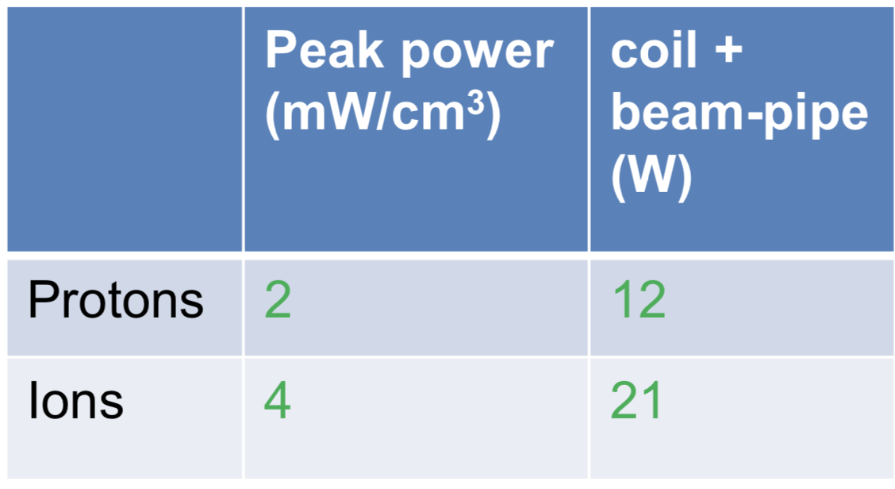
Total power in 11T dipole coil
1h beam lifetime
Total coil + beam pipe: obtained by summing up energy deposition estimated for coil and cold bore for the 1h beam lifetime scenario.

Slide 7
Total loads on cold masses
Q7
Q8
Q9
Q10
1h beam lifetime
{
{
{
{
Protons: 40W 20W ~0W 70W Max/cell = 70W
Lead ions: 70W 25W ~0W 140W Max/cell = 140W
Other sources of beam-induced loads on cold masses (inputs: WP2/10)
Ecloud: negligible
Beam-gas interactions: < 1W (both protons and ions)
Impedance, synchr. rad.: negligible

