Slide 1

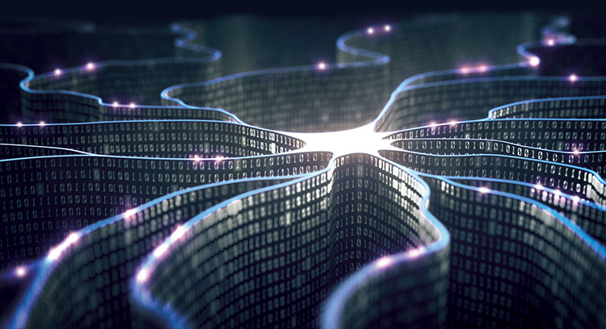
Machine Learning
Sergei Gleyzer
PART III
INSIGHTS CERN Lectures
Sep 21, 2018

Slide 2

Recap

Slide 3
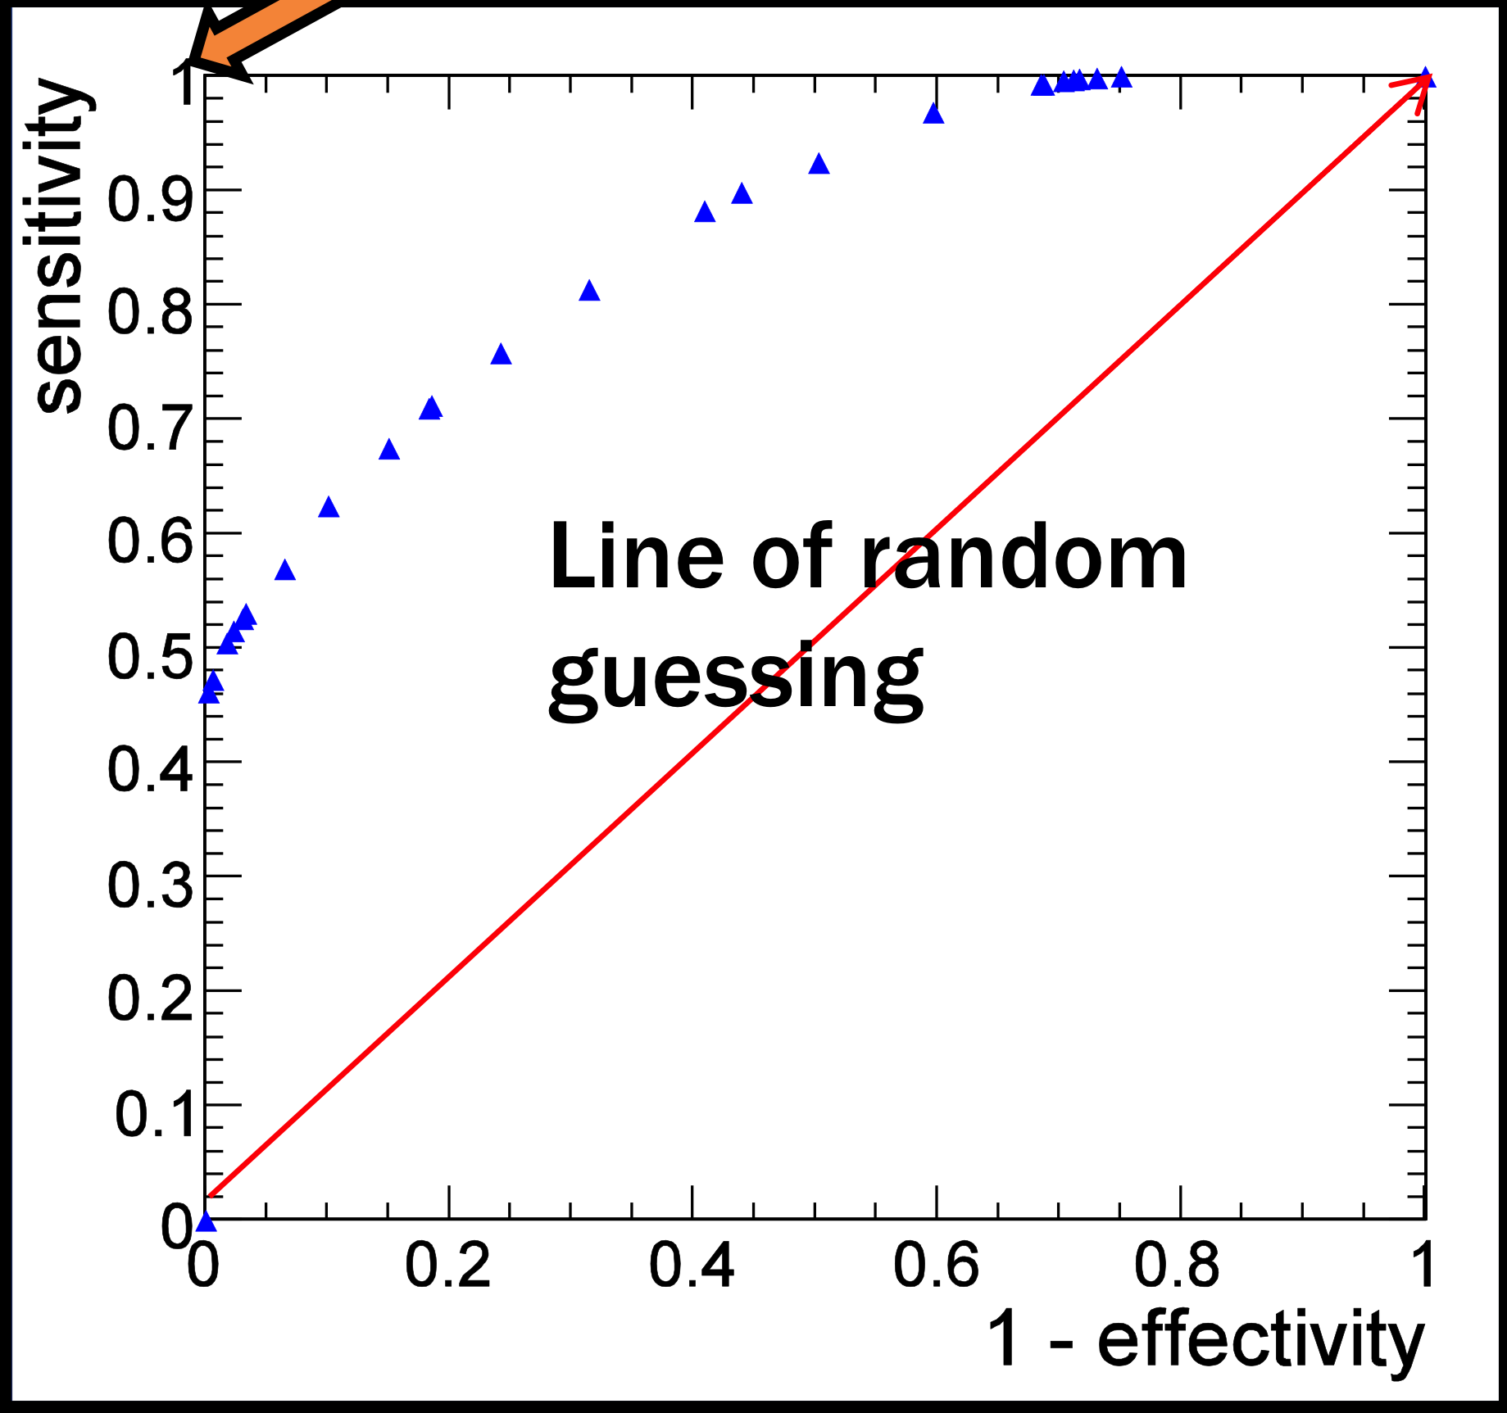
Classifier Performance
Receiver Operating Characteristic (ROC)
Commonly used metric
Perfect Classifier
Shows the relationship between correctly classified positive cases (sensitivity) and incorrectly classified negative cases (1-effectivity)

Slide 4
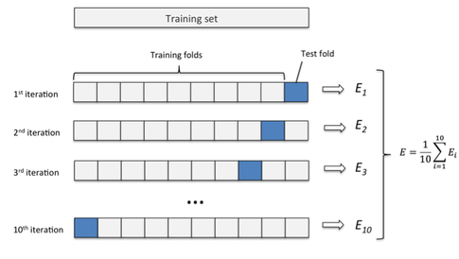
Cross Validation

Slide 5
Selection Methods
Filters
Wrappers
Embedded-
Hybrid
Feature Selection
Model Building
Model Building
Feature Selection
Feature Selection during Model Building

Slide 6

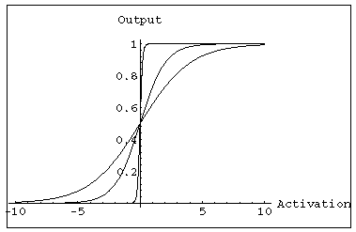
Graphical Representation
c_{j}
d_{ji}
Input Layer
b_{j}
x₁
a
n(x, w)
x₂
sigmoid
Output Layer
Hidden Layer
f is used for regression
n is used for classification
w = a, b, c, d

Slide 7
ReLU
Rectified Linear Unit (ReLU)
Rectified neuron
Faster training convergence
  Better solutions than sigmoids
    Vanishing gradients
  Trained by
  back-propagation
ReLU and Parametric PReLU

Slide 8
Convolution

Slide 9
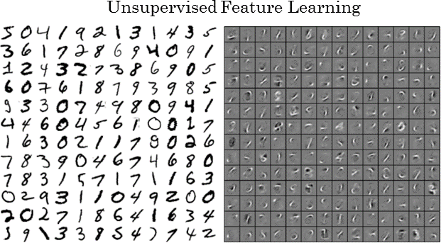
Filters
Convolutional Neural Networks:
Began with image and sequence-based problems in computer vision
  Images (2D)
  CNN’s learn features with simple structures
    Filters: repeatedly applied
    Unsupervised learning during first stage
  Jet images and evolution

Slide 10
Recurrent NN
Cycles

Slide 12
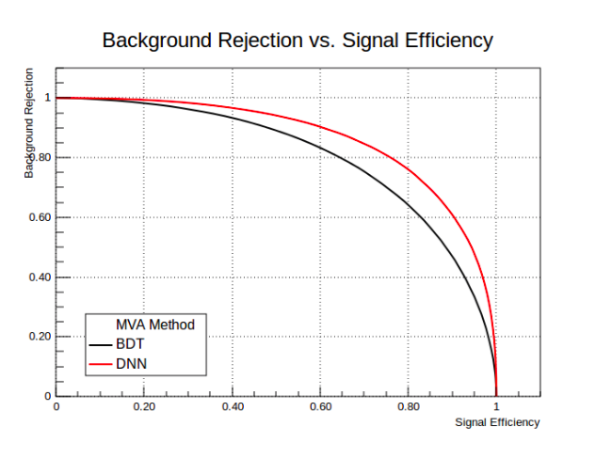

Deep Learning
Deep NN
BDT
Higher performance compared to previous ML methods
S. Gleyzer, et. al. 2017

Slide 13
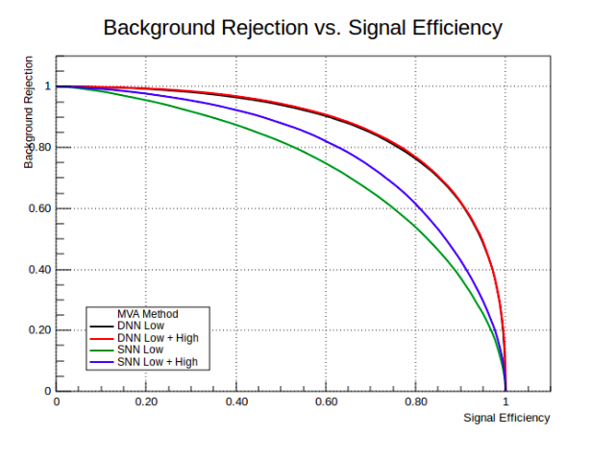
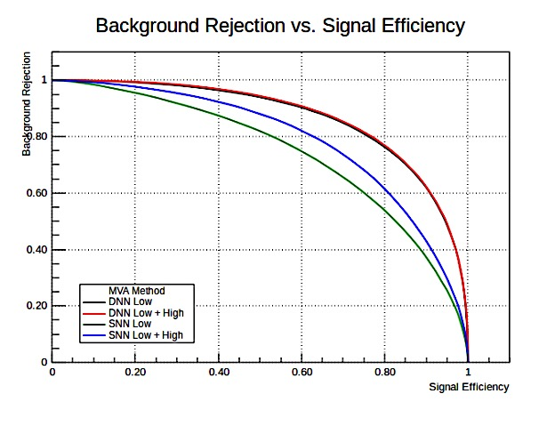
Feature Extraction
Deep NN
Shallow

Slide 14
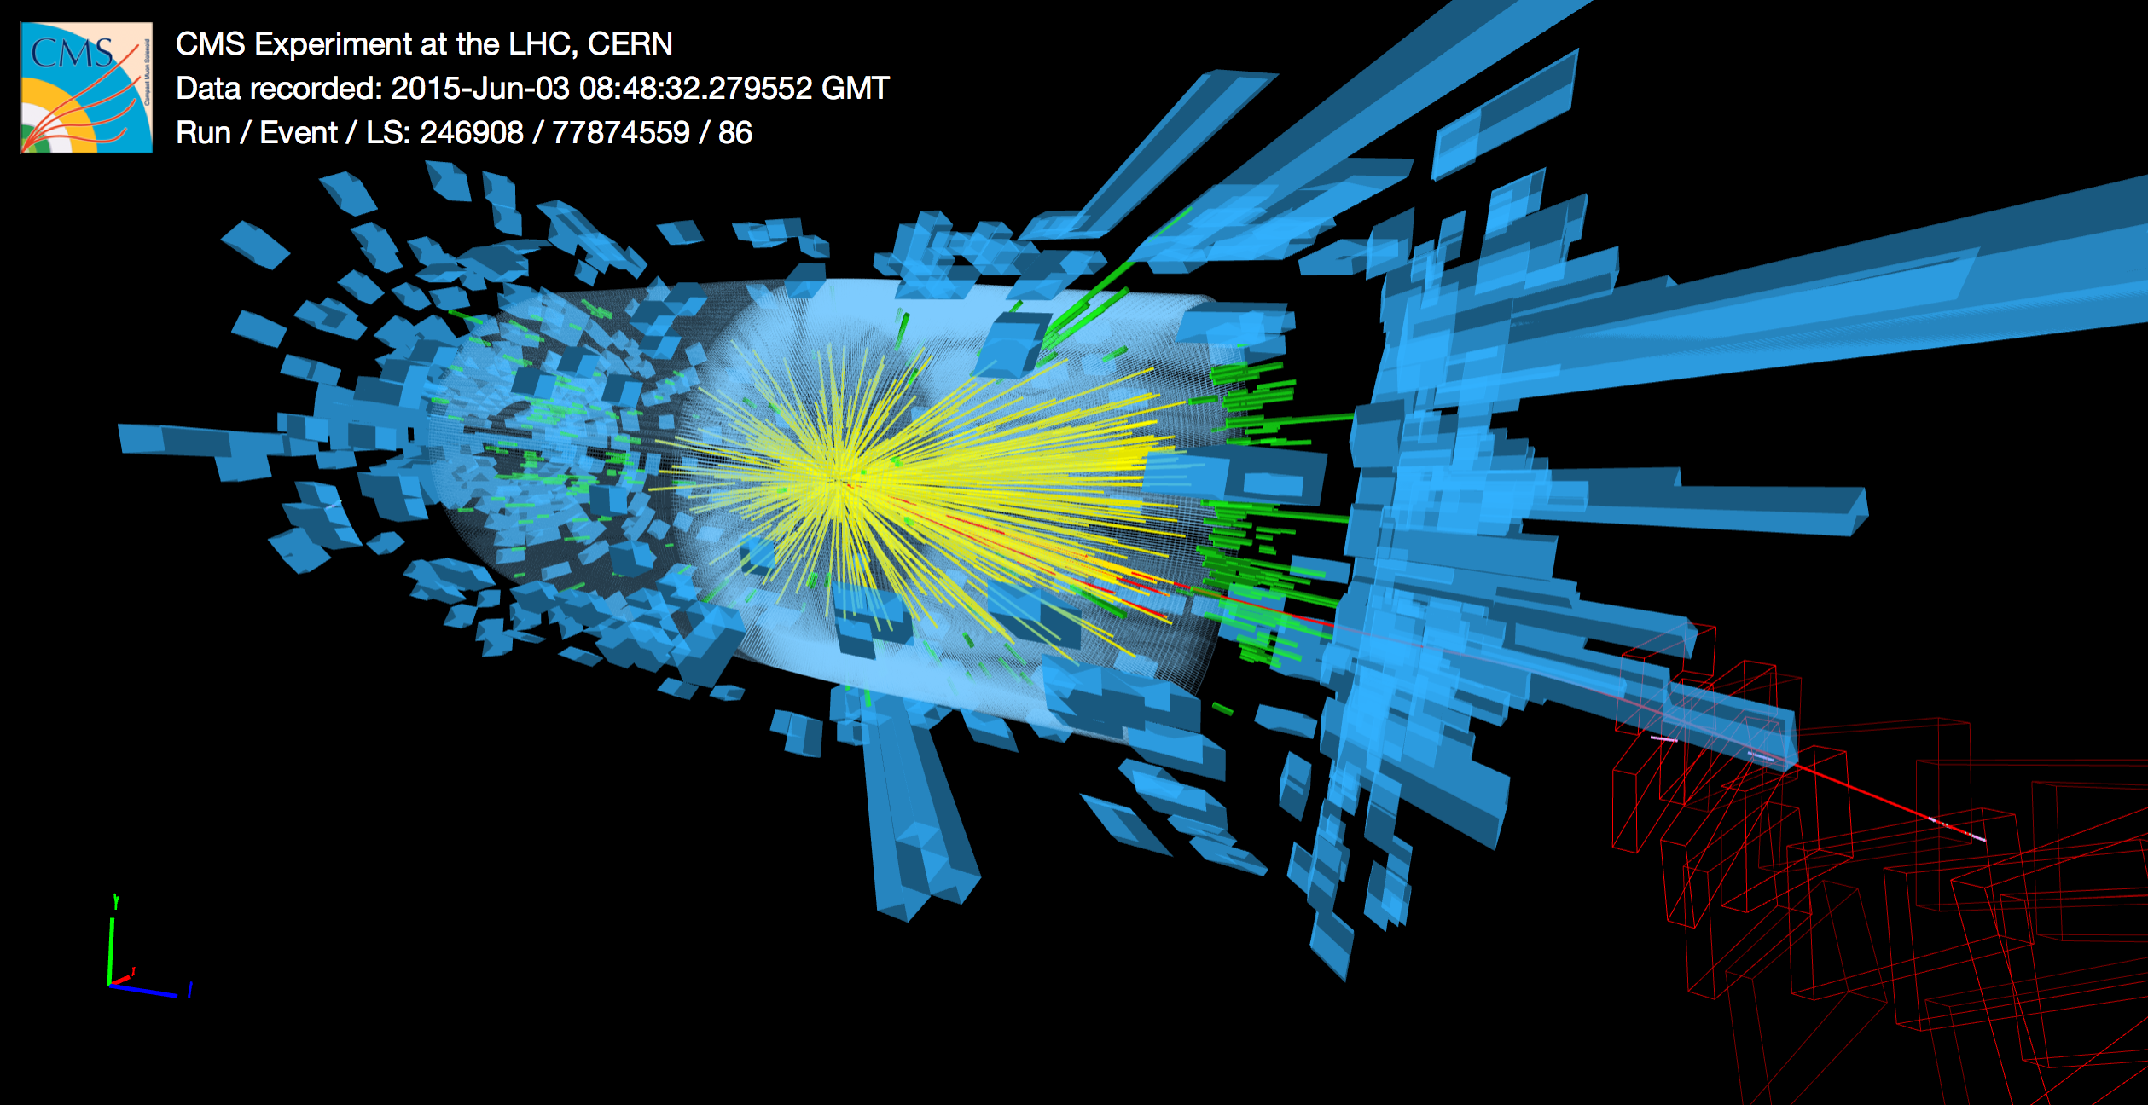
In Particle Physics

Slide 15
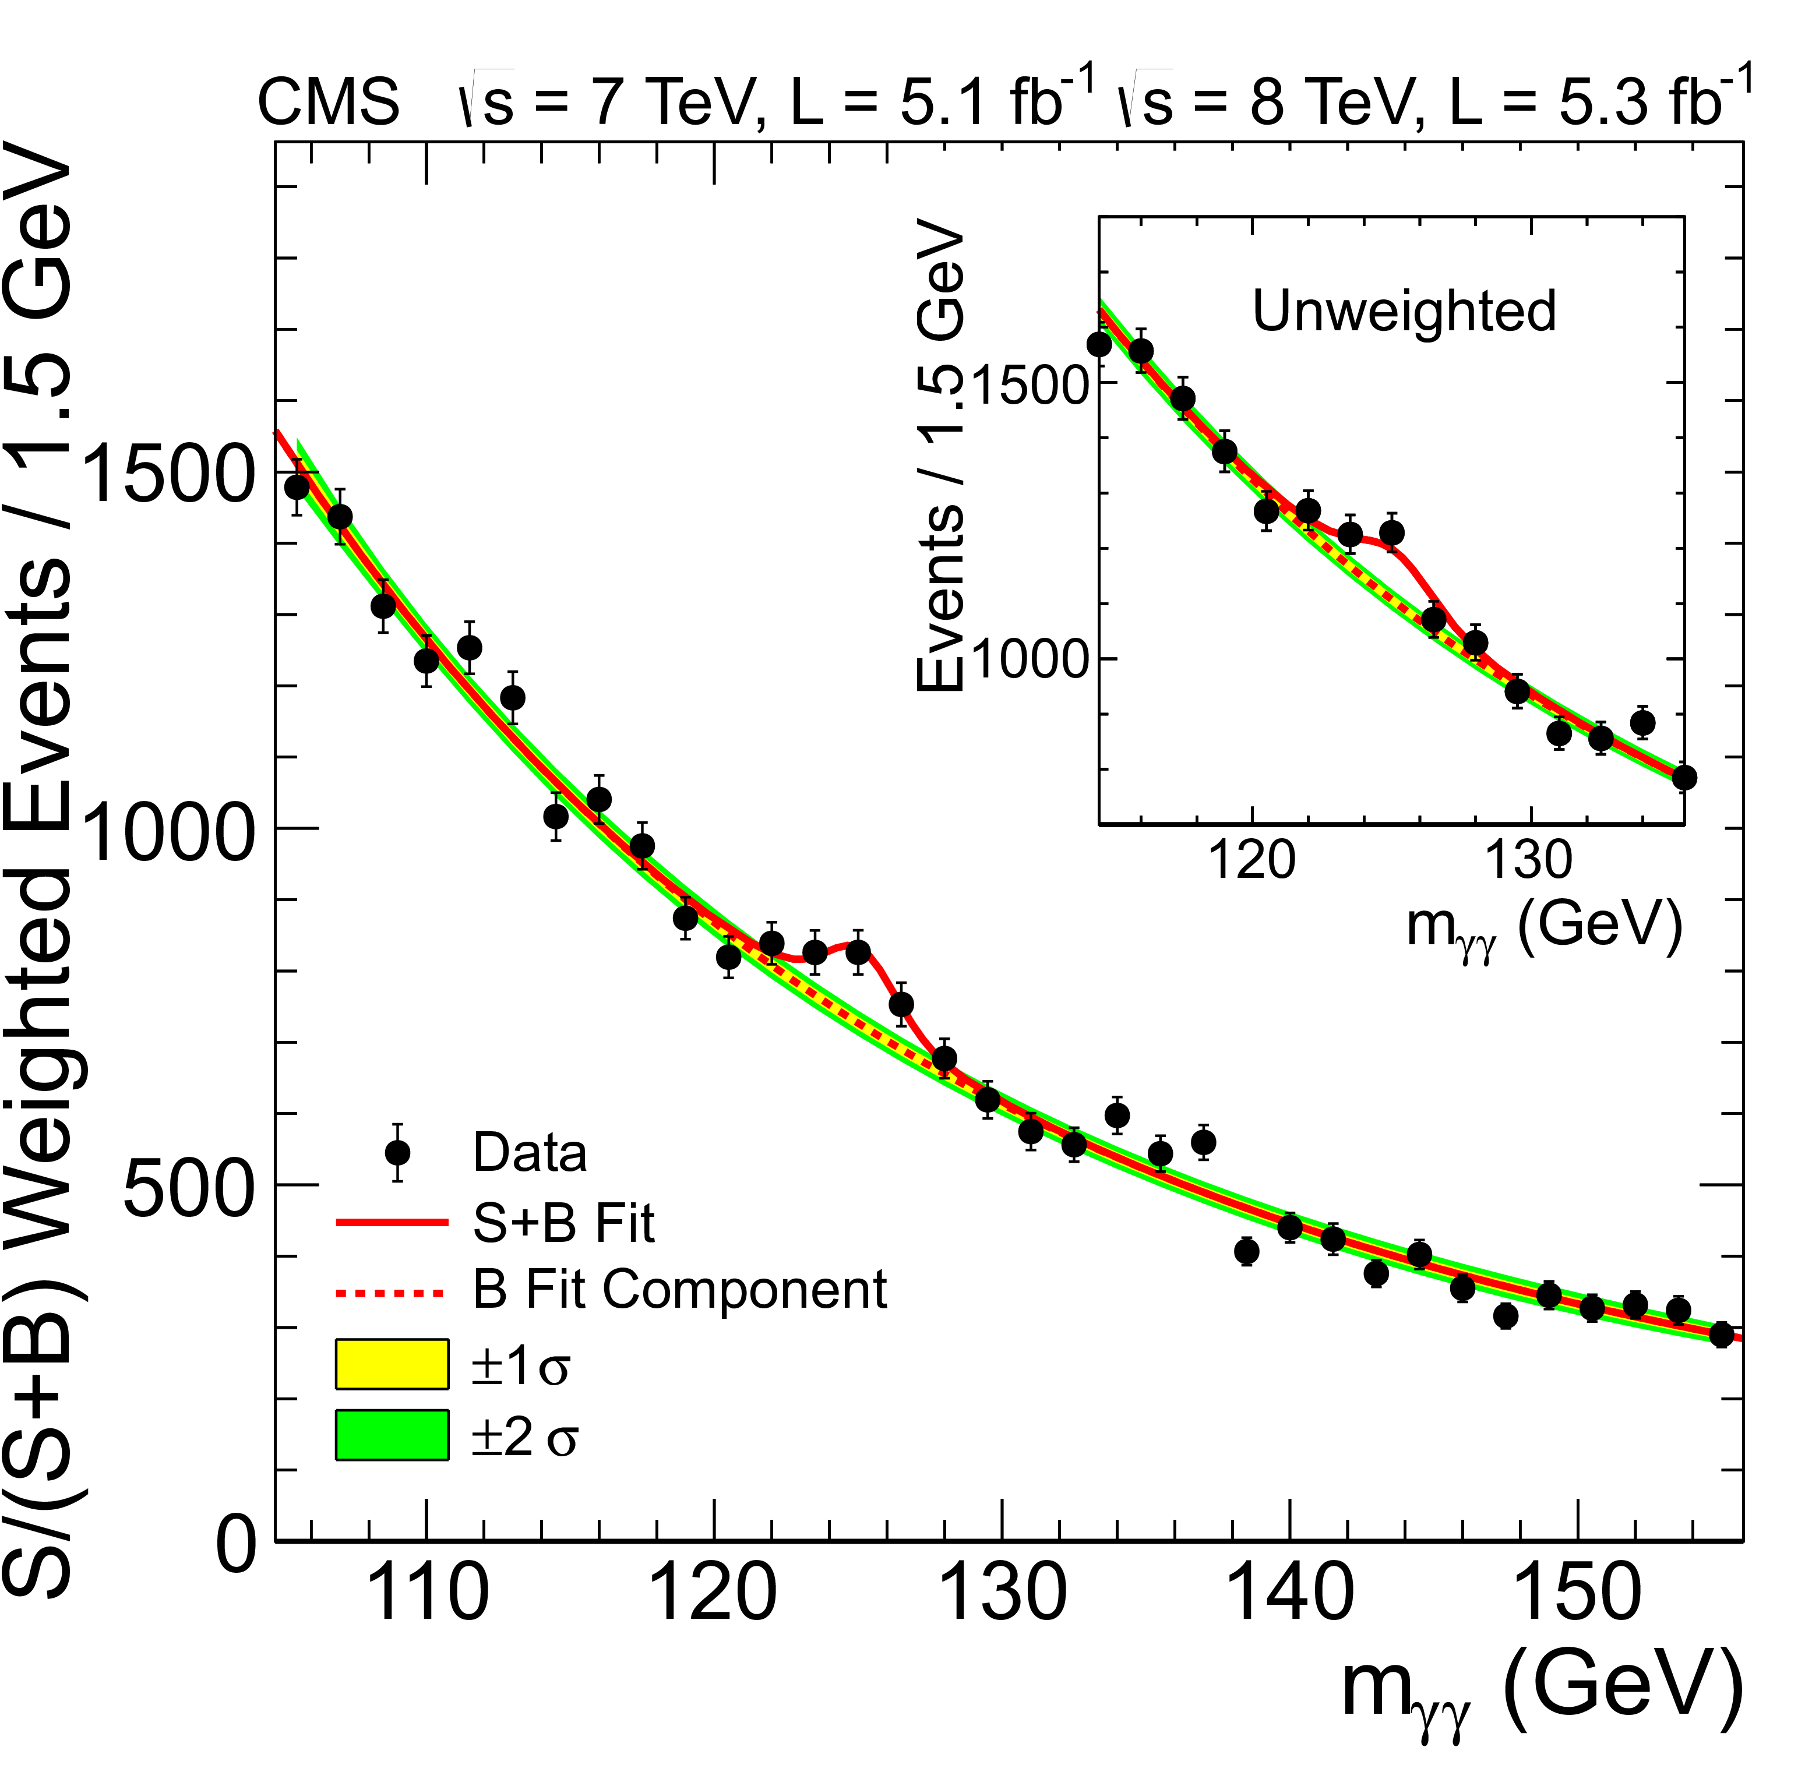
ML in HEP Today
Machine learning already at forefront of what we do:
Physics object identification
Event type classification
Object properties regression
Expanding quickly

Slide 16
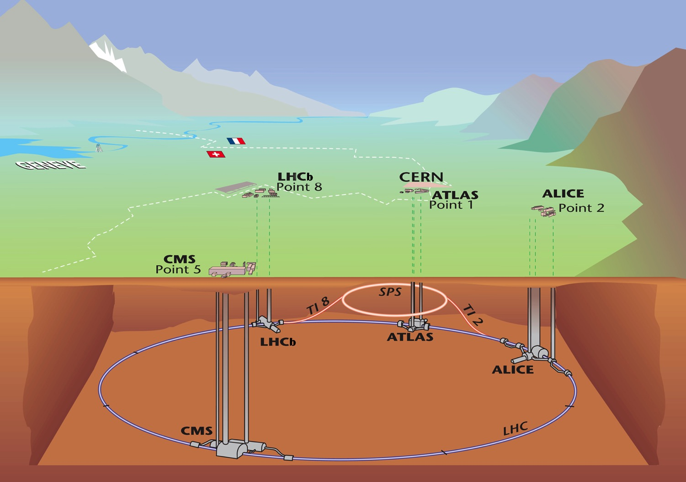

Large Hadron Collider
  17 miles in circumference
  Center of Mass Energy 13TeV

Slide 18


Slide 19
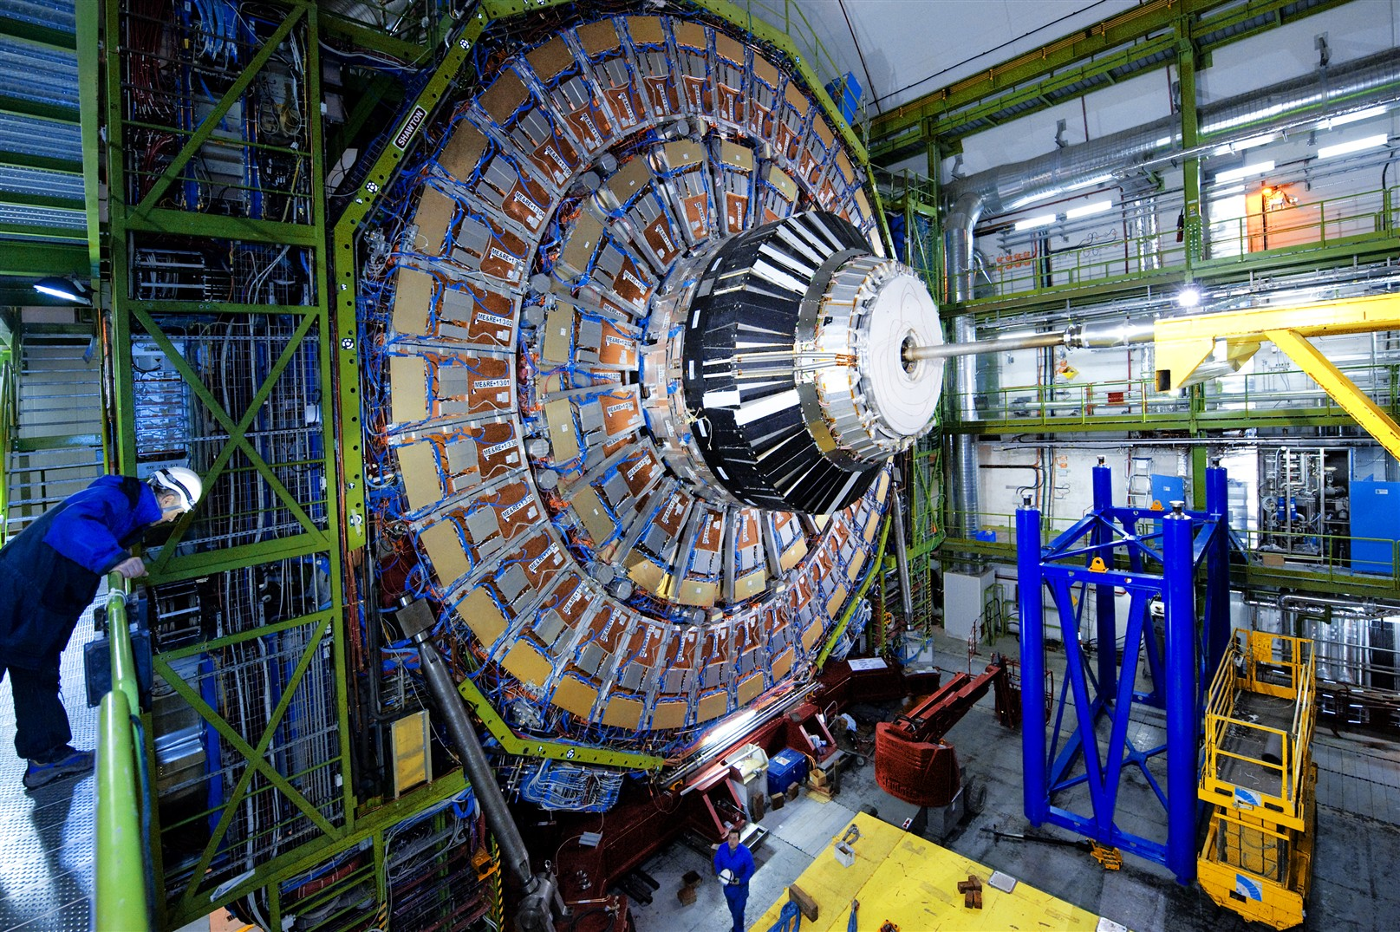

Slide 20
Applications
I. Classification
Particle Identification
Pattern Recognition (tracks)
Searches for New Physics
Data Quality Monitoring
II. Function estimation
Particle Properties
Regression

Slide 21

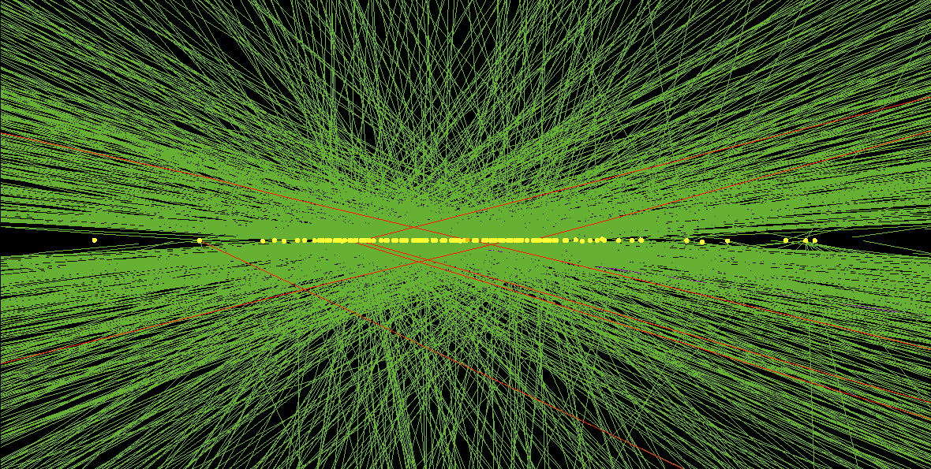
Present and Future Challenges
2

Slide 22
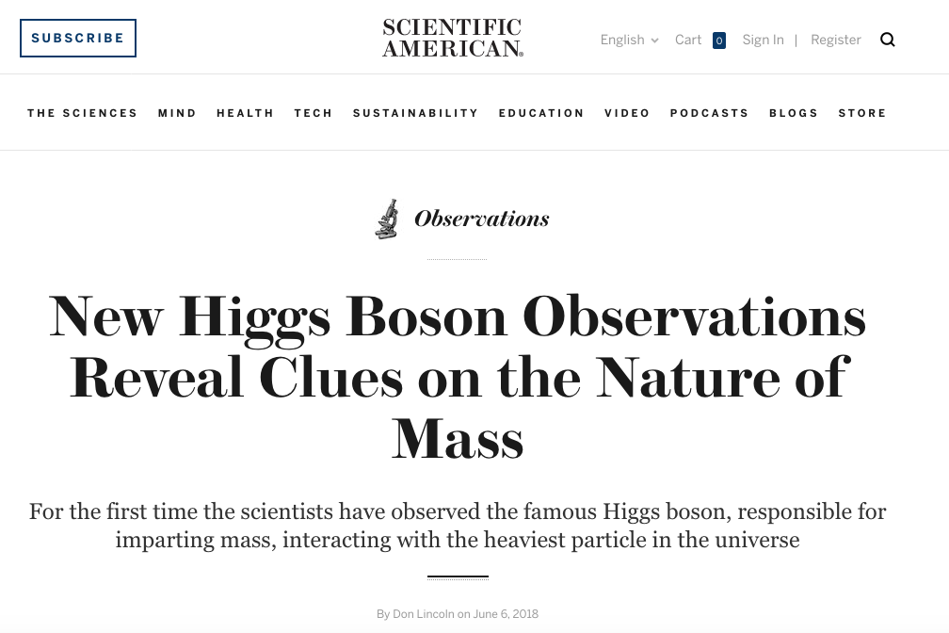
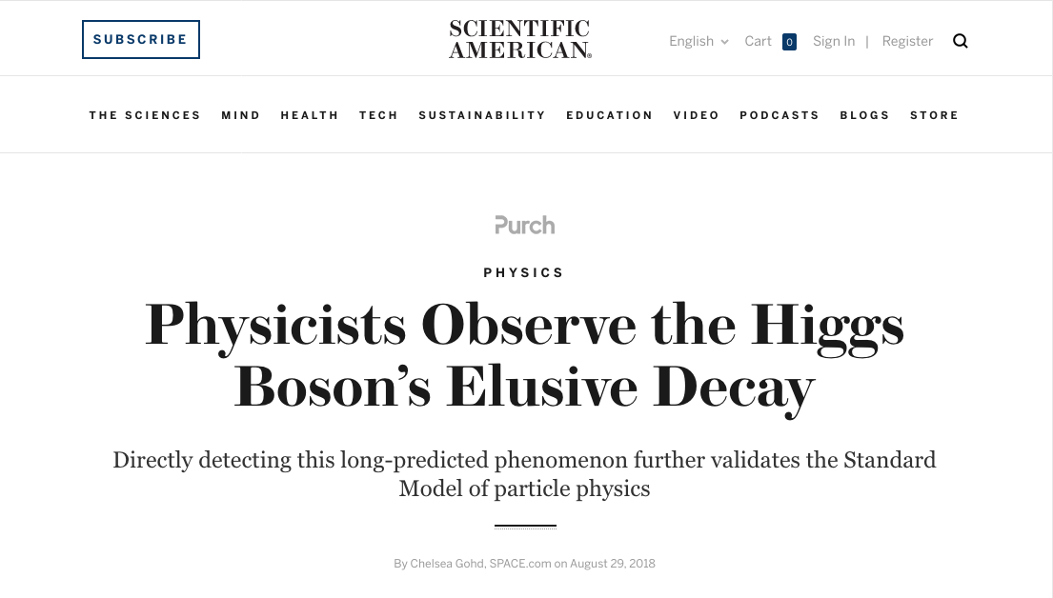
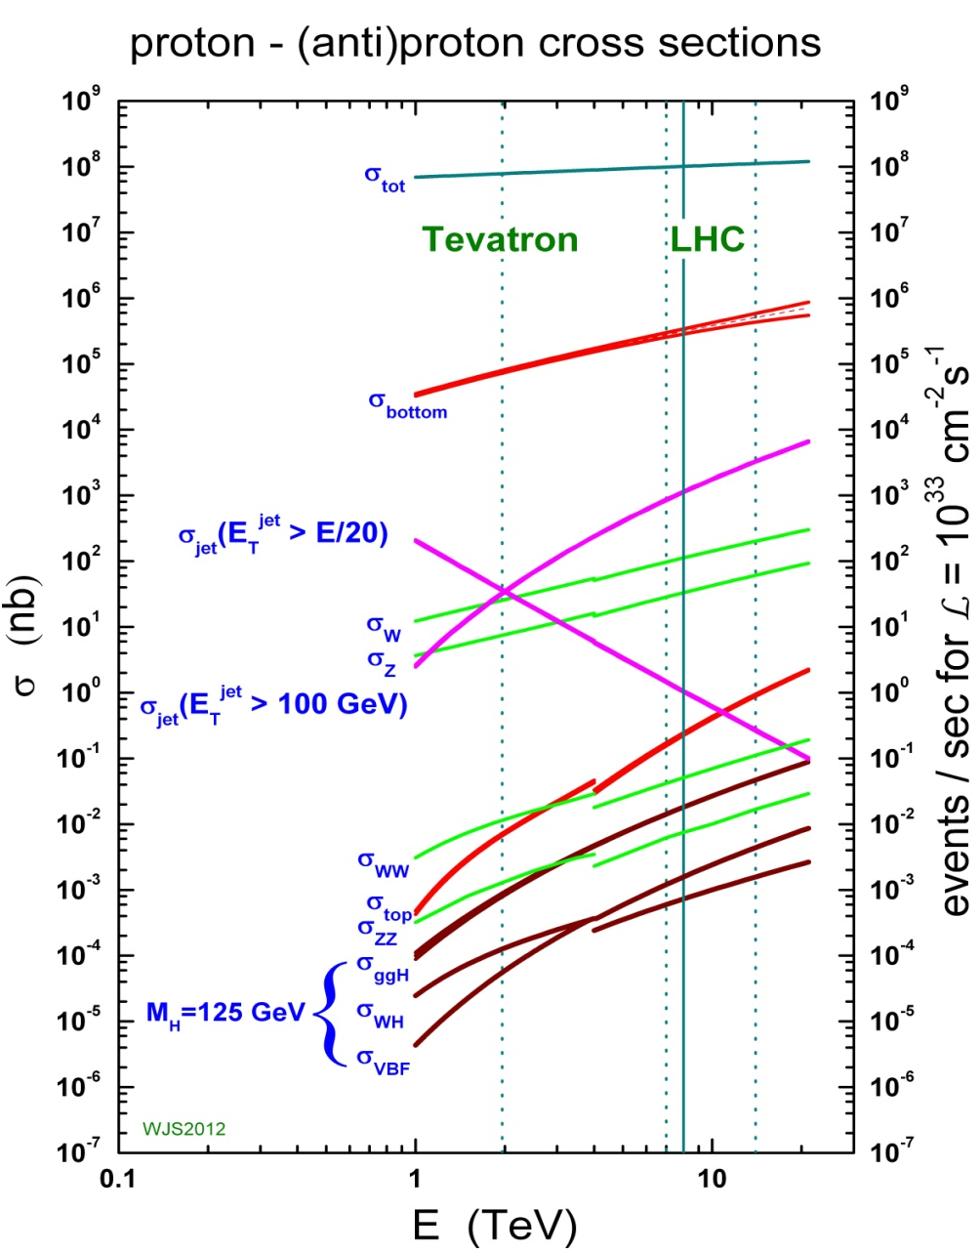
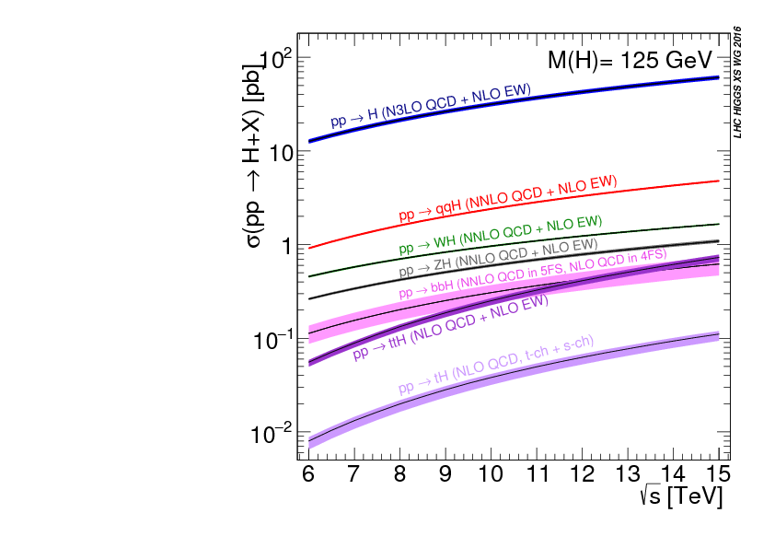
Multi-scale challenge
  Orders of magnitude between signals and backgrounds

Slide 23
Event Complexity

Slide 24
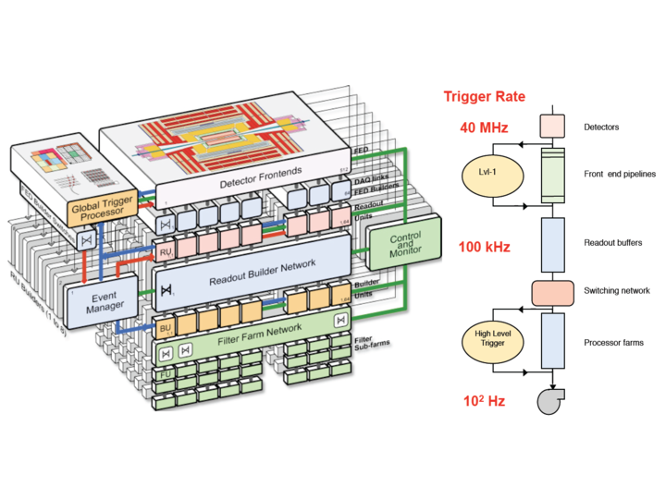
Trigger
10⁸ sensors

Slide 25
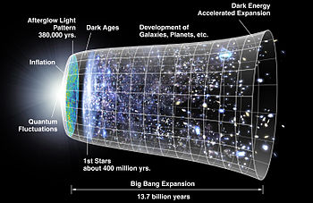
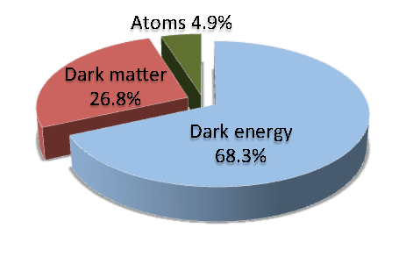
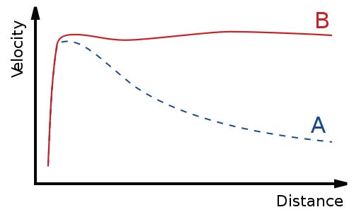
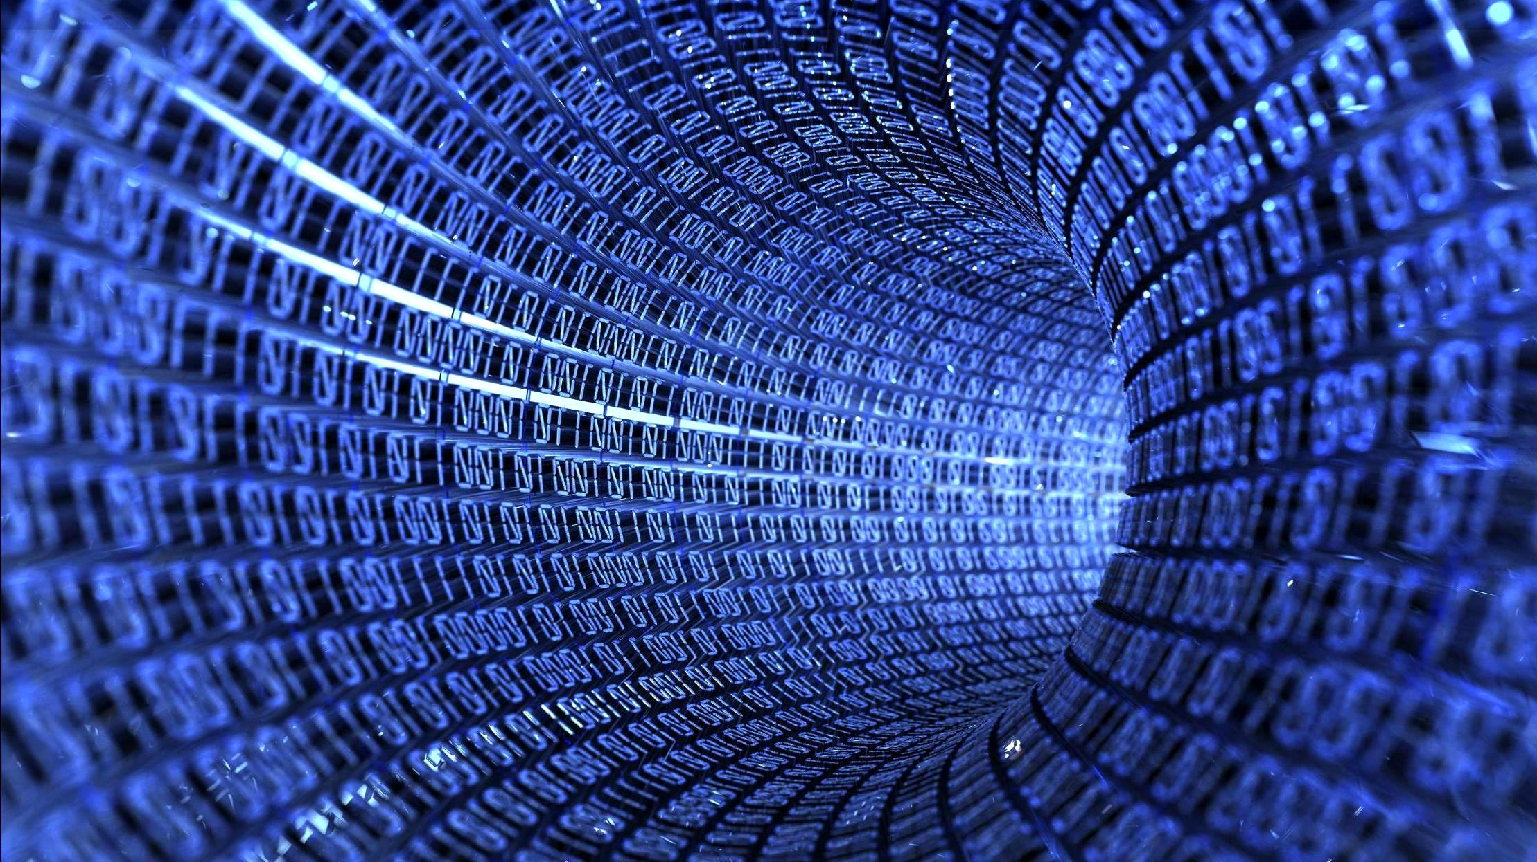
Upcoming Challenges
  Data size:
  LHC 15,000,000 Тb 2010 – 2035
  Resources not up as fast as data volume
Unknown Physics

Slide 26

3
3
HEP Applications

Slide 27
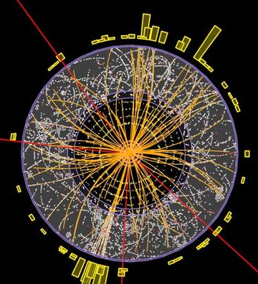
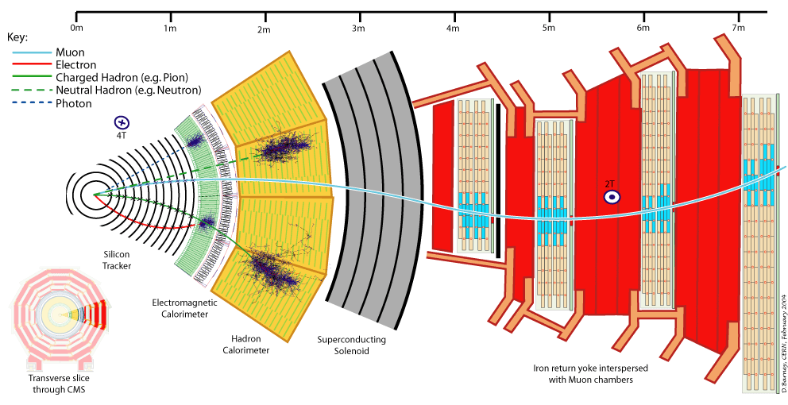
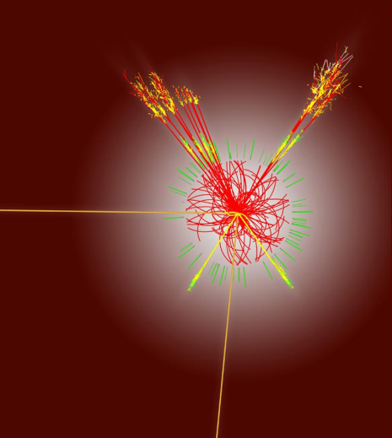
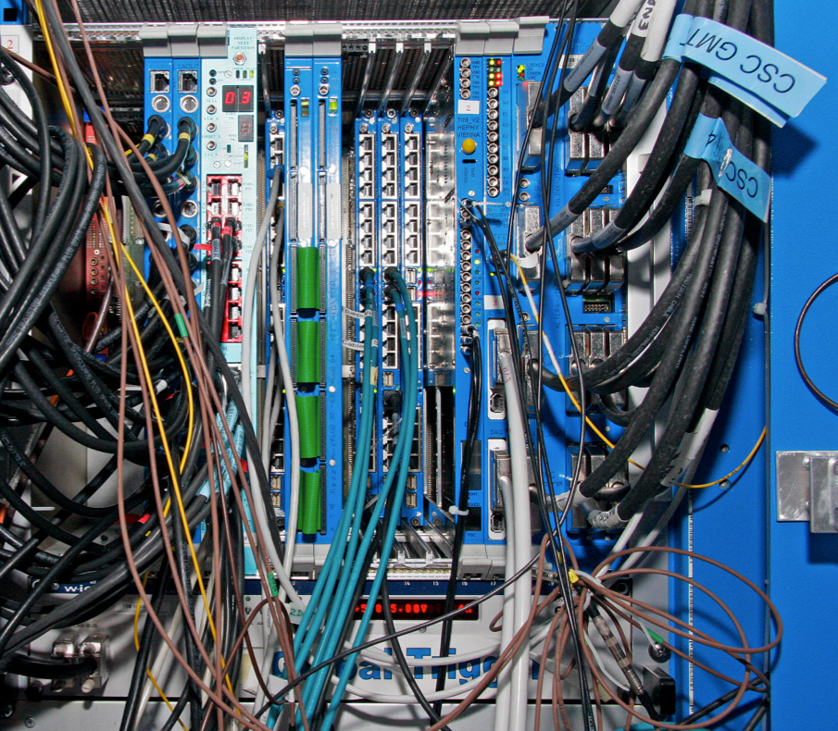
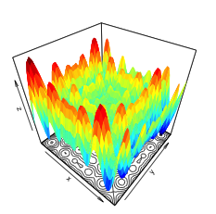
Interesting areas
Fast Event Simulation
Object Identification
Tracking
Trigger
Imaging Techniques
Simulation

Slide 28
Interesting areas
Deep Kalman,
LSTMs, GNN
Generative Models,
Adversarial Networks
FCN, Recurrent, LSTMs
Deep ML +FPGA
Convolutional NN
Multiobjective Regression

Slide 29
Defining the Problem
If a problem can be expressed as a known problem
Apply existing algorithms
  Example: convolutional neural networks from computer vision
If a problem has not been solved
Push the knowledge boundary forward

Slide 30
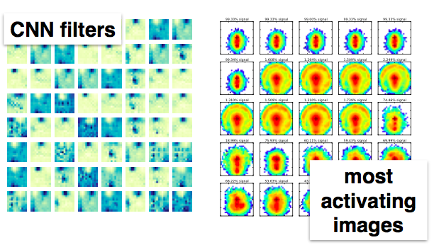
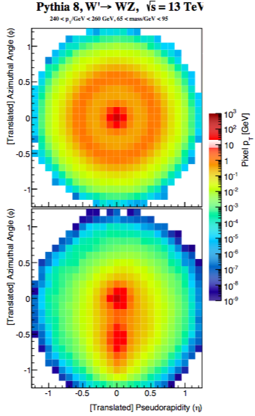
Early Examples
Jet images with convolutional nets
L. de Oliveira et al., 2015

Slide 31
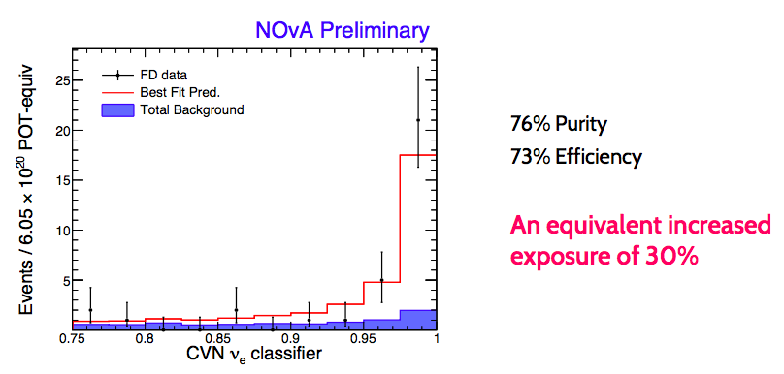
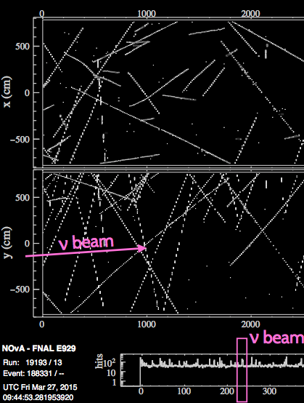

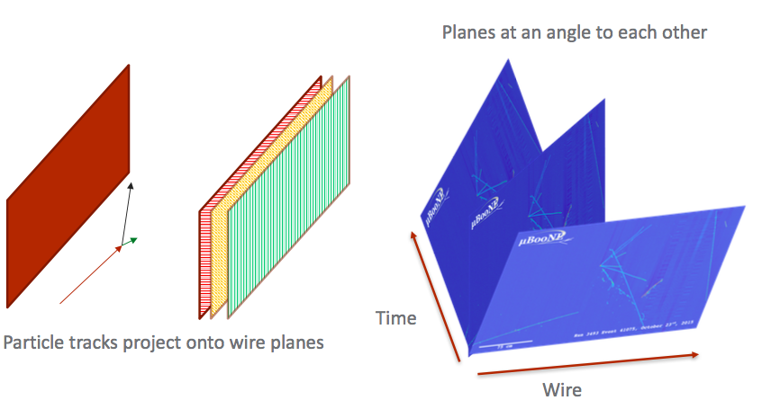
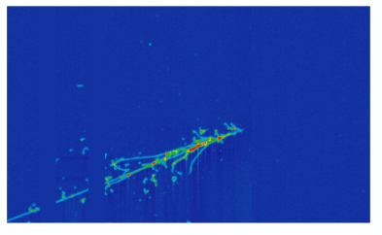
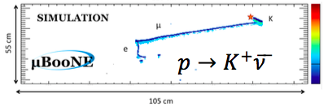
Examples
Neutrinos with convolutional nets
Aurisiano et al. 2016
μBooNE

Slide 32
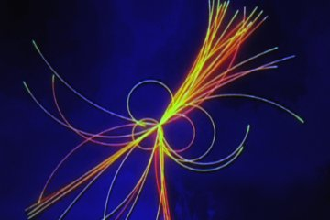
Tracking

Slide 33
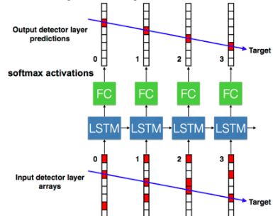
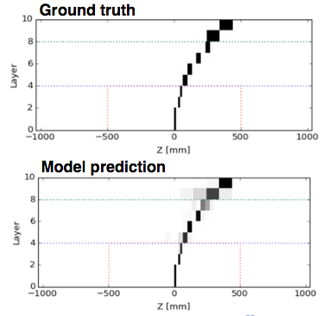
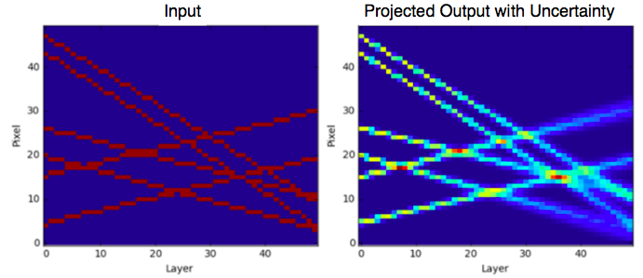
Examples
Tracking with recurrent nets (LSTM)
Time dimension
(state memory)
HEP.TrkX, CHEP 2018

Slide 34
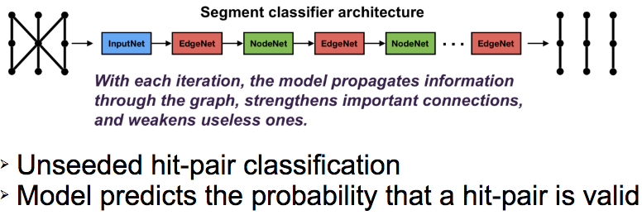
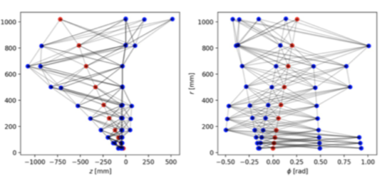
Examples
Tracking with Graph Neural Network
HEP.TrkX, CHEP 2018

Slide 35
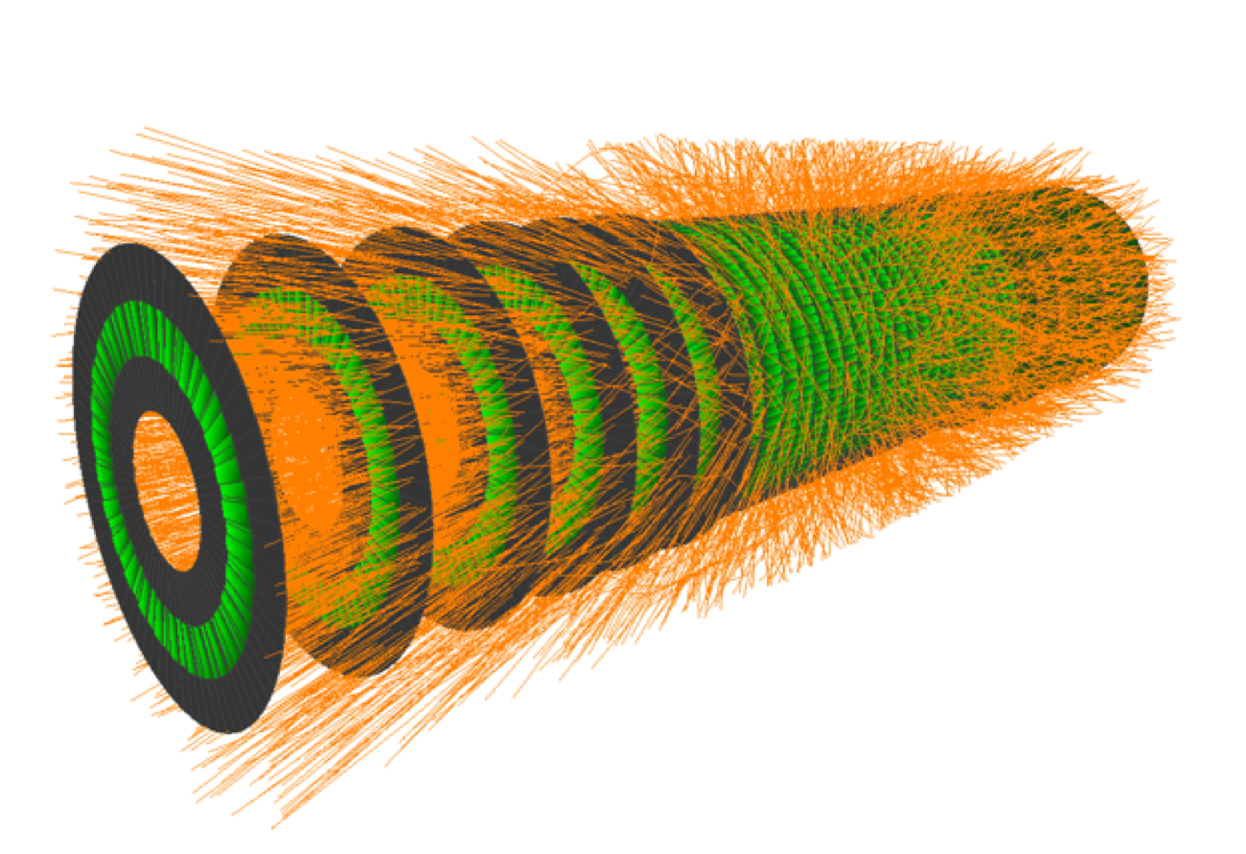
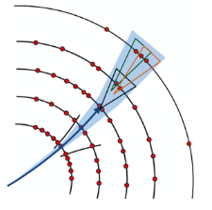
TrackML Challenge
https://www.kaggle.com/c/trackml-particle-identification

Slide 36
Meaningful Physics
Can we extract features with meaningful physics?
from low-level variables
Are we able to understand
ML models
physics interpretations

Slide 37
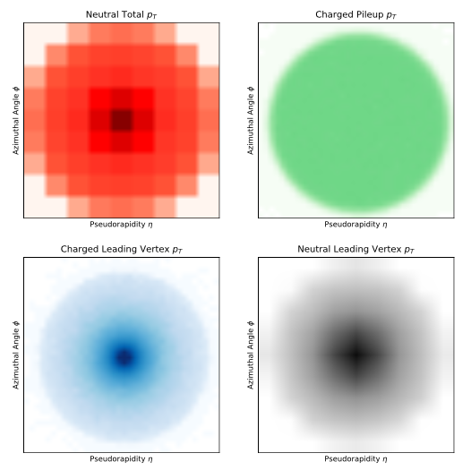
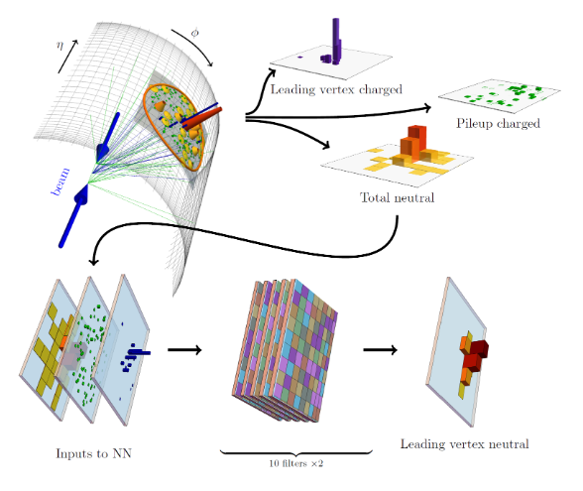
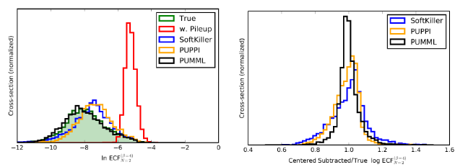
Meaningful Physics
Pile-up removal with CNN
Komiske et al., 2017

Slide 38
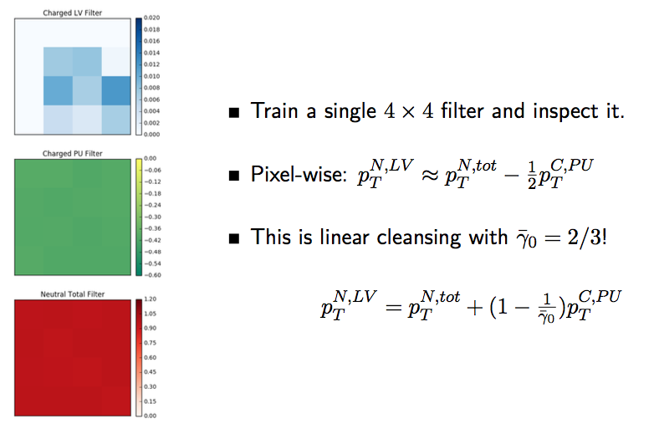
Meaningful Physics
Pile-up removal with CNN
What is learned?
Komiske et al., 2017

Slide 39
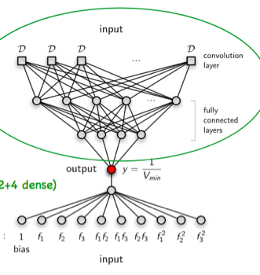
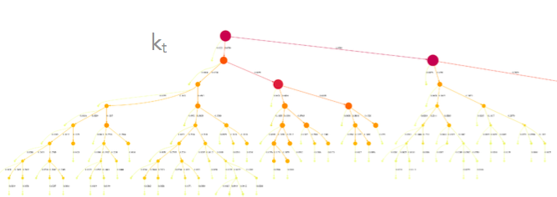
Defining the Problem
How to best use domain knowledge we have accumulated?
in designing the algorithms
Strings
Jet Images
Jet Clustering
Krefl, 2017
de Oliveira et al., 2015
Louppe et al., 2017

Slide 40
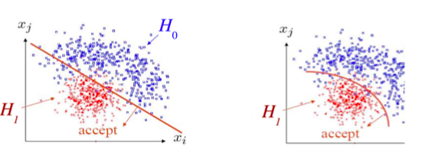
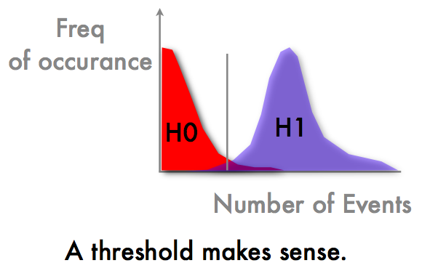

Uncertainties
Decision making

Slide 41


Uncertainties
G. Louppe et al., 2016 NNPDF Collaboration
Bayesian connection: Deep neural networks with drop-out approximate variational inference of Bayesian NNs: Gal and Ghahramani, 2016
Uncertainties matter

Slide 42

GANs

Slide 43

GANs
Generative Adversarial Networks

Slide 44





Simulation GANs
L. de Oliveira et al., 2017

Slide 45
Energy Regression
Inputs:
photon coordinates
photon shower information
median event energy
Target Output:
E_{MEASURED}/E_{TRUE}
10-30% improvement with shallow ML

Slide 46
Regression
Modify evaluation in induction algorithm
Maximum separation Minimal variance

Slide 47


Deep Learning Regression
Deeper
Higher
is better
Shallow

Slide 48







Online DQM
A. Pol et al., 2018

Slide 49
Real Time Application
Can we do ML in real-time?
ML: live video analysis, medical, self-driving cars
HEP Trigger Systems (software and hardware)

Slide 50





Trigger Applications
CMS L1
Belle II

Slide 51







ML on FPGA

Slide 52

GANs
VAEs
ADAM
Word2vec

Slide 53
Real Time Application
Can we do ML in real-time?
ML: live video analysis, medical, self-driving cars
HEP Trigger Systems (software and hardware)

Slide 54
ML on FPGA

Slide 55
Trigger Applications
CMS L1
Belle II

Slide 56






Tools

Slide 57
Summary
Introduction to machine learning theory, methods and applications
  Choose model based on the problem
  Experiment!
  Feature selection and extraction
  Uncertainty
  Emerging machine learning applications for fast inference in hardware

Slide 58
Multi-Objective Learning

Slide 59

Multi-Task Model

Slide 60
Multiple Targets
Multi-objective regressions:
Simultaneous estimate of several functions or targets
Use cases:
Fast nonparametric detector simulations
Learn complicated transformations

Slide 61
Example
14 input variables {a, b, c, d…}
  4 of them strongly correlated
14 target outputs to estimate {A, B, C, D…}
  4 of them strongly correlated
Challenge: build a predictive model to describe simultaneously all the outputs {A,B,C,D…}, provided a corresponding set of inputs.

Slide 62


Illustrative Example

Slide 63


Target Correlations
Target Correlations
Prediction-Target Difference
Very close to Zero

