Slide 1
Generative methods for Backgrounds
Suyong Choi
Korea University

Slide 2

Contents
Introduction: generating data-like distribution using GAN
Exercise with $b\overline{b}+γγ$
GAN as an interpolator for data-driven background estimation
Summary

Slide 3
Introduction
We are in an era where more statistics do not translate to better sensitivity. Systematic uncertainties must be reduced
Theoretical uncertainties
  Renormalization and factorization scale uncertainties- Multi-particle calculation has different mass scales and higher order calculation does not decrease the uncertainty to our desire
  Uncertainties from parton distribution functions
Experimental uncertainties
  Understanding the detector is the key
  Difference between data and simulation in detector response, resolutions etc.

Slide 4
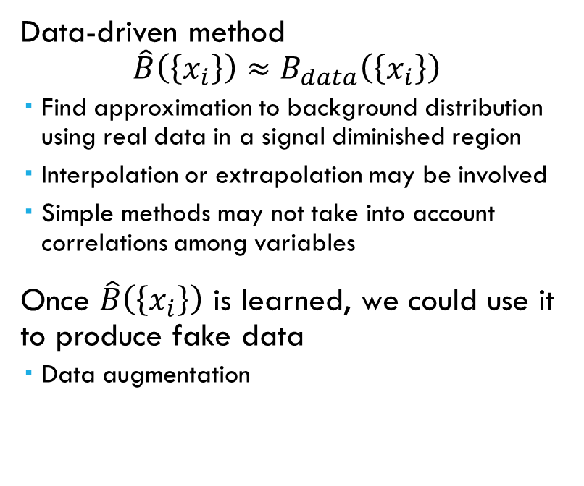
Data driven method for backgrounds
Data-driven approach used where
  Simulation of backgrounds with sufficient accuracy is not easy
  Background samples are difficult to produce in large quantity
Advantages
  Real detector response, resolutions, and efficiencies already in
  No theoretical uncertainty
Data-driven method
$\hat{B}\left(\left\{x_{i}\right\}\right)≈B_{data}\left(\left\{x_{i}\right\}\right)$
  Find approximation to background distribution using real data in a signal diminished region
  Interpolation or extrapolation may be involved
  Simple methods may not take into account correlations among variables
Once $\hat{B}\left(\left\{x_{i}\right\}\right)$ is learned, we could use it to produce fake data
  Data augmentation

Slide 5
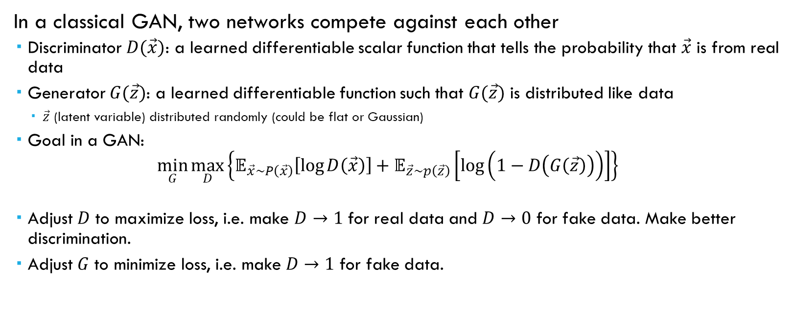
generative adversarial network (GAN)
In a classical GAN, two networks compete against each other
  Discriminator $D(\vec{x})$: a learned differentiable scalar function that tells the probability that $\vec{x}$ is from real data
  Generator $G(\vec{z})$: a learned differentiable function such that $G(\vec{z})$ is distributed like data
    $\vec{z}$ (latent variable) distributed randomly (could be flat or Gaussian)
  Goal in a GAN:
  $\min_{G}{\max_{D}\left\{𝔼_{\vec{x}\sim P\left(\vec{x}\right)}\left[\log{D\left(\vec{x}\right)}\right]+𝔼_{\vec{z}\sim p\left(\vec{z}\right)}\left[\log\left(1−D\left(G\left(\vec{z}\right)\right)\right)\right]\right\}}$
  Adjust $D$ to maximize loss, i.e. make $D→1$ for real data and $D→0$ for fake data. Make better discrimination.
  Adjust $G$ to minimize loss, i.e. make $D→1$ for fake data.

Slide 6

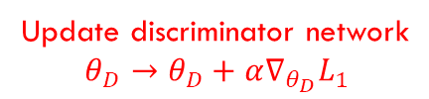

How GAN works
Original GAN (arXiv:1406.2661)
Update generator network
$$θ_{G}→θ_{G}−α∇_{θ_{G}}L_{n}$$
Generator
Generator
Discriminator
Step 1
Discriminator
Step 2
repeat
Discriminator
Step n
fake
fake
real
real
Real data
Real data
Update discriminator network
$$θ_{D}→θ_{D}+α∇_{θ_{D}}L_{1}$$
$$θ_{D}→θ_{D}+α∇_{θ_{D}}L_{n−1}$$

Slide 7
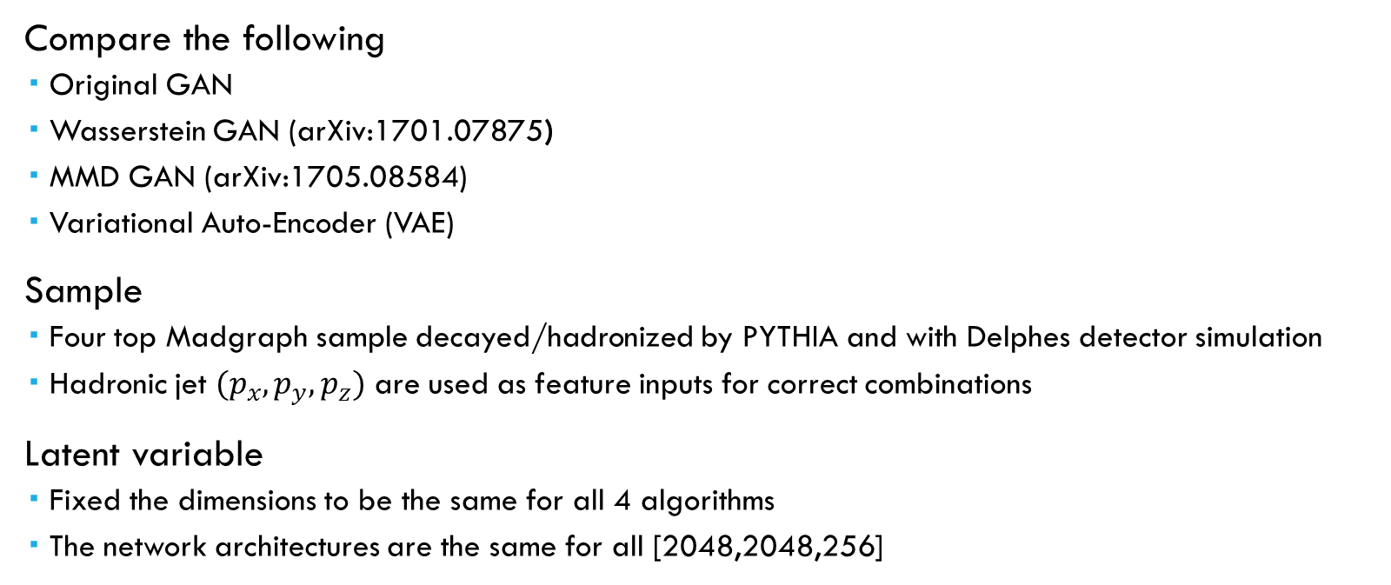
A case study
Compare the following
  Original GAN
  Wasserstein GAN (arXiv:1701.07875)
  MMD GAN (arXiv:1705.08584)
  Variational Auto-Encoder (VAE)
Sample
  Four top Madgraph sample decayed/hadronized by PYTHIA and with Delphes detector simulation
  Hadronic jet $(p_{x},p_{y},p_{z})$ are used as feature inputs for correct combinations
Latent variable
  Fixed the dimensions to be the same for all 4 algorithms
  The network architectures are the same for all [2048,2048,256]

Slide 8
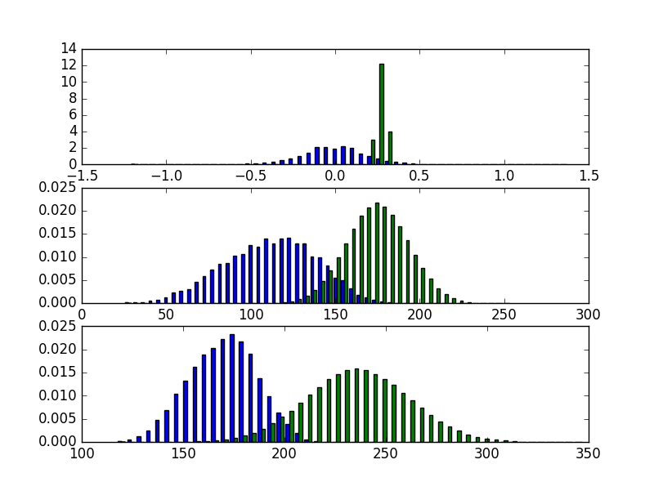
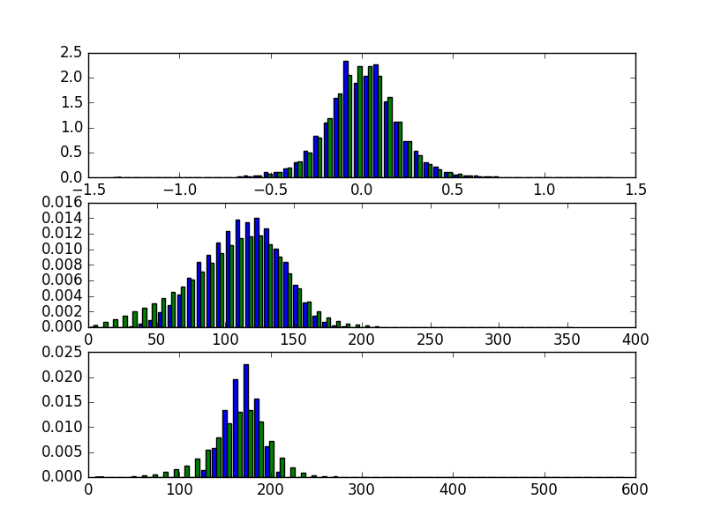
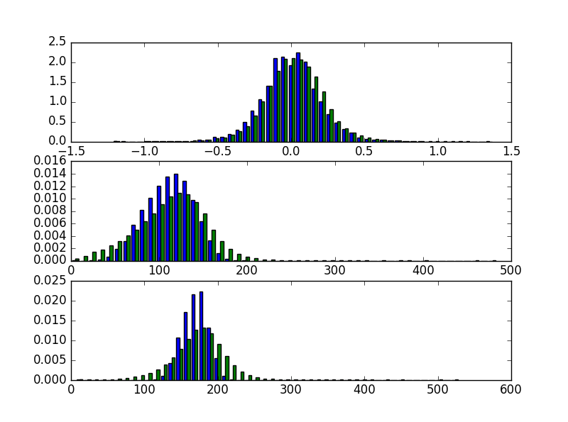
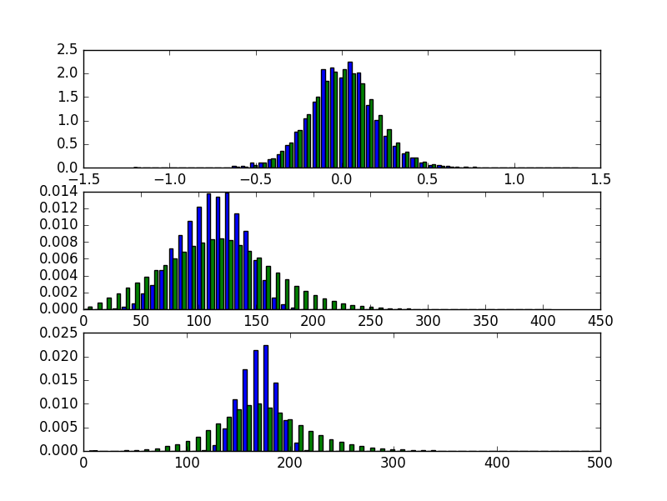
Comparisons
Original GAN
Wasserstein GAN
MMD GAN
VAE

Slide 9
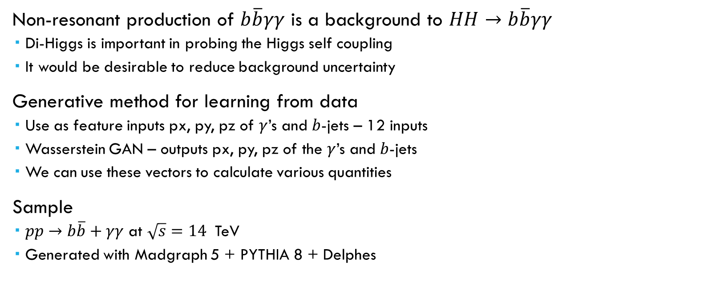

Exercise with $b\overline{b}γγ$
Non-resonant production of $b\overline{b}γγ$ is a background to $HH→b\overline{b}γγ$
  Di-Higgs is important in probing the Higgs self coupling
  It would be desirable to reduce background uncertainty
Generative method for learning from data
  Use as feature inputs px, py, pz of $γ$’s and $b$-jets – 12 inputs
  Wasserstein GAN – outputs px, py, pz of the $γ$’s and $b$-jets
  We can use these vectors to calculate various quantities
Sample
  $pp→b\overline{b}+γγ$ at $\sqrt{s}=14$ TeV
  Generated with Madgraph 5 + PYTHIA 8 + Delphes

Slide 10
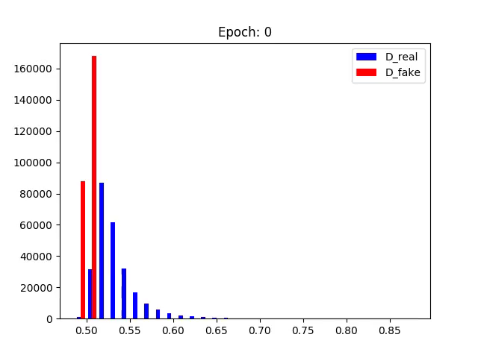
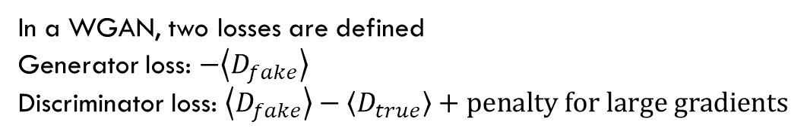
Training In WGAN
In a WGAN, two losses are defined
Generator loss: $−\left\langle D_{fake}\right\rangle$
Discriminator loss: $\left\langle D_{fake}\right\rangle −\left\langle D_{true}\right\rangle +penalty for large gradients$
Discriminator and generator, each a
DNN with [2048, 2048, 256] hidden nodes

Slide 11
Generated data vs Trained data
Generated
Training

Slide 12
Generated Data vs Trained Data
We can combine several generators together for a better performing generator
Overall correlations can be reproduced
Still, “sharp” features not reproduced and smoothing occurs

Slide 13
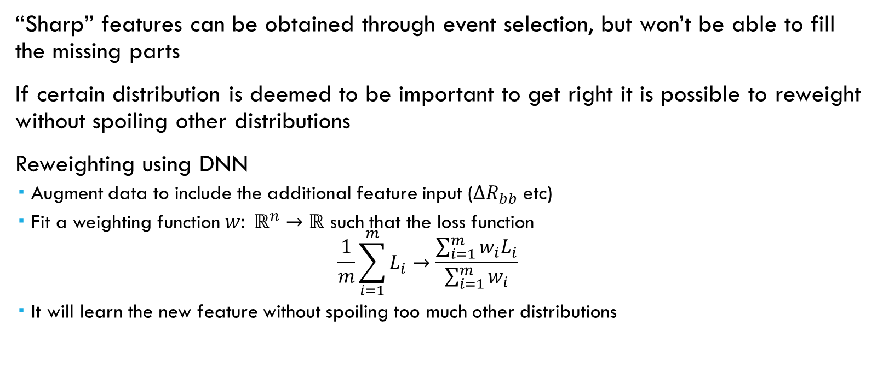
Reweighting
“Sharp” features can be obtained through event selection, but won’t be able to fill the missing parts
If certain distribution is deemed to be important to get right it is possible to reweight without spoiling other distributions
Reweighting using DNN
  Augment data to include the additional feature input ($ΔR_{bb}$ etc)
  Fit a weighting function $w: ℝ^{n}→ℝ$ such that the loss function
  $\frac{1}{m}\sum_{i=1}^{m}{L_{i}}→\frac{\sum_{i=1}^{m}{w_{i}L_{i}}}{\sum_{i=1}^{m}{w_{i}}}$
  It will learn the new feature without spoiling too much other distributions
Event weight
distribution

Slide 14
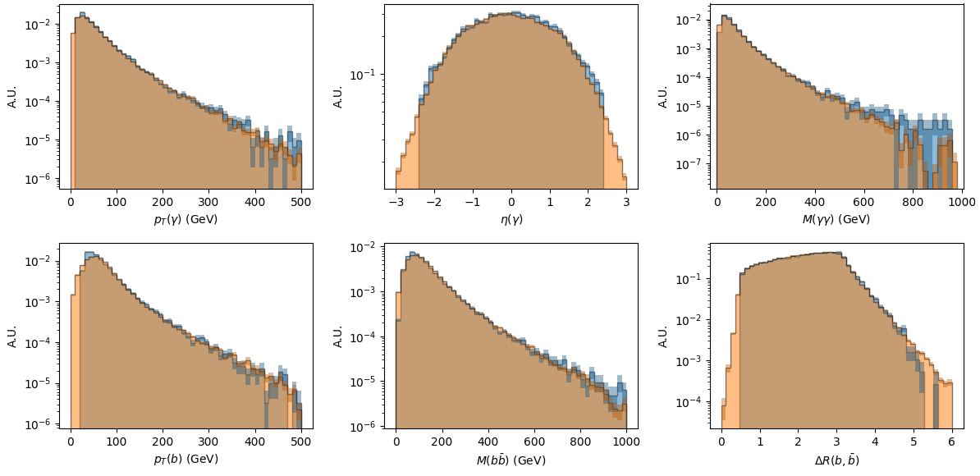
Reweighted
Reweighting in multidimensional space

Slide 15
Generative method
Data-driven background estimation

Slide 16
Can DNN Interpolate/Extrapolate ?
In data-driven background estimation methods we frequently need to interpolate or extrapolate
  Data in signal deficient or background dominant region used
  In a side-band method – interpolation to signal region from surrounding region
Seeing that DNN tries to smooth sharp distributions, can it interpolate?

Slide 17
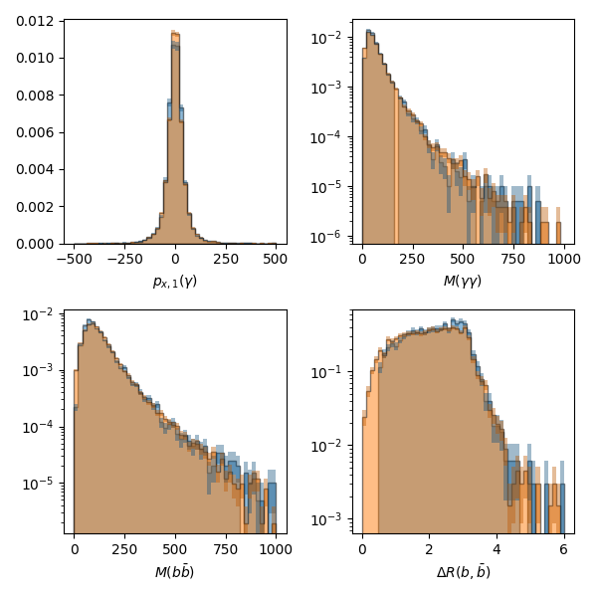

Removing one bin for training
True distribution
overlaid

Slide 18
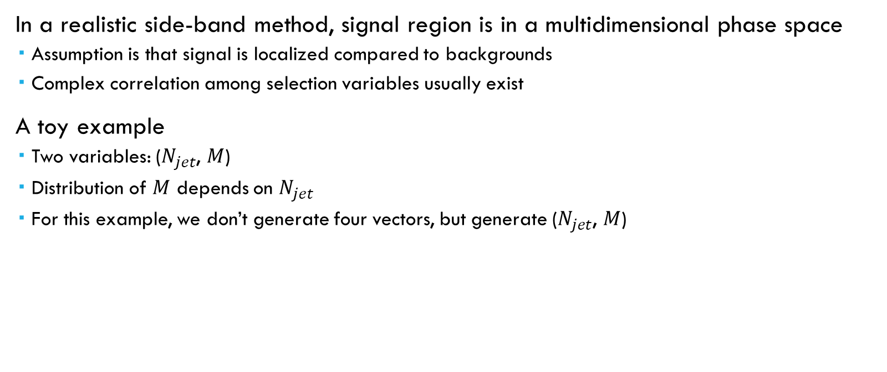
Complex Sideband method
In a realistic side-band method, signal region is in a multidimensional phase space
  Assumption is that signal is localized compared to backgrounds
  Complex correlation among selection variables usually exist
A toy example
  Two variables: ($N_{jet}$, $M$)
  Distribution of $M$ depends on $N_{jet}$
  For this example, we don’t generate four vectors, but generate ($N_{jet}$, $M$)

Slide 19
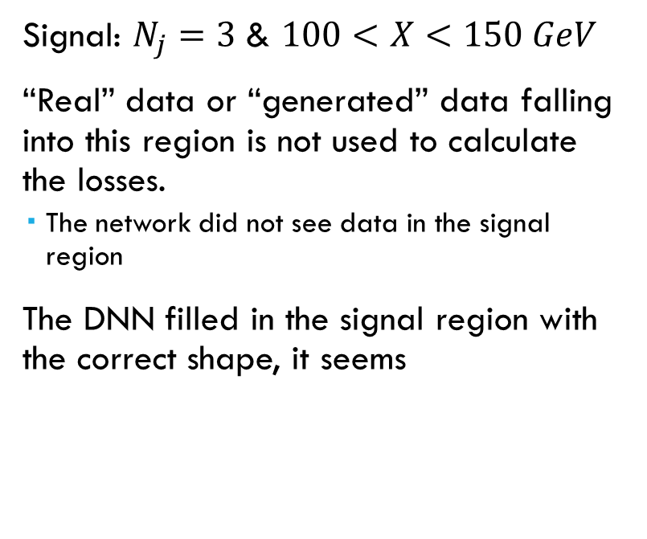


Testing GAN as an interpolator
All data
All data
Signal: $N_{j}=3$ & $100<X<150 GeV$
“Real” data or “generated” data falling into this region is not used to calculate the losses.
  The network did not see data in the signal region
The DNN filled in the signal region with the correct shape, it seems
$$N_{j}=3$$
$$N_{j}=3$$

Slide 20
Summary
Generative methods usage for HEP explored
Generating fake data
  Momentum vector components as feature. And correlations among feature inputs reasonable
  WGAN training seems work well for this purpose
  Can be used for data augmentation
Background estimation by interpolation
  Data-driven estimation by DNN
  Possibly could be used for multi variables case
  Toy example indicates it works

