Slide 1
Taking accelerator’s references
BCWG#13 – Aug. ^{31st} 2018

Slide 2
Reference ?
Header
Beam characteristics (Particle type, optic, integer tune part, etc…)
TGM User Name
LSA/Inca context name
Etc…
Data
Screenshots
Set of LSA/Inca settings
JAPC Acquired Parameter Values
Oasis signals
Extra type of data (Java object or external files?)
Tags/Keyword

Slide 3
Requirement
Capture a set of relevant data
Grouped by beam specifications
Characterised with deterministic keywords
Timestamped
Support for multiple formats (java objects)
Simple Java-API that can be added to any application
Check-list to ensure all required data is present
Ability to reload reference data
Directly from the application it has been taken
Immediate comparison with real-time

Slide 4
Implementation
eLogbook-like infrastructure
Oracle database
Application server
Java client for API and browser tool (development ongoing)
Web page for browsing (implementation to come later)
Oracle Application Server
Java API
Java applications
References Java UI
eLogbook-Refs DB
Web client

Slide 5
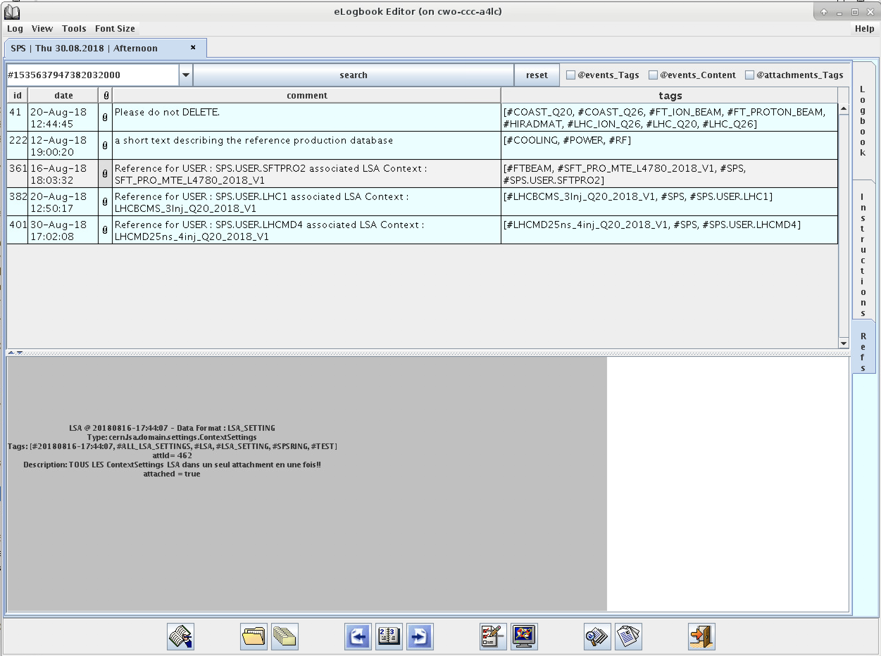
Principle
From eLogbook U.I.
One entry per reference
Header with beam definition and meta-data (to be completed)
Tags to ease identification and search process
Attachments linked to the reference
ANY kind of object
Tags

Slide 6
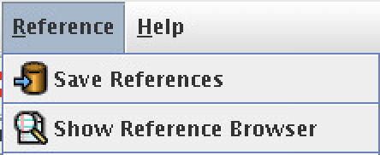
Principle (II)
From operational applications
A simple Java API with only 1 line of code “SpsReferencesApp.saveReference(…)”
Saving and tagging process included
Window for reference selection included
GUI components to integrate shall be available soon

Slide 7
Project status & perspectives
Works now
Saving mechanism and API are operational
Browsing available via eLogbook
Advanced java search methods for retrieving data available
In progress
Generic U.I. for reference capture (screenshot, file import).
Checklist and reference completion tool
Tags definition AND requirement identification for checklist by accelerator

Slide 8
More?
Web based solution for browsing and search
Study available technologies from eLogbook team
Spring rest, elastic search [etc…]
Depending on previous progression, might move out from database driven solution.
Offline accelerator data storage?

Slide 9
Conclusion
Reference
Simple
Configurable
Supports multiple data format
In progress
Storage solution available
More tools to come
Need feedback and return from experience

Slide 10
Conclusion (ii)
Need your input
Tags and checklist
Experience
New ideas?
Thanks a lot to operators and EIC for their help and their work DESPITE their own workload and being on shift
J.C. Dumont
K. FuchsBerger
R. Maillet

Slide 11
Thank you for your attention
It’s almost week-end!

Slide 12
Questions

Slide 13
F.A.Q
Why this project does not use Logging / Timber?
Need to store pictures / files / Java object
Timber search is mostly timestamp driven -> no keyword / tags to help search
Why not CO / NxCals?
NXCALS architecture would meet most of our requirement
Project not ready, data persistency was not guaranteed
CO would not commit into giving support before end of LS2
Can I use python?
Web-based solution so, nothings opposes the use of any other language, but you’ll have to do it yourself.

