Slide 1
Accelerator issues – discussion points
Erik Adli, Steinar Stapnes
Two aspects addressed:
  One: What accelerators are being prepared (world-wide) where the Norwegian community is or could be involved (Steinar) ?
    How are they/can they be related to the European Strategy and “our” national CERN programme ?
  Two: What are the natural next goals for the thriving Norwegian accelerator activities (Erik) ?
    Are there links to potential Norwegian installations in the coming decade ?
In red – points worth mentioning in a Norwegian European Strategy Update (ESU) document (for discussion)
1

Slide 2
The CERN complex/programme is well defined for the coming ~decade
LHC running, HiLumi is being constructed -> perspective for physics ~2035 (at least)
Fixed target, AD, ISOLDE, etc -> we are in ISOLDE and AEGIS
Several R&D opportunities for e+e- machine studies in CLEAR, AWAKE, etc -> we are in both – some uncertainty on how these evolve but likely to remain for quite some years
Our current Norwegian programme is well anchored in these facilities (make a sub-point about value of small acc. facilities for R&D)
Studies for new facilities, what is new since last Strategy Update:
With no BSM guidance not obvious choice – a tendency to wait for more LHC and HiLumi data for big decisions ?
Is BSM physics necessarily best accessed at the Energy Frontier (is higher energy our highest or only priority) – a tendency towards e+e- for detailed SM and “creative” lower energy precision measurements and searches (neutrino and flavour physics already pursuing this avenue)
Competing projects in Japan and China (SM with e+e-) that can be implemented faster than CERN can (more slide 4)
2

Slide 3
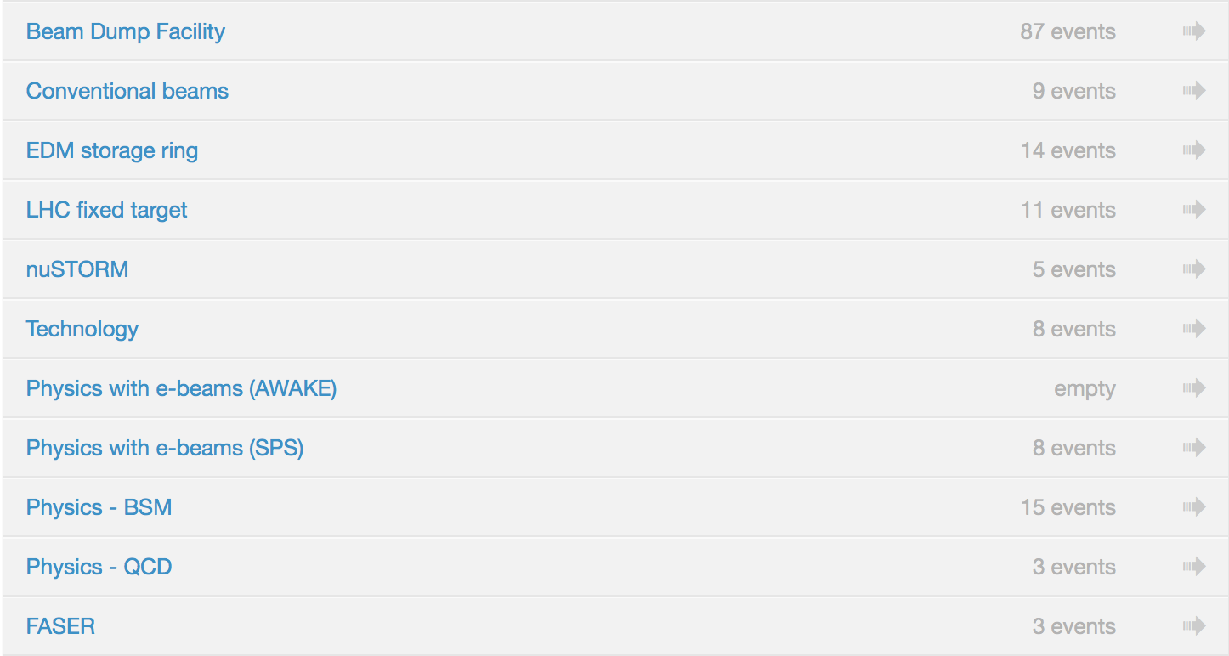
CLIC and High Energy LHC possible as next machine, FCC maybe later ( costs very high and timescales very long) – other ideas also on table (LHeC, plasma (beyond AWAKE), muons, etc) – not so clear how to organise future studies given the uncertainty on what the next machine should be.
At least four critical areas for R&D (RF, HF magnets, luminosity performance (very wide technical scope), physics&detectors) plus parameter studies for possible machines
Maybe worth thinking about organizing along such topics being flexible on machine implementations, instead of along less flexible machine collaborations ?
To what extend should these directions extend R&D scope beyond CERN sited projects ?
In any organisatinal form we (Norwegian scientists) can participate on the accelerator side and detector/physics side, which form do we prefer ?
Physics Beyond Collider ideas, increased momentum for these
– do we have a view about importance ?
3

Slide 4
Outside CERN long baseline programme and SuperKEKb interesting physics opportunities
The neutrino platform at CERN provides a possible access to the former, Belle II would require direct involvement with collaboration – many European groups do this.
A question more to our community than to the ESU.
250 GeV e+e- colliders being pursued in Japan (ILC) – upgradable to at least 500 GeV and CEPC in China – “upgradable” to a pp machine
Obviously interesting for Norway (I think), both accelerator, detector and physics – we would benefit from CERN providing “access” and European coordination both on accelerator and detector side.
A challenge for CERN – but can we imagine CERN not taking on this ?
Concerning nuclear physics it is unlikely that the European Strategy will overlap/interfere much with NUPECC long range plan (http://nupecc.org/lrp2016/Documents/lrp2017.pdf) - and certainly not contradict it.
Overlap related to ALICE (secured with LHC), some fix target experiments at CERN and some mentioning of LHeC (do we comment on this in our document?)
Participation in facilities in Europe as FAIR, the US (e.g. JLAB, new e-ion) and JAPAN will fall into “bi-lateral” categories, i.e. directly without CERN in the mix
We could also make a comment that participation EU projects with CERN is important for us (isn’t it?) in the areas of accelerator, detectors and various spin-off technologies/projects. Mention also EuPRAXIA ?
4

Slide 5
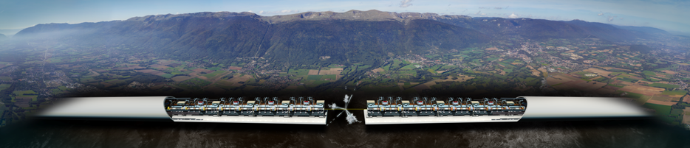
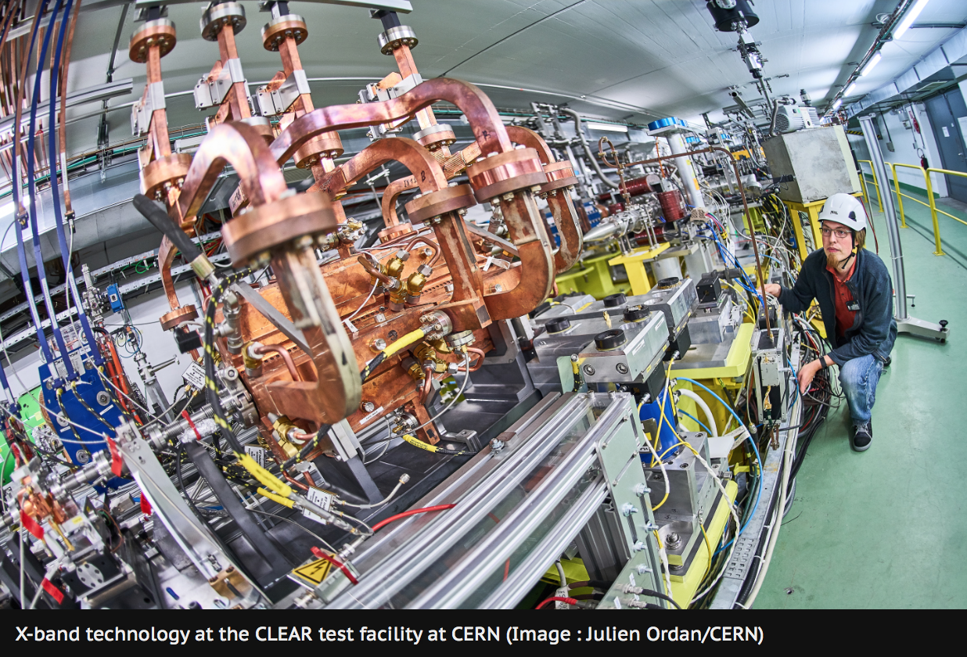
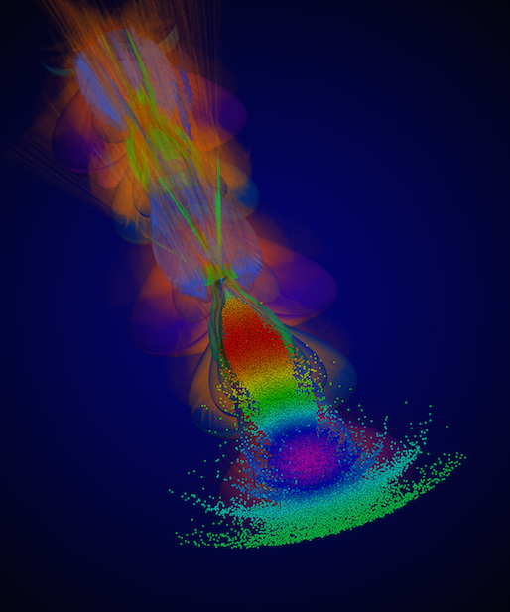
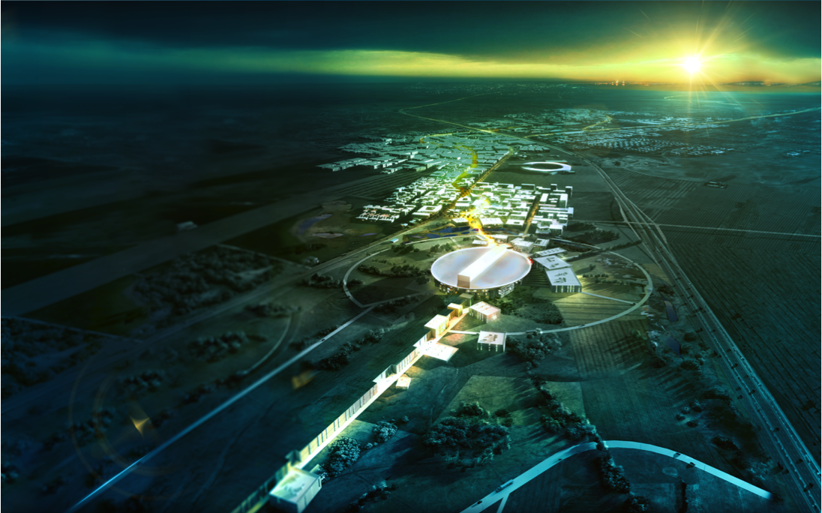
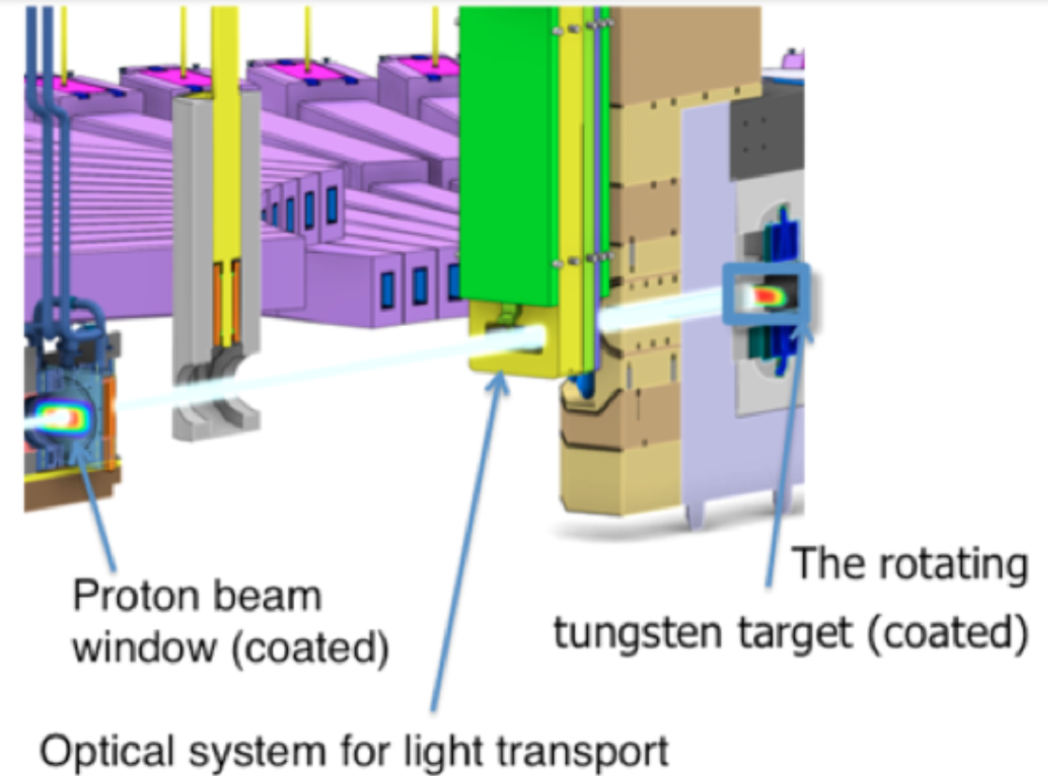
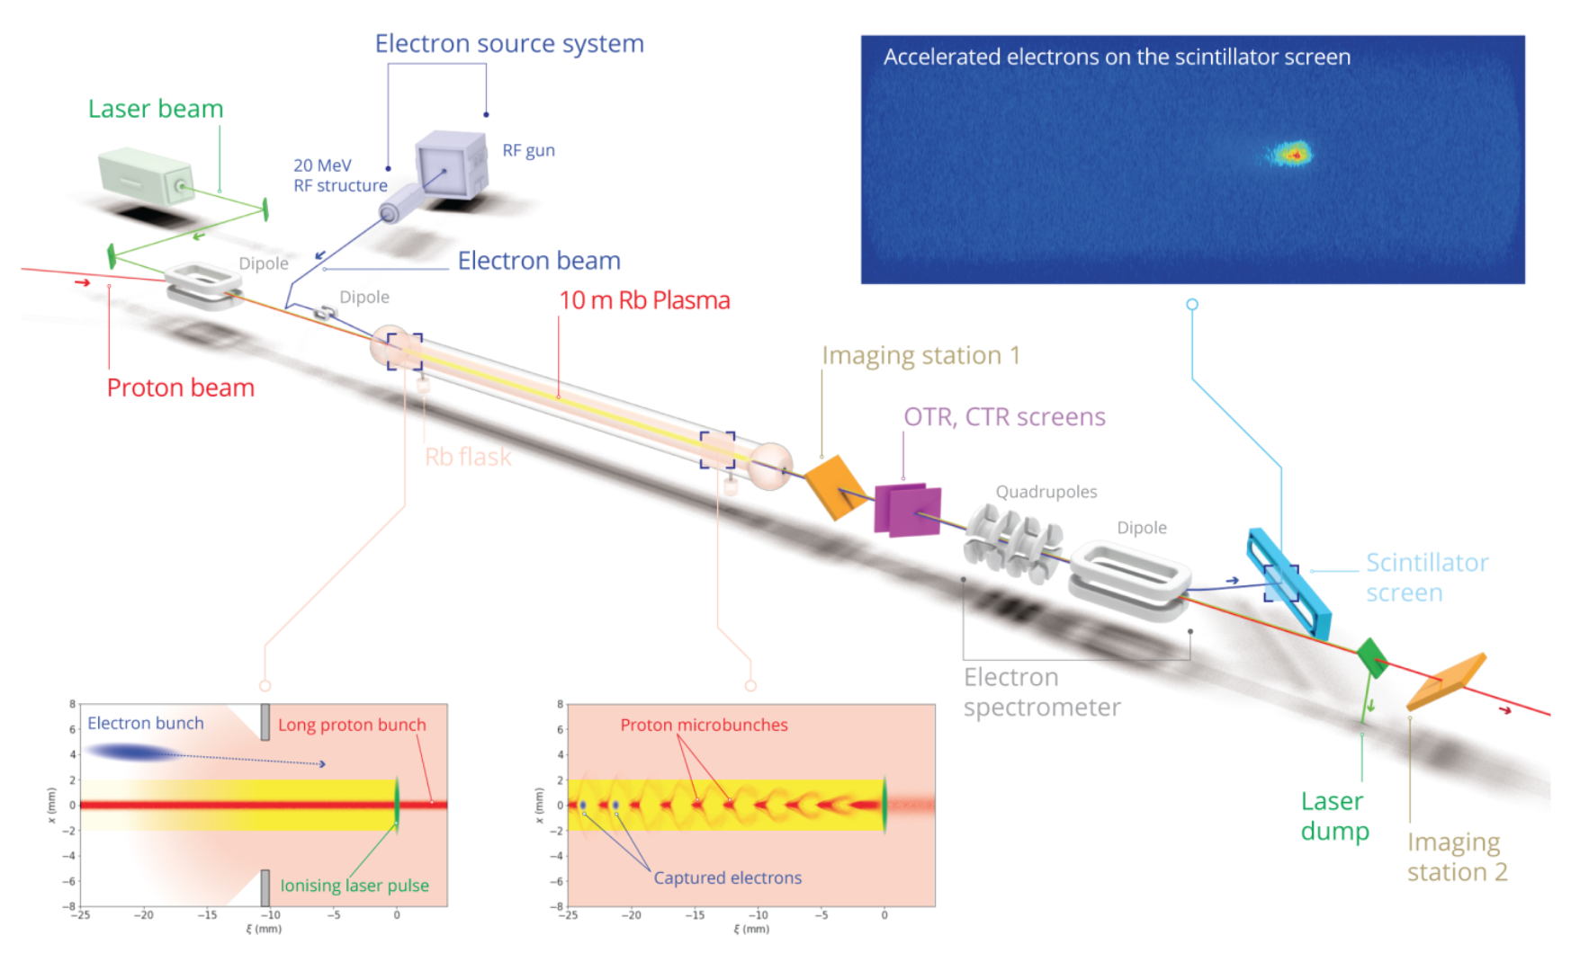
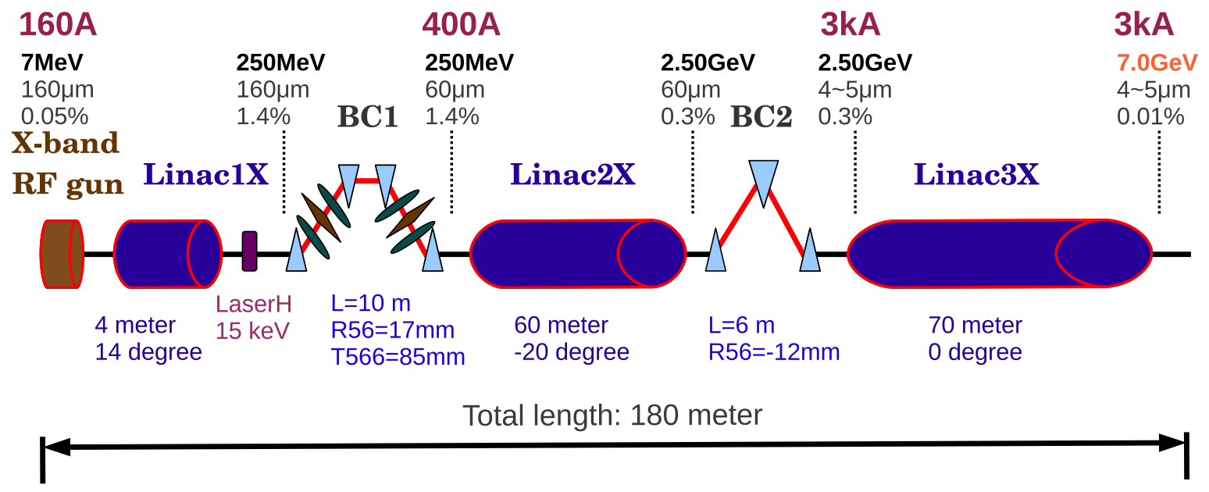
Oslo accelerator contributions
Compact Linear Collider
(Option for Multi-TeV electron positron collider)
High gradient X-band technology
Electron test beams demonstrations
at CLEAR@CERN
European Spallation Source
(The world’s most powerful proton driver)
Plasma wakefield acceleration
(Novel acceleration techniques)
Target proton beam
instrumentation
Compact light sources
(X-band technology)
3D particle-in-cell plasma simulation
for AWAKE@CERN.
Associated partner in EU project.

Slide 6
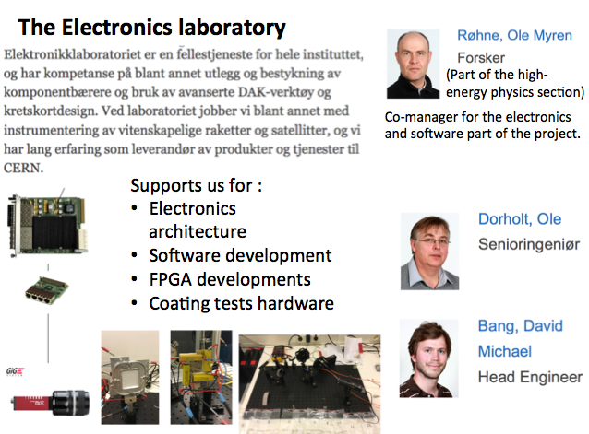
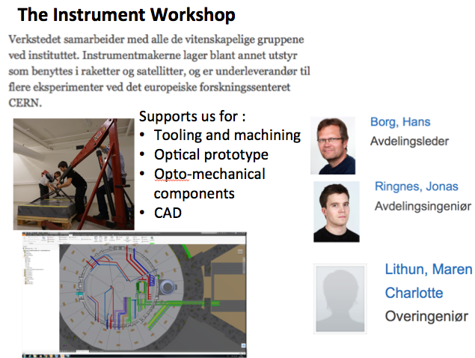
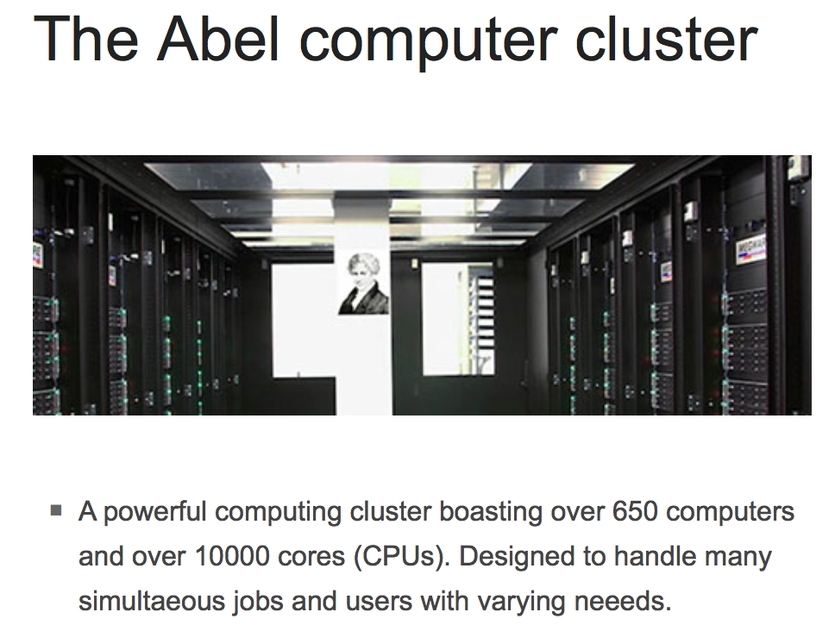
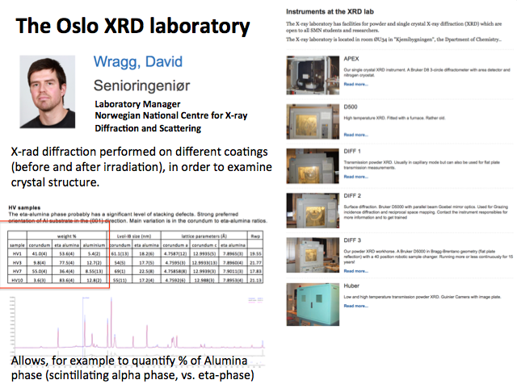
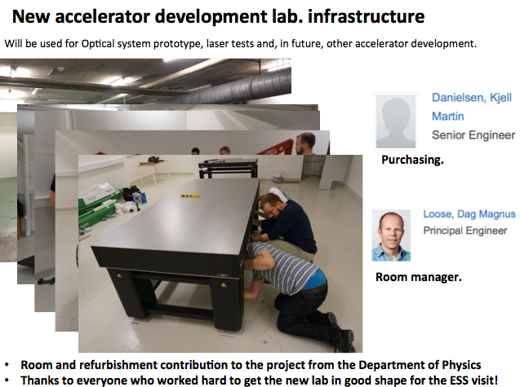
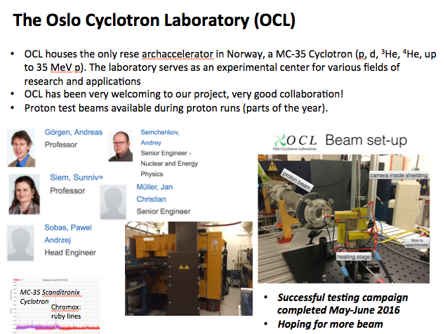
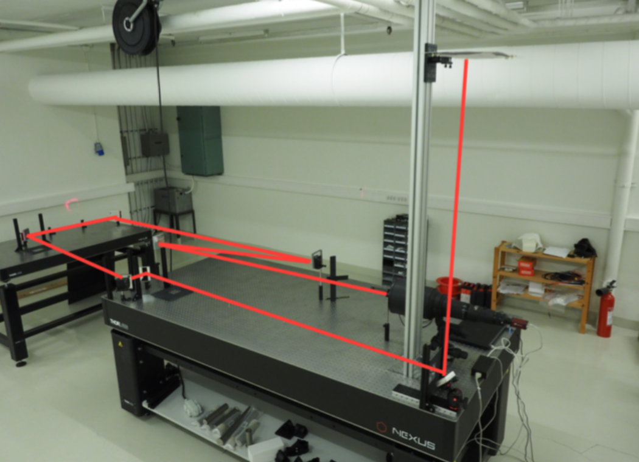
Oslo local capabilities
Accelerator instrumentation:
Utilizing a broad spectrum of
mostly permanent Oslo resources. Increasing Oslo competence for future participation in accelerator projects.
Local capabilities built up in Oslo through CERN and ESS collaborations.
experimental, cross-disciplinary, linking the HEP group with many parts of the Physics Department as well as the Chemistry Department.
We run accelerator and plasma simulations on Norwegian HPC-resources
Routinely allocations ~ 1M CPU-hours/year, free.
National advantage!
Capabilities puts us in position to contribute to any new CERN project

Slide 7
Outlook
Important to be present in CERN accelerator R&D developments the coming years, in order for us to participate in the scientific discussions and strategies about the next machine, and to contribute to the next machine (ensuring student opportunities, industrial return)
Oslo plans to continue involvement of future accelerator projects :
Participation in linear colliders (CLIC, ILC), future technology (AWAKE), also LHC(->FCC)
Continued ESS collaboration, ensuring experience with commissioning and operation
Follow compact light source developments, link to life science initatives, look into proton therapy technology
While using CERN as a focal point allows to leverage some resources through CERN student programs, a continuous base activity at Oslo is needed to keep momentum and base accelerator competence. At least on the level of a couple of researchers, plus students.
Most of current funding ends 2018 (free projects). While we continue apply for free NFR and EU funding, outcomes are very uncertain, and stable national funding would be required to guarantee a continuous activity
Expertise needed to, on the medium term, establish compact research accelerators in Norway. For example inverse Compton scattering light sources, linked to life sciences activities.

