Slide 1

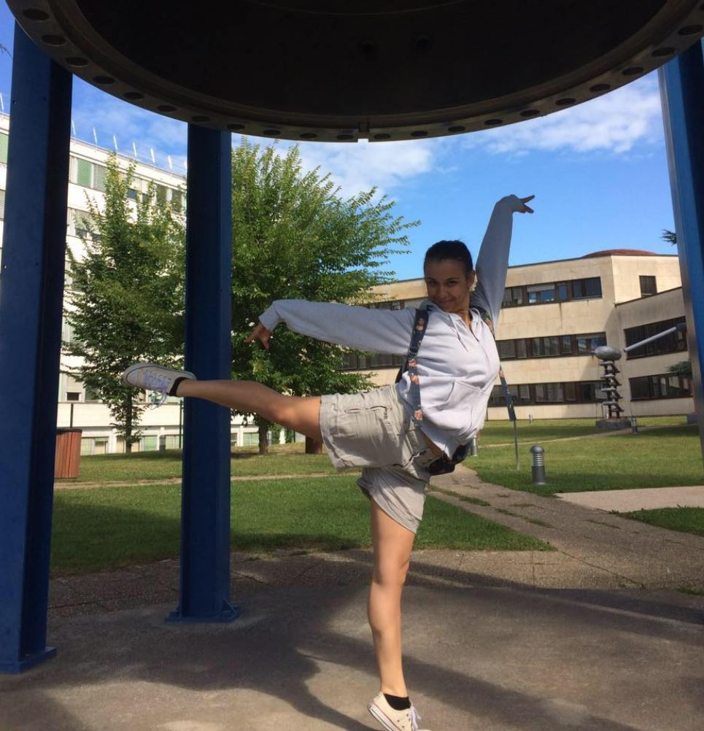
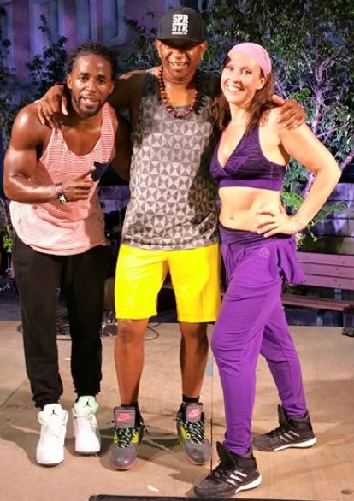
CERN Fitness Club
Greek Fire Disaster Fundraiser
Sat 11 August – Pump Hall (216)
10.00 – 11.15 Jazz workshop
11.15 – 11.30 break
11.30 – 12.30 Zumba
Sign up here: https://indico.cern.ch/event/748897/
All proceeds will go to victims of the fires in Greece.
Donate any amount on the day or transfer to
Account: 279-287931.01J
IBAN: CH33 0027 9279 2879 3101 J
BIC: UBSWCHZH80A
Titulaire: CERN Fitness Club
Contact fitness.club@cern.ch
Zumba with Rachel
Jazz with Konstantina

