Slide 1
Calibration of the RF voltage with tomography in PSB and PS
s
LIU-PS Beam Dynamics Working Group
09/08/2018
S. Albright, A. Lasheen

Slide 2
Outline
Measurement setup
Calibration of the RF voltage
  For LHC25 (h=7) and BCMS (h=9) rf settings in PS
Comparison of extracted vs. injected bunch profiles

Slide 3
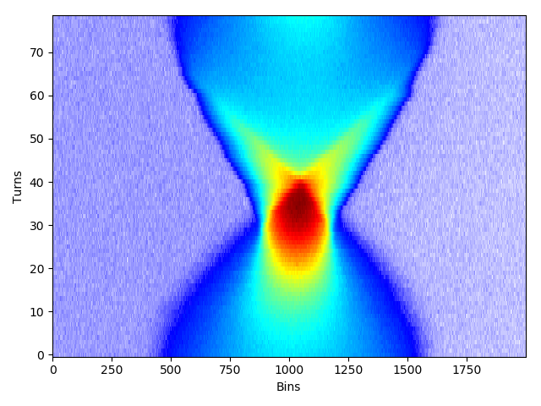
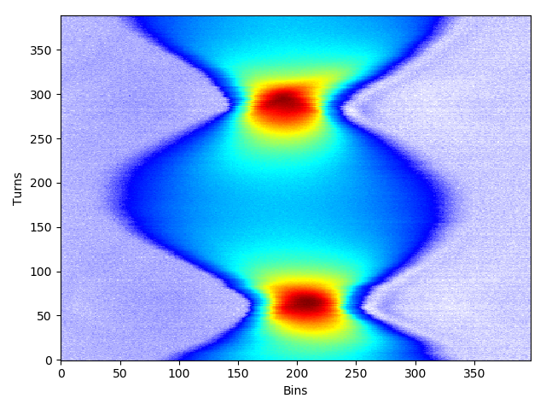
Setup
PS
LHCINDIV in PSB
Injected in different harmonics in PS
  LHC25 nominal -> harmonic 7
  BCMS -> harmonic 9
The rf calibration with tomography relies on quadrupolar oscillations to evaluate the rf voltage from the quadrupole frequency
Mismatch is initiated in the PSB by lowering the rf voltage and fast increase back to 8 kV (nominal)
The bunch is still mismatched in the PS -> calibration in both machine with same bunch
PSB

Slide 4
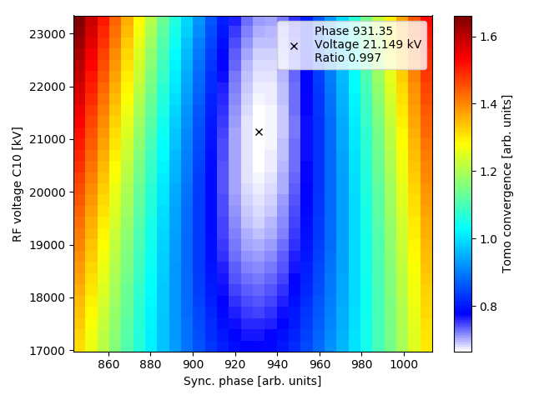
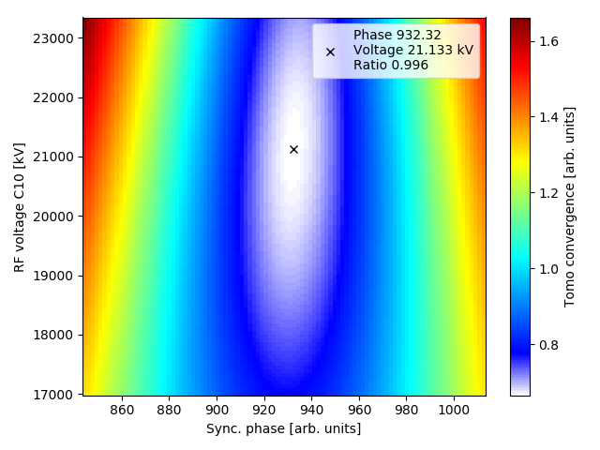
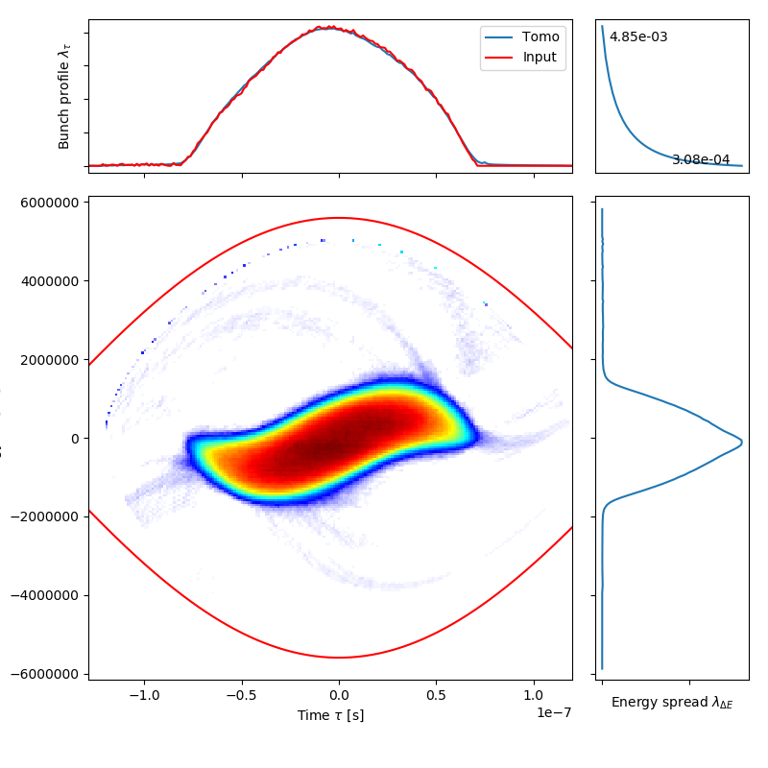
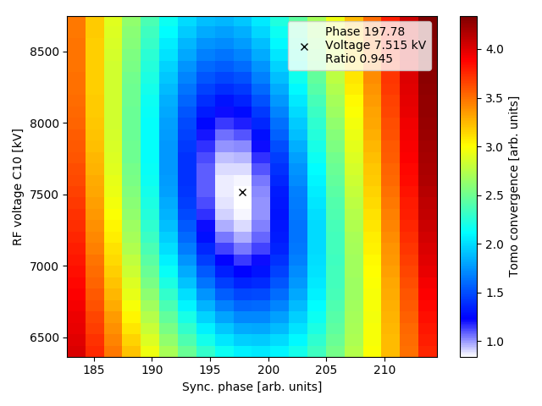
Convergence
S. Hancock, https://cds.cern.ch/record/1313732/files/cern-ats-note-2010-55-md.pdf
Iterating over the rf voltage and the synchronous phase to find the optimal reconstruction (smaller convergence value)
The value is the effective rf voltage, which also accounts for possible intensity effects

Slide 5
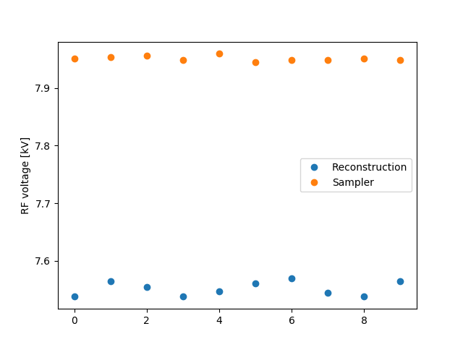
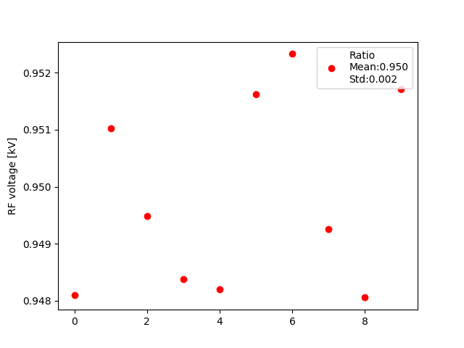
Calibration in PSB h1
Measurements performed over 10 shots in PSB and PS
The rf voltage obtained from the minimization with tomography is compared with the voltage obtained by the rf sampler
In the PSB the effective rf voltage is 95.0% of the sampled value in tomoscope

Slide 6
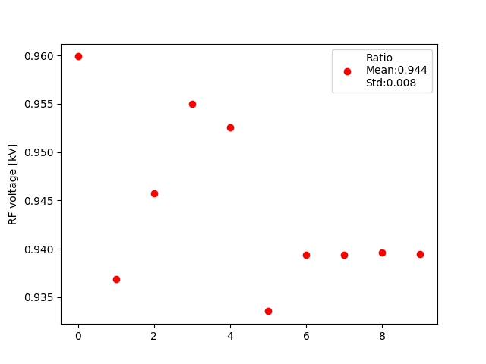
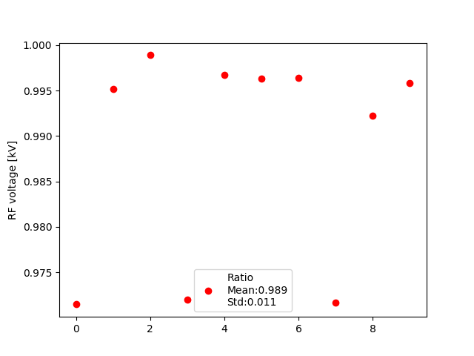
Calibration in PS
LHC25 h=7
BCMS h=9
Measurements performed with the rf settings of the LHC25 and BCMS cycles (different harmonics and rf voltage at injection)
  LHC25 in harmonic 7: 94.4% of the sampled value in tomoscope
  BCMS in harmonic 9: 98.9% of the sampled value in tomoscope

Slide 7
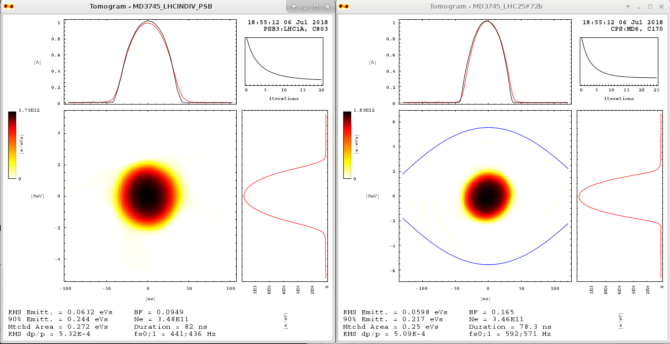
Evaluation of long. emittance from tomography
PSB
PS LHC25 h=7
Including the correction from the RF calibration is not sufficient to explain the discrepancy in the emittance obtained from tomography, that is still in the order of 5-10% smaller in PS (RMS, 90% and matched area)

Slide 8
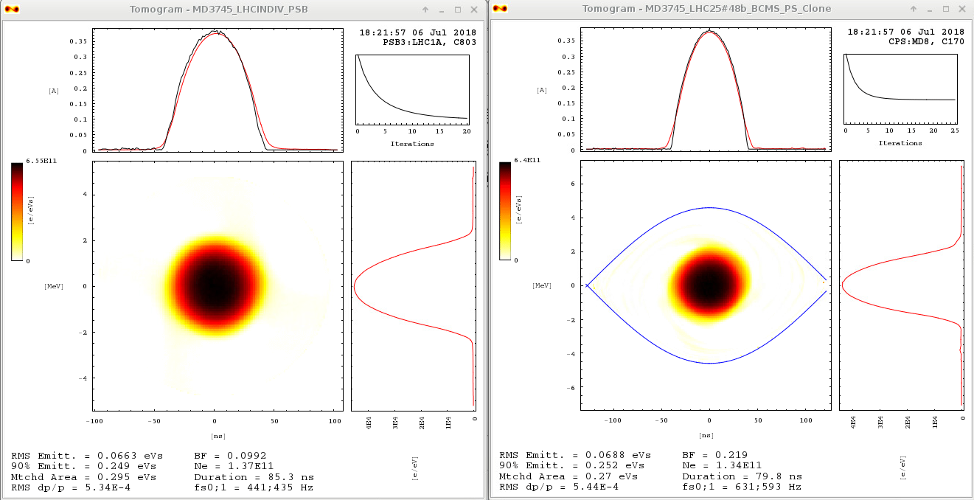
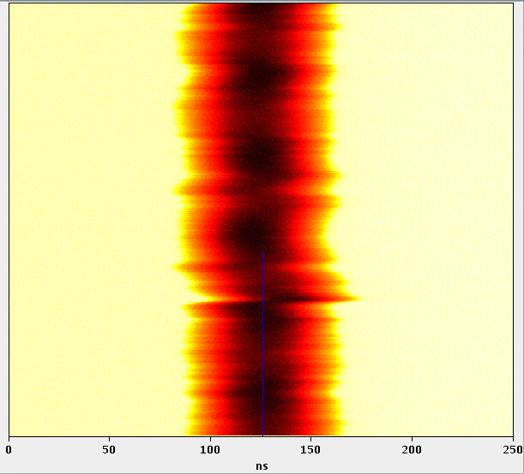
Evaluation of long. emittance from tomography
PSB
PS BCMS h=9
For the BCMS case with correction of the effective RF voltage, RMS and 90% emittances are larger in PS than in PSB (up to 5%), while the matched area is still larger in PSB than in PS (up to 10%)
The phase loop at injection has difficulties with an LHCINDIV bunch, possible degradation of the tomography in particular at large amplitude

Slide 9
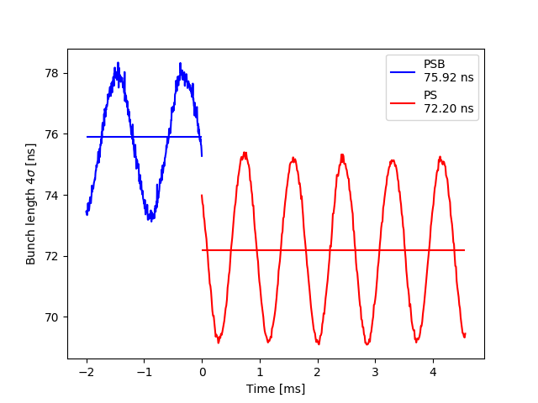
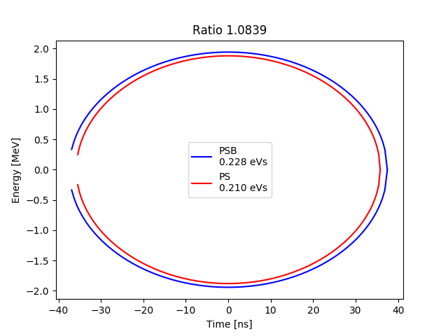
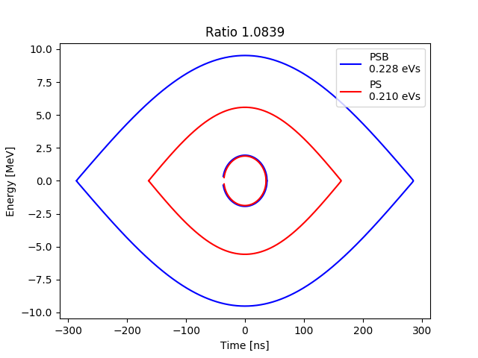
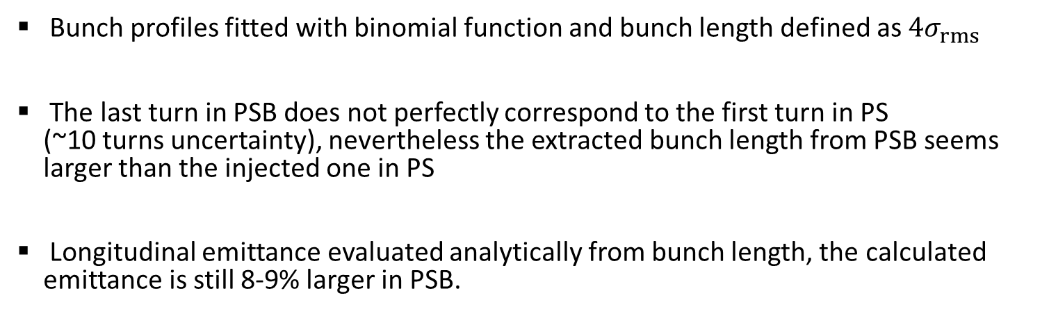
Evaluation of long. emittance from av. bunch length
PS LHC25 h=7
Bunch profiles fitted with binomial function and bunch length defined as $4σ_{rms}$
The last turn in PSB does not perfectly correspond to the first turn in PS
(~10 turns uncertainty), nevertheless the extracted bunch length from PSB seems larger than the injected one in PS
Longitudinal emittance evaluated analytically from bunch length, the calculated emittance is still 8-9% larger in PSB.

Slide 10
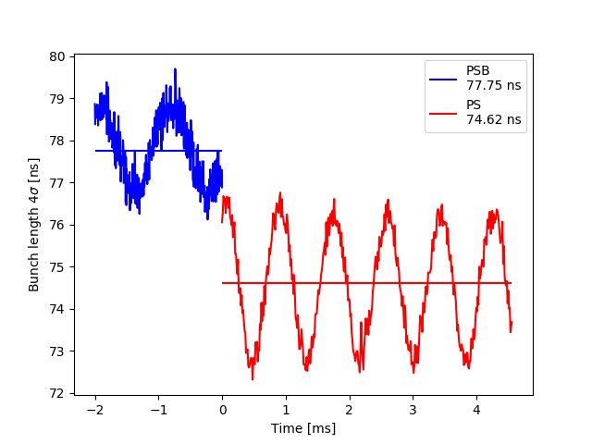
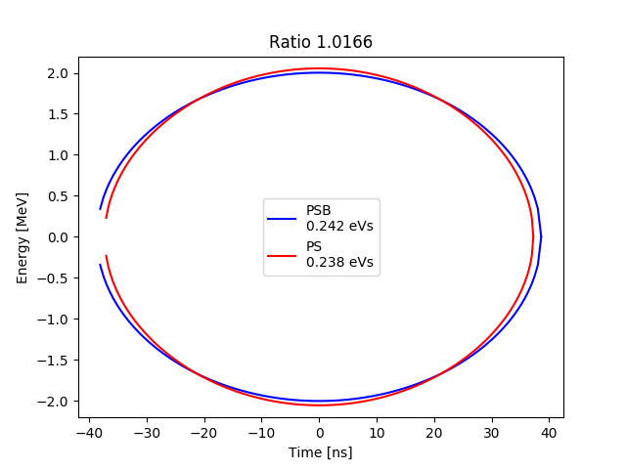
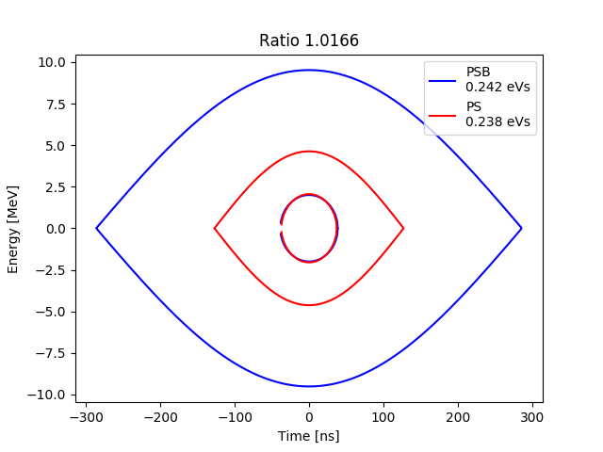
Evaluation of long. emittance from av. bunch length
PS BCMS h=9
For the BCMS case, the calculated emittance is larger in PSB but only by 1-2% when evaluated from the bunch length

Slide 11
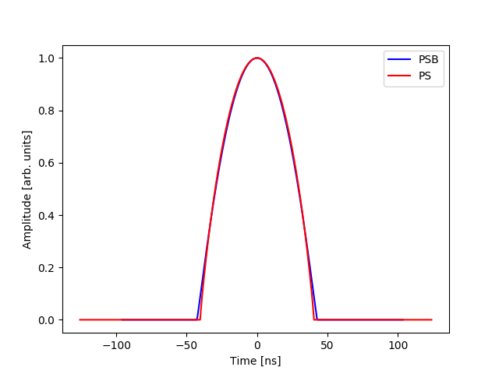
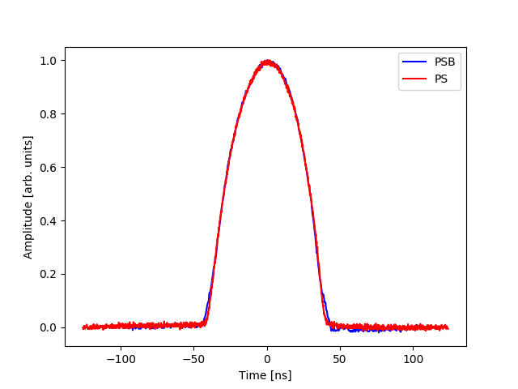
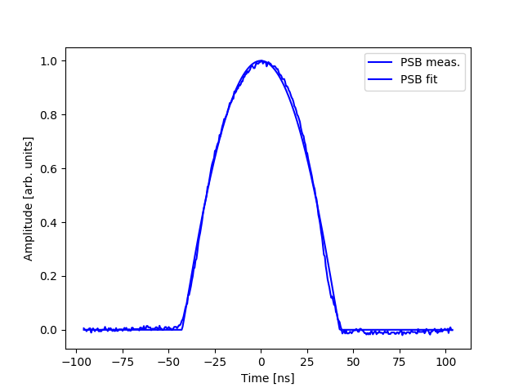
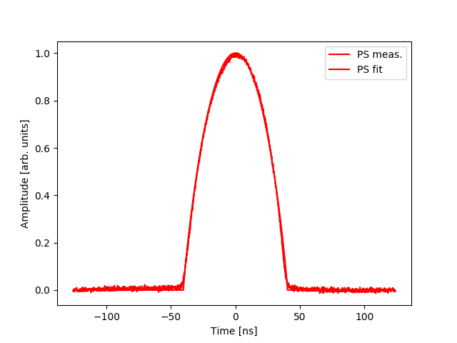
Fitting bunch profiles
The measured extracted bunches from PSB and injected in PS are very similar, except for the tails (baseline was corrected)
The difference in bunch length is in the order of 1-2%, which may not be sufficient to fully explain the discrepancy in emittance

Slide 12
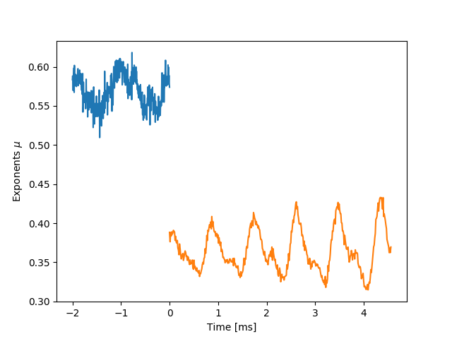
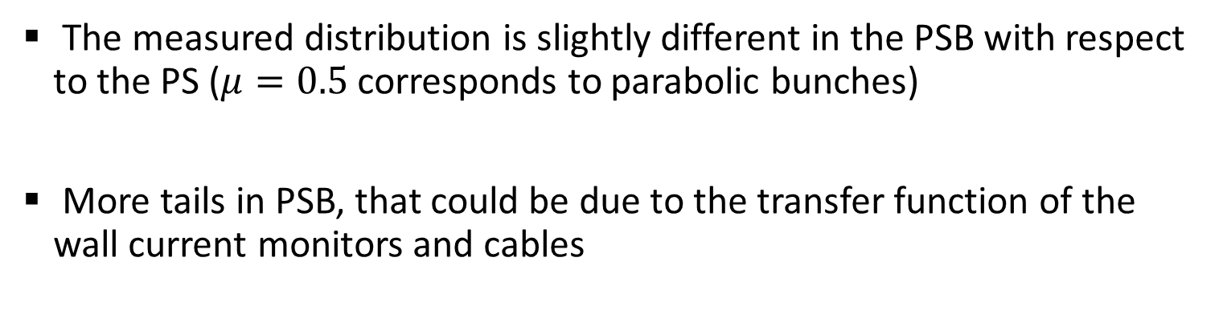
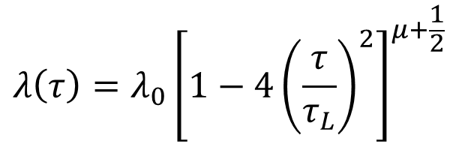
Distribution type
$$λ\left(τ\right)=λ_{0}{\left[1−4{\left(\frac{τ}{τ_{L}}\right)}^{2}\right]}^{μ+\frac{1}{2}}$$
The measured distribution is slightly different in the PSB with respect to the PS ($μ=0.5$ corresponds to parabolic bunches)
More tails in PSB, that could be due to the transfer function of the wall current monitors and cables

Slide 13
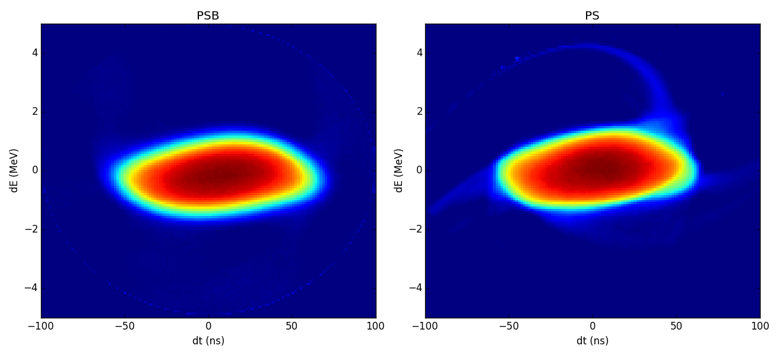
Tomograghy of extracted vs. injected bunches
The tomographic reconstruction at the last measured slice in PSB vs. the first measured slice in PS shows no obvious difference that would justify a lower longitudinal emittance in PS

Slide 14
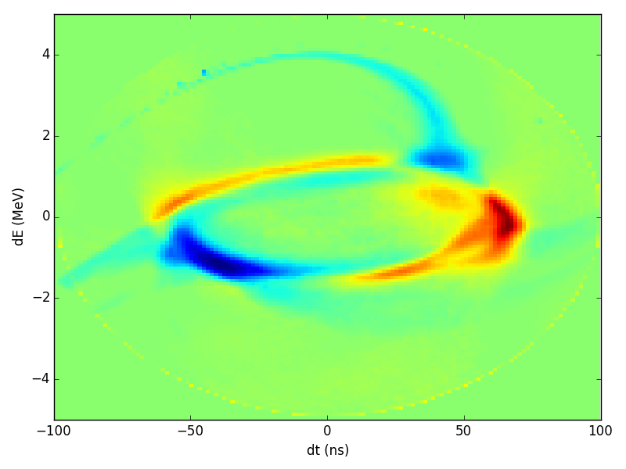
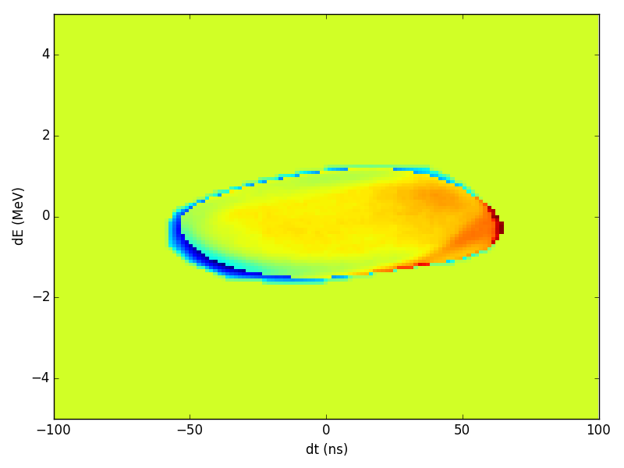
Tomograghy of extracted vs. injected bunches
Difference PSB-PS
Difference PSB-PS with tails cut
Taking the difference in phase space, with the densities normalized to 1

Slide 15
Conclusions
The effective rf voltage was calibrated by tomography in PSB and PS
  PSB h1: 95.0% of the sampled voltage
  PS LHC25 h7: 94.4% of the sampled voltage
  PS BCMS h9: 98.9% of the sampled voltage
The correction of the rf voltage for the tomography is not sufficient to match perfectly the emittances in PSB and PS
The measured bunches in PSB seem to have larger bunch length and tails. The difference is small and may not be sufficient to explain the difference in measured emittance.
Measurements of the last turn in PSB and first turn in PS were performed and will be analyzed soon

