Slide 1
GitLab deployment at CERN
Alex Lossent
IT-CDA-WF

Slide 2
In a nutshell
One-stop solution for collaboration on software projects
  Code hosting
  Code review
  Issue tracking
  CI/CD
  Container images
Operated by Version Control Systems team
  Also running Jira, SVN, Jenkins and CERNForge portal

Slide 3
Use cases (just a few highlights)
ATLAS Athena (offline software)
  1.2GB, 30k commits, 100 branches, 4k tags, 1400 forks
CERN Datacenter Configuration Management
  560 contributors, 700 projects
Docker containers
  Build and host Docker images
Machine Controls
  1000+ Java projects
Preparing physics papers
  Collaboration on Latex documents

Slide 4
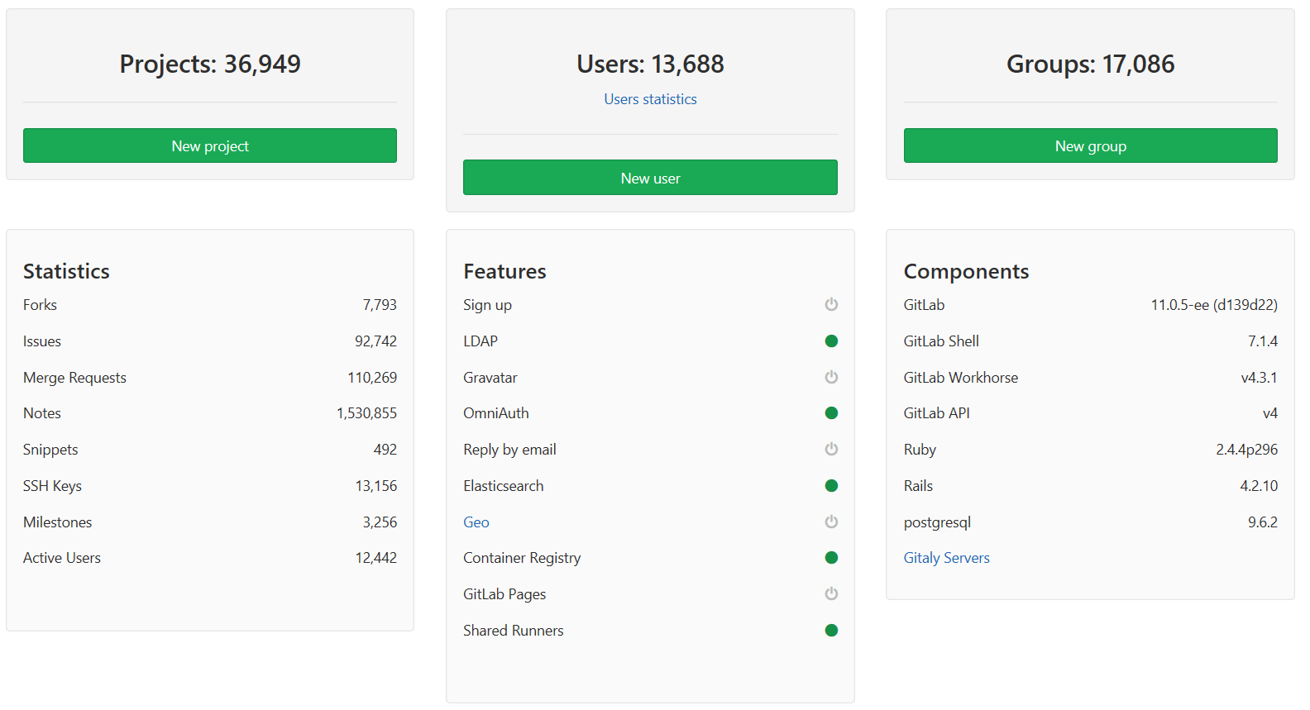
CERN GitLab in numbers

Slide 5
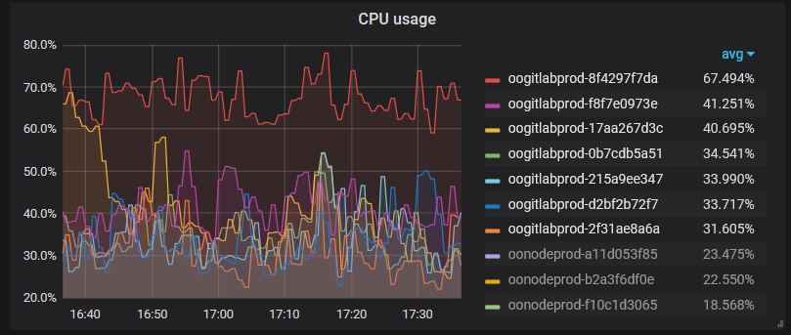
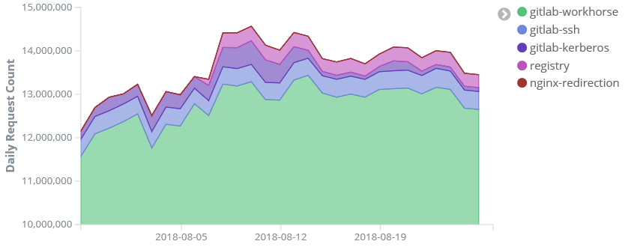
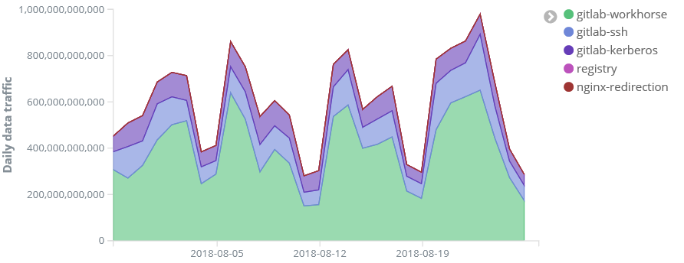
Infrastructure
7 nodes (10 cores, 30GB)
Containerized deployment
  with HA
Storage:
  Git repos: 3TB (NFS)
    3 volumes, each 1000iops
  Object storage: 10TB (S3)
    Docker images: 9.5TB
    CI artifacts, LFS: 0.5TB

Slide 6
History
2014: first experimental deployment
  Evaluation of code review capabilities
2015: production deployment
  Using EE for LDAP groups
  Contributed Kerberos, SAML support upstream
2016: introduced GitLab CI/CD
  Complete migration of git repositories out of gitolite
2017: move from VMs to Containers in Openshift
  Plan for closing SVN service
2018: scale out
  Infrastructure growing to 200GB RAM, 3 NFS filers
  Fully automated deployment and integration tests

Slide 7
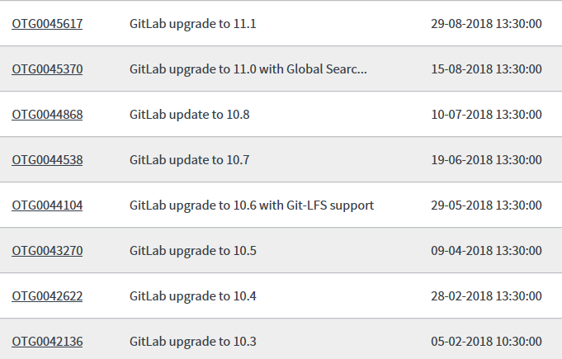
Version updates
GitLab releases minor versions on the 22nd of every month
  No LTS branch: new issues as well as fixed issues in each release
Usually deployed on gitlab.cern.ch 1-2 month after release
  Wait for patches to minor releases
  …but GitLab only supports the latest 3 releases
Fully automated process
  GitLab deploys itself via CI/CD
Automated tests
  Account/egroup integration
  Basic workflow
  ATLAS workflow

Slide 8
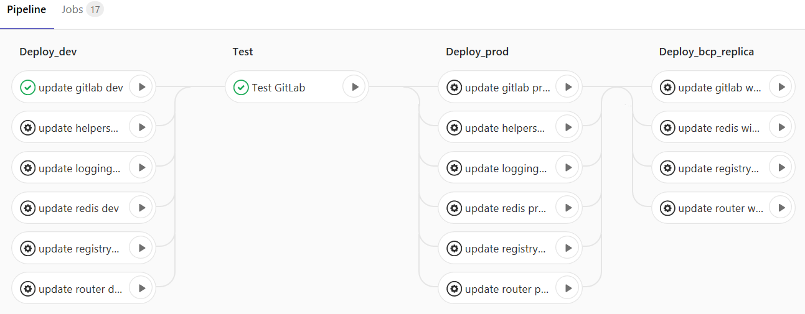
GitLab CI/CD
Rapidly increasing adoption
  140k jobs in 2016
  650k jobs in 2017
  1.3M jobs in 2018 (so far)
GitLab deploys itself via GitLab CI

Slide 9
Shared runners at CERN
Many options tried!
  Puppet, Swarm, Kubernetes, Openstack VMs via Docker-Machine…
  VM flavors and various options for Docker storage
Now using Openstack Magnum Swarm clusters + Ansible
  Easily provision a set of machines with Docker
  Leverage Openshift’s Ansible Playbook Bundle for automation
Shared runner types:
  Docker + CVMFS (default)
  Docker Builds – locked on running a custom builder image
  Docker Privileged (prototype) – using nested VirtualBox VM
Several hundreds private runners
  E.g. privileged docker, firmware testing…

Slide 10
Challenges
Manage growth of the Docker registry
  Registry design requires downtime to delete any image layer
  Policy to define. Remove old tag versions?
  Few reliable tools available for registry GC, but GitLab working on it
Starter vs. Premium features
  E.g. Jira dashboard, cross-project pipelines…
External accounts
  License costs, some technical difficulties

Slide 11
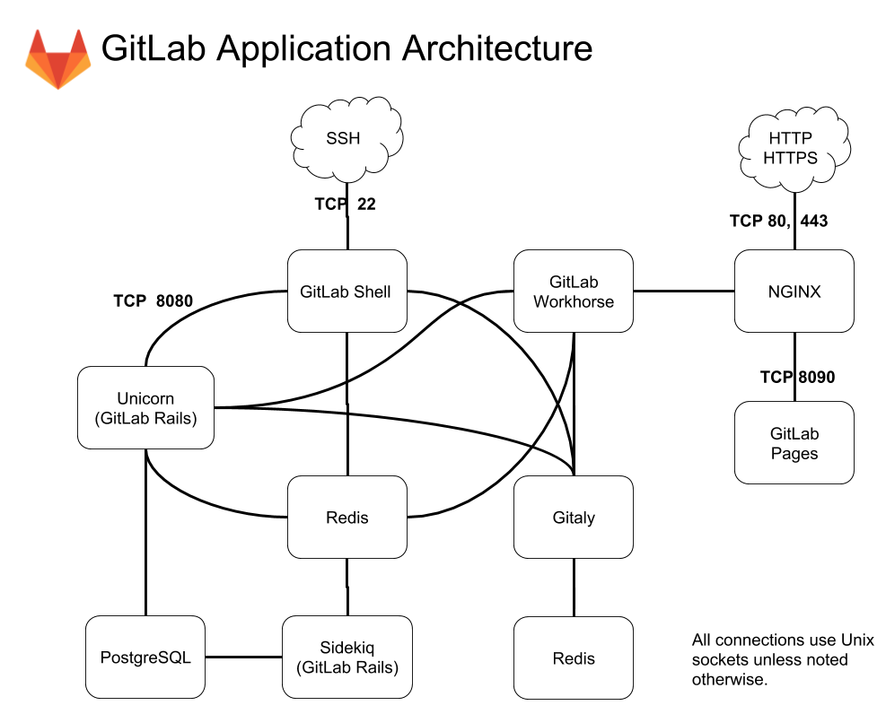
Challenges: performance
Changes in GitLab’s design
  All git repository access now handled by a dedicated ‘Gitaly’ service
Enables running without shared storage
  Gitaly server rather than a NFS server
Expected benefits:
  An order of magnitude reduction in latency for expansive operations
Drawbacks:
  Need to operate the storage infrastructure ourselves
  Snapshots/Off-site replica from Filer service
  Same SPoF as NFS server

Slide 12
Conclusion
Our GitLab instance keeps growing steadily
Opportunities for further performance improvement

Slide 13
Questions?

