Slide 1
On analytic solutions of 3+1 Relativistic Ideal Hydrodynamical Equations
Shu Lin
Stony Brook University
12/01/2009 Budapest

Slide 2
Outline
Basics of Relativistic Ideal Hydrodynamics and its applicability to Heavy Ion Collisions
Reduction from 3+1 problem to 1+1 problem by embedding
Flow profile of the embedding solutions and their physical interpretations
Possible connections with heavy ion collisions

Slide 3

Basics of relativistic hydrodynamics
Conservation equation
Constitutive equation
Equation of state
If there is a conserved charge
(1)
(2)
(3)
(4)
(5)
p=p(ε)
Assumption: local equilibrium
Thermodynamical relations
(1), (2), (5) lead to conservation of entropy
no disspative term
respect time reversion

Slide 4
Applicability of RIHD to HIC
Phenomenology of Heavy Ion Collisions
QGP produced at heavy ion collisions is believed to be strongly coupled.
Lower bound for general strongly coupled gauge theory:
Kovtun, Son, Starinets 2004
Even lower value for bulk viscosity at T>1.1T_{C}
Kharzeev, Tuchin 2007
Relativistic Ideal Hydrodynamics applicable in wide region of temperature

Slide 5
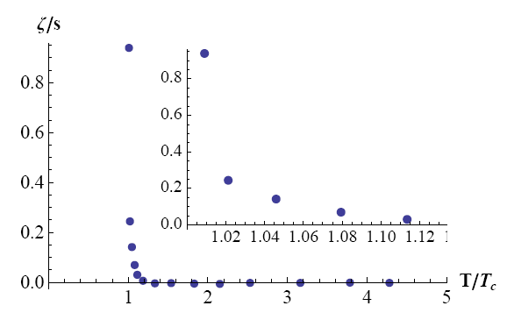
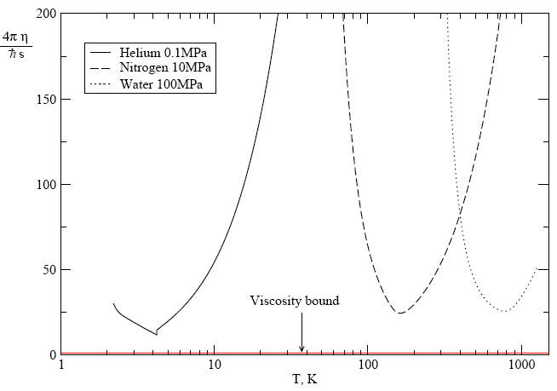
Bulk and Shear viscosity
QCD with lattice data
Conjecture for strongly coupled matter

Slide 6
Some well known solutions to RIHD
Landau, Khalantnikov 1950s
Hwa(1974)-Bjorken(1983)
Bialas, Janik, Peschanki 2007
Biro 2000
Csörgő et al 2004
Nagy, Csörgő, Csanád 2008
1+1D rapidity distribution approximately gaussian
1+1D boost invariant
1+1D interpolation between LK and HB
generalization to 3+1D solution with spherical, cylindrical and ellipsoidal symmetries

Slide 7



2D Hubble embedding
Fluid flow
In flat coordinate (t,x,y,z)
Solving hydrodynamical equations with specific Hubble-like transverse flow:
energy, pressure and longtudinal flow independent of
Liao and Koch 0905.3406 [nucl-th]
SL, Liao 0909.2284 [nucl-th]
See also Jinfeng Liao’s talk for more of embedding method

Slide 8


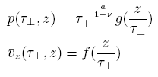

scaling ansatz
Equation of state
Speed of sound
dimensionful
dimensionless
scaling variable

Slide 9


Symmetries of the EOM
The solutions should preserve parity

Slide 10




Solving the equations
Linear ansatz
Nonlinear ansatz
SL, Liao 0909.2284 [nucl-th]

Slide 11
Solutions for general ν(EOS)
2D Hubble flow(analog of Hwa-Bjorken flow)
3D Hubble flow(spherical) |ξ|<1
Anti-Hubble flow |ξ|>1

Slide 12
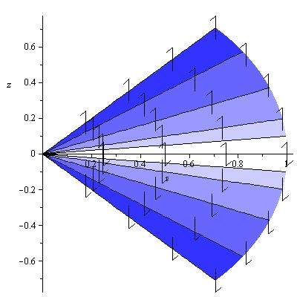
3D Hubble flow(spherical)
lightcone
Exploding flow
v_{x}=x/t, v_{y}=y/t, v_{z}=z/t
arrows indicate direction of the flow
darkness of the color indicate the flow magnitude

Slide 13
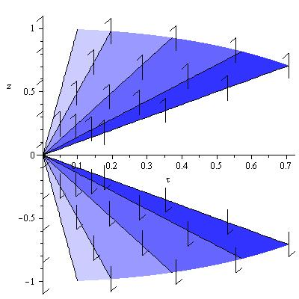
Anti-Hubble flow
lightcone
Exploding flow
rapidity gap

Slide 14
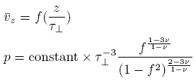
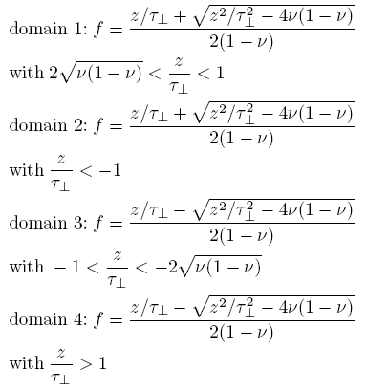
Solutions for general ν(EOS)
domain 1 and domain 3, domain 2 and domain 4 are related by parity!

Slide 15
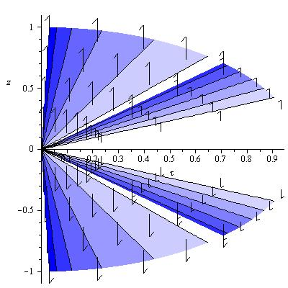
Solution with 4 domains
lightcone
rapidity gap
Exploding flow
4 causally disconnected pieces

Slide 16
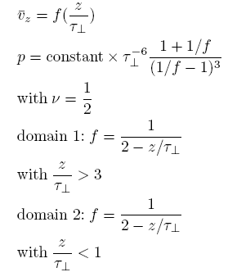
Solutions for specific ν(EOS)
Also its partiy partner

Slide 17
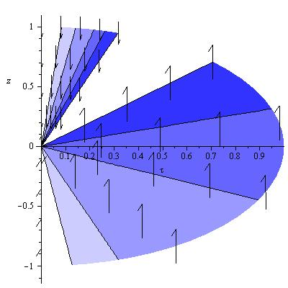
Flow with ν=1/2
sink
Impolding flow with a
moving “sink” at ξ=2

Slide 18
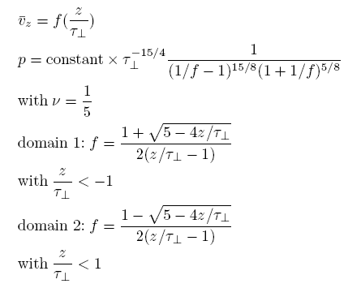
Solutions for specific ν(EOS)

Slide 19
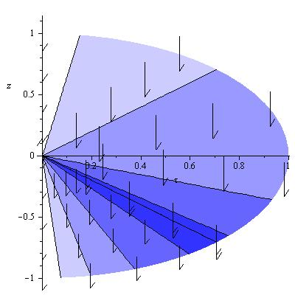
Flow with ν=1/5
Non-exploding or imploding, but one-way shock wave
2 causally disconnected pieces
Flow discontinuous at ξ=1, where flow speed reaches 1

Slide 20
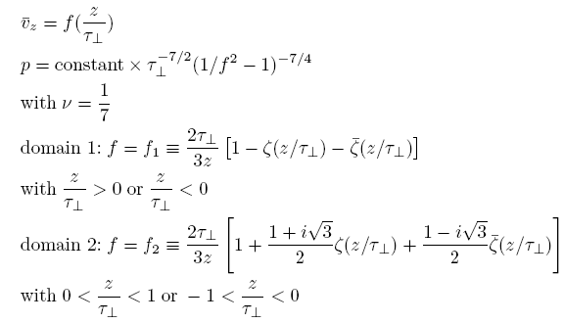
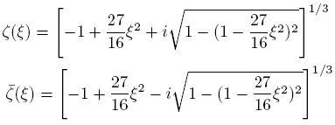
Solutions for specific ν(EOS)

Slide 21
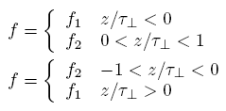
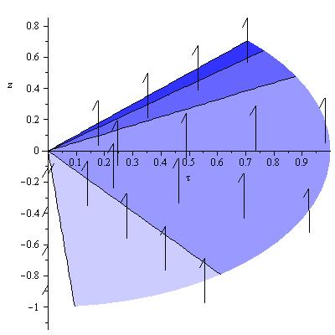
Flow with ν=1/7
Form a parity pair
One-way shock wave
Flow reaches speed of light at ξ=1

Slide 22
Connection to Heavy Ion Collisions
Flow direction is observer dependent
ξ=0
ξ= -#
One-way shock wave viewed from observer at ξ=0
Explosion viewed from observer at ξ= -#
A change of reference frame from ξ=0 to ξ= -# may be close to the situation of fireball explosion

Slide 23
Summary
We have found several longitudinal flow profiles based on prescribed transverse flow(embedding)
Connections to HIC may be established by applying longitudinal boost to certain solutions
Extension from cylindrical symmetry to ellipsoidal symmetry can be used to gain insight to elliptic flow

Slide 24
Thank you!

