Slide 1
GIF++ Installation in the EHN1/H4 Beam line
Layout – the Cs¹³⁷ 10TBq source
GIF++ organization
Schedule
Capeans Garrido, M – Fortin, R (PH/DT)
Rembser, C – (PH/ADE)
Efthymiopoulos, I (EN/MEF)
EDMS No :
LEAF Meeting
CERN, November 30, 2009

Slide 2
GIF++ in H4 beam line
Introduction
GIF : is a Gamma Irradiation Facility
  use a powerful source (Cs137, Co60) to irradiate detectors or other equipment for performance, or ageing studies
  strong point: presence of a particle beam to check detector performance, i.e. particle identification, on top of a photon background
++ : means upgrade wrt present installation in b.190
  more powerful source in view of sLHC needs
  bigger and better organized irradiation area to cover all needs
Present installation phased out due to the dismantling of the West Area → no beam !
Users: all gaseous detector builders (LHC & FT experiments, machine instrumetnation) plus groups related with radiation studies (EN/STI, RP,…)
If coupled with a neutron source would be a unique facility
  could also cover the needs of accelerator installation (R2E)

Slide 3
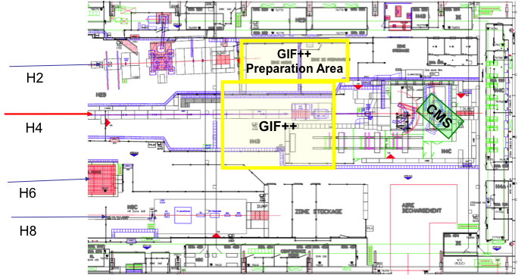
GIF++ in North Area/H4 beam line
Implementation proposal

Slide 4
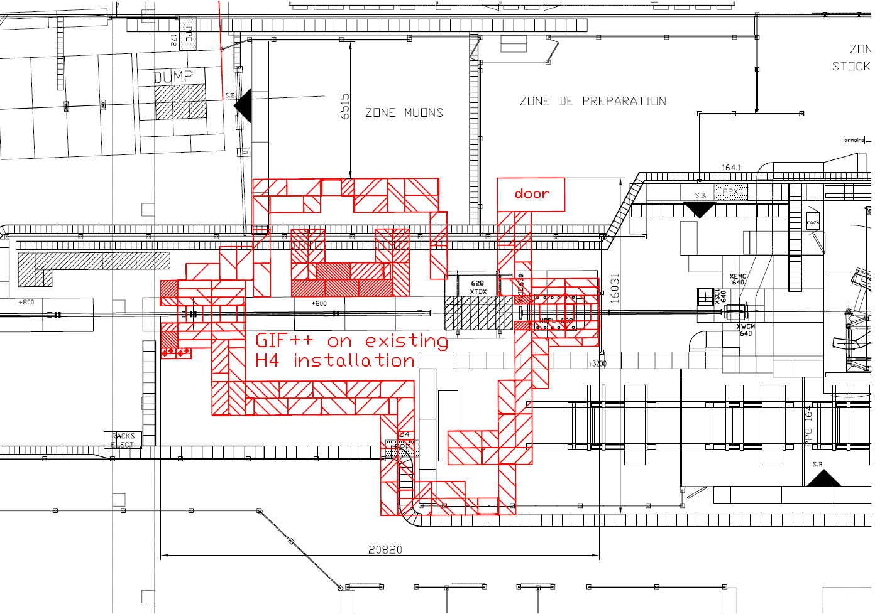
GIF++ in North Area/H4 beam line
Implementation proposal

Slide 5
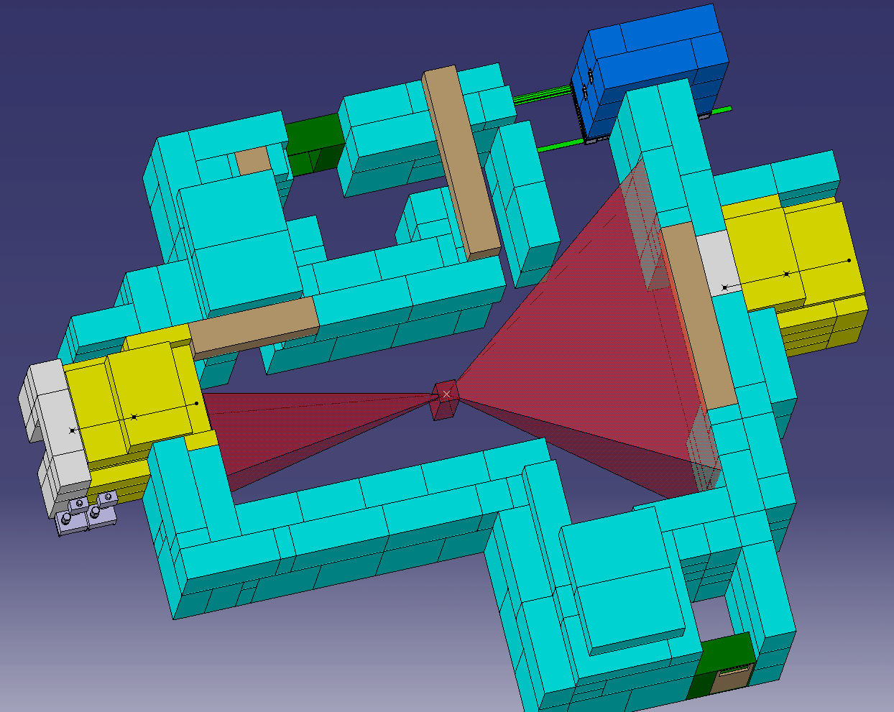
GIF++ in North Area/H4 beam line
Implementation proposal
Roof shielding of 0.8m concrete over the irradiation area

Slide 6
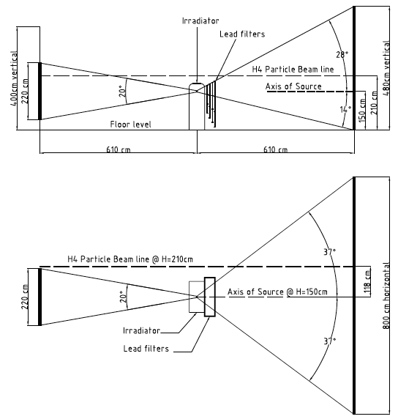
GIF++ : The Cs¹³⁷ Source
RP considerations – (Heinz Vincke)
Cs¹³⁷, 10 TBq
  × 13 than present GIF source
  half life 30 years
  Radiation field : photons of 662 keV (85.1%)
  ~1 Sv/h at 1m
The irradiation area will be classified as prohibited area
  at 30cm distance from the source we have ~10 Sv/h, i.e. 1000 times the limit of a prohibited area
  adequate side and roof shielding is required
EHN1 is a Supervised Radiation Area (new limits since 2006)
  < 3 uSv/h at permanent workplaces (was 25 uSv/h)
  < 15 uSv/h in low occupancy areas (was 100 uSv/h)
  These are the limits to achieve outside the shielding
Max. expected doses at sLHC | Equivalent time at GIF++ (~ 50 cm from source → 2Gy/h)
Si-trackers: ~ MGy/y | >> years
Calorimeters: ~ 20 kGy/y | < 1 year
Muon systems: ~ 0.1 Gy/y | ~ minutes
Lateral view of Source and Beam
Top view of Source and Beam

Slide 7
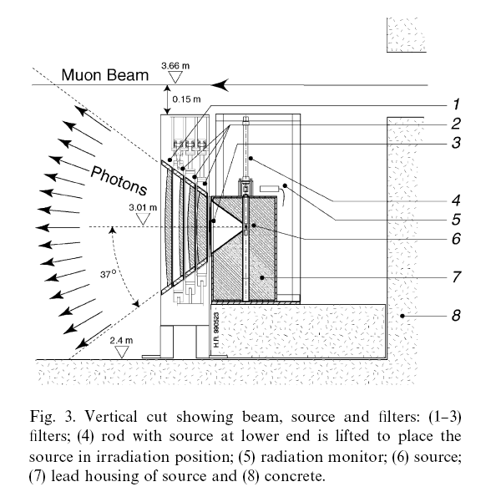
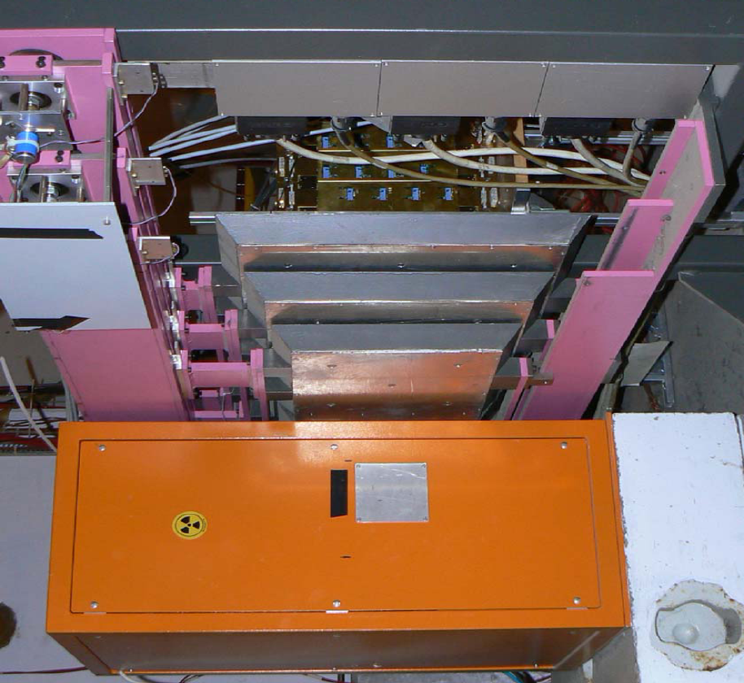
GIF++ Facility
The irradiator assembly
The irradiator will be purchased as a “box” with all the functionalities and control software included - specs by DG/SCR
The front filters will be recuperated from existing GIF; we may construct some new ones if needed
Yearly maintenance by constructor – organized by DG/SCR radioacvie source service

Slide 8
GIF++ Facility
Organization
GIF++
Beam time schedule : SPS Physics coordinator
Overall management
H4 Beam Line Physicist - presently I. Efthymiopoulos, EN-MEF
Technical support
Area and infrastructure - M. Jeckel EN-MEF
Users
GIF++ “spokesperson”/physics coordinator- ?????
GIF++ technical coordinator - R. Fortin PH-DT
RP supervision : Heinz Vincke DG-SCR

Slide 9
GIF++ Construction
Status - schedule
A Proposal was submitted to SPSC in September
  CERN-SPSC-2009-029 ; SPSC-P-339
  http://cdsweb.cern.ch/record/1207380/files/SPSC-P-339.pdf
SPSC referees : S. Maury (CERN) + M. Charlton(UK)
  Discussions with proponents and MEF
  Main issue: beam time (6-8 weeks/year) and likely re-activation of CMS calorimeter test area – downstream from GIF++
On positive recommendation from SPSC (rather likely) it will be brought to the RB for approval
We are in a typical round loop: users want CERN approval to start investing money on the project ↔ their funds would ease the approval

Slide 10
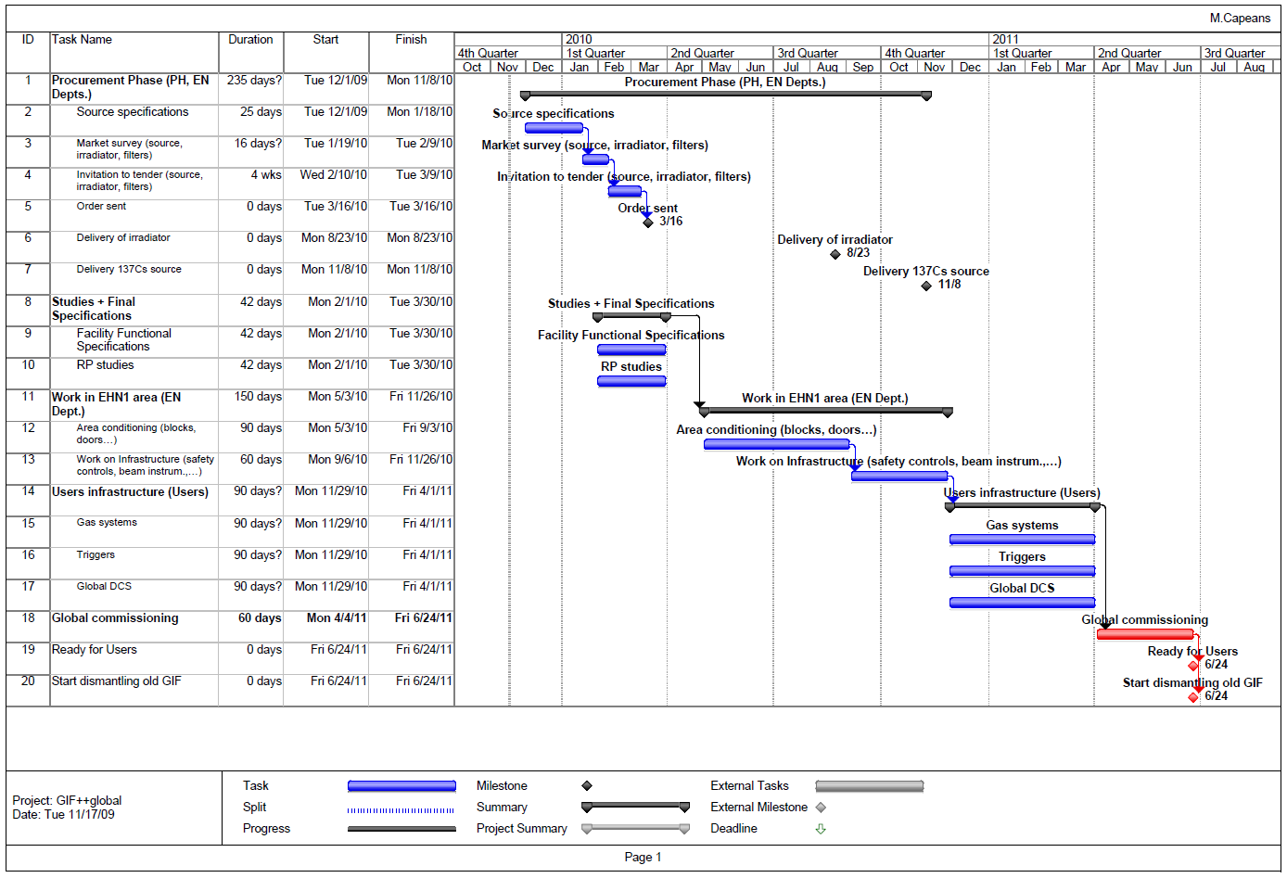
GIF++ Construction
Tentative schedule

Slide 11
GIF++ Facility
Organization – specific tasks
EN-MEF group
  Overall coordination and management
  Maintenance of the GIF++ exp. Area and installed equipment
  Assistance to the users for the installation and integration of their equipment
  Optimization of required beam conditions
  Maintenance of the fixed gas supply installations
PH-DT
  Assistance and liaison with users on a day-to-day basis
  Maintenance of the detector control system of the facility
  Maintenance of the gas mixing and purification plants, shared among the users
  Follow up the annual maintenance of the ¹³⁷Cs source by a competent external firm
  TSO of the facility
DG-SCR group
  Monitoring of all ionizing radiation in the area in view of safety regulations
  Radiological risk assessments in view of different test conditions
Users
  Responsible for their specific detectors and peripheral equipment such as user-specific gas equipment, cables, power supplies, readout electronics, DAQ, etc.
  Data taking shifts
PS/SPS Coordinator
  Allocation of particle beam time and its sharing between GIF++ users

