Slide 1
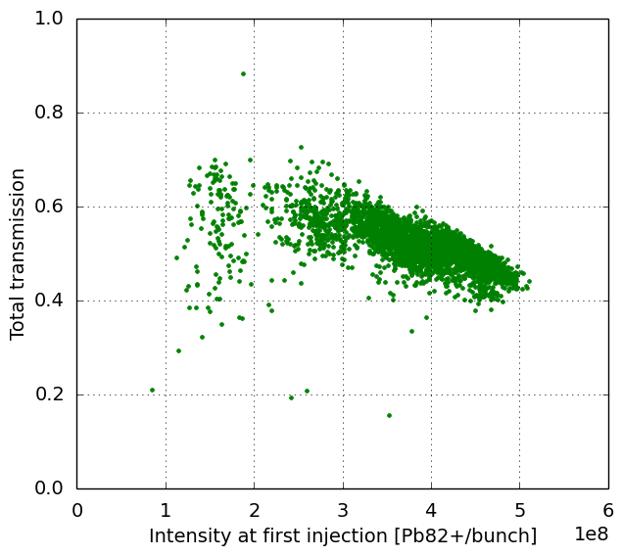
Performance target reach: risk & mitigation
2015 data (12 SPS injections)
Slip-stacking represents main performance risk
Without slip stacking only 58% of target for same beam production scheme (losses in SPS remain the main bottleneck)
Progress on alternative beam production scenarios
Option of 3 bunches spaced by 75 ns demonstrated with Xe-ions in LEIR & PS → 67% of target expected (to be tested with Pb)
Further gain from reduced batch spacing in SPS → feasibility of 125 ns to be tested with beam in 2018
 | Pb82+/b @SPS inj. | PS bunch spacing (ns) | bunches (from PS) | MKP gap (ns) | SPS slip stacking | LHC total bunches | expected SPS transmission | expected total Pb82+ | total intensity relative to target
baseline | 3.6e8 | 100 | 4 | 150 | YES | 1256 | 56% | 2.35e11* | 104%
4 bunches | 3.6e8 | 100 | 4 | 150 | NO | 696 | 56% | 1.40e11 | 58%
3 bunches | 4.8e8 | 75 | 3 | 150 | NO | 750 | 45% | 1.62e11 | 67%
3 bunches | 4.8e8 | 75 | 3 | 125 | NO | 798 | 45% | 1.72e11 | 71%
* including 5% losses for slip stacking

