Slide 1



Breakdown classification & new results with He implanted copper electrodes
A. Saressalo, A. Kyritsakis, V. Jansson, M. Veske, E. Baibuz, J. Lahtinen, F. Djurabekova
Helsinki Institute of Physics
CERN
I. Profatilova, W. Wuensch
anton.saressalo@helsinki.fi
Mini MeVArc 2018, November 13th

Slide 2
Outline
Reminder: Pulsed DC setup
Breakdown statistics
Pulses between breakdowns - primary & secondary events?
BD series after primaries
He implanted Cu electrodes
Effect of the implantation
Possible explanations
What is next?

Slide 3
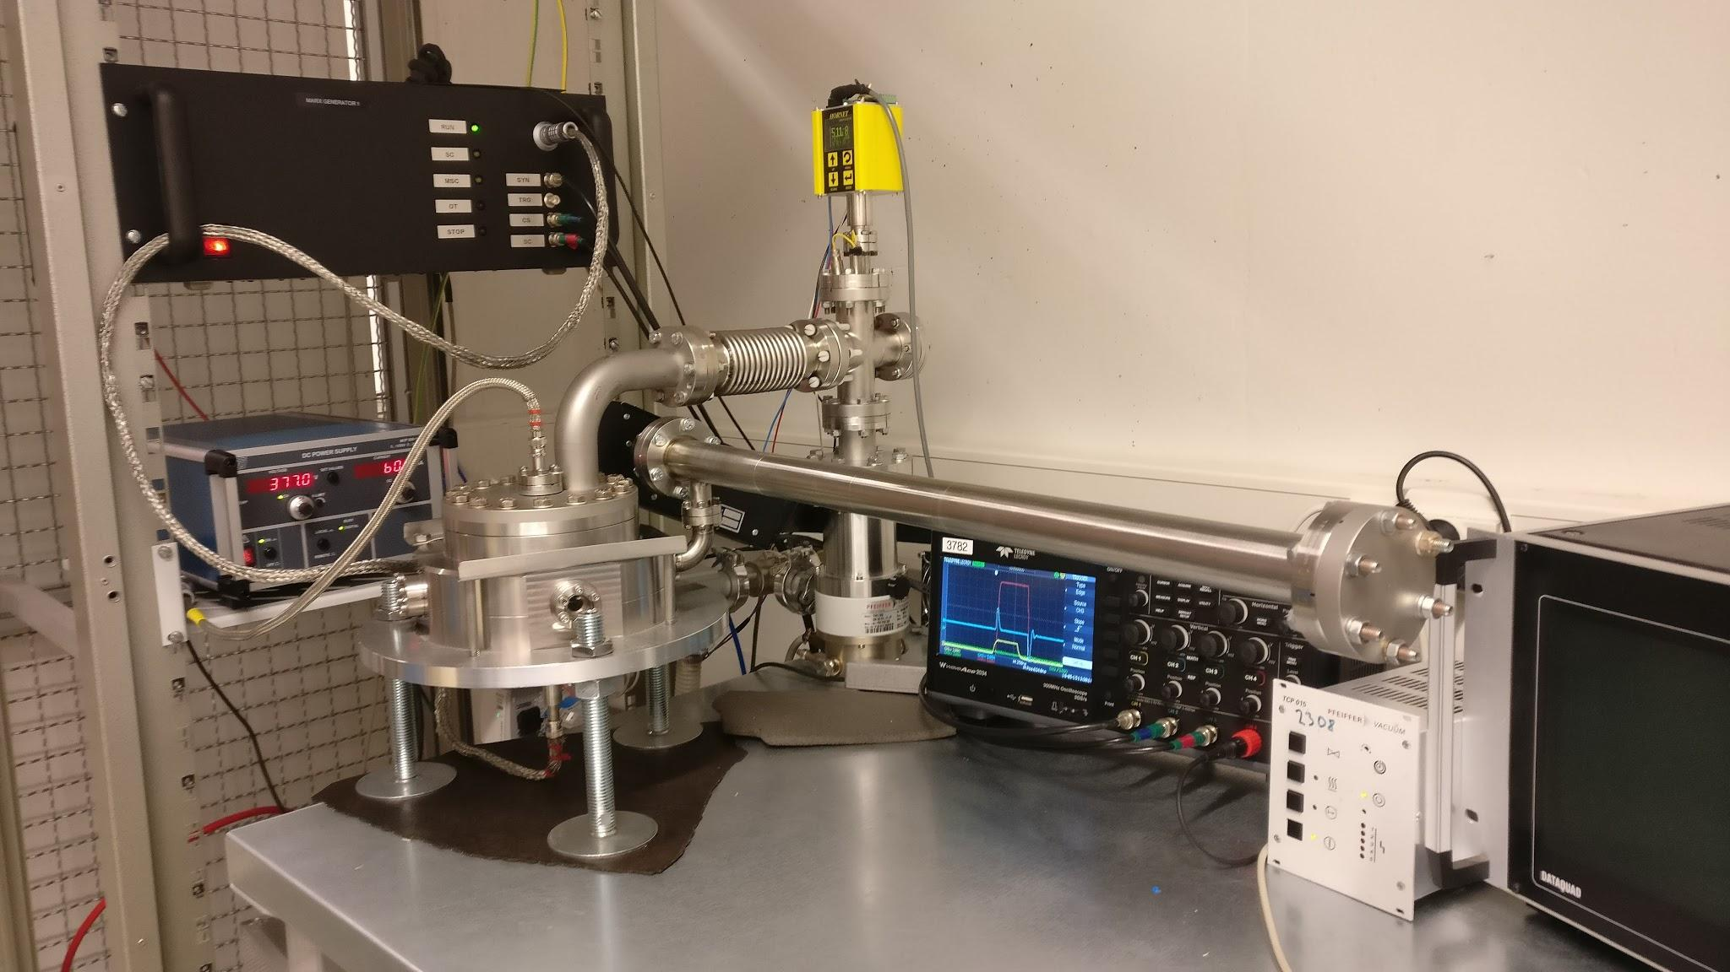
Experimental setup:
DC Spark System & Marx Generator
Cu electrodes
  62 mm diameter
  60 µm gap
Short DC pulses
  Electric fields
  even > 100 MV/m
  Pulse length ~ 1 µs
  Frequency up to 6 kHz
  High Vacuum
  (~ 10⁻⁸ mbar)

Slide 4
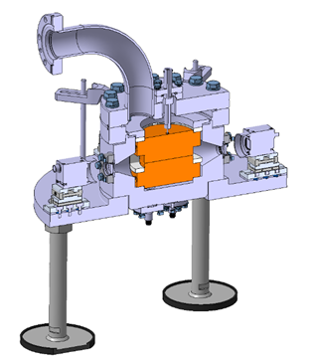
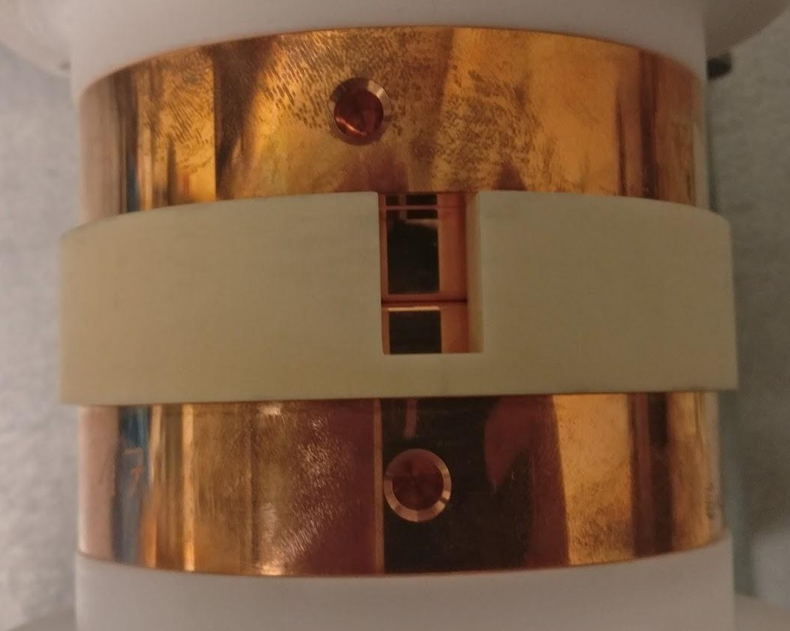
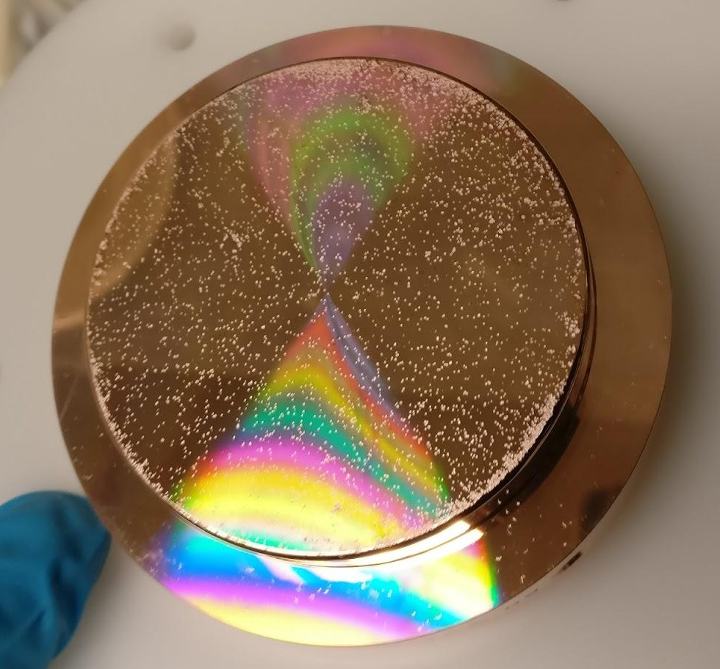
Large Electrode System

Slide 5
Flat mode & ramping
Flat mode = Constant target voltage regardless of breakdowns
Steady pulsing at 1-2 kHz, small pauses every 100 000 pulses
  Change of “period”
Pulsing stops at BD, after which the voltage is asymptotically ramped back to target from 1/5th
  “Exponential ramping”, 20 steps of 100 pulses on each

Slide 6
Breakdown statistics

Slide 7
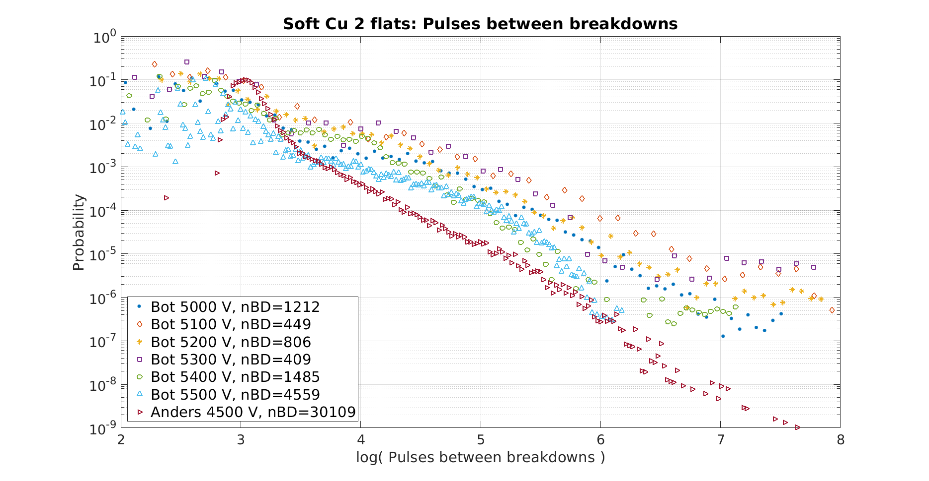
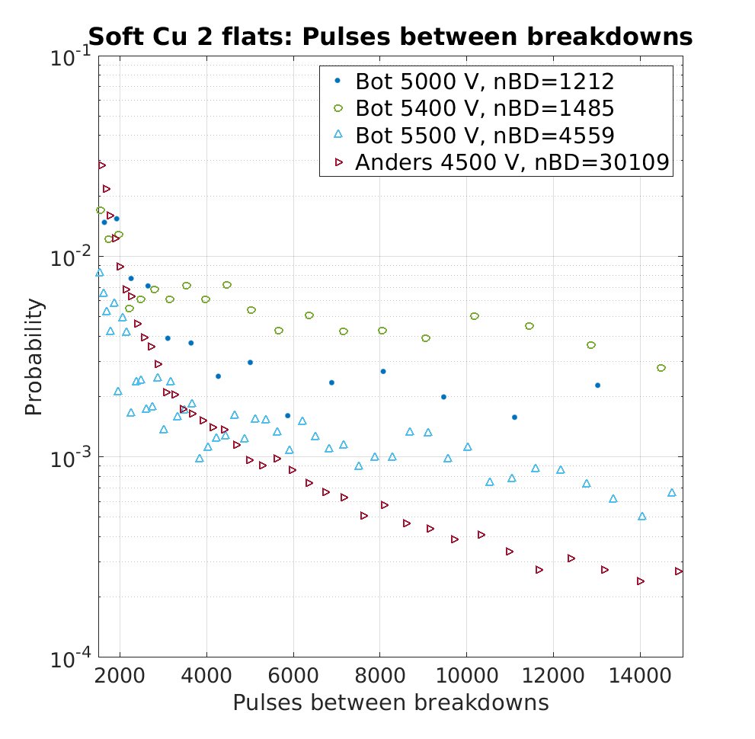
BD classification based on double Poissonian?
¹
¹ Wuensch, W., Degiovanni, A., Calatroni, S., Korsbäck, A., Djurabekova, F., Rajamäki, R., & Giner-Navarro, J. (2017).

Slide 8
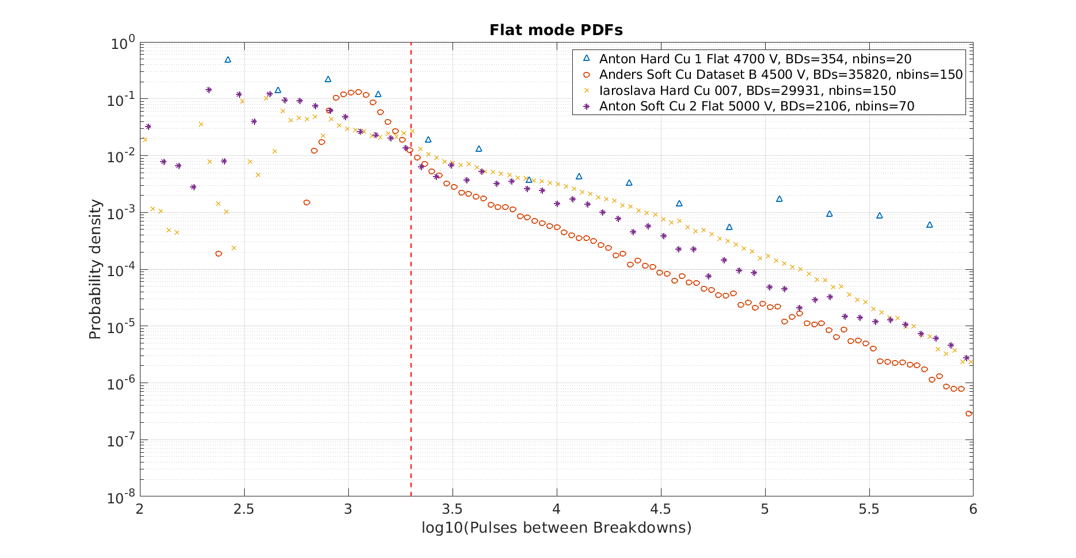
BD classification based on double Poissonian?

Slide 9
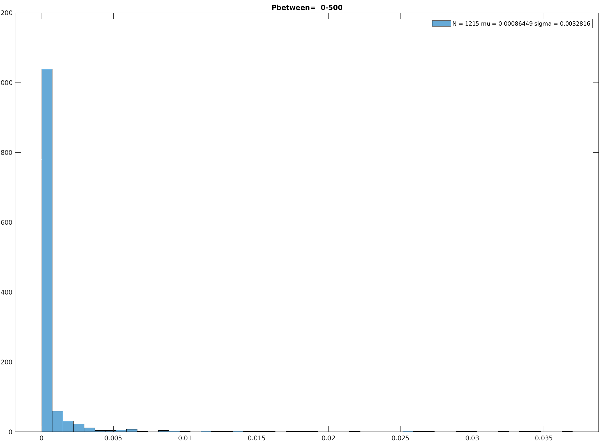
BD classification based on location?
Distance between consecutive BDs
Separated by number of pulses in between
Data: Iaroslava Hard Cu 007
Peak disappears at ~5000 pulses!
Distance (mm)
0 5 10 15 20 25 30 35

Slide 10
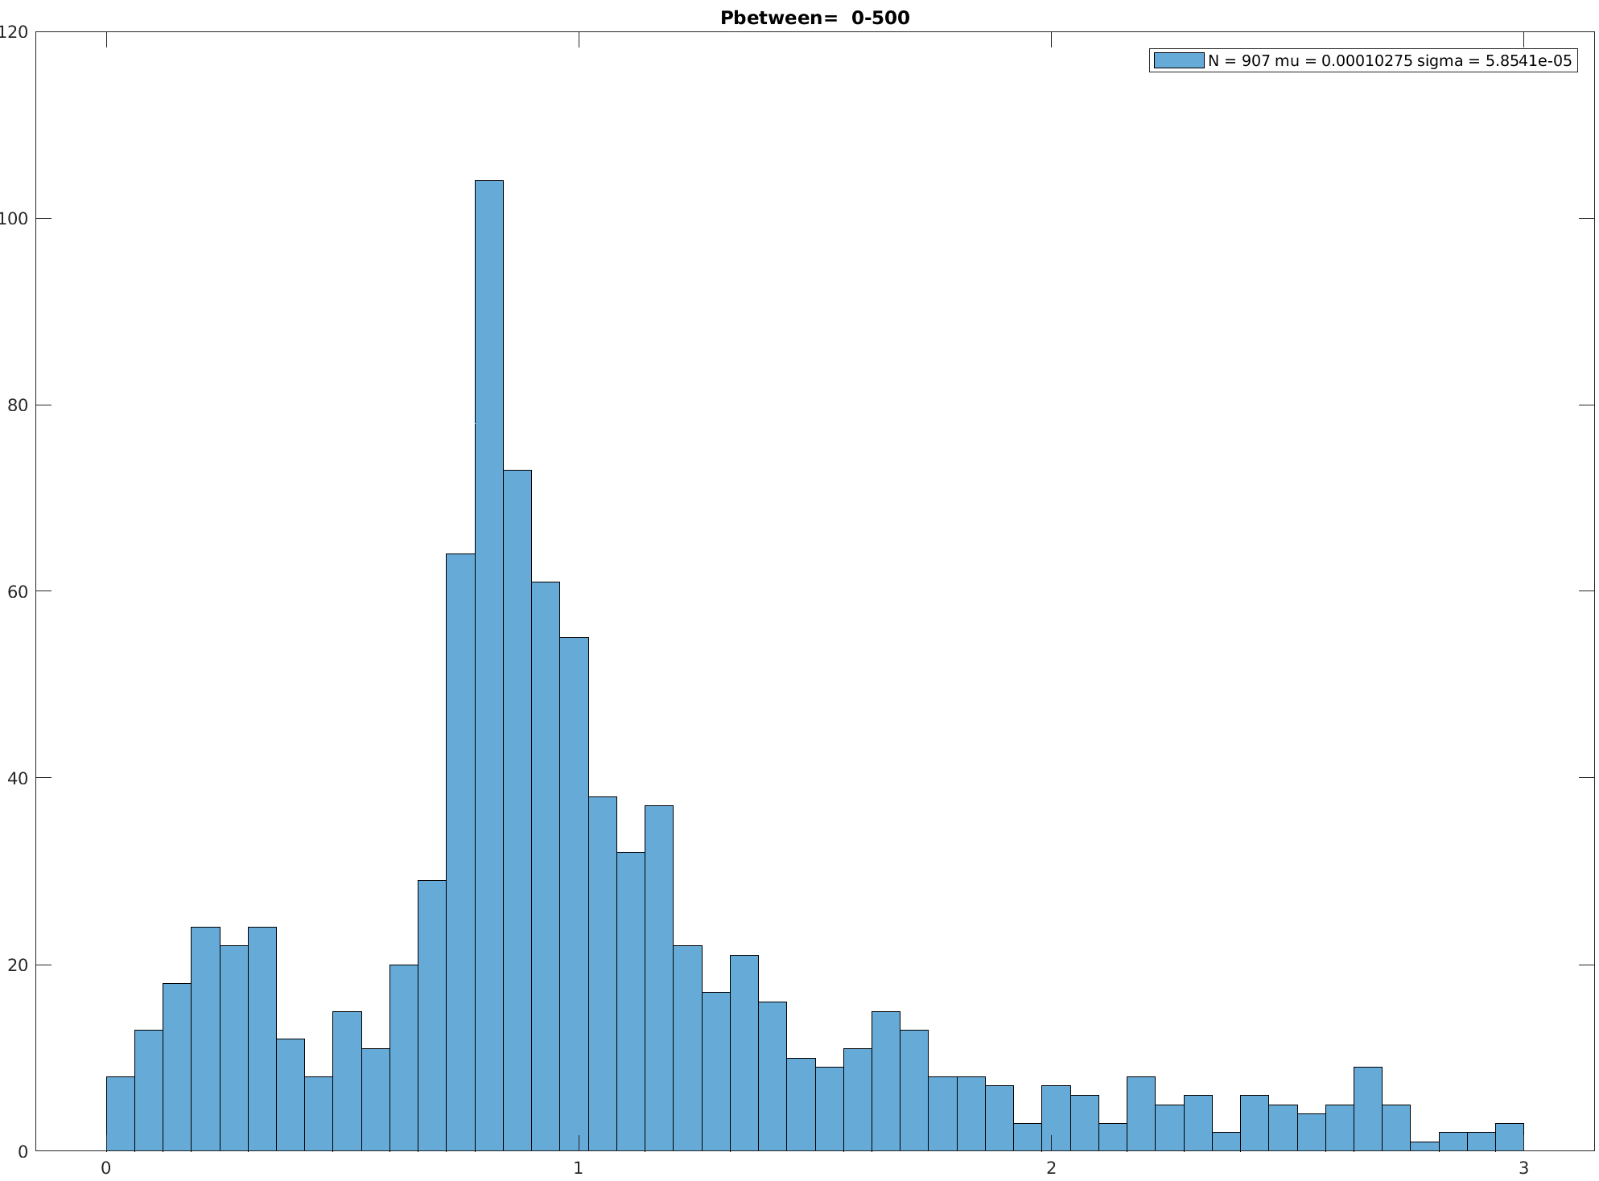
BD classification based on location?
Distance between consecutive BDs
Distance between consecutive BDs
Separated by number of pulses in between
Data: Iaroslava Hard Cu 007
Zoomed to closest 300 µm
Peak disappears at ~3000 pulses!
Distance (µm)
0 100 200 300

Slide 11
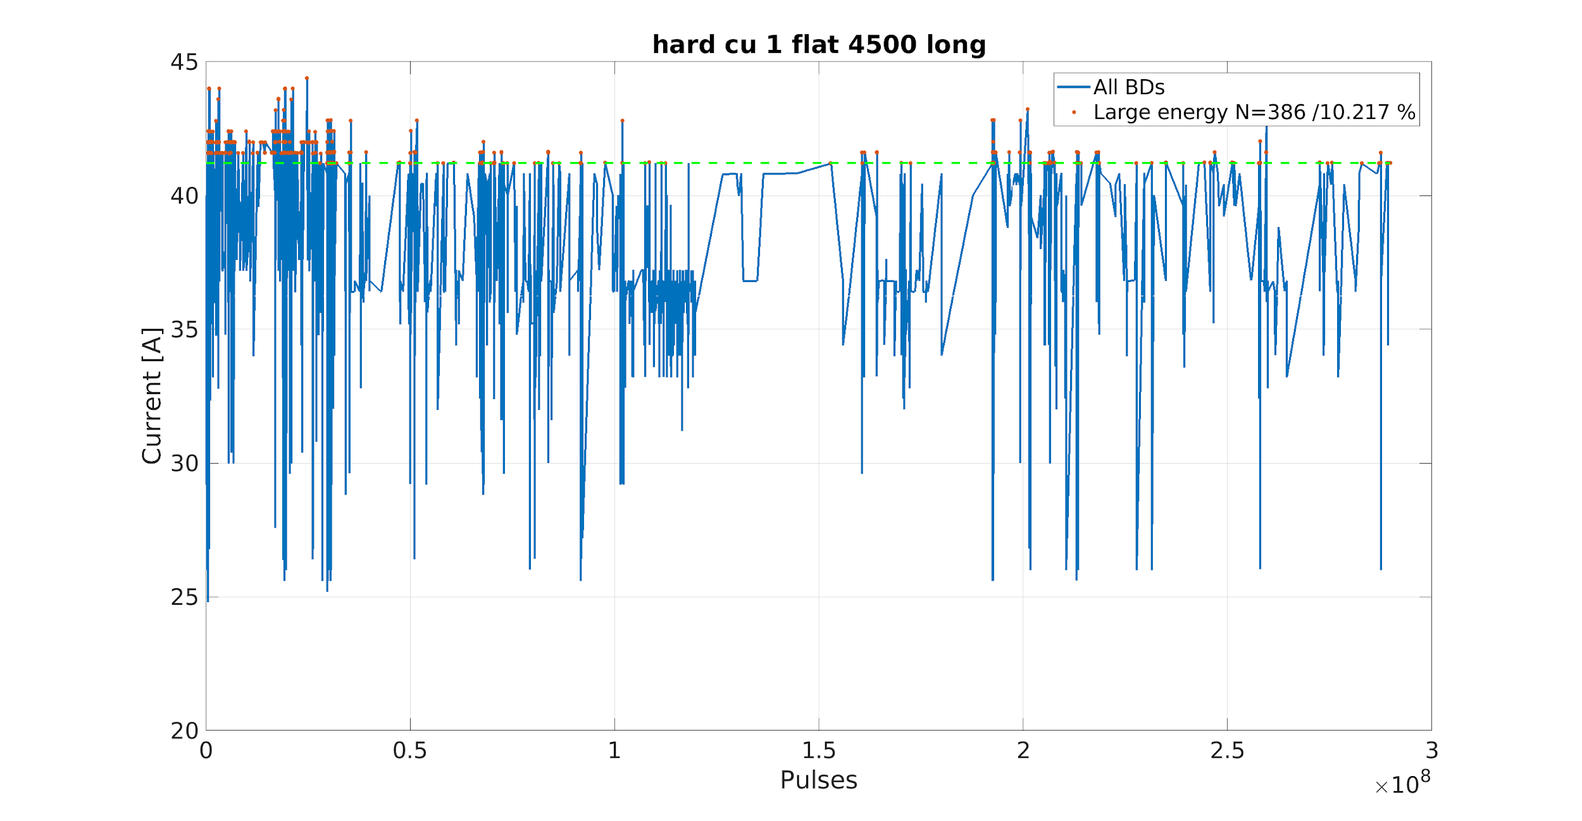
BD classification based on BD currents?

Slide 12
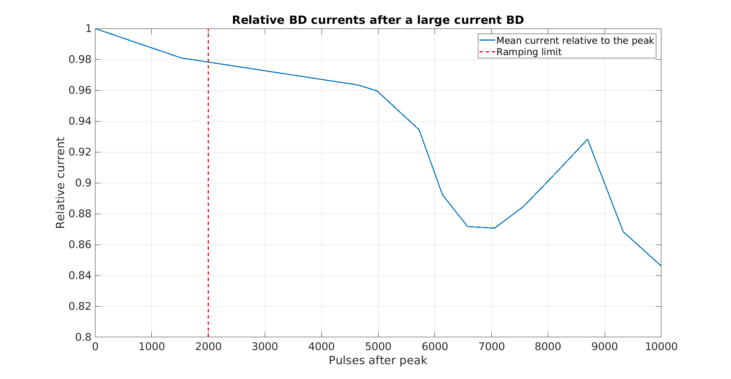
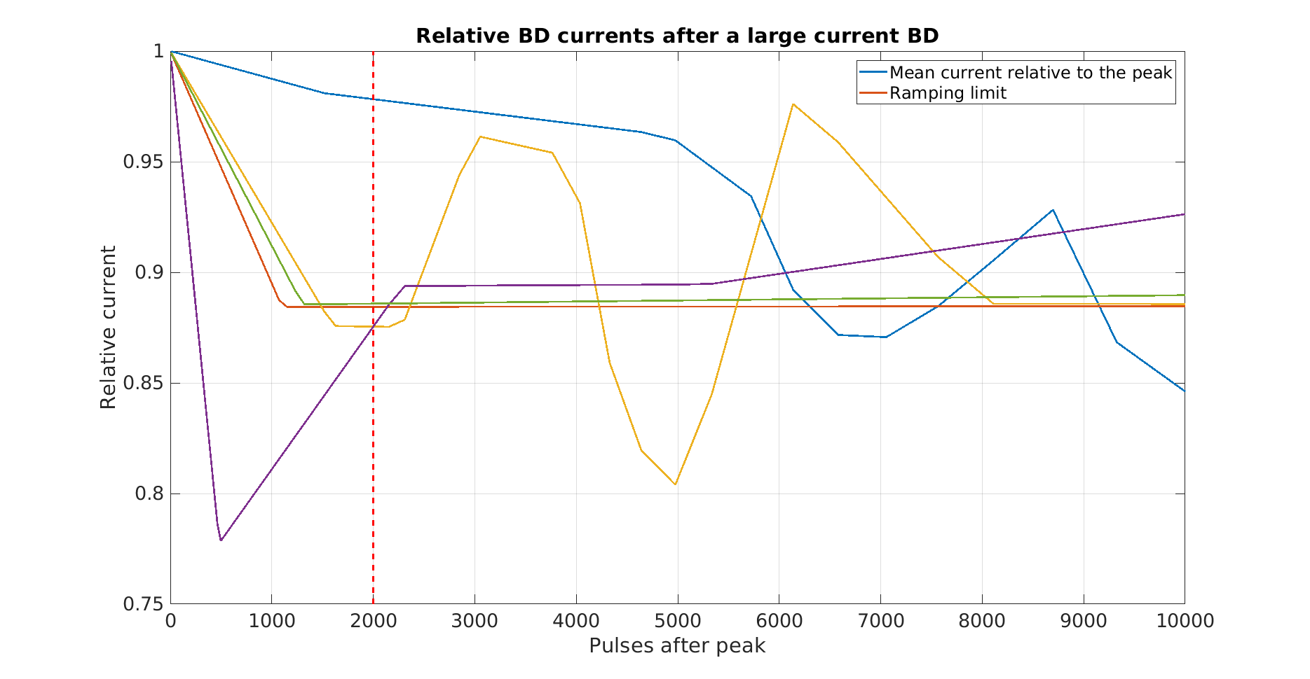
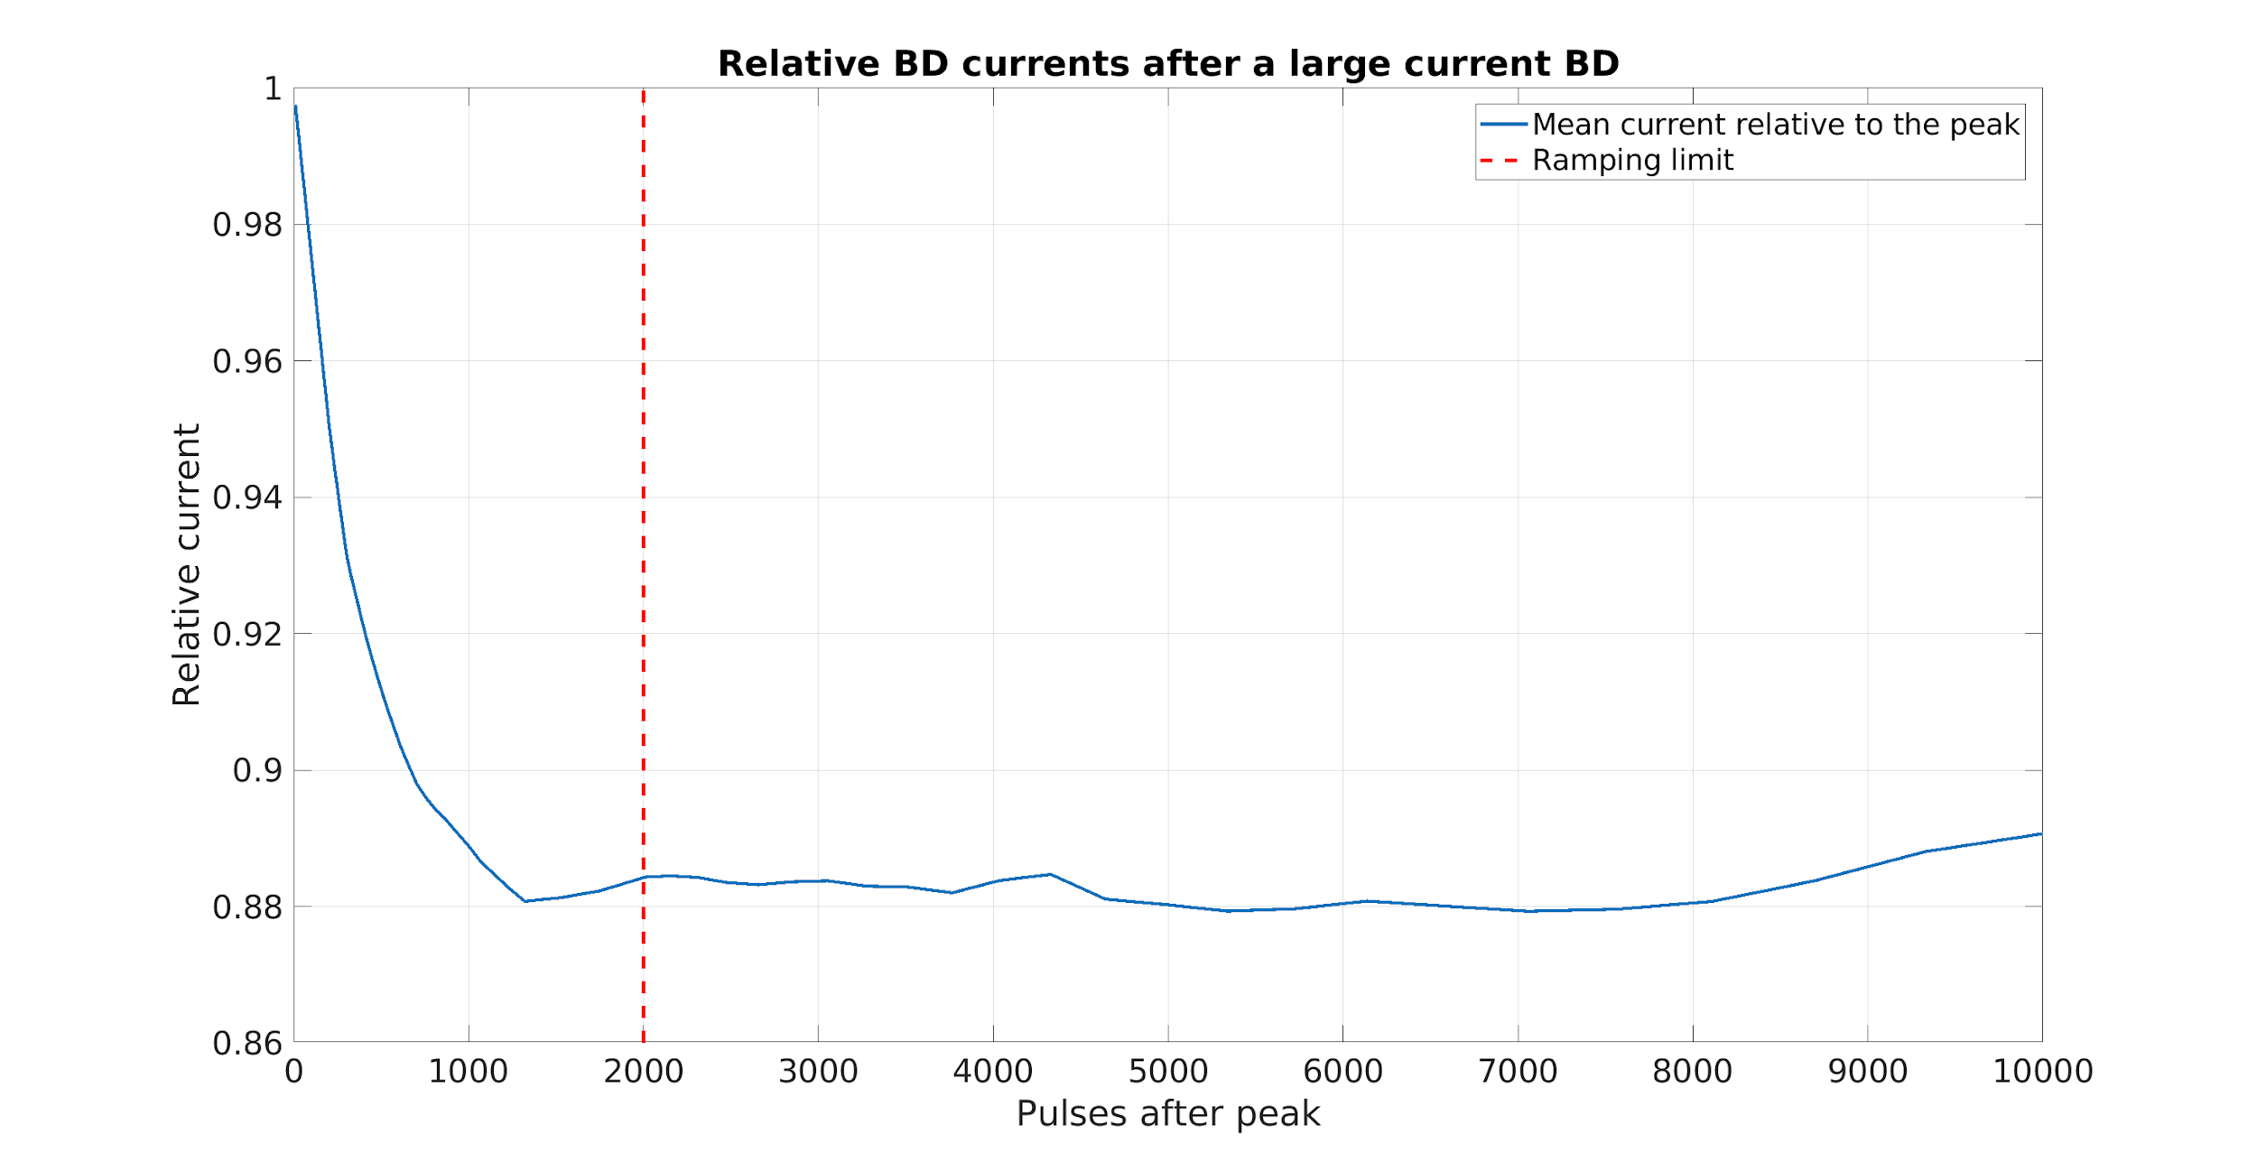
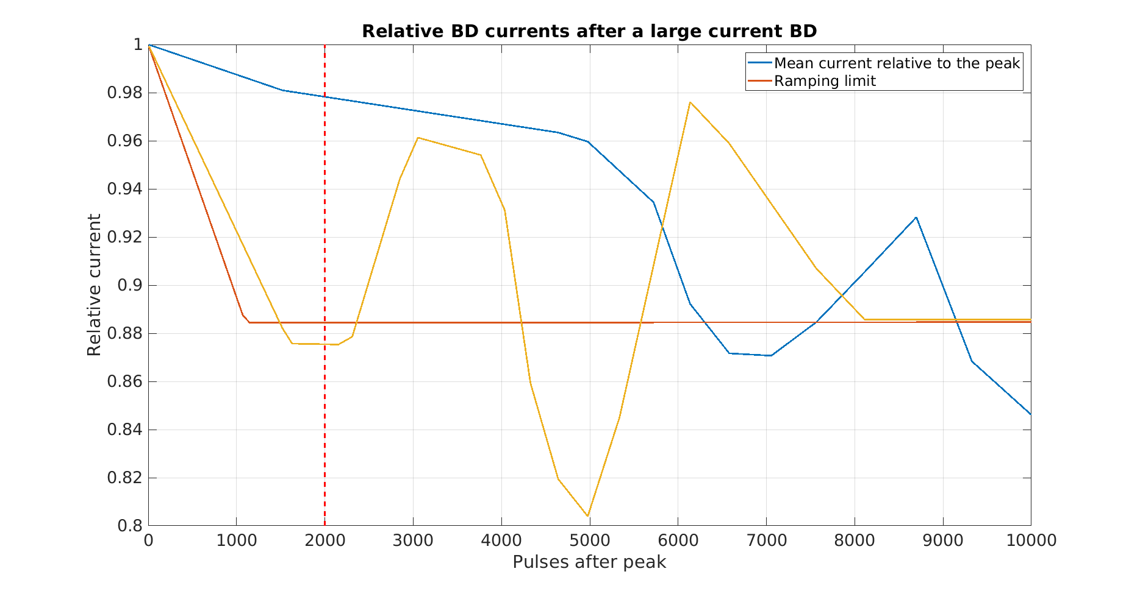
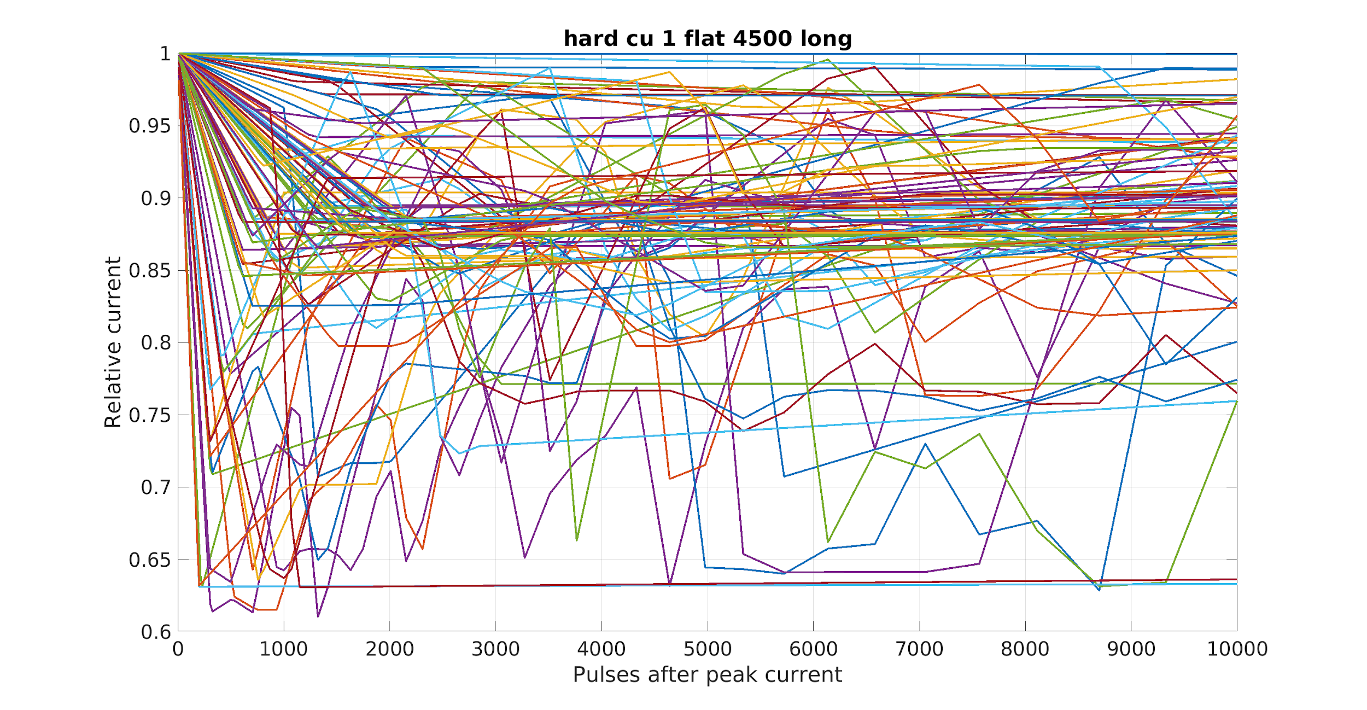
Currents after a big BD

Slide 13
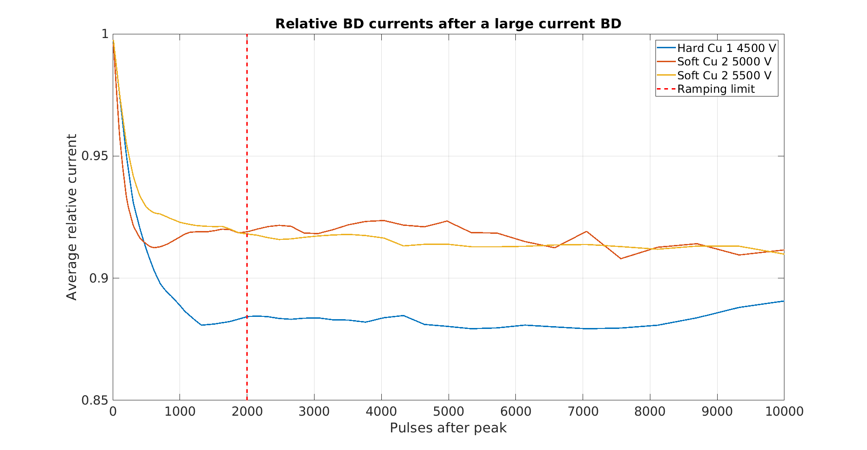
Mean of all the followup-currrents

Slide 14
He implanted Cu electrodes

Slide 15
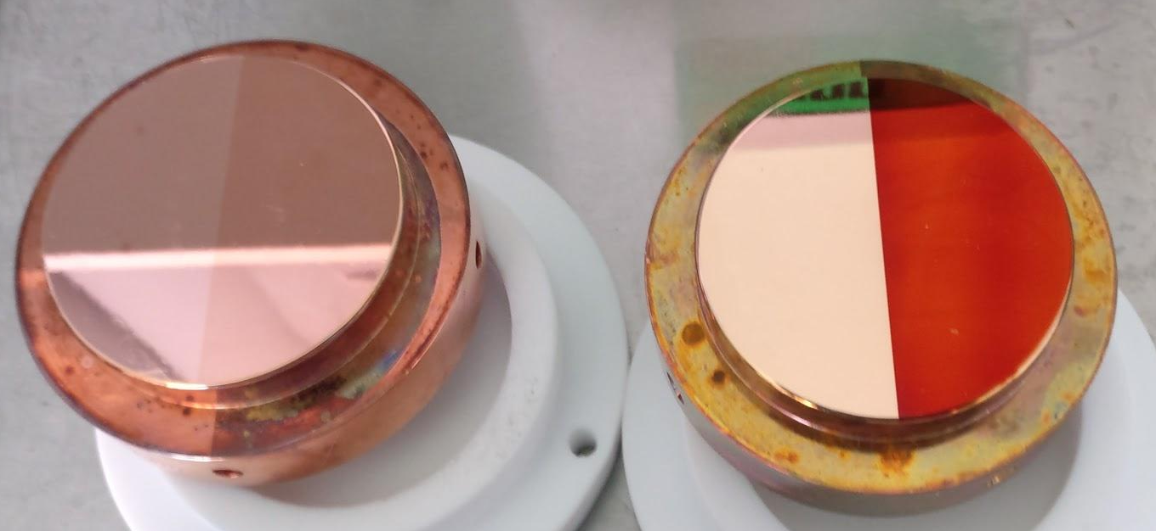
He implantation
Irradiation in 2015
  He⁺ with 30 keV
  Fluence 6.7 x 10¹⁶ He/cm² (around 5 at.%)
  🠞 vacancy clusters up to 300 nm from the surface

Slide 16
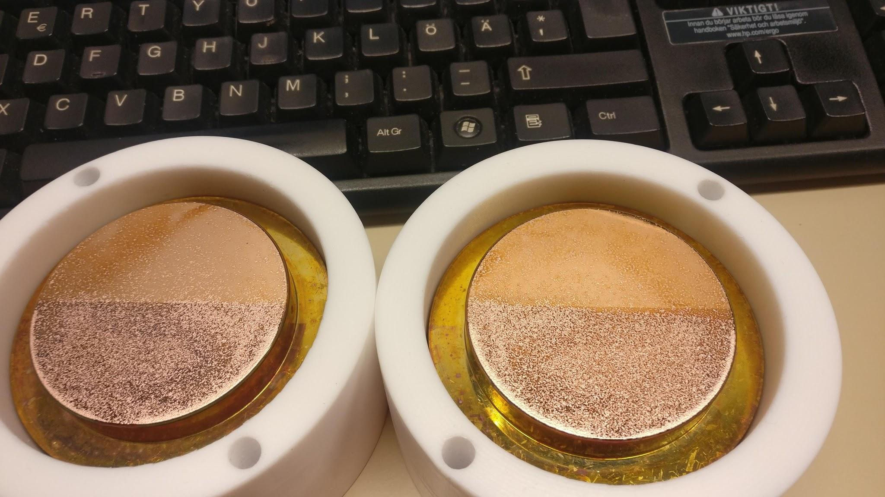
First results in June
noHe
noHe
He
He
Cathode
Anode

Slide 17
Twisting the electrodes
noHe
He
noHe
He
Cathode
Anode

Slide 18
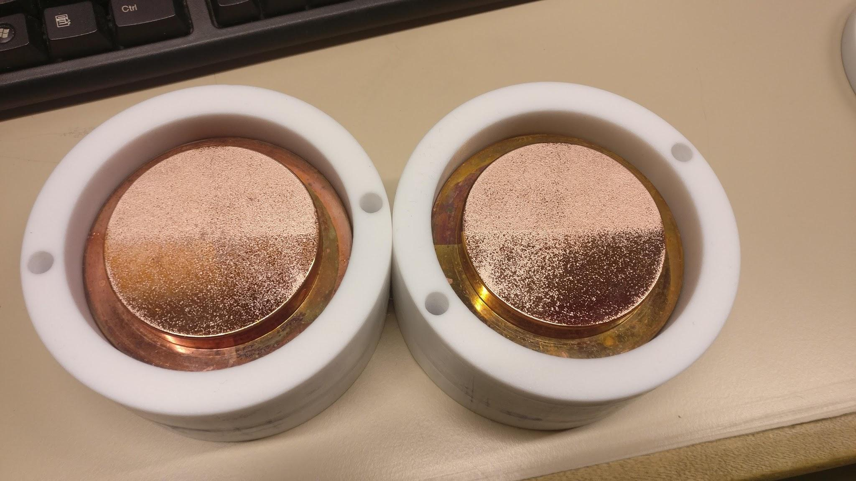
Twisting the electrodes makes a difference
noHe-noHe
noHe-noHe
noHe-He
noHe-He
noHe
noHe
He
noHe
He
He
He
noHe
He-He
He-noHe
He-noHe
He-He
Cathode
Anode

Slide 19
Surface composition
Both halves investigated using ERDA
Helium still detectable: 3 x 10¹⁶ He/cm² detected
  Surface now distorted due to BDs, so far exact
Also hydrogen, carbon and oxygen visible
  Carbon appears to be slightly deeper on He side

Slide 20
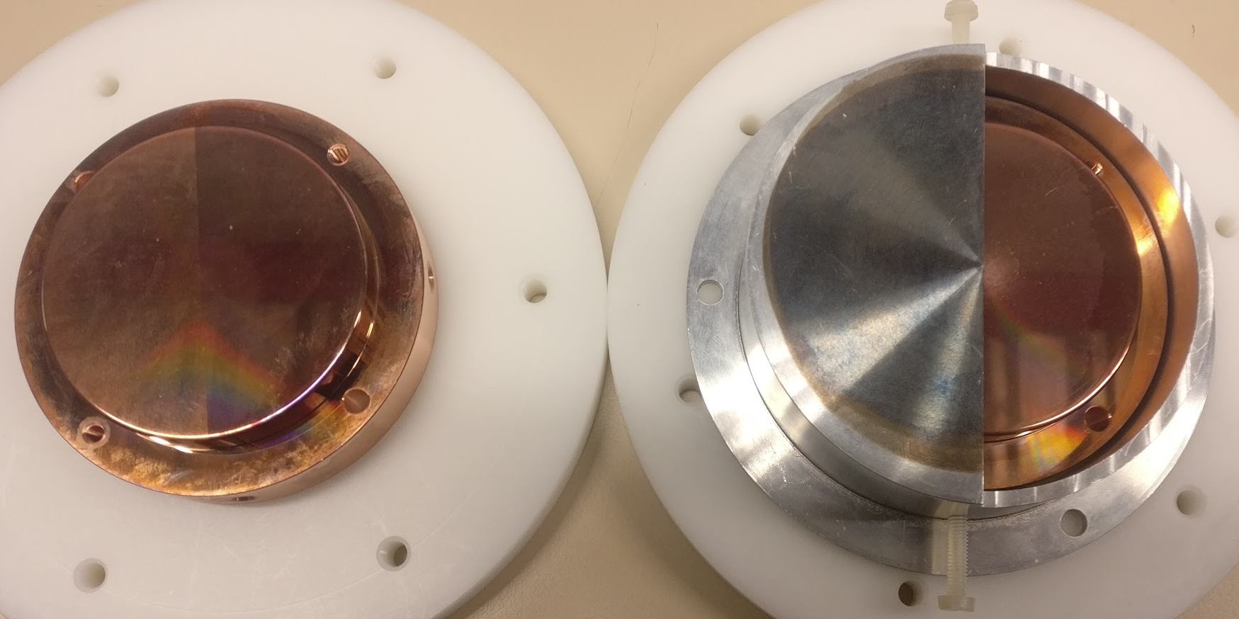
Next: Further investigation with He implantation
Pristine Hard Cu pair has just been implanted
  Same energy & fluence as previously
  Elemental composition & surface smoothness analysis before breakdowns
Differences between implanted Hard and Soft Cu?

Slide 21
Next challenges
Right now
Longer term plans
Wrapping up the statistics as a publication
Smaller Cu samples with different hardness levels
  Annealing & polishing
  Measuring with ultrasound & XRD
Quantifying the effect of ramping
Surface chemistry
BD experiments with smaller electrodes
Field Emission measurements

Slide 22
Conclusions
BD classification possible, but more proof needed
He irradiation seems to introduce BDs
Tradeoff between fundamental physics & applications
Anton Saressalo
anton.saressalo@helsinki.fi
Mini MeVArc 2018, November 13th

