Slide 1
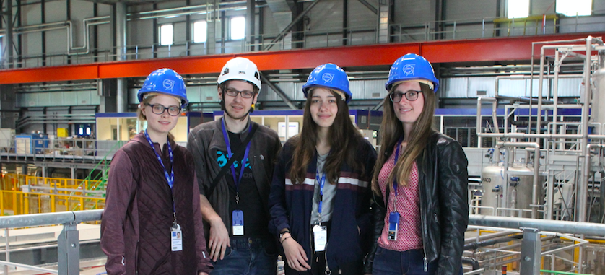
Development of electronics modules as communication bridges in test setups
Katharina Härdl and Franziska Große-Kreul
        Supervisor: Severin Haas 17.05.2019

Slide 2
Table of contents
Our task
What is a quench?
Quench protection
Kicad
Communication bridge
  Circuit diagram
  Soldered board
Visits
  Large Magnet Facility
  Neutrino Platform and Control Center

Slide 3
Our task
Build a communication bridge which connects the electronics board under test with a computer to test it.

Slide 4
What is a quench?
Sudden terminations of magnet operations
Rapid change of superconducting to resistive state
Can cause serious damage to the magnet (local thermal hotspot)
The liquid helium (1.9 K) evaporates, would cause explosion
https://www.universetoday.com/21895/first-images-emerge-of-damage-to-the-lhc/
Example of consequences of a quench (LHC, 2008)

Slide 5
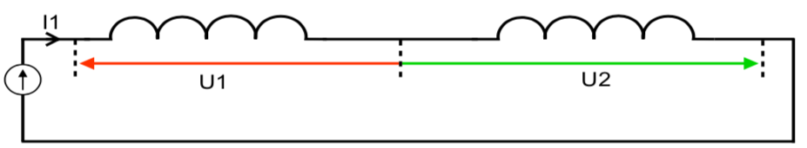
Quench protection
To terminate the operation, the quench must be detected
    Measuring the voltage across the magnet
      The quench electronics has to be tested

Slide 6
Quench Protection
Two voltage
measurement channels
Internal TE-MPE-EP wiki
One voltage and one current
measurement channel
Internal TE-MPE-EP wiki

Slide 7
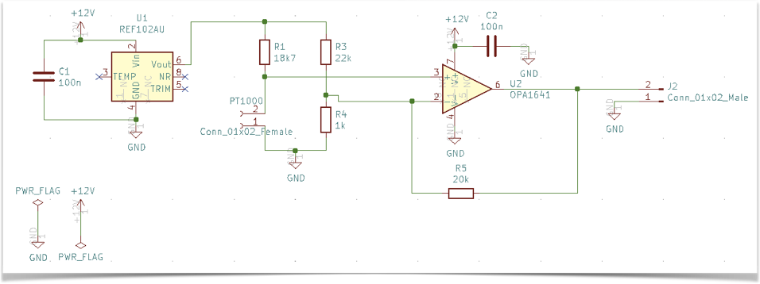
Kicad - Creating a circuit diagram
Learning to use Kicad - Temperature sensor

Slide 8
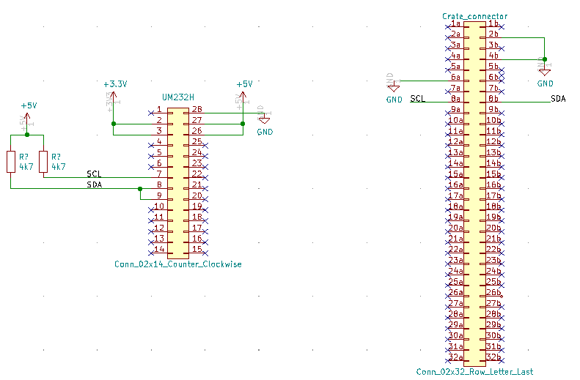
Communication bridge
Needed to connect the test setup on a computer with the quench electronics
FTDI 232H
Circuit Diagram

Slide 9
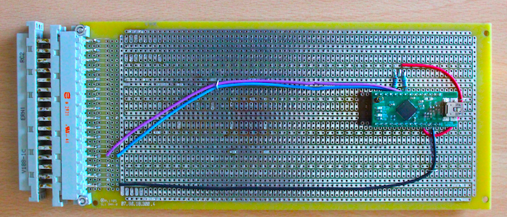
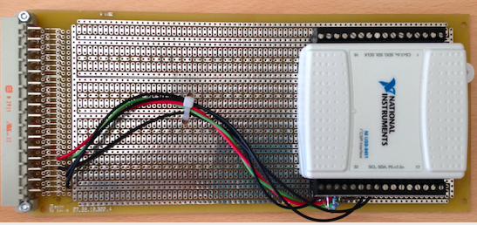
Soldered
Board
Based on
this model which
shall be replaced

Slide 10
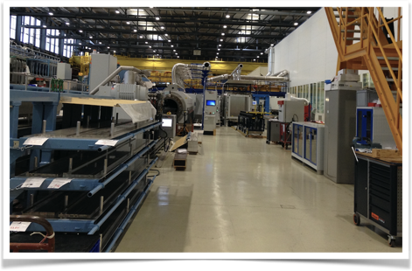
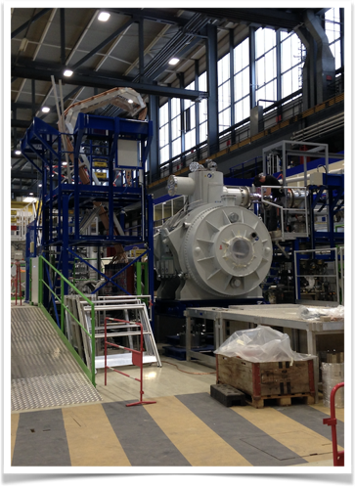
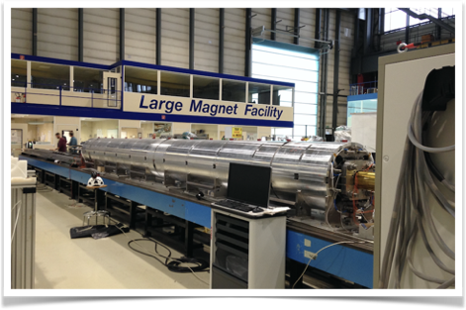
Visits
Large Magnet Facility

Slide 11
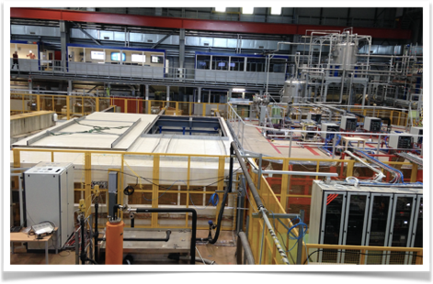
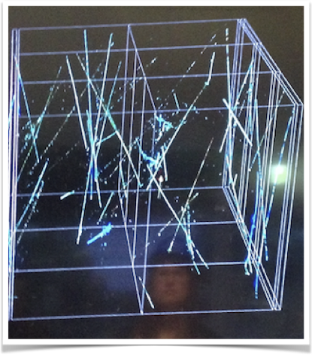
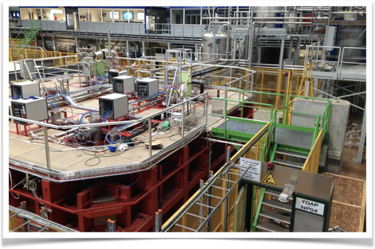
Neutrino Platform

Slide 12
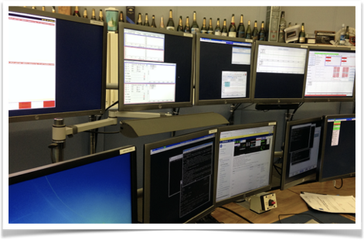
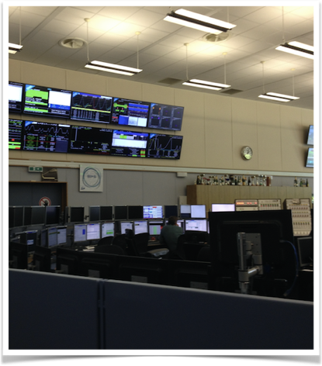
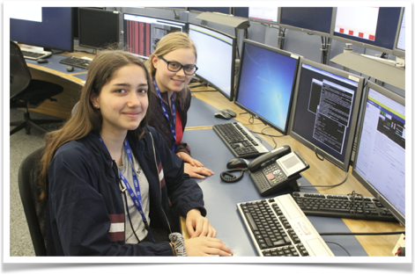
Control Center

Slide 13
Thank you for listening
      Are there any questions?

