Slide 1
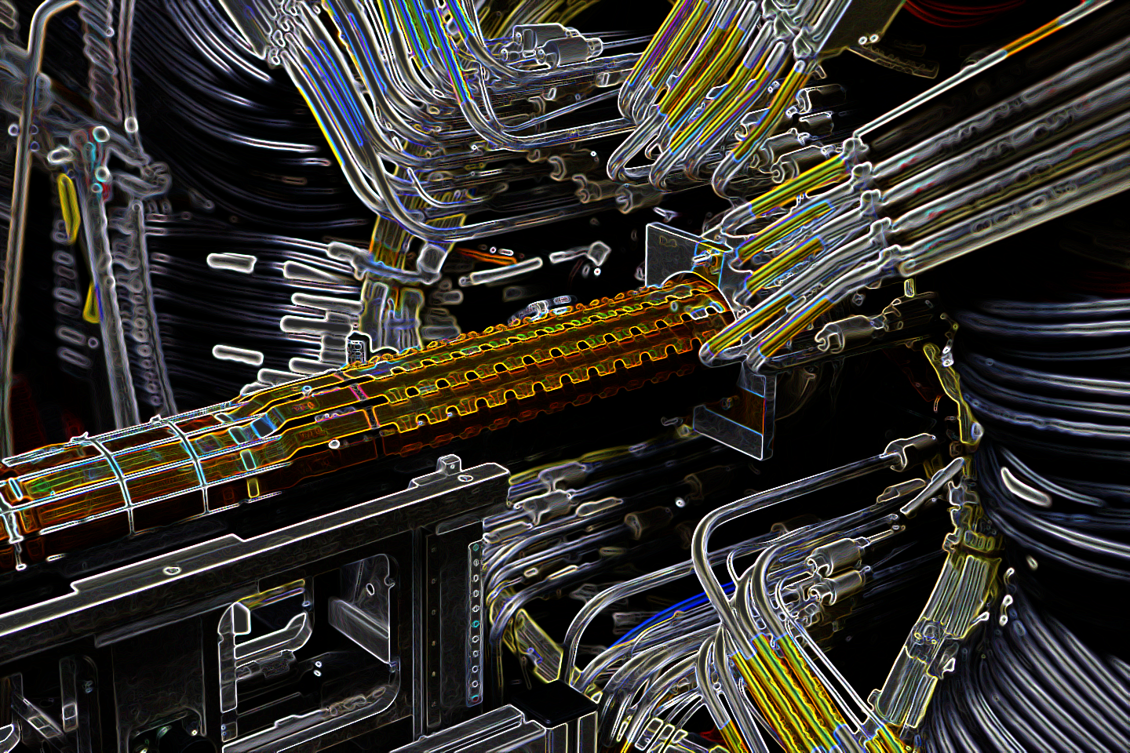
Save the ATLAS Pixel Modules
a presentation by Maria Klar and Alexander Gundermann

Slide 2
structure
1st – Theory and approach to the project
2nd – Programming the tool
3rd – Designing the Printed Circuit Board (PCB)
4th – Conclusion and reflection of our project work

Slide 3
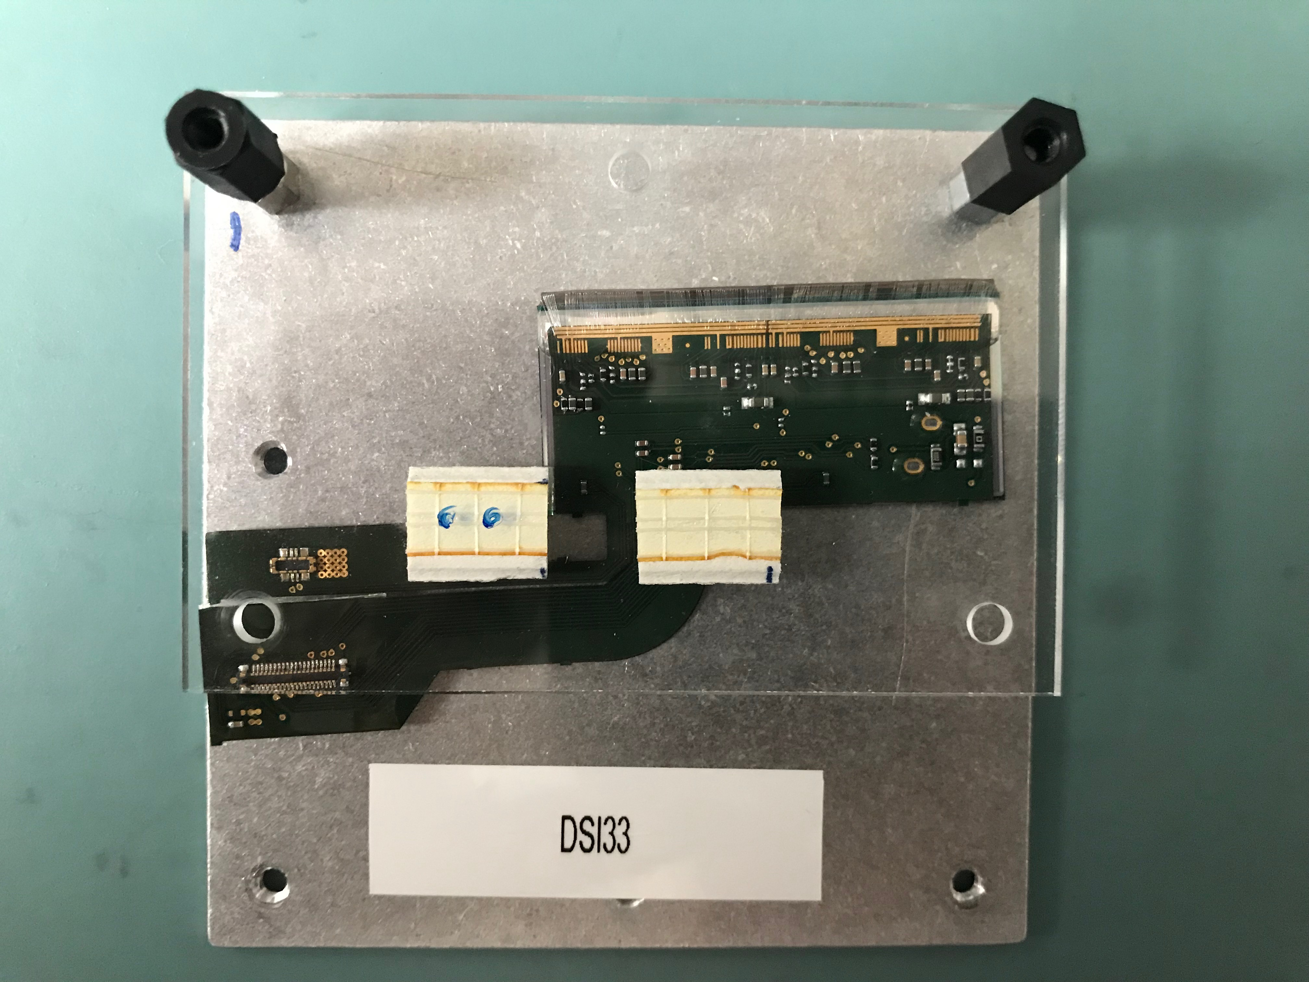
1st – Theory and approach to the project

Slide 4
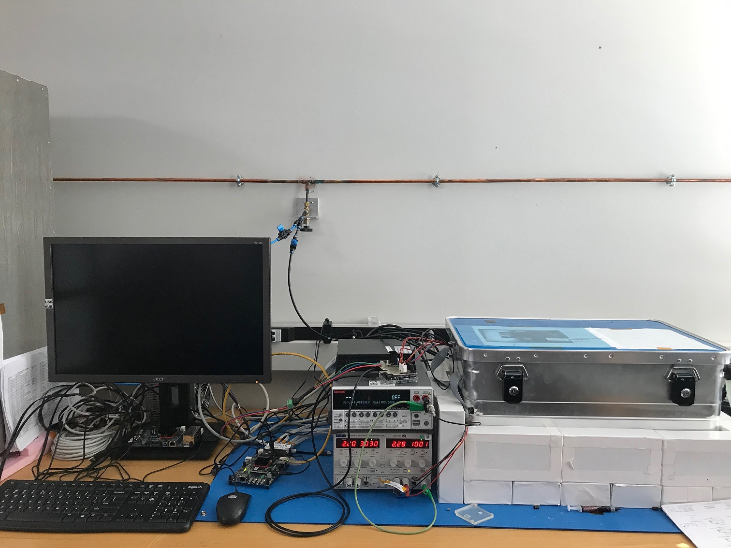
1st – Theory and approach to the project

Slide 5
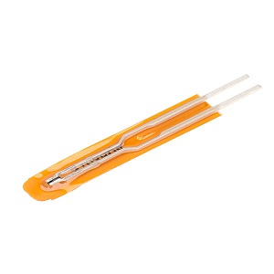
1st – Theory and approach to the project

Slide 6
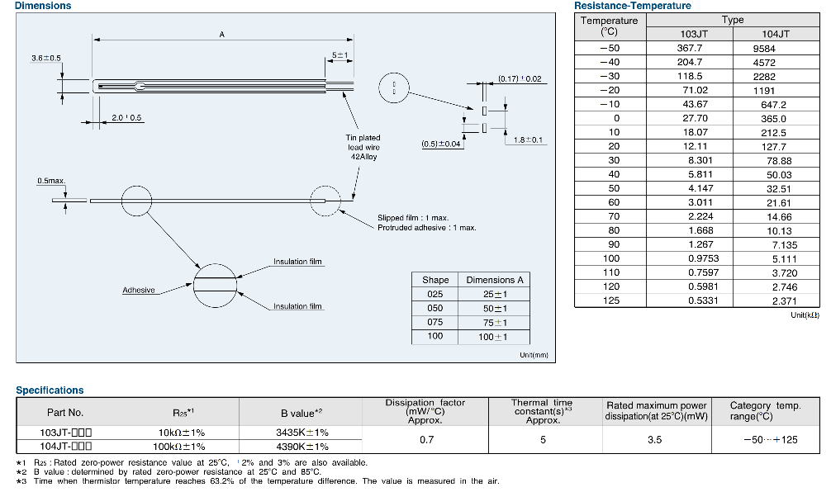
1st – Theory and approach to the project

Slide 7
1st – Theory and approach to the project

Slide 8
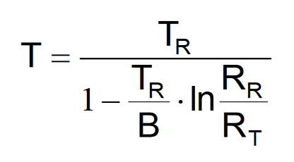
1st – Theory and approach to the project

Slide 9
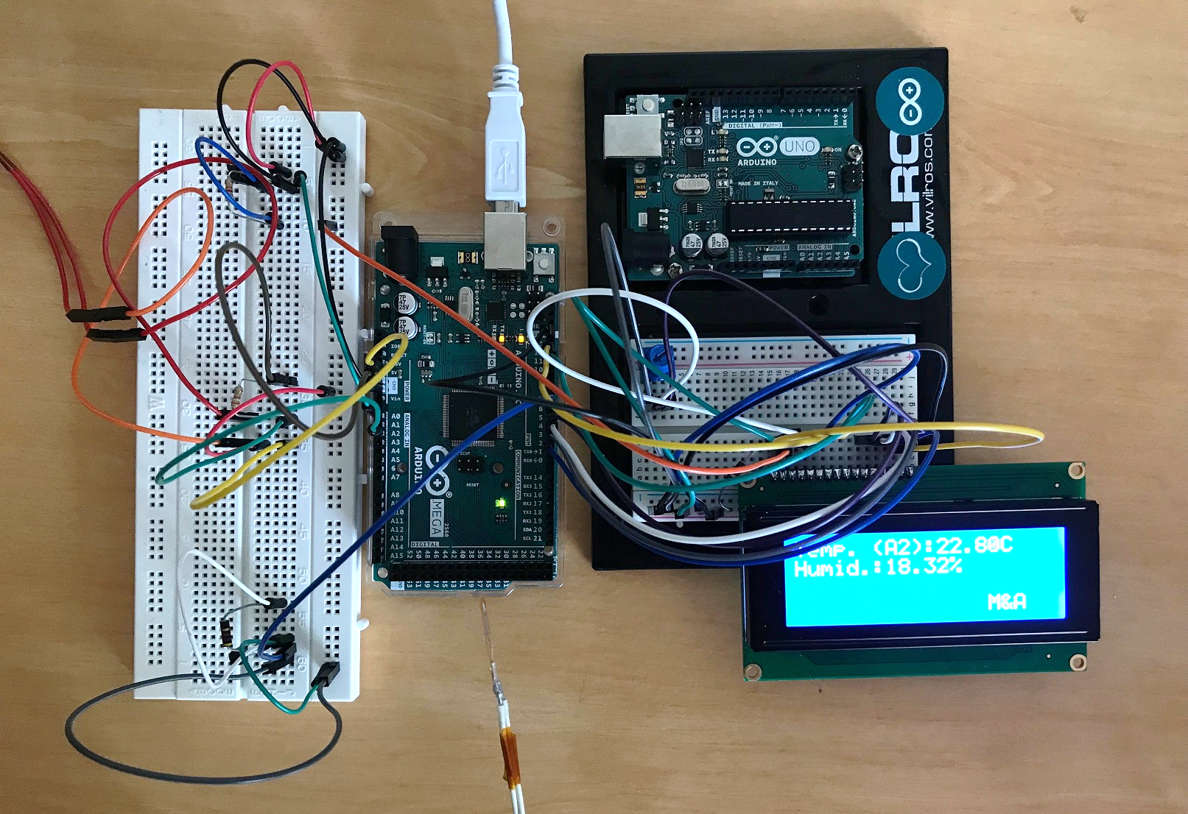
2nd – Programming the tool

Slide 10
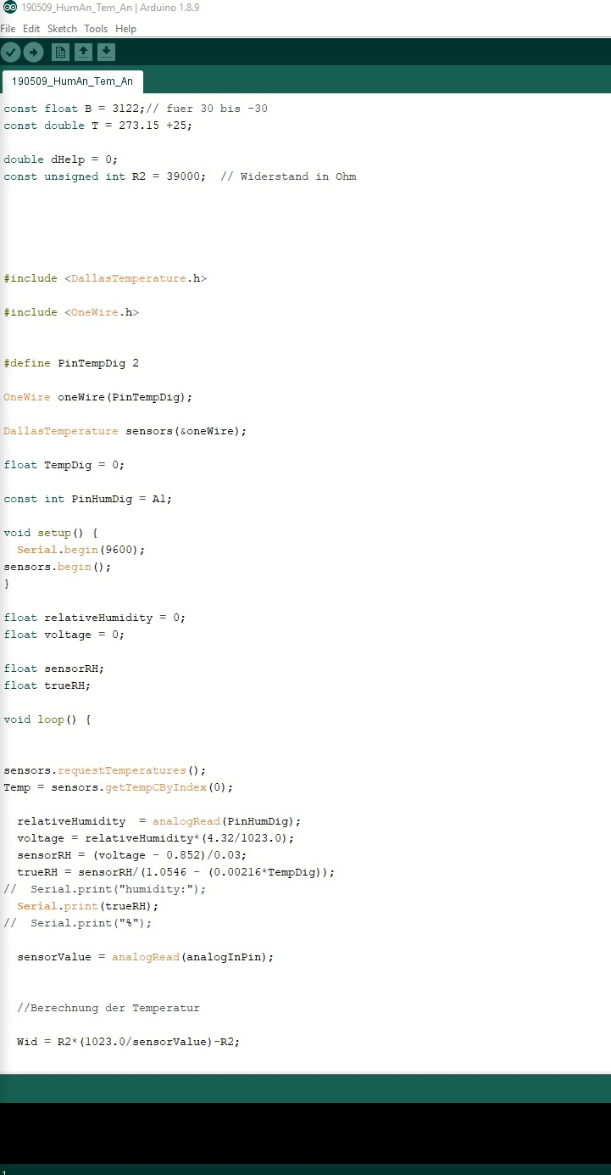
2nd – Programming the tool

Slide 11
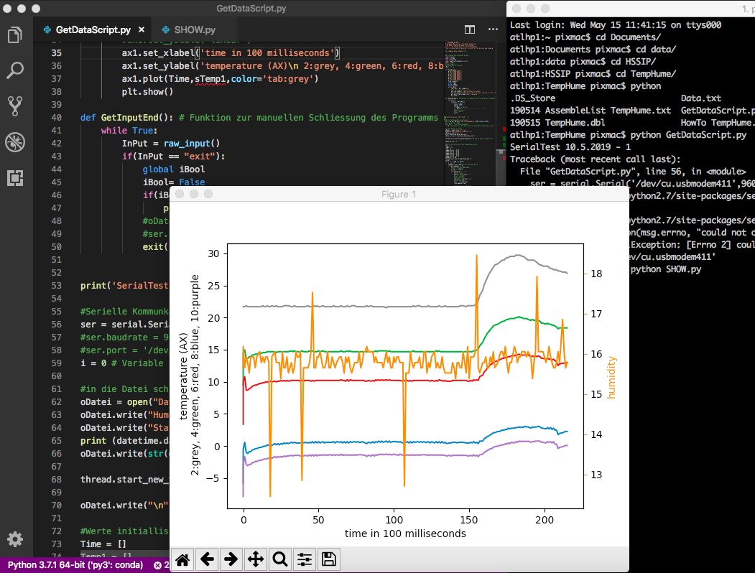
2nd – Programming the tool

Slide 12
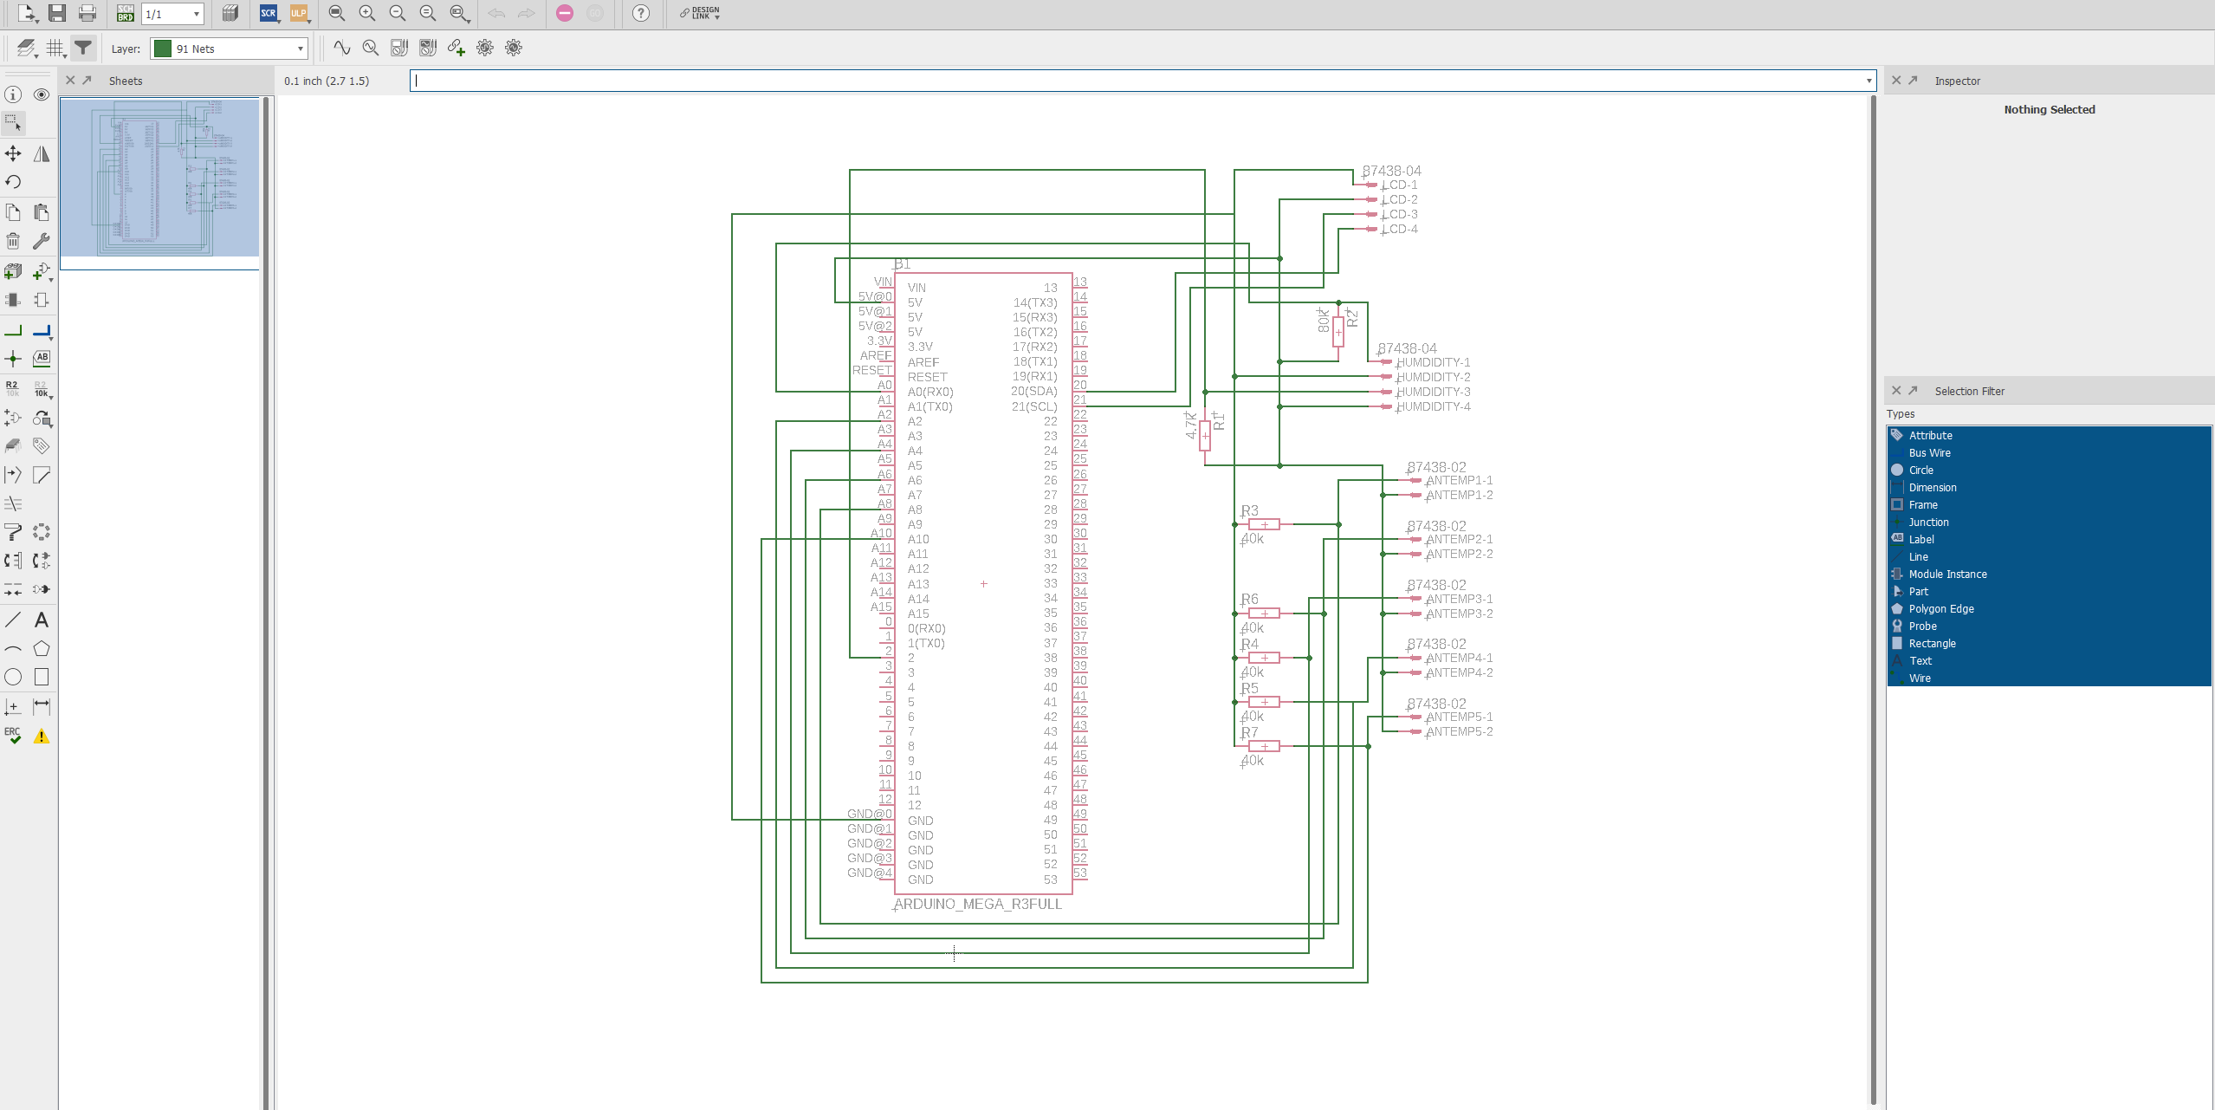
3rd – Designing the Printed Circuit Board (PCB)

Slide 13
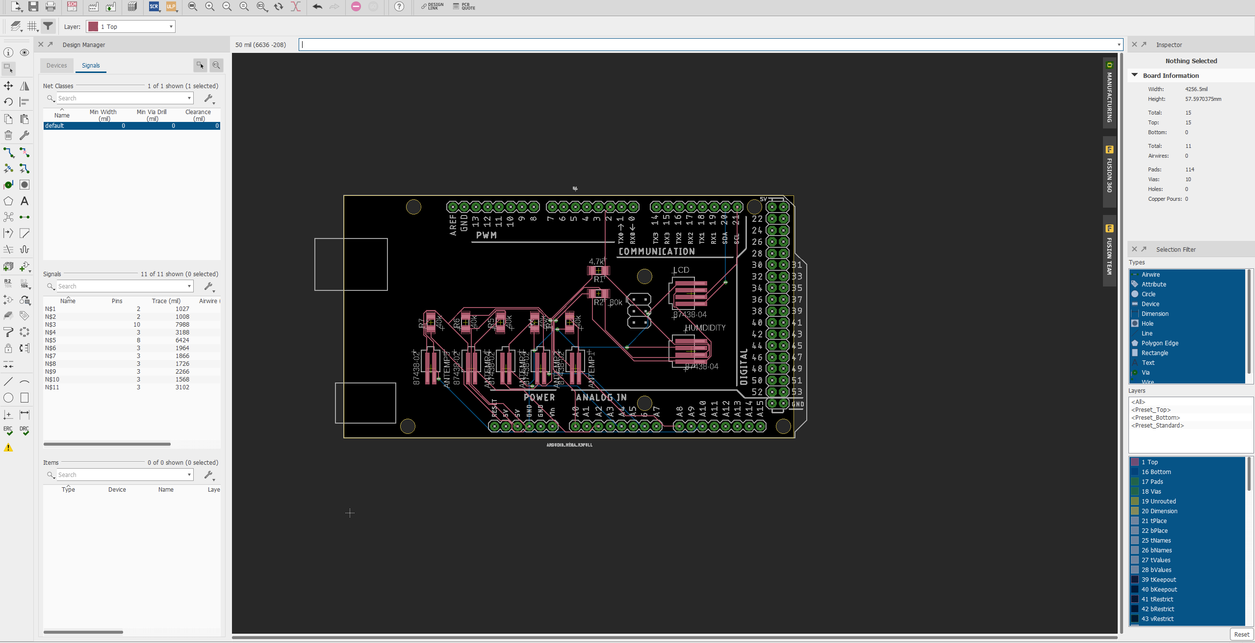
3rd – Designing the Printed Circuit Board (PCB)

Slide 14

4th – Conclusion and reflection of our project work

Slide 15
sources
home.cern/news/news/experiments/particular-new-podcast-atlas, 5/16/2019
rapidonline.com/atc-semitec-103jt-025-jt-thermistor-10k-025-shape-61-0430, 5/16/2019
controllersandpcs.de/lehrarchiv/pdfs/elektronik/pass01_03x.pdf, 5/16/2019
advertum.de/advertum_versicherungsmakler_versicherung_Betriebliche_Altersversorgung_ueberblick.php, 5/16/2019

Slide 16
Questions
?
?
?

Slide 17
Thank you for listening

