Slide 1



Cristian Pira
WP 15.2 Cleaning/polishing large sample substrates for RF facilities
6th ARIES WP15 Meeting, 31 August 2018

Slide 2
QPR Sample

Slide 3
QPR Sample
Copper part to be cleaned
From Riga Meeting Minutes:
Two samples will treated with EP and one sample with EP+SUBU5

Slide 4
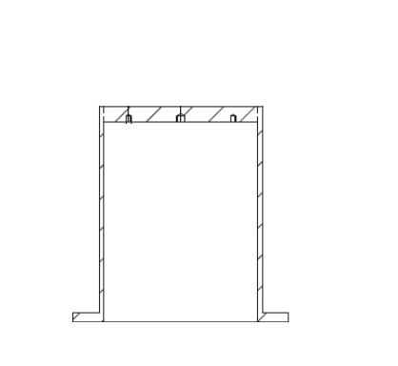

QPR Sample Polishing
-
+
Electropolishing
SUBU

Slide 5
QPR Sample Polishing risks
Surface defects due to bubble production

Slide 6
QPR Sample Polishing risks
Surface defects due to bubble production
Alternative: rotation of 90 ° and complete immersion of the QPR
Possible etching of Nb and brazing

Slide 7
QPR Sample Polishing Schedule
In September system assembling and test on copper samples
In October system ready for real QPR samples

