Slide 1
Status of RF characterisation facilities:
The HZB quadrupole resonator
Oliver Kugeler
6th WP15 ARIES meeting
31.08.2018

Slide 2
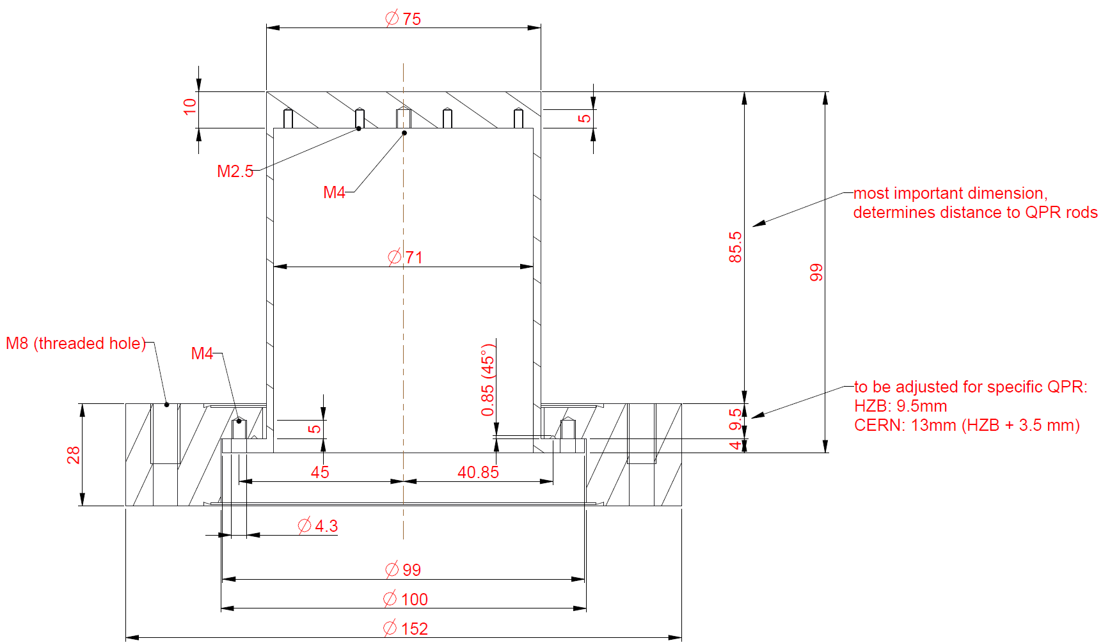
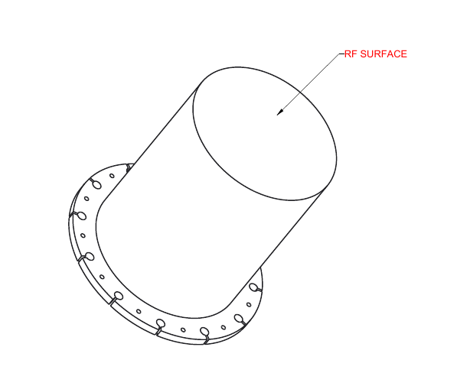
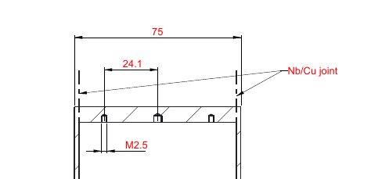
Samples to be manufactured at RI

Slide 3
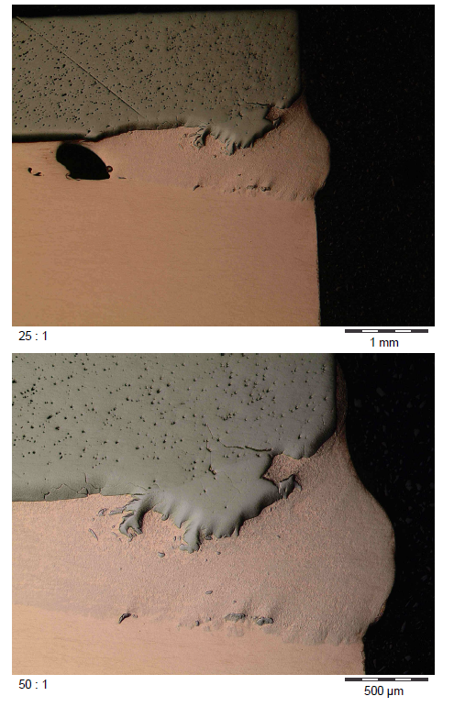
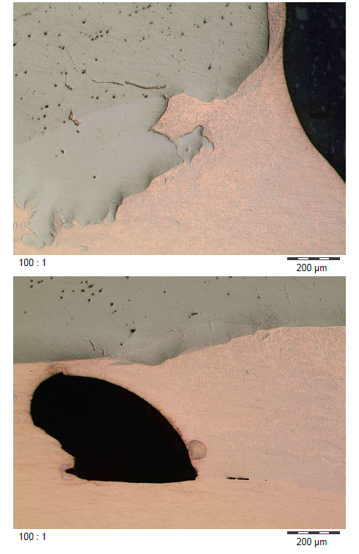
Status of sample production
Test welds Nb to Cu before etching, welding performed at RI
courtesy Research Instruments

Slide 4
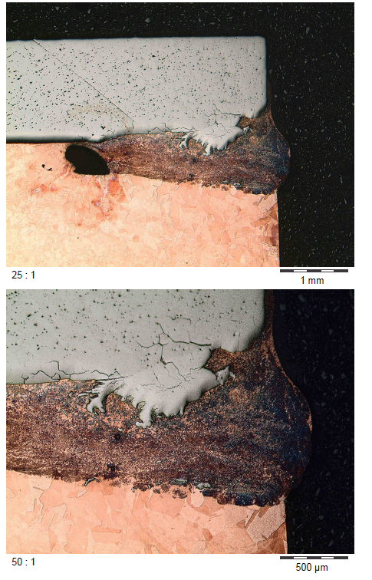
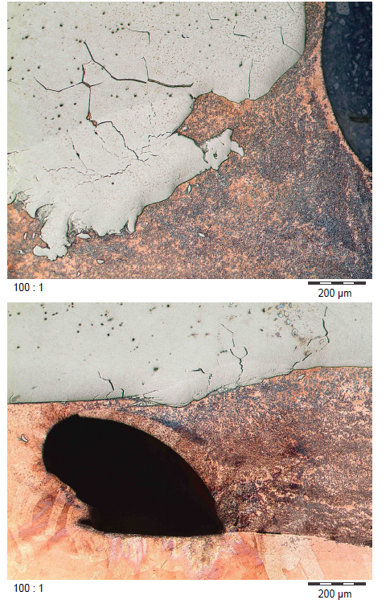
Status of sample production
Test welds – Nb to Cu after etching
courtesy Research Instruments

Slide 5
Status samples
Delays in the procurement process, but:
Cu has been delivered
Nb will be delivered by mid September
manufacture of Cu pieces has already started
Dmitry Tikhonov will accompany vital production steps
finalization of samples will be delayed
one RF test in 2018 still doable

Slide 6
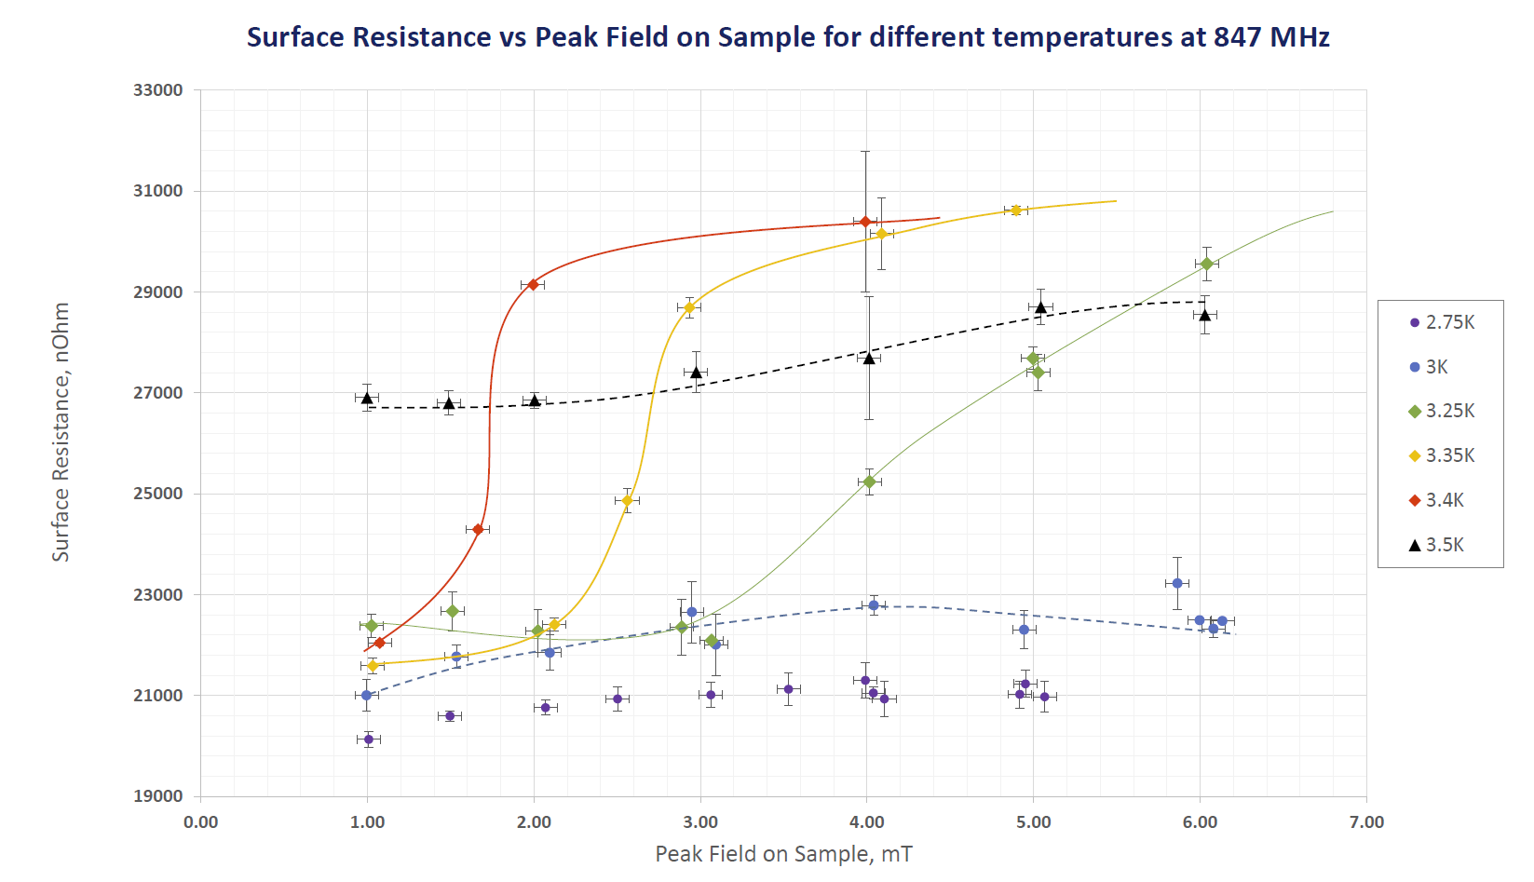
test of detachable sample
courtesy Dmitry Tikhonov

Slide 7
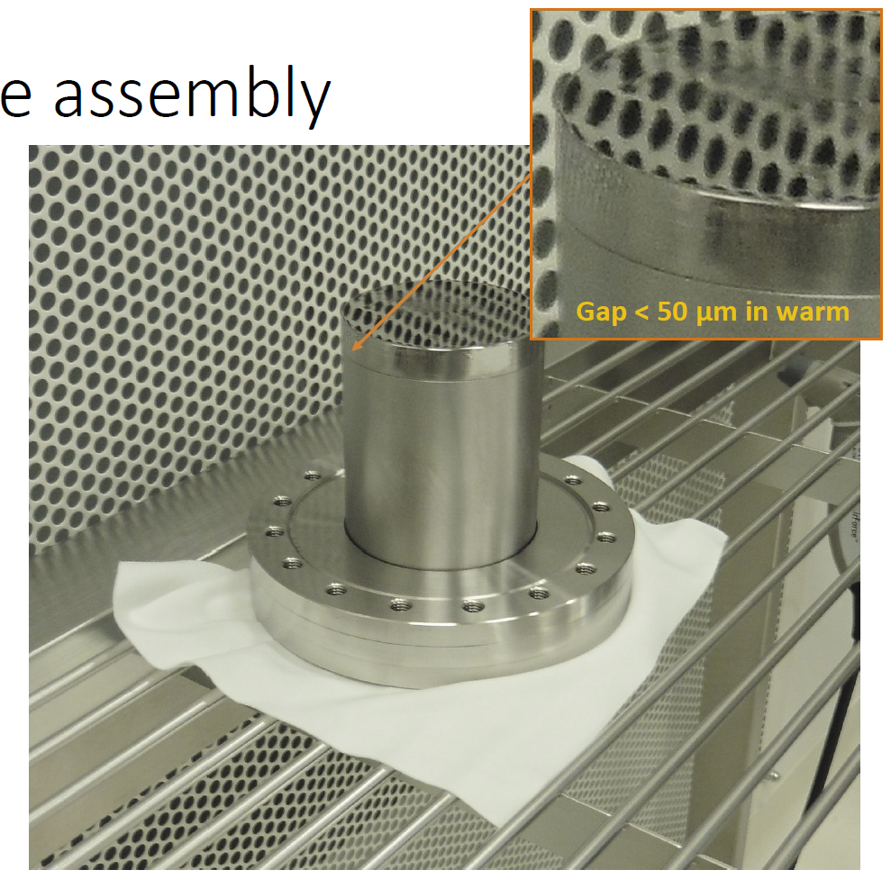
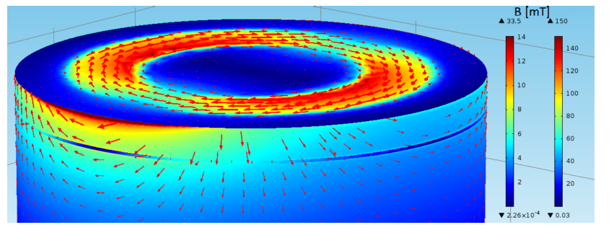
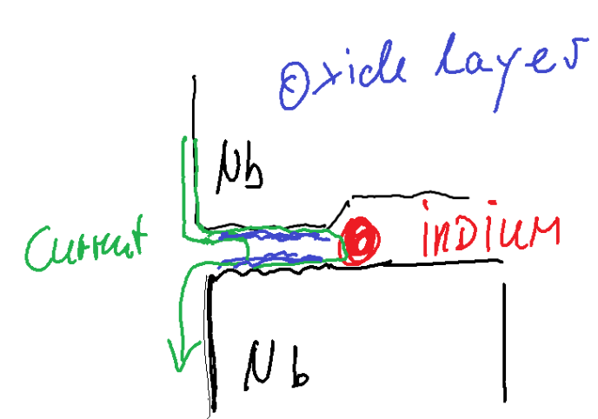
News from the QPR facility
interface-gap
(red arrows = currents)
courtesy Sebastian Keckert
Currents are driven perpendicular to the gap
Currents can enter the interface-gap (even if the RF cannot propagate)
Imperfect joint between sample and cylinder allows for a part of the current to cross the interface-gap, another part to reach the indium
Crossing currents experience voltage drop at NC oxide interface
Surface roughness of sample and cylinder at interface limits contact area, critical current density of Nb can be exceeded which causes local contained quenches and voltage drop (and Ohmic heating)
Voltage drop causes Ohmic heating which biases the calorimetric measurement (even dominates it)

