Slide 1
Production of stgc quadruplets
Meir Shoa On behalf of the Israeli team

Slide 2
Resources of the lab and activities
Manpower
  Technicians:
    5 Technicians with 5 to 35 years experience on TGC detectors
    16 technicians hired on the last year for the production of sTGC’s
  Physicists and Students
Laboratory (see slides associated with the visit at the laboratory)
  Space
  Equipment

Slide 3
Responsibility
QS3
Our responsibility is to produce 60 quads.
40 of type QL1 and 20 of type QS3
QL1

Slide 4
Responsibilities of the lab
ATLAS detectors lab.
Collaboration with TAU and Technion
Long term of equipment for the lab
TEST BEAMS
Maintenance
Of TGC
sTGC
sTGC production sites
Institute
Manpower
Constantly develop new tools and equipment for the lab
Responsibility of cathode boards
Production of sTGC

Slide 5
Responsibilities of the lab
ATLAS detectors B
Collaboration with TAU and Technion
Long term of equipment for the lab
TEST BEAMS
Maintenance
Of TGC
sTGC
sTGC production sites
Institute
Manpower
Responsibility of cathode boards
Production of sTGC
Take active part in detector R&D under beam conditions

Slide 6
Responsibilities of the lab
ATLAS detectors B
Collaboration with TAU and Technion
Long term of equipment for the lab
TEST BEAMS
Maintenance
Of TGC
sTGC
sTGC production sites
Institute
Manpower
Fixing/producing and replacing bad chambers on the wheels. Ehud will talk about it
Responsibility of cathode boards
Production of sTGC

Slide 7
Responsibilities of the lab
ATLAS detectors B
Collaboration with TAU and Technion
Long term of equipment for the lab
TEST BEAMS
Maintenance
Of TGC
sTGC
sTGC production sites
Institute
Manpower
Responsibility of cathode boards
Production of sTGC
Support all the production sites
Send people to advise and help when needed

Slide 8
Responsibilities of the lab
ATLAS detectors B
Administration and Bureaucracy at WIS:
Orders, Transportation, maintenance, etc
Collaboration with TAU and Technion
Long term of equipment for the lab
TEST BEAMS
Maintenance
Of TGC
sTGC
sTGC production sites
Institute
Manpower
Responsibility of cathode boards
Production of sTGC

Slide 9
Responsibility
QS3
Our responsibility is to produce 60 quads.
40 of type QL1 and 20 of type QS3
QL1

Slide 10
Production Flowchart
Reception and QC- of parts
Assembling 8 X 1/2 gas volumes
Assembling 4 gas volumes +tests
Assembling 2 Doublets +tests
Assembling 1 quadruplet +tests
Cosmic test at TAU
Shipping to CERN
Tests after arrival
NSW
GIF ++
Assembling and soldering adaptor boards
Wedge assembling

Slide 11
Reception and QC- of parts
There are approximately 120 parts for each quad , which should be tested, in order to make sure they are according to specifications. Each and every part has its own specifications and tolerances.
All the measurements are reported and added to the central DB
Assembling 8X 1/2 gas volume
Preparations and Graphite spraying –destiny the cathode boards to his gap chamber and spray it according to.
QA&QC of the board
Gluing frames, supports and buttons to the board .
The strip boards goes to clean room , and pad boards goes to the winding machine room.

Slide 12
Winding wires to the half gap chamber
We start with QC of the pad board came from last step and wind wires to this cathode board.
We can wind 2 boards in one step
Need to adjust the position of the wires to the board and wind.
Solder the wires to the boards and disconnect from the table.
QC of the winding and send to the clean room.

Slide 13
Assembling gas volumes(detectors) in the clean room
Clean room team have to check very well the cathode boards coming from the different steps in the lab
Assembling the right strip with the right pad and test them together with HV before glue them. Ilia will present results of current measurement.
Sealing and retest the gap before approving the gap chamber as good.
X-ray test is performed for all the gap chambers. Ilia will present this.
Every accepted single gap is assembled to doublet and 2 doublets to quadruplet in the assembling room.
Each step in the clean room and assembling room pass a flatness and thickness measurement.

Slide 14
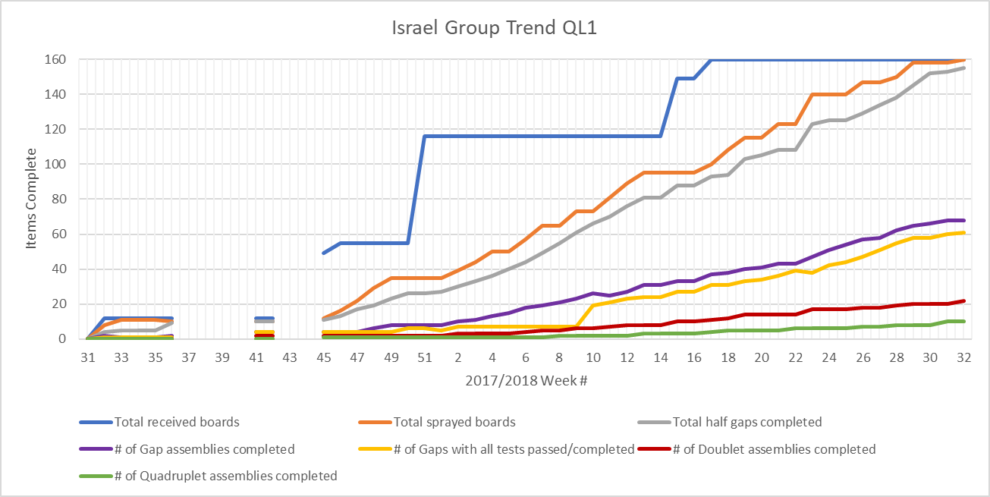
Status of the production of QL1and qs3

Slide 15
Attaching adaptor boards
Adapter boards are being mounting and soldered ( around 4000 soldering points)
During the assembling of the different adaptors, HV tests and connection test of channels are needed to make sure there are no ground sparks, and all the channels are connected.
A special system that inject a pulse to the wires will let us read out the channels
Shipping to CERN
The chambers will be transported to CERN on wood palettes. Each palette is equipped with a barcode, shock sensors and shock absorbing devices.
The chambers will be transported in a well air-conditioned containers or truck.

Slide 16
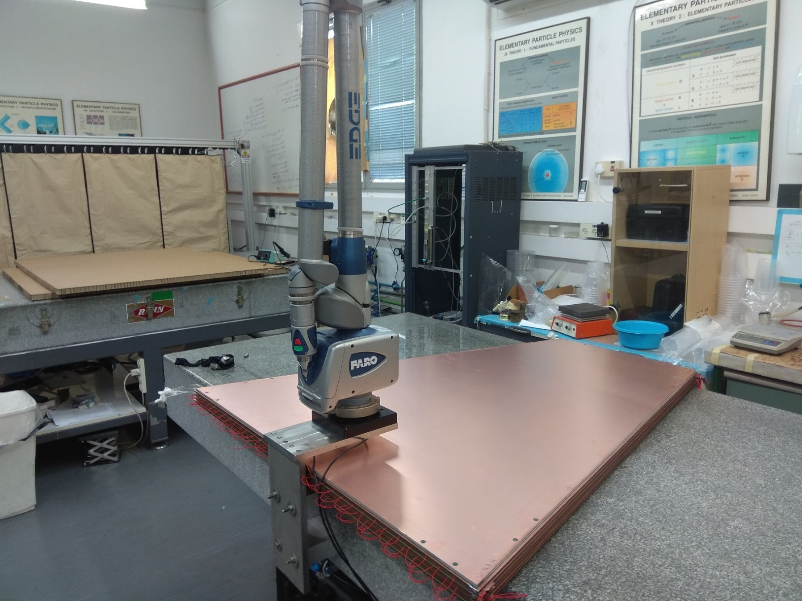
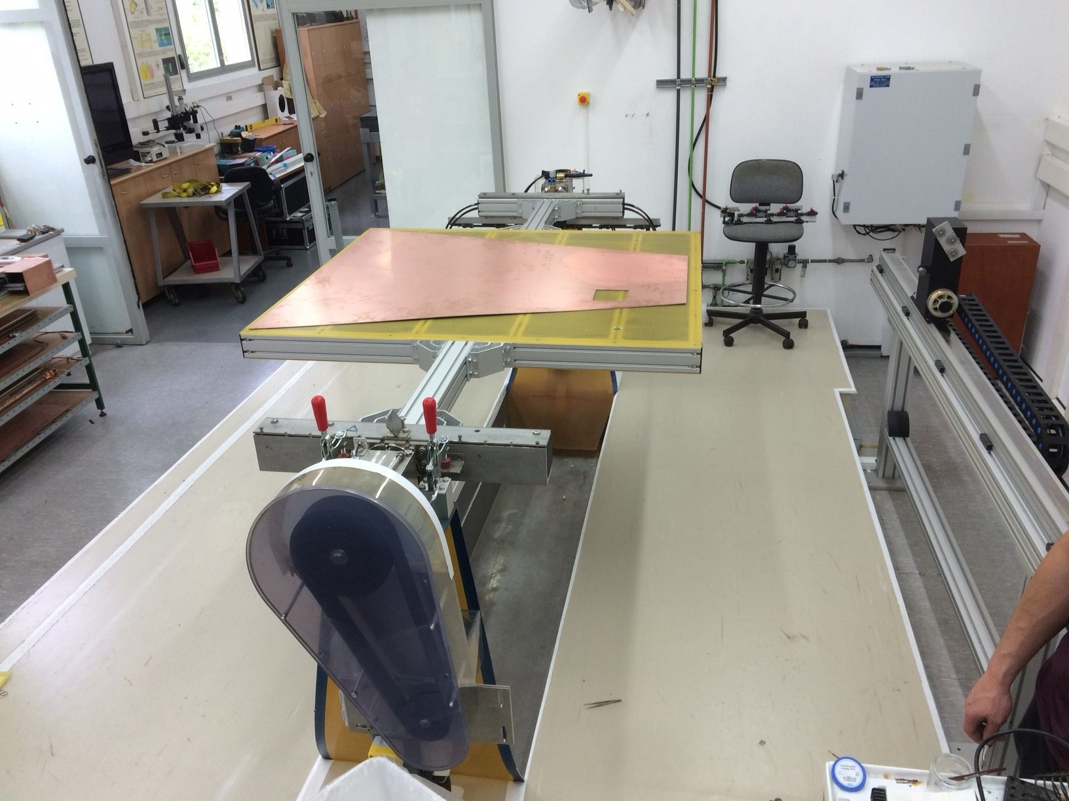
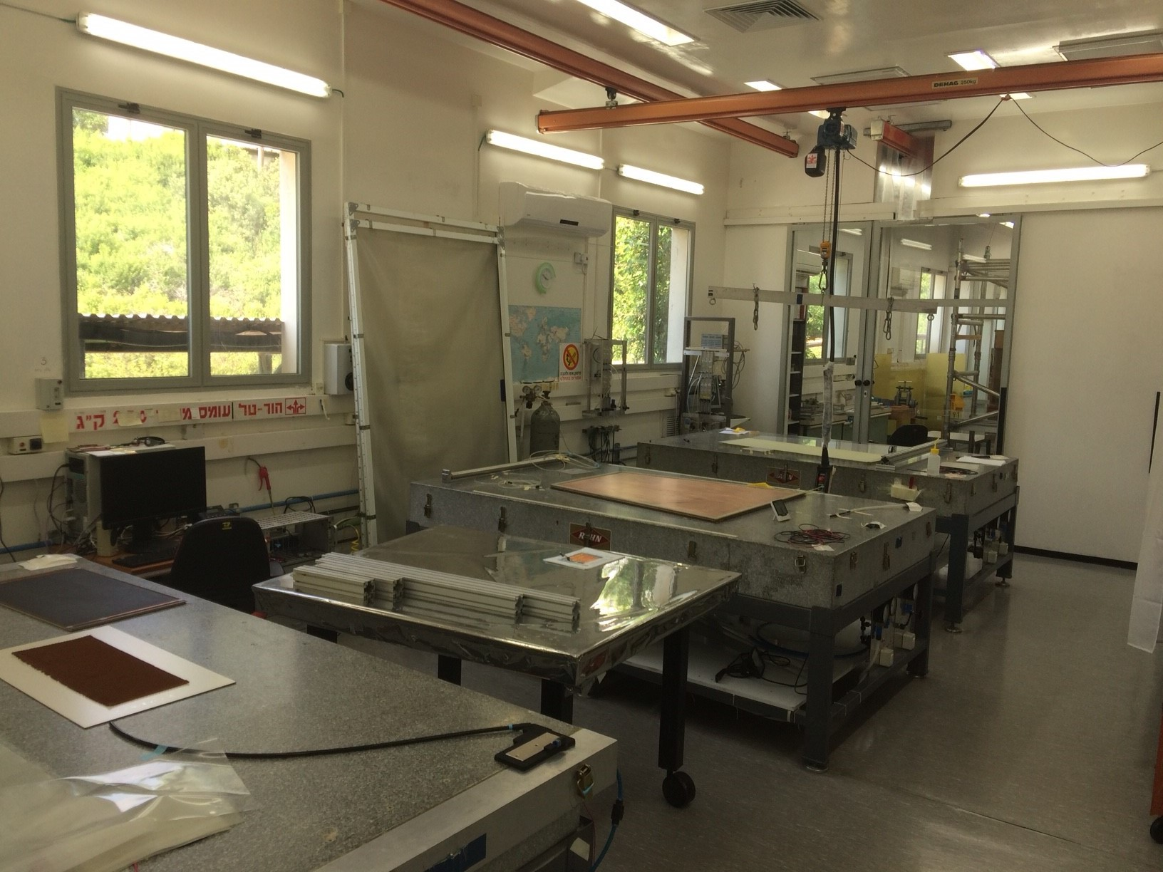
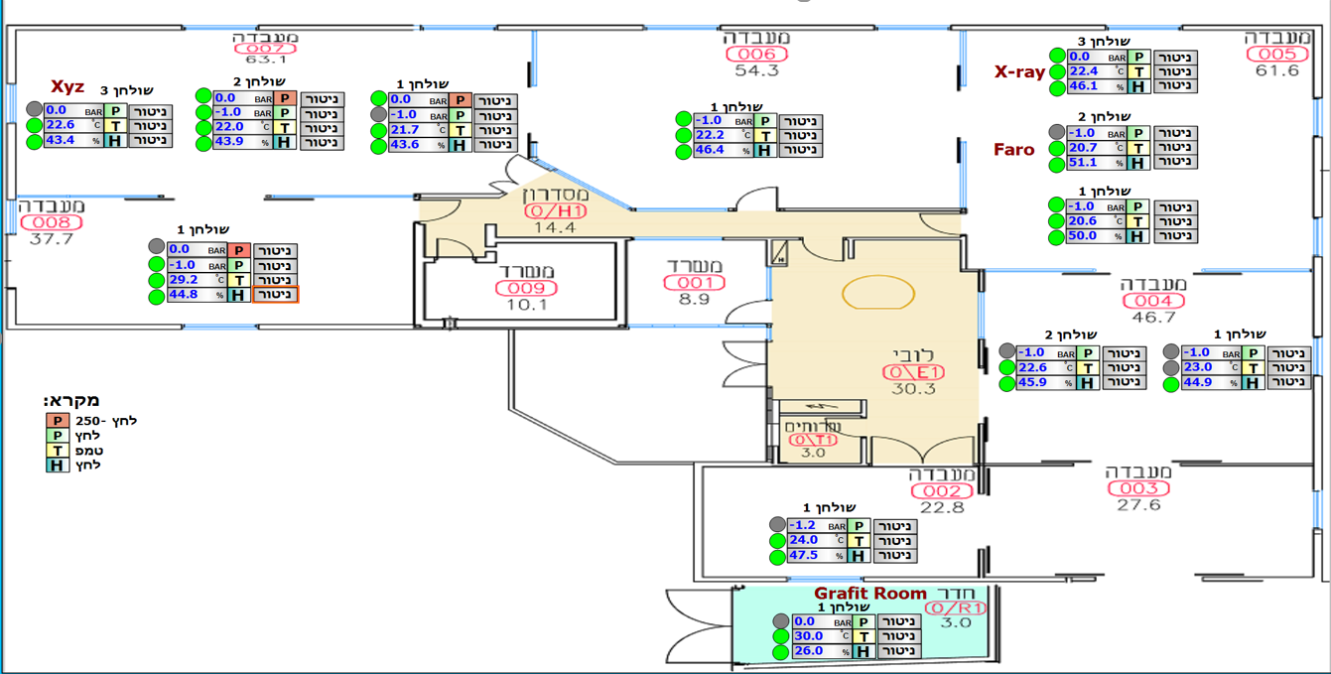
thanks

