Slide 1
NSW Phase-I Electronics status
Lorne Levinson
ATLAS Israel Review, 22 August 2018

Slide 2
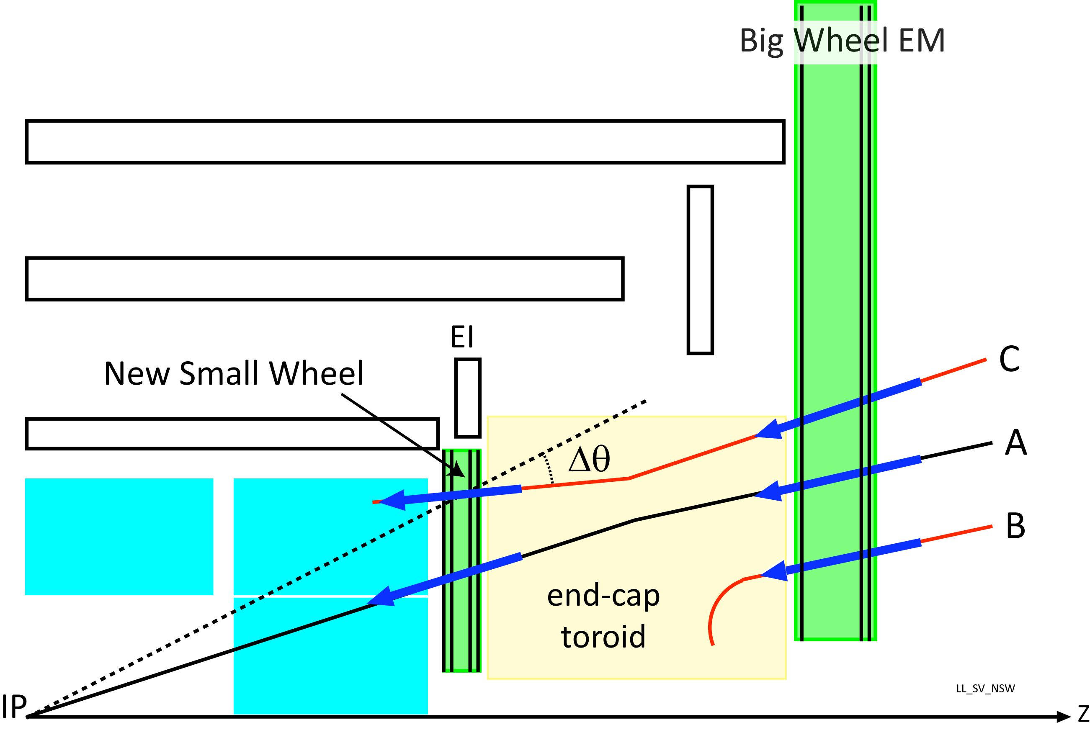
Purpose of the NSW
×
✓
×

Slide 3
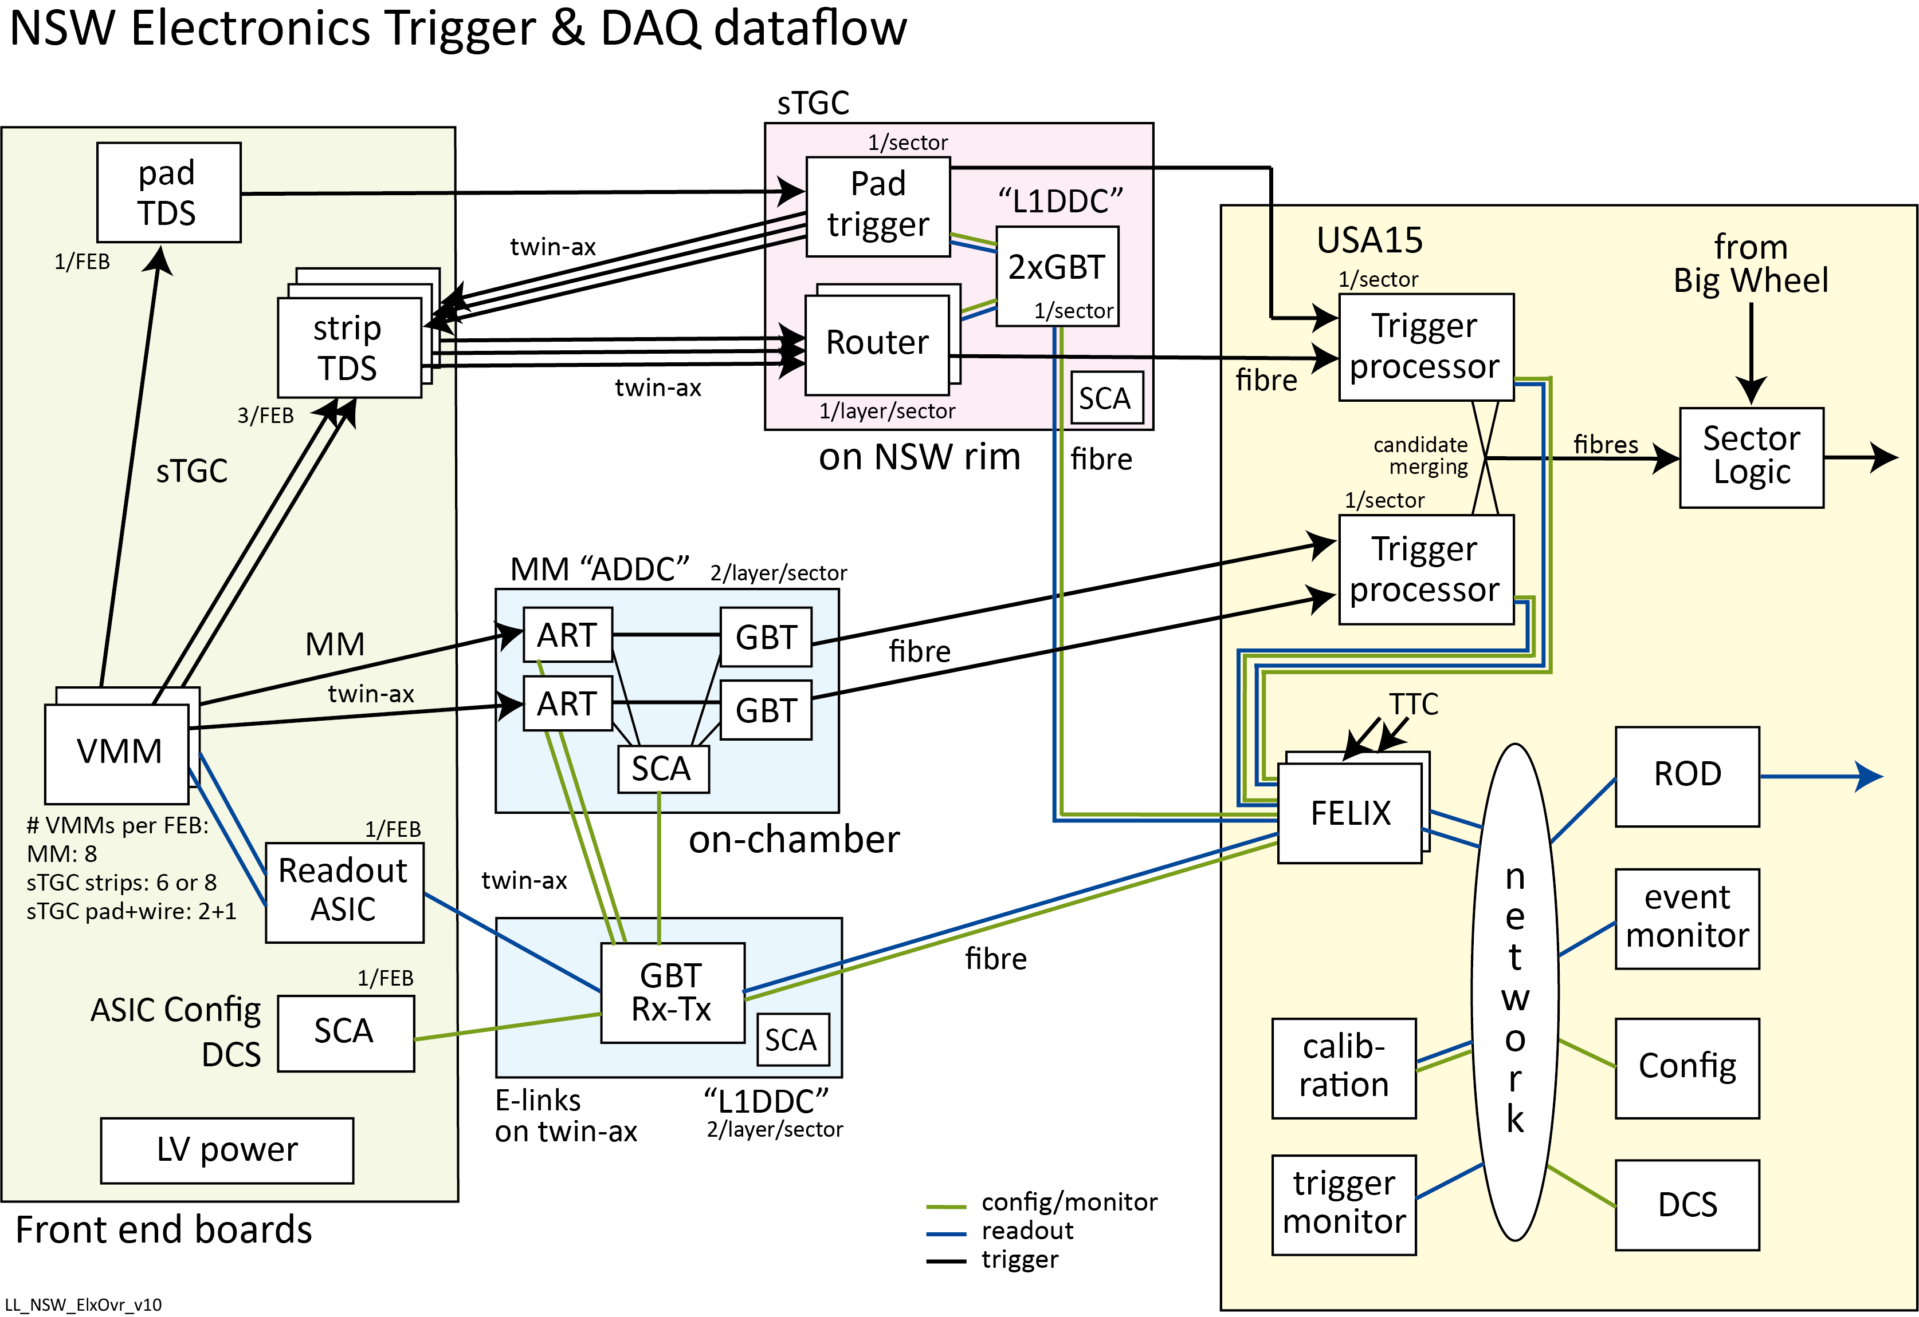
Not enough bandwidth to send
all data to an off-detector trigger
Paths:
Readout
Config / monitor
sTGC trigger
MM trigger
TTC

Slide 4
NSW Electronics -- challenges
Needs to support two detector technologies
  Share as much as possible; push people to share
Meet Phase 2 requirements for Phase 1 installation → Phase 1 technology
  Phase 2 requirements were a moving target → delays in Read Out ASIC
Sophisticated front end requirements required for 2.4M analog channels
Very aggressive schedule
Limited latency for trigger path
Very limited access after installation (never for on-detector elx; once per year on Rim)
→ redundancy
Radiation and magnetic field tolerance
Limited space

Slide 5
NSW Electronics – overall status: On-detector and Rim
Four front end board ASICs: all in production, i.e. some fraction of final chips now being packaged
  VMM: 64 channel analog frontend + digitization + digital L0 pipeline – for MM & sTGC
    working with foundry to improve yield due to unstable baselines of some chips (wafer or batch issue)
  ROC: Read Out Controller for up to 8 VMMs: L1 pipeline – for MM & sTGC
  TDS: Trigger Data Serializer: transmits pad or chosen strip data to trigger chain – for sTGC
  ART: transmits earliest strip in a VMM for up to 8 strips from 32 VMMs (2048 strips) to MM trigger
MM Front end board: final prototypes with final VMM being evaluated in test beam
  Resolved issues with DCDC noise
sTGC Frontend board: next to final prototype with final VMM
  Final prototype with resolution of DCDC noise and final cooling scheme expected in next few weeks
ADDC (with MM ART trigger ASIC): ASIC packaging problems. Moving to new packager.
L1DDC (aggregates twinax readout connections from several FE boards to FELIX via fibers)
  MM, sTGC, Rim variants: FDR’s and PRR’s already passed or will be by 30 October.
Pad Trigger: FDR Oct 29
Router: production starting

Slide 6
Collaboration
U. Mass. Amherst
Arizona
BNL
Bucharest & Brasov
Harvard
Hong Kong cluster
Michigan
NTUA
Rome 1
Taipei
Technion
UC Irvine
USTC
Weizmann

Slide 7
VMM prototype and Front end board testing
More details in next talks
At Weizmann we have quadruplets and the infrastructure for running them
in a cosmic ray telescope, or with a pulsed x-ray source.
From the electronics point of view, testing of detectors with the VMM front end ASIC either with a single VMM test FE board or prototypes of the sTGC FE board, provided feedback on:
  Time walk and actual pad timing
  Optimizing ground schemes
  Diagnosing FE board noise and anomalous “oscillations”
  →(“oscillations” solved by separate VMM power for FE input stage and FE ADC)
  Efficiency of 3-out-of-4 coincidence versus time window (one layer can be very late
  Optimising “π”-networks for pads and wires for optimal signal-to-noise for MIPs and dead time due to saturation by very large pulses
  Feedback on operation of the DAQ systems
Extensive tests done at Technion to characterize the VMM FE ASICs from VMM1 thru’ VMM3 and VMM3a :
  Saturation and dead time behaviour with high charge pulses
  Behaviour with long opposite polarity tails, i.e. as for real sTGC strip and pad signals

Slide 8
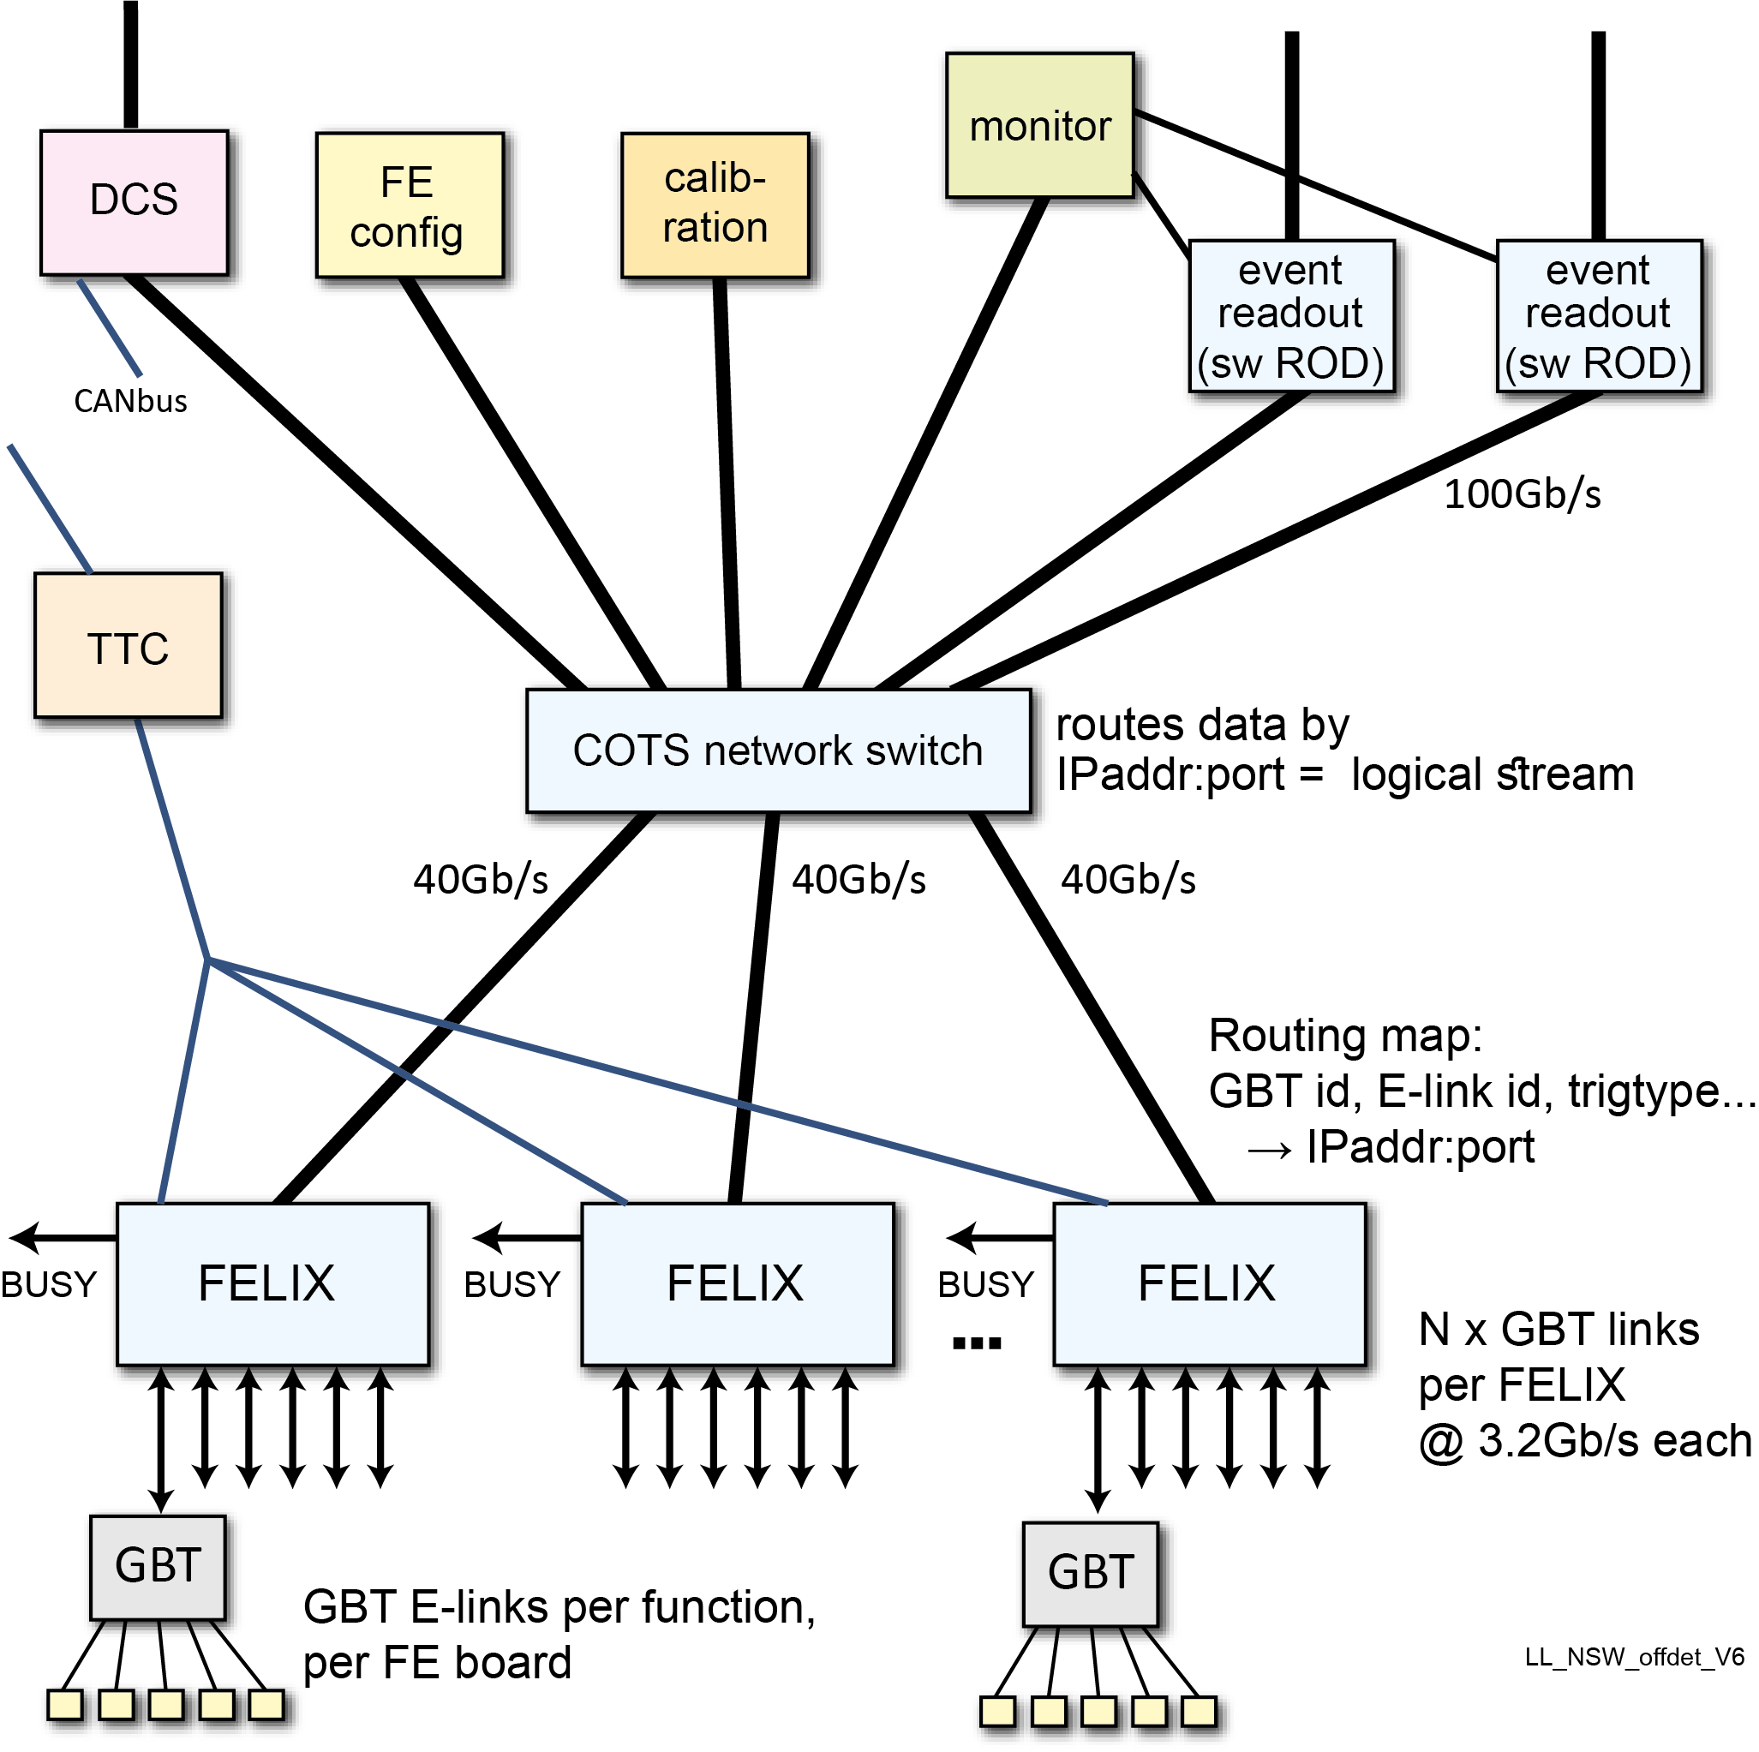
FELIX
The new ATLAS common readout component
Aggregates several CERN custom rad-hard optical
links to standard commercial network equipment.
Configurable to support a variety of detector readout architectures
Enables different logical data flows to be handled
by different off-detector end points.
  Routing of event data, detector control, configuration, calibration, monitoring, TTC
  In the past done by using separate physical interconnect media.
Distributes TTC (Timing, Trigger & Control) signals
Reduces the amount of custom HW in ATLAS in
favour of software and COTS hardware.
Phase 1: NSW, BIS78, L1Calo Trig, LAr demonstrator
Phase 2: all ATLAS. Current demos: Tilecal, strips, pixels

Slide 9







FELIX Phase 1 Team
Hucheng Chen
Kai Chen
Francesco Lanni
Shaochun Tang
Weihao Wu
Andrea Borga
Henk Boterenbrood
Frans Schreuder
Jos Vermeulen
Anamika Aggarwal
Mark Dönszelmann
Frank Filthaut
Rene Habraken
Kevin Bauer
(Daniel Guest)
Serguei Kolos
Andrew Lankford
Gokhan Unel
Daniel Whiteson
Michael Oberling
Alex Paramonov
Jinlong Zhang
Mikael Baymani
Markus Joos
Jörn Schumacher
Wainer Vandelli
Will Panduro
Israel Grayzman
Lorne Levinson
(Julia Narevicius)
Alex Roich

Slide 10
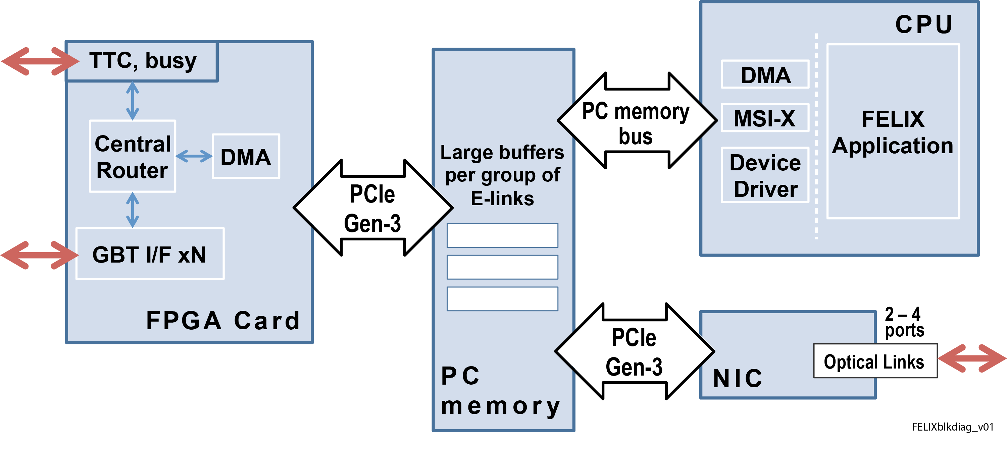
FELIX internal block diagram
FELIX is a data router between custom links (GBT, FPGA, TTC) and industry standard hi performance networks
Separates data transport (ATLAS common) from data processing (detector specific).
Essential functionality is spread over hardware, firmware, software
  Consistent with the fundamental philosophy of a FELIX-based DAQ architecture:
  “Do as much as possible in software without compromising performance.”
Custom FPGA card in a COTS server
Weizmann
input fibers
from detector
to network
end points,
e.g. data handlers

Slide 11
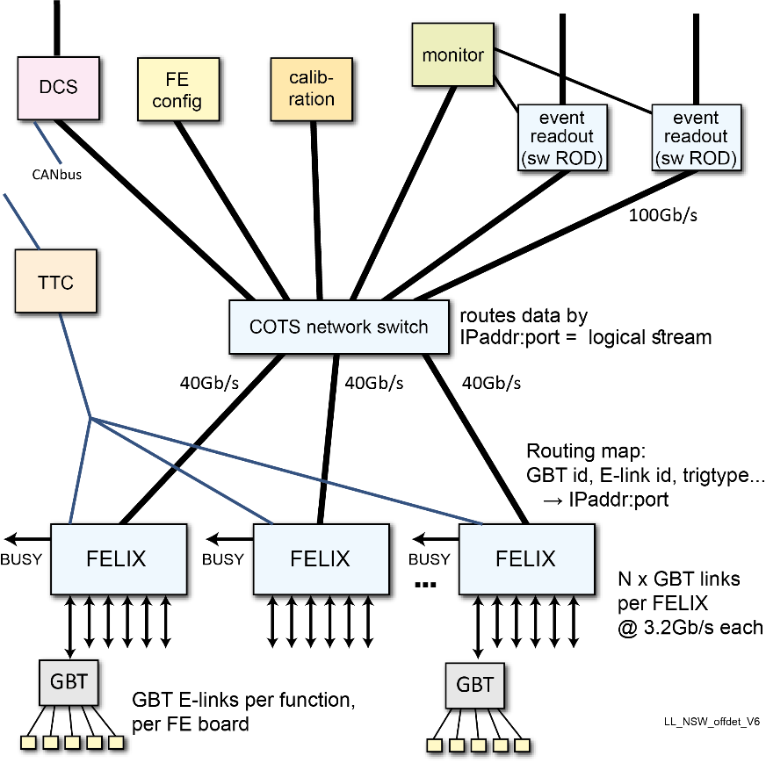
Our contribution to FELIX
The original concept and persuading the ATLAS community to adopt it
FELIX architecture details and consequent changes to ATLAS TDAQ
architecture, e.g. the Software ROD
  RODs in Run1, Run2 are typically VME FPGA boards,
  unique for each sub-detector
Understanding Phase 2 detector requirements
TTC input mezzanine board for mini-FELIX
Central Router -- the core of the firmware
  GBT ASICs have several, e.g. ~20, “E-links”, electrical links which connect to
  individual FE ASICs and carry event data, configuration, TTC, DCS data
  Central Router handles E-links on 24 GBT links (fibers) → 24x20 = 480 logical links
  Routes them, according to configuration information,
  to/from the appropriate end-points on the DAQ network
  Ongoing effort to optimize resource use and timing and adding additional features
Project status: Tender process begun for the FELIX FPGA board production, FELIX server, swROD server

Slide 12
Trigger Processor firmware
More details tomorrow from Enrique
Division of responsibilities:
  sTGC algorithm firmware: Technion, Weizmann
  MM algorithm firmware: Harvard
  Common FW “Ancillary functions” firmware (L1A readout, monitoring, configuration, …):
  Amherst, Technion, Weizmann
  FPGA-based ATCA hardware in USA15: Bucharest
Separate MM and sTGC segment finding merged before sending to New Endcap Sector Logic
32 input fibers per sector per detector type
Challenges:
  Limited latency limits sophistication of the algorithm
  Time aligning the input and distributing correct inputs to each instance of the algorithm
  Fixed latency to the Sector Logic
Intermediate Firmware Review on 30 October

Slide 13
Trigger Processor hardware status
Trigger Processor hardware consists of:
  Two mezzanines with fiber input and output that runs the algorithms
  Each mezz handles one sector of MM and sTGC
  A Carrier board that supplies services to the mezzanine such as the FELIX connection, clock distribution and perhaps part of the monitoring and L1A readout logic
Originally intended the hardware to meet both Phase 1 and Phase 2 requirements
  Now assumed that Phase 2 will have new hardware
Mezzanine card is ready for production,
assuming change of clock jitter cleaner solves fixed latency issue
New carrier board prototype expected by December – Old uses obsolete FPGAs
  We proceed with FW development using the existing Carrier,
  as well as FPGA development boards with the current generation of FPGAs

Slide 14
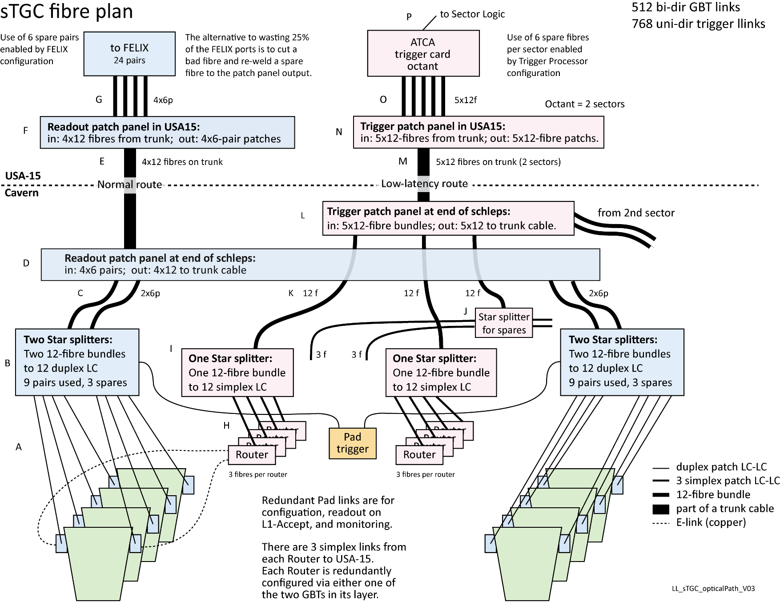
Optical fibers
Fibers for one sTGC sector (MM is similar)
For readout and trigger
Requirements, design,
interface to supplier
Issues:
  Latency of trigger path
  Losses due to couplers
  needed for:
  aggregation, construction,
  and opening of the Endcaps
  Radiation tolerance
  Install Phase 2 at Phase 1
Total readout: 1536 fibers
Total trigger: 960 fibers
IL Core contribution:
  sTGC & MM readout
  sTGC trigger
Delivered and being installed

Slide 15
END

Slide 16
Backup

