Slide 1
NSW wedge assembly and integration
Y. Benhammou

Slide 2
outlook
Workflow
Chamber reception
Wedge construction
Wedge tests
Electronic installation
Services installation
Wedges tests
Sector assembly
On going activity
conclusion

Slide 3
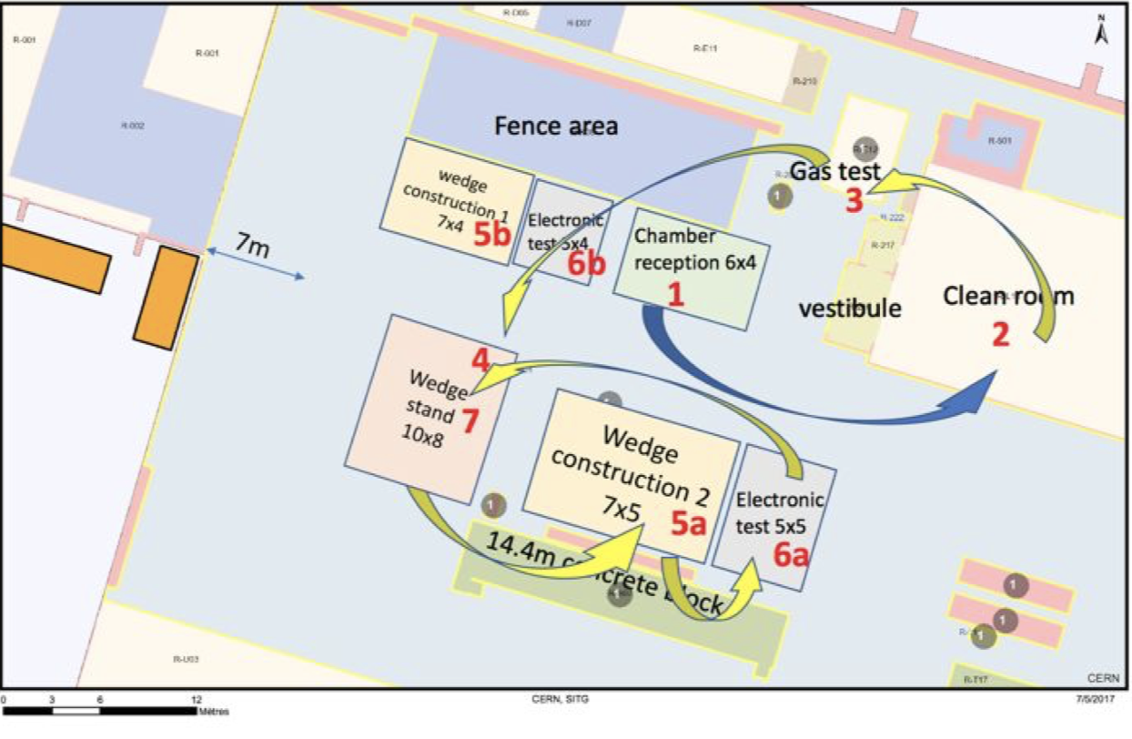
Workflow : building 180

Slide 4
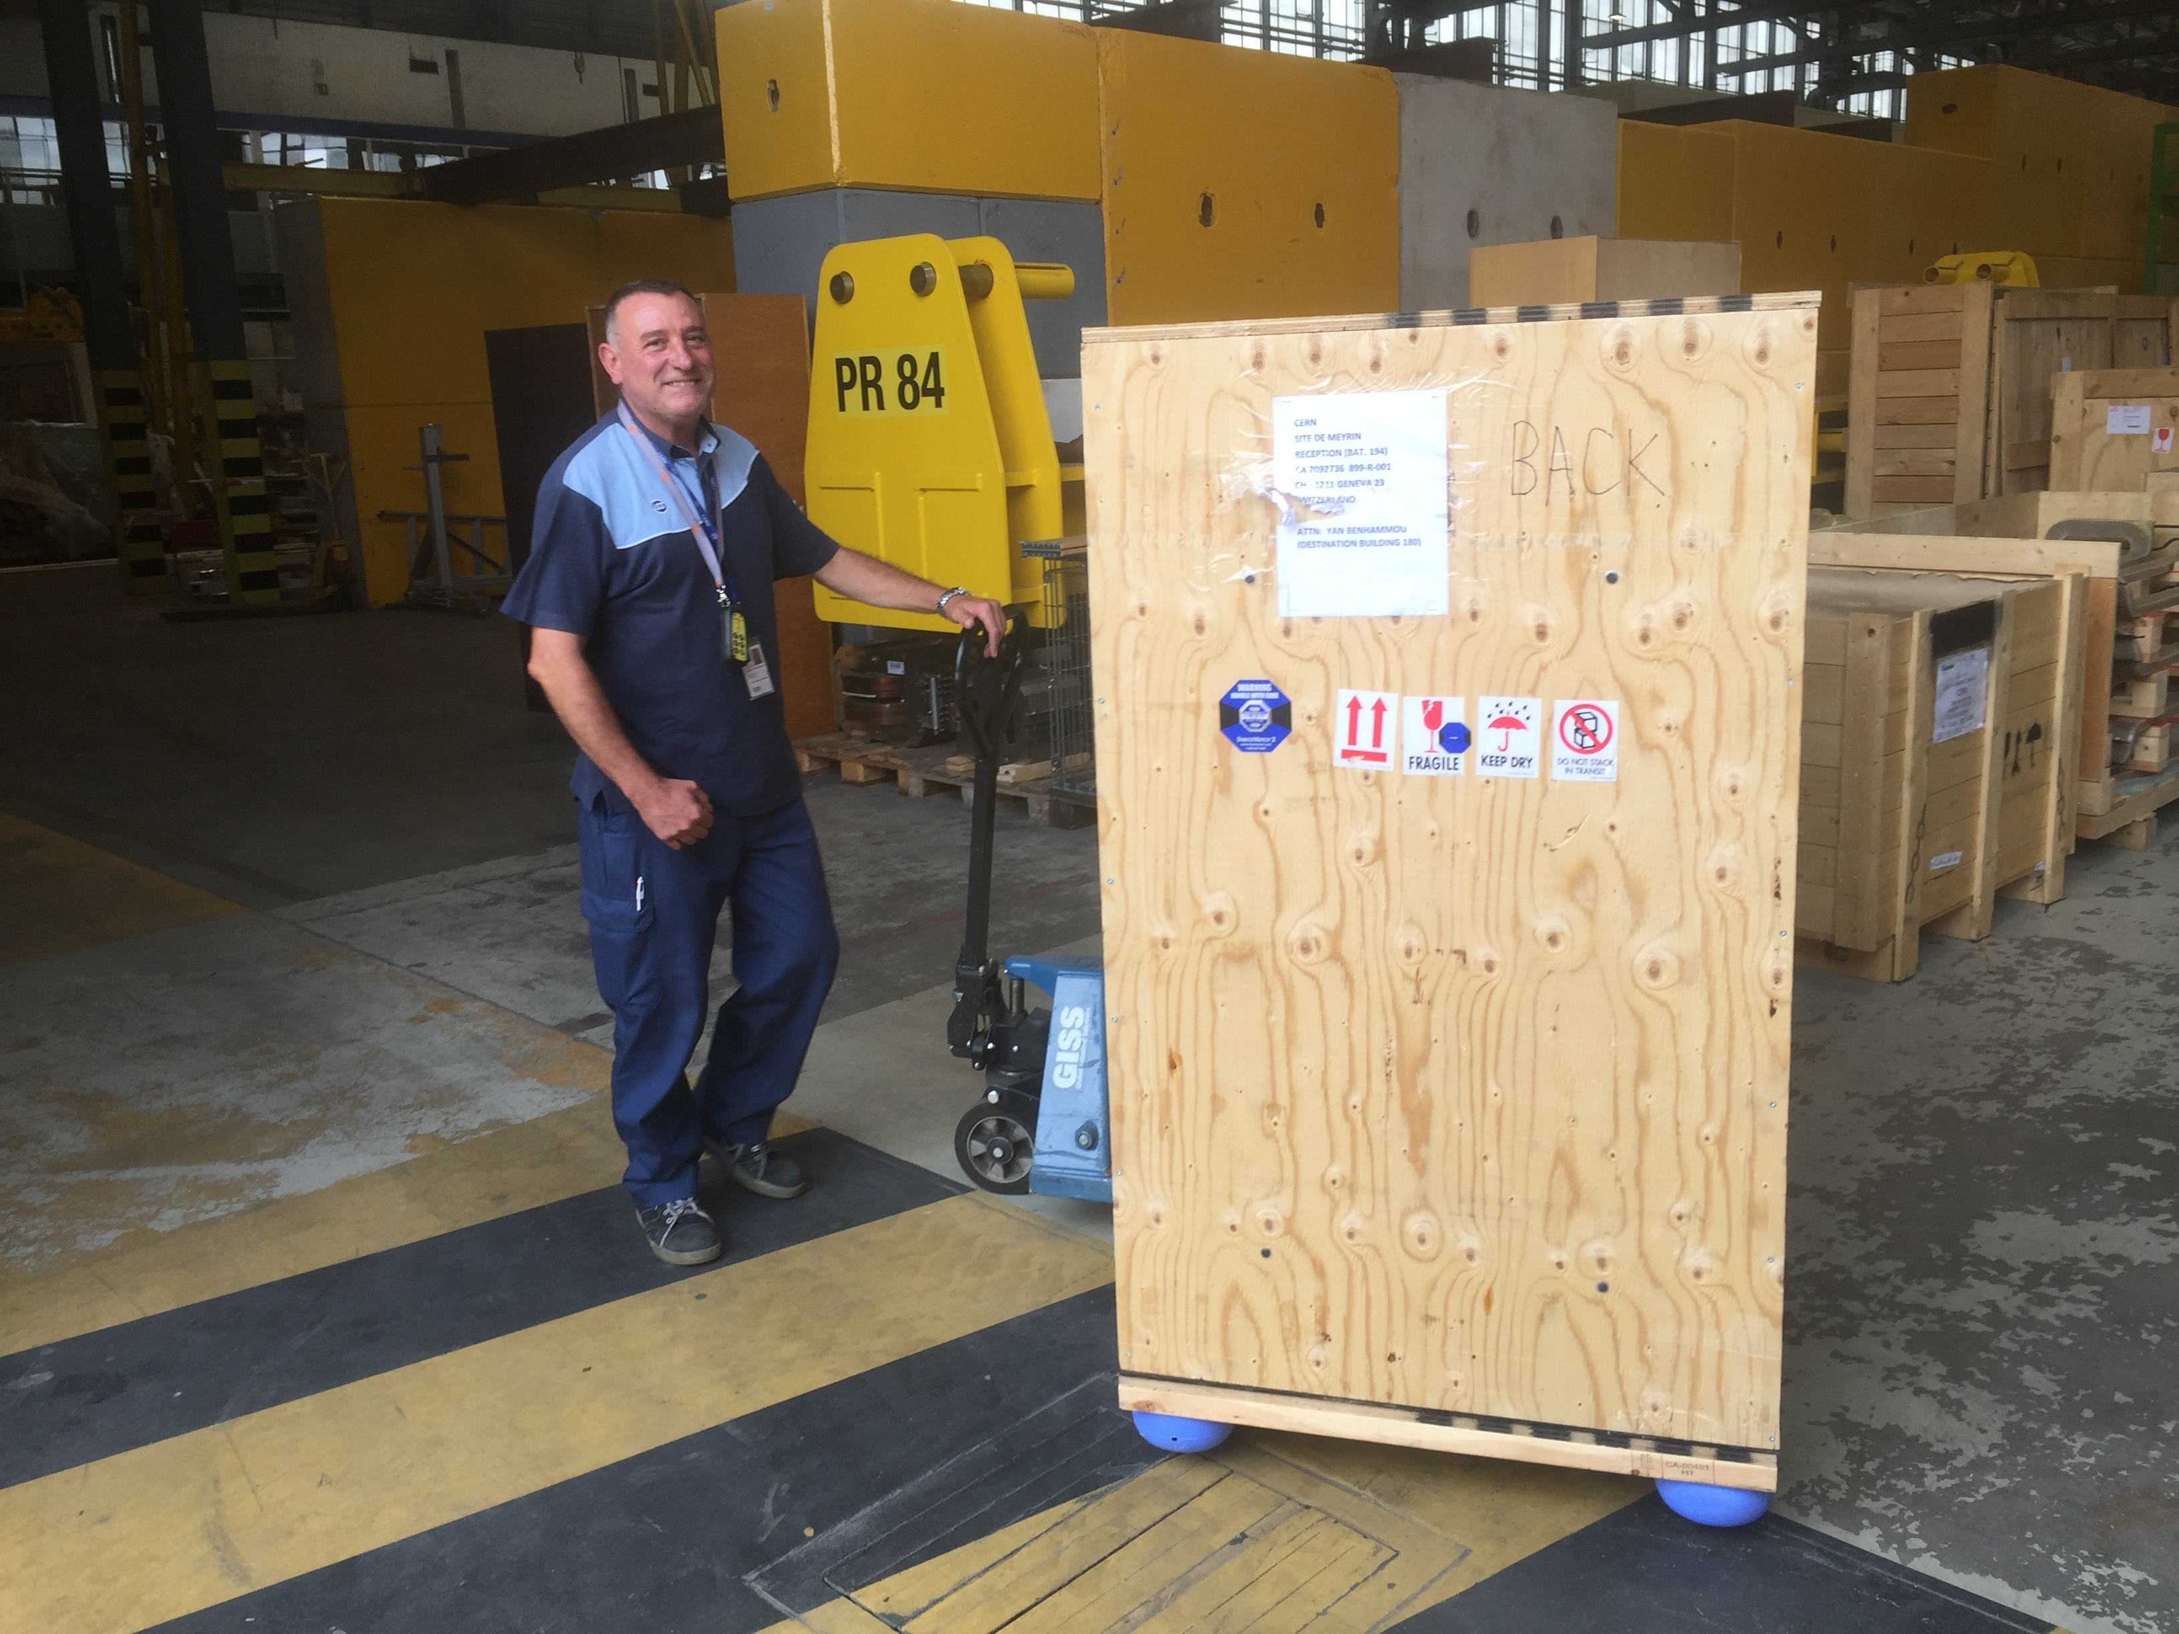
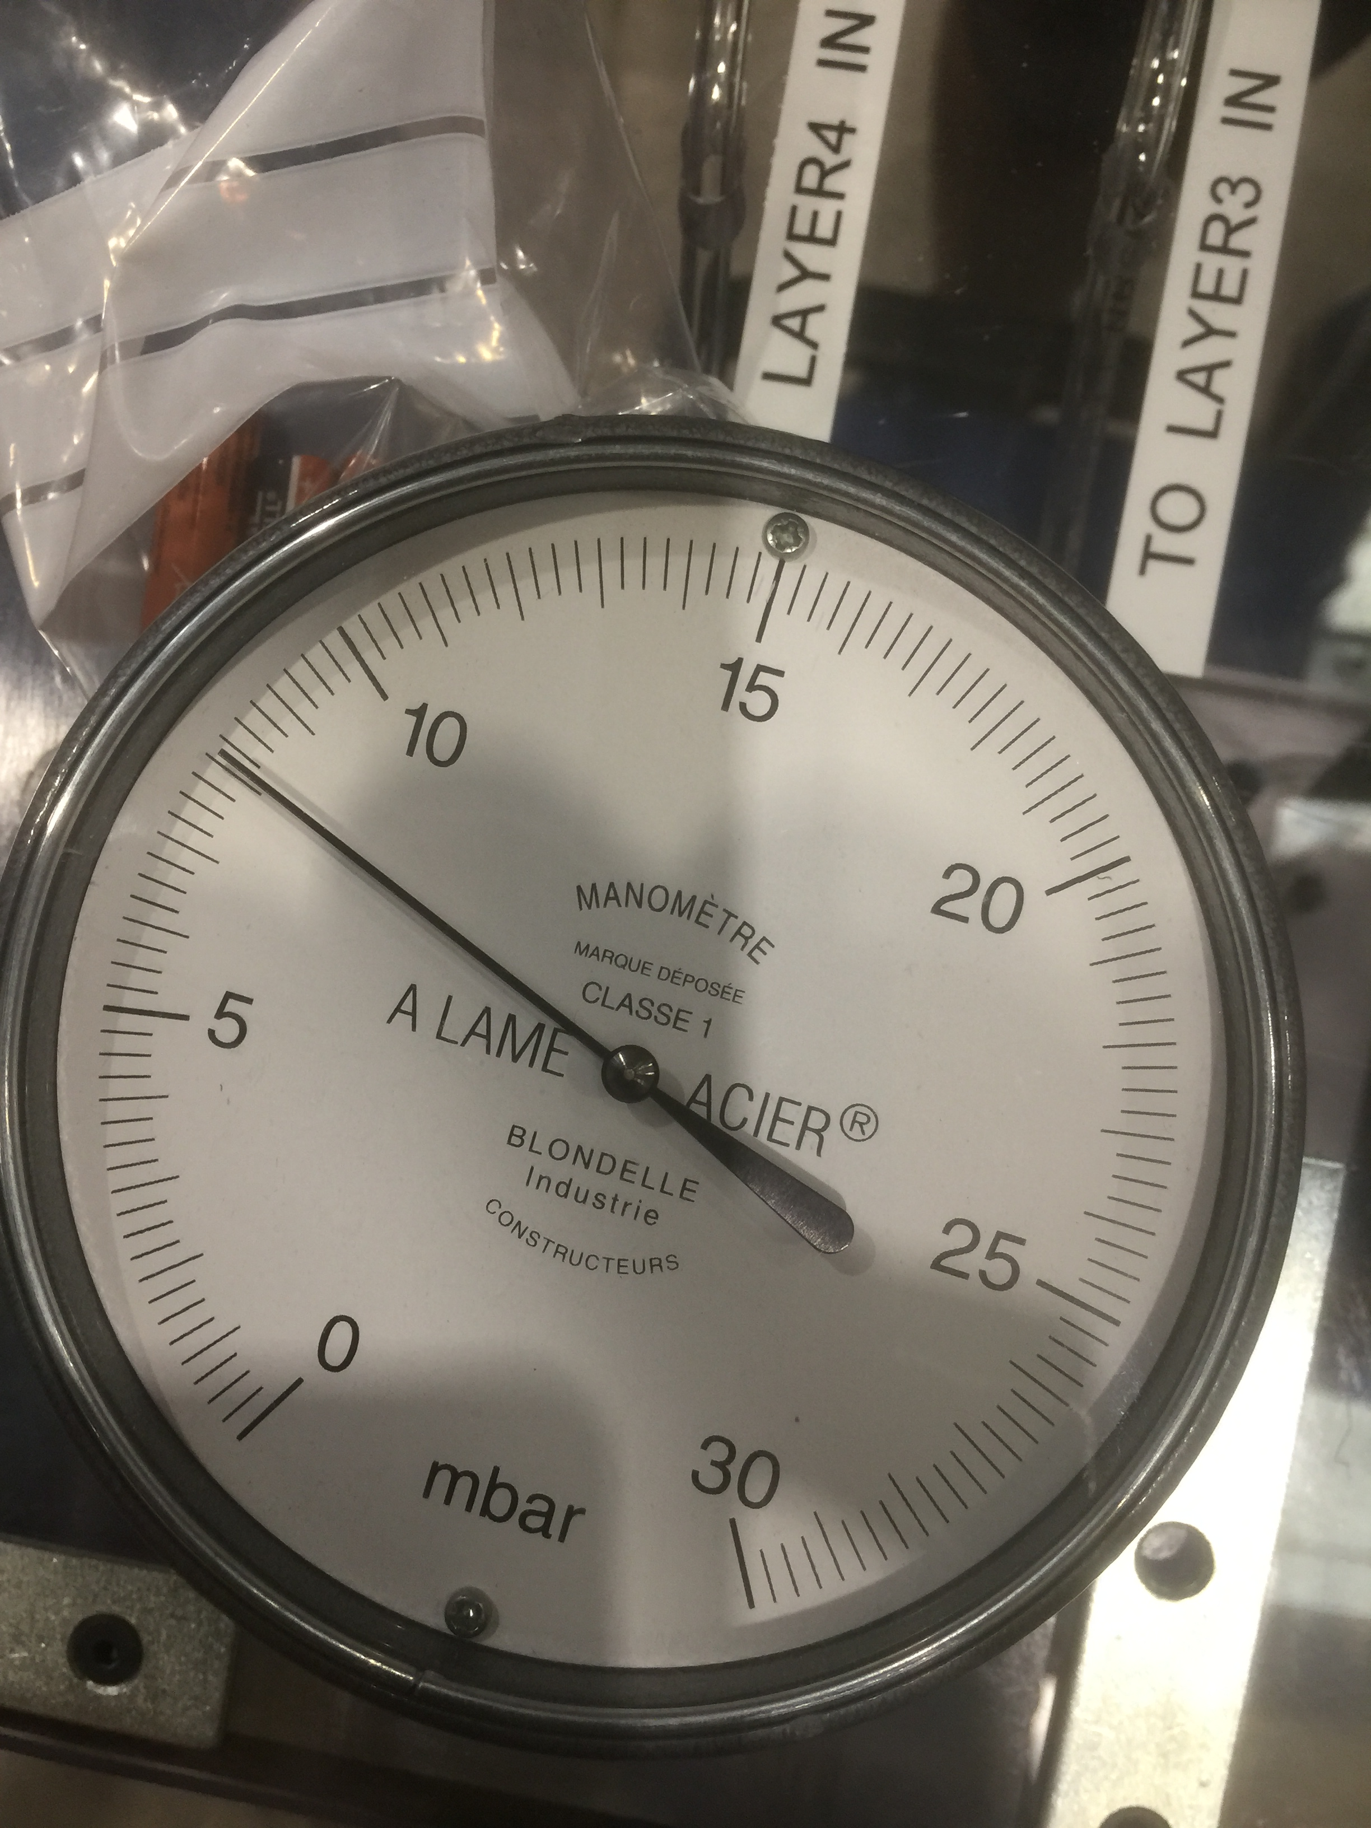
Chamber reception
Need to check that the chamber didn’t suffer from the transport :
  Gas leak test : tested on the first chamber
  HV test : tested on the first chamber
Check the chamber under radiation : GIF++
  All the infrastructure is ready
  Tested with the first chamber

Slide 5
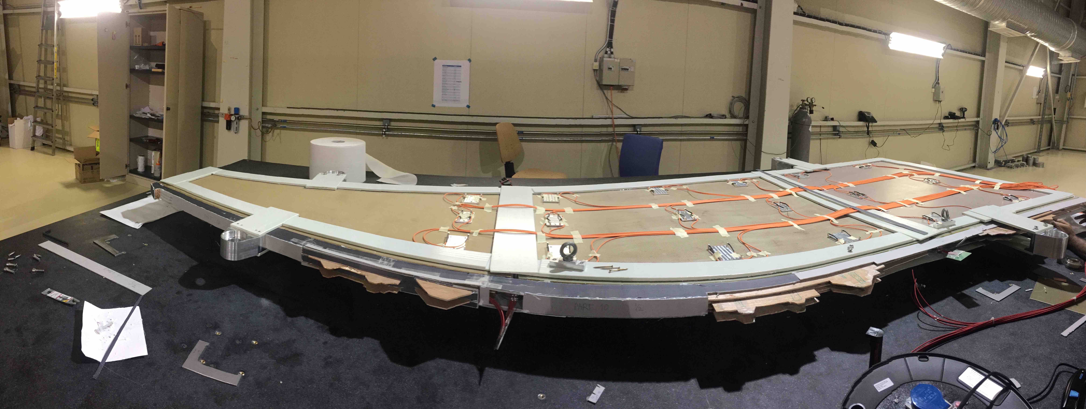
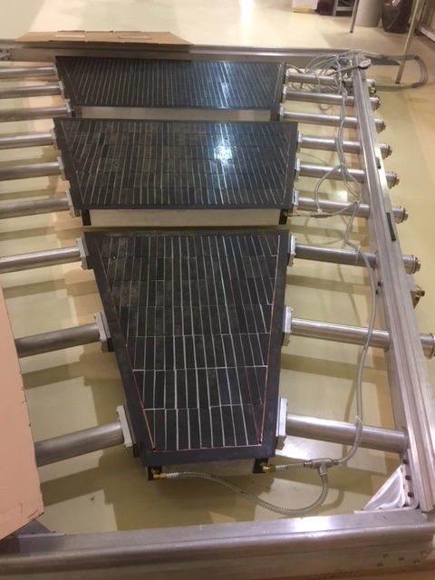
Wedge construction
Steps :
  Align the chambers on the flat table
  Glue the frame
  Return the wedge
  Glue the alignment system
  Glue the frame
We built the two types of wedge, large and small from dummy chambers
We built a small wedge with real chambers
→ all the procedures and all the tools are ready

Slide 6
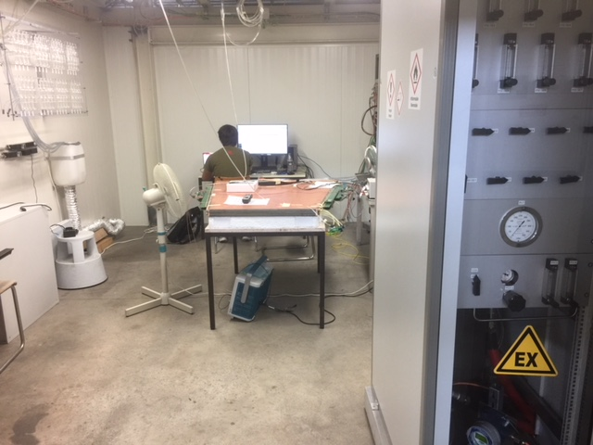
Wedge tests
In the clean room, installation of the faraday cage around the wedge : procedure is tested and FC already delivered in 180 :
  Before closing, pulser test to check the continuity
  Installation of the HV filters and cables
  leak test to check the sealing of the FC
After the installation of the faraday cages, the wedges are moved to the gas room :
  Transport tools are ready and produced
  Gas room is fully operational and passed all the safety inspection (it will be used to check the TGC as well, we empty the BB5 barrack this monday)
  HV operational and working. Last GUI modifications on going

Slide 7
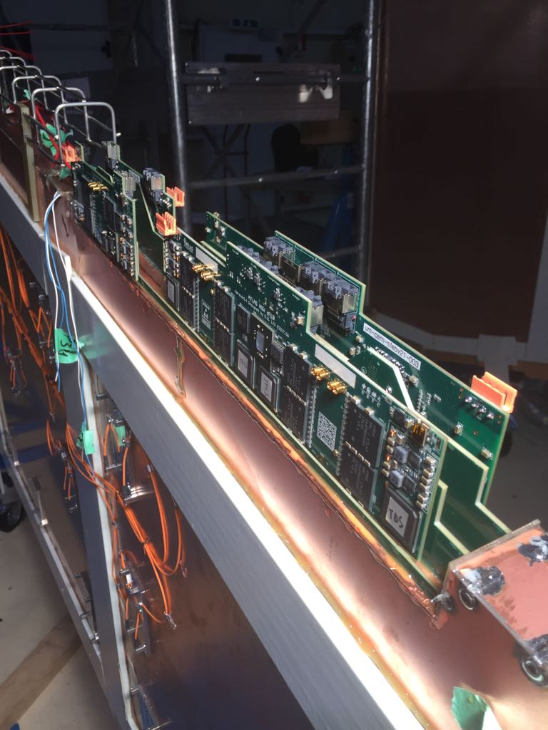
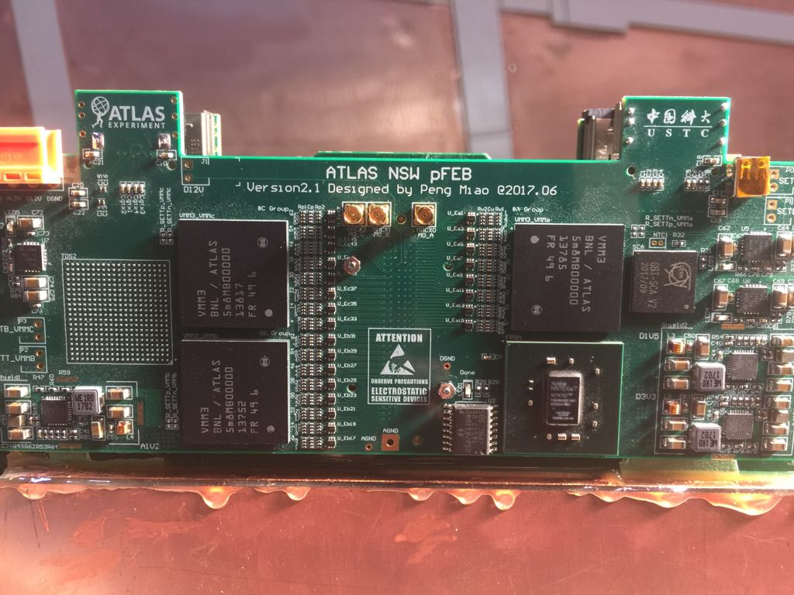
Electronic installation
Once the gas/HV tests are done, the wedge is transported to the electronic installation stand (or waiting in the wedge storing place)
Front end board are tested before the installation
After installation of each FEB, test of the continuity to be sure we don’t have non connected channels

Slide 8
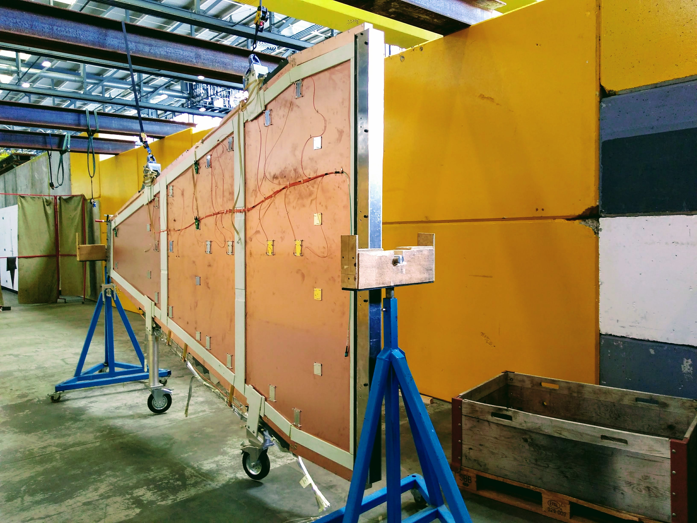
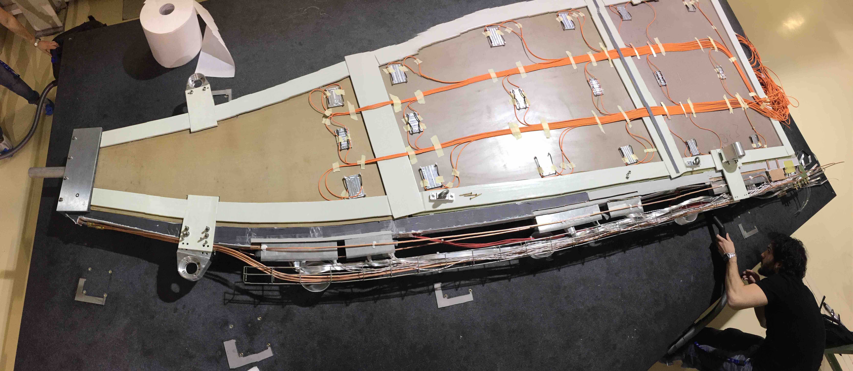
Services installation
Once the electronic is installed, we need to install :
  Cooling system
  Low voltage card and cables
  Read out cables
  Electronic card (for read out – L1DDC)
  Cable tray

Slide 9
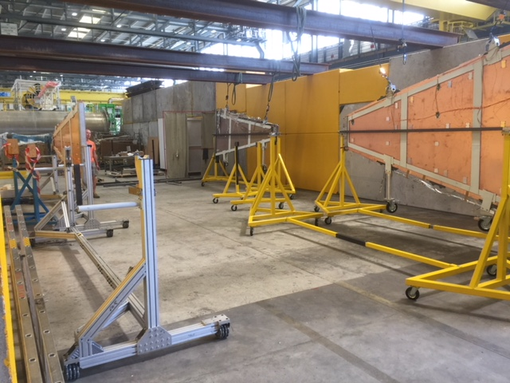
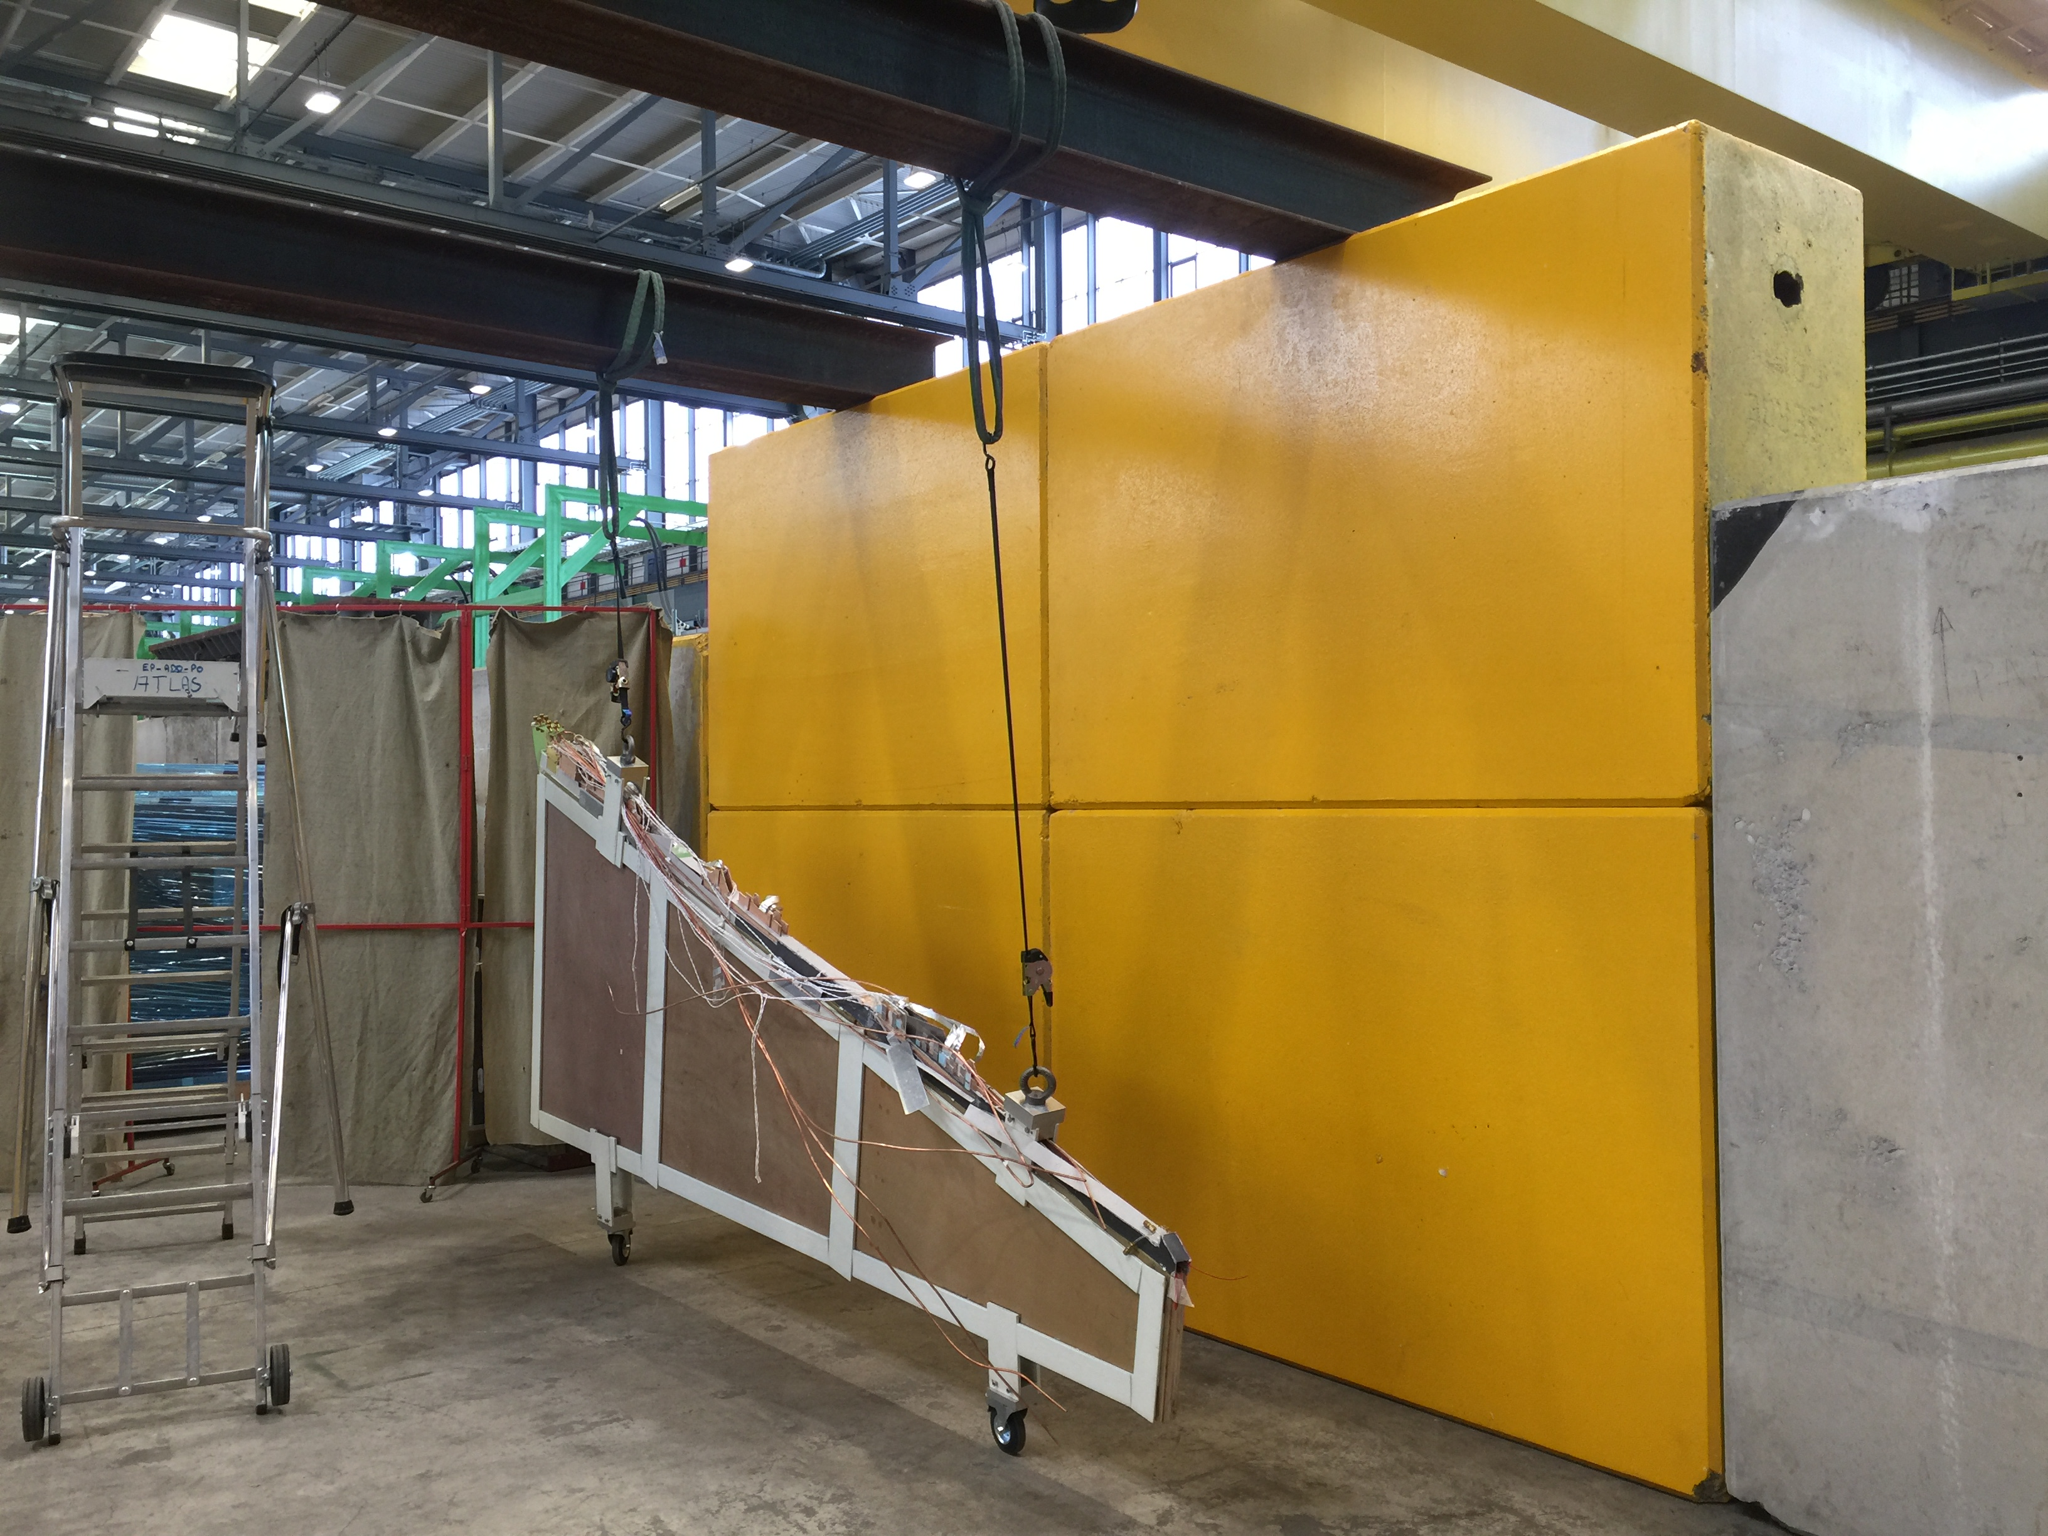
Wedge tests and storage
The full wedge will be tested with the “close-to-final” readout system
Then the wedge will be store

Slide 10
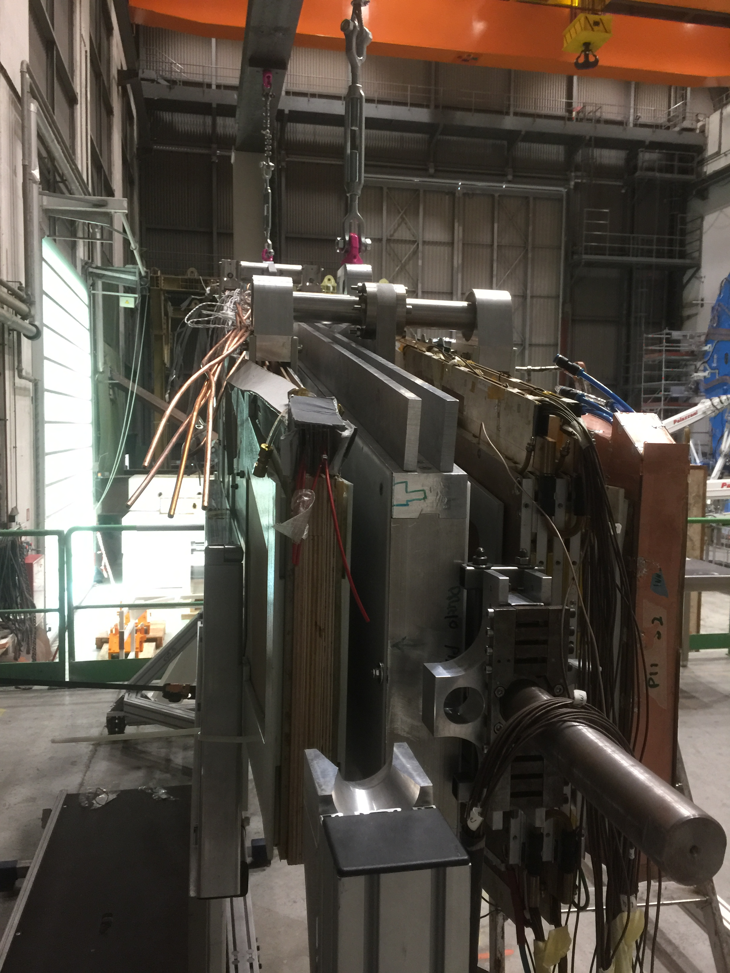
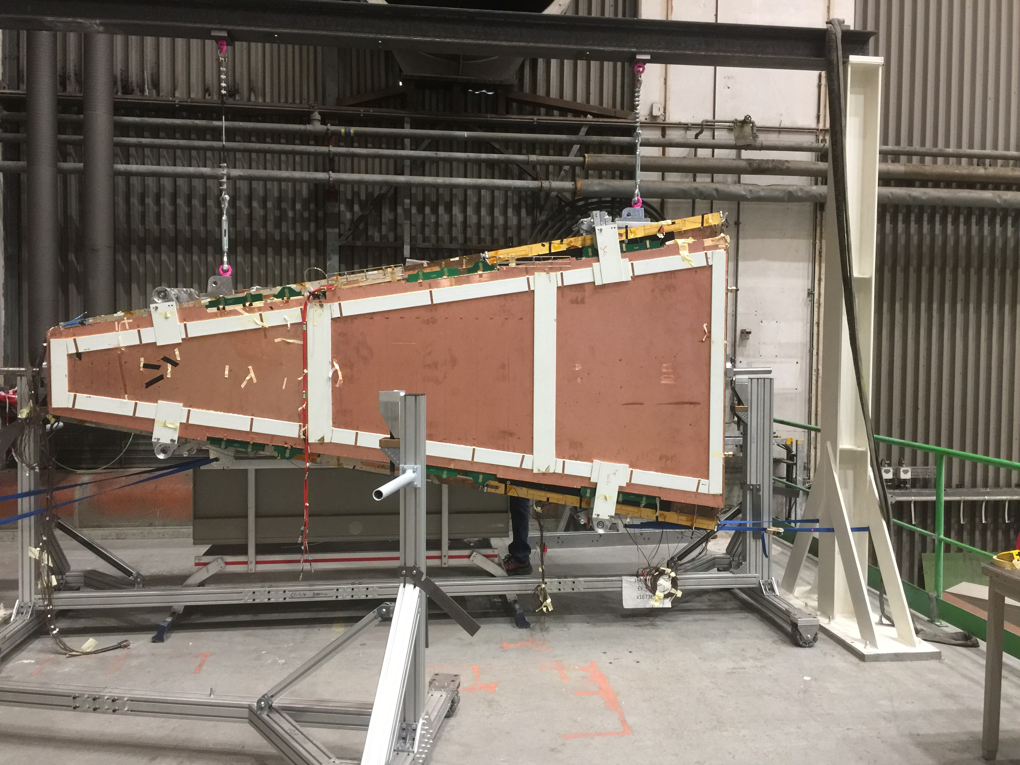
Sector assembly
Last month we proceed to the first sector assembly (with P. Ponsot and TC)
  Sector : sTGC-MM-MM-sTGC
All the tooling has been tested : small modifications are now included in the final tooling

Slide 11
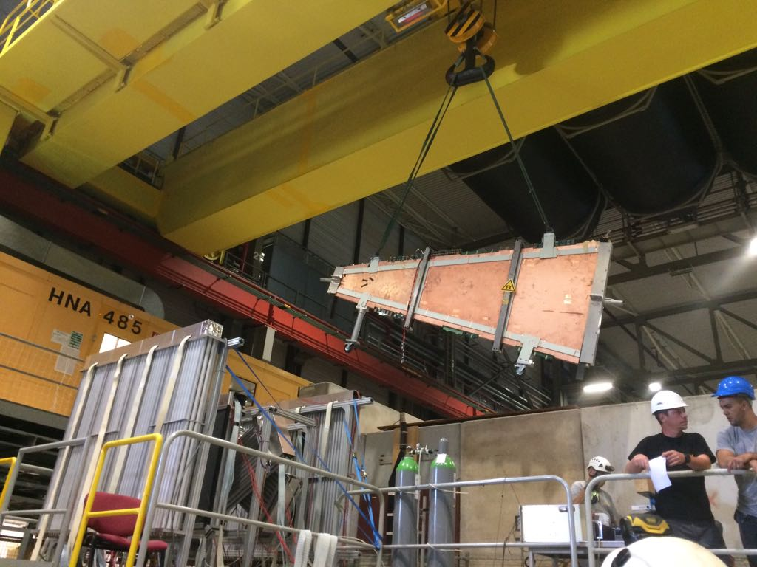
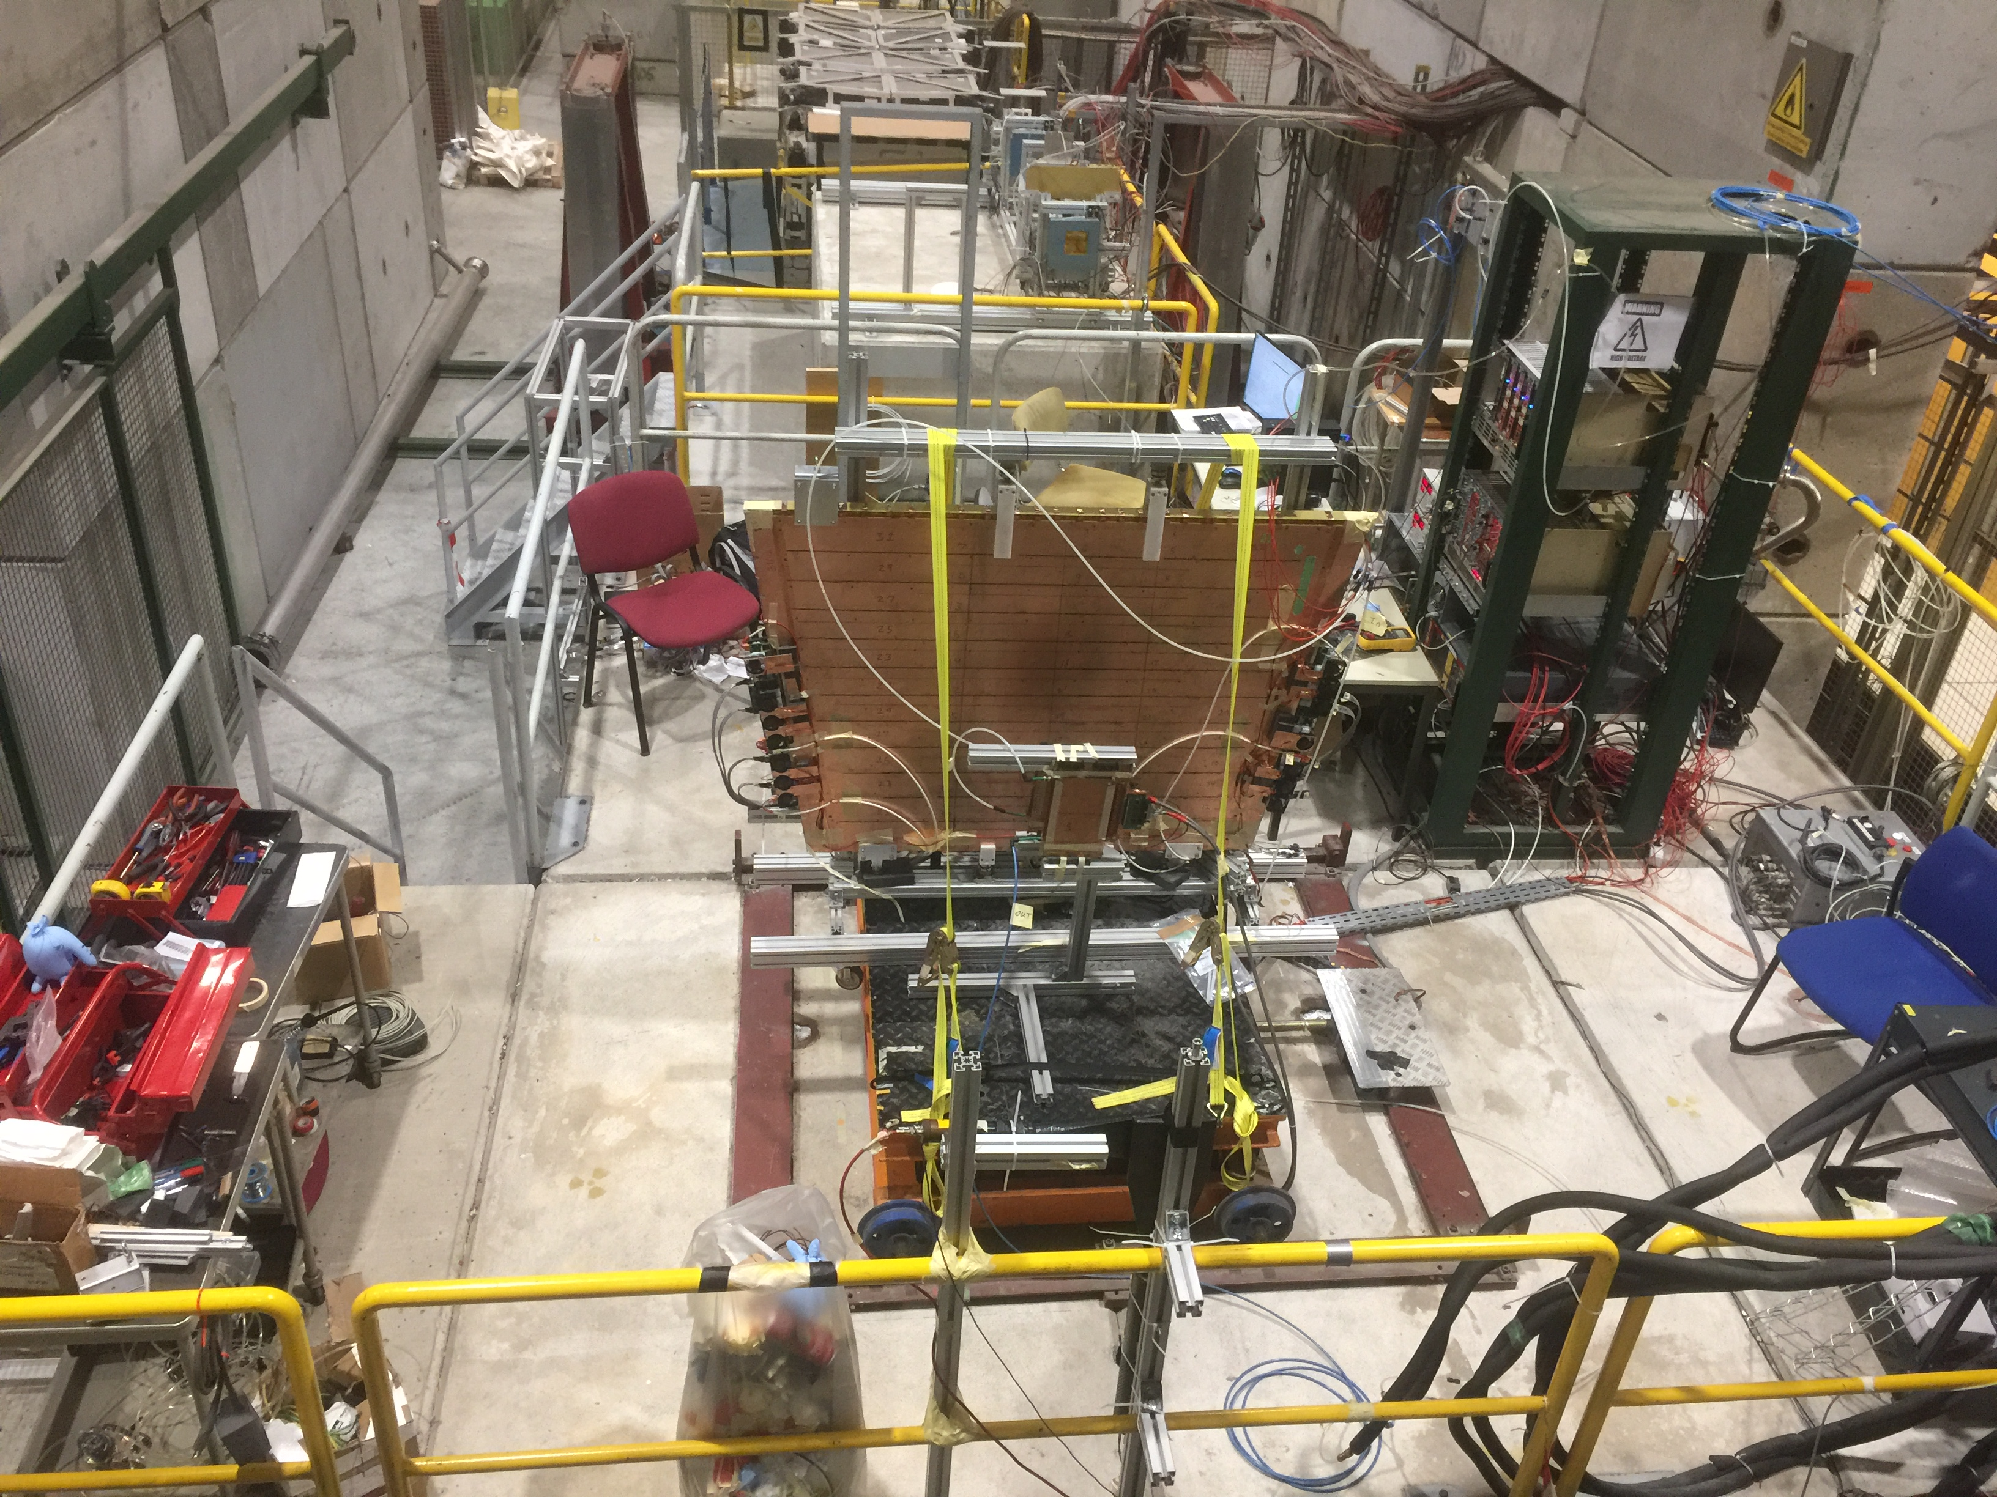
On going activity
We finished the wedge test beam in H8 (one week in July)
We received the QS3 chamber from Canada:
  Chamber fully equipped (4 pFEB and 4 sFEB)
  Chamber finished the test beam in H8 (10/8->15/8)
  Chamber installed in GIF++ (15/8->29/8) : on going test with irradiation and beam

Slide 12
conclusion
All the tools and the procedures have been tested for :
  Testing chambers
  Gluing wedge
  Testing wedge
  Transporting wedge
  Sector construction
All the pieces for the tools are at CERN and almost finished to mount
The July/August test beams (H8/GIF) with chamber and wedges increased our knowledge of the systems and trained a really good team
WE ARE READY !

