Slide 1
TGC Mainenance run-2
S. Tarem for H. Abreu
Current DCS team: H. Abreu, E. Gozani, E. Kajomovitz, S. Tarem
Weizmann detector team: M. Shoa, B. Yankovsky, V. Smakhtin, I. Rabinovitch
CERN team: G. Mikenberg, H. Abreu

Slide 2
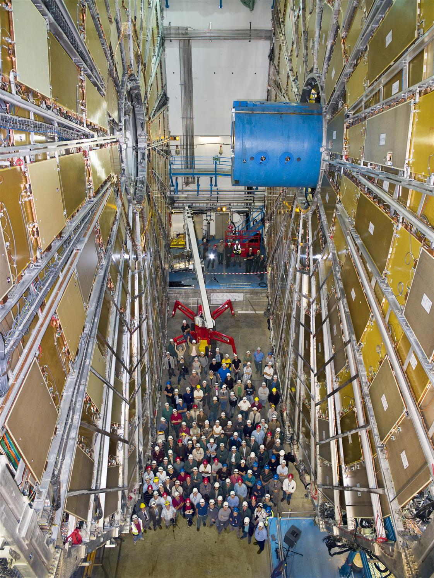
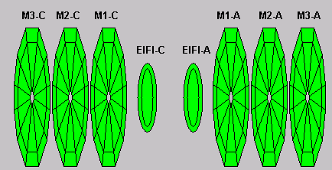
TGC now
At big wheel completion
The TGC system comprises on each side
  2 big wheels, a triplet and a doublet pair in the middle MS station
  In the inner station, a small wheel and partial coverage in EI

Slide 3
Responsibilities
IL is responsible to maintain:
  Chambers
  DCS
  DAQ
  Connection with gas group
The Japanese are responsible for
  Trigger electronics
  Power supplies
  Primary on call
There is cooperation and help to both sides

Slide 4
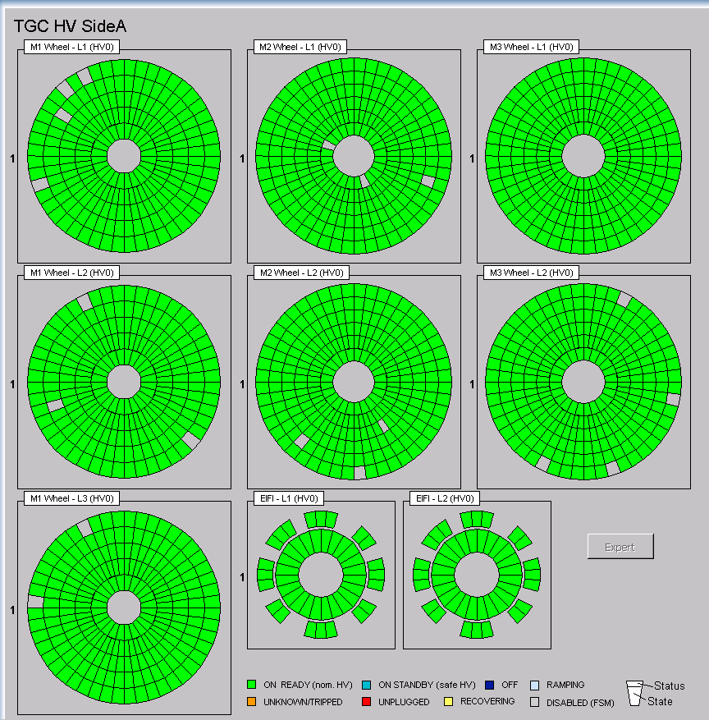
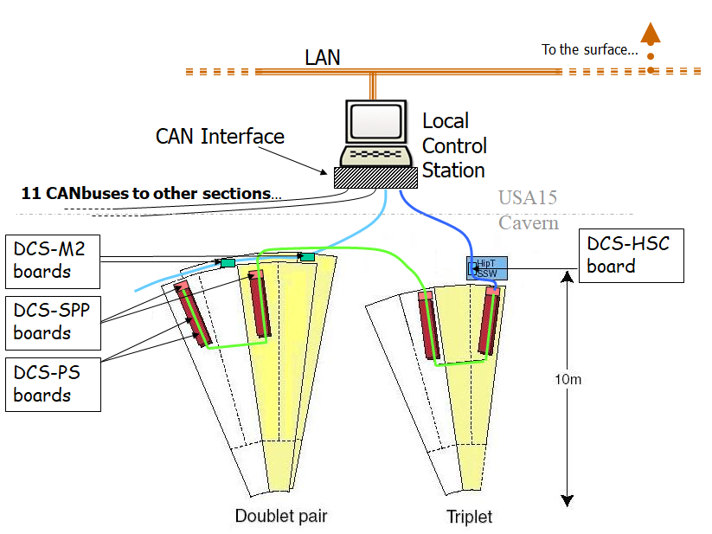
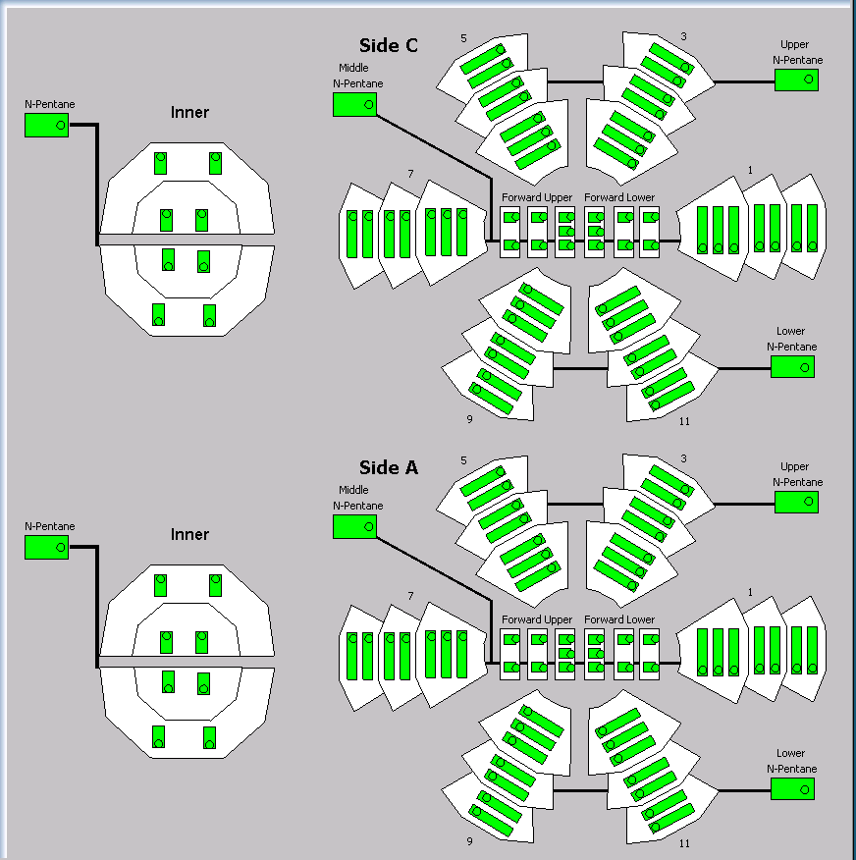
DCS topology
1524 DCS-PS
boards on sectors connected by CAN bus to USA15
Elmbs control ASD thresholds, CCMC,
Monitor LV and temperature
CAN BUS
HV
3732 HV channels and 344 LV channels
Connected via easyCrates and branchControllers to 2 CAEN mainframes in USA15
Gas system under control of CERN gas group, followed by us
Gas

Slide 5
Overall performance
TGC operation quite smooth in run2
Chamber hit efficiencies are stable since run1. No sign of aging damage
TGC chamber efficiencies are quite stable against instantaneous luminosity up to 2.1x10³⁴ (<pileup number> up to 65)
99% of chambers operating w HV
Burst problems mitigated by Japanese colleagues

Slide 6
TGC DCS status -Run2 preparations
  Windows → Linux migration in the full ATLAS DCS system. TGC Custom drivers translation.
  TGC DCS added in the Beam Injection System (BIS) discipline.
  Many improvements in the Graphical User Interface (GUI), mostly creation of new panels and re-arrange of several FSM nodes (for instance, CCMC, CAN PSU, CAN BUSES).
  Upgrade of the power supply control system (CAEN Mainframes).
    We gain speed. However telnet lost, a panel was developed to allow experts check/control defective chambers.
  Shift training material updated.

Slide 7
During run2 – First half
  TGC DCS:
  TGC DCS experts on-call provide instructions and actions to solve problems that appear during collision operations.
    Maintenance work (software/hardware) :
      Voltage drops in chambers caused by communication glitches in HV boards → fixed by upgrading the firmware on the HV board controller (seen in all muon sub-detectors, TGC was the more affected).
      Replacements of 3xELMBs (mainly broken in unexpected power cuts). A test system was built in B180 to understand this issue.
      Replacing broken components of the CAN PSU and in the DCS computers.

Slide 8
TGC Detector status
Since the beginning of run2
Together with G.M., we take care of the chamber operations and we are contact people of TGC gas system:
    Frequent optimization of working parameters (i₀, V_{set}) of chambers that don’t work in standard conditions.
    Dealing with issues in electrical installations (cables, power supply, etc.)
    CO2 burning recovery: At the end of every year, some chambers are tested with CO2 in order to burn parasitic resistances caused by carbon hairs. Recovery efficiency is ε ~ 50%

Slide 9
Chamber Replacements
  Weizmann team and G.M.
    Every year, there are a small fractions of TGC detectors that stop working properly or are working in non-standard conditions.
    Those detectors are reported as problematic and need to be exchanged before a new data-taking period.
    A team from Weizmann exchanges the detectors (Meir, Boris)
    As soon as the new detectors are installed in the experience, a series of test are performed (gas, voltage, etc.) and reintegrated into the experiment (database, DCS).
    More in Ehud’s talk

Slide 10
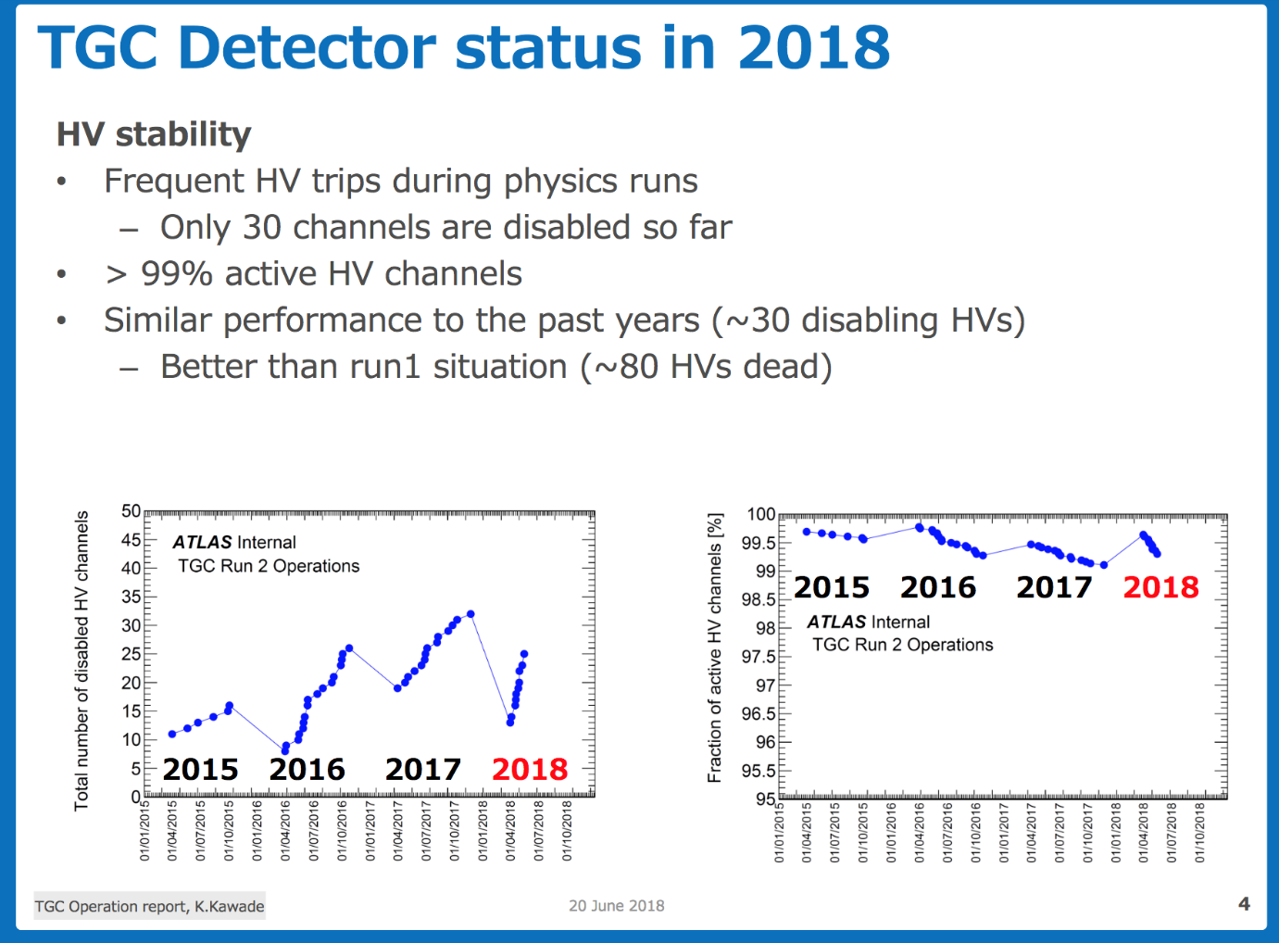
Since the beginning of run2 :
TGC Detector status:
16 units replaced in EYETS 2016-2017: 14 Triplets and 2 Doublets
Detector status in June 2018 shown in the last Muon week by Kentaro Kawade: https://indico.cern.ch/event/729730/contributions/3032296/attachments/1671093/2681128/ATLAS_MuonWeek_TGC_20180620_KentaroKawade.pdf

Slide 11
End of run2 - from EYETS 2017-2018
TGC DCS Developments
  Self-disabling of HV (chambers) + elog post after reached the maximum numbers of trips (motivated by some confusing scenarios during the last year).
  Improvement of the alarms/alerts during shutdown periods. It allows to distinguish real failures than just messages from unplugged components.
  CentOS7 & Winccoa migration.
TGC detector status:
  Ongoing work to understand gas performance after 10 years of operations under LHC conditions.
Preparation for LS2:
  35 disabled chambers (https://bit.ly/1HzXva8).
  Several parts of the Big wheels will be reachable. See Ehud’s talk.

