Slide 1
Group’s Performance
Ehud Duchovni

Slide 2
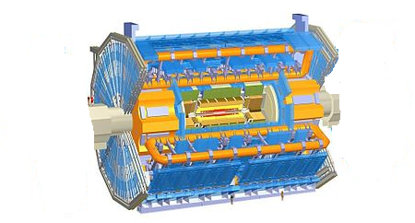
The TGC Structure
Side C
Side A
M1
MDT
MDT
M2
MDT
MDT
M3
M3
M2
M1
Doublets
Triplets
Doublets

Slide 3
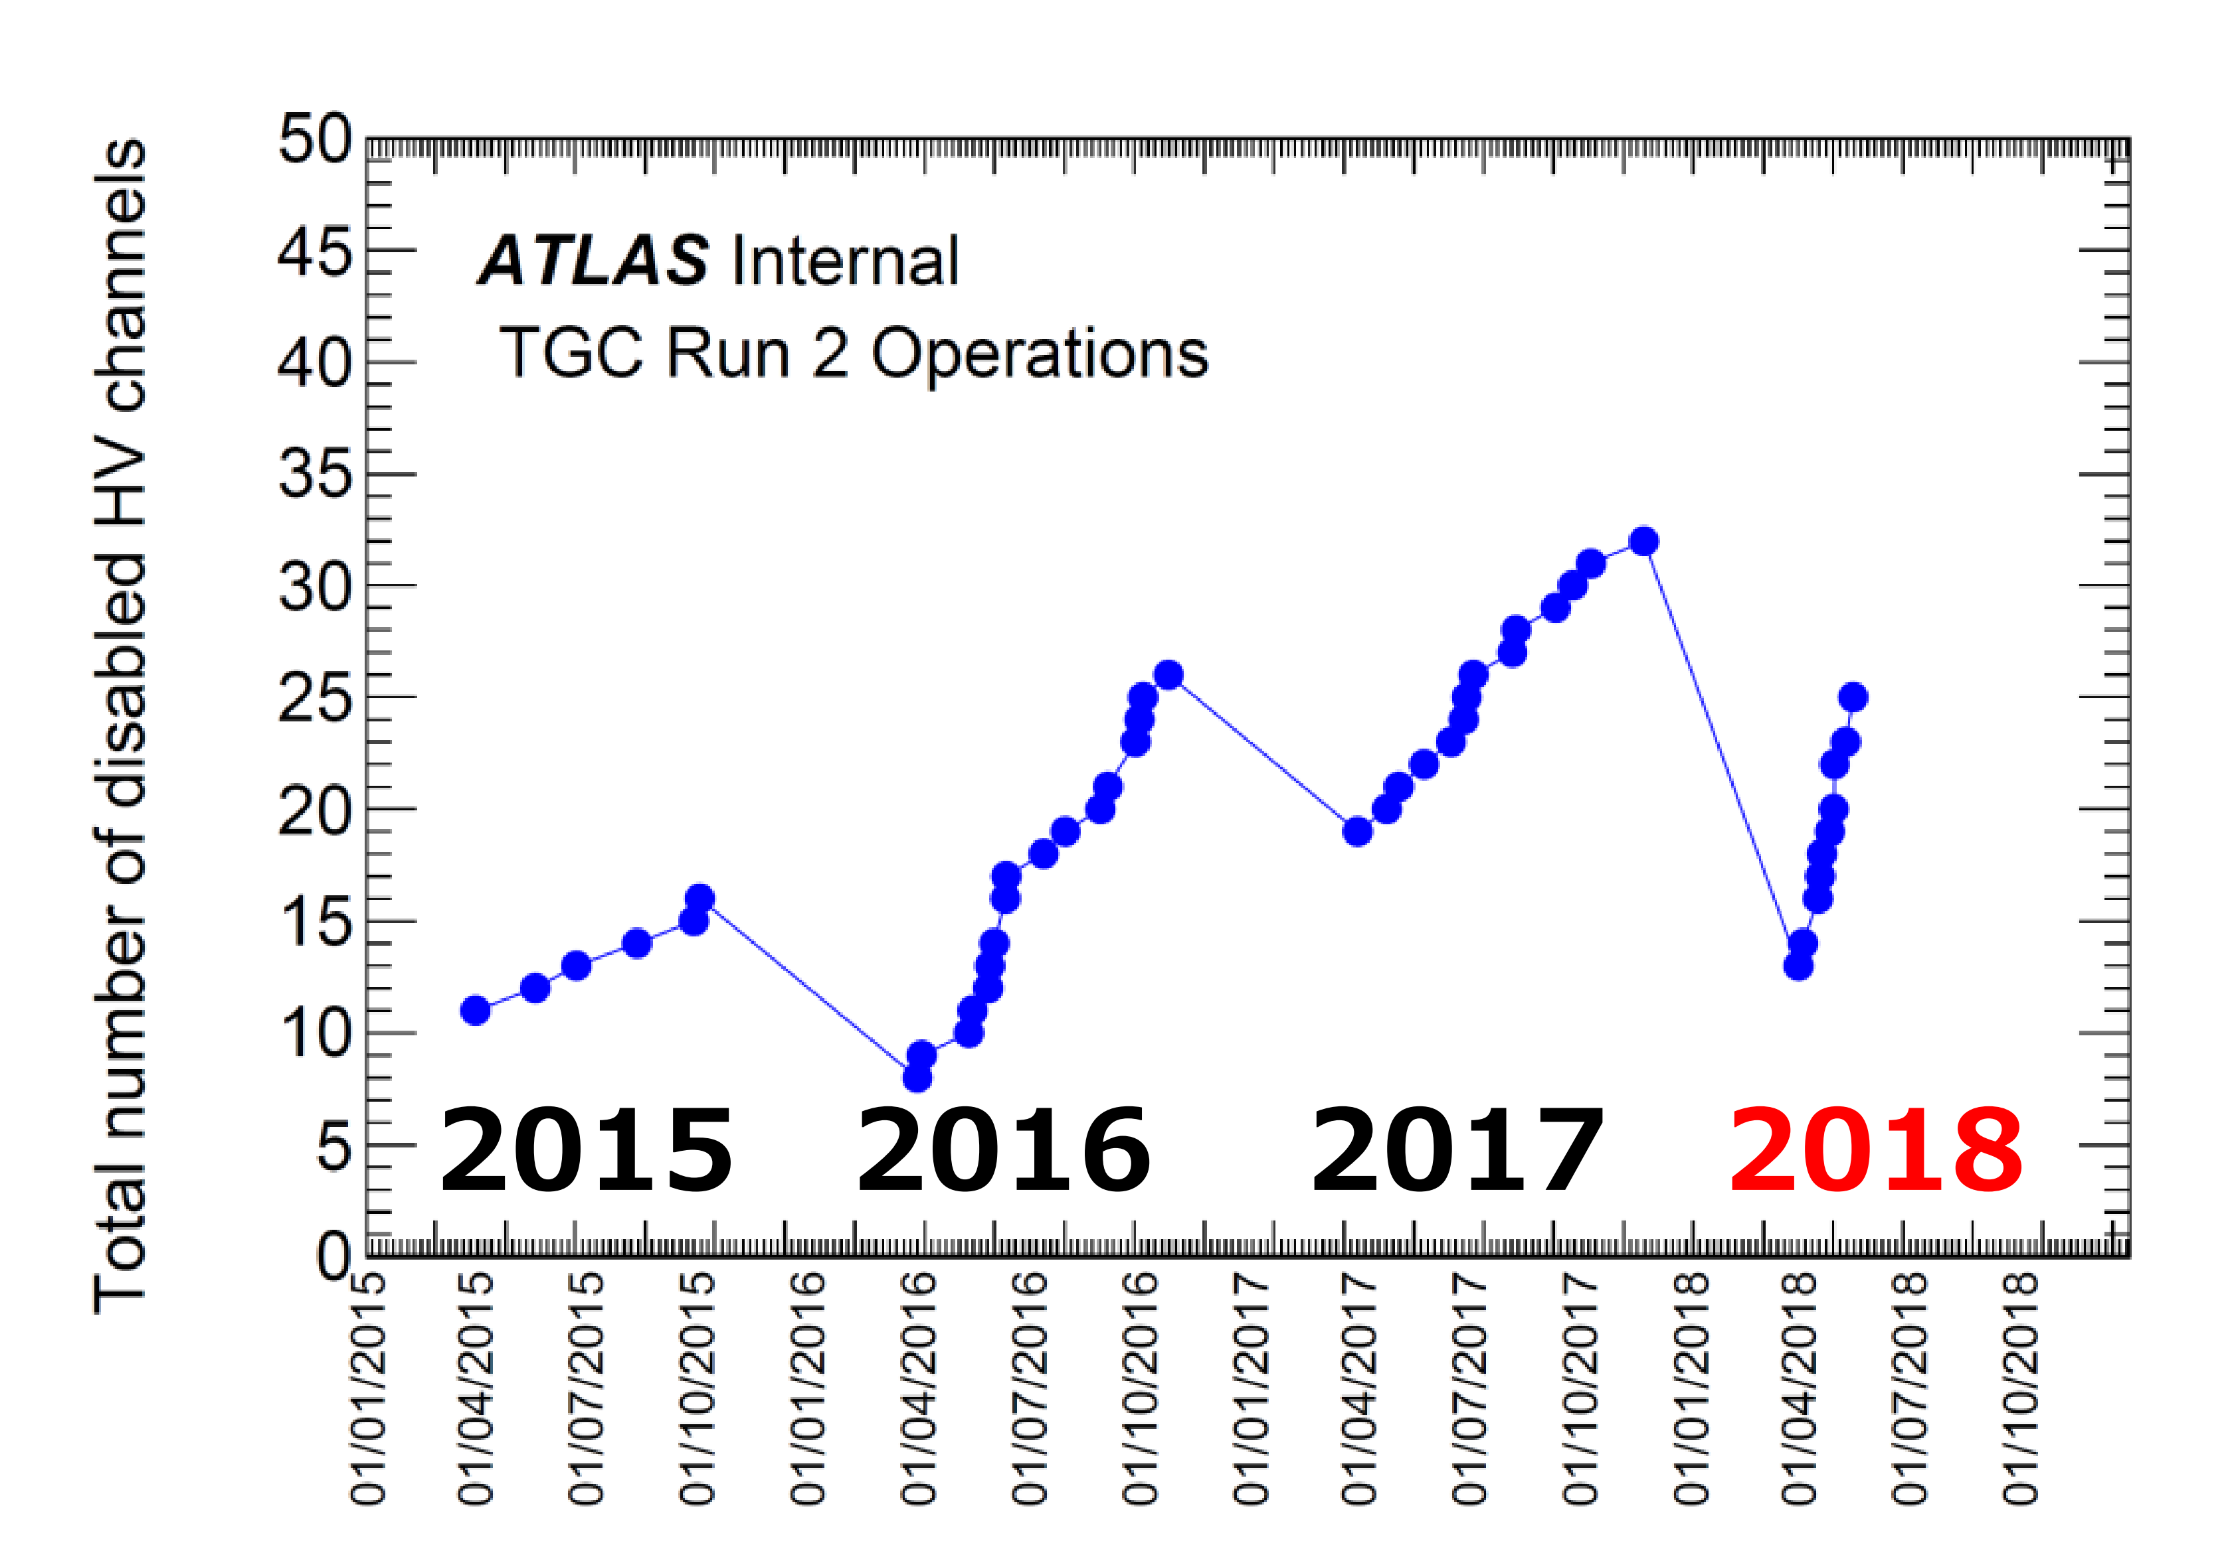
How many TGC layers are “off”?
2015
2018
Oscillations due to annual maintenance were detectors are fixed or replaced
Kentaro Kawade June 20th talk

Slide 4
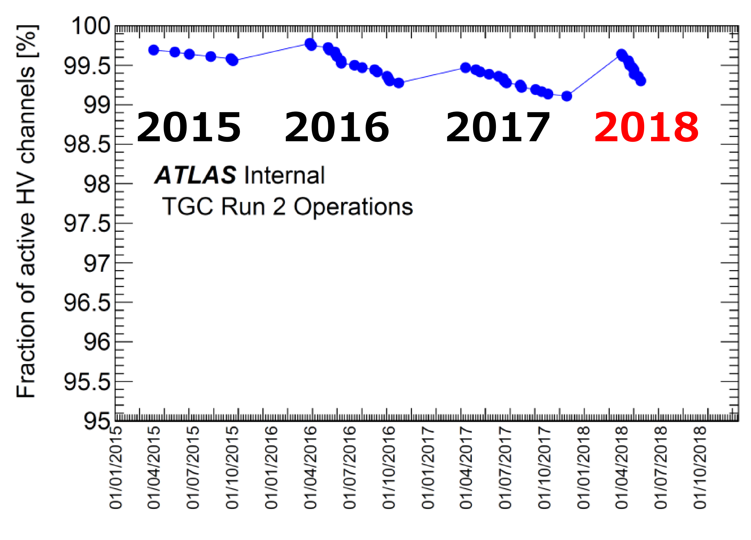
Fraction of ‘Turned-off’ TGC Layers
2015
2018
Practically fully efficient >99%

Slide 5
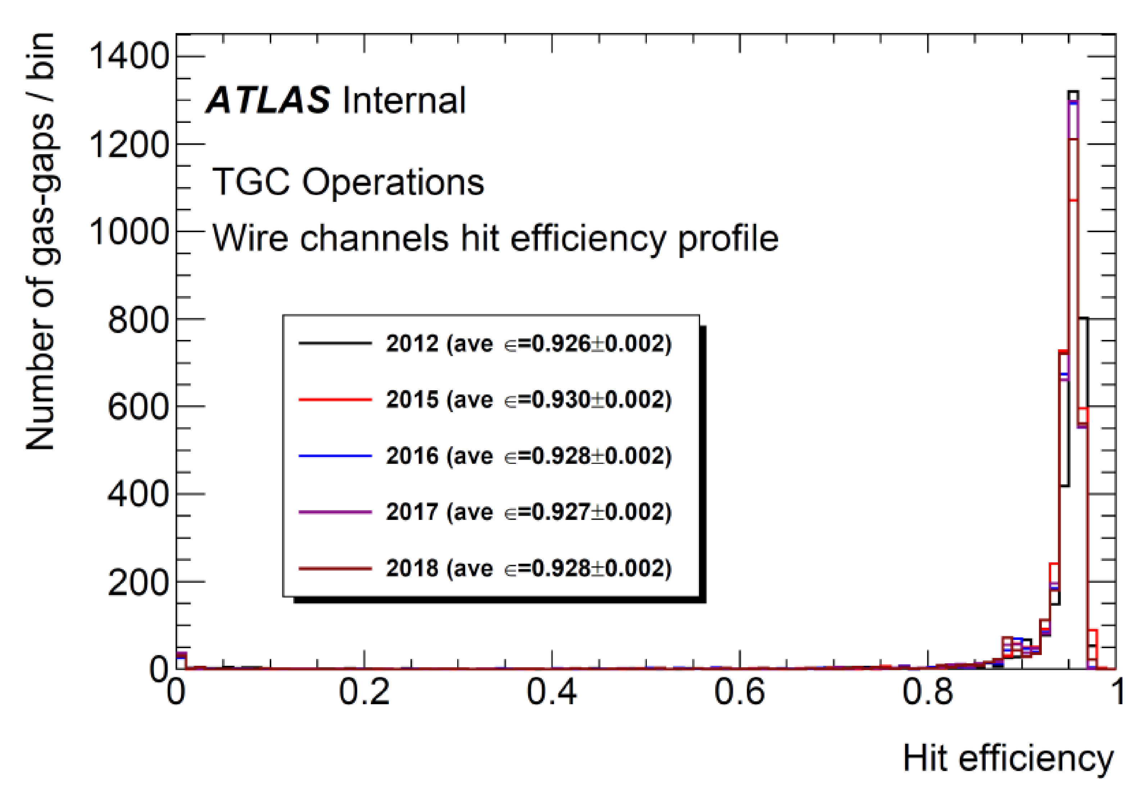
Hit efficiency
Hit efficiency is very high

Slide 6
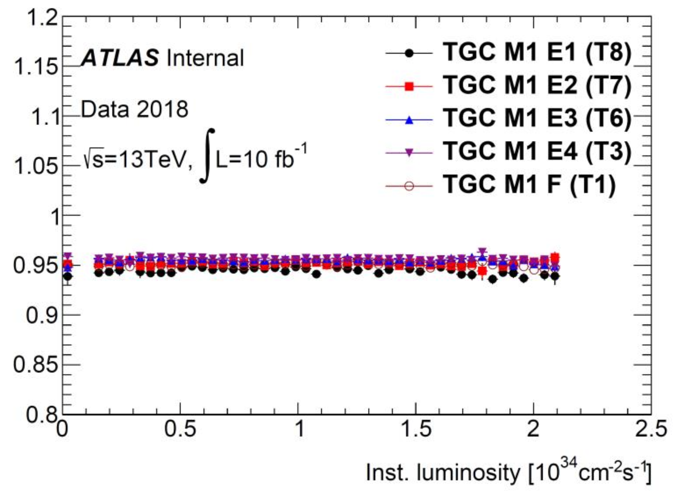
Luminosity Dependence
Efficiency doesn’t drop at the highest luminosity

Slide 7
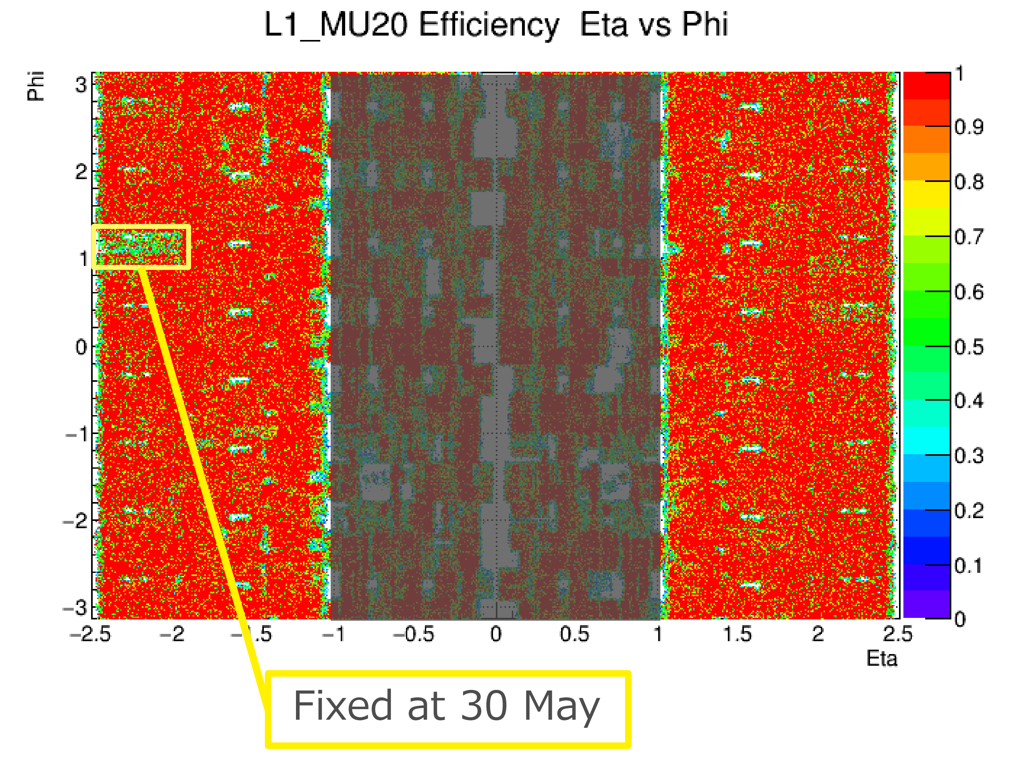
Coverage
ϕ
η
Full Coverage: no holes

Slide 8
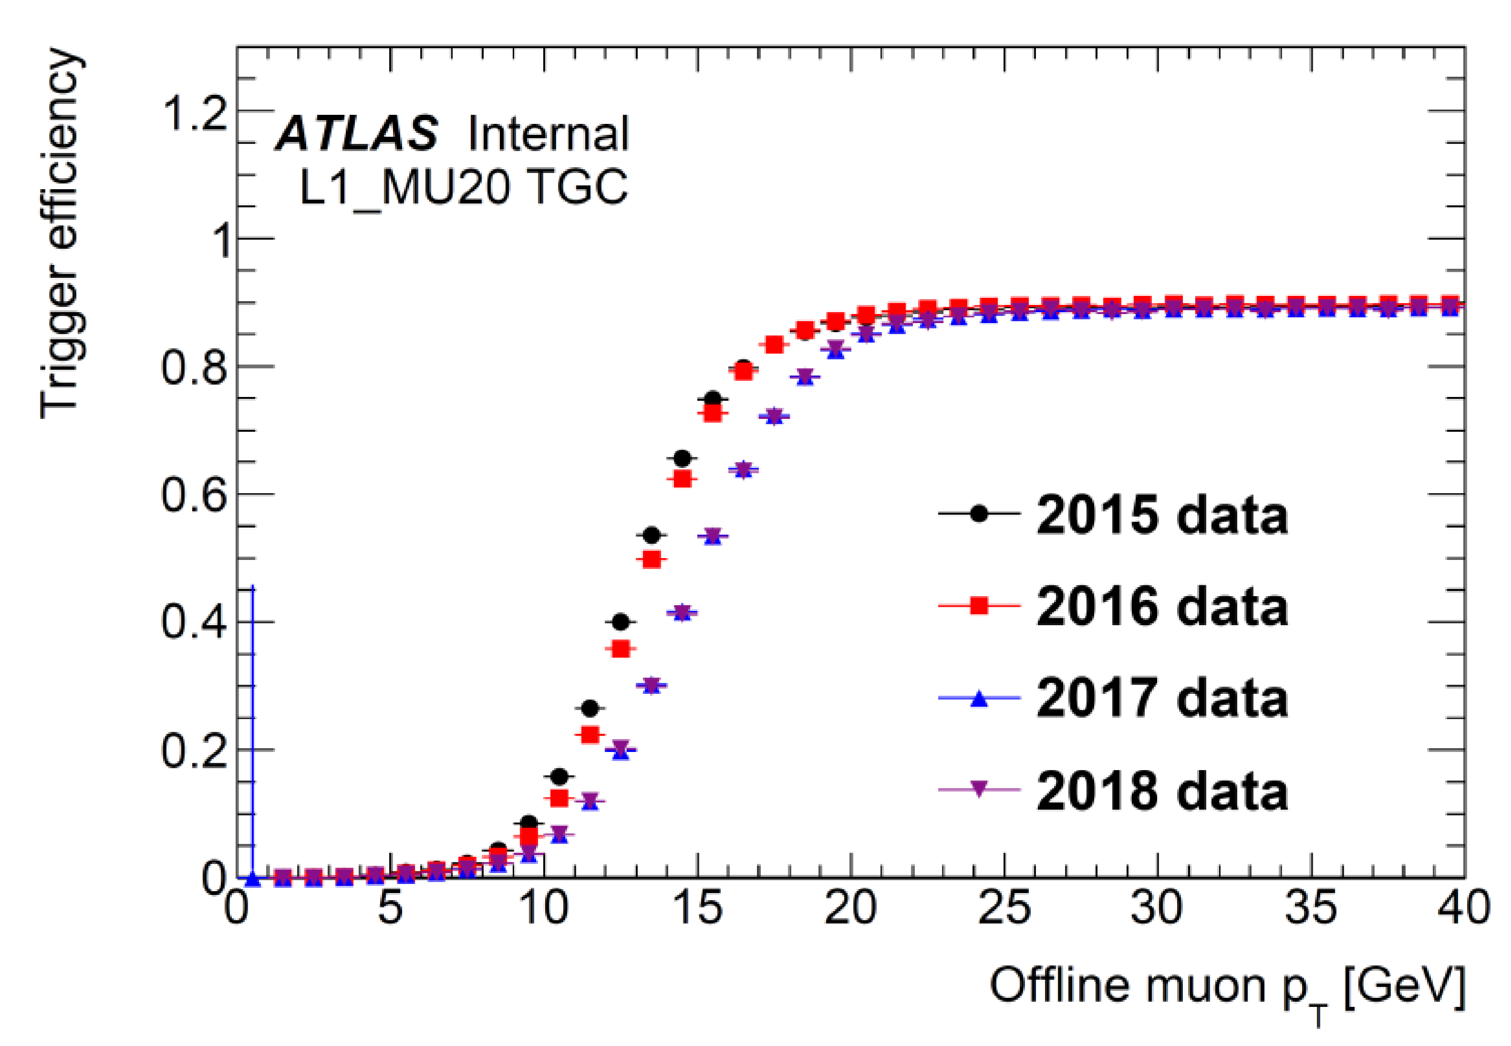
Trigger Threshold
Nice behavior

Slide 9
How Can One Keep a 3600 Units-System Working?
Daily monitoring of the system (Giora Mikenberg and Henso Abreu) and weekly fixing of faulty units (GM & HA) on top of annual maintenance work (fixing detectors and replacing unfixable ones) (Mexico team).
Had 2-4% spares and currently we start running out of units. The T8 and T7 Triplets (first units produced at Israel and Japan) are the most problematic ones.
Need to build new units to replace the ones with no spares left, and to refresh our stock of spare chambers

Slide 10
On and off-line Detector & Trigger Monitoring
Easy
Medium
Side C
Hard
Side A
M1
MDT
MDT
M2
MDT
MDT
M3
M3
M2
M1

Slide 11
Maintenace maps
SIDE A M1
January
T8B
A/M1/03/PHI1/E1
New – U08b1i-126\20mtweiu080126
Old – U08b1i-013.1\ 20mtweiu080013
A/M1/02/PHI1/E1
T8B
New – U08b1i-128\20mtweiu080128
Old – U08b1i-107.5\ 20mtsduu080107
T7B
T8B
A/M1/01/PHI3/E2
Erased
A/M1/07/PHI1/E1
New – U07b1i-002\20mtweiu070002
Old – U071b-002\ 20mtkek0711002
T1B
New – U01b1i-115.7\20mtweiu010115
Old – U01b1i-112.4\ 20mtweiu010112
T7B
A/M1/11/PHI2/F;
Erased
A/M1/12/PHI3/E2
A/M1/11/PHI1/E1
T8B
New – U08b1i-122\20mtweiu080122
Old – U08b1i-019.7

Slide 12
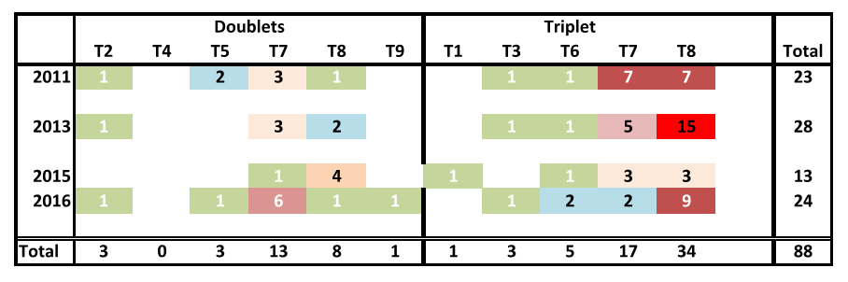
History of Annual Maintenance
Up to now 88 detectors have been replaced

Slide 13
Prospects
Right now we have O(10) new dead layers in each year.
There is no evidence that the rate of deceased units depends on the luminosity, but it may.
The TGC will be exposed to a much higher radiation than expected
We don’t know what is the life-expectancy of a detector.
Need to build more detectors, but,each gas-gap costs ~4,000$

Slide 14
4
A/M1/03/PHI2/E1/L2/HV0+L3/HV0
SIDE A M1 - HO
5
3
T8F
A/M1/03/PHI0/E1/L1/HV0
T8F
6
2
T7F
A/M1/04/PHI2/E4
A/M1/03/PHI0/E4
T3F
A/M1/02/PHI2/E2/L1/HV0
T3F
T8F
A/M1/07/PHI0/E1
T8F
A/M1/01/PHI2/E1/L3/HV0
7
1
8
12
A/M1/11/PHI0/E1
9
T8F
11
10

Slide 15
Treating the Various Cases
 | Side A
 |  | T9 | T8 | T7 | T6 | T5 | T4 | T3 | T2
 | Easy(T) | 0 | 2 | 2 | 1 | 0 | 0 | 0 | 0 | T | 5 | 15
 | Easy(D) | 0 | 0 | 1 | 0 | 0 | 0 | 0 | 0 | T | 1 | 2
 | Medium(T) | 0 | 5 | 1 | 0 | 0 | 0 | 3 | 0 | T | 9 | 27
 | Medium(D) | 1 | 5 | 2 | 0 | 0 | 2 | 0 | 0 | T | 10 | 20
 | Hard(D) | 5 | 4 | 2 | 1 | 0 | 3 | 0 | 1 | D | 16 | 32
 |  |  |  |  |  |  |  |  |  |  |  | 96
 | Side C
 |  | T9 | T8 | T7 | T6 | T5 | T4 | T3 | T2
 | Easy(T) | 0 | 3 | 0 | 0 | 0 | 0 | 0 | 0 | T | 3 | 9
 | Easy(D) | 0 | 0 | 1 | 1 | 1 | 0 | 0 | 1 | T | 4 | 8
 | Medium(T) | 0 | 12 | 3 | 1 | 0 | 0 | 0 | 0 | T | 16 | 48
 | Medium(D) | 0 | 0 | 7 | 0 | 0 | 0 | 0 | 0 | T | 7 | 14
 | Hard(D) | 0 | 0 | 3 | 5 | 0 | 3 | 0 | 1 | D | 12 | 24
 |  |  |  |  |  |  |  |  |  |  |  | 103
 | All
 |  | T9 | T8 | T7 | T6 | T5 | T4 | T3 | T2
 | Easy(T) | 0 | 5 | 2 | 1 | 0 | 0 | 0 | 0 | T | 8 | 24
 | Easy(D) | 0 | 0 | 2 | 1 | 1 | 0 | 0 | 1 | T | 5 | 10
 | Medium(T) | 0 | 17 | 4 | 1 | 0 | 0 | 3 | 0 | T | 25 | 75
 | Medium(D) | 1 | 5 | 9 | 0 | 0 | 2 | 0 | 0 | T | 17 | 34
 | Hard(D) | 5 | 4 | 5 | 6 | 0 | 6 | 0 | 2 | D | 28 | 56
 |  |  |  |  |  |  |  |  |  |  |  | 199

Slide 16
Production of Spare TGC
The sTGC is at the highest possible priority.
The construction will end sometime toward autumn 2019
Once the sTGC production is over we will use the trained team and continue with TGC construction.
In order to move smoothly from TGC to sTGC we will have to order all materials not later than spring 2019.
In order to reduce the cost a team was sent to CERN (working as we speak) who tests the ~150 TGC chambers that were moved from BB5 to Bldg 180. A large number of these detectors are expected to be in bad condition.
Those who can be fixed will be sent to Israel.
The good ones will reduce the number of units that will be built.
It is advisable to renew, on this occasion, the spares such that we will have enough till the end of ATLAS scientific program

Slide 17
Summary
The TGC system is functioning extremely well.
About 90 units have been replaced since 2012.
Some types (mainly T8 & T7) ran out of spares
We would like to use the opportunity of long shutdown to open the detector and maintain regions that cannot be maintained in annual sessions.
We would also like to use the trained team to build replacement units and some spare units.
ATLAS applied for 180K$ in 2019 and 180K$ in 2020 to finance the construction of ~90 gas-gaps

Slide 20
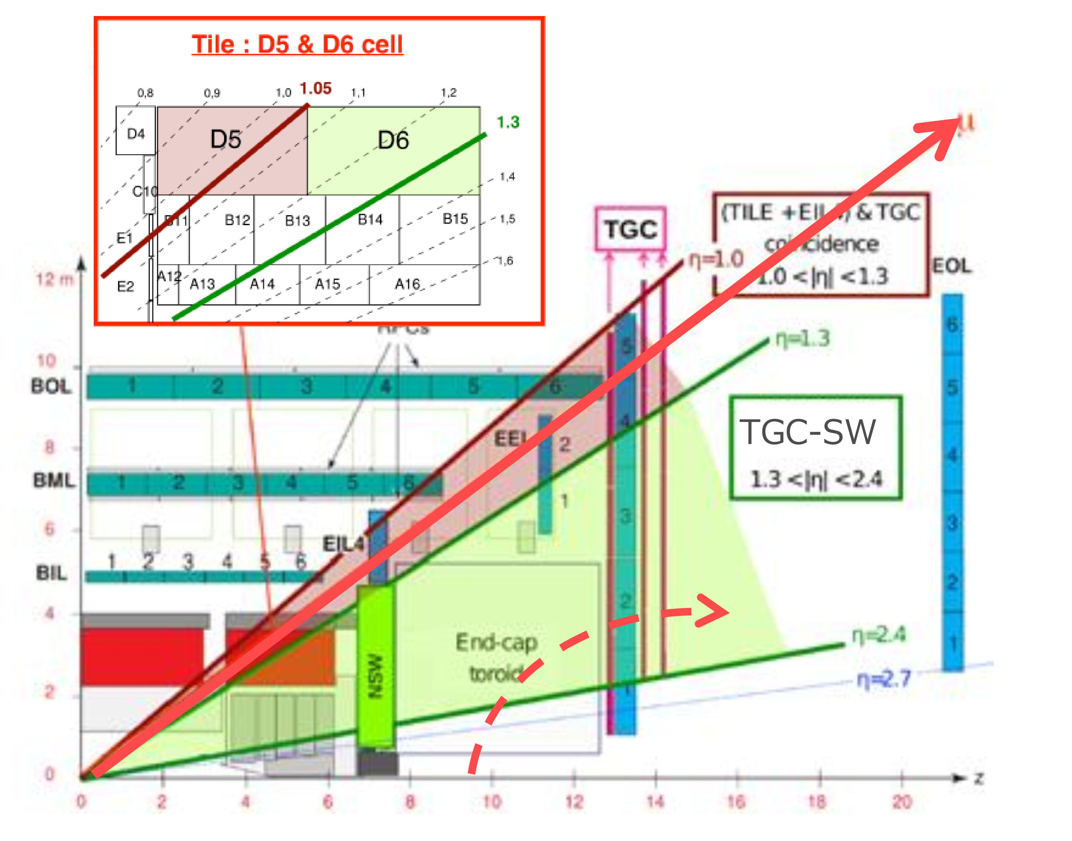
On and off-line Detector & Trigger Monitoring

Slide 21
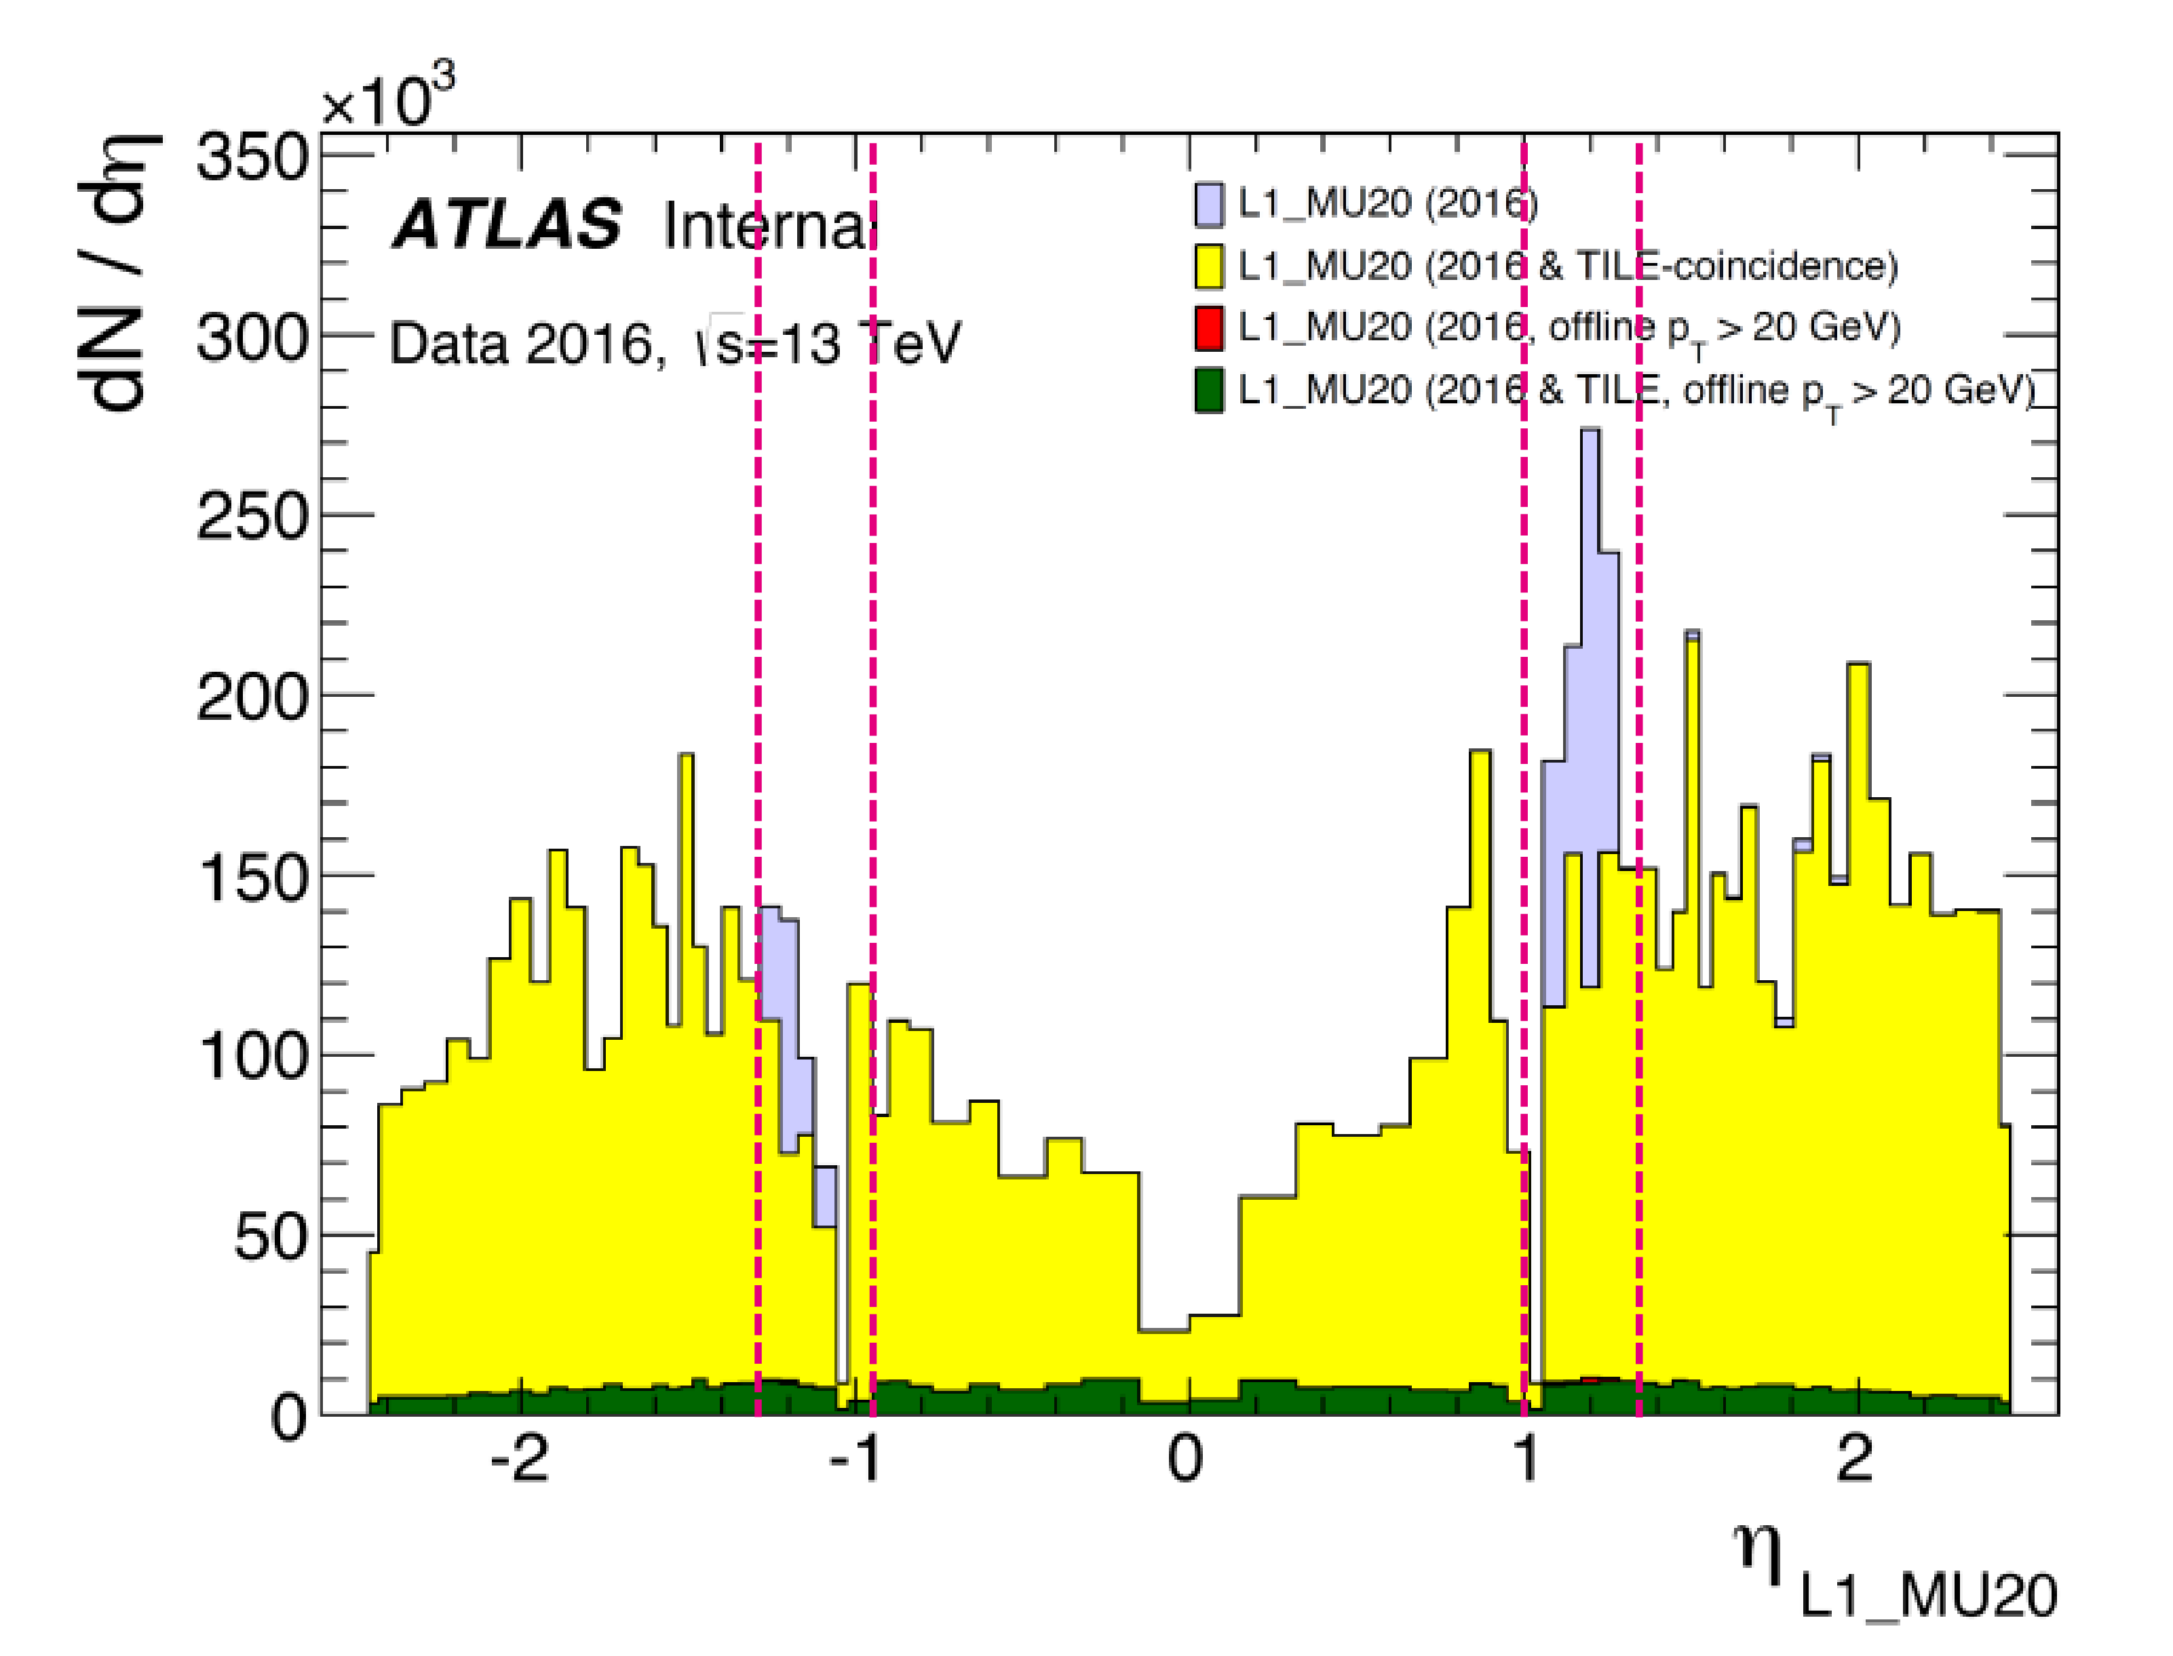
Fake News
(Trigger)
Ergo
NSW

