Slide 1
The ATLAS lab for production of detectors at the Weizmann Institute
Meir Shoa On behalf of WEIZMANN team

Slide 2
Resources of the lab and activities
Manpower
  5 Technicians with 5 to 35 years experience on TGC detectors
  All the rest of the technicians were hired on the last year for the production of sTGC’s
Laboratory
  Space
  Equipment

Slide 3
450 m² laboratory to develop and construct TGC’s and STGC’S
Main facilities
10 flat granite tables equipped with vacuum system, including pumps, sensors, HV and gas supplier
Many working stations fully controlled for Vacuum, Temperature and Humidity
  Including automatic alert system (e-mail and sms)
Excellent crane all along the lab
Network controlled centralized HV system
Advanced electronic devices for developing and read out signals from the chambers
Custom tools to spread epoxy
Advanced equipment for precision measurement; Faro arm and X-Y-Z machine
A new automatic graphite spraying machine is expected to replace the old one in about 3 months

Slide 4
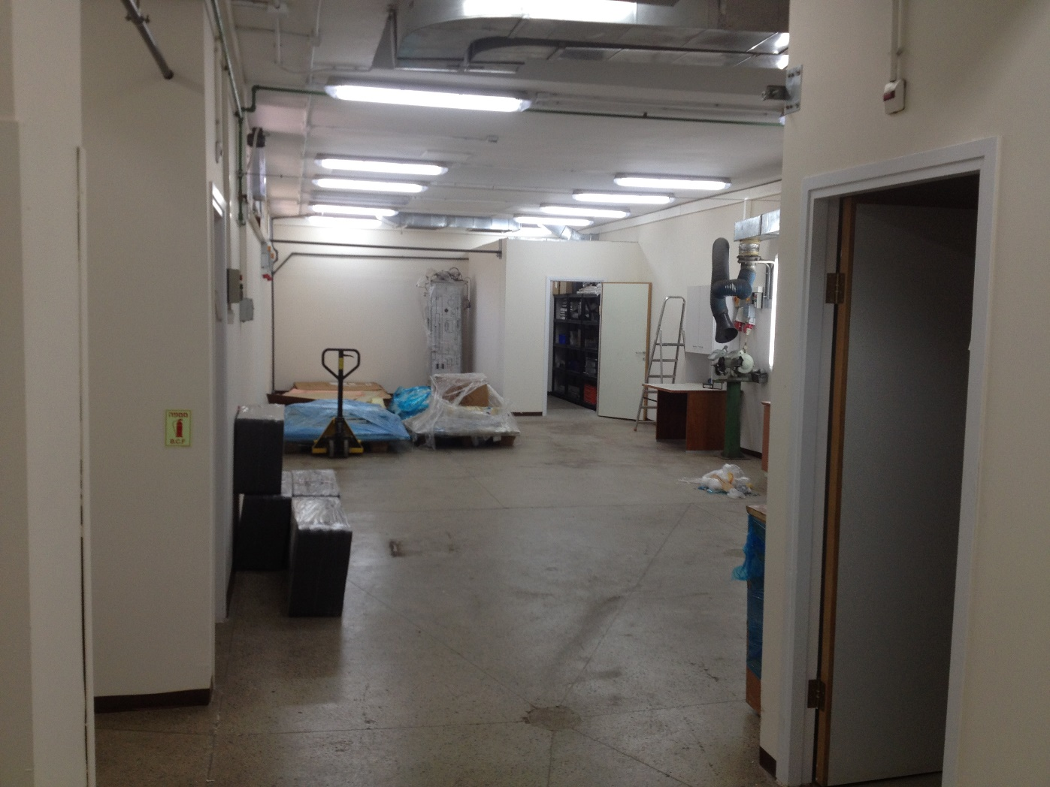
120 m² of storage area
Used for:
Storage of materials and parts for the sTGC production
Testing the sTGC parts (in particular the cathode boards) All the
Storage of produced quadruplets
Preparation of quadruplets for shipment to CERN
The new graphite spray machine will be assembled in this area

Slide 5
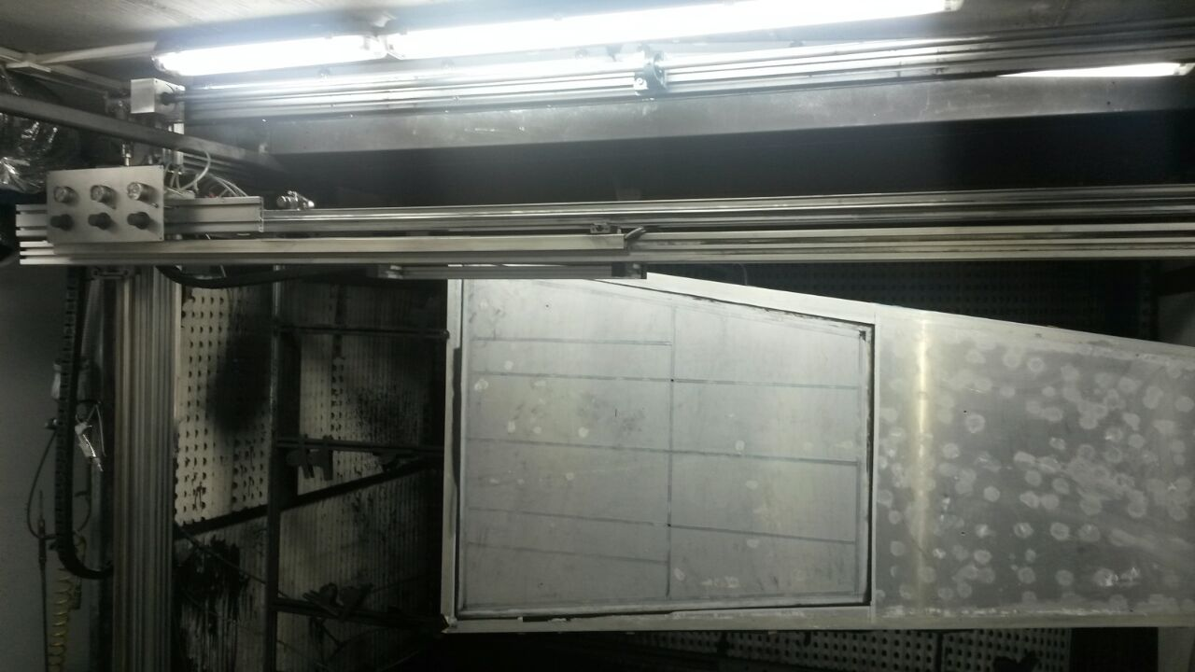
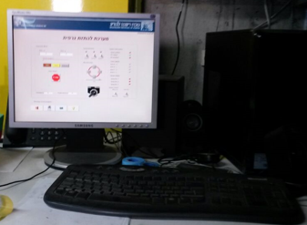
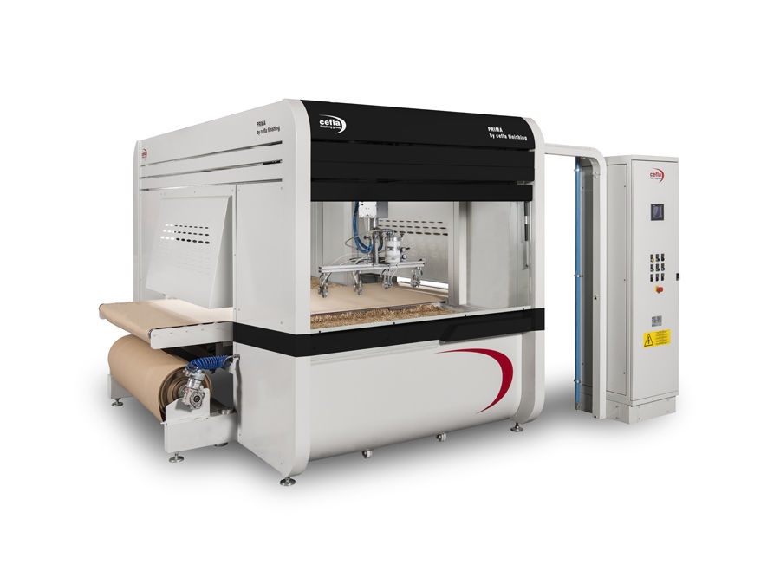
Old Graphite spraying room
Spraying is done automatically
  On an X-Y system
Spraying is done in the open space
  Requires controlled temperature and humidity
  Tuning is needed on a regular basis
new Graphite spraying machine
Based on the good experience of the Canadian and
Chilean groups
The Procurement of the PRIMA by Cefla spraying machine is approved by the Institute
  As part of the annual internal equipment grants
Location was found for the new machine
Will be installed in about 3-4 months.

Slide 6
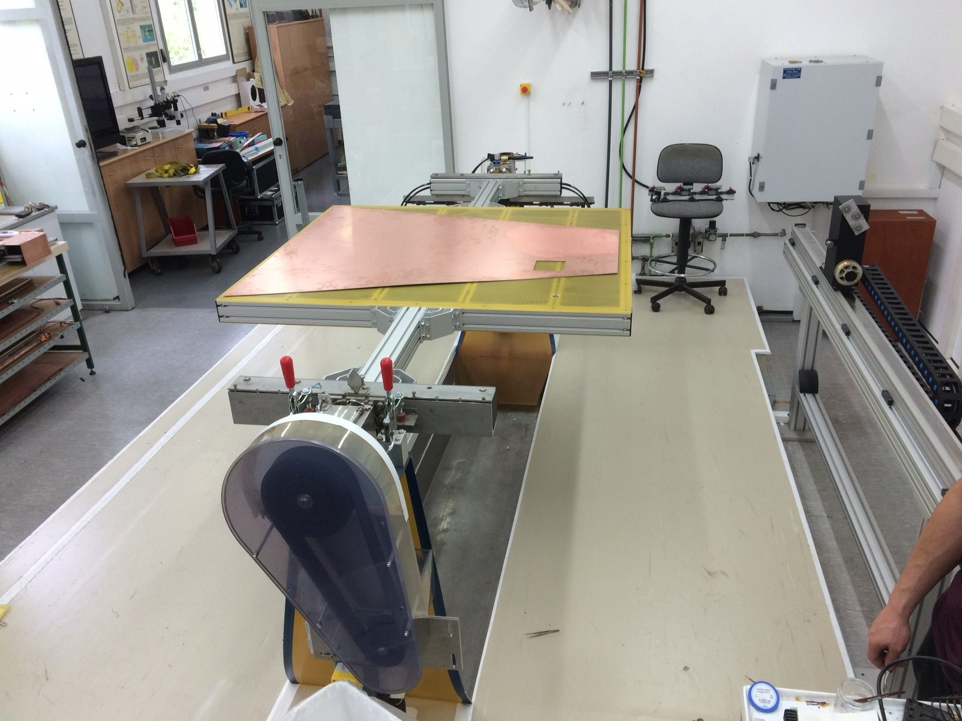
WINDING MACHINE
The winding machine was developed at Weizmann
  The prototype used for the TGC production was built at Weizmann The current prototype was built by an external company
The machine is working in the lab for the last 2 years without any problem
Four out of five production sites use the same winding machine
The same machine can be used for different detector geometries, including sTGC and TGC
  By adapting the winding table

Slide 7
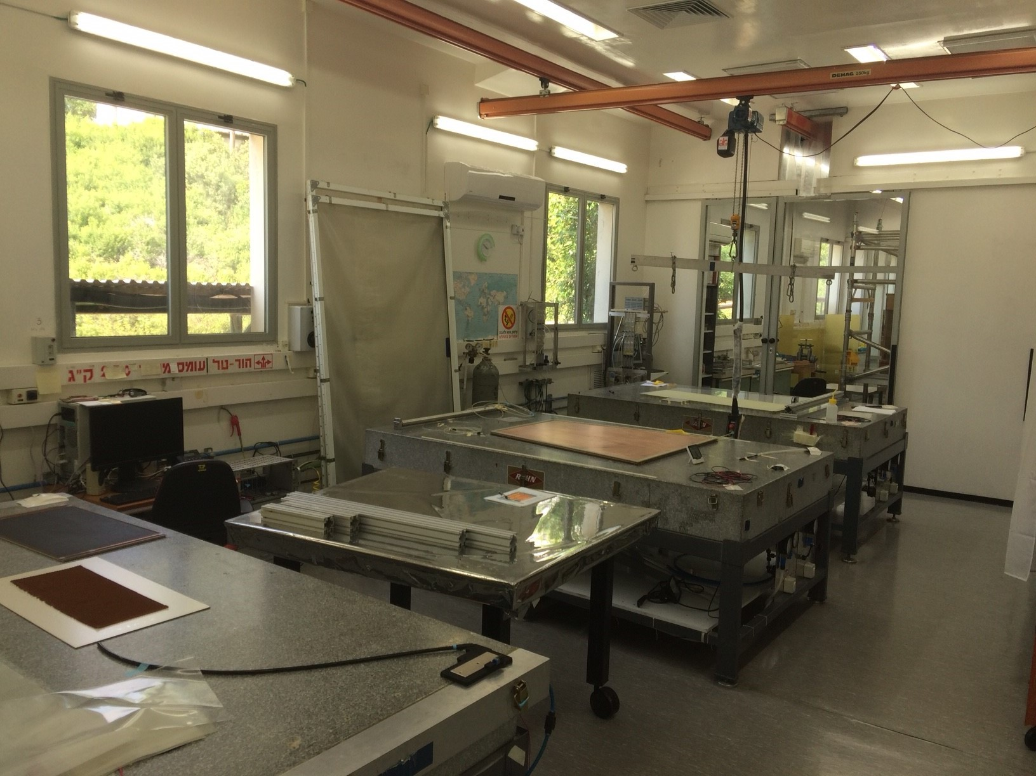
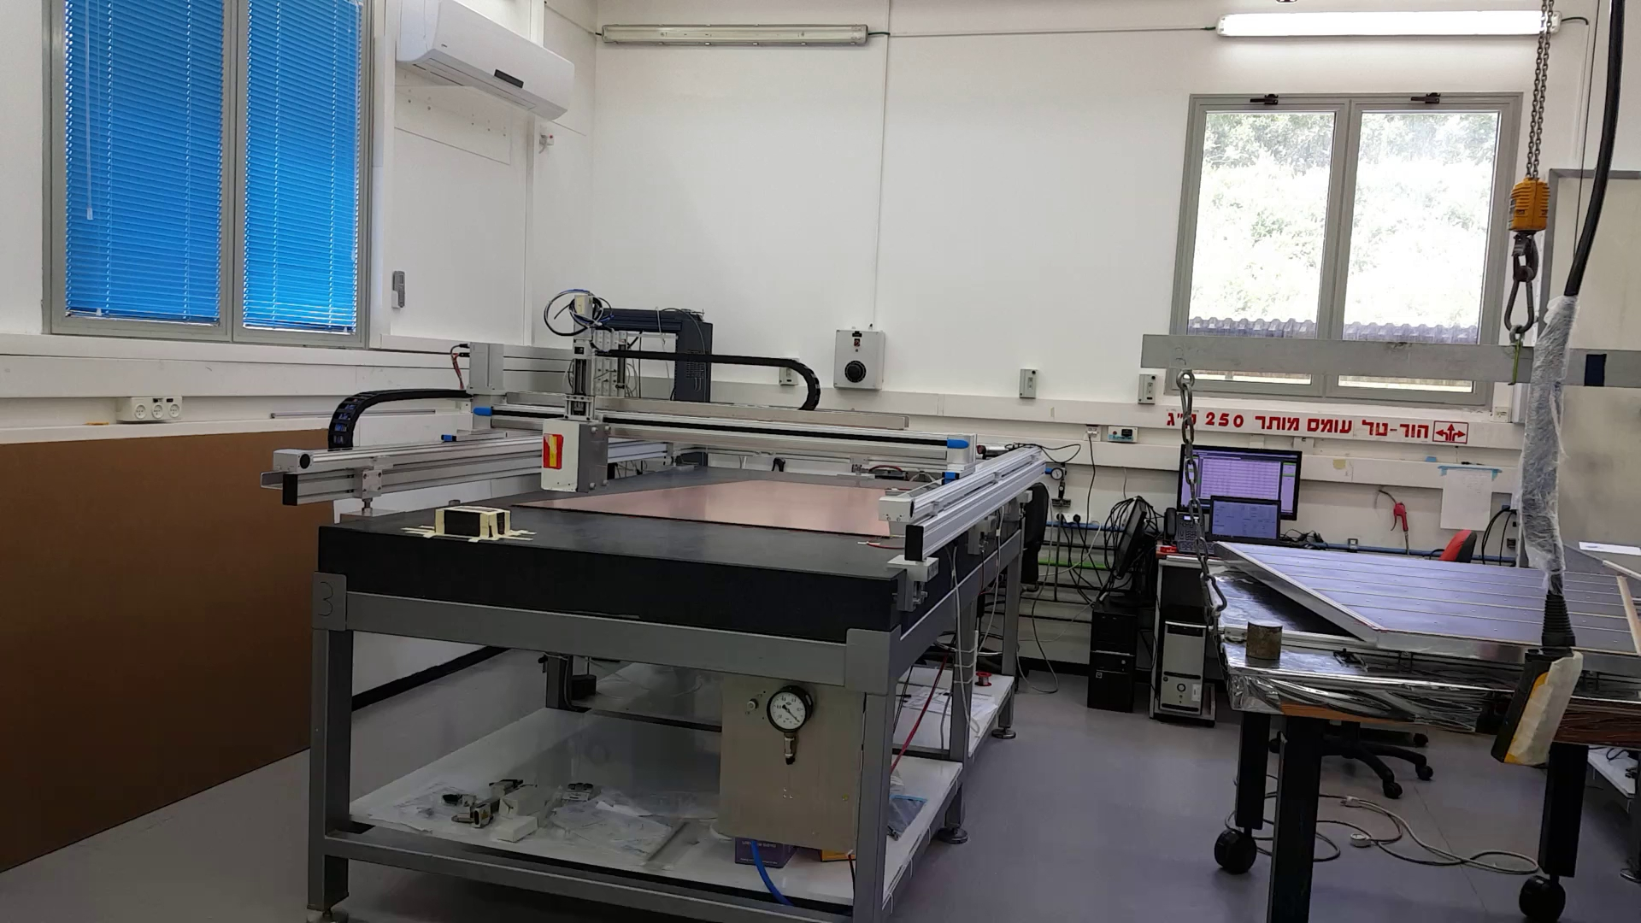
CLEAN ROOM
Gas gaps are closed in a clean room
The room is equipped with central gas system, crane, vacuum system, HV system, filtered air system and air conditioning + humidity controlled system.
Up to 2 gas gaps can be closed per day
X-Y-Z auto machine USABLE FOR
Automatic detector cleaning with air pressure
Flatness measurements with precision laser
Epoxy spraying with built in dispenser
Chamber irradiation with X-Ray source

Slide 8
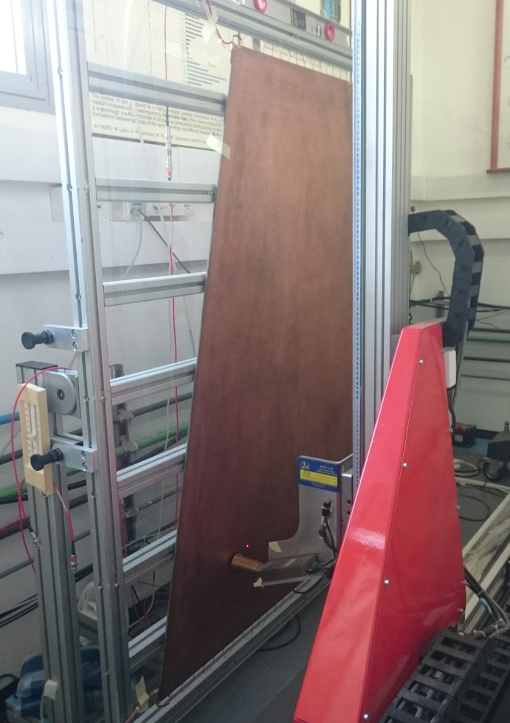
X RAY MACHINE
Designed by the Russian group for the QA/QC of the sTGC
Consists of an x-y machine synchronized with an X-RAY tube
Each gas gap is scanned to exclude the existence of hot spots and other potentially weak point

Slide 9
Temperature, humidity and vacuum monitoring systems
Monitoring Data system, alert if the values are outside the supported range for humidity temperature and vacuum
The system should alert us on changes in humidity, temperature and vacuum, by email and SMS .
Synoptic real time screen
Graphical display screen by cutting dates and positions
Notification and contact settings
Fault archive
We can access to view the status using a browser on any device with a Web browser.
Designed and assembled by Freddy.
Freddy belhasan 8/2018

Slide 10
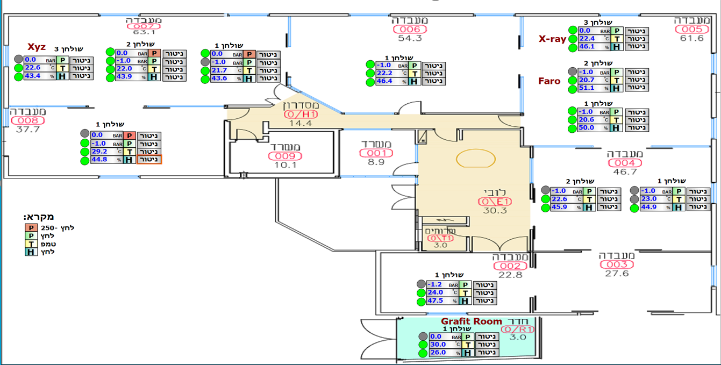
Freddy belhasan 8/2018

Slide 11
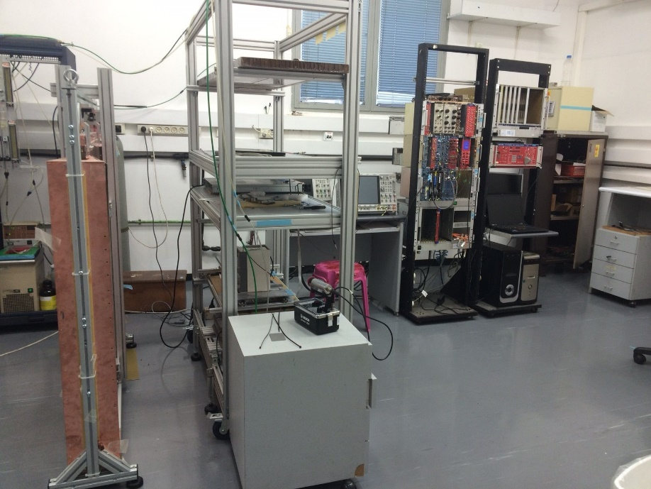
TESTING ROOM
Detector R&D is carried out in a dedicated room
With cosmic-ray muons using custom telescope
With various radiation sources
Equipped with all the necessary tools: gas system, HV, LV, readout electronics, etc.

Slide 12
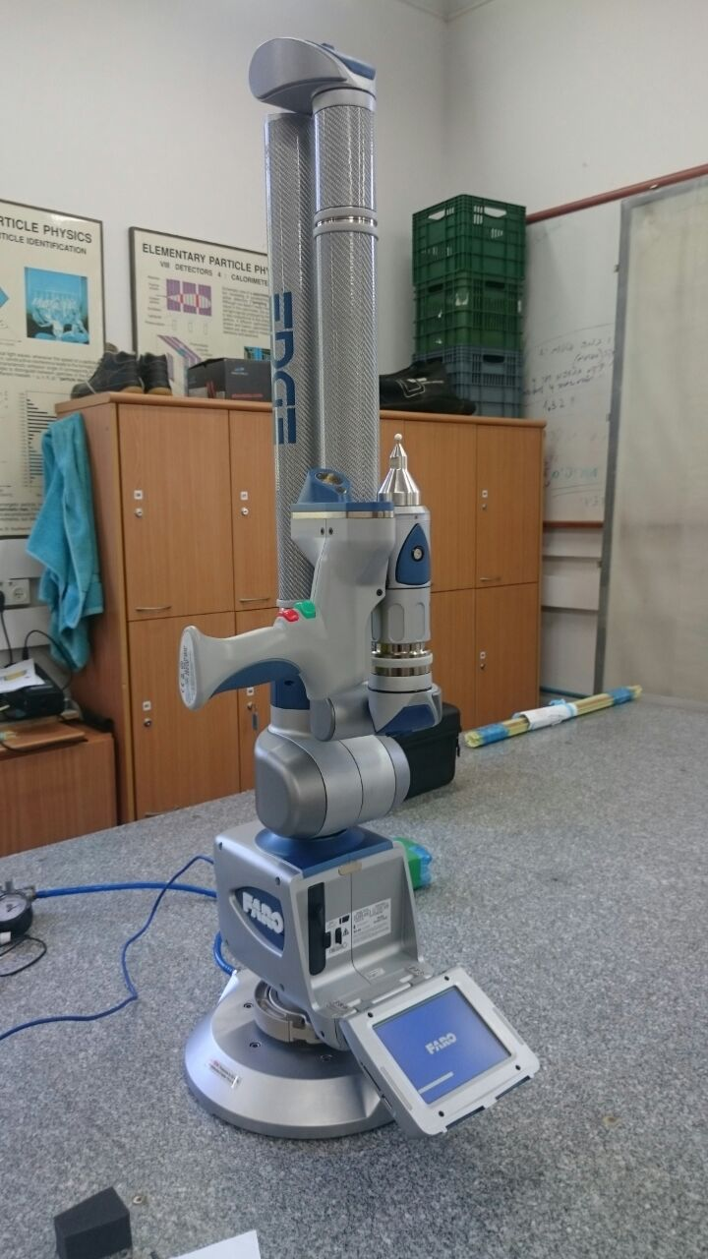
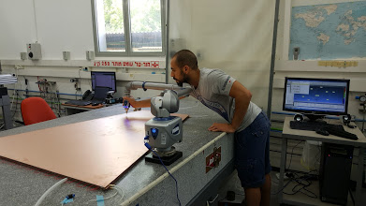
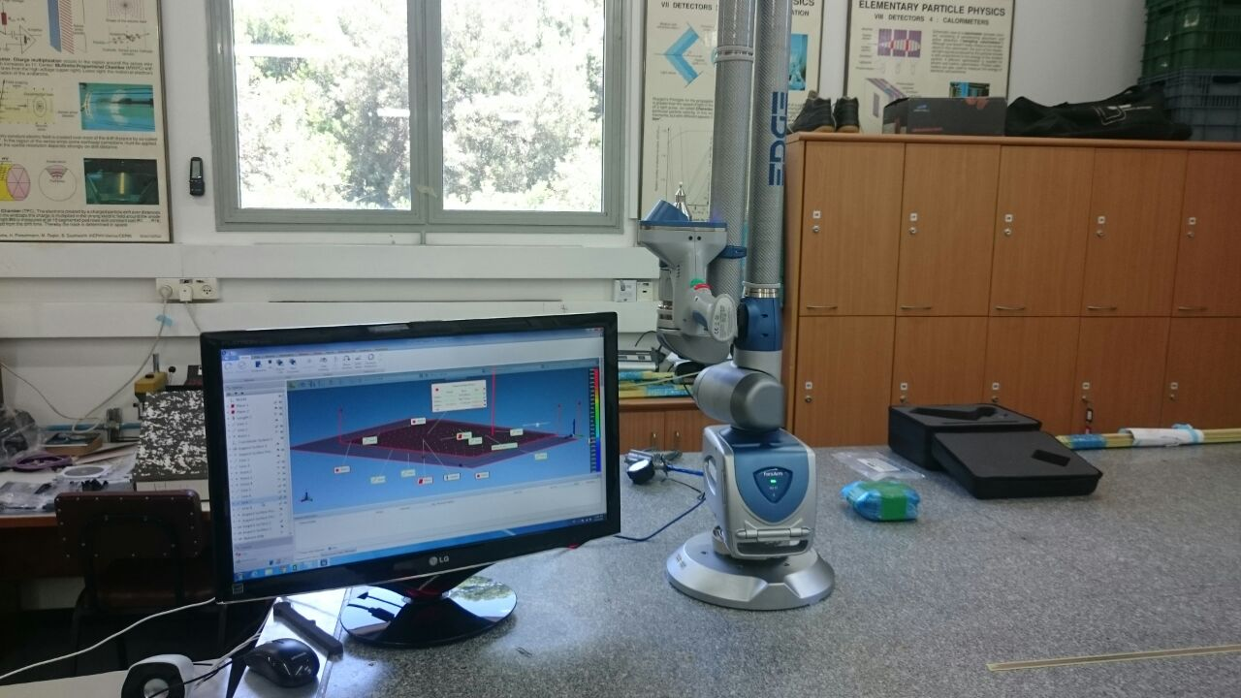
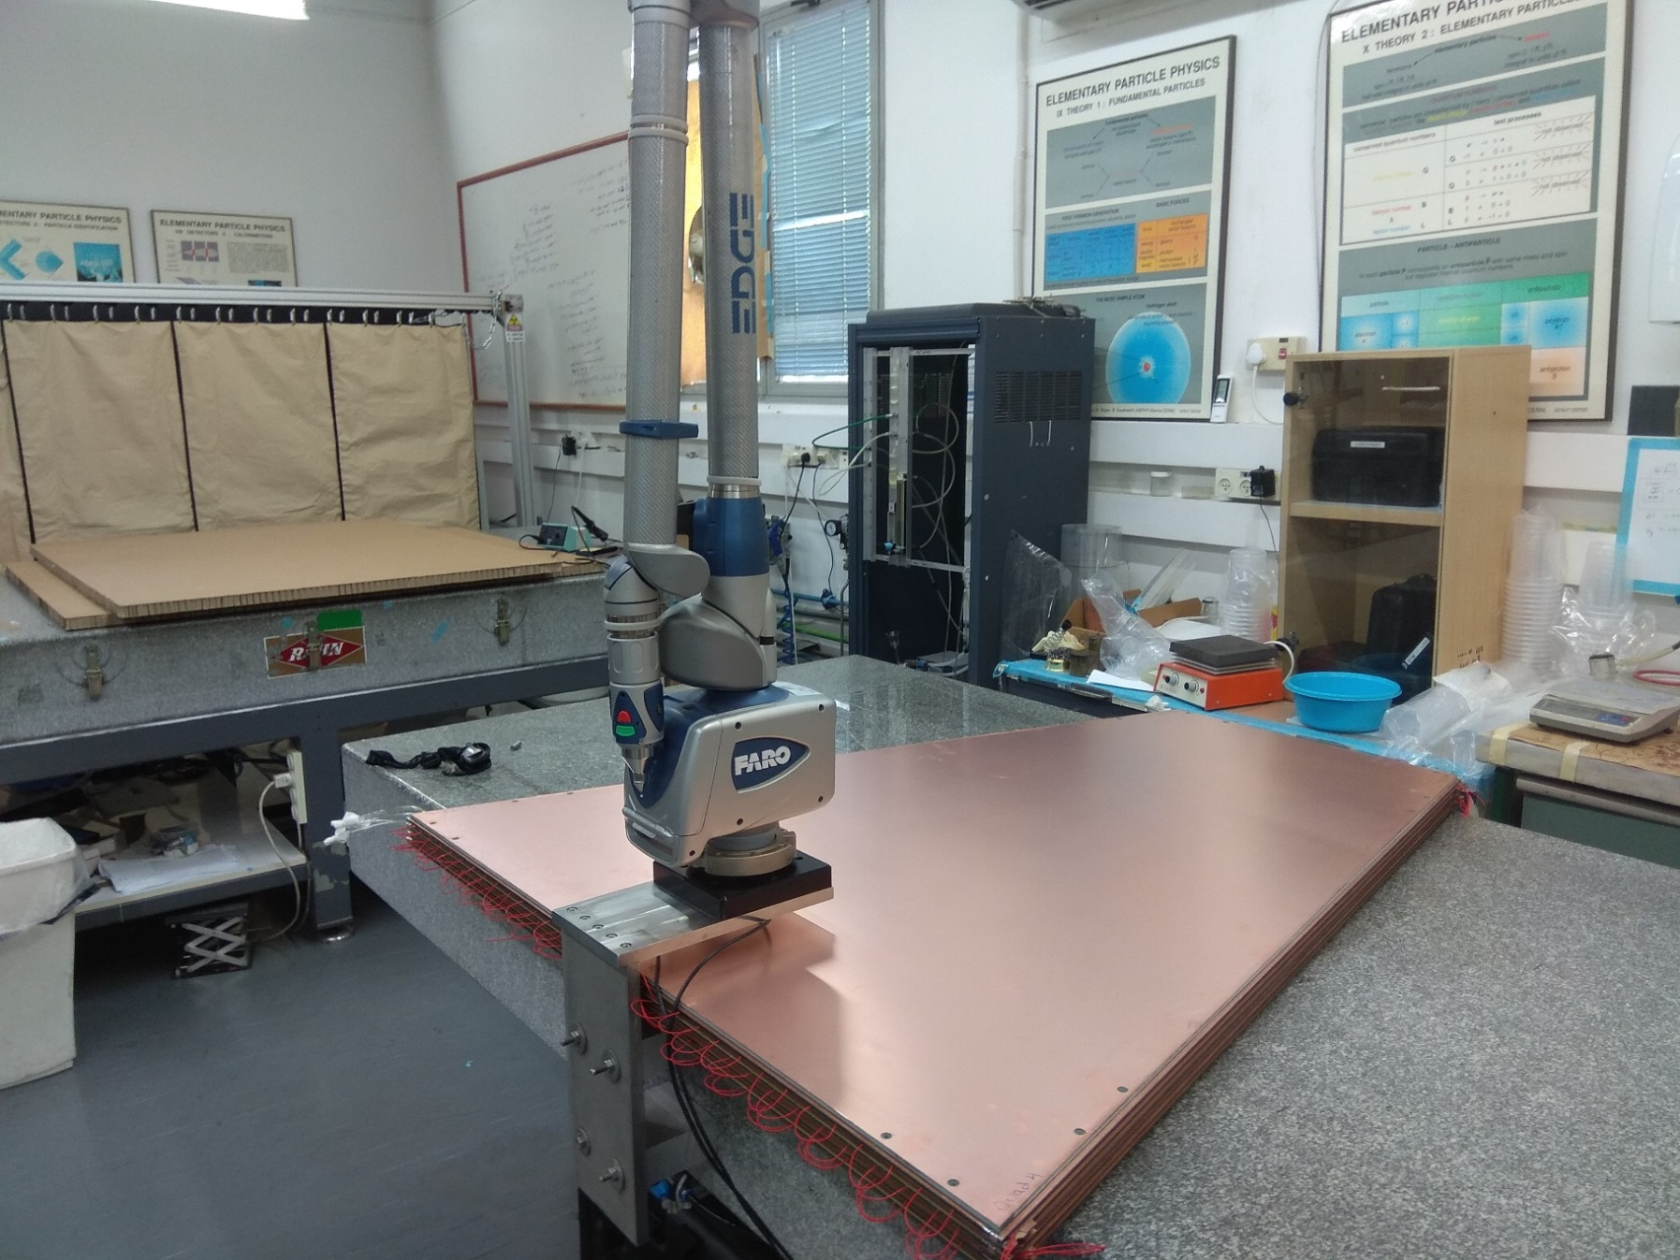
FARO ARM
3D precision measurement tool
  As good as 27 Micron resolution
2.7m coverage around the connection point
Measurements with touching points or laser scanner
Used for QA/QC of the cathode boards
Used for measuring the final alignment of the quadruplets

Slide 13
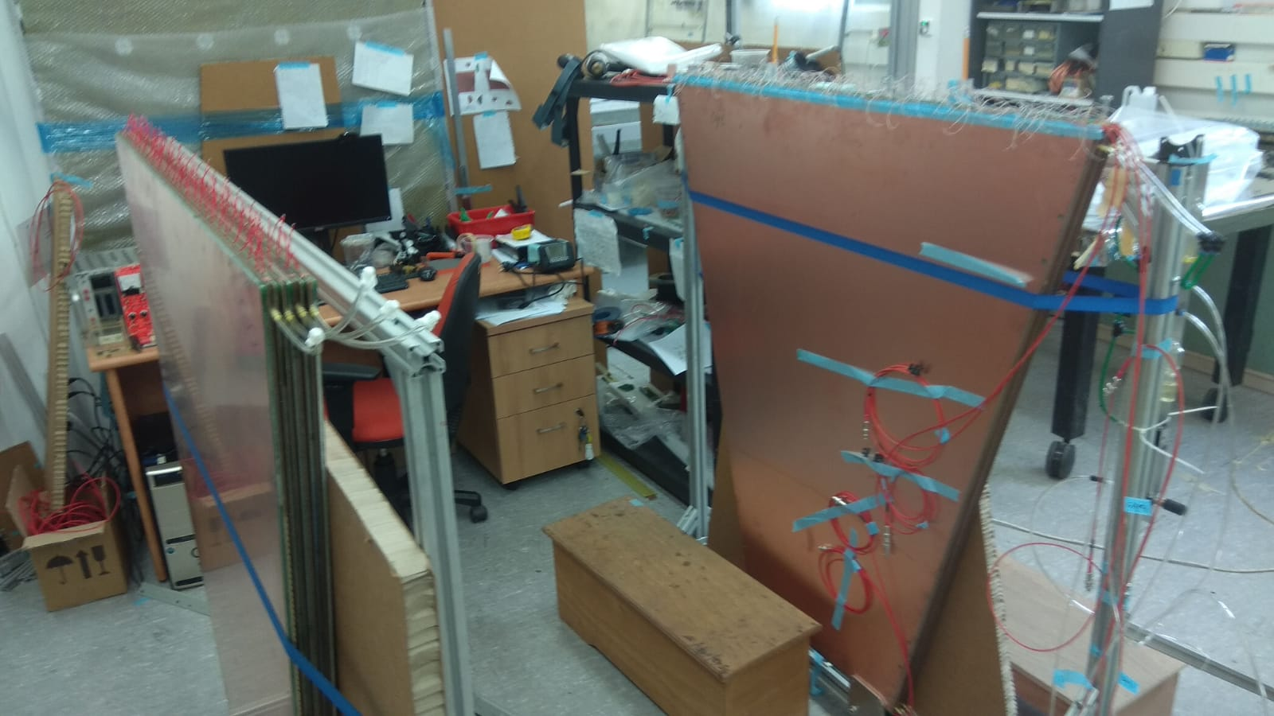
Adaptor boards mounting
We have 22 different AB on each quad of QL1
We have to separate the work to 2 different station to avoid mistakes.
We are preparing different tools and jigs to have better quality and faster mounting of AB
We will start soon to add more manpower on the AB mounting.

Slide 14
thanks
We go to see this for real now.

