Slide 1
On and off-line Detector & Trigger Monitoring
Daniel Lellouch and Ehud Duchovni

Slide 2
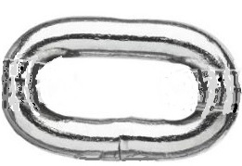
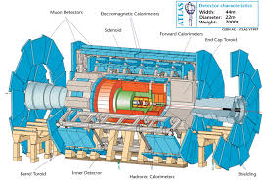


The Goal
The highest possible number of physics events.
To achieve that – all the stages of the data collection mechanism should work impeccably.
As ATLAS becomes more mature, the number of experts is shrinking.
The monitoring system should find and diagnose weak links in the sTGC sub-system

Slide 3
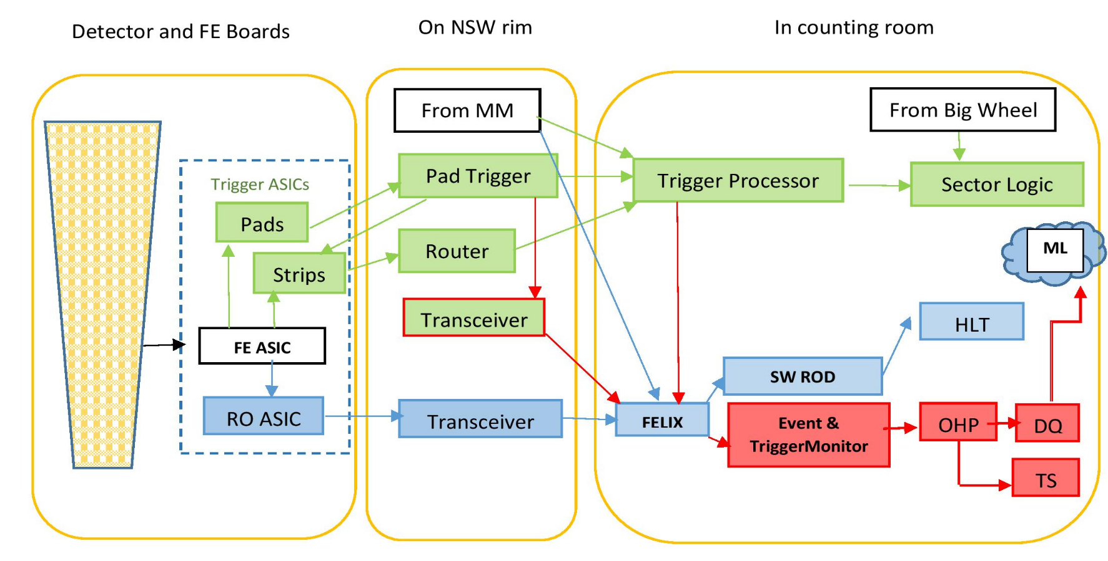
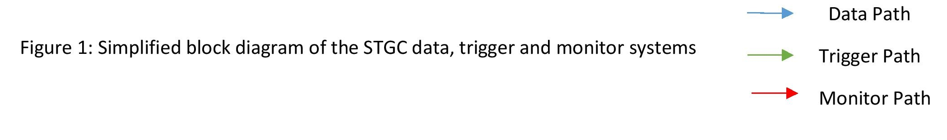
The System: Trigger Flow

Slide 4
The System: Trigger Flow
Felix gets all the information from the sTGC Trigger path

Slide 5
The System: Trigger Flow
Felix gets all the MM Trigger info

Slide 6
The System: Trigger Flow
L1A
Felix gets the full info in case of L1 “accept”

Slide 7
The Cases
There is a wealth of information (RO of strips, pads, wires MM strips, Pad trigger in & out) coming from the sTGC, MM and the big wheel into Felix. This allows a comprehensive study of the various sub-system performance
Case | sTGC | MM | L1A
“Good” | v | v | v
sTGC-Miss | x | v | v
MM-Miss | v | x | v
sTGC-Only | v | x | x
MM-Only | x | v | x
EIL4 will be added later

Slide 8
The Obvious Case
The integrity of the system, as monitored by the various monitoring devices that monitor the voltages, temperatures, gas flow, and the like will, of course, be the basic thing to be monitored (DCS).
The system should identify faulty components, alert the shift person, and advise him what action should be taken.
This will heavily rely on common ATLAS tools.

Slide 9
The “Good” case
The “good” case occurs when both the sTGC and MM identify a triggering muon and the L1 sector logics decides to send an “Acccept” signal. While such a case is the desirable one there is still a lot to learn about the system performance by analyzing “good” events. For example, the resolution of the sTGC and MM can be compared.

Slide 10
The sTGC-Miss Case
Obviously, this is the most interesting case. Here, one should strive to understand why the sTGC failed to trigger while the MM did and the Sector Logics decided that a trigger should be initiated.
Possible sources for such a problem are:
  “Holes” in the algorithm
  Improper functioning of the NSW Trigger Processors or its sources
  Bad alignment corrections
  Rejected by Sector Logic, MUCTPI, CTP?
A thorough analysis of the sTGC data flow and decisions will be carried out aiming at minimizing such events.

Slide 11
Sources for sTGC-Miss events
  There are quite a few reasons for sTGC-Miss cases. Among them one may study
  Are misses correlated to bad NSW segment quality due to missing layers? If so, which layers? (related to HW monitoring)
  Are misses related to the cluster shape in any of the layers?
  What is the R-φ distribution of misses?
  Are MM and sTGC misses correlated?
  Are misses due to the failure to properly correct misalignments,
  i.e. does the segment match an adjacent RoI?

Slide 12
The MM-Miss Case
This is just the complementary of the previous case. Here the MM will be analysed attempting to understand why the MM failed to recognize a good event. The study will be done by the MM team.

Slide 13
The L1A-Miss Case
Such events may occur due to mismatch between the NSW and the BW. A special forced L1A trigger (at a level of few 10 Hz) for events in which no other L1A is issued, but having a sTGC, MM trigger (or even a sTGC pad trigger) will be implemented. Such “forced L1A” events will be studied and an attempt to figure out the circumstances will be done.

Slide 14
The sTGC-Only Case
Similar to the previous case, a forced trigger will be implemented for events in which the sTGC issued a trigger while the MM did not and the sector logic rejected the sTGC request. The trigger will be at a level of 1-10Hz. It is likely (but certainty not sure) that most of these events should never be triggered. Understanding why the sTGC issued a spurious trigger may reduce the false-positive occurrences and reduce the fake trigger rate.

Slide 15
The Random trigger Case
Random BC is also available to study the performance of the sTGC system.

Slide 16
The MM-Only Case
Like the previous case, but in this case the MM team will do the study.

Slide 17
Preparing the data for AI
One of the aims of this sub-project is to accumulate the relevant information and arrange it in such a way that the Machine Learning and the global-trigger sub-projects will have an easy access to it.

Slide 18
Summary
The “On and off-line Detector & Trigger Monitoring” team will
Analyze the trigger performance and try to increase the trigger efficiency and purity. As our understanding deepens on-line monitoring will be implemented in order to identify and fix performance issues asap.
The ML team will use the infrastructure set by the monitoring team to further improve the performance of ATLAS.

Slide 19
On and off-line Detector & Trigger Monitoring

