Slide 1
FELIX -- Phase 2
Lorne Levinson
ATLAS Israel Review, 22 August 2018

Slide 2







FELIX Phase 1 Team
Hucheng Chen
Kai Chen
Francesco Lanni
Shaochun Tang
Weihao Wu
Andrea Borga
Henk Boterenbrood
Frans Schreuder
Jos Vermeulen
Anamika Aggarwal
Mark Dönszelmann
Frank Filthaut
Nikolina Ilic
Rene Habraken
Kevin Bauer
(Daniel Guest)
Serguei Kolos
Andrew Lankford
Gokhan Unel
Daniel Whiteson
Phase 2
Already joined:
Bologna
Wuppertal
Michael Oberling
Alex Paramonov
Soo Ryu
Jinlong Zhang
Mikael Baymani
Markus Joos
Jörn Schumacher
Wainer Vandelli
Will Panduro
Israel Grayzman
Lorne Levinson
(Julia Narevicius)
Alex Roich

Slide 3
ATLAS DAQ Today
Custom
point-to-point links
FE
FE
FE
FE
FE
Frontend
Custom electronic
components
ROD
ROD
ROD
ROD
ROD
ReadOut
Driver
Point-to-point
S-links
100 kHz /
~200 GB/s
~2000
links
~100
servers
ROS
ROS
ROS
ROS
ROS
ReadOut
System
Ethernet
PCs
(COTS)
HLTPU
HLTPU
HLTPU
HLTPU
HLTPU
~1500
servers
HLTPU
HLTPU
HLTPU
HLTPU
HLTPU
HLTPU
HLTPU
HLTPU
HLTPU
HLTPU
HLTPU
HLTPU
HLTPU
HLTPU
HLTPU
High-Level Trigger Farm
Run 2
Run 3
Run 4
Today
2015
2017
2019
2021
2023
2025
Notes:
Run2 event data
Custom FE electronics
Subdetector specific RODs
ROS first part in the chain with COTS hardware (PCIe)
goal

Slide 4

Upgrade for Phase-I
Custom electronic
components
including
FELIX cards
GBT links* or
FULL mode links
NSW
LAr
L1 Calo Tr.
FE
FE
FE
FE
FE
PCs
ROD
ROD
ROD
100 Gb Ethernet
HPC Network
Data
Handler
Data
Handler
ROS
ROS
ROS
HPC Network
PCs
(COTS)
HLTPU
HLTPU
HLTPU
HLTPU
HLTPU
HLTPU
HLTPU
HLTPU
HLTPU
HLTPU
HLTPU
HLTPU
HLTPU
HLTPU
HLTPU
HLTPU
HLTPU
HLTPU
HLTPU
HLTPU
* GBT: GigaBit Transceiver with Versatile Link
High-Level Trigger Farm
Run 2
Run 3
Run 4
2019
2015
2017
2019
2021
2023
2025
Notes:
Goal: remove one layer of custom hardware
Number of subdetectors directly interfacing to felix
Industry standard networks

Slide 5
Upgrade for HL-LHC
Custom electronic
components
including
FELIX cards
GBT, LpGBT* or FULL mode links
FE
FE
FE
FE
FE
~20,000 links
COTS network technology
less than
10 TB/s
HPC Network
Data
Handler
Data
Handler
Data
Handler
Data
Handler
Data
Handler
HPC Network
PCs
(COTS)
HLTPU
HLTPU
HLTPU
HLTPU
HLTPU
HLTPU
HLTPU
HLTPU
HLTPU
HLTPU
HLTPU
HLTPU
HLTPU
HLTPU
HLTPU
HLTPU
HLTPU
HLTPU
HLTPU
HLTPU
High-Level Trigger Farm
*LpGBT: Low power GBT
Run 2
Run 3
Run 4
2024
2015
2017
2019
2021
2023
2025
Notes:
Bandwidth and scalability will increase more for HL-LHC
All subdetectors by 2024

Slide 6
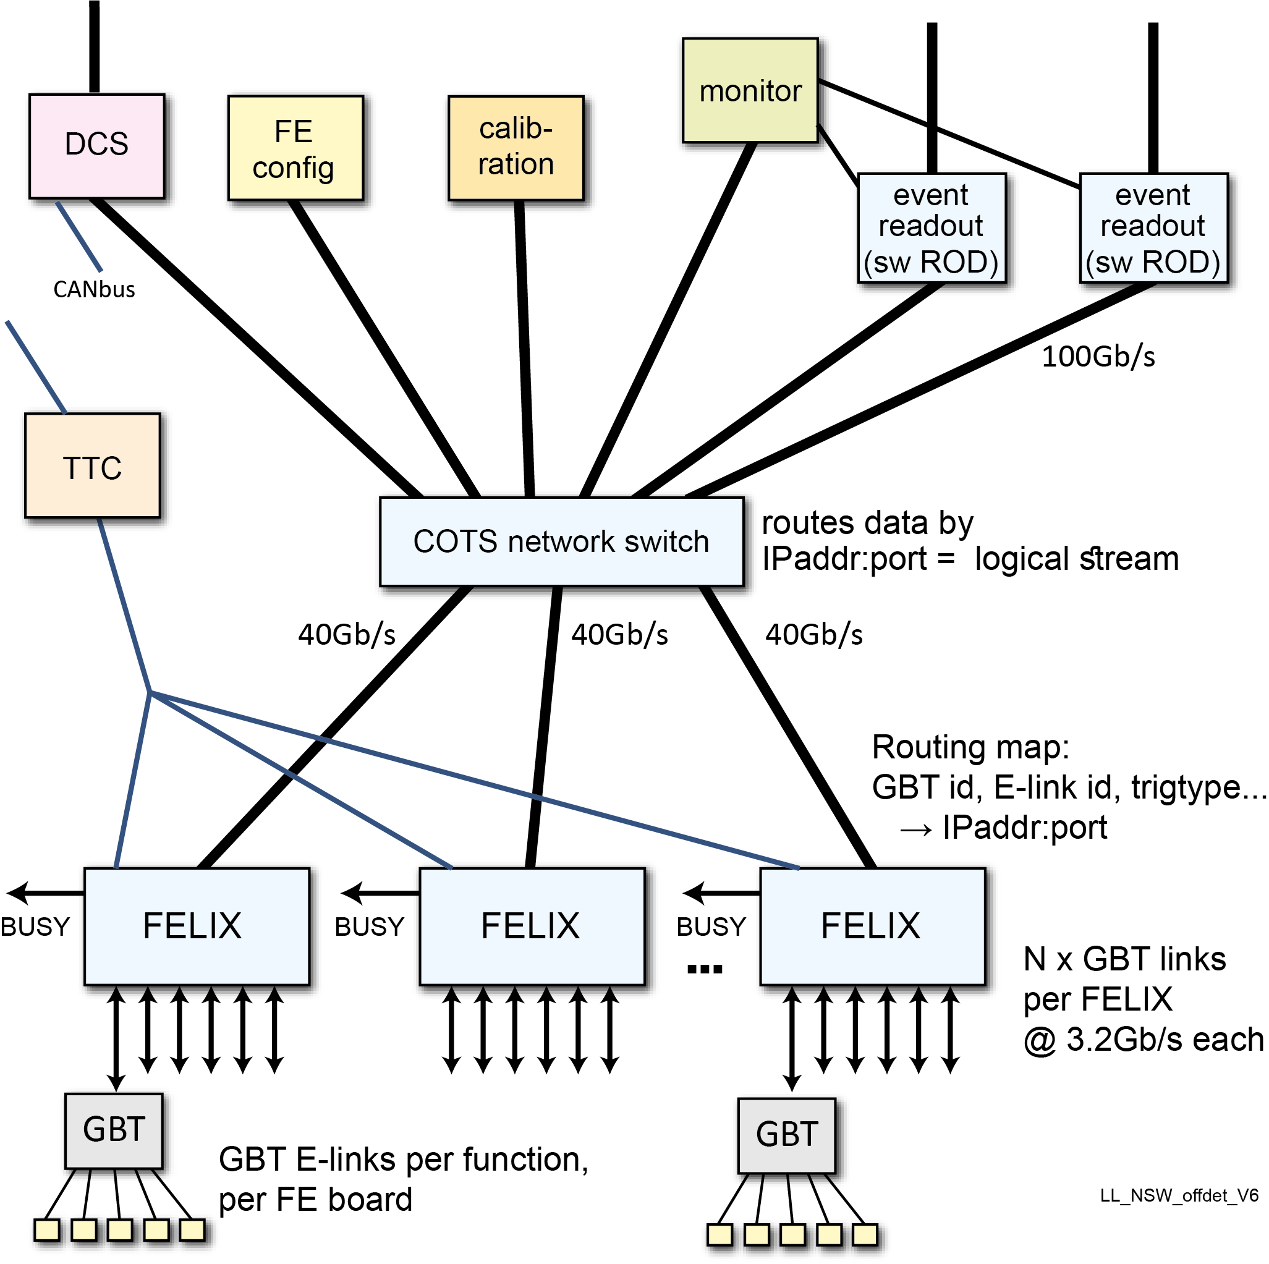
Phase 2 FELIX
Basic concept remains: aggregation, COTS network, software
All ATLAS detectors → more variety & more complex requirements
  Dedicated protocol for ITK
  Higher bandwidths
  Newer GBT: Tx/Rx: GBTx @4.8G/4.8G → 10G/2.5G
  Many more links
  ITK has extra requirements to support efficient calibration
  New TTC/BUSY system (“LTI”) allows synchronization of
  commands stored in FELIX that configure FE ASICS with
  timing defined by the TTC system
Design depends on:
  Experience in Run 3
  Experience with the Phase 2 demonstrators (ITK) now starting
  Detailed requirements from the detectors (in progress)
  How industry progresses with:
    Processors
    PCIe → …
    Networks
    FPGAs

Slide 7
Scope of the project effort
Capture of Phase 2 requirements from all the ATLAS detectors
FPGA hardware that fulfills our requirements (links, clocks, performance)
Firmware that implements the required functionality
Software for controlling, configuring, reading and routing data streams, including SCA (DCS) data streams
Interface to the new TTC system and its interaction with calibration sequences
Low level software: drivers, debugging tools, configuration GUI's, etc.
Performance studies and bench-marking to optimize the FW and SW
Network interface software and network studies to optimize networking
Does not include, but we work in close association with:
  Software ROD: requirements and interface with FELIX
  Backend support of GBT-SCA for DCS and detector front end configuration/calibration
Requirements for selection of the server PC and of the FPGA card manufacturer
User support of the detector groups in developing their FELIX-based DAQ
  JIRA tickets, User Workshops, documentation, hands-on participation in detector tests

Slide 8
Current estimation of links
Detector | # FELIX boards | # down links | BW (Gb/s) | # up links | BW (Gb/s)
ITk Pixel | 224 | 1285 | 2.5 | 10596 | 5
ITk Strips | 76 | 1552 | 2.5 | 1824 | 10
LAr LASP | 36 | 100 | 2.5 | 770 | 10
LAr LDPB | 8 | 31 | 2.5 | 155 | 10
L0Calo | 8 | 16 | 2.5 | 120 | 10
NSW | 96 | 864 | 5 | 1440 | 5
NSW Trigger | 4 | 64 | 5 | 64 | 5 or 10
Global Trigger | 4 | 48 | 2.5 | 96 | 10
Tile | 8 | 160 | 10 | 160 | 10
TGC | 8 | 192 | 10 | 192 | 10
MDT | 64 | 1536 | 10 | 1536 | 10
RPC | 4 | 64 | 10 | 64 | 10
CTP | 1 | 12 | 10 | 12 | 10
MUCTPI | 1 | 4 | 10 | 4 | 10
LUCID uplink | 1 | 24 | 5
ZDC uplink | 1 | 24 | 5
AFP uplink | 1 | 12 | 5
 | 545 | 5988 |  | 17033
System will be much bigger, more complex,
higher typical speeds:
Phase 1 total: 2,200 links
Phase 2 total: 18,000 links
×10
FELIX system was designed to be scalable.
Is it really scalable?

Slide 9
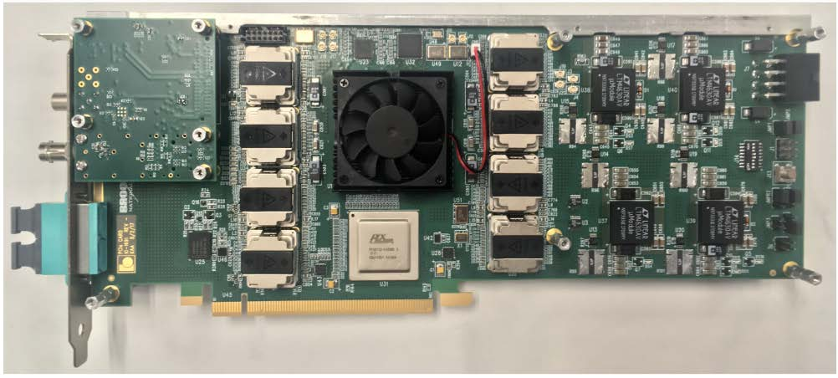
Phase 1 FELIX PCIe FPGA card
Open question if Phase 2 FELIX will remain a PCIe card
BUSY output
TTC fiber input
multi-fiber
connector
(fiber ribbons to
2x4 “minipods”
not shown)
BNL-712
$$ Most of the cost of FELIX is this board and its FPGA.

Slide 10
ITK
On-going major effort required to understand ITK requirements
… and map them to a FELIX-based TDAQ architecture
Demonstrators, finally in progress, will really help to converge understanding
Compared to NSW, ITK has much tighter integration with the trigger system:
  for calibration
  especially if ATLAS adopts a system with a two-level hardware trigger (baseline is one level)
  → low latency transmission of L0 regions of interest info back to the FE ASIC via the TTC path
ITK plans on using a data transmission protocol not used by the Phase 1 detectors
Added complexity due to need to put, readout, configuration, DCS, and trigger info on the same electrical link to/from the FE ASIC
FE chips so far need a pre-aggregation of five 1G links to one 5G link.

Slide 11
Resources needed
We need already now to play a larger role in working with the Phase 2 demonstrators in order to understand their requirements
Firmware engineering expertise
To support the development, testing, bench-marking
  A full FELIX path from front end emulators thru’ the swROD needs to be working in Israel
    Software and Linux expertise to maintain and help operate
    The equipment

Slide 12
Open issues
Currently the PC server is in the data path, i.e. all the data flows thru’ PC memory
Need to investigate architectures with FPGA → network with the PC software only controlling
Solutions for the ITK pre-aggregation:
Needs to be as close as possible to the detector.
Does this mean an aggregation ASIC or rad tol FPGA
Understand the interaction and division of labour with the TTC LTI module (Local Trigger Interface)
for a two-level trigger
for calibration sequences

Slide 13
End

