Slide 1
Event Filter
S. Tarem

Slide 2
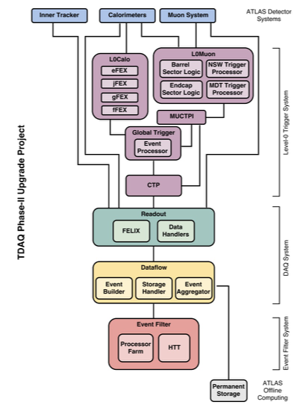

Where does this part of the program fit?
The Event Filter (EF) is designed to work at a luminosity of 7.5x10³⁴ cm² s⁻¹, sustain a maximum input rate of 1MHz and select events with a maximum output rate of 10KHz.
Many of the initial fast rejection techniques presently used in the Run-2 High Level Trigger (HLT) will be implemented in the Level-0 hardware trigger in Phase-II
EF algorithms and selections designed to maximize efficiency with respect to offline reconstruction and minimize systematic bias from the trigger. Analysis-based selections are expected to contribute to reducing the bandwidth.
We present: Muons/Slow particle/Jets/Displaced Vx
$$✓$$

Slide 3
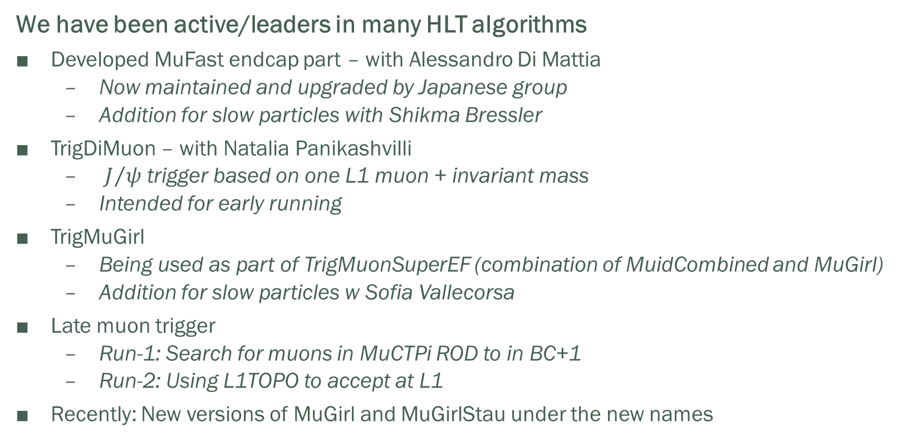
Technion heritage in HLT
We have been active/leaders in many HLT algorithms
Developed MuFast endcap part – with Alessandro Di Mattia
  Now maintained and upgraded by Japanese group
  Addition for slow particles with Shikma Bressler
TrigDiMuon – with Natalia Panikashvilli
  $J/ψ$ trigger based on one L1 muon + invariant mass
  Intended for early running
TrigMuGirl
  Being used as part of TrigMuonSuperEF (combination of MuidCombined and MuGirl)
  Addition for slow particles w Sofia Vallecorsa
Late muon trigger
  Run-1: Search for muons in MuCTPi ROD to in BC+1
  Run-2: Using L1TOPO to accept at L1
Recently: New versions of MuGirl and MuGirlStau under the new names

Slide 4
Current involvement
Since Mugirl has been conceived in 2006 ATLAS gained knowledge about muons and the detector, and many new relevant software tools have been developed.
In 2015 MuGirl/MuGirlStau has been revised into 2 separate packages with Niels Van Eldik
MuonInsideOutRecoTool
  reconstructs muons starting from an ID track
  Uses new extension tools to MS
  Uses Hough transform for pattern recognition in MS
  Correlate Hough maxima with extrapolation points
  Continue as before
MuonStauRecoTool
  Extrapolation and pattern recognition as for muons
  Use MDT t₀-segments to fit space and time together per segment

Slide 5


Refactored MuGirl: efficiency similar
$$Z→μμ$$
$$t\overline{t}$$

Slide 6
Refactored MuGirl: Purity improved
$$Z→μμ$$
$$t\overline{t}$$

Slide 7
Muons in Phase-II
New detectors for muons in Phase-II
  New RPC chambers in the inner station of the MS, increase the coverage in the barrel from 65% to 95%.
  New small-tube MDT chambers in barrel inner station.
  TGC chambers in EIL4 will be replaced with new triplets that improve position measurement capabilities.
Muon reco must incorporate new detectors, new electronics
Use of MDT precision coordinates will sharpen the L0 muon trigger turn-on curve.
  The MDT hits can be included in the trigger when a BCID is provided by RPC, TGC or Tile.
  The trigger selectivity of the Level-0 muon trigger is expected to improve - new requirements on the High Level Trigger.

Slide 8
Timing issues for slow particles
BCID calibration
  Hits in each detector element are assigned BCID – to assemble events correctly
  Particles originating together and traveling with speed c are calibrated to have same BCID assigned in all detector elements
If β < 1 the particle may have different BCID in the MS
ID Calorimeter Muon Spectrometer
1 m
3 m
6 m
3.3 ns
14.2 ns
33 ns
µ: β~1
ToF=33 ns
LLP: β~0.5
ToF = 67 ns
6.7 ns
28.3 ns
67 ns
A µ from next BC arrives at this time

Slide 9
Timing issues in trigger and reconstruction
Muon: Tube Segment
Slow particle: radii in tube are reconstructed too large
We can find the particle speed if we know Δt, BUT IF NOT larger radii = bad segment
t_{0μ}
t_{drift}
R=R(t_{drift})=
R(t_{measured}-t_{0μ})
t_{measured}=t_{0μ}+t_{drift}
t₀(slow particle) =t_{0μ}+Δt
t_{drift}
R_{measured} = R(t_{measured}-t_{0μ}) = R(t_{drift}+Δt) > R
t_{measured}=t_{0μ}+Δt+t_{drift}

Slide 10
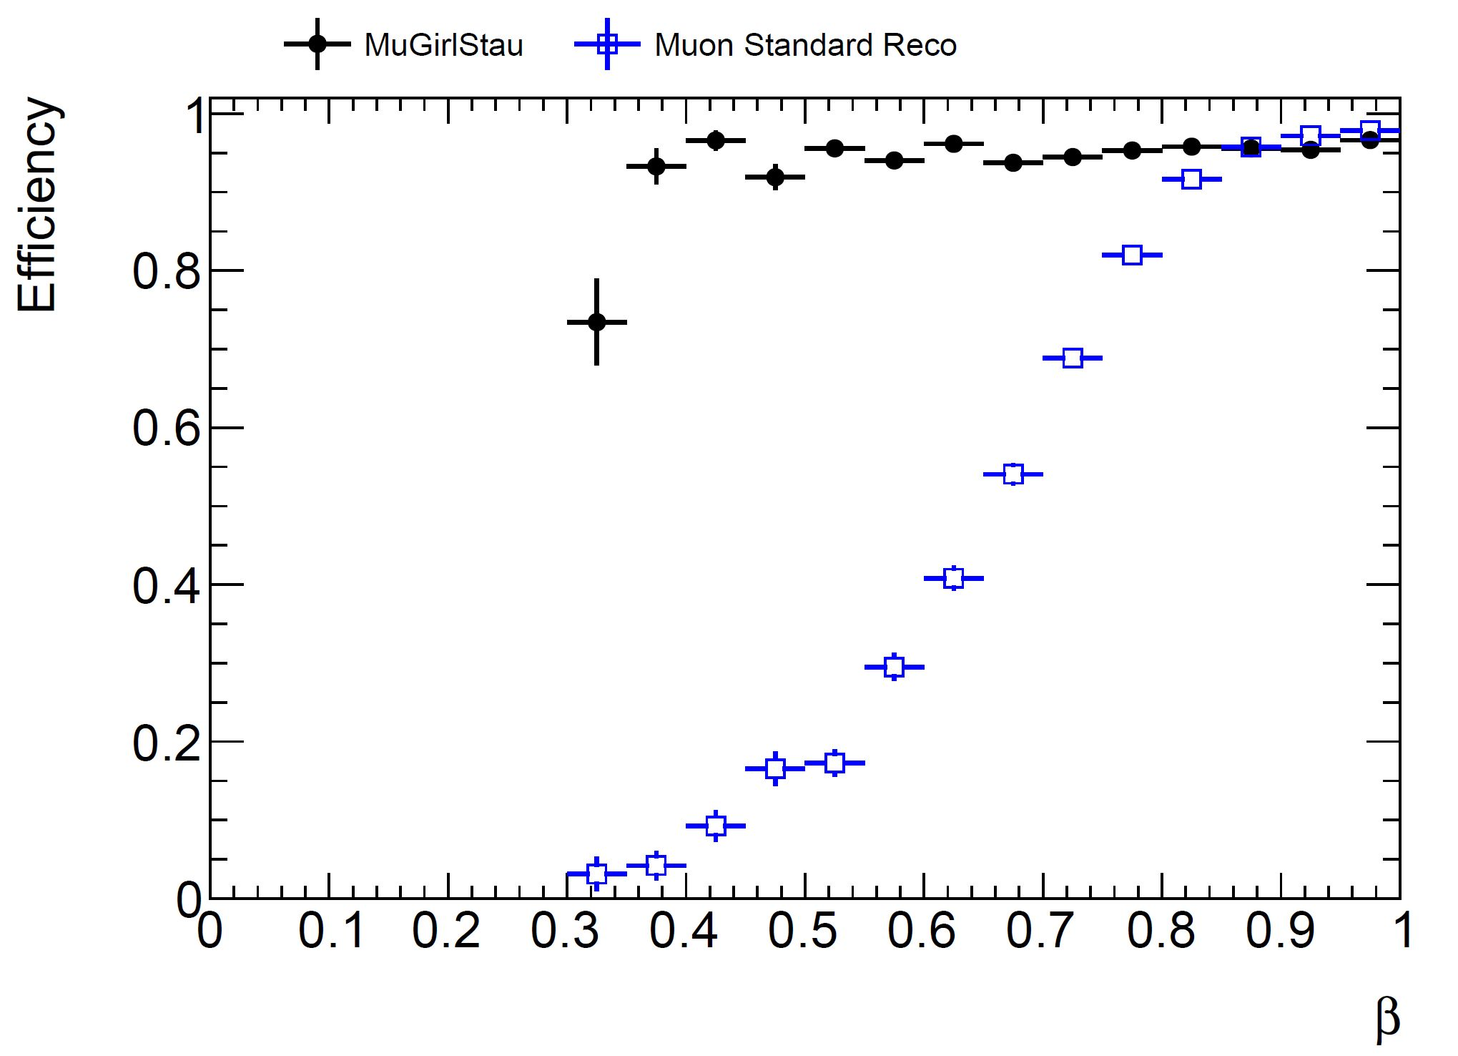
Dedicated trigger and reconstruction
L1
L1Topo allows to combine relatively low MET (or jet) with a muon in the next BC
The longer global-L0 latency may allow for more BCs for late particles
EF
Do the new detectors and electronics give time measurements? How accurate?
Do they allow for out-of-time hits?
Will the new electronics reduce current capabilities?
Efficiency L1Topo
Efficiency if central BC
β
β

Slide 11
Summary
As new detectors are incorporated in ATLAS, Muon reconstruction and trigger must study their characteristics and incorporate them
  The Technion team has long and wide experience in muon trigger and reconstruction and can well contribute to this goal
If we want to be able to discover long-lived charged particles, dedicated trigger and reconstruction are required
  This has always been the domain of the Technion team, we are the experts, and we plan to continue to work on it
However, these projects require the detector simulation and digitization to already exist, so may take some time to start

