Slide 2

Measurement of cosmic radiation by straw detector
Response of the straw detector to ionizing radiation and calibration
Kristína Júlia Jarinová, Richard Rippel
Supervisor: Peter Lichard

Slide 3
Main objectives
Examine detector response to different types of radiation
Investigate the effect of changed straw detector parameters, namely operating voltage and pressure on signal amplitude.
Simulate effects of changed parameters on time resolution

Slide 4
Contents
Straw detectors
Radiation sources
Experimental apparatus
Experimental results
Garfield simulation

Slide 5
Straw detectors

Slide 6
Primary ionization
Electrons
Ions
Straw - cathode
Gas
Wire - anode

Slide 7
Secondary ionization
Electrons
Ions

Slide 8
Signal generation
Image charge

Slide 9
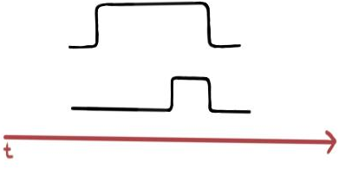
Extra resolution
r
r
signal

Slide 10
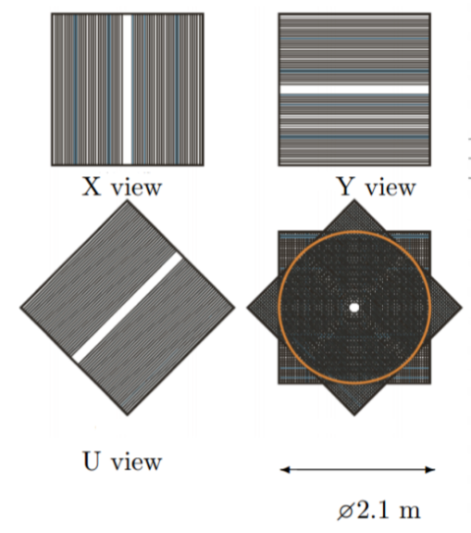

Slide 11
Radiation sources

Slide 12
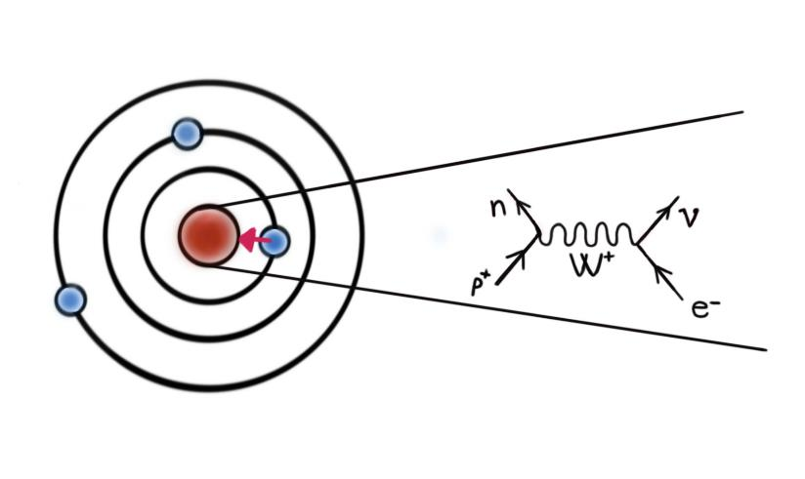

${}_{}^{55}{Fe}$ Electron capture decay

Slide 13
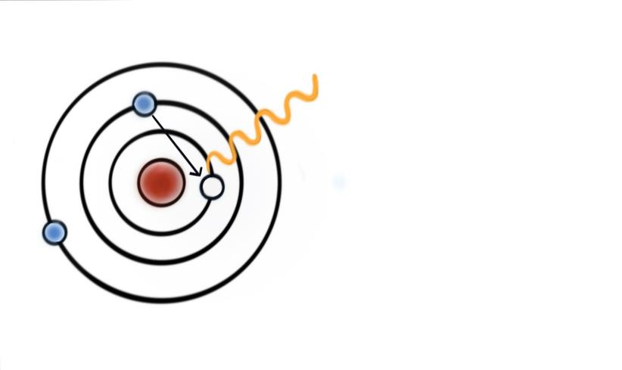
${}_{}^{55}{Fe}$ Electron capture decay
5,9 keV
photon
Absorbed all at once
Consistent amount of energy
Consistent detector signal

Slide 14
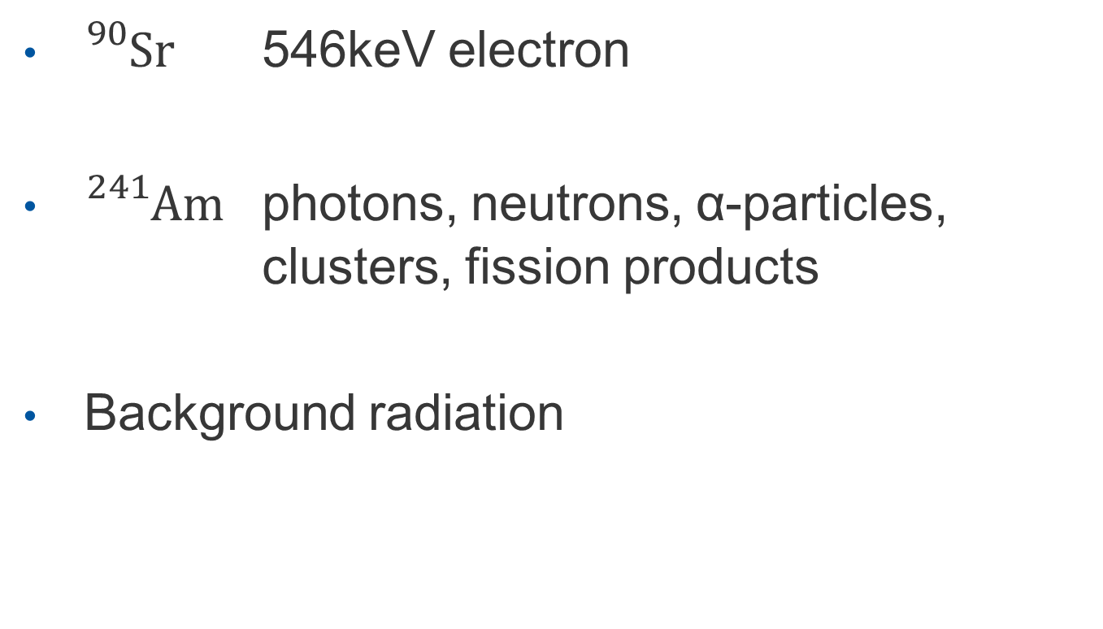
Other radiation sources
${}_{}^{90}{Sr}$ 546keV electron
${}_{}^{241}{Am}$ photons, neutrons, α-particles, clusters, fission products
Background radiation

Slide 15
Experimental aparatus

Slide 16
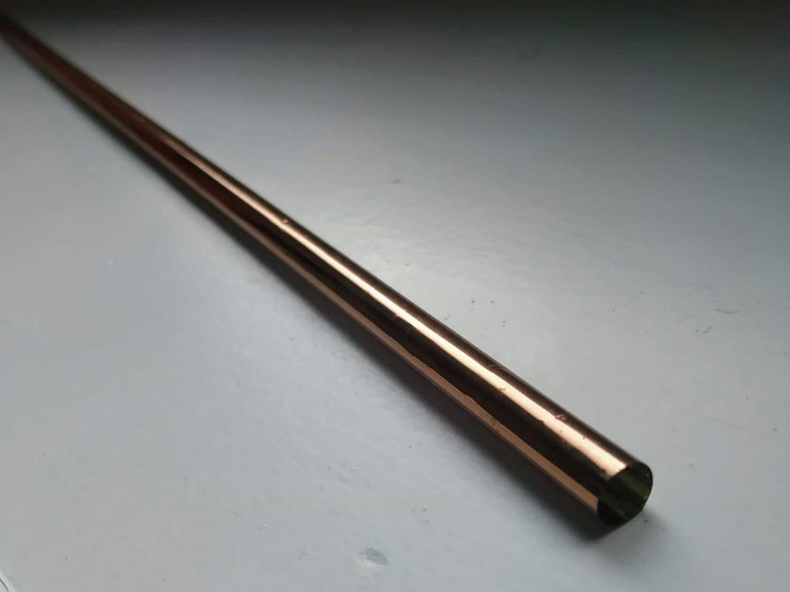

Slide 17
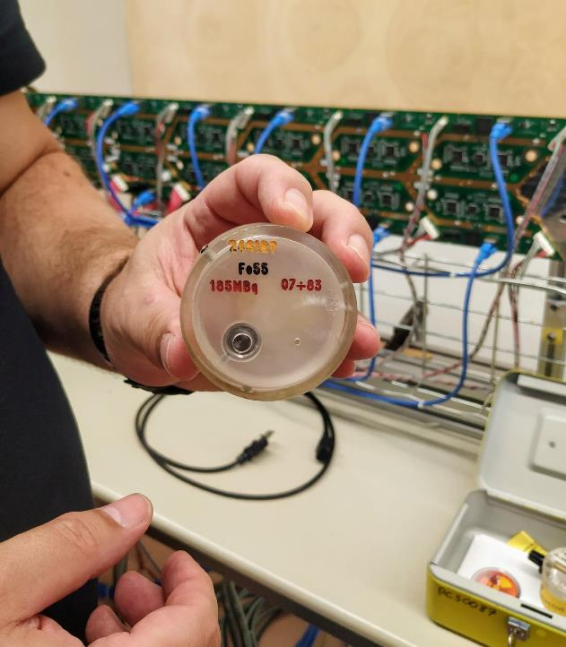

Slide 18
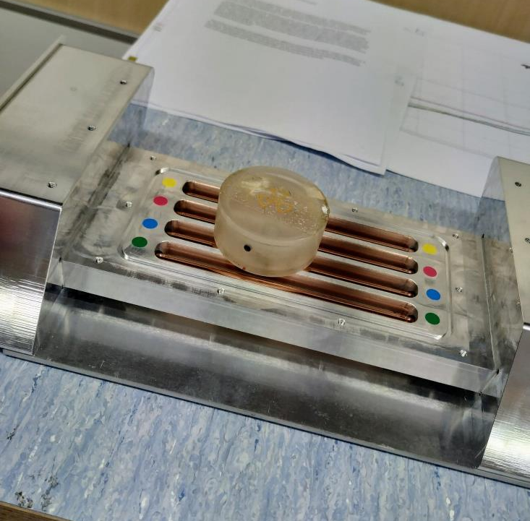

Slide 19
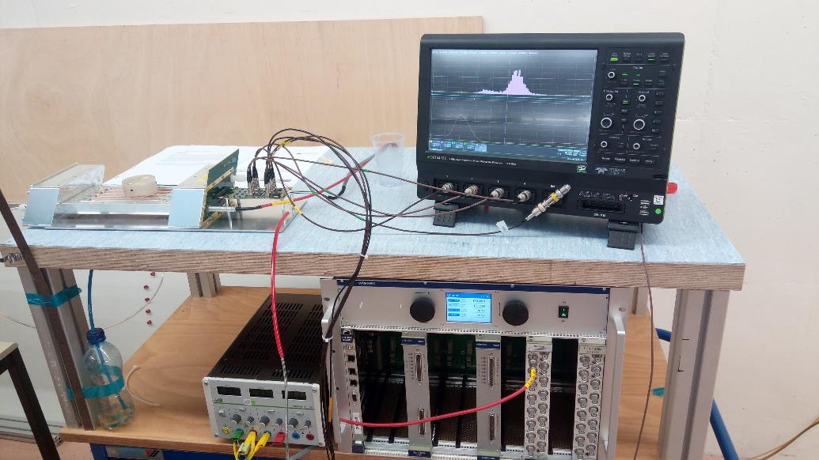

Slide 20
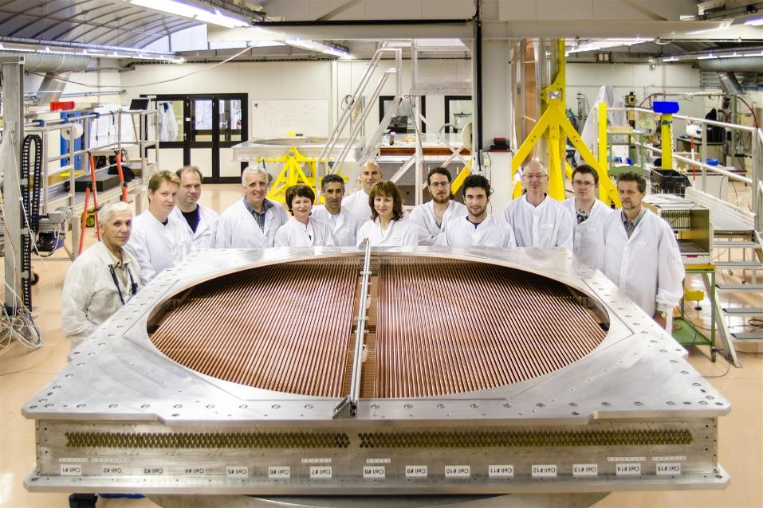

Slide 21
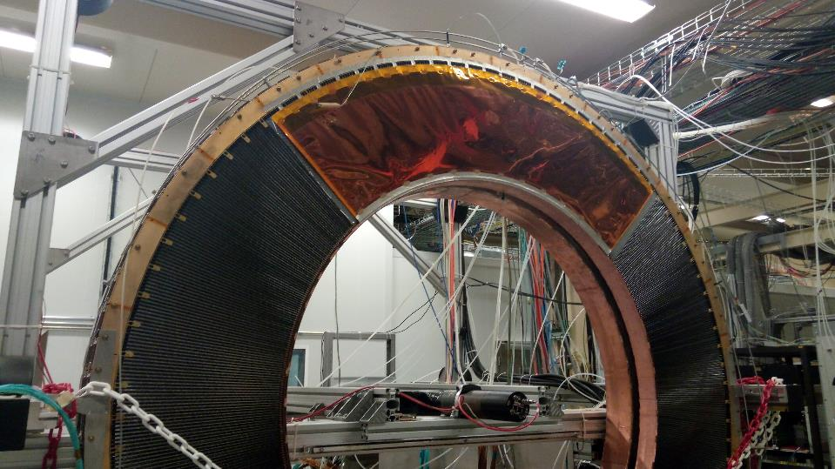

Slide 22
Experimental results

Slide 23
Typical signal (after electronic processing)

Slide 24
Background radiation

Slide 25
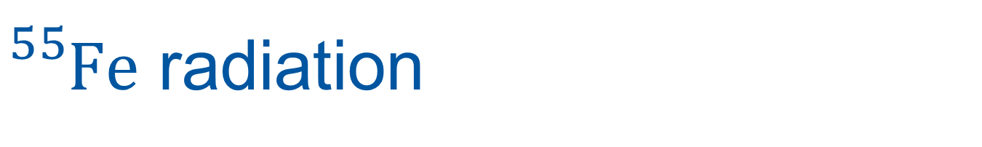
${}_{}^{55}{Fe}$ radiation

Slide 26
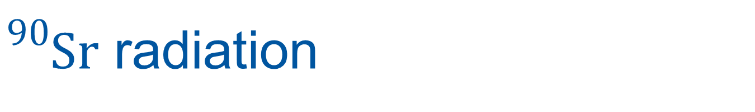
${}_{}^{90}{Sr}$ radiation

Slide 27
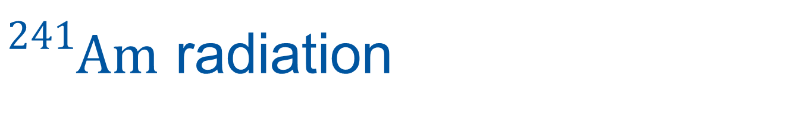
${}_{}^{241}{Am}$ radiation

Slide 28
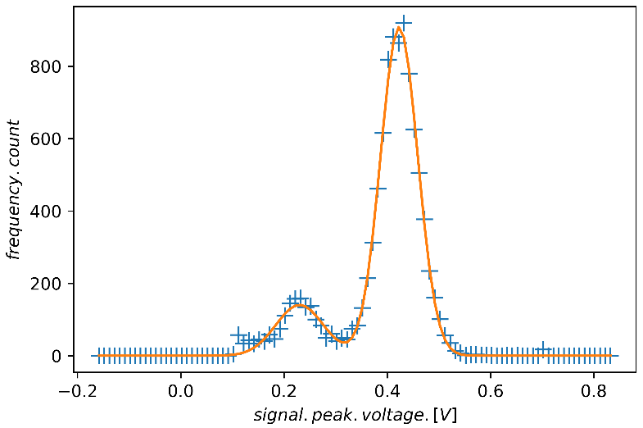

Slide 31
Garfield simulation

Slide 32
r
r
signal
Impact parameter
Leading time

Slide 33
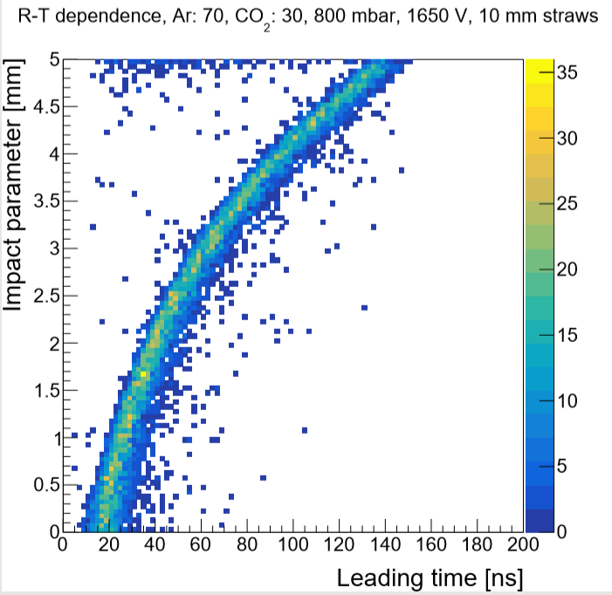
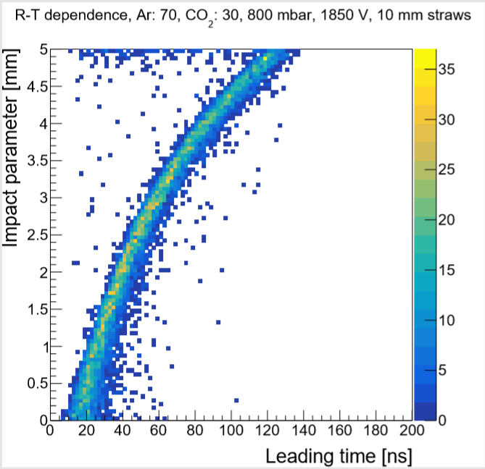
Different supply voltage

Slide 34
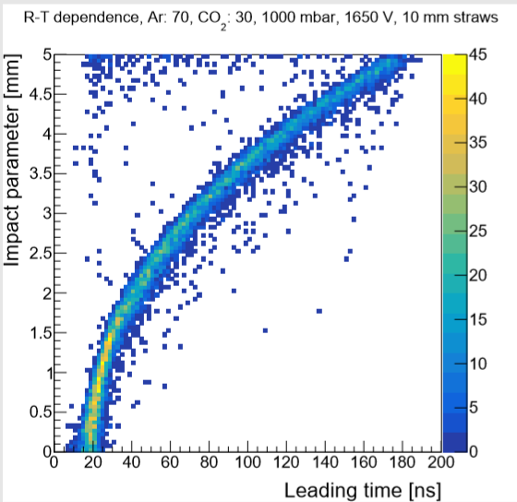
Different pressure

Slide 35
References
Uhliarik, A. (2019). Optimization of STRAW spectrometer parameters for the NA62 experiment (bachelor thesis).
Híveš, Z. (2019). Time resolution studies of the STRAW detector at the NA62 experiment (bachelor thesis).
https://cds.cern.ch/record/1454654?ln=sk
Photo source

Slide 36
https://drive.google.com/file/d/1PbhPPaNLzsyDU3Bb1vaXGHe8K70RuMC6/view?usp=sharing

