Slide 1

CERN
Tape Archive monitoring
Filip Pajkoš, Ema Podhorná, Jozef Skokan

Slide 2

Content
The CERN tape archive system
What is Linux?
What is Python?
Python documentation
Our code
What is JSON?
What have we learned?
Sources

Slide 3
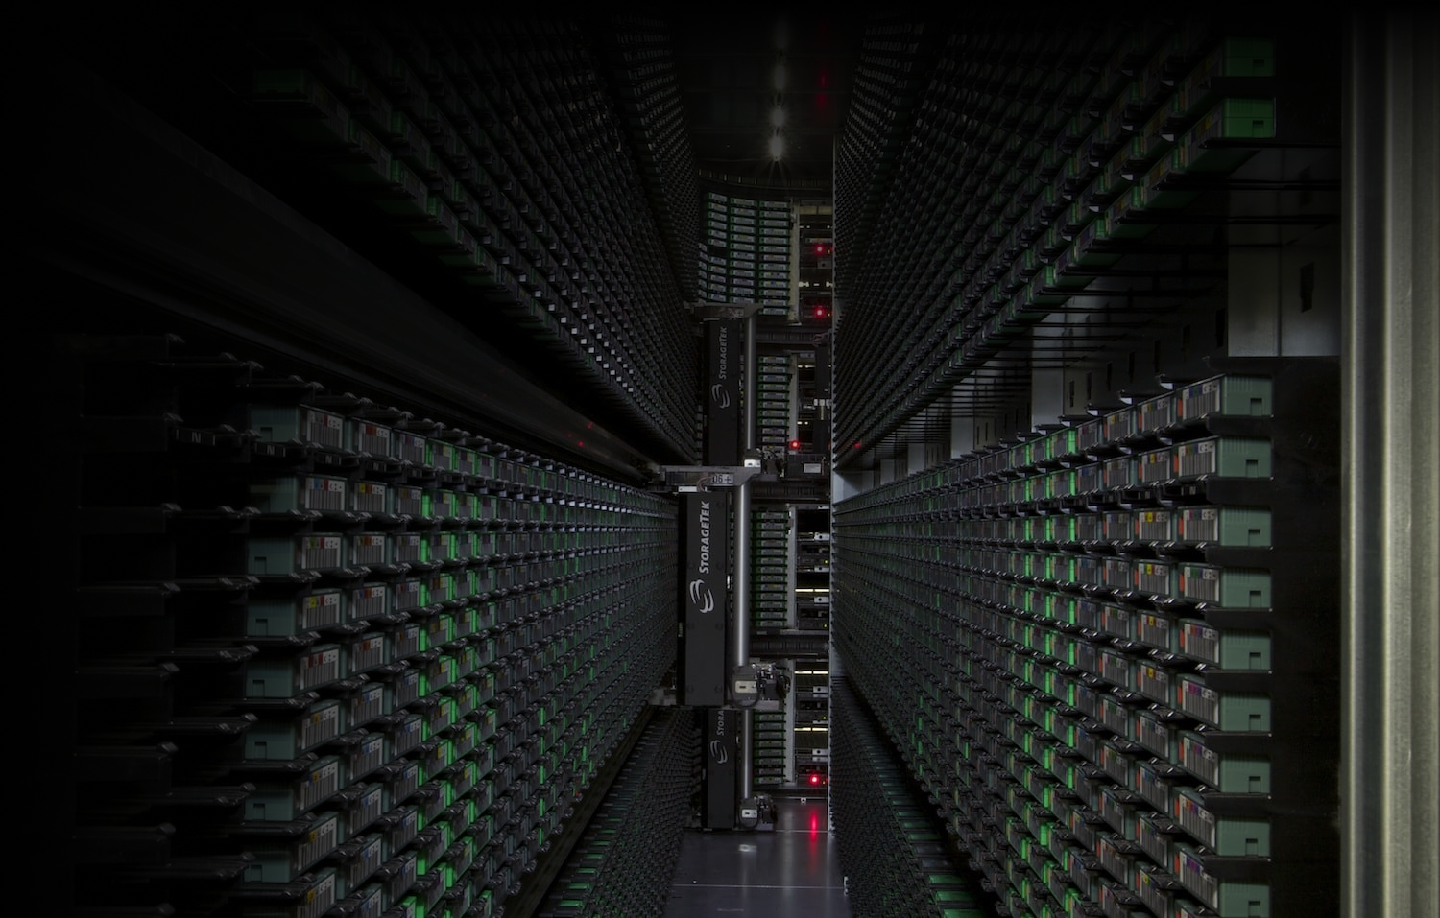
Tape archive system at CERN
Permanent storage for physics data
Currently stores ~340 PB of data
Using 4 different tape libraries
Contain ~30 000 tapes
Using ~100 tape drives

Slide 4
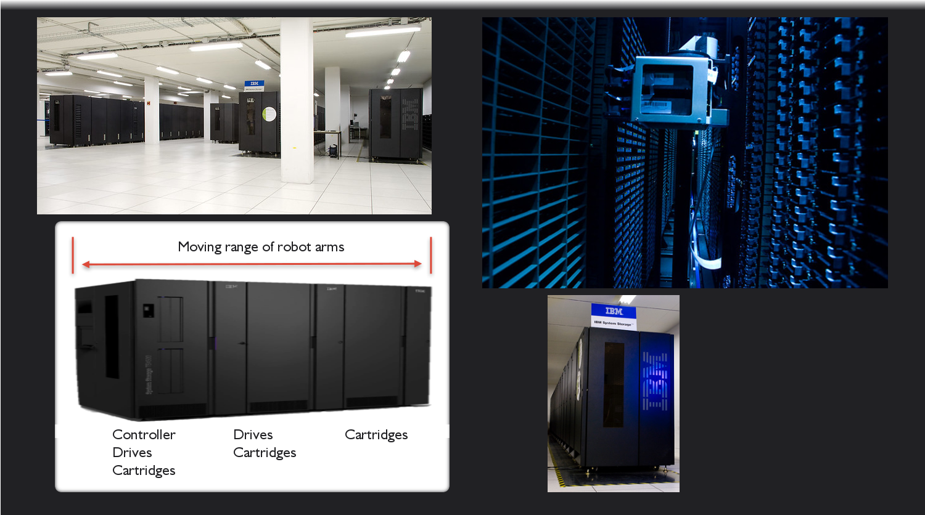

Slide 5

What is Linux?
Modified UNIX based on Linux core
The philosophy of UNIX:
1.Many small programs doing one thing
2.Output of one program -> input into another program
Linux + GNU utilities = free UNIX
All these small programs make a distribution

Slide 6
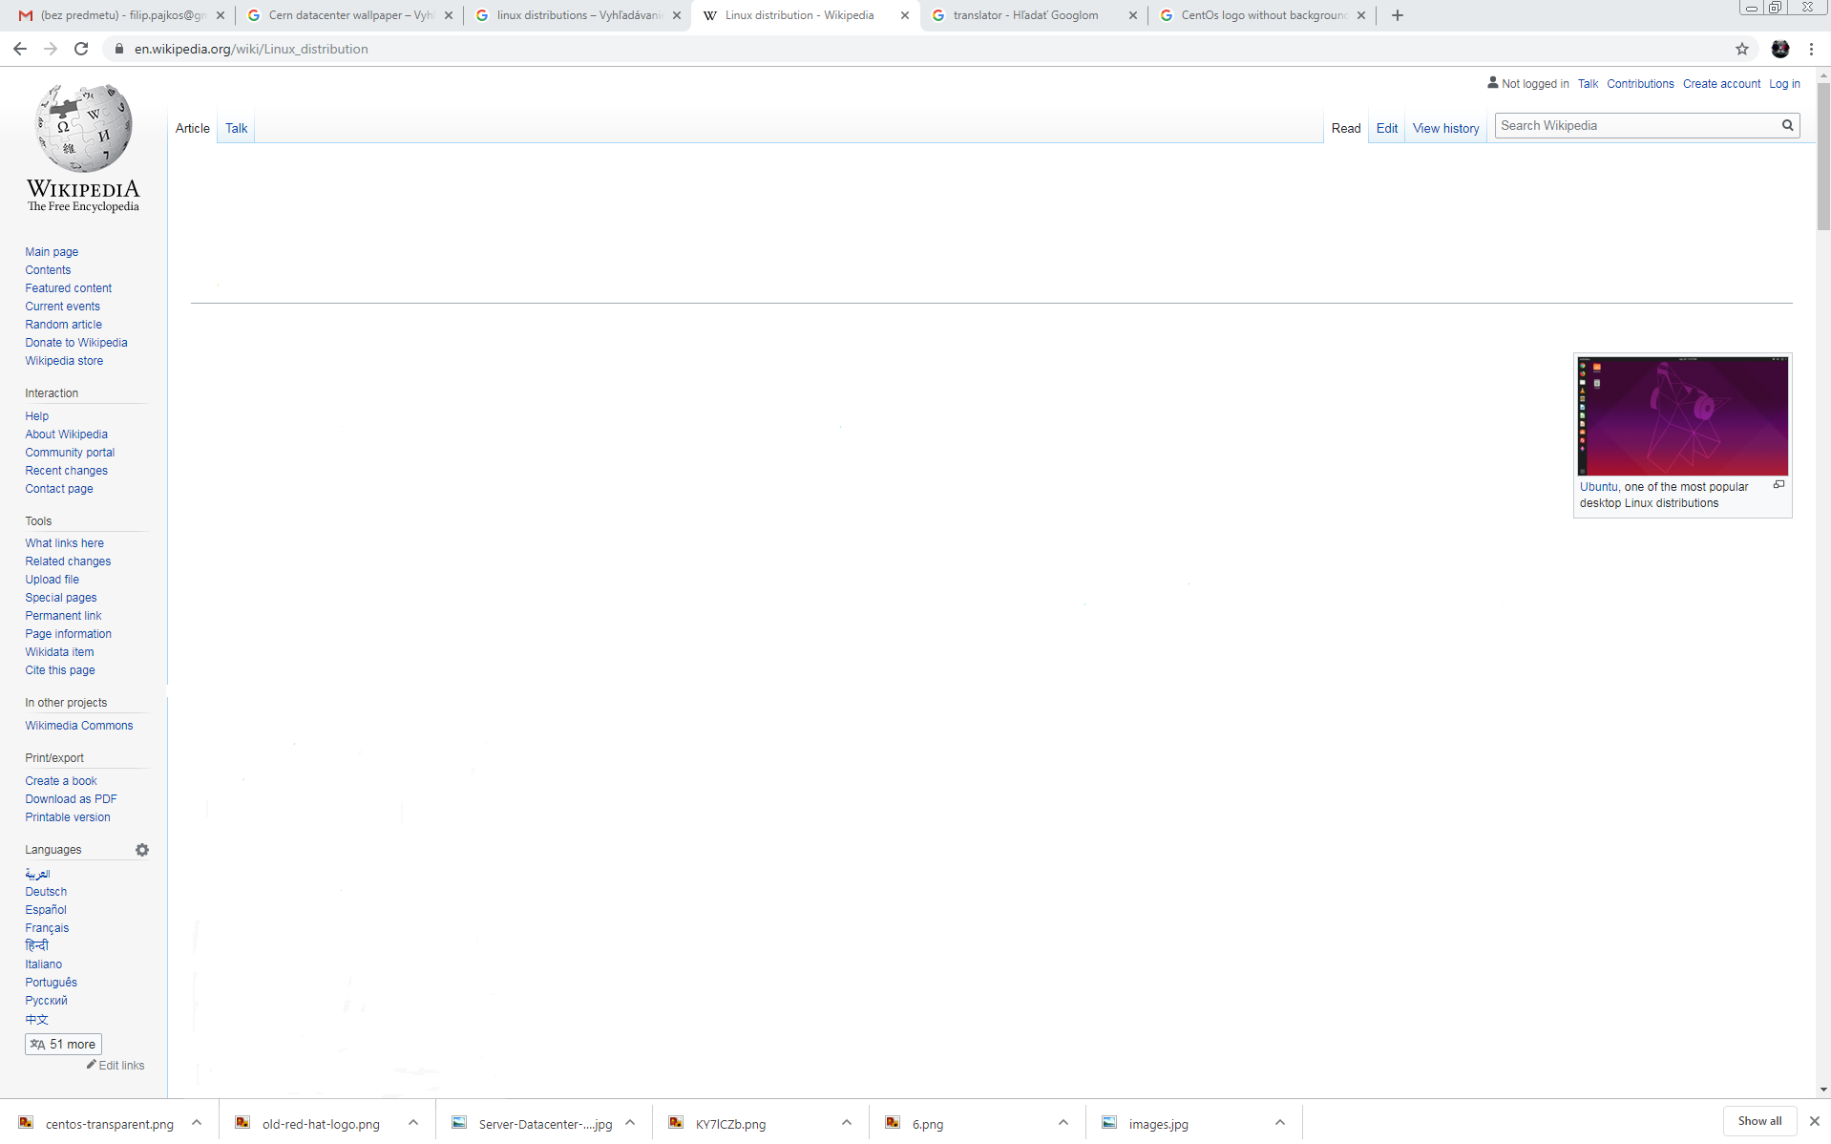
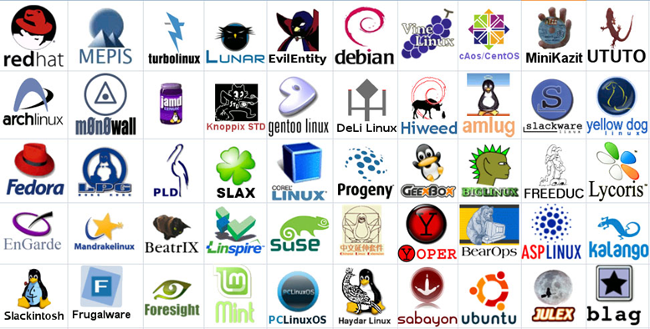
Linux distributions

Slide 7



Linux distributions
CERN uses CentOS, which is a
free version of RedHat
Enterprise Linux

Slide 8
Linux commands we used:
-bash-4.2$ help
Network: ssh
Shells: BASH
Command Information: man
Symbols: |, >, >>, <
Filters: grep, less
Hotkeys: <ctrl><c>,
File System: ls, cd, pwd, cat, chmod, cp
File Editors: nano, vim
-bash-4.2$

Slide 9

What is Python?
>>> Python_Overview
"Open-source programming language, can be used for opening apps"
>>> Python_History
["early 90s v1.0, Guido Van Rossum", "named after Monty Python"]
>>> Scope_Of_Python
{Industry, Science, Administration[Web Dev, UNIX][CGI],
AI[Machine Learning, True AI, Robots]}
>>> print (str(Python_Advantages) + ".")
Object orientation, INDENTATION, Open-source, Portable, POPULAR,
Easy to use, EASY TO LEARN, Powerful, extensive library of modules

Slide 10
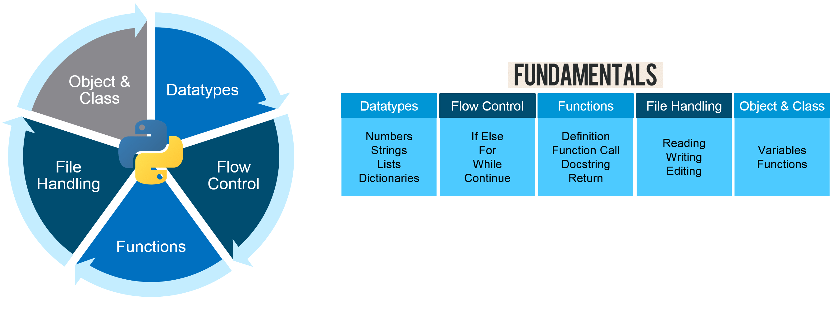
Python Fundamentals

Slide 11
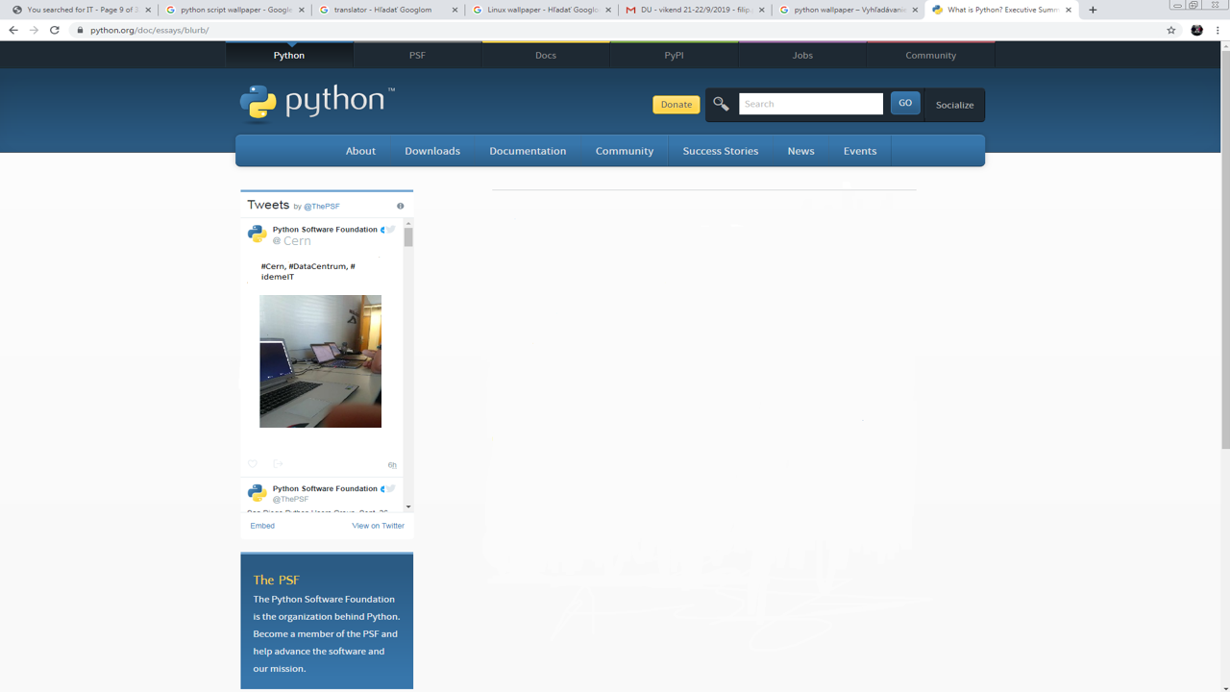
Python Documentation
docs.python.org/3/tutorial/inputoutput.html
stackabuse.com/read-a-file-line-by-line-in-python/

Slide 12
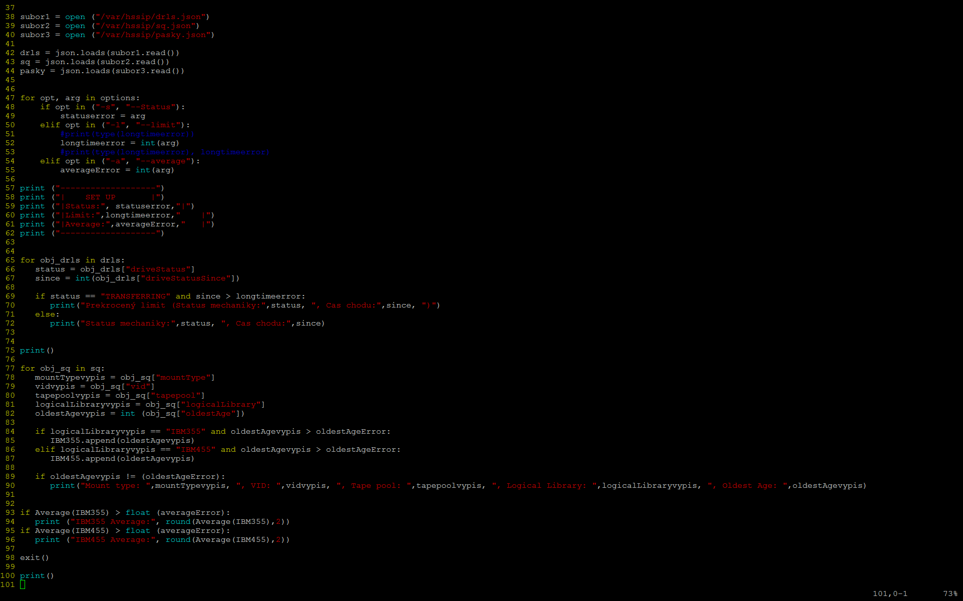

Our Code

Slide 13
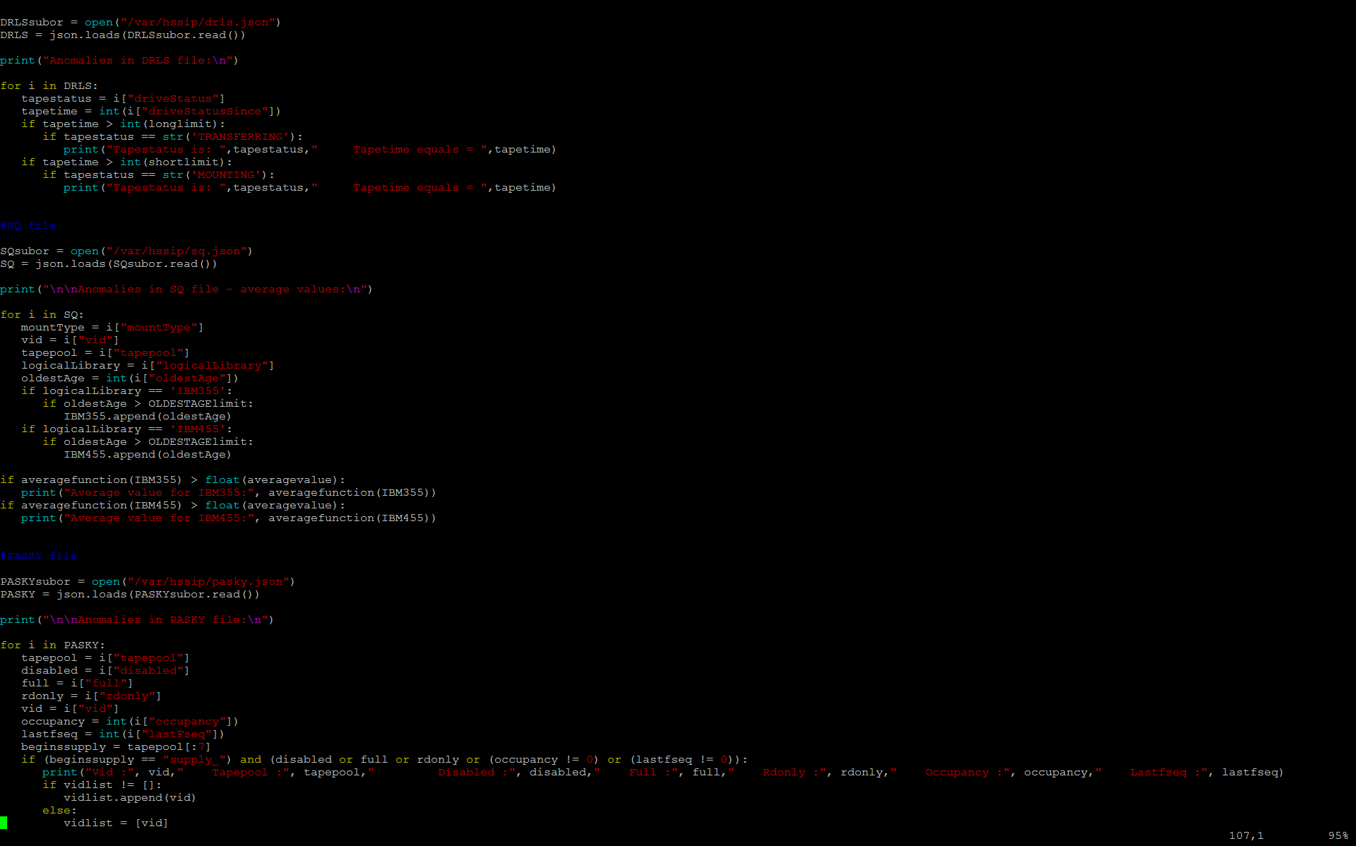
Our Code has 3 parts
1) Checks that the tape drives are used efficiently
  Checking the transition and running states
2) Checks the length of the tape queues
3) Checks the state of the tapes in the supply

Slide 14
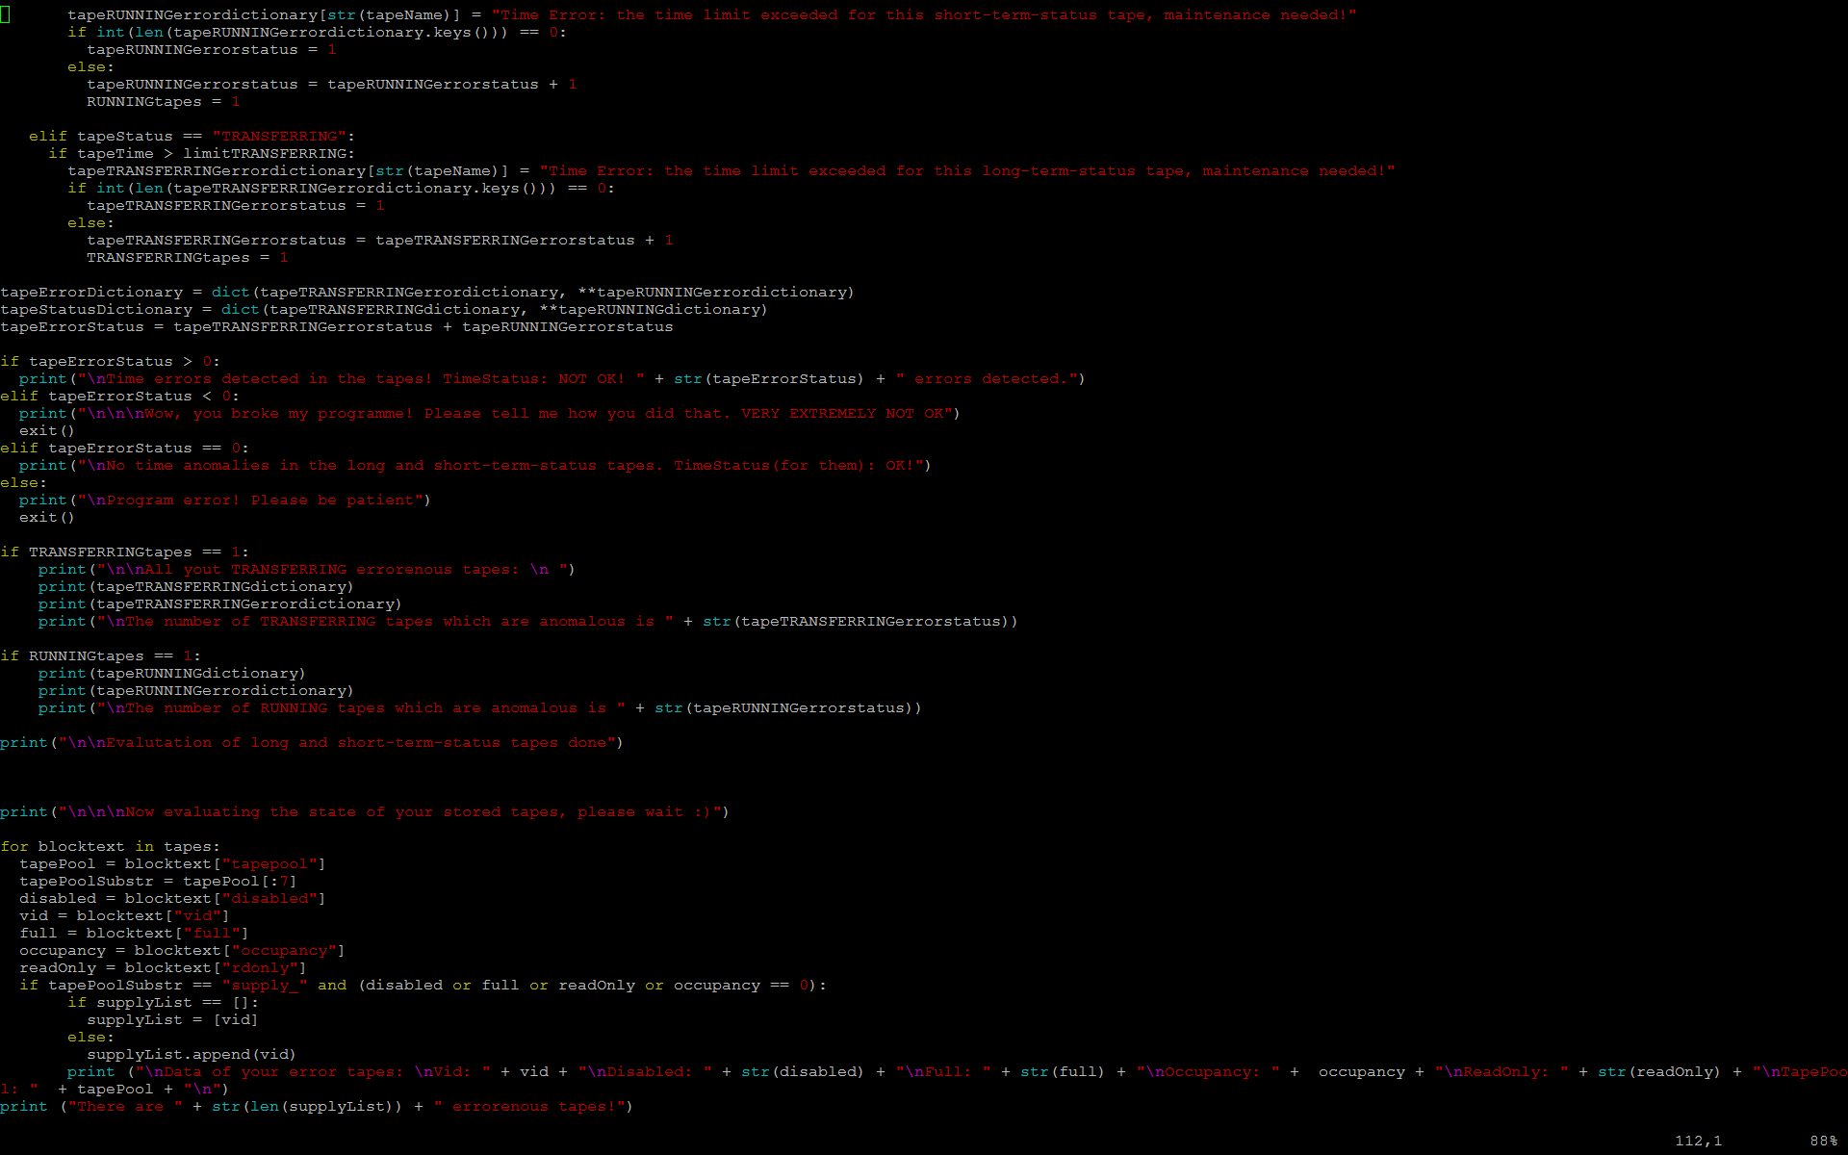
We used the following data types
Boolean bool(True, False)
Number int(9) or float(42.21)
String str("Hello!")
List list[val1, val2, val3,...]
Dictionary dict(key1:value1, key2:value2)

Slide 15
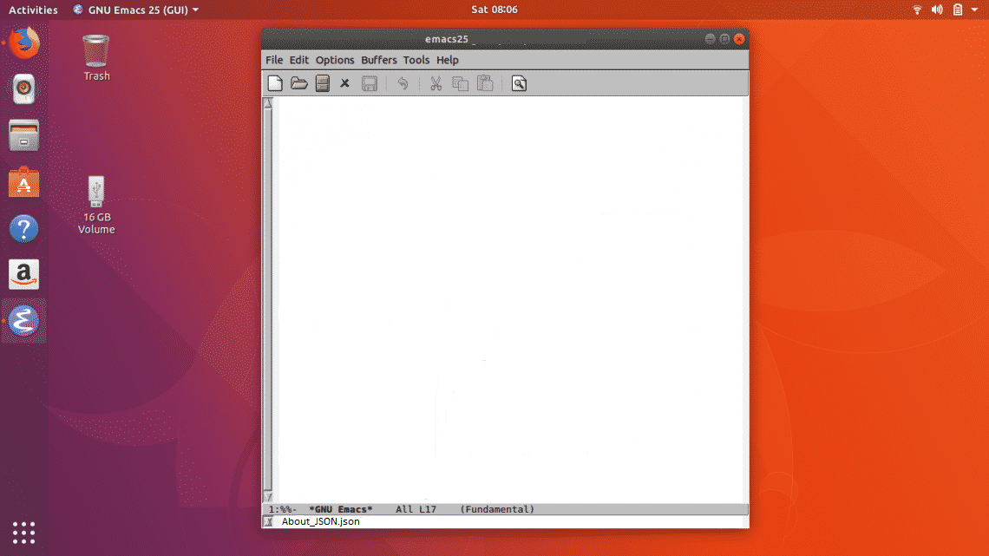
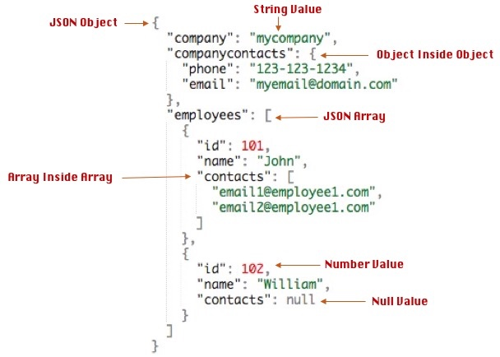
What is JSON?

Slide 16

What have we learned?
Tape data storage
Principles and functions
Libraries, drives, tapes and their statuses
Programming
Commands
Data types
Using modules
Handling json files
HSSIP
CERN mission, particle physics, detectors and colliders, scientific society...
New people
Geneva and its attractions
Eat fondue
What are anomalies and how to detect them

Slide 17

Sources
https://www.python.org/doc/essays/blurb/
http://openbookproject.net/courses/intro2ict/system/os_intro.html
https://personalpages.manchester.ac.uk/staff/m.dodge/cybergeography/atlas/linux_anatomy.pdf
https://www.kernel.org/category/faq.html
http://timelessrepo.com/json-isnt-a-javascript-subset

Slide 18


Nous vous remercions
pour votre attention

