Slide 1
Remote alignment for HL-LHC link to the experimental beam pipe TA(X)S alignment ATLAS and CMS
Antje BEHRENS
Dirk MERGELKUHL
Joint meeting WP8-WP15 – CERN – 21.08.2018

Slide 2
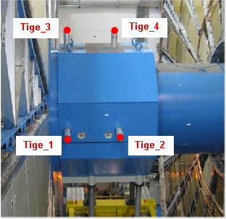
ATLAS TAS situation
ATLAS TAS, bars, shielding and cylinders

Slide 3
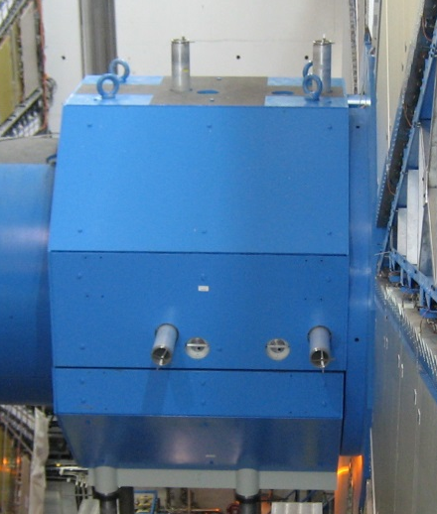
Actual ATLAS TAS Alignment Concept
TAS alignment based on bars attached to TAS and traversing the JFC and JFS shielding
Bars are made of two parts
1st part fix inside TX1STM
2nd part removable in JFS and supports the targets
2nd part needs to be (dis-)mounted manually for opening/closing
Z-coordinates of 2 top points determine vertical alignment
X-coordinates of 2 side points determine radial alignment
Alignment in single configuration possible (experiment closed, shafts open, cherry-picker available to put bars and targets)
Regular manual intervention with constraints on configuration, planning, access, exposure

Slide 4
Survey procedure for TAS (ATLAS)
Same survey procedure as since 2007 for TAS
Fiducials on 2 vertical and 2 horizontal bars
Access with nacelle for bar, target installation and adjustment
Measurement frequency: every YETS/EYETS/LS
Adjustment frequency
ATLAS: YETS/EYETS/LS if difference to nominal > 0.5 mm
Measurement with laser tracker (AT40x) and high precision 1.5 inch targets

Slide 5
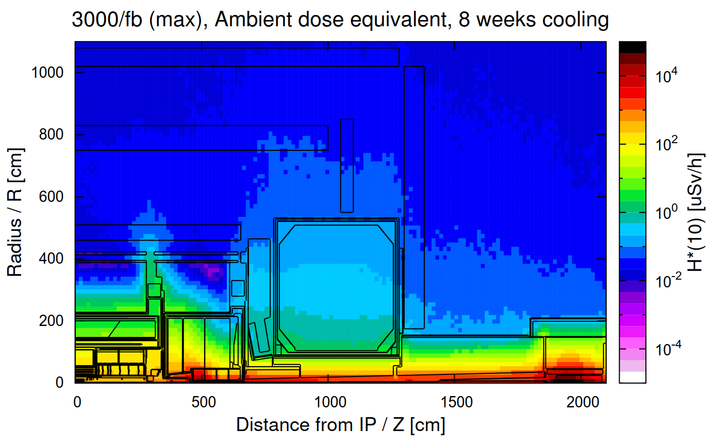
RP Calculations
Situation outside ATLAS JFS shielding in LS6
Radiation dose next to TAXS bars < 10uSv/h
Acceptable for installation and alignment
Reference: CERN-RP-2014-119-REPORTS-TN

Slide 6
Movements ATLAS TAS in time
Horizontal + = to LHC entre
Vertical + = to top
Horizontal + = to LHC entre
Vertical + = to top
Largest adjustments have been after installation with up to 5.4 mm
Maximum adjustment after first beam up to 1.2 mm
Generally adjustments >= 0.5 mm in YETS or LS
Insertion problem for bars ‘’creates’’ offset of ~6 mm

Slide 7
Movements of TX1STM shielding
Movements TX1STM-A+C in time (GLANCE) from ~20 measurements (2008-2017)
TX1STM is the shielding that supports the TAS
Maximal movements for TX1STM-A
In Xatl (m) : 0.0011 (radial)
In Yatl (m) : 0.0024 (vertical)
In Zatl (m) : 0.0040 (longitudinal)
Maximal movements for TX1STM-C
In Xatl (m) : 0.0012 (radial)
In Yatl (m) : 0.0030 (vertical)
In Zatl (m) : 0.0045 (longitudinal)
Vertical movement of ~1 mm included due to JFC1-3

Slide 8
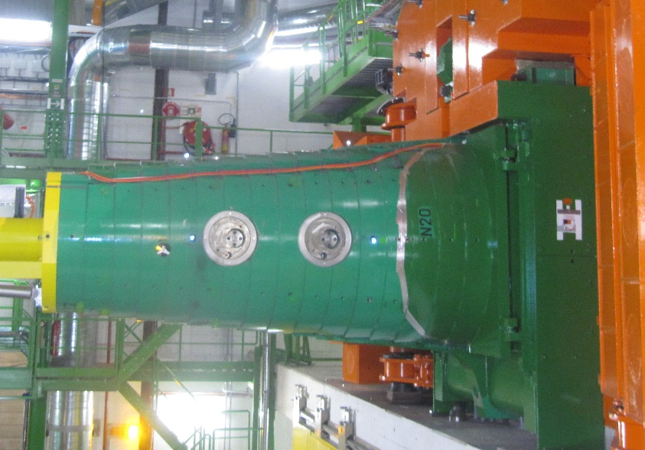
CMS TAS situation
CMS TAS, shielding, bars, retro targets

Slide 9
Actual CMS TAS Alignment Concept
TAS alignment based on bars attached to TAS and traversing the FIN shielding (green)
Single parts of bars stay permanently
1st fix part inside FIN
Retro-targets are mounted as targets in 2009
Rotating shielding needs to be open for measurement
Z-coordinates of 2 top points determine vertical alignment
X-coordinates of 2 side points determine radial alignment
Manual intervention with constraints on configuration, planning, access, exposure

Slide 10
Survey procedure for TAS (CMS)
Same survey procedure as since 2009 for actual TAS
Fiducials on 2 vertical and 2 horizontal bars
Shorter bars and targets are permanently installed
Non-contact measurement (distance ~12.0 m)
Adjustment frequency: last adjustment in 2009!
For TAXS: Change of equipment to laser tracker and precision PLX1.5 inch targets (permanent, ceramic)

Slide 11
Movements CMS TAS in time
Position of TAS targets wrt CMS coordinate system in time
Vertical position: min -1.7mm
Radial position: min -0.9mm
Vertical movement from last alignment 10.2009 to 12.2017 (8 years):
1.1 mm for TAS 54
0.5 mm for TAS 56

Slide 12
ATLAS and CMS TAS
Measurement possible in long and short TS
Adjustment possible in long (short?) TS
Lessons from actual TAS
Z-stoppers for both experiments
Installation of shielding plugs for ATLAS
Eventually rigid tubes instead of flexible bars
=> redundancy allows control of fiducialisation and installation of bars
Best case for ATLAS: modified cylinders and shorter, rigid bars to reduce significantly the installation time

Slide 13
Adjustment range of TAS and TAXS
Reduced adjustment range due to knowledge of actual shielding position
Reduced tolerances for production and installation of shielding
Adjustment range of +- 10.0 mm for ATLAS and CMS
ATTENTION: Adjustment is sequentially for 2x2 directions!
New mechanical system still to be designed:
Current priorities of WG8 on LS2 activities
Design of mechanical system during / after LS2 by WG8

Slide 14
Actual baseline for TAXS
Baseline for future TAXS alignment:
Same concept as so far (limited mechanical choice); 2x vertical, 2x horizontal
Permanent targets for laser tracker (non-magnetic) in CMS
TAXS get Z-stoppers => no alignment in beam direction
Demanded accuracy for adjustment 0.5 mm at 1 sigma (unchanged)
For ATLAS:
Alignment based on 4x long bars (2 parts) for ATLAS (points outside second layer of shielding called JFS)
As so far but with more rigid bars and different connection system
For CMS:
Alignment based on 4x short, rigid bars for CMS (points outside first layer of shielding called FIN)

Slide 15
Error budget for TAXS measurements
A) Target precision with support
B) Fiducialisation using mole (to be produced)
C) Cavern network up to UPS gallery
D) Low-beta system (UPS gallery to Q1, Q2, Q3)
E) Fiducialisation of low-beta magnets (warm)
Cold warm transition not considered!
Worst case (linear add 1 sigma):
A) 0.03 mm, B) 0.25 mm, C) 0.30 mm
D) 0.10 mm, E) 0.08 mm => Total = 0.76 mm

Slide 16
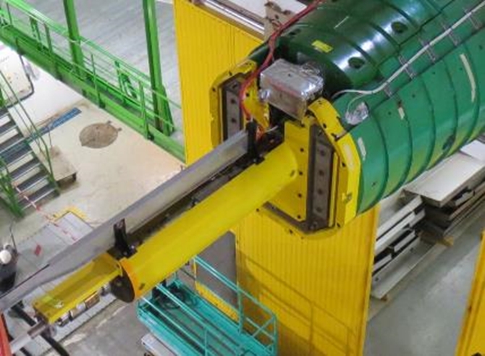
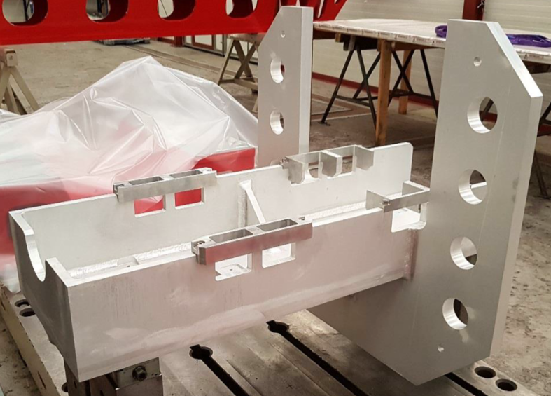
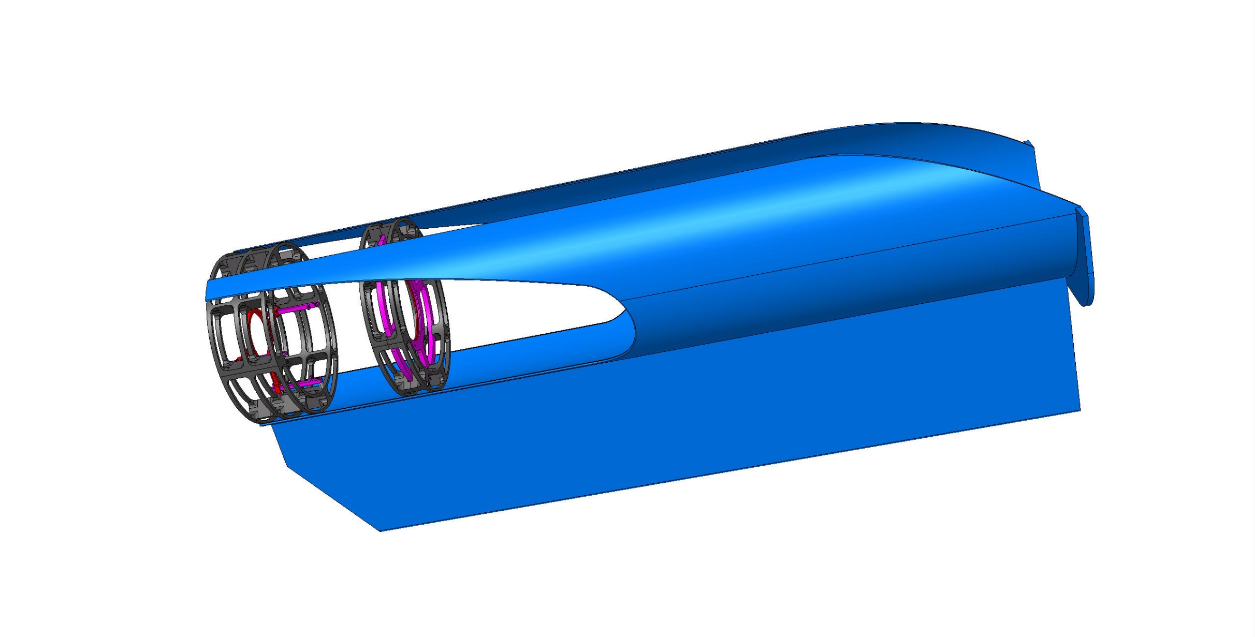
CMS - VAX support and BP support @ 16m
New VAX and beampipe support @ 16m
LS2:
Installation of VAX support box without equipment
Installation of new beampipe and beampipe support at 16m
LS3:
Installation of VAX equipment, valve, bellows
CMS Engineering and Integration Center
VAX support
prototype
Beam pipe support @ 16 m
3D model

Slide 17
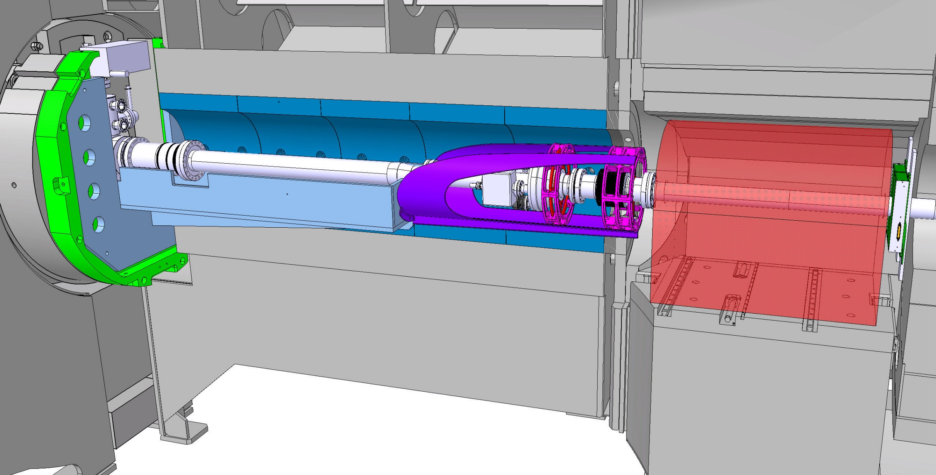
CMS – LS2
CMS Beam pipe supports
New half shells inside Thin rotating shielding
VAX support
Pump and BP support @16m
Forward support @16000
concept
A. Gaddi, CMS E&I center

Slide 18
ATLAS and CMS - VAX alignment
Alignment of empty VAX support after installation
CMS: LS2
ATLAS: LS3
Installation of VAX equipment based on plug-in
No alignment of VAX equipment in cavern
No future alignment of VAX box foreseen due to increased valve diameter (current situation)
Final design of VAX support, beampipe support
Survey interfaces, fiducialisation and alignment still to be defined

Slide 19
Thanks for your attention!

Slide 20
BACK UP SLIDES

Slide 21
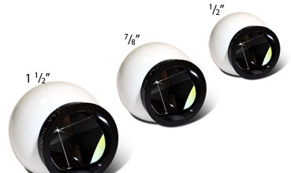
Change of Targets
Advantages:
Different reflectors exist on the market (size, type)
Non-magnetic devices exist (ceramic)
Compatible with laser trackers available at CERN
Size and weight of target support could be reduced
Radiation hard up to 10 MGy (test crab cavities)
No access needed for measurement (if permanent)
Constraints:
Long-term maintenance could be necessary
Cleaning from dirt, dust
Protection?
Costs per prism ~1000-1500 EUR
8 prisms per experiment needed (if permanent)
Prisms available for temporary installation
but access needed in this case! Exposure?
Prism supports need to be manufactured (design is available)

