Slide 1

Alignment: VAX region
Jaime Perez Espinos
TE-VSC
21 August 2018

Slide 2
Outline
New VAX area: comments
Mechanical cross-sections
Summary

Slide 3
New VAX area
TAXS-Exp.
  Need of sectorization to decouple experiment’s vacuum from machine vacuum
  Instrumentation in front of Q1 moved to the experiment’s cavern to reduce radiation to the personnel: robustness, remote handling and tooling are required
  Objective: unique diam. 80 mm aperture along all the VAX vacuum components (vacuum valves are TBC)
  Big transversal compensation through at least bellows to TAXS; second bellows to be studied according to alignment constraints and methodology
Q1-TAXS, considered as a free maintenance area:
  Vacuum instrumentation to be reduced at minimum; high quality and robustness are required
  Risk analysis to drive the final connection concept ⇒ few alternatives due to confined space, bad accessibility, high radiation levels and exceptional potential interventions
  Pumping and bellows needed to decouple room temperature TAXS from cryogenic temperature triplet
  Big transversal compensation through connection bellows

Slide 4
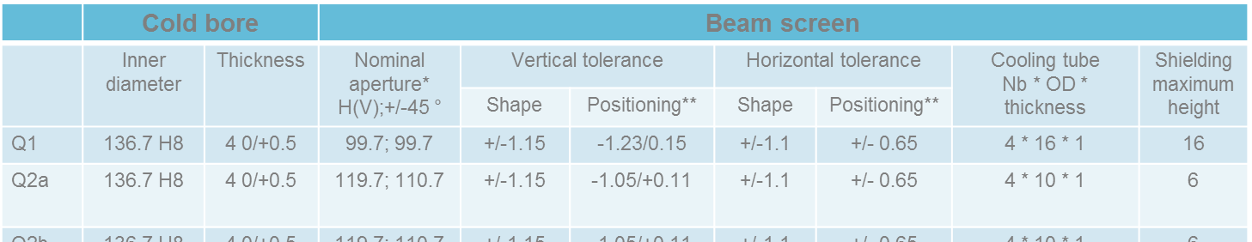
HL-LHC beam aperture and TAXS alignment tolerances
34 mm in LHC
54 mm as first proposal for HL-LHC
Optical Element | Distance from IP [m] | Average beam separation [mm] | Maximum beam size ⁽⁴⁾[mm], A | Mechanical aperture separation [mm] | Minimum inner mechanical aperture [mm], B | Nominal inner mechanical aperture [mm], C | Alignment and ground motion [mm], D
End TAXS | 20.85 | 0 | <56.8(hv) | n/a | 60⁽¹⁾ (hv) | 60⁽¹⁾ Circle | 3.2
End D1 (MBXF) | 80.917 | 4.39 | <112.1(hv) | n/a | 115.3 (hv) | 119.7, 110.7 (45°) Octagonal | 3.2
Start TAXN | 127.135 | 148 | <80.6(hv) | 148 | 85⁽¹⁾ (hv) | 85⁽¹⁾ Circle | 4.4
End TAXN | 130.467 | 158 | <78.6(hv) | 158 | 85⁽¹⁾ (hv) | 85⁽¹⁾ Circle | 4.4
Start D2 (MBRD) | 138.624 | 183 | <72(hv) | 188⁽²⁾ | 83(hv) | 86/77(45°) Octagonal | 4.4
End D2 cryostat | 152.383 | 194 | <71.5(hv) | 194⁽³⁾ | 83(hv) | 86/77(45°) Octagonal | 4.4
Start Q4 (MCBY) | 173.091 | 194 | <53.4(hv) | 194 | 57.8(hv) | 60.05/50.45 Rectillipse | 4.4
End Q4 (MQY) | 181.300 | 194 | <53.4(hv) | 194 | 57.8(hv) | 60.05/50.45 Rectillipse | 4.4
Start Q5 (MQY) | 205.790 | 194 | <53.4(hv) | 194 | 57.8(hv) | 60.05/50.45 Rectillipse | 4.4
End Q5 (MCBY) | 209.190 | 194 | <53.4(hv) | 194 | 57.8(hv) | 60.05/50.45 Rectillipse | 4.4
Start Q6 | 225.990 | 194 | <40.6(hv) | 194 | 45.1(hv) | 47.15/37.55 Rectillipse | 4.4
End Q6 | 230.790 | 194 | <40.6 (hv) | 194 | 45.1(hv) | 47.15/37.55 Rectillipse | 4.4
Start Q7 | 260.004 | 194 | <39.6(hv) | 194 | 44(hv) | 46.35/36.75 Rectillipse | 4.4
End Q7 | 267.171 | 194 | <39.6(hv) | 194 | 44(hv) | 46.35/36.75 Rectillipse | 4.4
TAXS: extraction from HL-LHC TDR
C. Garion
15/11/2016
shape tolerance to be studied and accounted either on mechanical aperture or design aperture based on a trade off between beta* reach and radiation protection
Transition from 188mm to 194mm occurs on the CWT
In D2 cold mass the beam pipes will be parallel
The beam size is take from the average beam separation and not the mechanical aperture separation
WP12 computation:
B=A+3.3.1+3.3.2+3.3.3+3.3+3.2
WP2 computation:
A=B-D
B=C-3.3
D=3.3+3.2
R. De Maria
26/04/2017

Slide 5
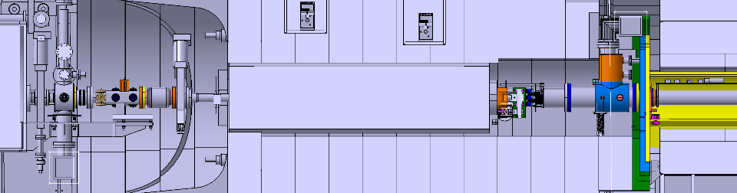
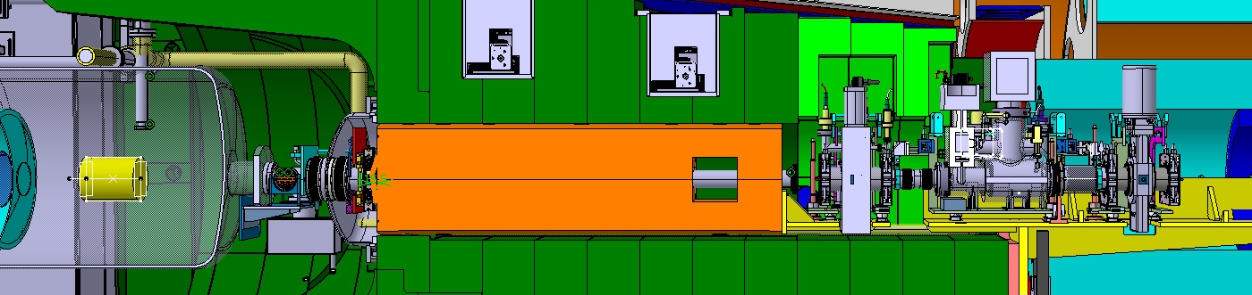
LHC and HL-LHC mechanical cross-sections (IR5 VAX area)
LHC IR5 ‘as installed’
48*
63
63
60-69-60
63
34
34
46
100
63
All transitions @ ≤15°
New HL-LHC RF-shielded 80 mm aperture valve (TBC)
HL-LHC IR5 current proposal
Standard LHC RF-shielded valve
100
80
60
54
1st version
54
60
63
80
80
63
80
RF transitions
100
80
60
current version
60
80
80
80
80
80

Slide 6
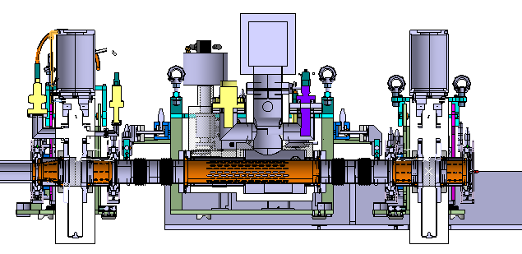
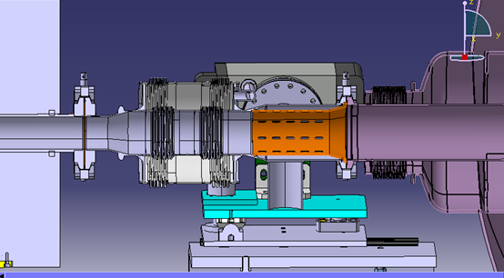
HL-LHC (HL-LHC IR5 VAX area)
Bellows to compensate +/- 10 mm transversal
Baseline: no RF fingers (presented in 32nd HL-LHC TCC)
???
60
54.8
Beam apertures
∼49

Slide 7
Summary
TAXS-Experiments & Q1-TAXS designed at a preliminary level (small changes are ongoing)
  Same alignment/aperture concept in IR1 and IR5, both on left and right sides
Mechanical aperture and transitions are currently quite homogeneous
  Development of a new standard mechanical aperture valve in synergy with other HL-LHC needs is ongoing
10 mm of relative transversal movement is specified at both sides of the TAXS (alignment procedures and tunnel-cavern movement compensation)
  Big bellows to compensate such movements
  Big enough apertures to avoid active re-alignment
High radiation levels expected combined with bad accessibility areas ⇒ remote handling required ⇒ need of robust and ‘proven’ solutions
  Baseline: non-shielded bellows

