Slide 1
Why do we need coated collimators?
S. Antipov, D. Amorim, N. Biancacci, X. Buffat, E. Carideo,
J. Guardia, E. Metral, N. Mounet, B. Salvant
HL-LHC WP2 Meeting, 28.08.18

Slide 2
What is the motivation for collimator impedance reduction?

Slide 3
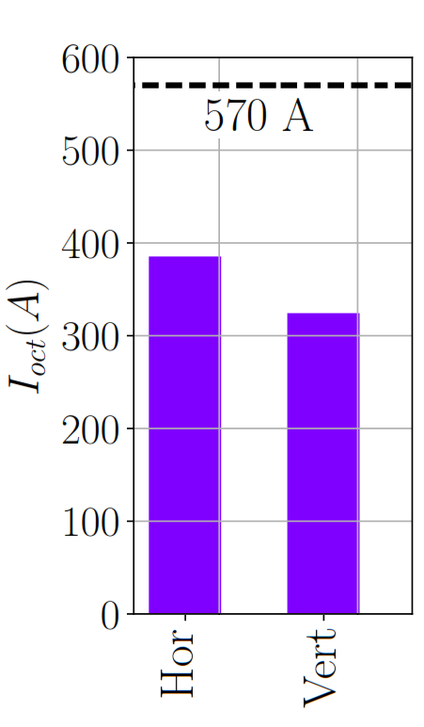
Impedance of LHC collimators has to be reduced for the Hi-Lumi upgrade
Octupole current close to threshold
Current study:
Ultimate OP scenario
Right before collision
No beam-beam
No help from ATS
Linear coupling
Magnet imperfections
Feedback noise
Optics errors
Uncertainty of beam distribution
x2 margin
Present operational experience:
Need a factor 2 margin at least
Compared to pure impedance

Slide 4
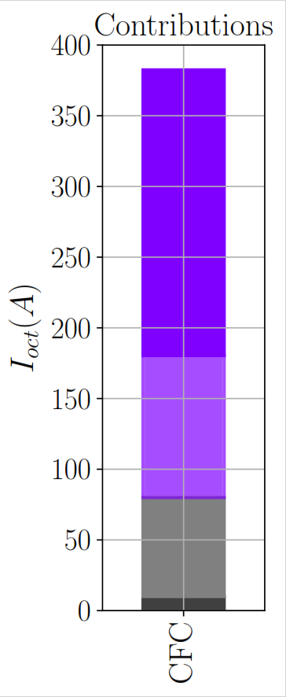
Impedance of LHC collimators has to be reduced for the Hi-Lumi upgrade
Octupole current close to threshold
Dominant component is the
collimator impedance
11 secondaries in IR-7 - 200 A
To be upgraded
4 to be replaced during LS 2
x2 margin
4 primaries - 100 A
To be upgraded*
2 to be replaced during LS 2
All other collimators - 70 A
Everything else - < 10 A
* 2 approved at the moment

Slide 5
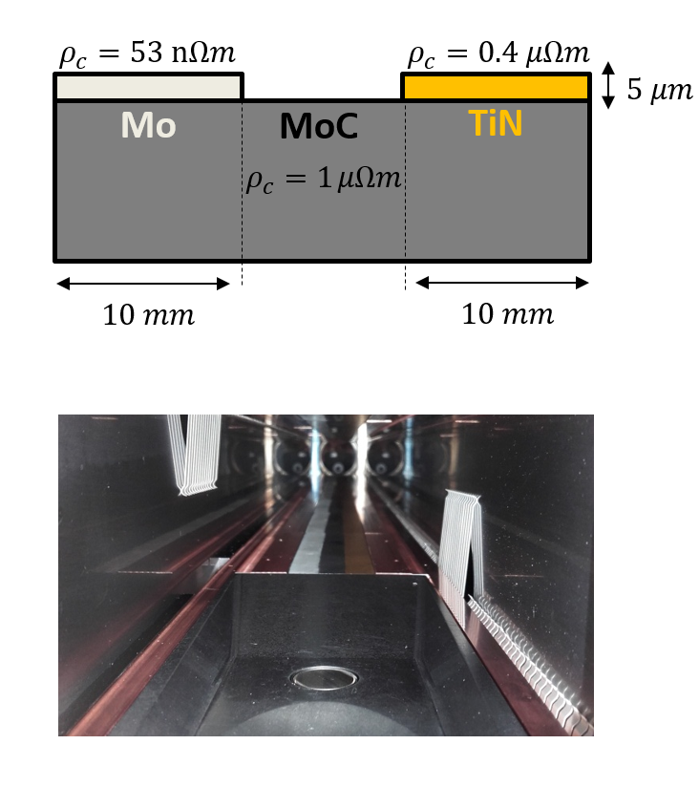
Study of the low impedance collimator in LHC
Currently, both primary and
secondary collimators
have CFC jaws (ρ_{c} = 5 μΩm)
Primary collimators:
  MoGr to replace CFC
Secondary collimators:
  MoGr jaw
  Low-resistivity coating
MoGr
N. Biancacci
Notes:
The TCSPM is unusual from the jaw point of view: prototype built to benchmark the HL-LHC impedance reduction achieved with conductive coatings.
Three stripes of different material (MoGr bulk and TiN - Mo coatings on MoGr).

Slide 6
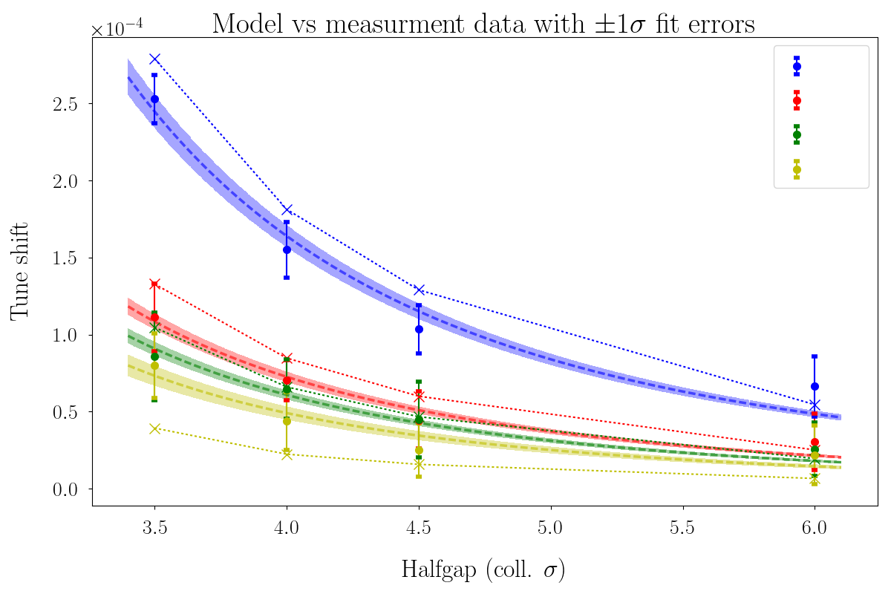
The largest reduction of the resistive wall tune shift measured for Mo coating
Good
CFC
MoC
TiN
Mo
Better
model
Best
exp.
S. Antipov, et al., IPAC’18

Slide 7
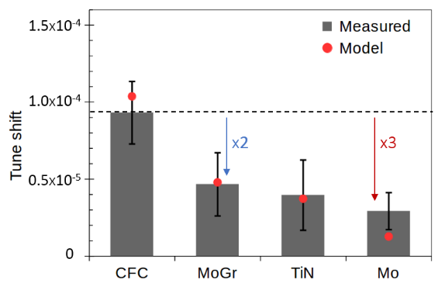
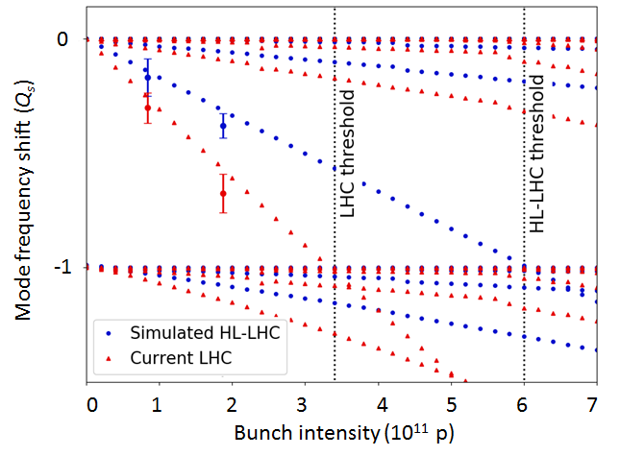
IR-7 Secondary collimators are the right target for impedance reduction
Collimator Tune shift goes down
Significant reduction in impedance was measured in the TMCI MD
1.8x10¹¹ p
That’s a huge
tune shift!
Measured tune shift of 1 collimator: TCSG.D4, TCSPM

Slide 8
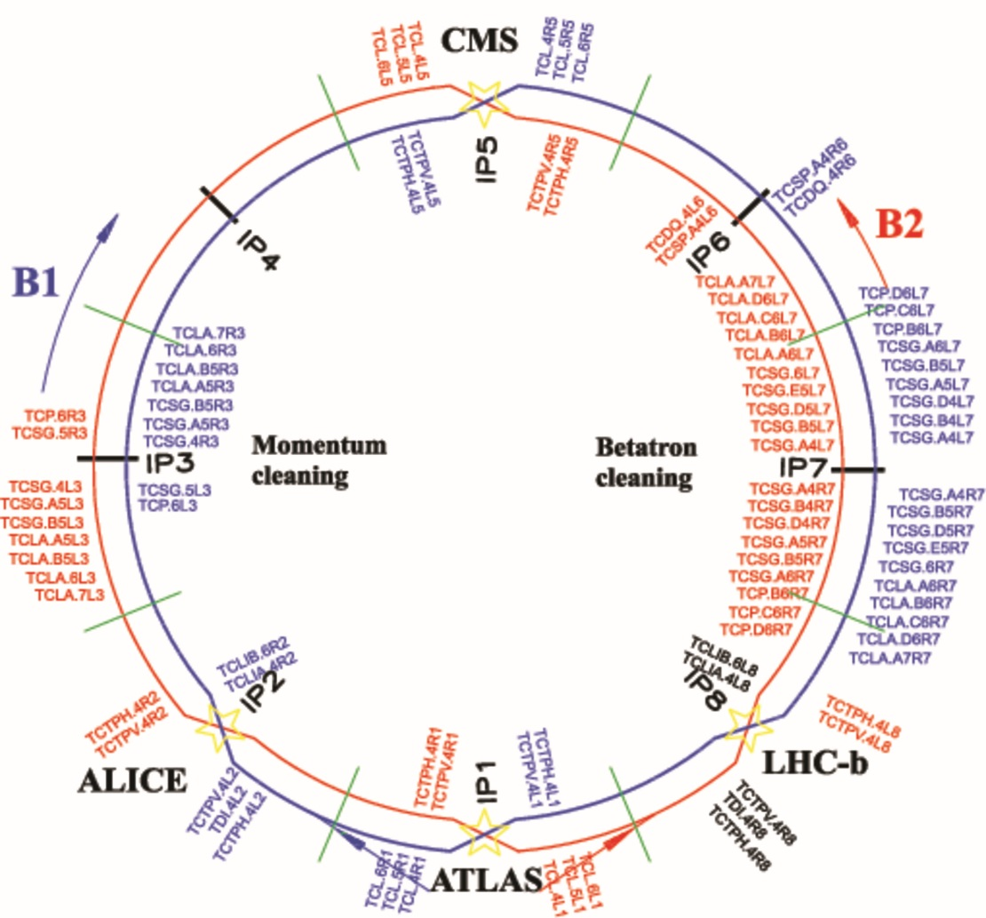
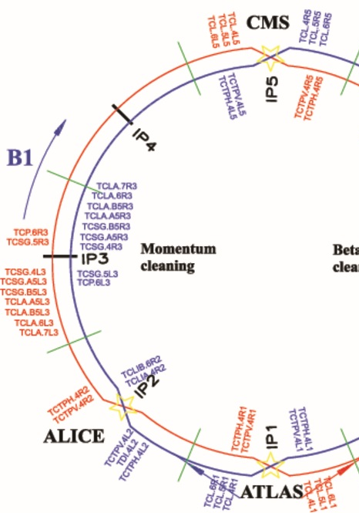
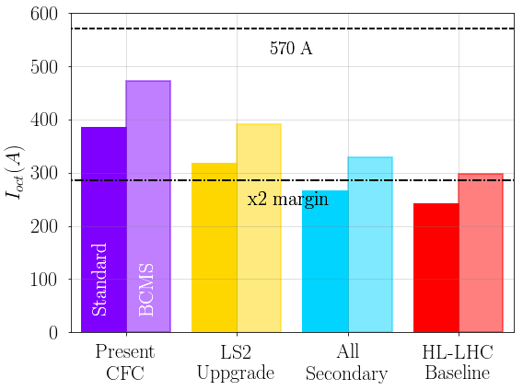

Low impedance collimators
$$I_{oct}^{max}$$

Slide 9
How does the gain scale with coating resistivity?

Slide 10
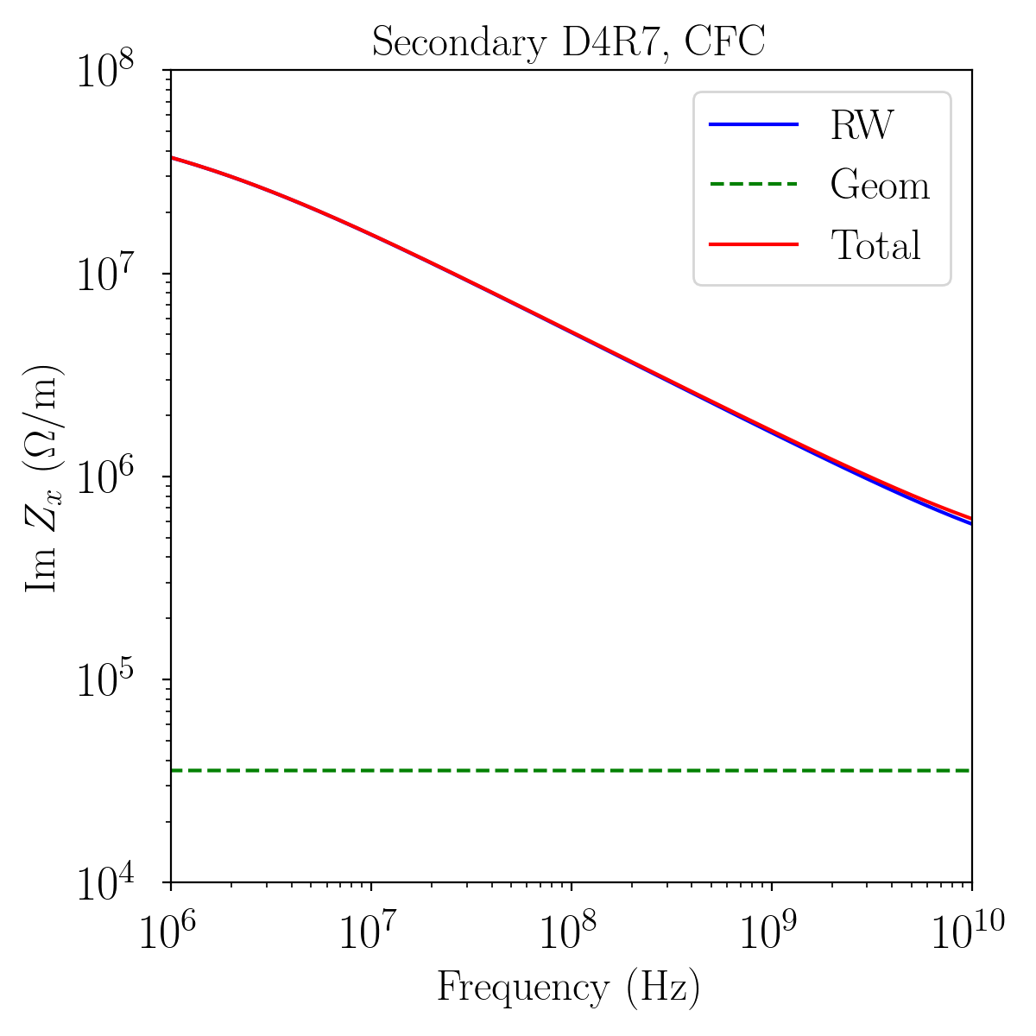
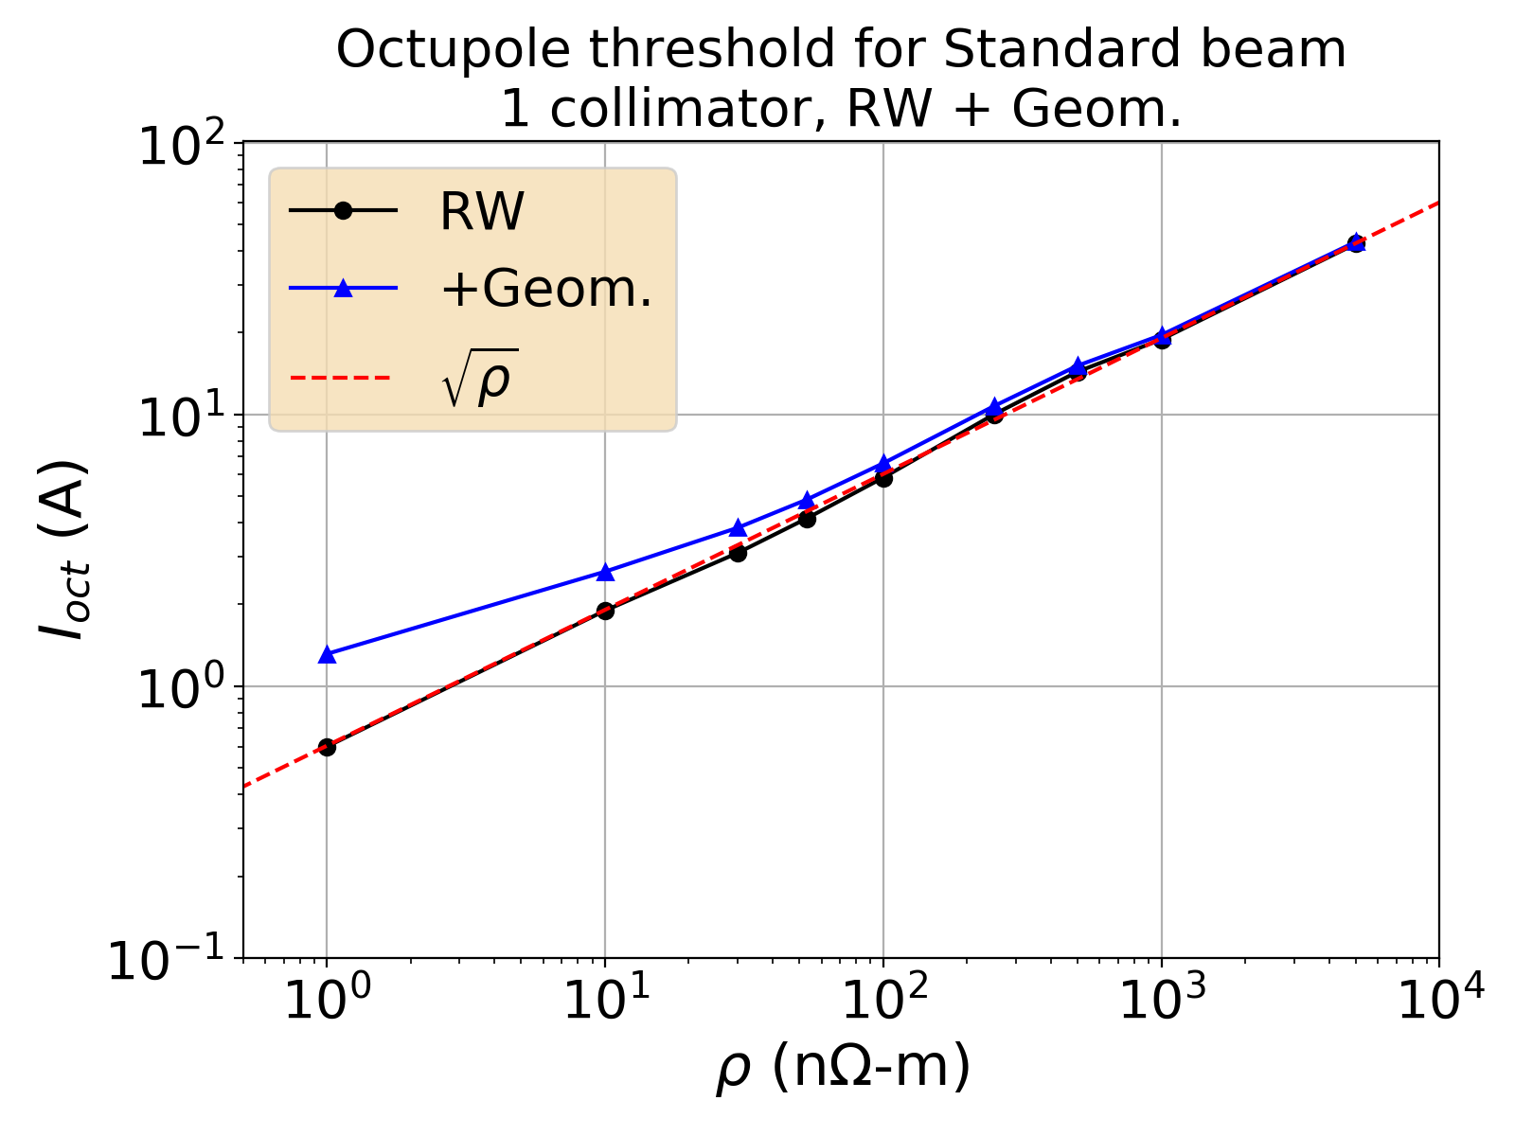
One collimator, closer to the beam:
Coating is very efficient
Damper suppresses
coupled-bunch motion
Vertical collimator, Halfgap: 1.4 mm

Slide 11
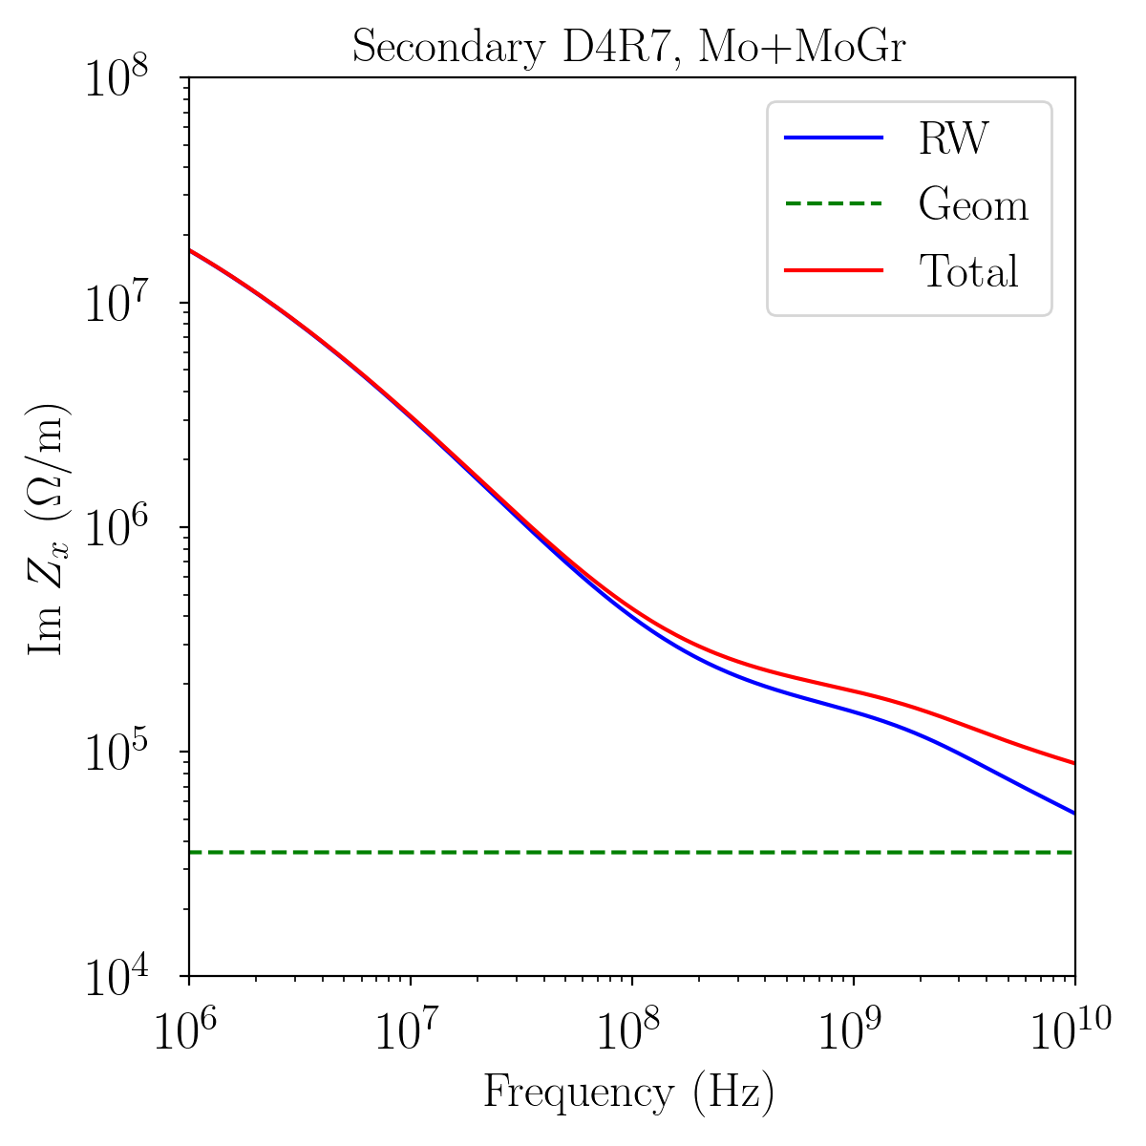
One collimator, closer to the beam:
Coating is very efficient
Damper suppresses
coupled-bunch motion
Vertical collimator, Halfgap: 1.4 mm

Slide 12
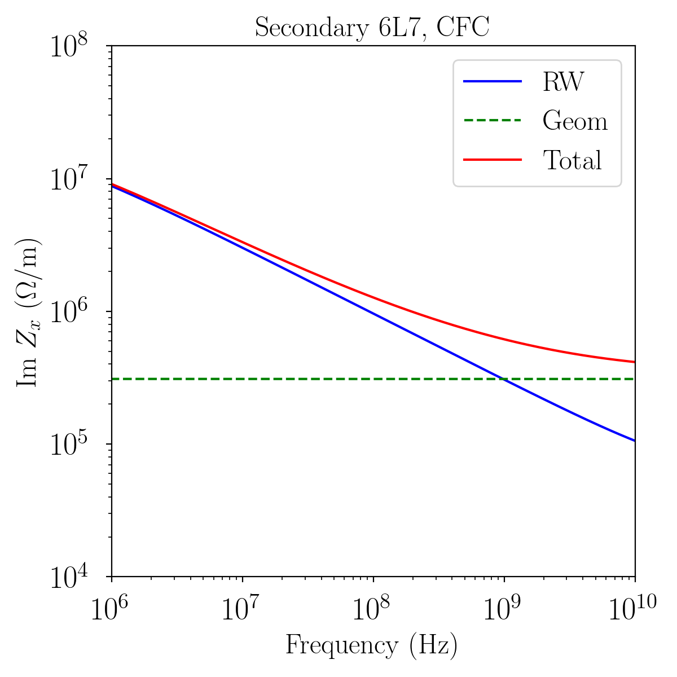
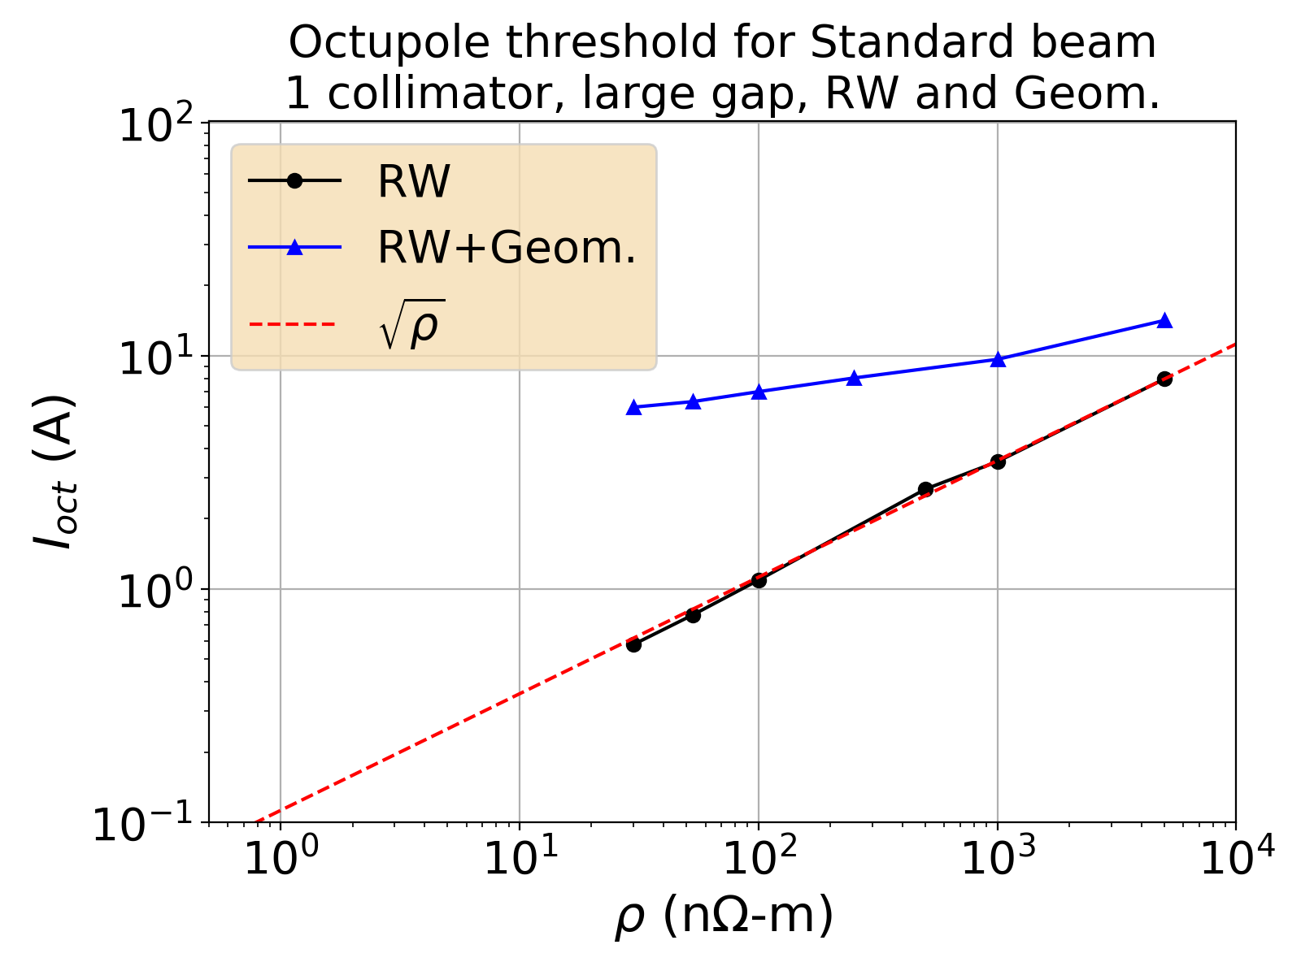
Coating is less efficient when other sources of impedance take part
Damper suppresses
coupled-bunch motion
Horizontal collimator, Halfgap: 3.1 mm

Slide 13
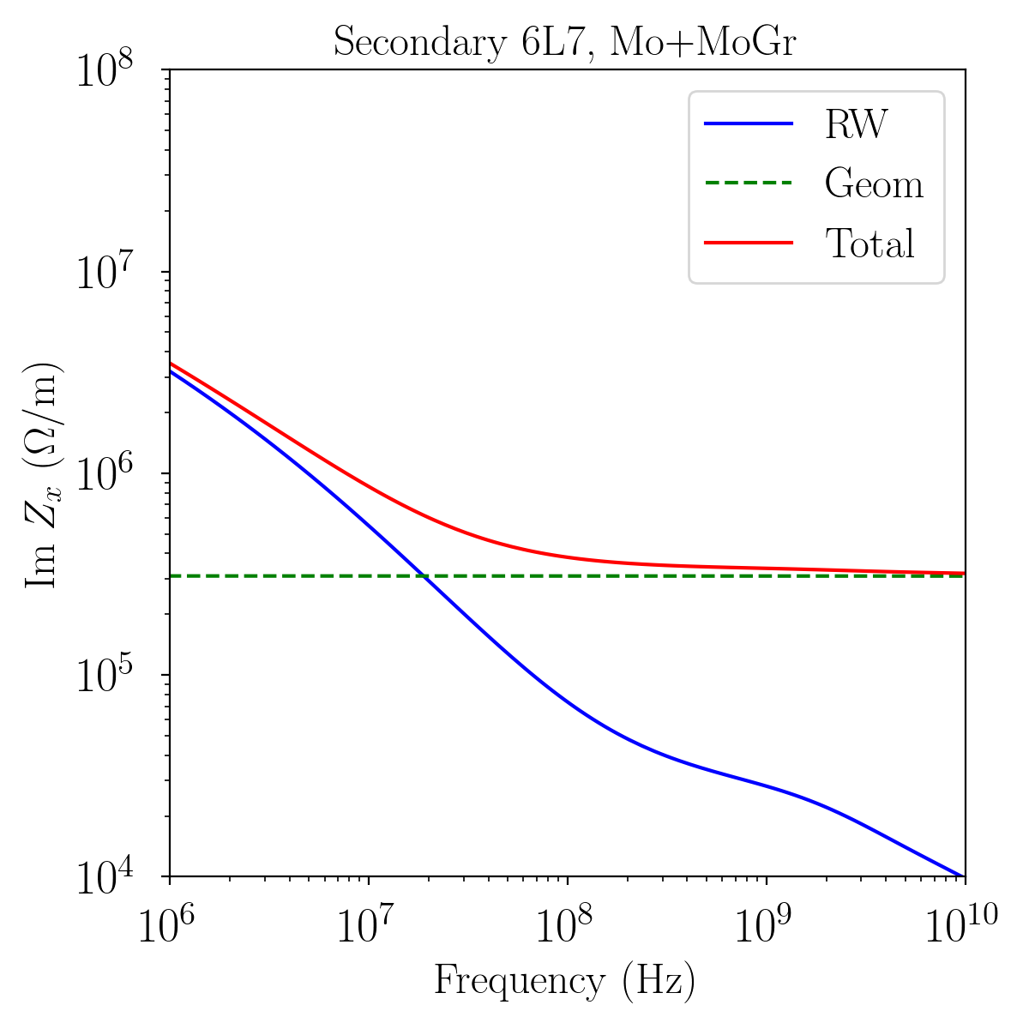
Coating is less efficient when other sources of impedance take part
Damper suppresses
coupled-bunch motion
Horizontal collimator, Halfgap: 3.1 mm

Slide 14
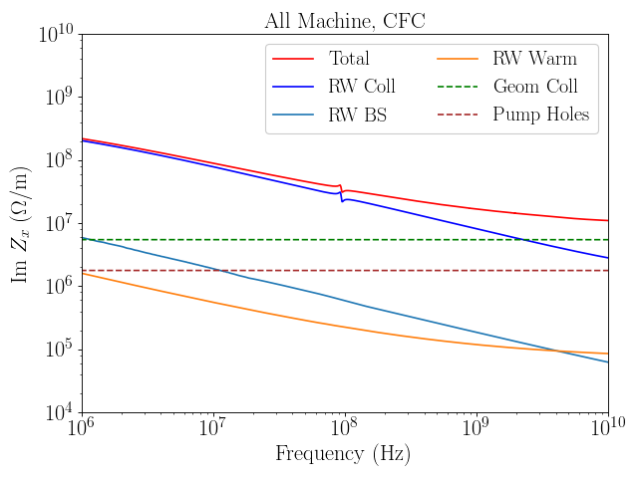
Broadband components of impedance limit how much the total can be reduced
Being refined by E. Carideo
Being checked by T. Dascalu

Slide 15
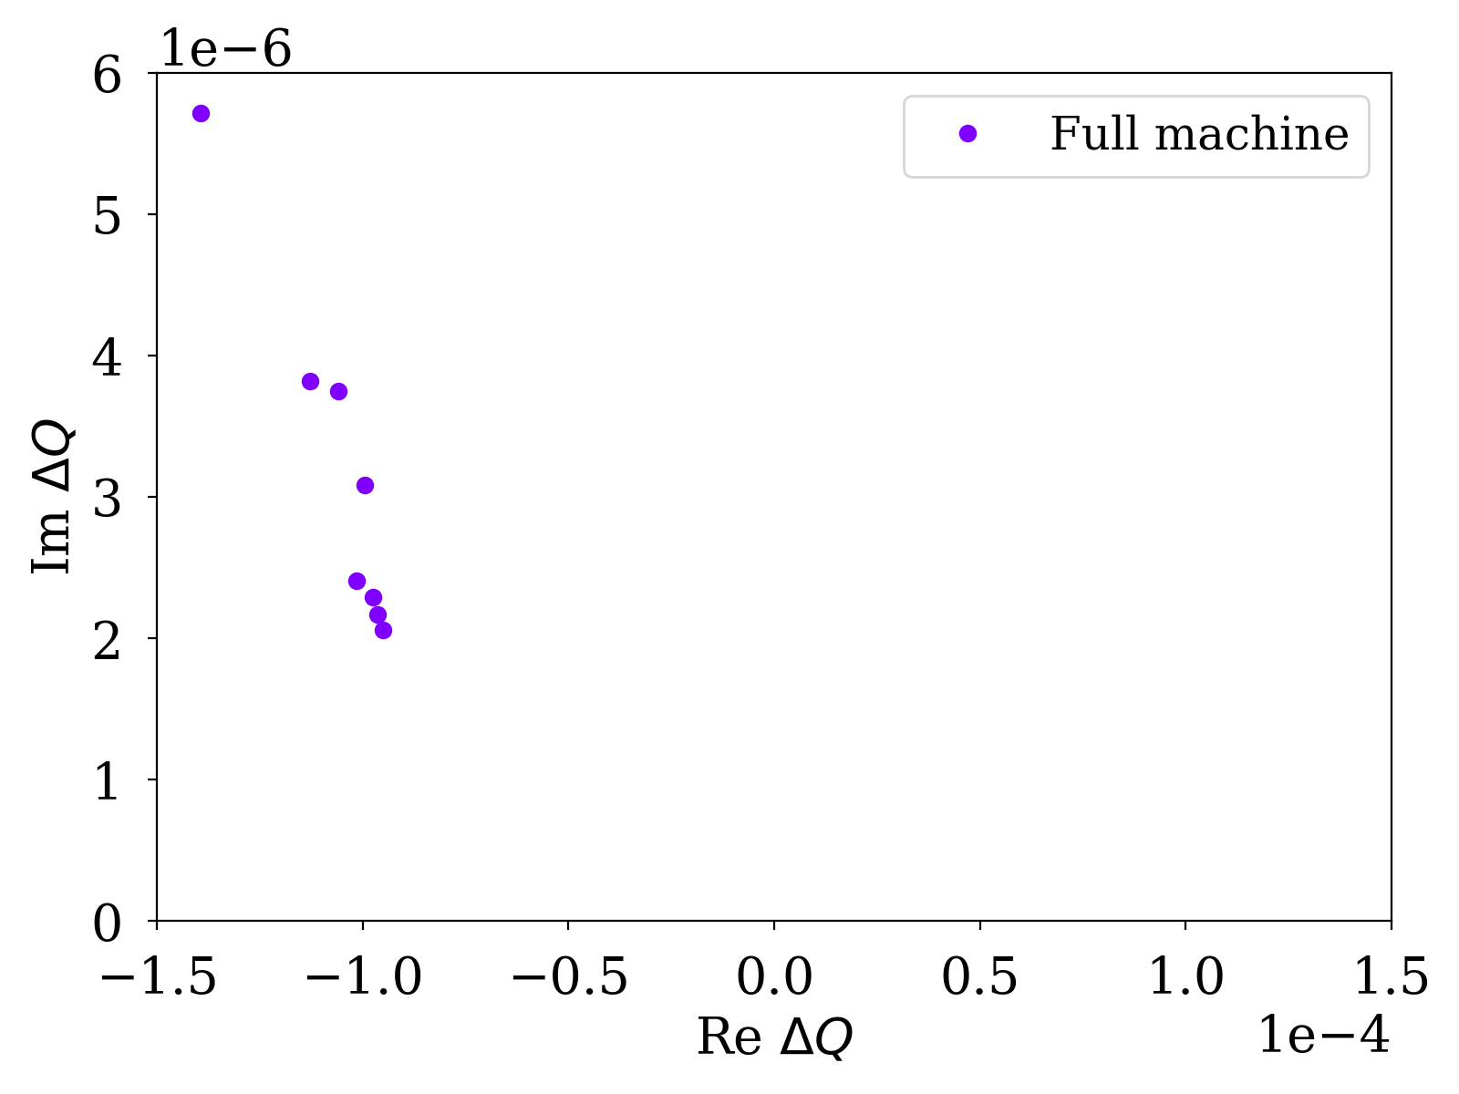
Stability diagram: Full machine
Coating IR7
TCSGs
Other
sources

Slide 16
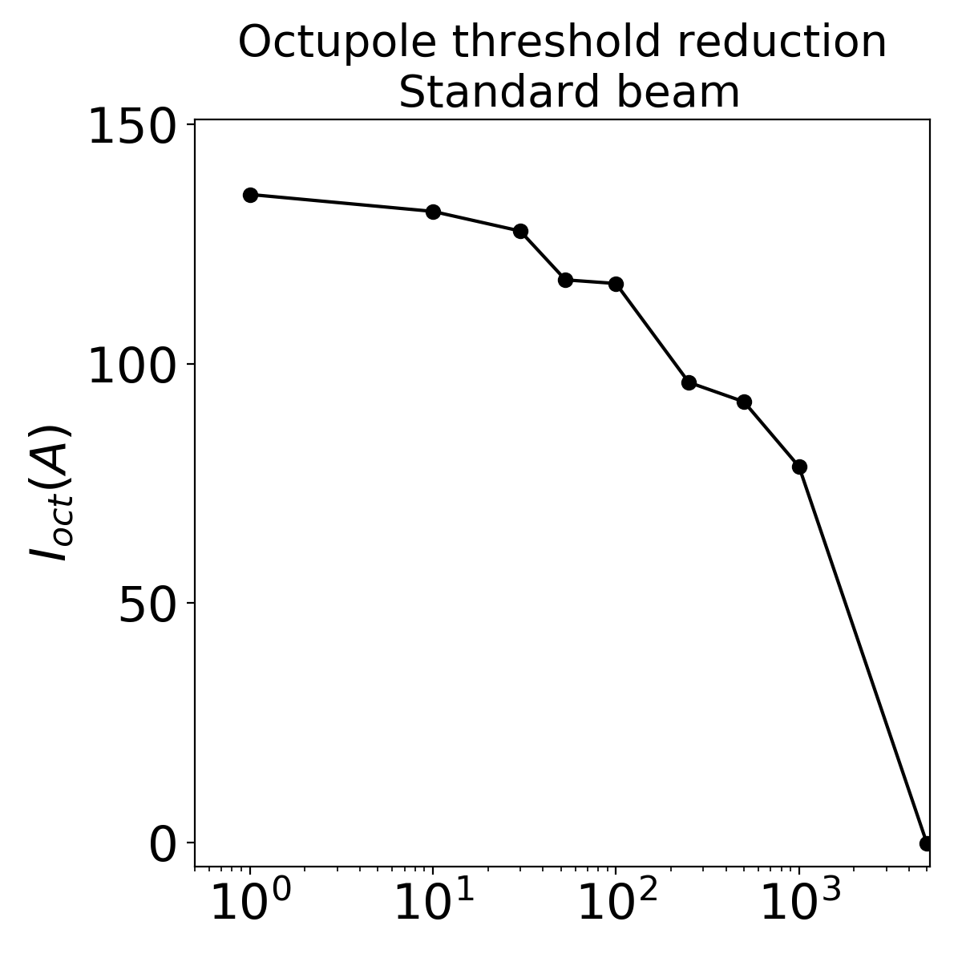
Further reducing the resistivity gets less effective as one goes to better conductors
Cu
Cu (TDIS)
Mo
Mo (TCSPM)
MoGr
CFC
Resistivity (nΩ-m)

Slide 17
What could be different (go wrong)?
Need tighter collimator settings for machine protection
Mo coating does not perform as expected
Have to settle for uncoated secondary collimators
Something left unaccounted for in the model
  Refining the model of geometric impedance
  Noise leading to instabilities with large latency times
  Beam-beam interaction reducing the Stability Diagram

Slide 18
LHC keeps tightening the collimator gaps during its operation
Originally, there were three collimator scenarios for HL-LHC:
  1.0 σ: TCP – 6, TCS – 7 (for 3.5 μm ref. emittance, “Nominal” design report)
  1.5 σ: TCP – 5, TCS – 6.5
  2.0 σ: TCP – 5.7, TCS – 7.7
Ultimately became the baseline
Are we sure the settings are not going to change in the future?

Slide 19
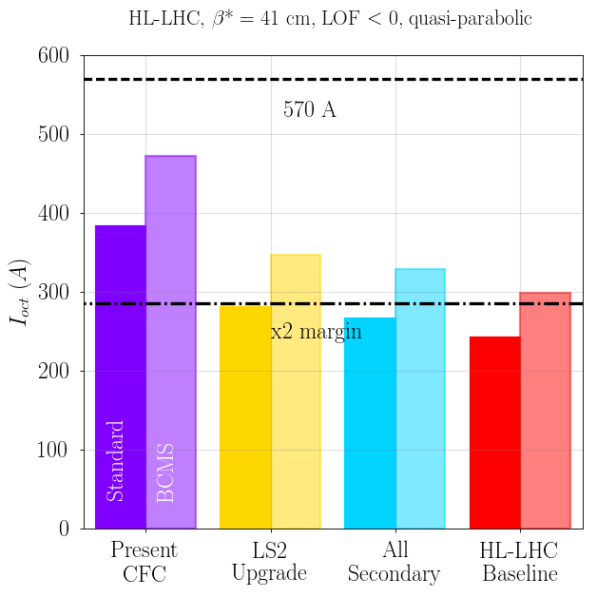
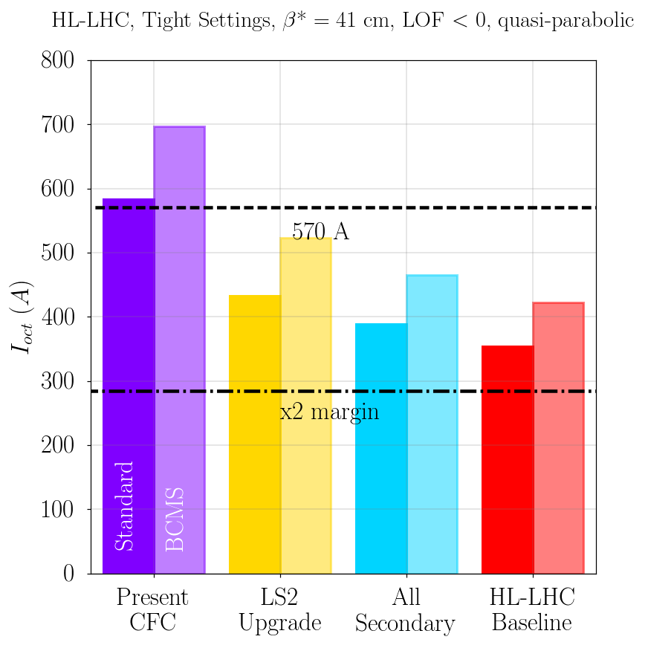
Little or no safety margin for tighter settings if the full impedance reduction is not done
Nominal settings
Tight (non-baseline) settings

Slide 20
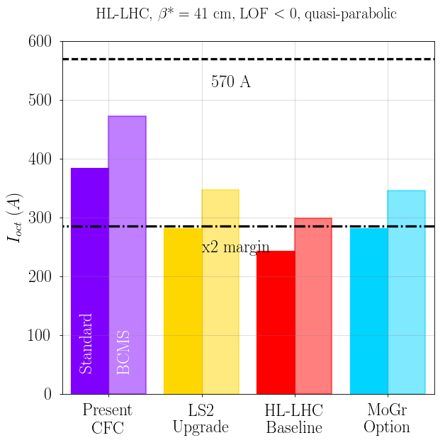
Not coating the secondary collimators:
Octupole current threshold – similar to post-LS2

Slide 21
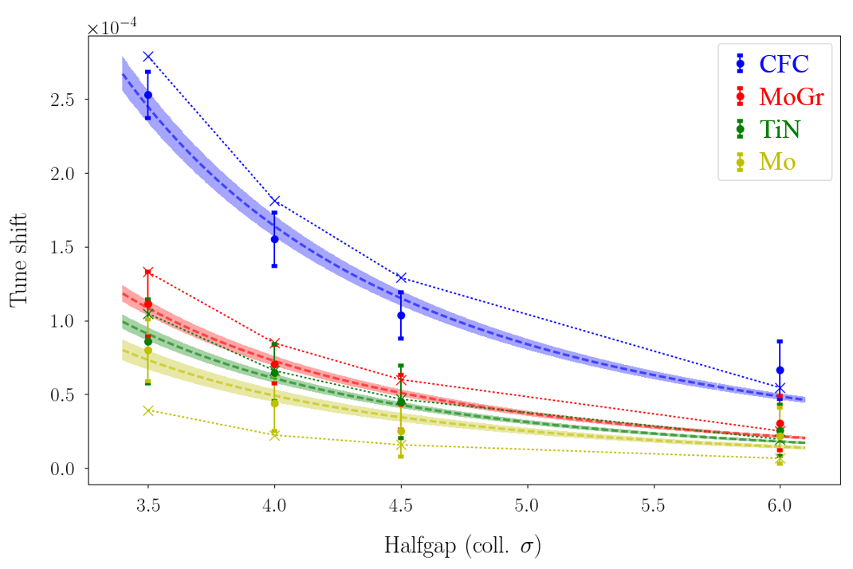
The actual resistivity of Mo coating might be higher than the model value
Material | Model | Beam | Lab: DC | Lab: RF
CFC | 5000 | 4030 ± 380 | 5000 – 6000 | -
MoGr | 1000 | 760 ± 60 | 900 ± 100 | -
TiN | 400 | 340 ± 40 | - | ~400
Mo | 53.5 | 250 ± 50 | 100 – 300 | ~300
S. Antipov, et al., IPAC’18

Slide 22
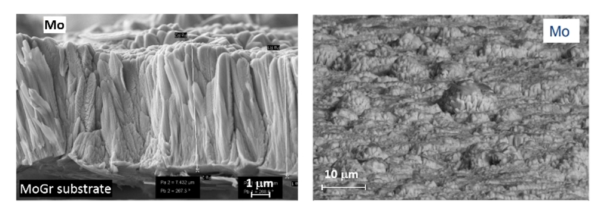
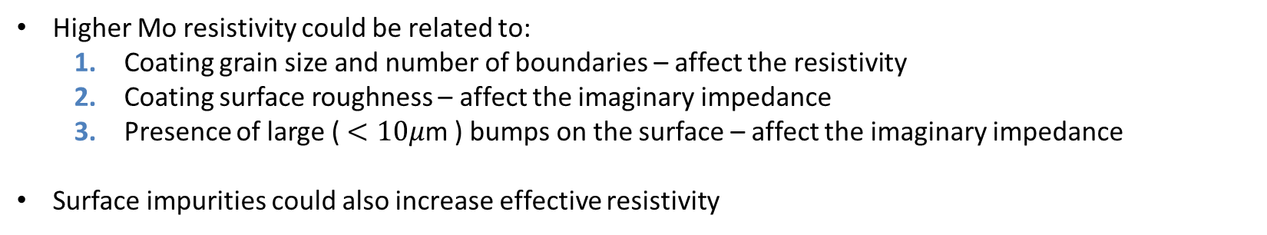
Surface studies
2
3
1
Higher Mo resistivity could be related to:
  Coating grain size and number of boundaries – affect the resistivity
  Coating surface roughness – affect the imaginary impedance
  Presence of large ($<10μ$m ) bumps on the surface – affect the imaginary impedance
Surface impurities could also increase effective resistivity
N. Biancacci, et al., IPAC’18

Slide 23
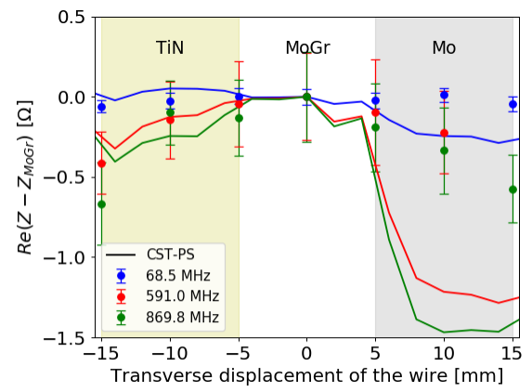
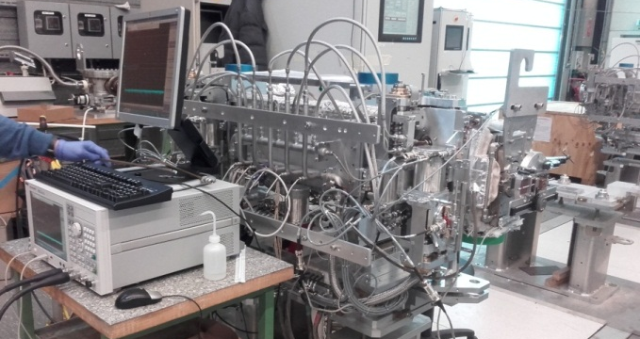
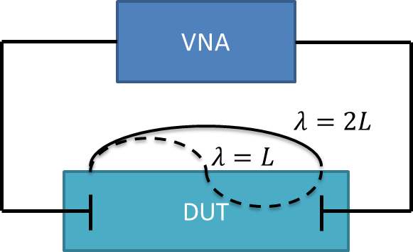
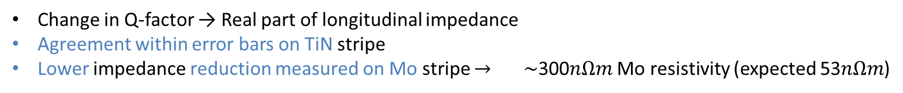
Bench RF measurements suggest the importance of the microstructure
Resonant wire measurement setup
DUT
Change in Q-factor → Real part of longitudinal impedance
Agreement within error bars on TiN stripe
Lower impedance reduction measured on Mo stripe $→$ $\sim$300$nΩm$ Mo resistivity (expected 53$nΩm$)
N. Biancacci, et al., IPAC’18

Slide 24
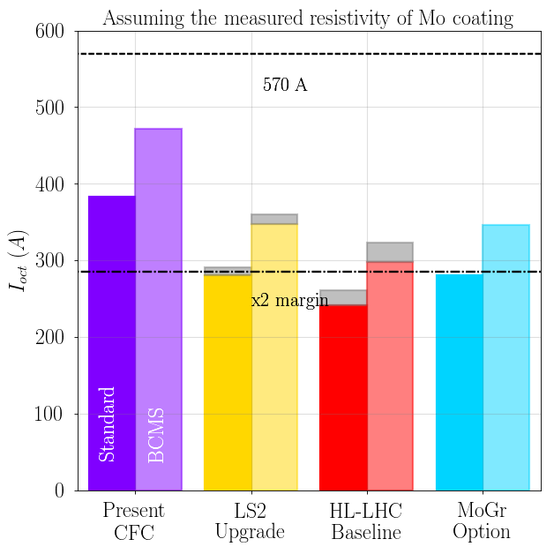
Impact of higher than expected Mo resistivity
Assuming measured Mo resistivity (250 vs 54 n$Ω$-m): 25 (20) A reduction in margin for BCMS (Standard) beam

Slide 25
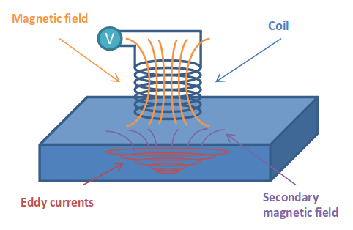
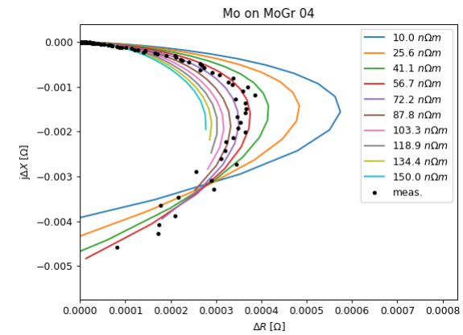
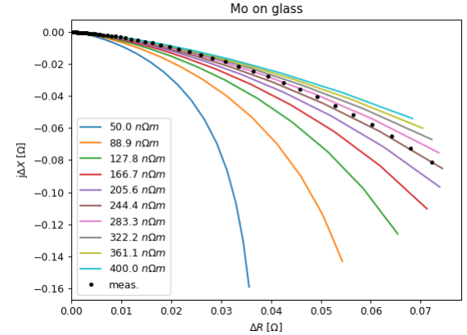
Latest Mo-coated samples show good electrical conductivity
Eddy current measurement is required to qualify the coating
  DC not enough – not ‘beam’ frequency, does not account for surface roughness
Newer coatings show 60-70 nΩ-m
Some (older ones) feature up to 300 nΩ-m
N. Biancacci, Update on Mo coating resistivity, 18.05.18

Slide 26
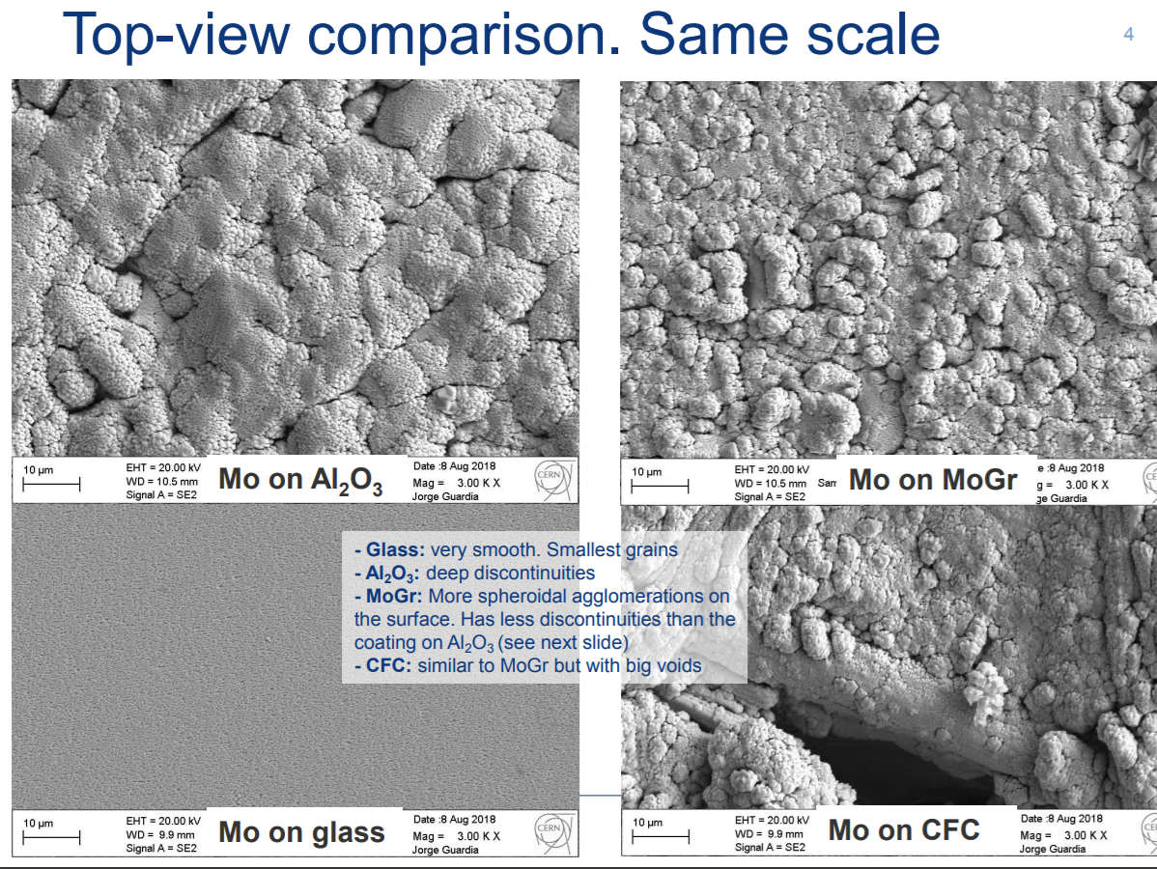
The increase in Mo resistivity is likely to be governed by its microstructure
J. Guardia, Impedance Meeting, 24.08.18

Slide 27
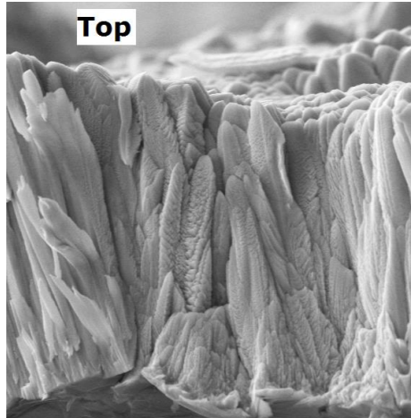
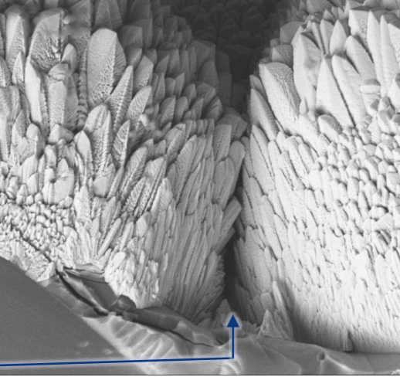
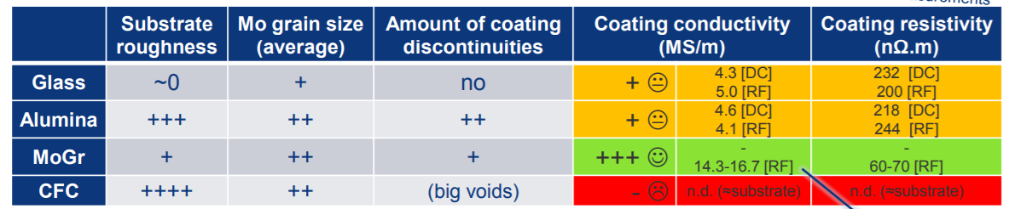
The increase in Mo resistivity is likely to be governed by its microstructure
The larger the better
The less the better
J. Guardia, Impedance Meeting, 24.08.18

Slide 28
Propose to set the limit for production such that a degradation of the octupole current is < 10%
Cu
Cu (TDIS)
Mo
Mo (TCSPM)
MoGr
Limit for production
CFC
Resistivity (nΩ-m)

Slide 29
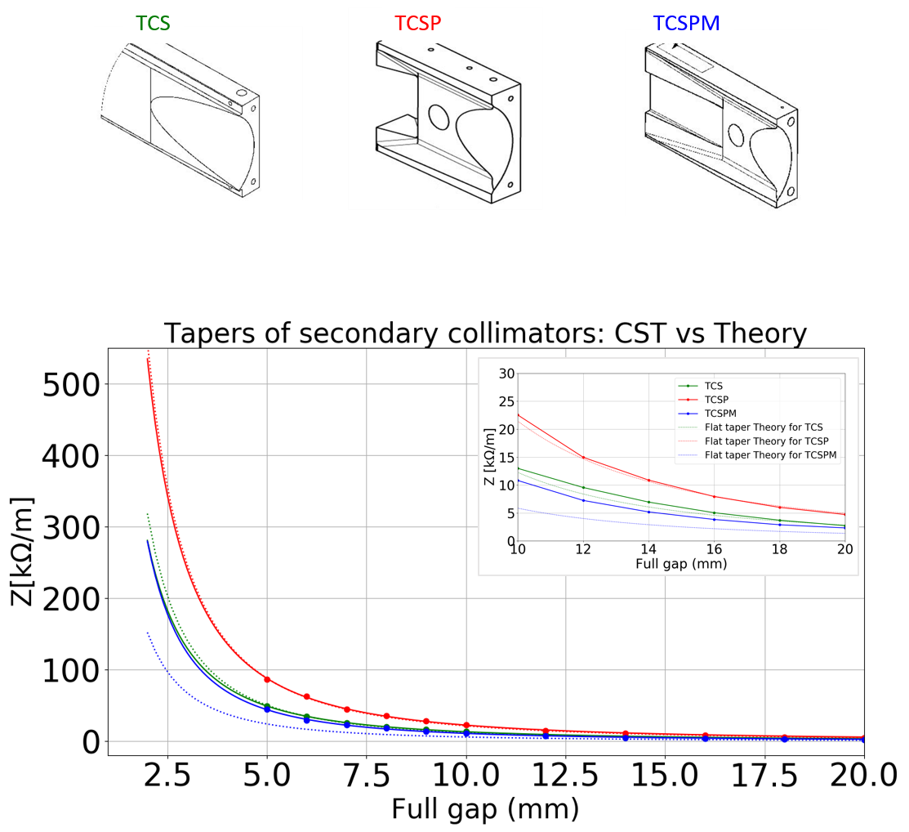
Changes in geometric impedance:
New taper geometries
TCS | TCSP | TCSPM
11,6° | 16°, 16,5° | 16,5°, 5°
97 mm | 37 mm, 27 mm | 36 mm, 80 mm
Optimized for Imp.
This is the only geometry in the model at the moment
Simulated as a broadband flat taper impedance
E. Carideo

Slide 30
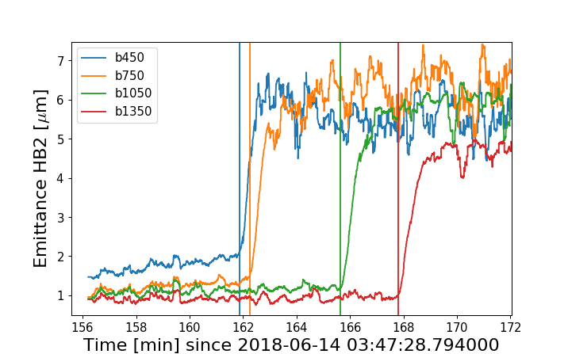
Noise triggers an instability with high latency time at Flat-Top
Increasing noise amplitude

Slide 31
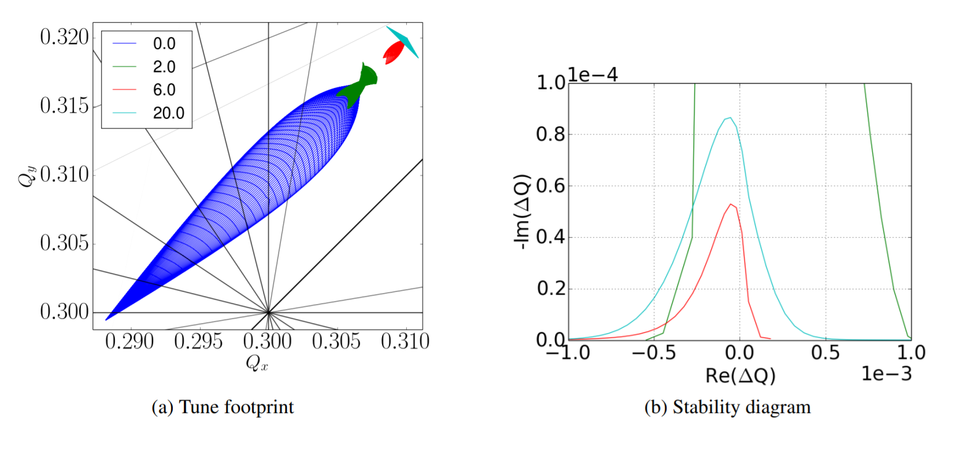
Stability diagram collapses as the beams are brought into collision
Minimum at a certain beam separation
Predicted theoretically and observed in a dedicated MD
Octupole
Beam-beam
X. Buffat et al., CERN-ACC-NOTE-2018-0036, 2018

Slide 32
Conclusions
IR-7 primary and secondary collimators are the right target for impedance reduction
  From the past operational experience, a x2 margin in octupole threshold is required
  Mo coating on MoGr offers the largest reduction of impedance and octupole current in HL-LHC
  For the ultimate scenario one gains up to 150 A (BCMS beam) by coating all the secondaries in IR-7
  Additional 30 A (BCMS) can be gained by replacing the 2 primary collimators with MoGr
  1/2 the gain with LS2 upgrade (2 primary + 4 secondary) or with uncoated MoGr secondaries
A collimator resistive wall component of the octupole threshold scales as ρ^{-1/2}
  Coating provides a large gain
  Only for the collimators that are close to the beam; further away – the taper geometry plays a role
In a realistic accelerator the scaling is worse than ρ^{-1/2}
  Other sources of impedance: beam screen, tapers, etc. Act on 50% of effective beam impedance
  At small resistivities, a further reduction is less effective
  Can set a limit of 100 nΩ-m for the production Mo coatings

Slide 33
Back-up

Slide 34
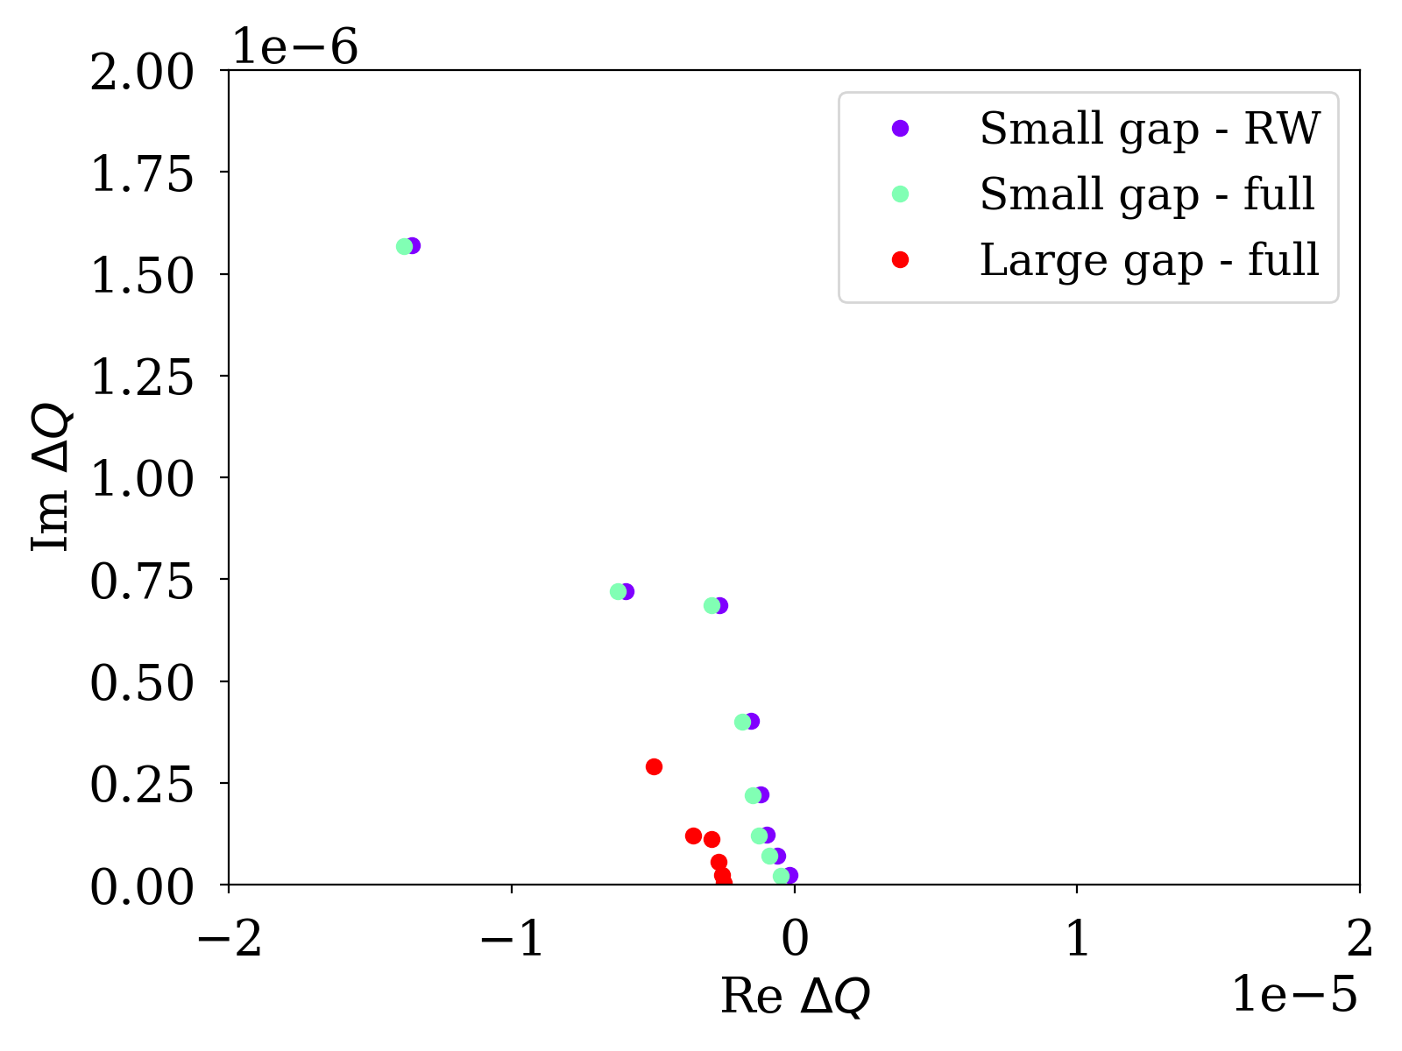
Stability diagram: 1 Collimator
RW
Geom

Slide 35
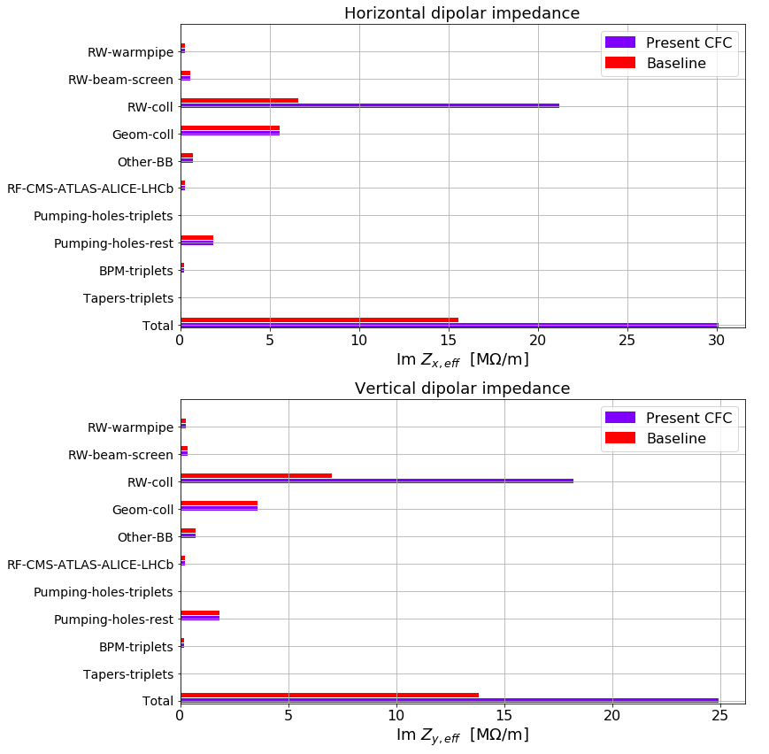
Geometric component of collimator tapers is comparable to resistive wall after the upgrade

Slide 36
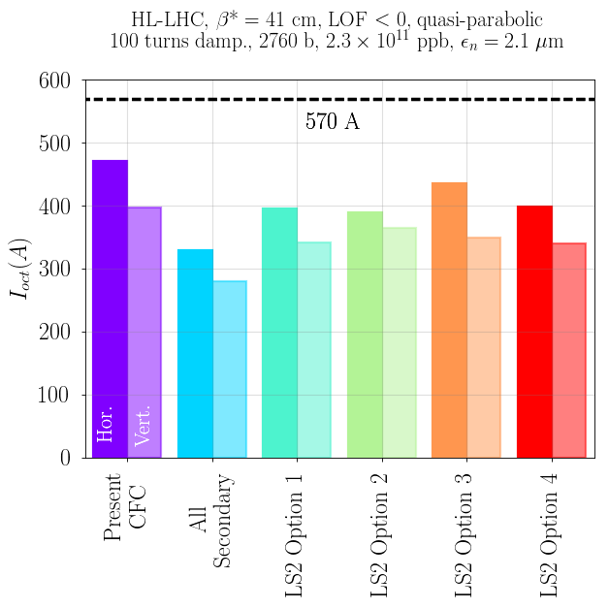
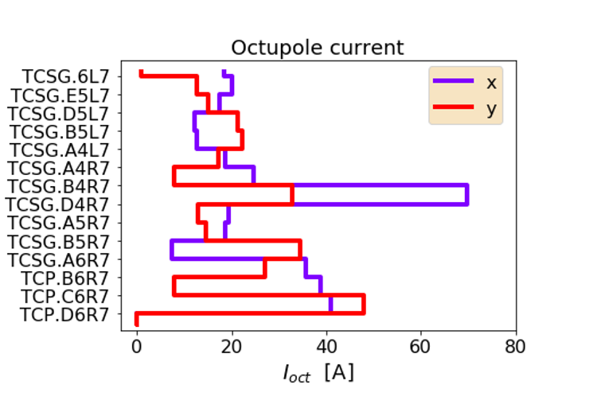

Staged installation of low impedance collimators in LS2:
Maximizing reduction in the most critical, horizontal plane
$$I_{oct}^{max}$$
  Impedance reduction
  Injection/extraction failure events or asynchronous dumps
  Steady exposure to beam losses

Slide 37
Fitting the taper impedance:
$$Z[Omh/m]=A∗{g[m]}^{−α}$$
Name | A | α
TCS | 2,07*10⁻³ | 1.9
TCSP | 2,57*10⁻³ | 2.0
TCSPM | 1,02*10⁻³ | 2.0
The model can be used to refine the prediction for HL-LHC
Work ongoing
E. Carideo

Slide 38
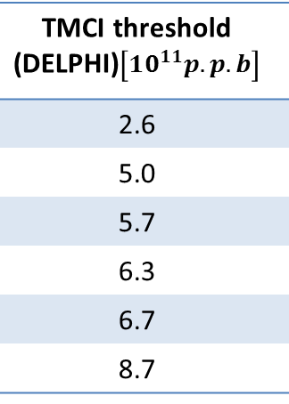
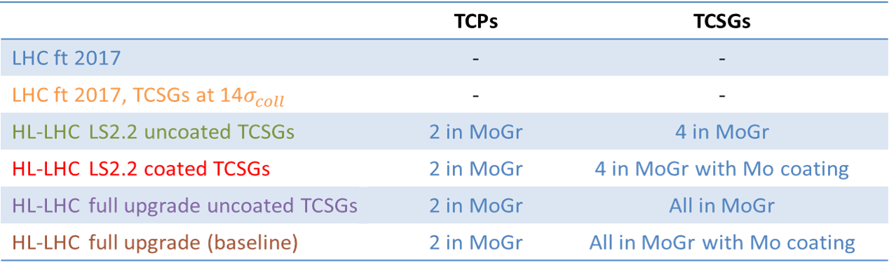
TMCI Threshold for different coating scenarios
Simulated
Measured
Simulated
Looser settings
D. Amorim

Slide 39
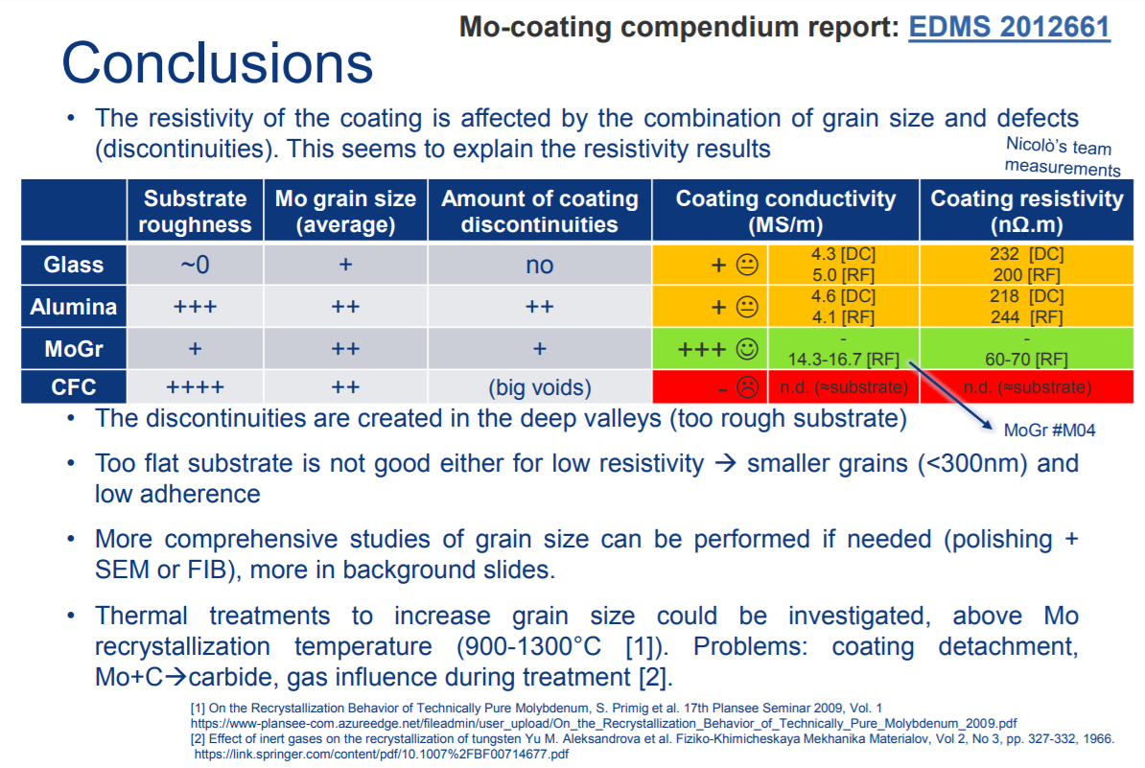
J. Guardia

