Slide 1

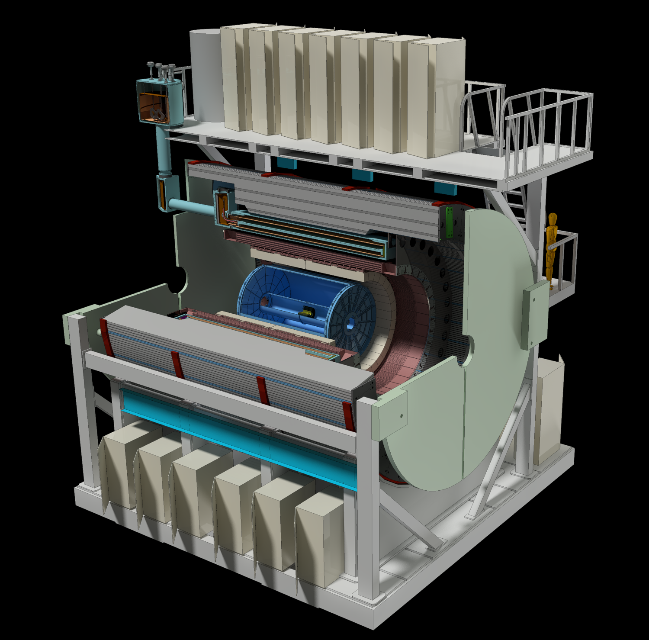
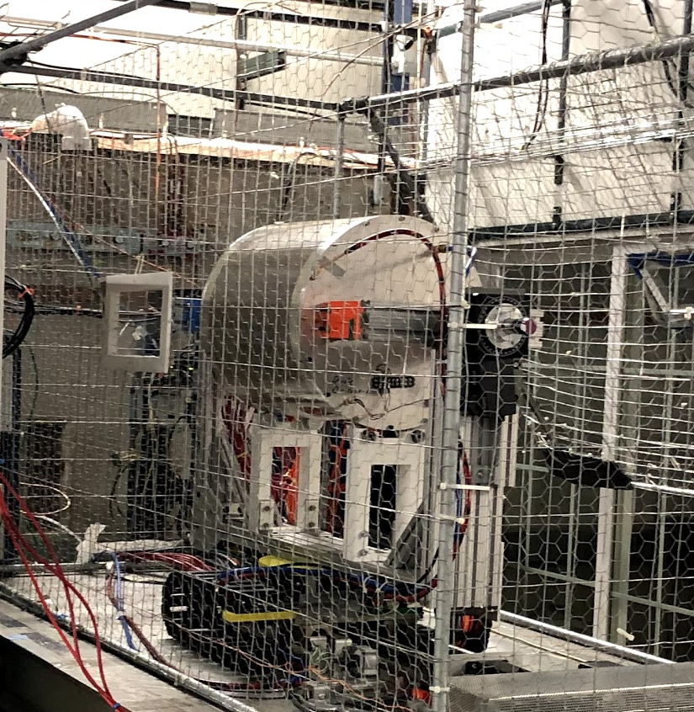
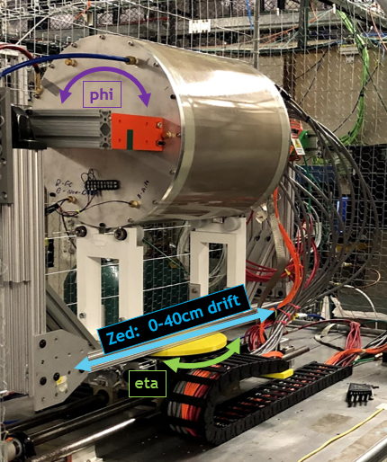
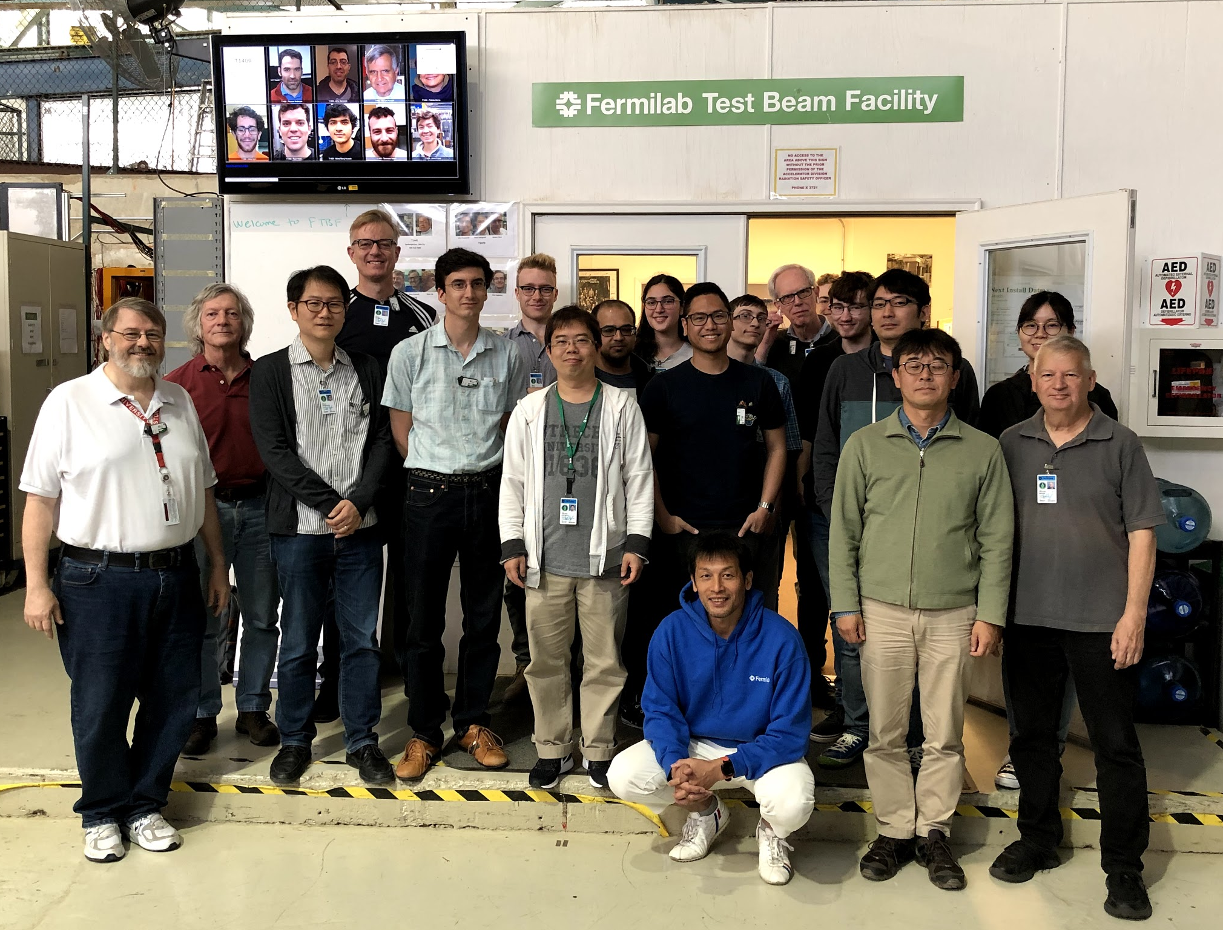
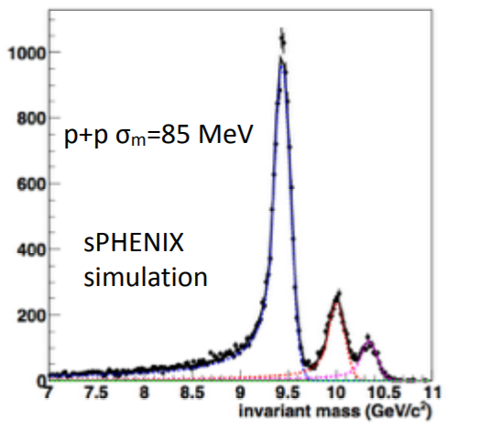
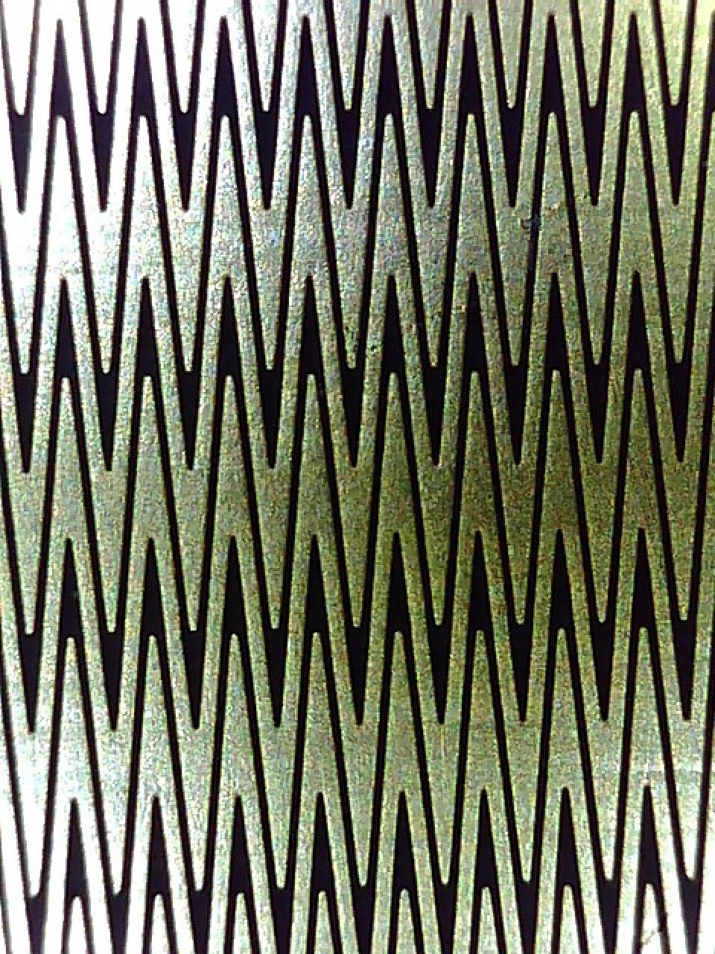
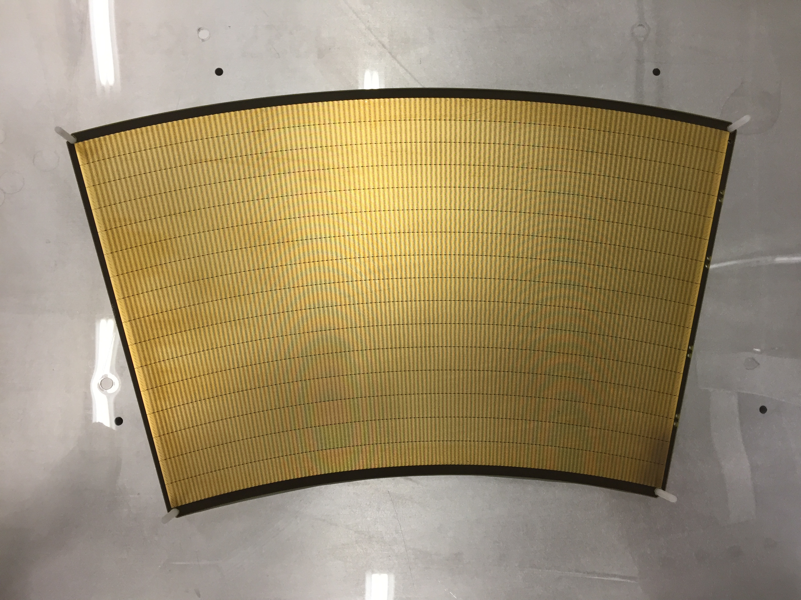
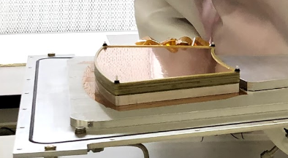
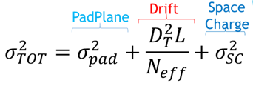
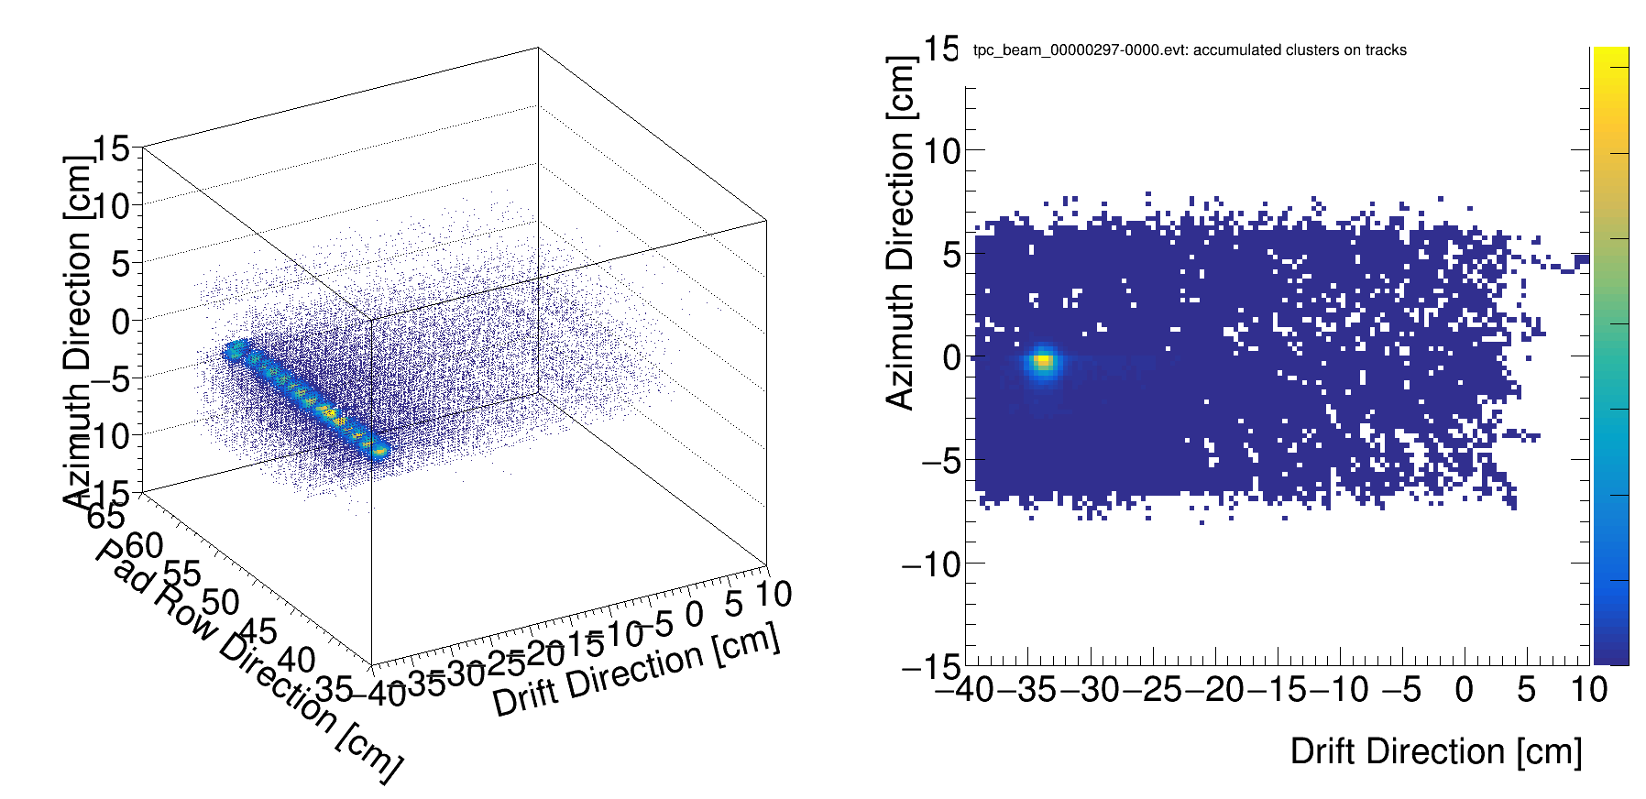
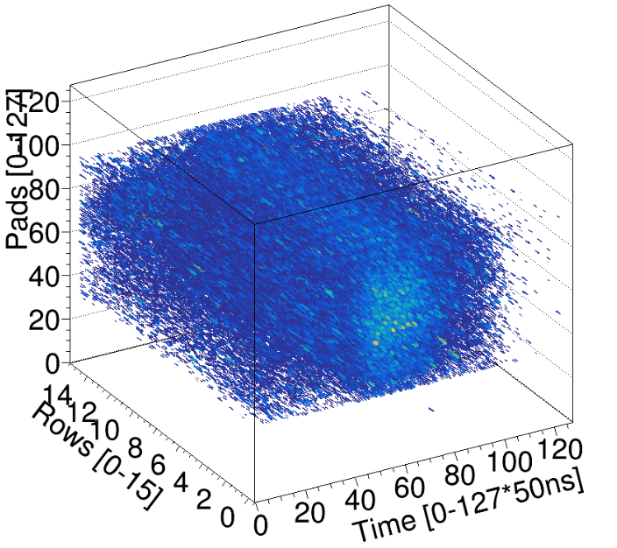
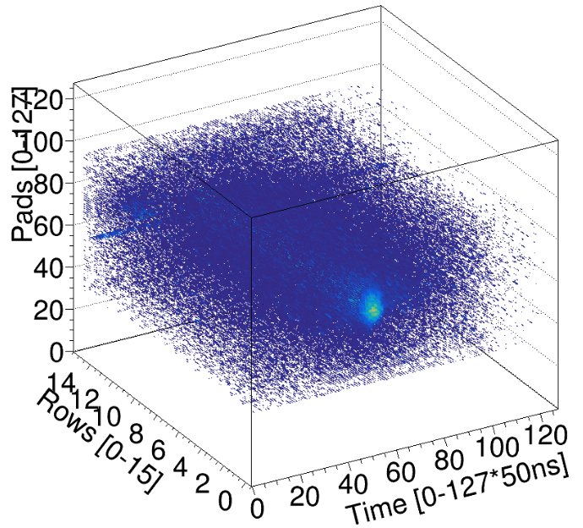
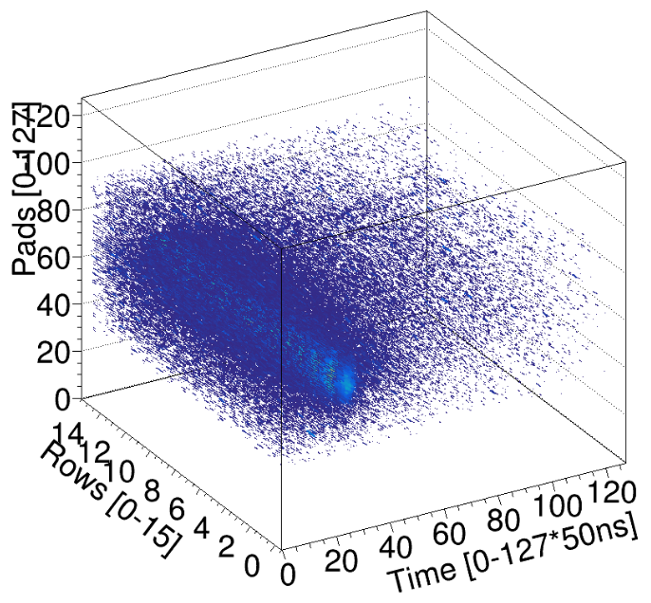
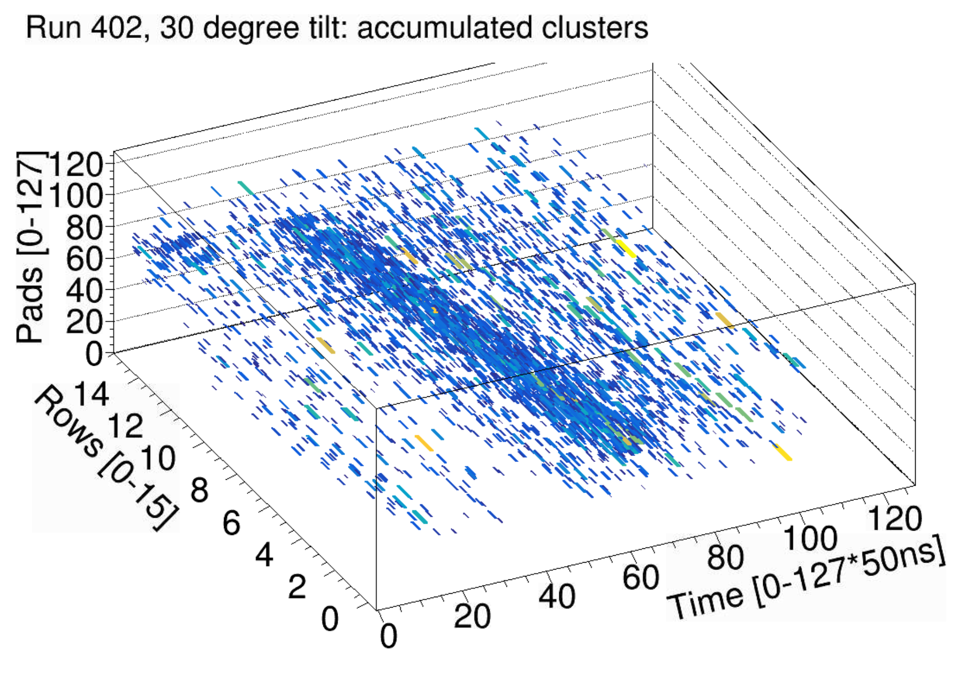
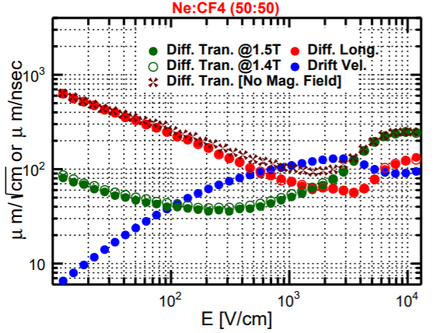
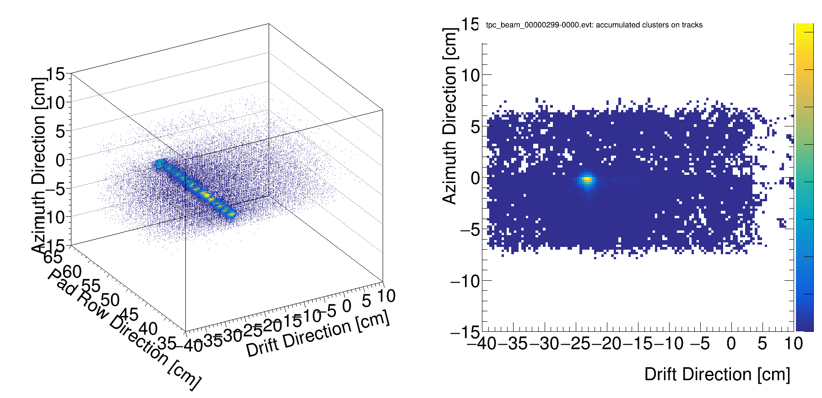
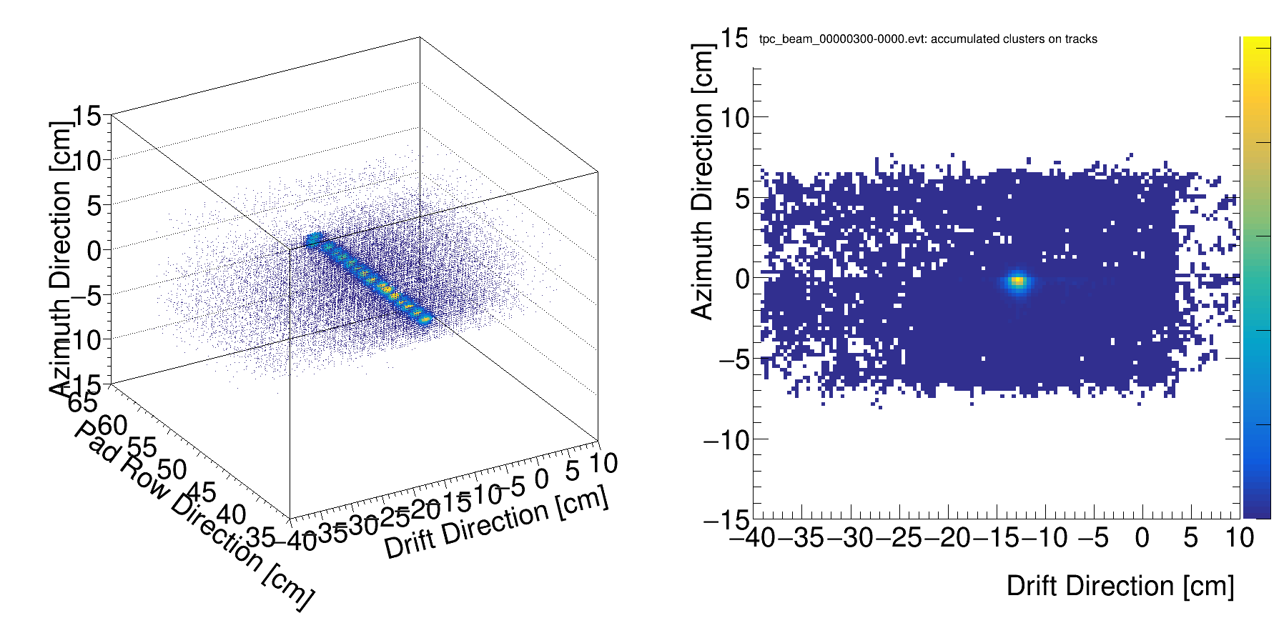
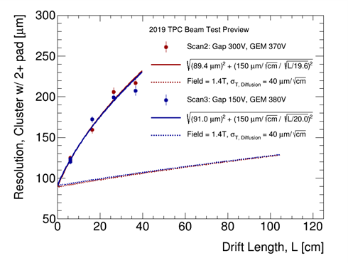
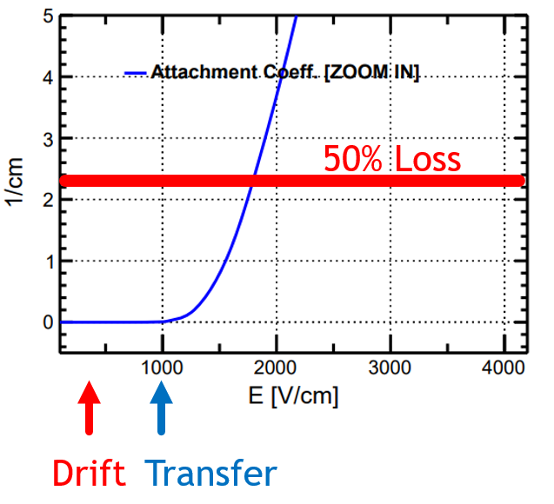
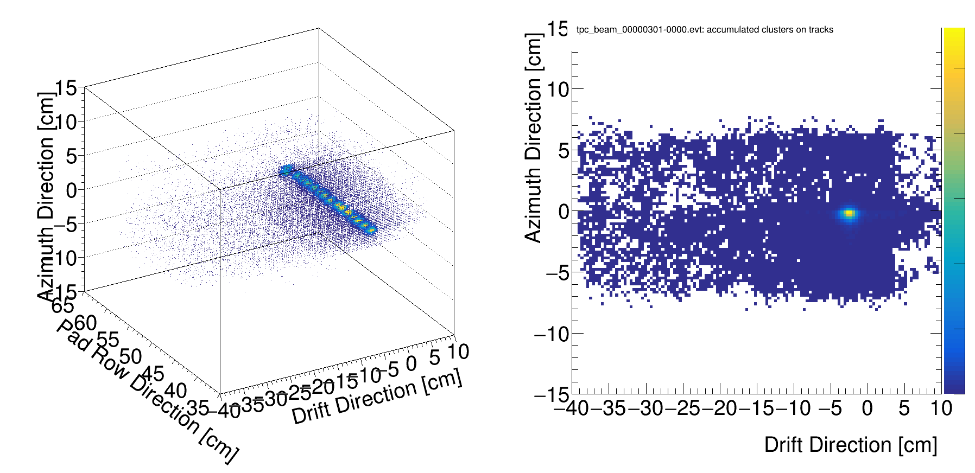
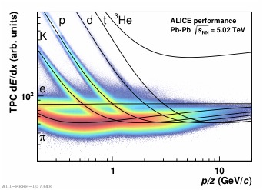
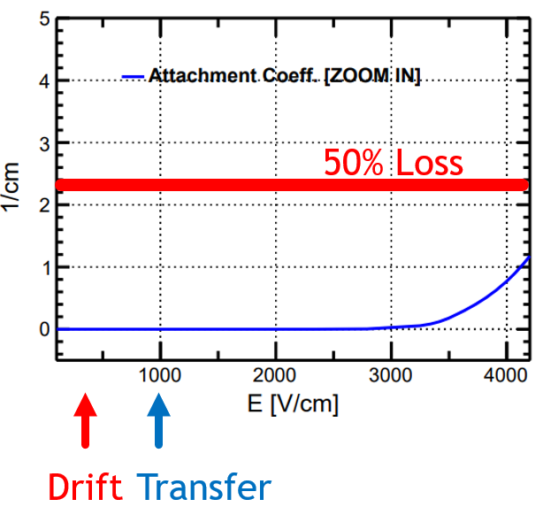
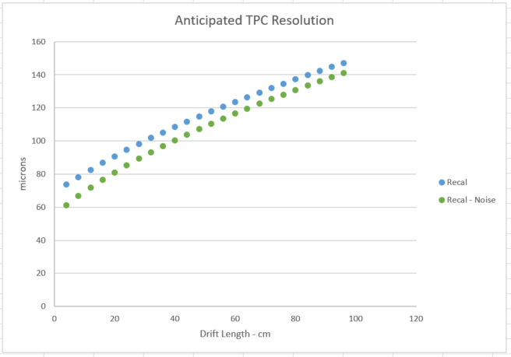
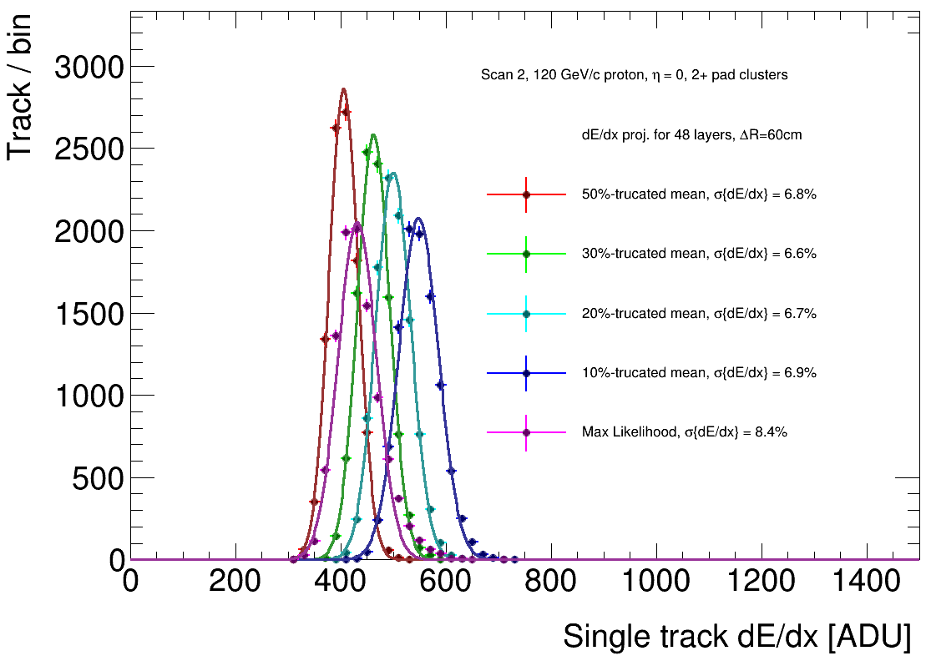
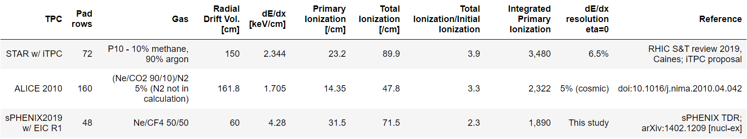
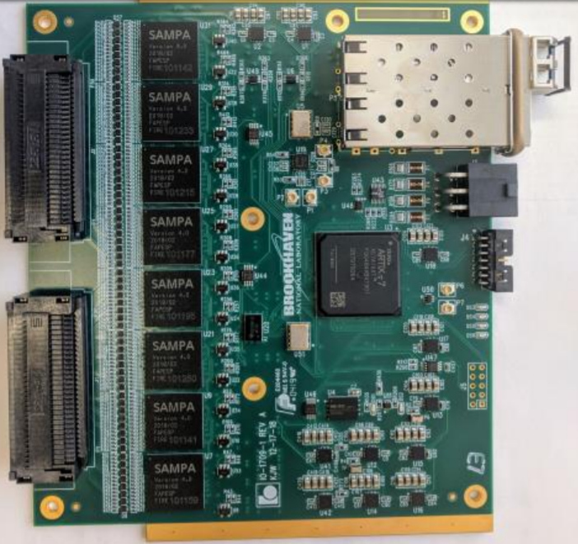
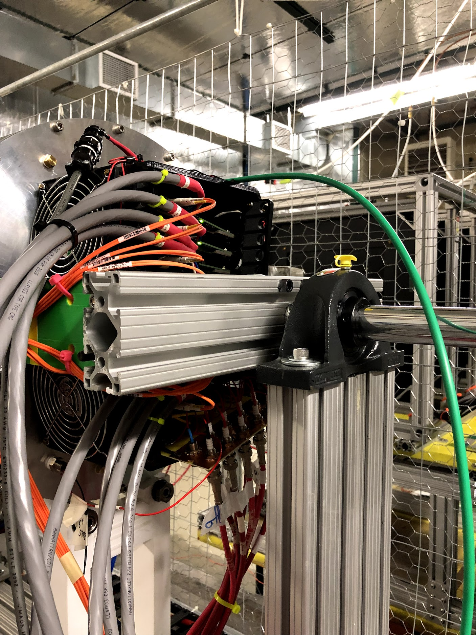
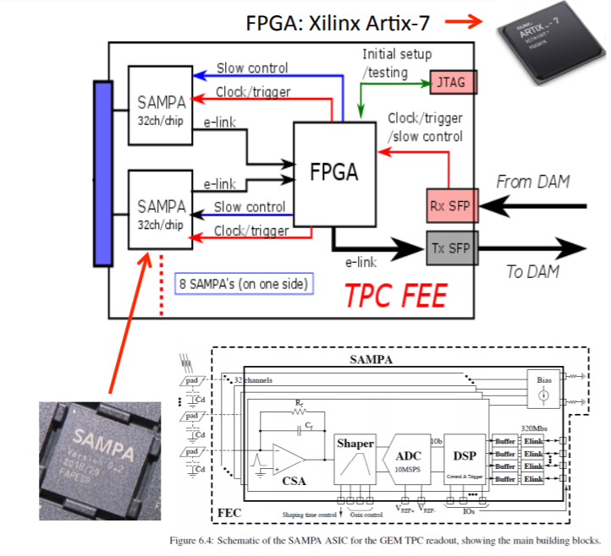
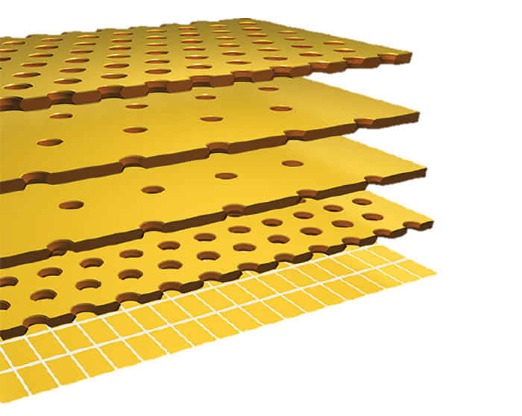
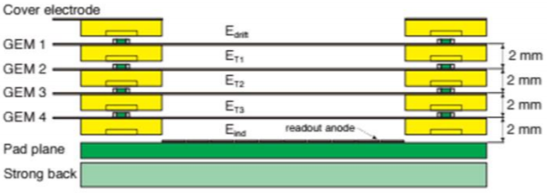


Test Beam Results for the sPHENIX TPC Prototype
Henry Klest, for the sPHENIX Collaboration
Department of Physics and Astronomy,
Stony Brook University, SUNY, Stony Brook, New York 11794-3800, USA
Abstract
A Time Projection Chamber (TPC) will be the central tracking detector in the sPHENIX experiment. Its main task is to provide a high tracking efficiency and excellent momentum resolution for precise upsilon spectroscopy and jet measurements. The TPC will cover the full azimuth and a pseudorapidity range of up to |η| < 1.1.
A small-scale prototype TPC with a radial extension of 40 cm and a similar drift length has been manufactured which can accommodate a full-size amplification module as for the sPHENIX TPC. The prototype has been exposed to a 120 GeV proton beam at the Fermilab Test Beam Facility (FTBF). The results of the test-beam campaigns including SAMPA readout electronics will be presented.
2019 sPHENIX TPC Test Beam
Test Beam Goals
Demonstrate stable operation of GEMs in low ion backflow mode, sPHENIX requires <1%
Test almost final frontend electronics
Explore Ne:CF4 50/50 mixture
Maintain or improve spatial resolution
The Prototype TPC
sPHENIX Prototype TPC
TPC surrounded in safety cage due to exposed 20kV cathode
Mylar window for beam
TPC
40 cm long, one-sided TPC
Exposed to 120 GeV protons at Fermilab Test Beam Facility
400 V/cm drift field
Ne:CF4 50/50 gas mixture
Single module, 1/36 of an endcap
Quad-GEM with zig-zag pads
Moving stage allows for movement simulating tracks inclined in z,η,φ
No magnetic field, realistic momentum resolution requires extrapolation
Free parameters: GEM voltages, cathode voltage, gas mixture, TPC position, beam species
Drift
Several GEM voltage configurations tested for low IBF (<.5%) on tabletop at Yale were implemented successfully
Beam Exits
Low Ion Backflow modes were stable
FEE performed acceptably
Spatial resolution improved
dE/dx resolution measured for the first time, much better than expected, sPHENIX TPC could be used for PID
Identical setup to Summer 2018 test beam allows for performance comparison of gas mixtures and voltages
Spatial Resolution
sPHENIX physics goals require spatial resolution < 200 µm from TPC
sPHENIX magnet will provide ~1.4T
Measurement of resolution as a function of drift length in prototype TPC requires extrapolation to value with magnetic field
Ne:CF4 50/50 provides a significant improvement over 90/10, likely due to reduced electron attachment
10K high multiplicity events from shower in lead block
10K events with TPC inclined 10° in φ
10K events with 6 cm drift length
Several events with TPC inclined 30° in η
Summer 2019 Results
dE/dx Resolution
“Particle identification performance at ALICE” - ALICE Collaboration
Ne:CF4 (90:10)
Measuring the energy loss for different particle species enables particle identification in a TPC, critical measurement for EIC
sPHENIX TPC is compact, covers 20 < r < 78 cm
dE/dx measurements generally use long baseline: STAR radial drift volume 150 cm, ALICE 162 cm
Due to large ratio of primary ionization to total ionization, CF₄ enables high dE/dx resolution in a smaller TPC
Ne:CF4 (90:10)
Series of events at different drift lengths used to determine spatial resolution as a function of position
Extrapolate
GEM fringe fields?
Definite improvement over summer 2018 results!
~130 at 1m
Ne:CF4 (50:50)
~145 at 1m
Meas <114>
Resolution [μm]
Limit <106>
Readout Electronics
sPHENIX needs to run in low IBF configuration due to high rate and occupation, makes dE/dx more difficult, but for EIC IBF is not as large of a concern
Projection of test beam data to full TPC provides a possible dE/dx resolution of σ = 6.6%
sPHENIX TPC is a capable day-one detector for EIC!
  Continuous readout via 8 SAMPA per front-end card
  8 FEE cards for prototype TPC
  256 Channel SAMPA Optical readout
3D printed cradle contains 8 cards, 2048 total channels
Low Ion Backflow Configurations
Fiber Optic Transmission Lines
Space charge from ions in the avalanche can significantly distort the electric field lines
MPGDs such as GEMs and Micromegas can reduce the amount of ion backflow below 1%
The IBF of several configurations of voltages on individual GEM layers was tested at Yale
These configurations were then implemented in the prototype TPC
Voltages on GEM tops and bottoms could be tuned remotely during a run
All low IBF configurations were stable with no sparking
Passive gating grid has potential to further reduce IBF (See Poster by P. Garg)
  Prototype employs almost-final FEE
  80 ns peaking time required for sPHENIX
  SAMPA v5 coming soon!
  Streaming readout performed well, aside from some event chopping issues
Quadruple GEMs as implemented by ALICE
(R. Majka, “The ALICE TPC Upgrade Project”, Quark Matter 2017, Feb. 8 2017)
IBF % No Passive Gating Grid | 0.44% | .39% | .33% | .31%
IBF % With Grid | .22% | .2% | .17% | .16%
GEM1 Top | 4208V | 4658V | 5124V | 5118V
GEM1 Bot | 3951V | 4401V | 4851V | 4861V
GEM2 Top | 3051V | 3351V | 3651V | 3661V
GEM2 Bot | 2721V | 3021V | 3321V | 3342V
GEM3 Top | 1821V | 1971V | 2121V | 2142V
GEM3 Bot | 1409V | 1559V | 1709V | 1709V
GEM4 Top | 1379V | 1529V | 1679V | 1679V
GEM4 Bot | 900V | 1050V | 1200V | 1200V
Structure of TPC Front-end electronics
GEM Voltage Configurations With IBF Properties Tested at Yale

