Slide 2
Outline
LS1 consolidation & Post-LS1 recommissioning
Power converter performance & evolution during Run 2
  IPD, IPQ, IT
  LHC600A
  LHC120A
  LHC60A
  Others…
LS2 activities, impact on recommissioning & operations

Slide 3
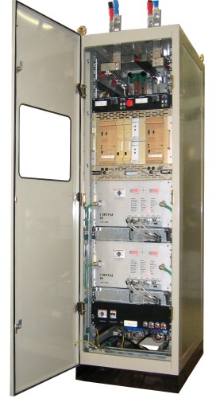
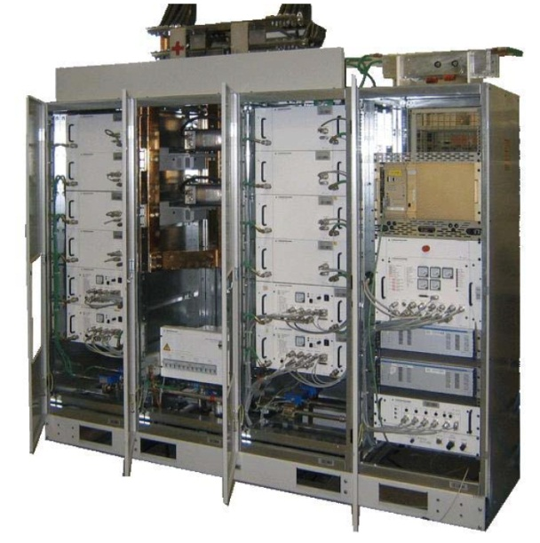
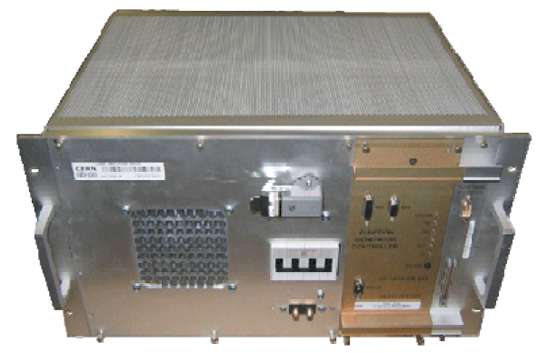
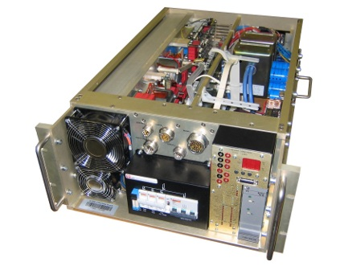
LHC Power Converters
Typical use | Type | Current | Voltage | Location | Quantity
Main Dipoles | RPTE | 13kA | 180V | UA | 8
Main Quads | RPHE | 13kA | 18V | UA | 16
IPD, IPQ, IT | RPHx | 4-6-8kA | 8V | RR UA/UJ | 189
600A Multipole correctors | RPMBx | 600A | 10V | RR/UL UA/UJ | 400
Orbit correctors | RPLB | 120A | 10V | RR/UL UA/UJ | 290
Orbit correctors | RPLA | 60A | 8V | ARC | 752
Saturn_2s | RPADO | 850A | 700V | SR | 4
RPMC 600A-40V | RPMC | 600A | 40V | UJ/TZ | 37
Other warm circuits | RPTx |  |  | UA/UJ/TZ | 26
Σ |  |  |  |  | 1722
≈1050 in LHC radiation areas

Slide 4
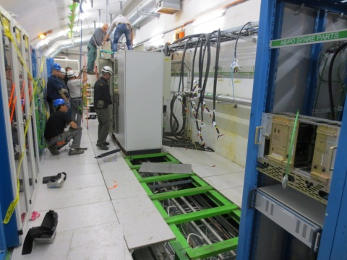
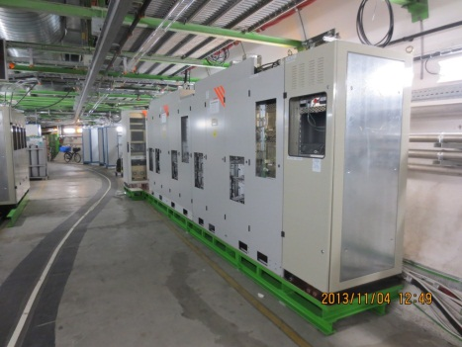
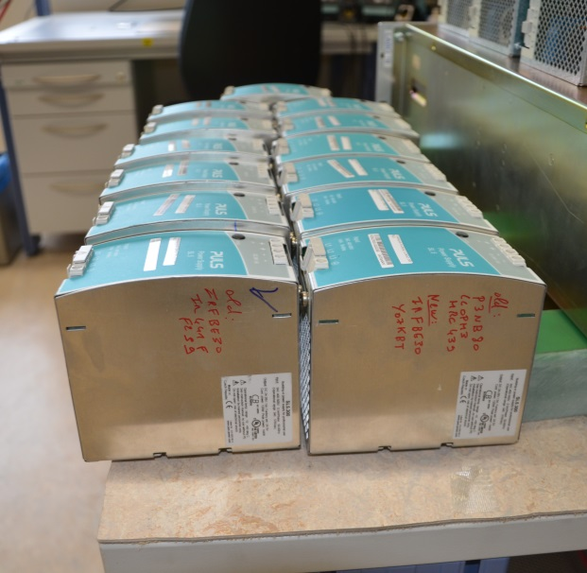
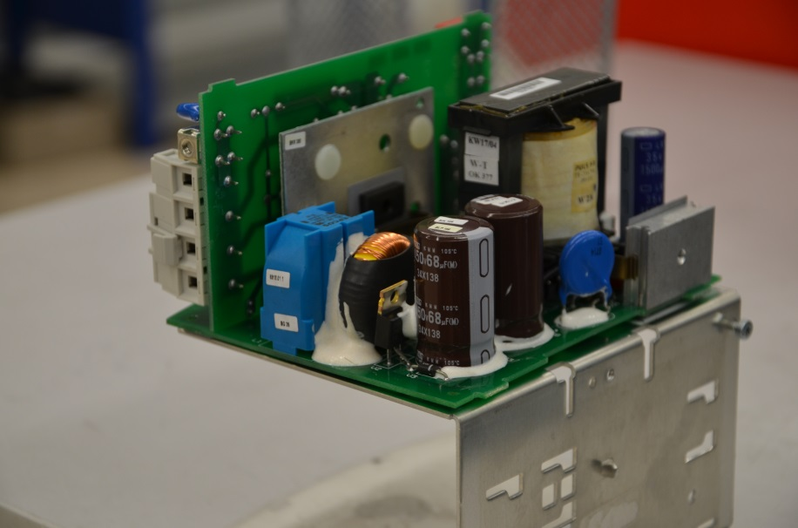
LS1 Consolidation: R2E project
Decrease exposure to radiation as a Single Event Effect mitigation
Relocation of power converters from UJ to UL14/16, UL557, TZ76
Enhanced shielding in the RRs in P1, P5 & P7
System consolidation: LHC600A-10V Converters
Auxiliary Power Supply : Single Event Effect mitigation
Montabonnet, Chamonix’16

Slide 5
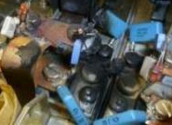
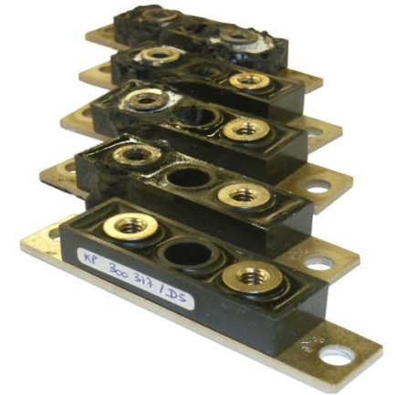
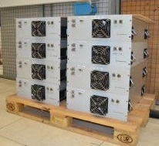
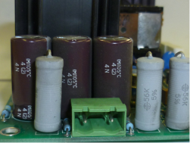
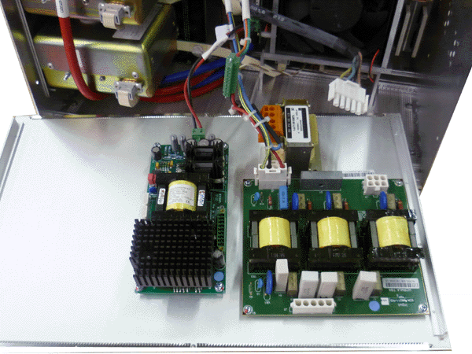
LS1 Consolidation
IPD/IPQ and RQD/RQF converters
Output module consolidation due to diode case reliability issue and improvement of the thermal environment for a better reliability at 7TeV (full current)
LHC60A-08V converters
Consolidation of the Auxiliary Power Supply due to capacitor ageing
Montabonnet, Chamonix’16

Slide 6
Recommissioning Post-LS1
Short-circuit tests on converters that were relocated
New water-cooled DC cabling & their resistance.
DC cables short-circuited at the DFB to test
power converter performance, full cabling and ventilation
Impact on the Hardware Commissioning (HWC)
All power modules and changes on the Auxiliary Power Supplies were tested
in the A7 EPC test zone then re-tested during the HWC.
No major issues were reported.

Slide 7
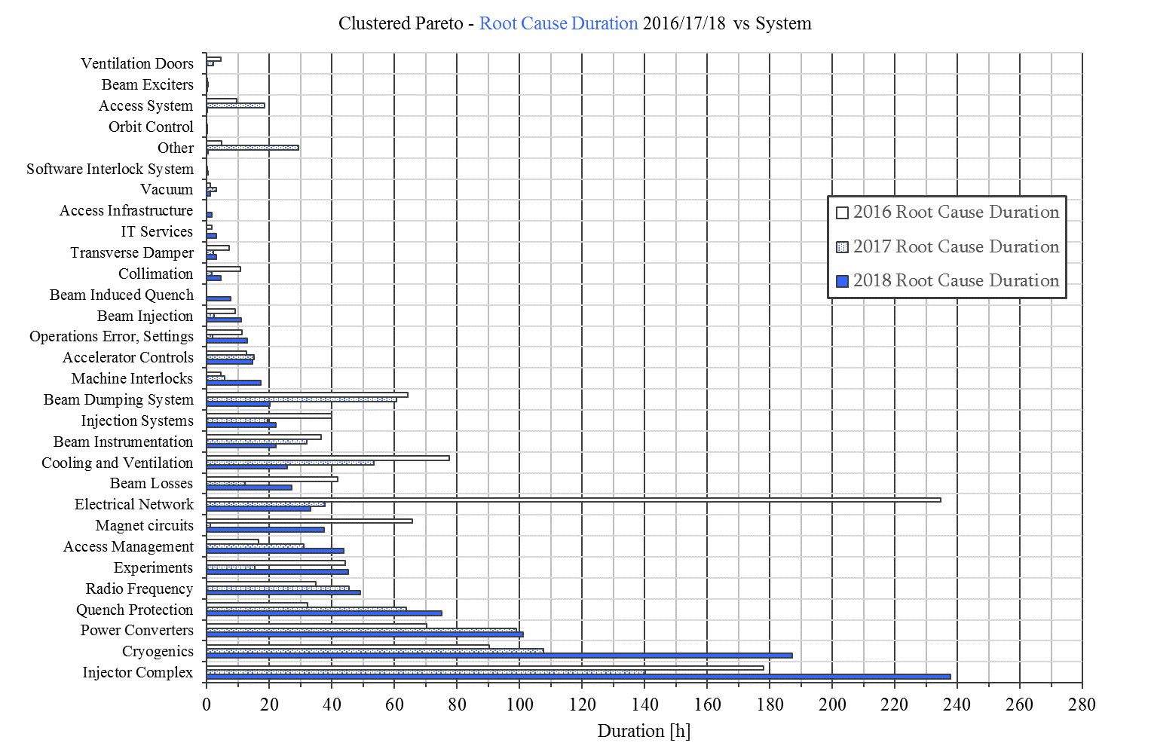
Converter performance: Run2
 | 2015 AFT no check | 2016 | 2017 | 2018
Faults in AFT | 99 | 75 | 109 | 107
Downtime in AFT | 112h | 76h | 99h | 101h
2017 | Increased R2E-related failures in RRs (TCL6 closed) Big impact intervention on RB.A12 PC (20h)
2018 | R2E-related failures in RRs (TCL6 open)

Slide 8
Converter performance: Run2
Montabonnet, Chamonix’16
Romera, Evian’17
 |  | 2015 |  | 2016 |  | 2017 |  | 2018
Converter type | Qty | Faults | R2E Power/controls | Faults | R2E Power/controls | Faults | R2E Power/controls | Faults | R2E Power/controls
RPMBx - LHC600A | 400 | 38 | - / 1 | 45 | 4 / 3 | 44 | 3/2 | 43 | 6 / 2
RPHx - IPD, IPQ, IT | 189 | 12 | - / - | 10 | 1 / 1 | 6 | -/ - | 8 | - / -
RPLB - LHC120A | 290 | 15 | 2 / 1 | 9 | - / 1 | 8 | - / 5 | 8 | - / 3
RPLA - LHC60A | 752 | 5 | - / 5 | 4 | - / - | 10 | - / - | 2 | -/ -
RPTE - Dipole | 8 | - |  | 3 |  | 7 |  | 4
Saturn_2s | 4 |  |  |  |  | 3 |  | 2
RPMC 600A-40V | 37 | 4 |  | 4 |  | 3 |  | -
Other warm circuits | 26 | ~10 |  | 2 |  | 2 |  | 13
 | Σ | 84 | 10 | 77 | 10 | 83 | 10 | 81 | 11
FGClite deployment
ARC, EYETS’16-17
FGClite & PC deployment
RRs, LS2
FGClite & PC deployment
RRs, LS3: HL-LHC-(60-120)A-10V
The table covers the faults from EPC DB impacting machine availability
No events recovered in the shadow are analysed e.g. 600A trips during the ramp down

Slide 9
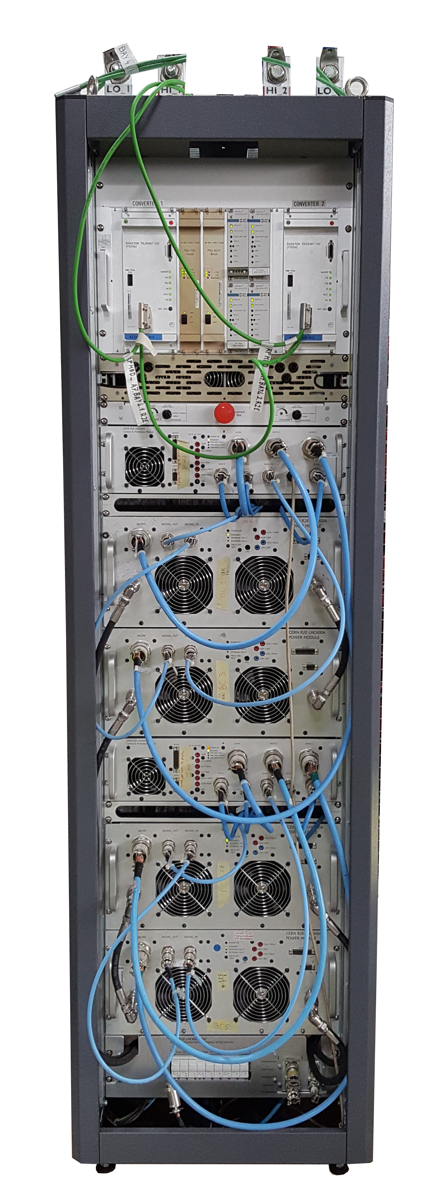
Converter performance: RPMBx - LHC600A
 |  | 2015 |  | 2016 |  | 2017 |  | 2018
Converter type | Qty | Faults | R2E Power/controls | Faults | R2E Power/controls | Faults | R2E Power/controls | Faults | R2E Power/controls
RPMBx - LHC600A | 400 | 38 | - / 1 | 45 | 4 / 3 | 44 | 3/2 | 43 | 6 / 2
FGClite & R2E-LHC600A will be deployed in all RRs (120x)
R2E failures will be addressed by the FGClite and a new rad-tol converter
It is expected that an infant mortality problems might decrease the overall availability
in the first weeks of operation Post-LS2
Consolidation in UA/UJ during LS2 (280x)
Least reliable converter and with the highest impact on availability.
2018 Failure mode diagnosis and consolidation in UJ/UA locations
studies on-going to improve its reliability.
Consolidation request for the rest of 280x during LS3 (?)

Slide 10
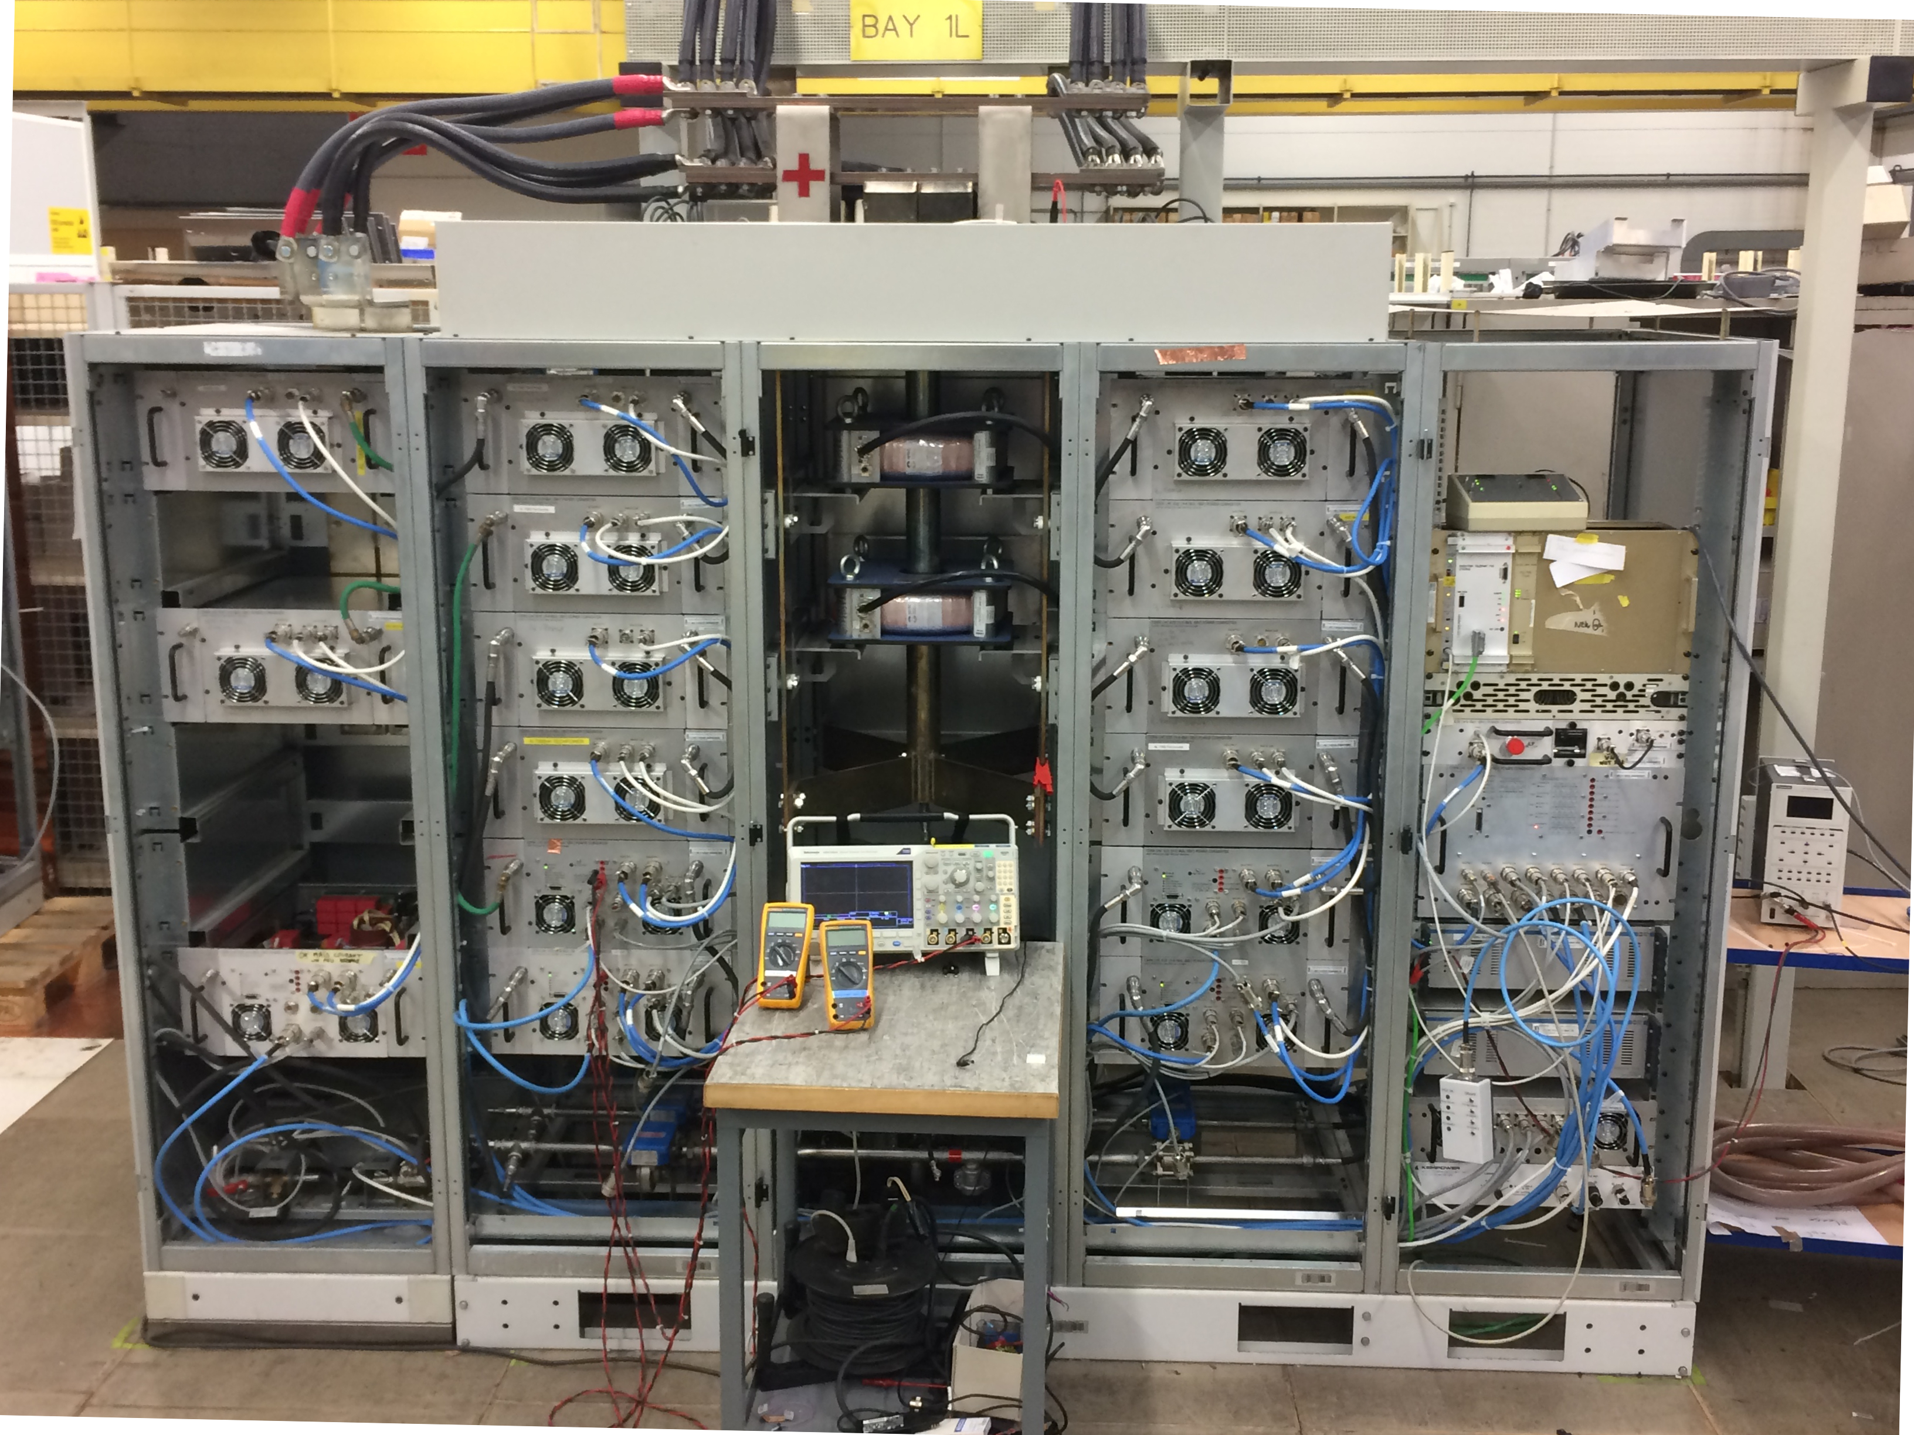
Converter performance: RPHx - IPD, IPQ, IT
 |  | 2015 |  | 2016 |  | 2017 |  | 2018
Converter type | Qty | Faults | R2E Power/controls | Faults | R2E Power/controls | Faults | R2E Power/controls | Faults | R2E Power/controls
RPHx - IPD, IPQ, IT | 189 | 12 | - / - | 10 | 1 / 1 | 6 | -/ - | 8 | - / -
FGClite & R2E-LHC4-6-8kA will be deployed in all RRs (64x)
R2E failures will be addressed by the FGClite and a new rad-tol power modules
It is expected that an infant mortality problems might decrease the overall availability
in the first weeks of operation Post-LS2
High Reliability of the Power Converter (125x)
No action required during the LS2

Slide 11
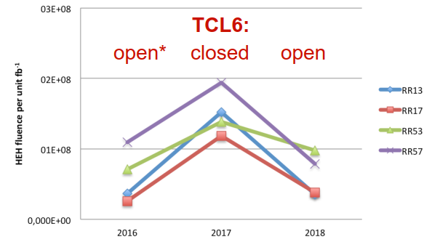
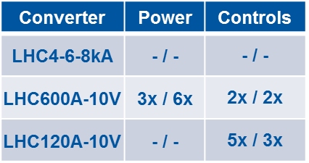
Rad-levels in RRs
Radiation levels in RRs in P1 & P5 dependency on TCL6 settings
R2E failures 2017 vs. 2018
Reduction of ~4x for IP1 & ~2x for IP5 in 2018 vs. 2017 but increase in P7 due to betatron losses.
The ARC rad-levels increased due to open TCL6 impacting MPE equipment in DS (increase in cell8).
From the R2E perspective: preferable post-LS2 configuration will be TCL6 closed, owing to radiation hardness of RR EPC equipment.

Slide 12
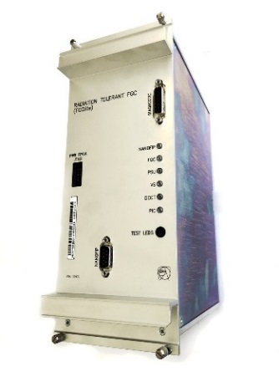
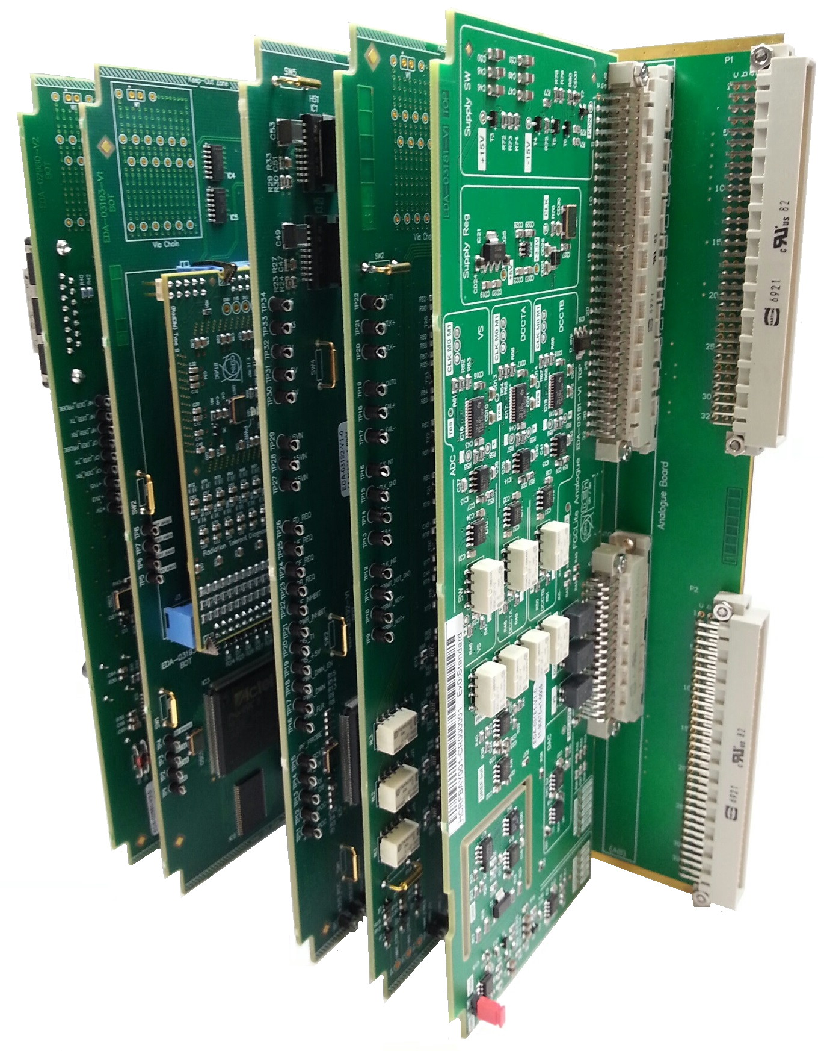
Converter performance: RPLB - LHC120A
 |  | 2015 |  | 2016 |  | 2017 |  | 2018
Converter type | Qty | Faults | R2E Power/controls | Faults | R2E Power/controls | Faults | R2E Power/controls | Faults | R2E Power/controls
RPLB - LHC120A | 290 | 15 | 2 / 1 | 9 | - / 1 | 8 | - / 5 | 8 | - / 3
FGClite will be deployed in all RRs (102x)
R2E failures will be addressed by the FGClite.
High Reliability of the Power Converter (188x)
No action required during the LS2.
Consolidation of the power part will be done during the LS3.

Slide 13
Converter performance: RPLA - LHC60A
 |  | 2015 |  | 2016 |  | 2017 |  | 2018
Converter type | Qty | Faults | R2E Power/controls | Faults | R2E Power/controls | Faults | R2E Power/controls | Faults | R2E Power/controls
RPLA - LHC60A | 752 | 5 | - / 5 | 4 | - / - | 10 | - / - | 2 | -/ -
FGClite deployment lessons learnt
Commissioning of the FGClite after EYETS’16-17 was complicated due to the Post Mortem tool interfaces.
Known SW integration problems solved during 1st phase and ready for the 2nd phase of deployment:
LHC120A (102x), R2E-LHC600A (120x), R2E-LHC4-6-8kA (64x).
Extremely High Reliability of the Power Converter and FGClite
The power part of the converter has never exhibited any radiation-induced trip.
FGClite deployed during EYETS’16-17 addresses the radiation-induced failures in the controls.
Consolidation of the power part will be done during the LS3.

Slide 14
Converter performance: Others
 |  | 2015 |  | 2016 |  | 2017 |  | 2018
Converter type | Qty | Faults | R2E Power/controls | Faults | R2E Power/controls | Faults | R2E Power/controls | Faults | R2E Power/controls
RPTE - Dipole | 8 | - |  | 3 |  | 7 (26h) |  | 4 (3h)
Saturn_2s | 4 |  |  |  |  | 3 |  | 2
RPMC 600A-40V | 37 | 4 |  | 4 |  | 3 |  | -
Other warm circuits | 26 | ~10 |  | 2 |  | 2 |  | 13
RPTE – Main Dipole: water leak on water-cooled busbars
Water-cooled busbars for RB.A12 caused a big downtime in 2017 but poor quality of welding on cooling plates is seen on all converters. One water-cooled busbar for RB.A12 changed during the YETS 2017-18.
LS2: Consolidation of all busbars
FMCM trips in 2016 & mitigation
No triggers of the FMCM in 2017 nor 2018.
RD1/RD34 replaced with Saturn converters during EYETS’16-17
helped to significantly reduce FMCM triggers: 23x (2016) vs. 9x (2017) vs. 3x (2018)
Warm circuits
2x Ageing of capacitors due to over temperature (ALICE compensators): LS2 consolidation.
9x Voltage over ripple (RPTM & RPTF): Analysis on-going but not conclusive yet.

Slide 15
Recommissioning Post-LS2
R2E-LHC600A & R2E-LHC4-6-8kA: Short-circuit tests
All converters and FGClites are tested in A7 prior to deployment.
FGClites, power converters & water-cooled DC cabling will be installed in P.1 & P.5.
These changes will validate the R2E power converter performance, full cabling and ventilation.
No short circuit tests are foreseen in P.7 where new FGClites & power converters are installed.
Hardware Commissioning (HWC) tests
FGClites will be installed in RRs and tested during HWC on LHC120A.
Load & Converter tests are done in the A7 test zone on each power module
but expert performance tests will need to be done post-deployment.
1-2weeks of test time requested during Hardware commissioning for EPC Expert Regulation tests:
variety of systems/magnets is big (load parameters, QPS, converter type).
QPS will experience less of the problems due to 0V-crossing (30% of population changed).

Slide 16
Conclusions
Overall good performance of power converters in 2018
Stable fault duration with respect to the 2017 (within 2%), stable number of intervention.
LS2 deployments will address the R2E failures in RRs
Observed increased number of radiation induced in 2016 to 2018.
Post LS2 all known rad failure modes will be eliminated allowing for operation with TCL6 closed settings:
LHC120A (102x FGClite only), R2E-LHC600A (120x), R2E-LHC4-6-8kA (64x).
During LS3: HL-LHC-(60-120)A-10V and Rad-Tol Controls PSU will be deployed.
LS2 consolidation work & Recommissioning
Work on-going on water-cooled busbars on RPTE.
New R2E-LHC600A will address the reliability of 30% of population, consolidation in UJ/UA on-going.
Saturn performance confirmed significant reduction of FMCM trips.

Slide 18
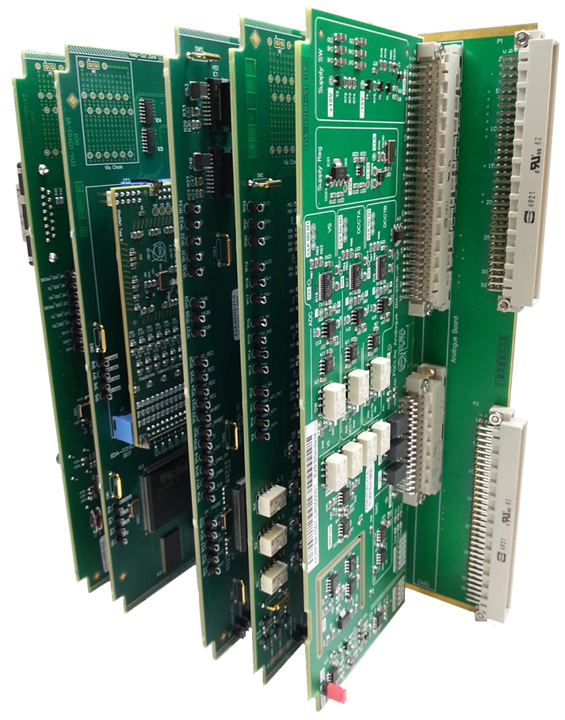

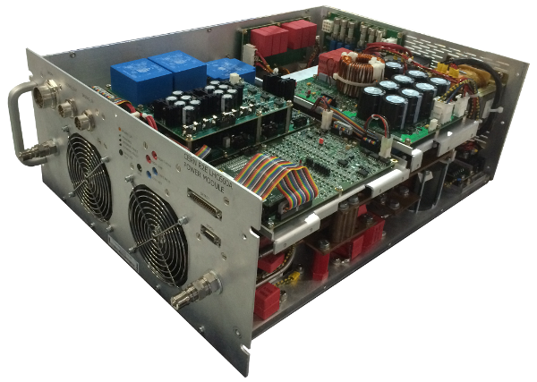
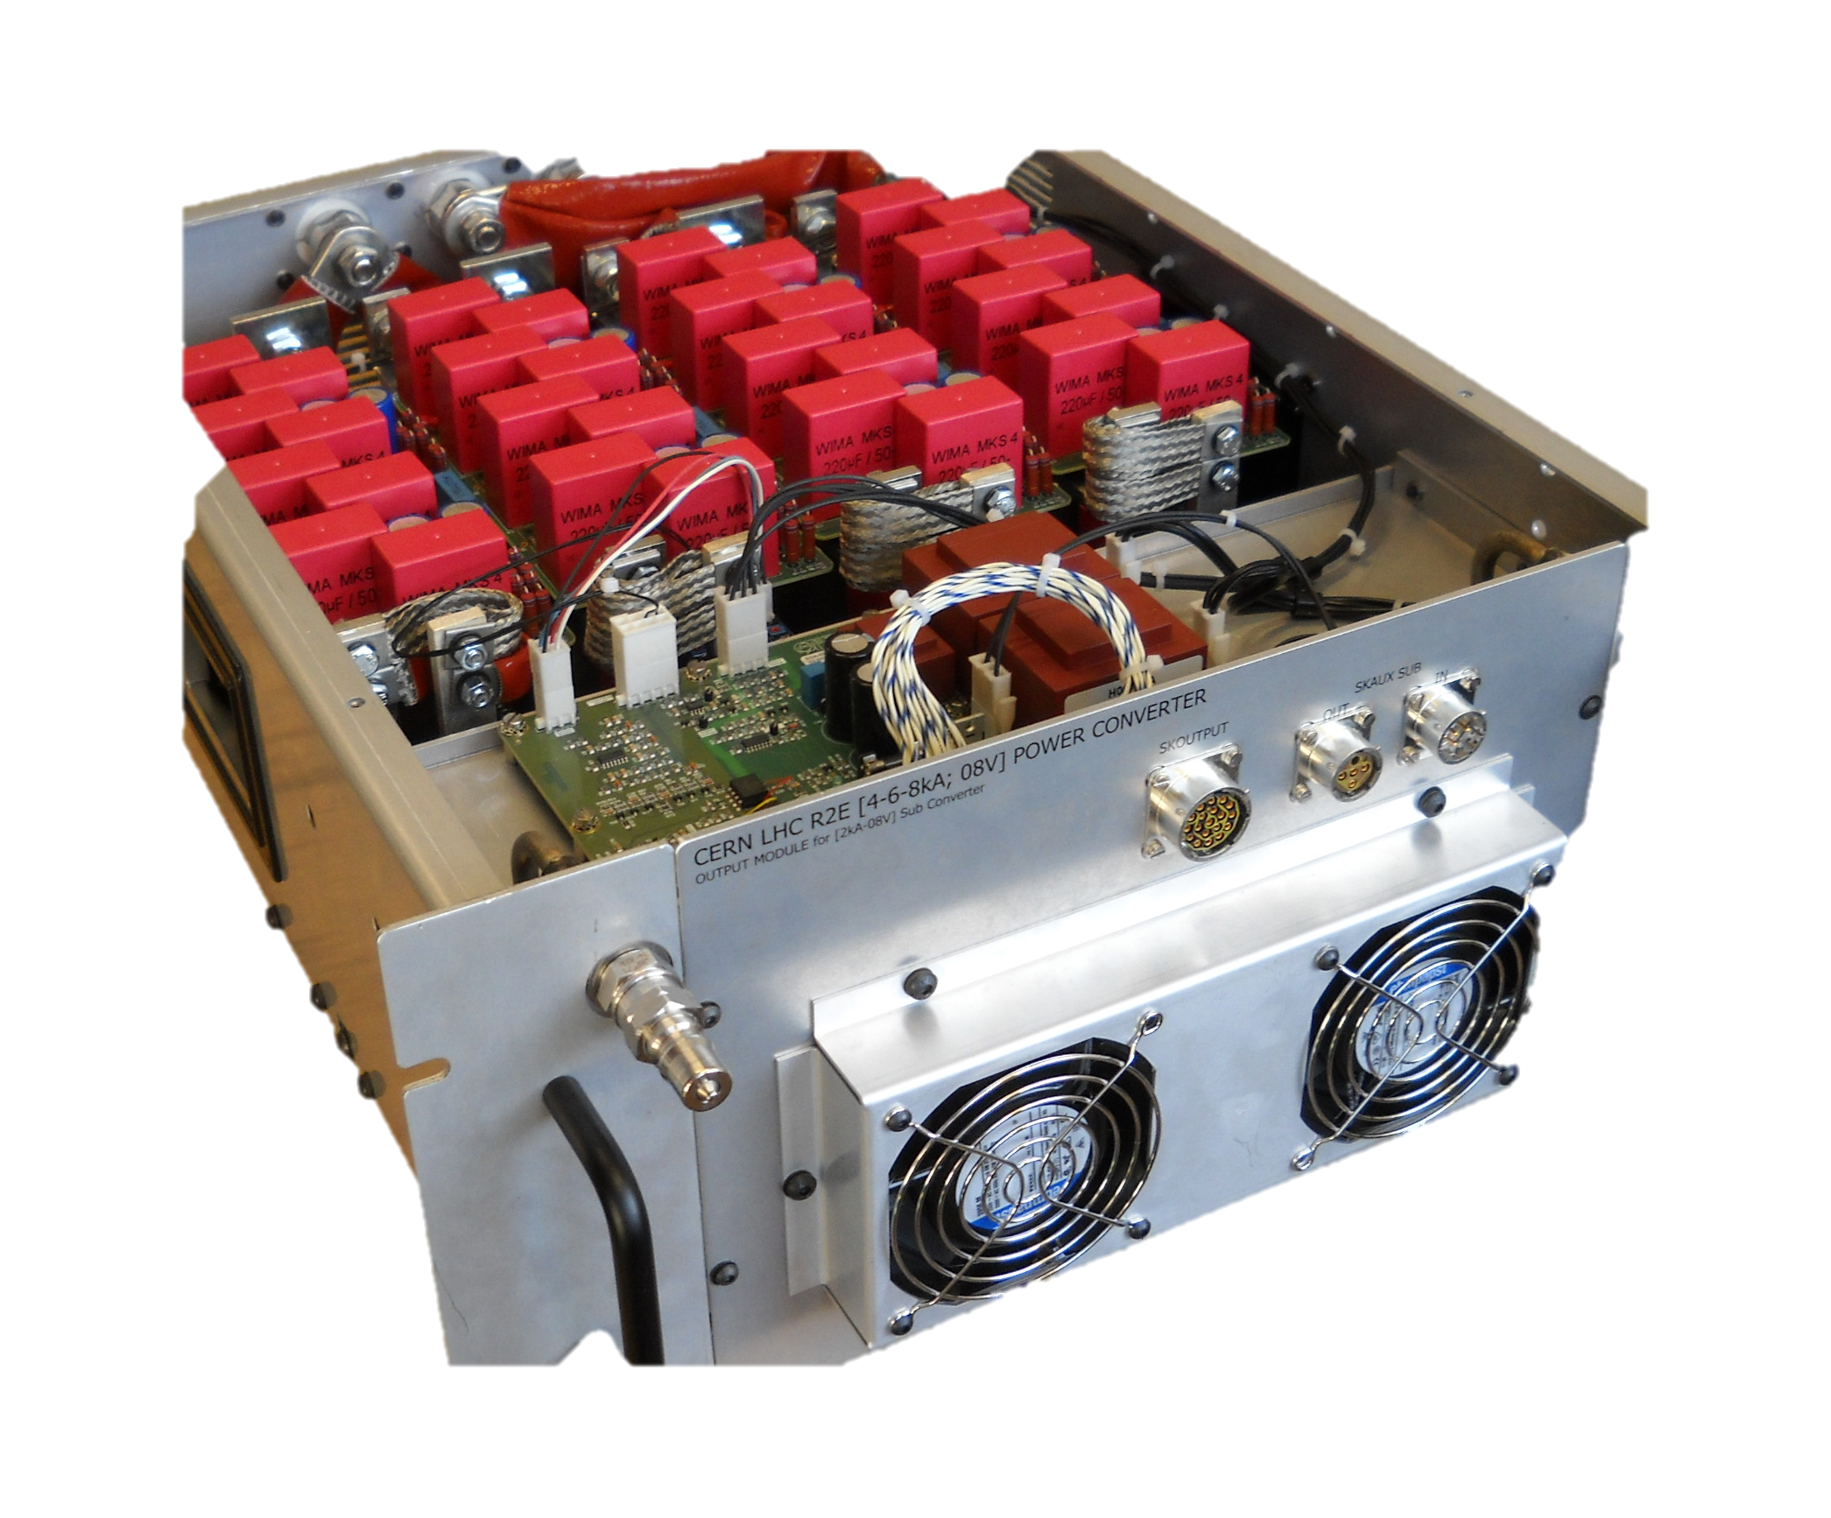
Qualified R2E projects
EPC Item / type | Status | TID [Gy] | SEE XS [cm²] | DD [/cm2] | Available | Deployed
FGClite | In operation | 200 qualified | <10⁻¹³ qualified | >10¹² qualified | 2016 | ARC: EYETS RR1/5/7: LS2
RadDIM | In operation | 200 qualified | <10⁻¹³ qualified | >10¹² qualified | 2016 | ARC: EYETS RR1/5/7: LS2
R2E-LHC 600A-10V | Production | 300 qualified | <10⁻¹² qualified | >10¹² qualified | 2019 | RR1/5/7: LS2
R2E-LHC 4-6-8kA-08V | Production | 60 qualified | <10⁻¹² qualified | >10¹² qualified | 2020 | RR1/5/7: LS2

Slide 19


On-going R2E projects
EPC Item / type | Status | TID [Gy] | SEE XS [cm²] | DD [/cm2] | Budget | Design/ Production
Tri-Volt Bi-Volt | R2E-funded (design) Production not funded 740x*/490x* | 200 Spec | <10⁻¹² Spec | >10¹² Spec | 1.1 MCHF* | 2019-2020 Deployment Post LS2
R2E-HL-LHC60A-10V | HL-Funded (design + prod) R&D >LS2 | 70-200 Spec | <10⁻¹² Spec | >10⁻¹² Spec | 7.8 MCHF | 2022+ Deployment LS3
R2E-HL-LHC120A-10V | HL-Funded (design + prod) R&D >LS2 | 70-200 Spec | <10⁻¹² Spec | >10⁻¹² Spec | 4.4 MCHF | 2022+ Deployment LS3
* Numbers not accounting for units for HL-LHC120A and HL-LHC60A
Price estimation based on production of 25 units
EPC Item / type | Status | TID [Gy] | SEE XS [cm²] | DD [/cm2] | Cost [/unit] | Design/ Production
Fan-Tray | Not funded 200x | 200 | <1E-12 | >1E12 | ? | On-hold Needed for LS3?

Slide 20
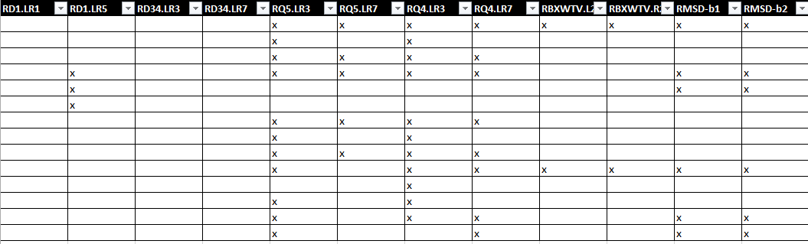
Converter performance: Others
RPTE – Main Dipole: water leak on water-cooled busbars
Water-cooled busbars for RB.A12 caused a big downtime in 2017 but poor quality of welding on cooling plates is seen on all converters. One water-cooled busbar for RB.A12 changed during the YETS 2017-18.
LS2: Consolidation of all busbars
FMCM trips in 2016 & mitigation
No self triggers of the FMCM in 2017 nor 2018.
RD1/RD34 replaced with Saturn converters during EYETS’16-17
helped to significantly reduce FMCM triggers: 23x (2016) vs. 9x (2017) vs. 3x (2018)
Potential availability gain if improving glitch rejection on RQ5.LR3 (x11), RQ4.LR3 (x11)

